Slide 1
Combining two analyses result
I. Larin

Slide 2
Difference in two analyses
The most part of two analyses (unitizing constraint and hybrid mass techniques) is the same (both analyses use FB nuclear density model and ~2% increased nucleus radius value)
The main difference is related to yield extraction technique, which may lead to small difference in background conditions
Another difference is that in the last version of constraint mas analysis E-channels higher than 165 have been excluded
Thus we can expect small difference in stat. error and slightly different yield extraction error
The main point is that both analyses have mostly correlated systematic and stat. uncertainty, which can not be combined as in case of independent measurements

Slide 3
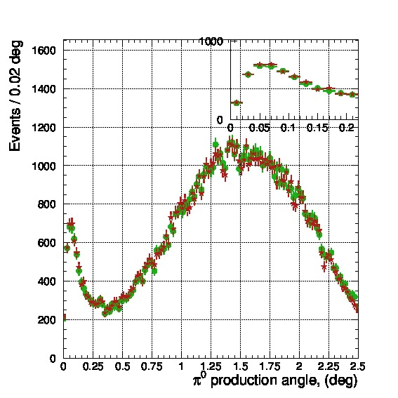
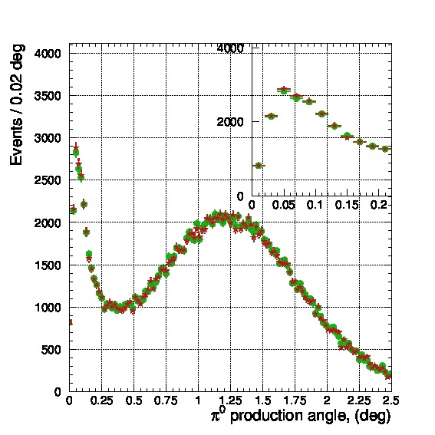
Comparison of two yields:
- Hybrid mass
- Constrained mass
Extracted π⁰ yield up to 2.5 deg.
method | ¹²C | ²⁸Si
Hybrid mass | 83,751 | 165,329
Constr. mass | 84.015 | 165,736

Slide 4
Two analyses results and uncertainties
Energy constrained yield method result:
Si: 7.766eV ±0.064eV(stat) ±0.132eV(syst), i.e. ±1.9%(total)
C: 7.753eV ±0.134eV(stat) ±0.141eV(syst), i.e. ±2.5%(total)
C+Si: 7.763 ±0.058eV (stat)±0.134eV(syst), i.e. ±1.9%(total)
Hybrid mass yield method result:
Si: 7.831eV ±0.058eV(stat) ±0.120eV(syst), i.e. ±1.7%(total)
C: 7.783eV ±0.115eV(stat) ±0.133eV(syst), i.e. ±2.3%(total)
C+Si: 7.821 ±0.052eV(stat) ±0.123eV(syst), i.e. ±1.6%(total)

Slide 5
Simple technique to combine to correlated results with slightly different stat. errors
According to results stat. errors assign weight to each result proportional to (stat. error)⁻²
Once two results are close enough (within stat. error) there is no need to apply scale factor technique
Combine all values and errors according to these weights
Combining two targets assumes independent stat. errors and mostly correlated systematics. Here we conservatively assumed absolutely correlated systematics for targets combining
Two analyses combined result:
Si: 7.802eV ±0.061(stat) ± 0.125(syst), i.e. ±1.8%(total)
C: 7.770eV ±0.123(stat) ± 0.136(syst), i.e. ± 2.4%(total)
C+Si: 7.795 ±0.055(stat) ± 0.128(syst), i.e. ±1.8%(total)

Slide 6
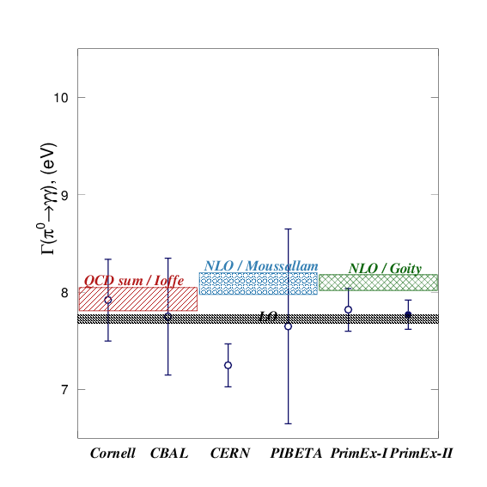
Γ(π⁰→γγ) combined from two targets
Combining two targets averaged over two analyses gives us:
Γ(π⁰→γγ) = 7.795eV ± 0.139eV,
(1.8% total uncertainty)

Slide 7
PrimEx-II combined result
Γ(π⁰→γγ) = 7.795eV ± 0.7% stat. ± 1.6% syst. (1.8% total)

