Slide 1


PrimEx-II data analysis:
Γ(π⁰→γγ) result and photoproduction cross section
  I. Larin

Slide 2
Outline
  PrimEx-II vs PrimEx-I, what is new
  Calibrations and calorimeter reconstruction algorithm
  π⁰ event selection
  Monte-Carlo simulation and ω background
  π⁰ yield and photoproduction cross section
  Fit to extract Γ(π⁰→γγ)
  Systematic errors assessment
  Summary

Slide 3
PrimEx-II vs PrimEx-I: main upgrades
  PrimEx-II used 10% Carbon and new Silicon targets :
    We successfully collected twice more statistics on carbon compare to PrimEx-I and about 5 times more statistics on Silicon target compare to PrimEx-II Carbon
  Tagger energy range have been increased by factor of ~1.5
  Central part HyCal was upgraded with individual TDC modules:
    out of time clusters were rejected
  New upgraded DAQ electronics were used since the middle of PrimEx-II
    This main data subset was used in this analysis
  New island reconstructed algorithm has been implemented, replacing old 5x5 algorithm

Slide 4
PrimEx data chart
PrimEx-I
Run | Target | Target thickness | Photon beam flux used in analysis
PrimEx-I | ¹²C | 5% | 1.4×10¹²
PrimEx-I | ²⁰⁸Pb | 5% | 0.72×10¹²
PrimEx-II | ¹²C | 8% | 2.0×10¹²
PrimEx-II | ²⁸Si | 10% | 5.3×10¹²
¹²C
²⁰⁸Pb
²⁸Si
PrimEx-II

Slide 5
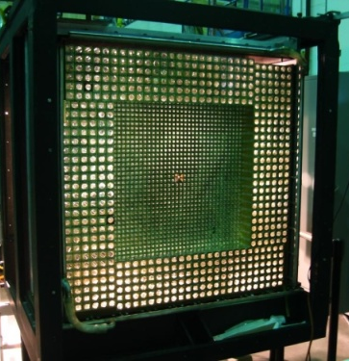
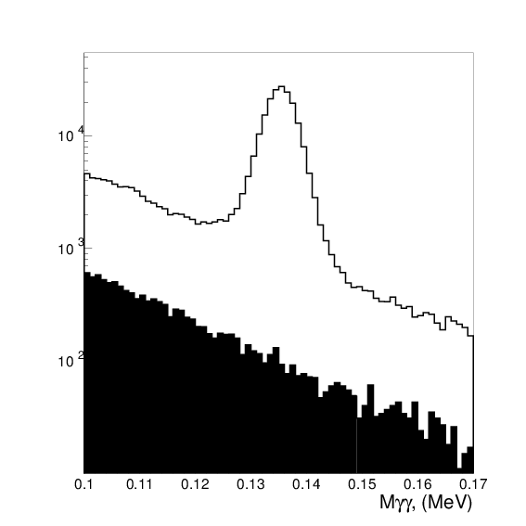
HyCal individual TDCs
  Central 20x20 modules zone was upgraded with individual TDCs
  Cluster pairs with mismatch time were safely rejected from analysis:

Slide 6
HyCal calibrations
  Individual pedestal and LMS tables were created for each individual run (few millions constants uploaded)
  LMS runs with no reference PMT were recovered using average LMS gain for far from beamline channels
  π⁰ gain tables were created for data sets with enough to calibrate statistics (total about 10 sets), then gain tables were calculated for each individual run based on LMS gain correction
  Eventually timing alignment has been performed for each individual module based on π⁰ signal time and time-walk correction (tdiff peak width reduced from 1.5…1.6ns to 0.9…1.1ns)

Slide 7
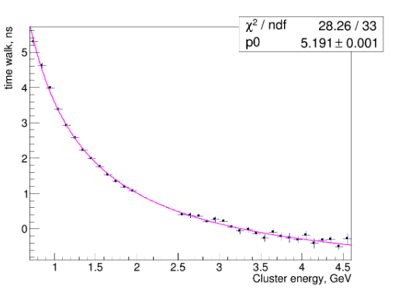
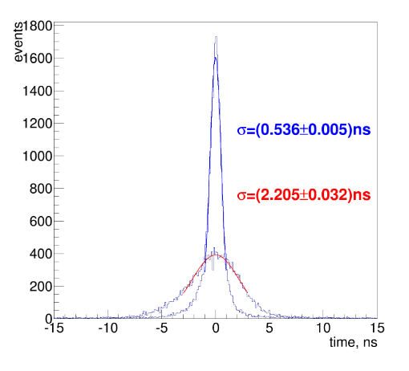
HyCal timing
Time difference between two clusters from π⁰ decay, before and after alignment and correction
V. Tarasov, PrimEx note 84
Time-walk correction (PMT time delay vs energy deposited),
V. Tarasov, PrimEx note 84

Slide 8
π⁰ reconstruction upgrade
  Electromagnetic shower profile data collected with 6x6 PWO crystals prototype have been utilized to create database necessary for island algorithm. Lead glass profile data was used from GAMS detector database
  We additionally added fluctuation function to regular (mean value) profile function needed for χ² calculation
  Second step separation was switched off in island algorithm for PrimEx since it doesn’t have very high occupancy to exclude artificial cluster splitting, which may occur at sub percent level
  Old 5x5 algorithm didn’t find any missing clusters after island algorithm
  New algorithm was tested with downstream multiphoton reconstructions

Slide 9
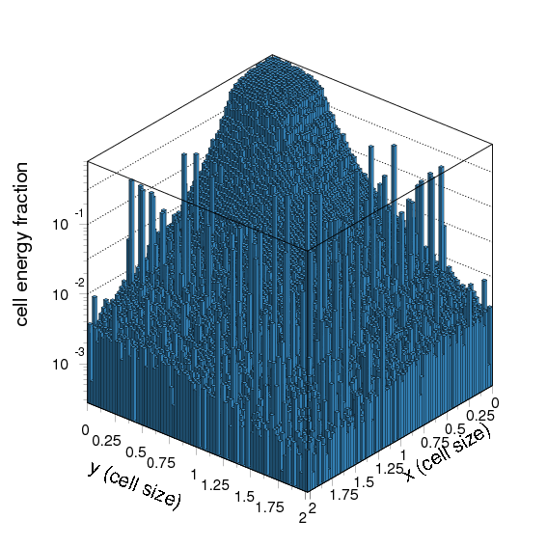
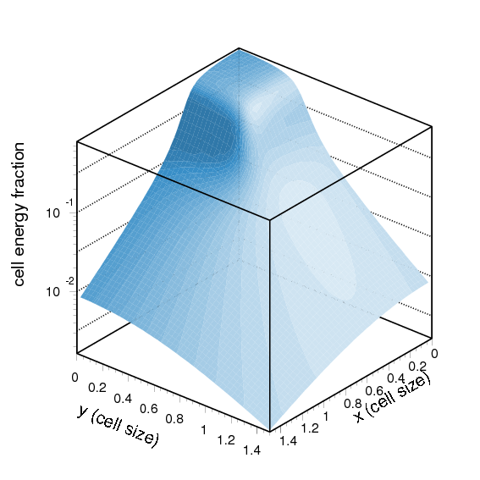
PWO electromagnetic shower profile, first measurement
Prototype data
Parameterized shape
ΔY
ΔX
FIT
Cell energy fraction VS distance between hit point and cell center: electron scan data (E_{e}≈4GeV) and it’s fit

Slide 10
Fluctuations of shower profile in PWO
  To fit the shape of the shower one needs to calculate χ² . Fluctuations (RMS) of measured profile can be well described with the following parameterization:
  where α ~ 1/√E(hit); β~c1+c2/√E(hit)

Slide 11
Island algorithm separation ability check with multiphoton reconstructions
η → 3π⁰
ω → π⁰ + γ
σ = 6MeV
σ = 15MeV
HYCAL
He
η’ → η(→2γ) + 2π⁰
a₀ → η(→2γ) + π⁰
σ = 10MeV
Γ≅ 100MeV
1m…2m

Slide 12
π⁰ event selection criteria
  Trigger = HyCal
  Clusters in PWO part of HyCal
  Minimum cluster energy 0.5GeV
  Minimum cluster pair energy 3GeV
  Time difference between beam photon in Tagger and HyCal trigger within ±5ns window. For accidentals subtraction we used ±10ns wide window without inner ±5ns part
  Only one beam candidate (if anything found within 5ns) with the best time difference was selected per event
  First 165 Tagger E-channels have been used in the final analysis version

Slide 13
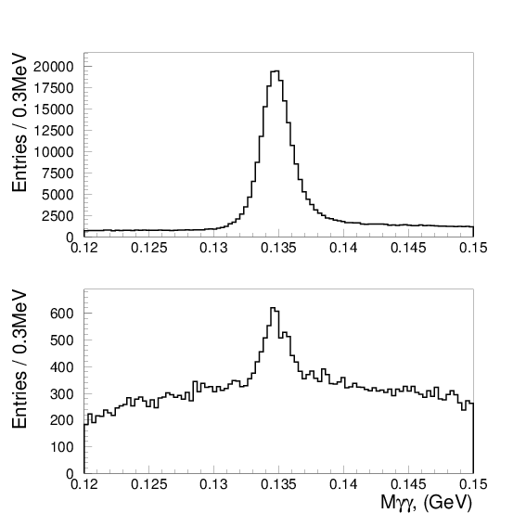
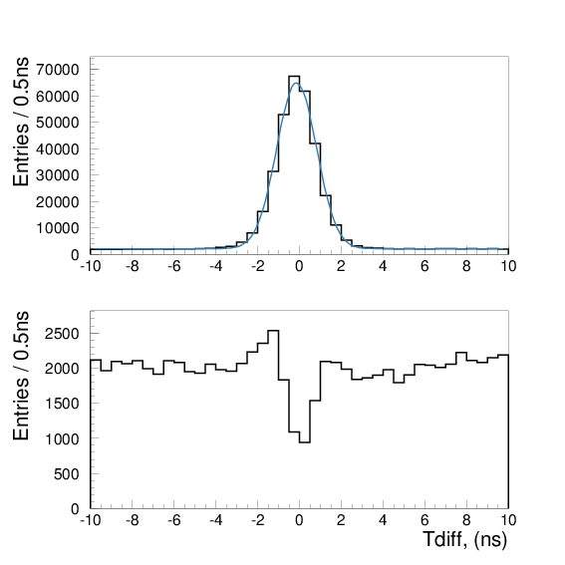
Beam candidate selection
Mγγ inv. mass with beam energy constraint
Tdiff (beam vs HyCal)
Best in time beam candidate
2nd best in time beam candidate
Lost 1.0%±0.2% (stat.),
thus we have 1.0% correction and 0.2% systematic input

Slide 14
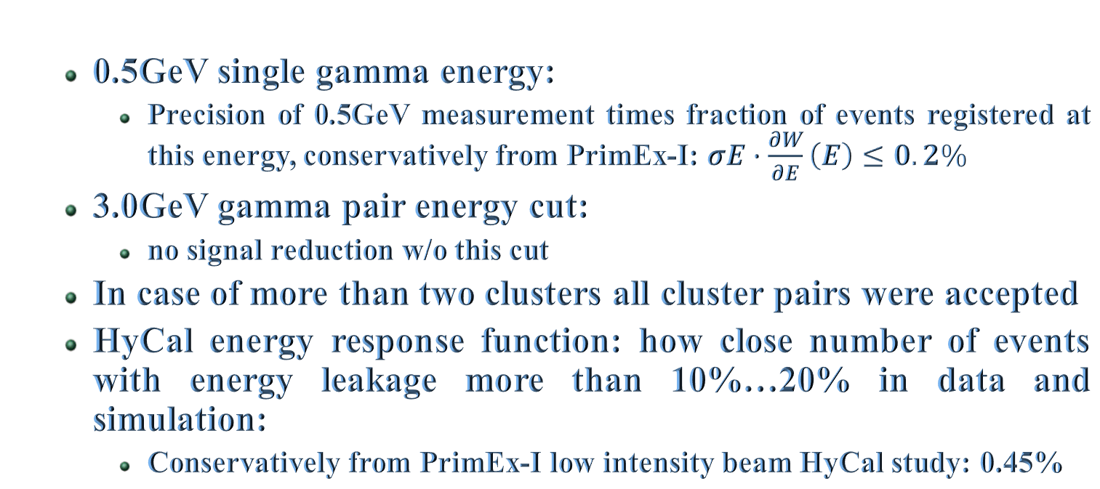
HyCal cluster selection
  0.5GeV single gamma energy:
    Precision of 0.5GeV measurement times fraction of events registered at this energy, conservatively from PrimEx-I: $σE∙\frac{∂W}{∂E}\left(E\right)≤0.2\%$
  3.0GeV gamma pair energy cut:
    no signal reduction w/o this cut
  In case of more than two clusters all cluster pairs were accepted
  HyCal energy response function: how close number of events with energy leakage more than 10%…20% in data and simulation:
    Conservatively from PrimEx-I low intensity beam HyCal study: 0.45%

Slide 15
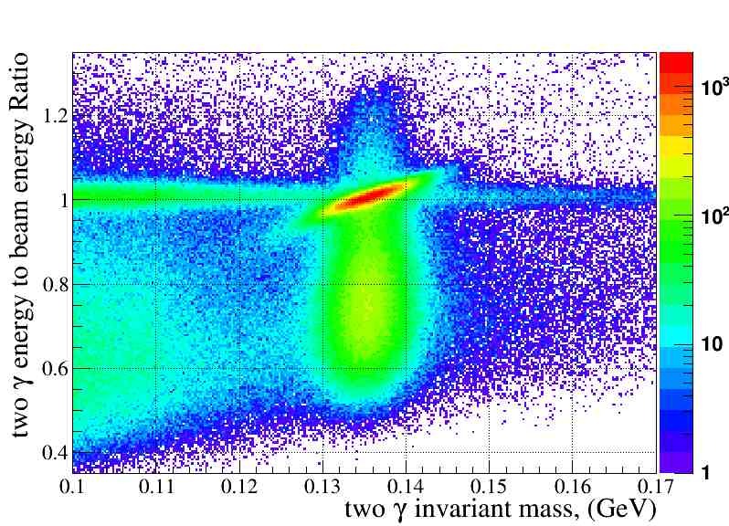
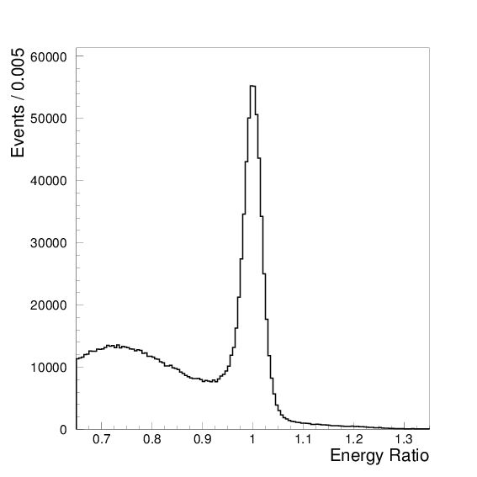
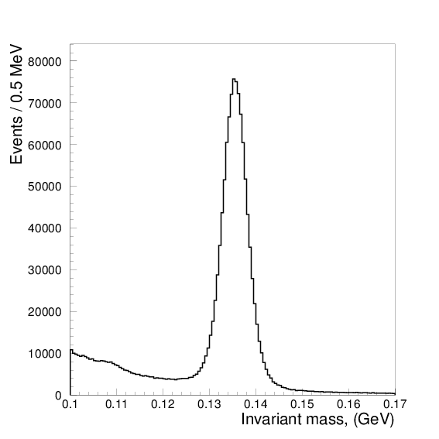
Analysis kinematic variables: π⁰ mass and elasticity
Elasticity, σ ~1.7%
Mγγ, σ ~2.5MeV

Slide 16
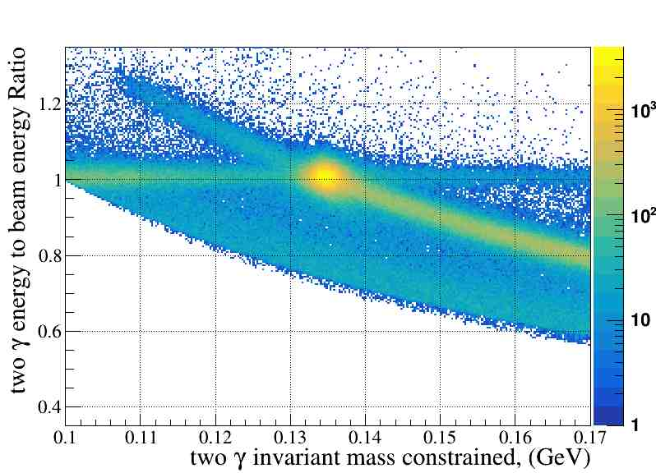
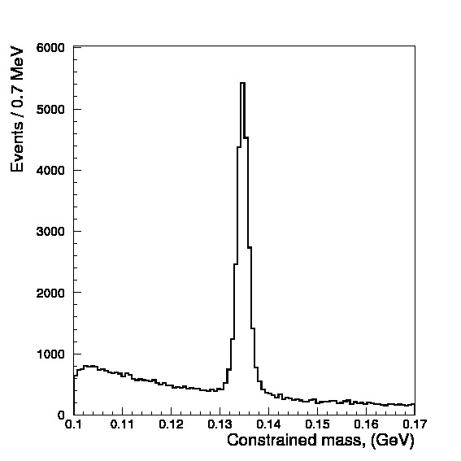
π⁰ yield extraction: applying energy constrain to recalculate mass
M_{c}γγ, σ ~1.3MeV

Slide 17
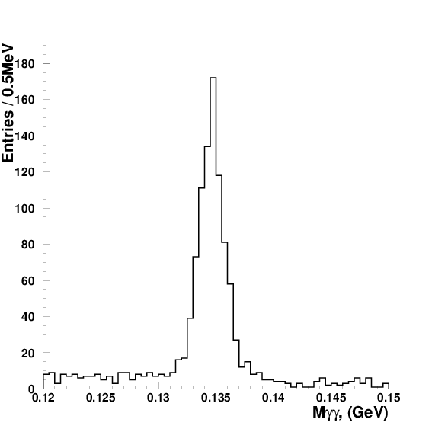
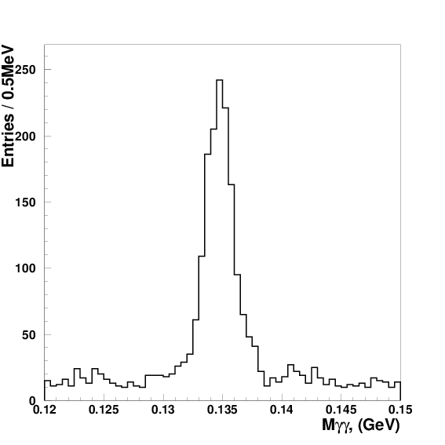
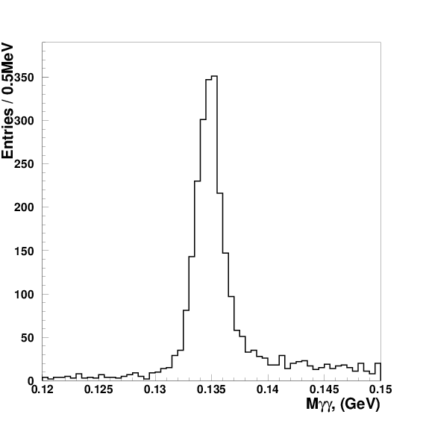
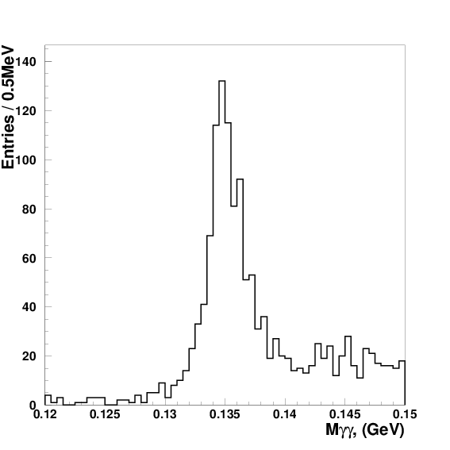
π⁰ yield extraction, 2nd step: split events according to production angle
Constraint inv. mass M_{c}γγ (silicon events):
0.00 ° – 0.02°
0.20 ° – 0.22°
1.00 ° – 1.02°
2.00 ° – 2.02°

Slide 18
Monte-Carlo simulation used to:
  Simulate realistic π⁰ spectrum (angular, energy and statistics) to perform π⁰ calibration for Monte-Carlo
  Perform high statistics uniform on production angle MC simulation for every E-channel (~50B events total)
  Perform realistic statistics simulation for known preselected spectrum parameters
  Simulate ω → π⁰ + γ background similar to PrimEx-I way (details in PrimEx notes 44 and 51)

Slide 19
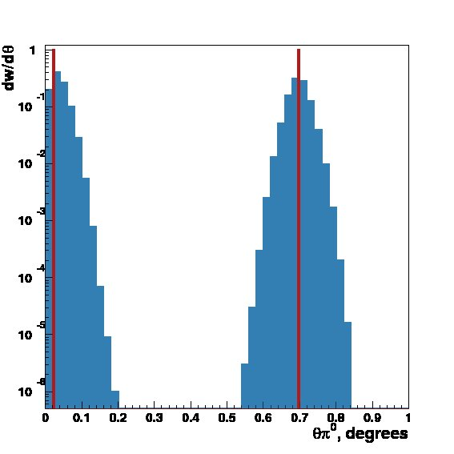
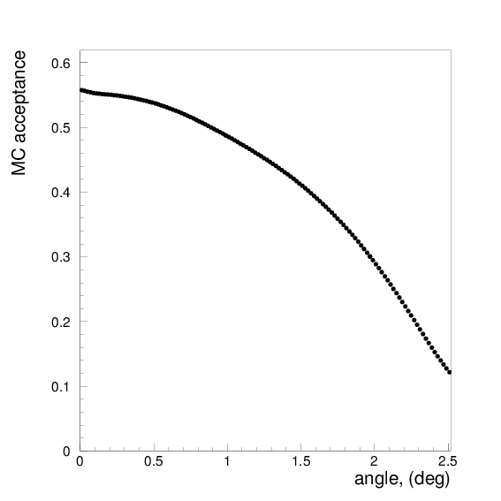
High statistics Monte-Carlo simulation used to obtain Setup acceptance and resolution
  Two acceptance/resolution matrix elements
  MC acceptance as a function of π⁰ production angle averaged on π⁰ energy spectrum
Very fine bins (0.001°) for theory input (normalized to unit)
  <E> ~4.9GeV
Experimental angular bins (0.01°, 0.02° and 0.03° versions)

Slide 20
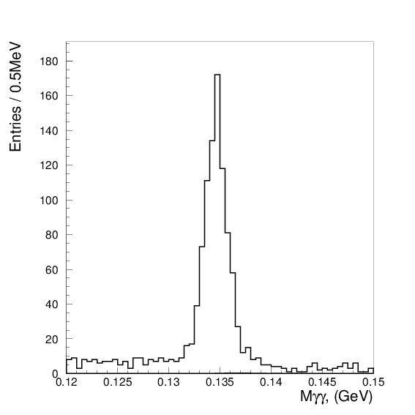
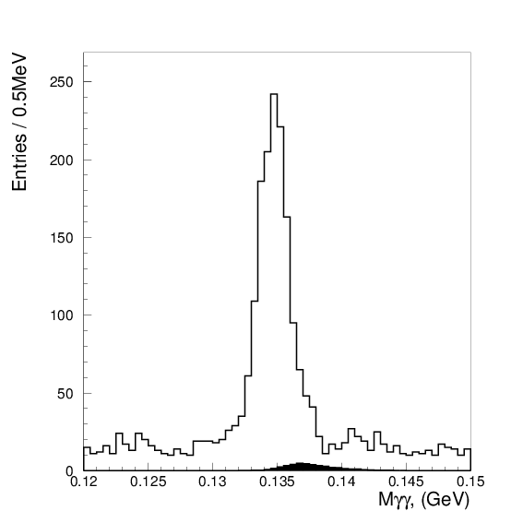
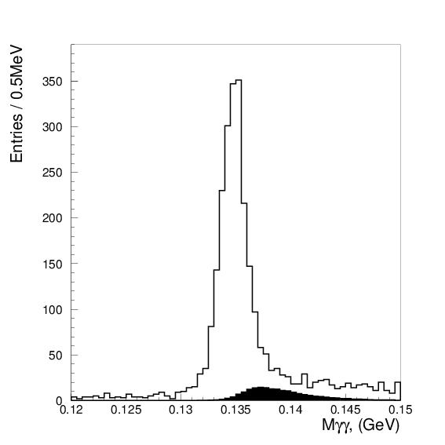
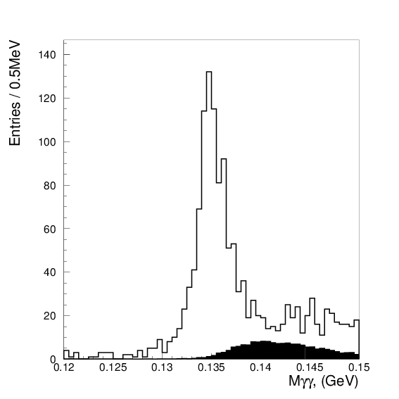
ω background simulation and subtraction
Constraint inv. mass M_{c}γγ (silicon events) with simulated ω background:
0.00 ° – 0.02°
0.20 ° – 0.22°
1.00 ° – 1.02°
2.00 ° – 2.02°

Slide 21

ω background subtraction
Constraint inv. mass M_{c}γγ (silicon events) :
  Simulated high statistics ω background has been scaled, fixed in amplitude added to background in the fit function
  To estimate systematics from ω production cross section uncertainty scale factor has been changed by ±20%; variation in final answer has been used as a systematic input:
    Si: -20% = +0.01%, +20% = -0.04%
    C: -20% = +0.00%, +20% = -0.06%
0.00 ° – 2.50°

Slide 22
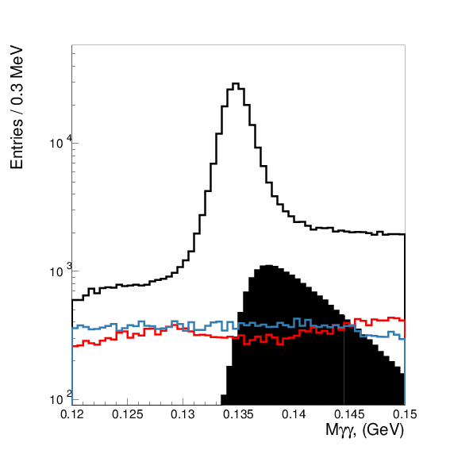
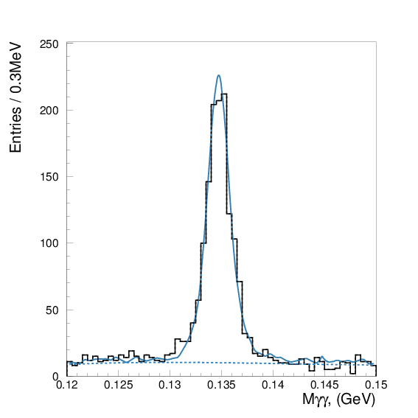
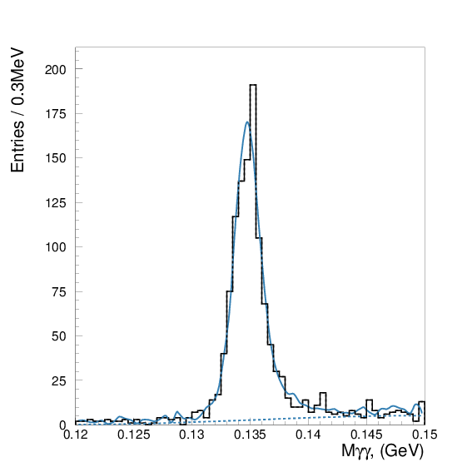
Accidentals
π⁰ yield extraction, 3rd step: fit constrained mass spectra with background terms added to the fit function
Constraint inv. mass M_{c}γγ (silicon events) :
0.10 ° – 0.11°
1.00 ° – 1.01°
Empty tgt
ω

Slide 23
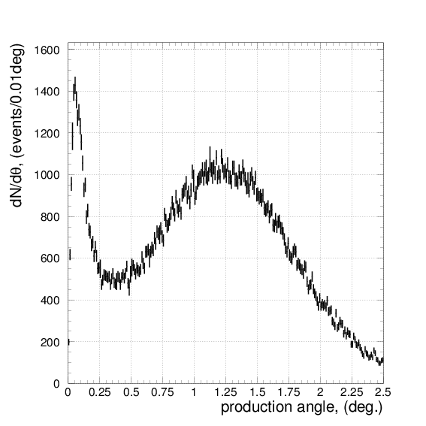
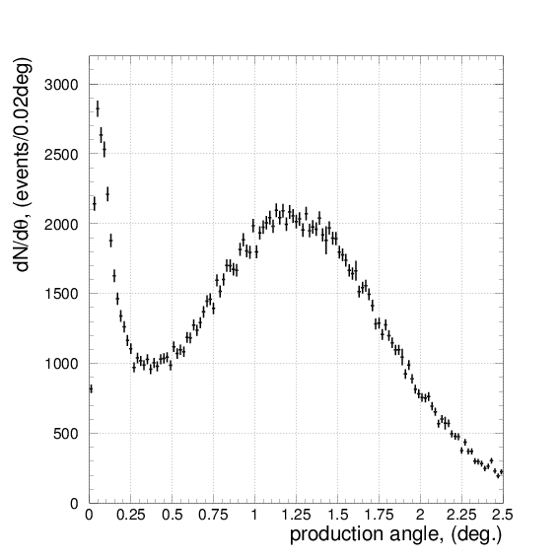
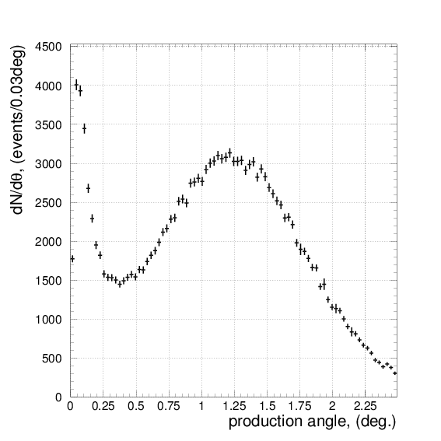
π⁰ yield obtained; Si target
0.01° binning; 165.62K events
0.02° binning; 165.74K events
0.03° binning; 165.67K events

Slide 24
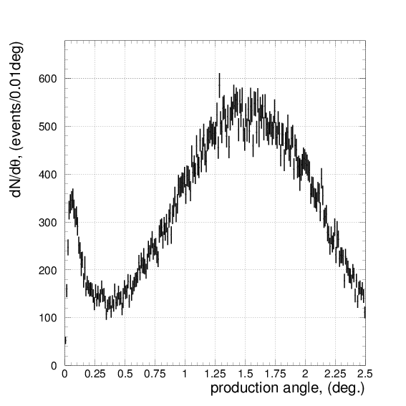
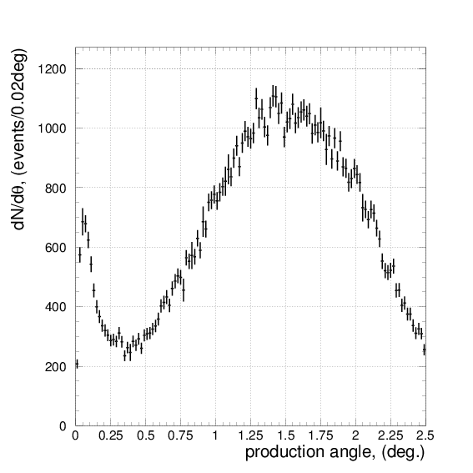
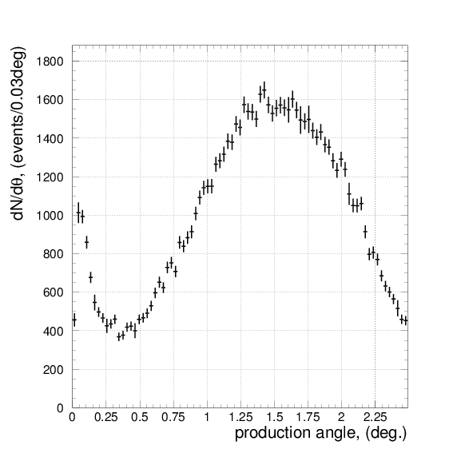
π⁰ yield obtained; ¹²C target
0.01° binning; 83.04K events
0.02° binning; 83.31K events
0.03° binning; 83.26K events

Slide 25
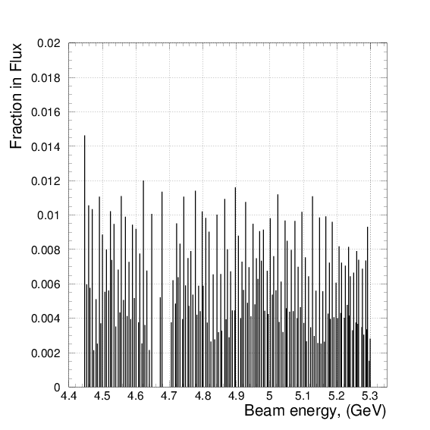
Photon beam energy distribution used in the analysis
  It is important to provide exact energy range for the reported precise cross section values
  Average energy ~4.9GeV
  Minimum energy ~4.4GeV
  Maximum energy ~5.3GeV

Slide 26
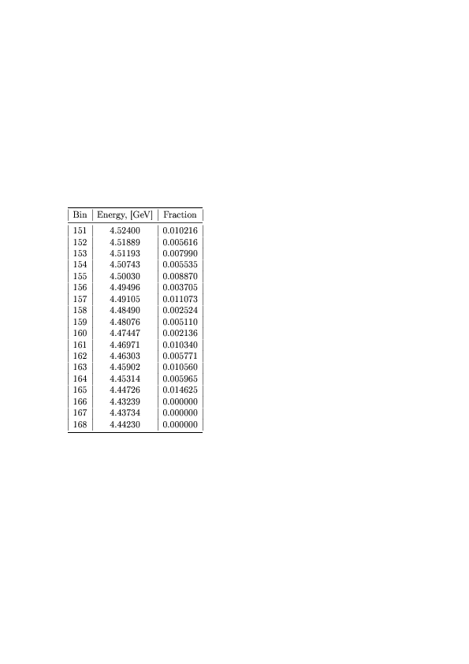
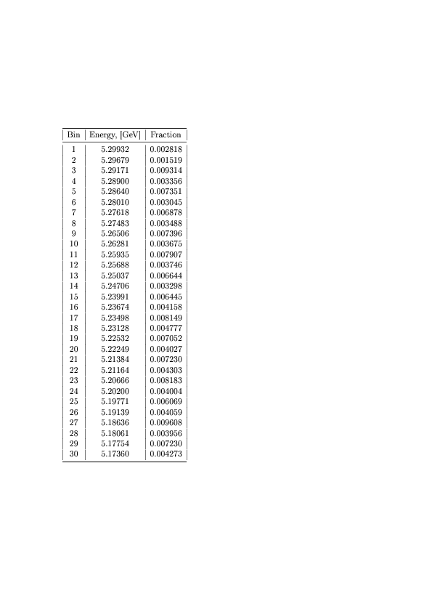
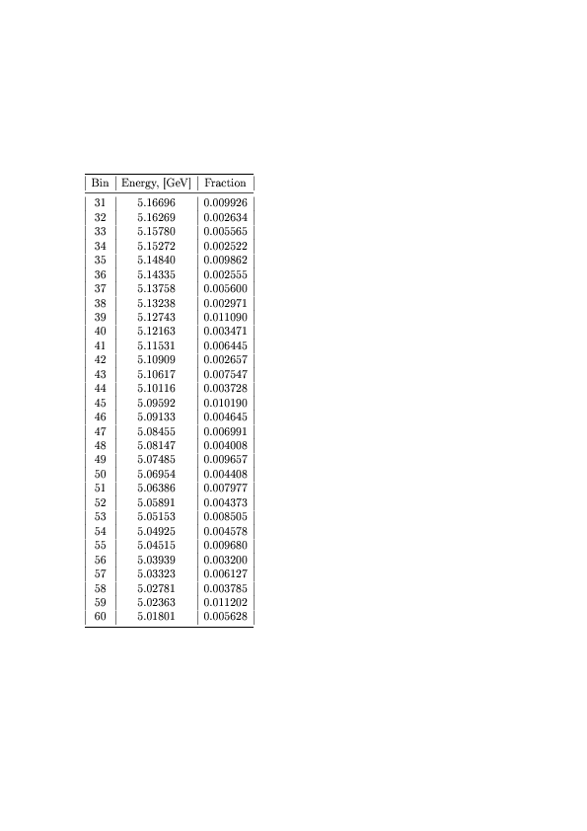
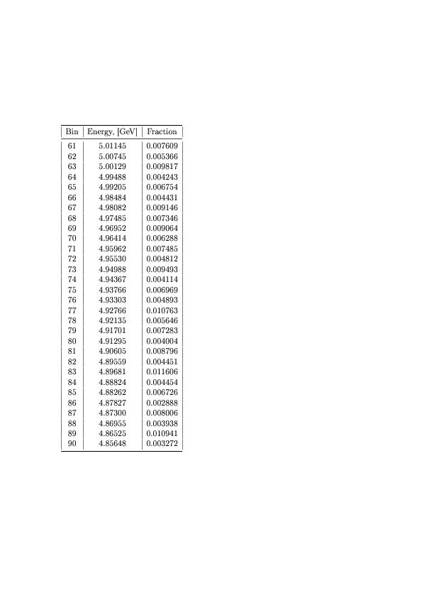
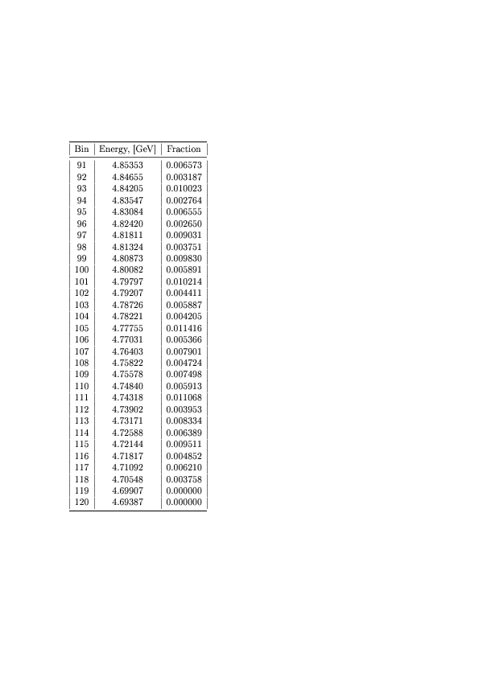
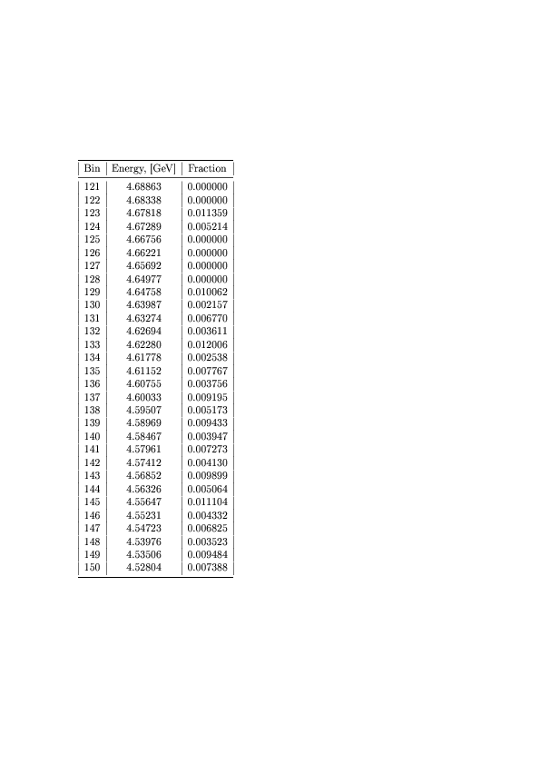
E-channels used in analysis, their energies and flux fractions

Slide 27
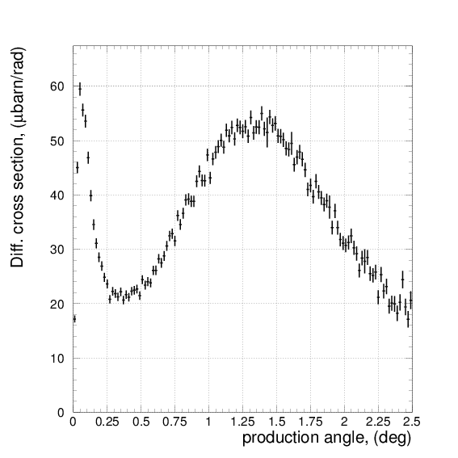
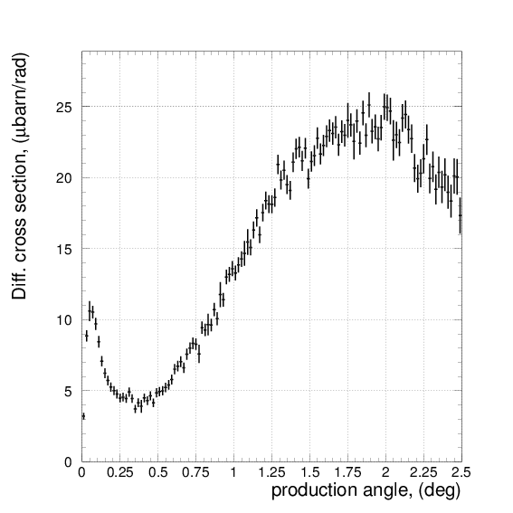
Differential cross sections vs production angle (0.02° binning)
²⁸Si
¹²C

Slide 28
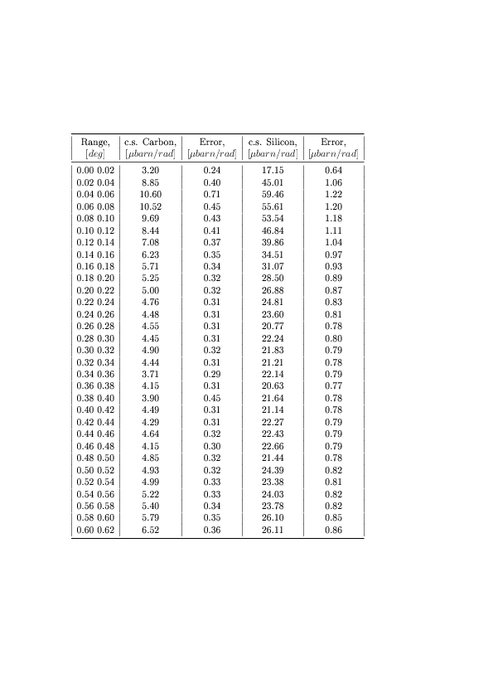
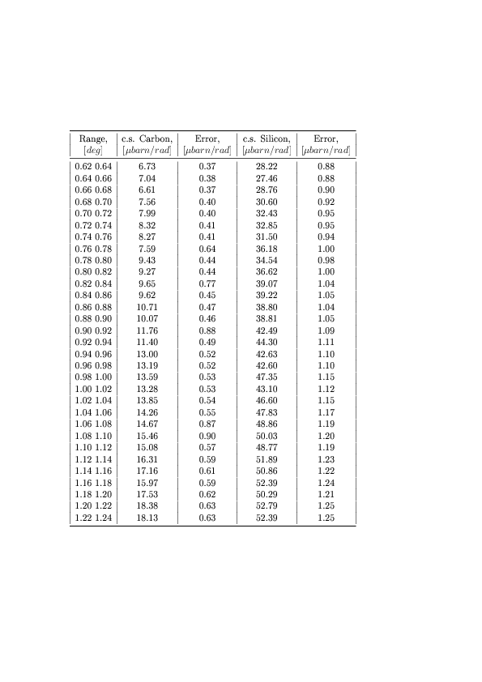
Differential cross sections vs measured production angle

Slide 29
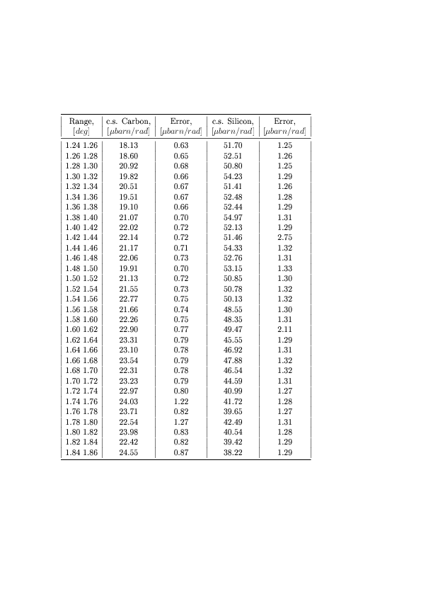
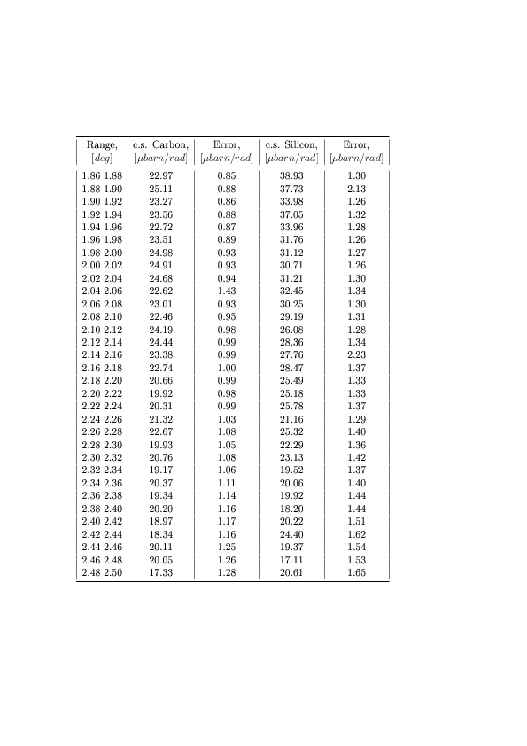
Differential cross sections vs measured production angle (continued)

Slide 30
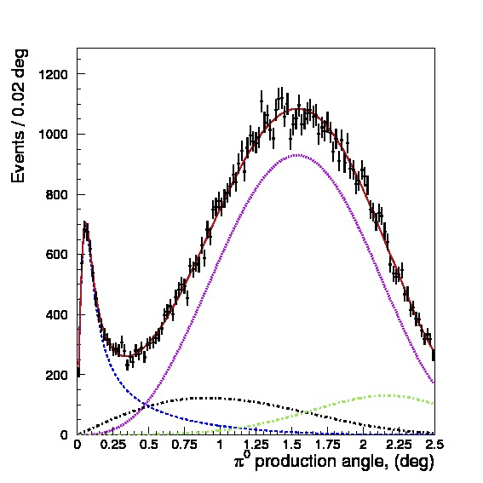
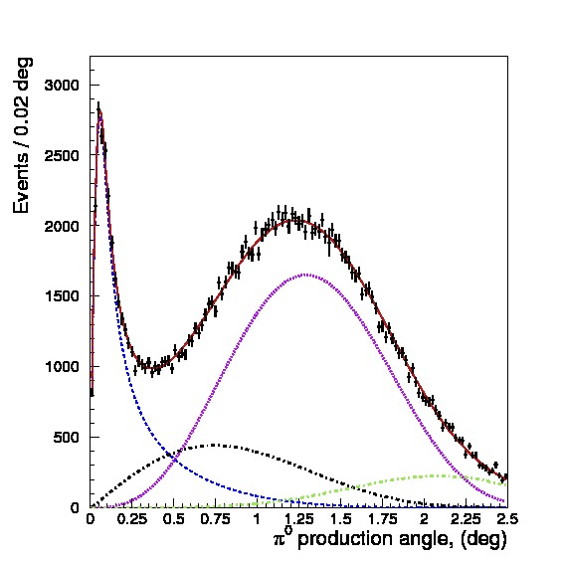
Yield fit to extract Γ(π⁰→γγ)
  Theory terms were folded with experimental resolution and setup acceptance to fit the data:

Slide 31
Fit to extract Γ(π⁰→γγ) results
Target | Bin | Γ(π⁰→γγ) , eV | C_{S} | φ, rad | C_{I} | χ² / Ndof
Si | 0.01° | 7.709±0.066 | 0.941±0.007 | 0.942±0.022 | 1.318±0.033 | 0.998
Si | 0.02° | 7.710±0.064 | 0.943±0.007 | 0.947±0.022 | 1.328±0.034 | 1.321
Si | 0.03° | 7.719±0.064 | 0.944±0.007 | 0.946±0.022 | 1.329±0.034 | 1.120
C | 0.01° | 7.658±0.129 | 1.065±0.013 | 1.058±0.035 | 0.671±0.042 | 1.079
C | 0.02° | 7.696±0.134 | 1.065±0.013 | 1.048±0.036 | 0.691±0.042 | 1.055
C | 0.03° | 7.694±0.146 | 1.063±0.013 | 1.038±0.038 | 0.704±0.044 | 1.083

Slide 32
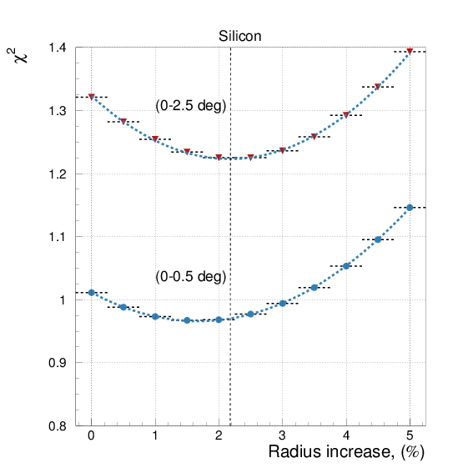
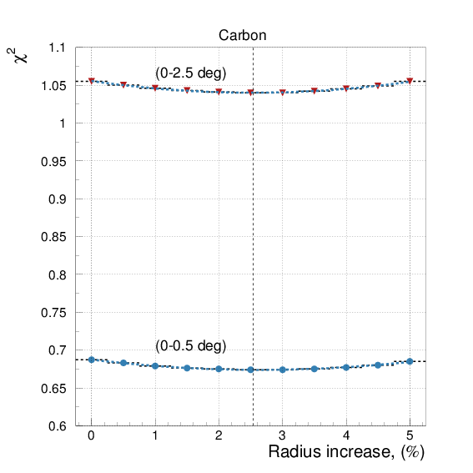
Fit χ² shows improvement with nucleus radius increase

Slide 33






χ² vs nucleus radius increase
0.01° binning
0.02° binning
0.03° binning
²⁸Si
¹²C

Slide 34

Γ(π⁰→γγ) vs radius increase
  Radius increase values minimizing χ² and their errors
  Si : +2.18% ± 0.63%
  C : +2.54% ± 1.86%
  were used in final result and systematic error budget

Slide 35



π⁰ yield fit; Si target
0.01° binning
0.02° binning
0.03° binning

Slide 36



π⁰ yield fit; ¹²C target
0.01° binning
0.02° binning
0.03° binning

Slide 37
PrimEx-II systematic uncertainty
(silicon target)
Nuclear density 0.25%
pN cross section and phase 0.1%
Shadowing effect amplitude 0.31%
Nuclear coherent shape 0.1%
Incoherent model 0.1%
Non-zero spin admixture ≤0.1%
Nuclear strong vs EM radius 0.24%
Total 0.51%
Energy 0.3%
Position 0.2%
Slope 0.15%
Width 0.2%
Total 0.44%
Absolute tagging ratio 0.37%
Electron counting 0.55%
Beam position/collim. 0.18%
Relative tagging ratio 0.4%
Total 0.80%
Background 0.4%
Fitting range 0.4%
Empty target subtraction 0.2%
Fit parameter uncertainty 0.55%
Extraction from MC test 0.65%
Omega/rho background subtraction 0.06%
Bin migration at zero angle 0.2%
Fit procedure 0.3%
dN/dθ binning 0.01°, 0.02°, 0.03° 0.12%
Total 1.11%
Density 0.35%
Thickness 0.03%
Purity <0.01%
Total 0.35%
Trigger efficiency <0.1%
ADC errors <0.1%
Total 0.1%
Target absorption 0.24%
Pi0 angular resolution 0.26%
Pi0 two gamma decay branching 0.034%
Calorimeter geometry 0.2%
Calorimeter energy response 0.44%
Limited statistics 0.05%
Total 0.60%
Gamma energy cut 0.2%
Pion energy cut <0.1%
Time window 0.06%
Wrong beam candidate 0.09%
Total 0.25%

Slide 38
Target
Beam parameters
Budget item | Value Si, [%] | Value C, [%}
Target density | 0.35 | 0.019
Target thickness | 0.03 | 0.04
Chemical purity | <0.01 | 0.1
Total | 0.35 | 0.11
Budget item | Value, [%]
Beam energy | 0.3
Beam position | 0.2
Beam width | 0.2
Beam slope | 0.15
Total | 0.44

Slide 39
DAQ
Photon beam flux
Budget item | Value, [%}
Tagging Ratio (TAC reproducibility) | 0.37
Electron counting | 0.55
Beam position/collimation effect on Tagging Ratio | 0.18^{A}
Relative Tagging Ratio | ≤0.4^{B}
Total | 0.80
Budget item | Value, [%}
Trigger efficiency (electronics) | <0.1
Events with ADC error | <0.1
Total | 0.1
A: From Aram’s thesis, page 92: 0.45% per 1.3mm beam pos. shift, we interpolate to 0.18% for <0.5mm possible beam shift for PrimEx-II data
B: Uncertainty from PrimEx-I run (Photon Flux article)

Slide 40

Event selection
Yield extraction
Budget item | Value
Single gamma energy cut | 0.2
Gamma pair energy cut | <0.1
Time difference cut | 0.06(Si), 0.34(C)
Wrong beam particle selection | 0.09(Si), 0.20 (C)
Total | 0.25(Si), 0.45(C)
Budget item | Value
Mgg Background function variation | 0.4
Mgg fit range variation | 0.4
Empty target subtraction | 0.2
Mgg peak fit parameter variation | 0.55
Realistic MC test | 0.65
Omega/rho background subtraction | 0.06
Resolution “improvement” at zero angle (due to bin migration) | 0.2
Fit procedure correction | 0.3
dN/dθ binning variation (0.01°, 0.02°, 0.03° fit) | 0.12(Si), 0.49(C)
Total | 1.11(Si), 1.21(C)
dN/dθ binning variation (0.01°, 0.02°, 0.03° fit) $\frac{∆Γ}{Γ}$:
Si: 0.01° = -0.01%, 0.02° ≡ 0, 0.03°=+0.12%
C: 0.01° = -0.49%, 0.02° ≡ 0, 0.03°=-0.03%

Slide 41

MC Simulation
Applied theory parameters
Budget item | Value
Absorption in target | 0.24(Si), 0.2(C)
Pi0 angular resolution | 0.26(Si), 0.12(C)
Pi0 Branching ratio | 0.034
HyCal distance to target (based on 1cm uncertainty) | 0.2
HyCal energy response | 0.44
Limited MC statistics per angular bin | 0.05
Total | 0.60(Si), 0.54(C)
Budget item | Value
Nuclear density parameters variation | 0.25
Pi-N interaction cross section and phase | 0.1
Shadowing-effect amplitude (ξ value variation by 0.25) | 0.18(C), 0.31(Si)
Nuclear Coherent amplitude dependence on energy | 0.1
Incoherent model variation | 0.1
Non zero spin isotope admixture | ≤0.1
Nuclear strong radius increase | 0.39(C), 0.14(Si)
Total | 0.54(C), 0.47(Si)
pi0 angular resolution improve test (10%; 20%):
Si: 10% = -0.26%, 20%=-0.50%
C: 10% = -0.12%, 20%=-0.23%
$\frac{∂Γ}{∂R}∙\frac{σR}{Γ}$Si: $0.030∗0.36/7.767$ = 0.14%;
C: 0.022 $∗$1.36 / 7.753 = 0.39 %

Slide 42
Example: Nuclear Coherent term dependence on energy:
Modified Cornell ($E^{1.2+α}$), Sibirtsev and Laget parametrizations
¹²C
²⁸Si
α | ΔΓ/Γ [%]
0.1 | 0.013
0.2 | 0.026
0.3 | 0.039
0.4 | 0.052
0.5 | 0.065
0.6 | 0.078
0.7 | 0.091
0.8 | 0.117
0.9 | 0.130
1.0 | 0.143
Sibirtsev | 0.052
Laget | 0.026
α | ΔΓ/Γ [%]
0.1 | 0.026
0.2 | 0.052
0.3 | 0.078
0.4 | 0.091
0.5 | 0.104
0.6 | 0.130
0.7 | 0.156
0.8 | 0.182
0.9 | 0.195
1.0 | 0.195
Sibirtsev | 0.077
Laget | 0.039

Slide 43

Yield extraction and long term stability checks
  Run time stability:
  Yield extraction uncertainty:
  A set of Monte-Carlo data samples has been generated with predefined parameters (Γ(π⁰→γγ) , φ, coherent amplitude). Γ(π⁰→γγ) has been extracted and compared with predefined value: found no shift of average values and statistical spread

Slide 44
Γ(π⁰→γγ) and cross section uncertainty table
Budget item | Value, [%]
Beam parameters | 0.44
Photon flux | 0.80
Target | 0.11(C), 0.35(Si)
DAQ | 0.1
Event Selection | 0.45(C), 0.25(Si)
Monte-Carlo simulation | 0.54(C), 0.60(Si)
Pi0 Yield Extraction | 1.21(C), 1.11(Si)
Pi0 photoproduction theory (not a cross section systematic budget item) | 0.54(C), 0.47(Si)
Total systematic | 1.76(C), 1.69(Si)
Statistical (for Γ(π⁰→γγ)) | 1.73(C), 0.82(Si)
Total | 2.47(C), 1.88(Si)

Slide 45

This analysis and previous measurements
Result (with increased radius):
Si: 7.766eV ±0.064eV(stat) ±0.132eV(syst),
i.e. ±1.9%(total)
C: 7.753eV ±0.134eV(stat) ±0.137eV(syst),
i.e. ±2.5%(total)
C+Si: 7.763 ±0.058eV (stat)±0.134eV(syst),
i.e. ±1.9%(total)

Slide 46
Summary
  Γ(π⁰→γγ) is one of the few precision QCD predictions at low energy.
  A measurement at a percent accuracy offers a stringent QCD test.
  A high resolution PrimEx experimental setup has been developed and
  constructed. Two PrimEx experiments have been successfully carried out.
  Compton cross section measurement verifies PrimEx systematical
  uncertainty for the cross section on the 1.5% level
  PrimEx-II reduced measurement error below 2%:
  This analysis result for two targets:
  Γ(π⁰→γγ) = 7.763eV ± 0.75% stat. ± 1.73% syst. (1.88% total)

Slide 47
Spare slides

Slide 48

Relative tagging ratio check at low intensity with TAC run: Carbon target
100nA
100nA
Relative tagging ratio: high vs low beam intensity
(PrimEx note is in progress: V. Tarasov and I. Larin)
100pA

