Slide 1
Compton analysis

Slide 2
Analysis updates
Cross section calculations with radiative corrections
Double Compton kinematics applied according to radiative corrections calculations
Extended Carbon data set (15nA and 5nA beam current runs) was used
Syst. error budget table presented

Slide 3
Compton event selection
11 “production” T-counters were used (no low energy T-counters included in analysis)
Minimum cluster energy 0.5 GeV
Minimum cluster pair energy 3.5 GeV
Tdif cut 4.5 ns (“timing sidebands” subtracted)
Best-in-time beam candidate only
PWO-only with 4 central vertical columns off
χ² of kinematic fit <100

Slide 4
Kinematic constraint
Energy conservation: E_{γ} = E_{γ’} + E_{e-}
Momentum conservation: P_{x,y γ’} = -P_{x,y e-}
Corrected coordinates and energies used in further analysis

Slide 5
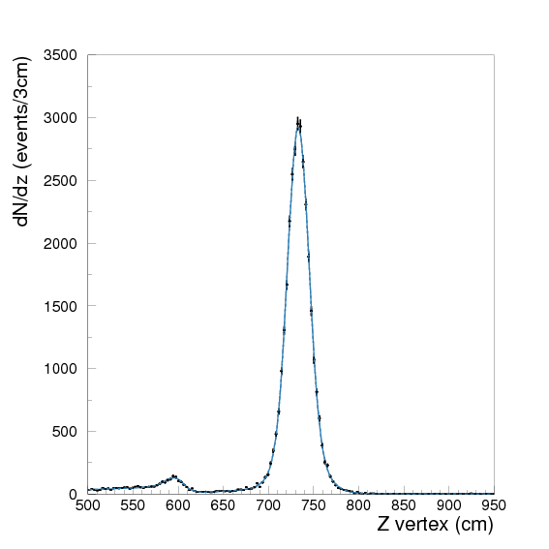
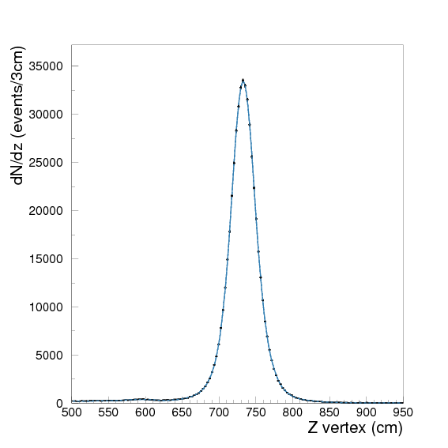
Yield extraction, two targets
Z coordinate of reconstructed event, calculated
assuming Compton kinematics, used to extract yield
Be
C¹²

Slide 6
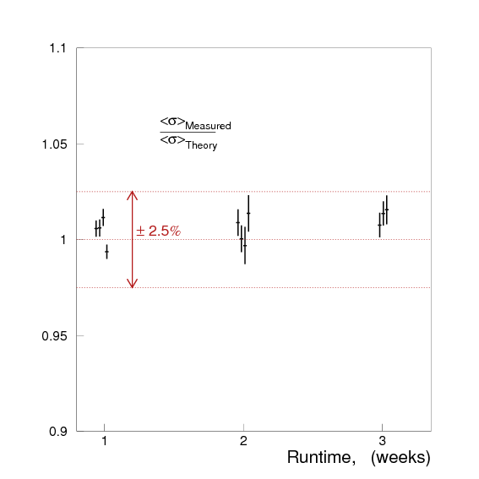
Yield stability VS Runtime
¹²C
Where:
- fraction of flux
- efficiency
- cross section
for i^{th} T-counter

Slide 7
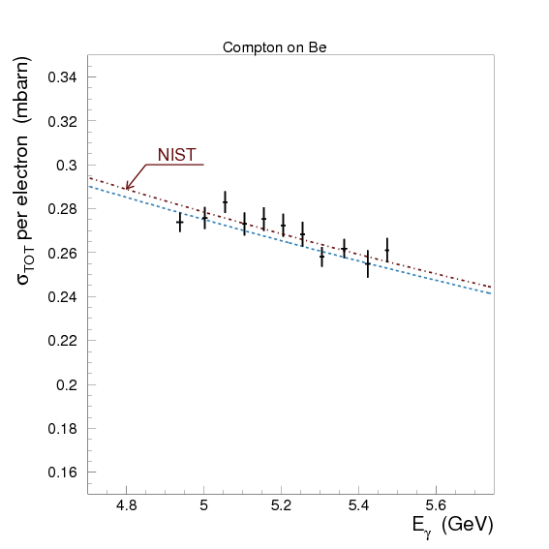
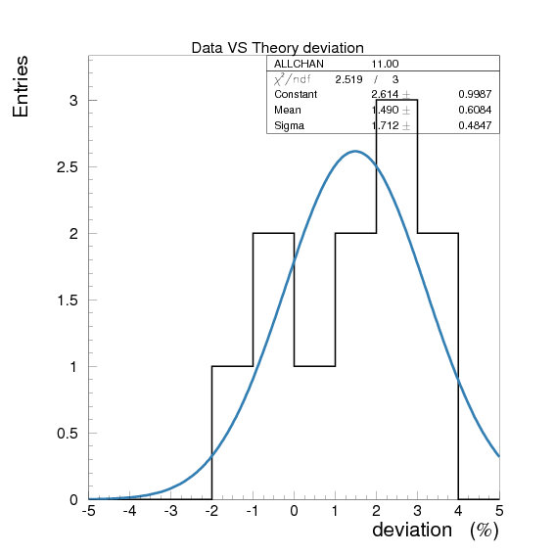
Total cross section, Be
Data VS Theory Deviation:
Mean = +1.5% ± 0.6%
σ = 1.7% ± 0.5%

Slide 8
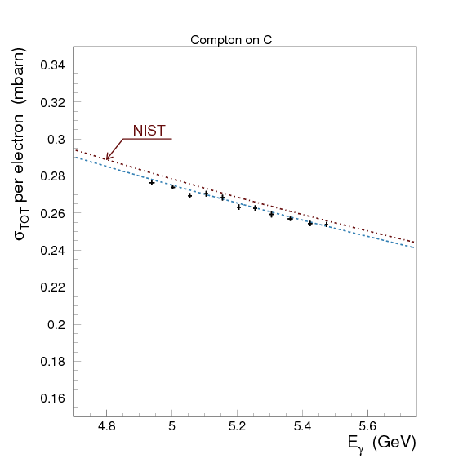
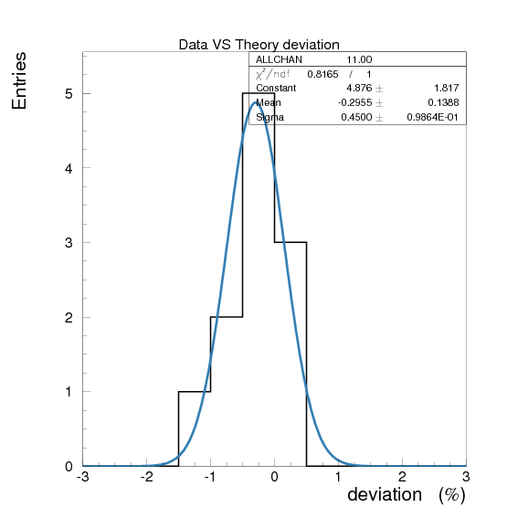
Total cross section, C
Data VS Theory Deviation:
Mean = -0.3% ± 0.13%
σ = 0.45% ± 0.1%

Slide 9
Error budget
Stat. errors: Be – 2%; ¹²C – 0.5%
Syst. error:
Contributions | Errors, [%]
Photon Beam Flux | 1.0
Target | 0.1
Beam parameters | 0.3
Setup acceptance | 0.3
Yield extraction | 1.5
χ² cut | <0.1
Min. cluster energy cut | 0.12
Model errors | ?
Total | 1.9

Slide 10
Conclusion
Cross section values are in agreement with predicted by theory calculations within stat. and systematcis error:
Carbon: -0.3% shift with 0.45% spread
Beryllium: +1.5% shift with 1.7% spread
Estimated total syst. error for extracted cross sections 1.9%, total error (Carbon) 1.9%

Slide 11
Spare slides

Slide 12
Unconstrained pi0 analysis
Same cuts and selection as in constraint analysis:
Tdif cut 4.5ns
Crystal only HyCal part
Best-in-time beam candidate
Veto cut applied

Slide 13
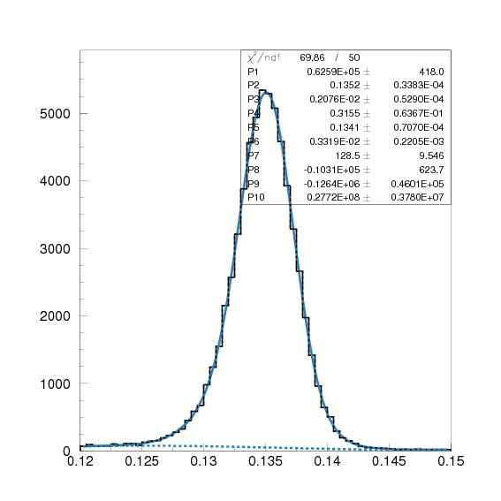
Pi0 distribution on invariant mass
θ = 0 – 2.7°

Slide 14
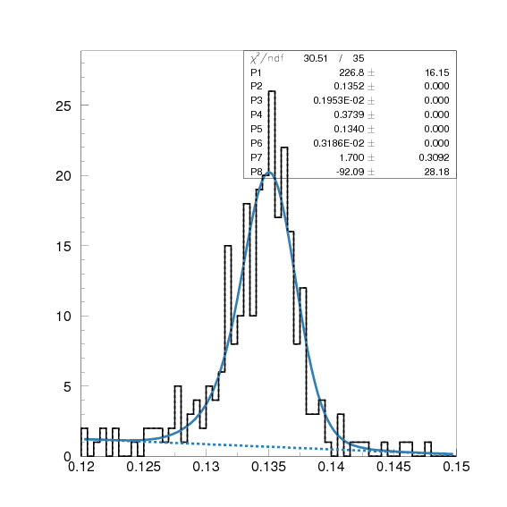
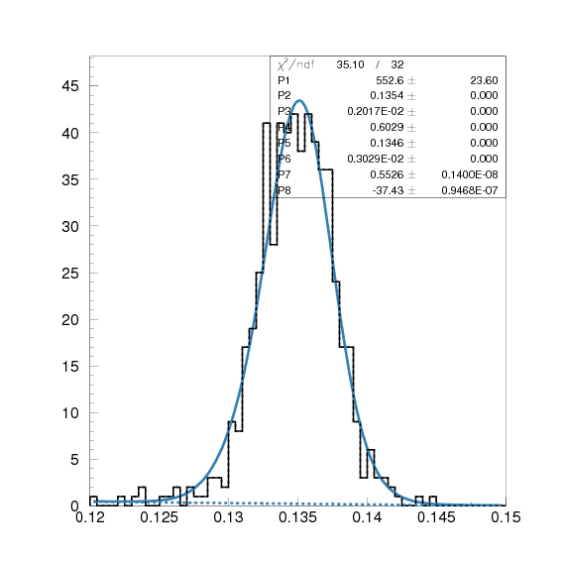
Pi0 distribution on invariant mass
θ = 0.2°
θ = 2.0°

Slide 15
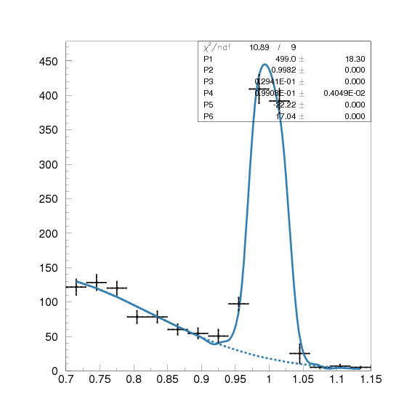
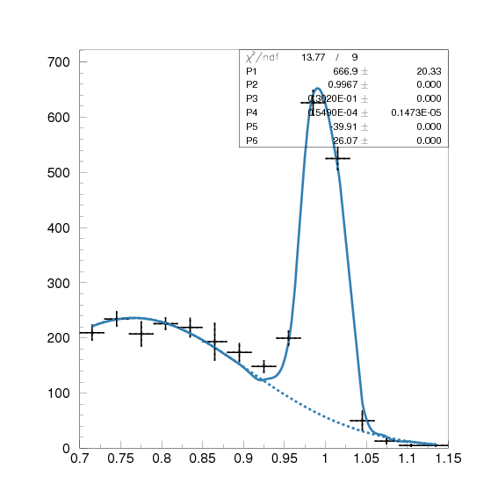
Pi0 distribution on elasticity
θ = 0.2°
θ = 2.0°

Slide 16
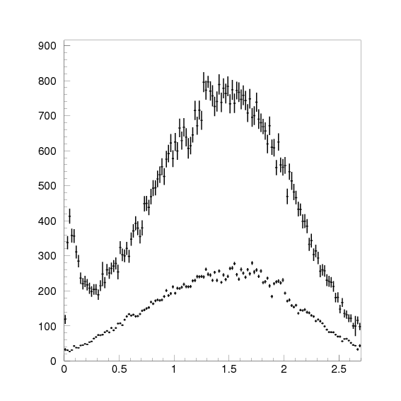
Pi0 dN/dθ distribution
Elastic + inelastic
Inelastic (x= 0.85…1.15)

Slide 17
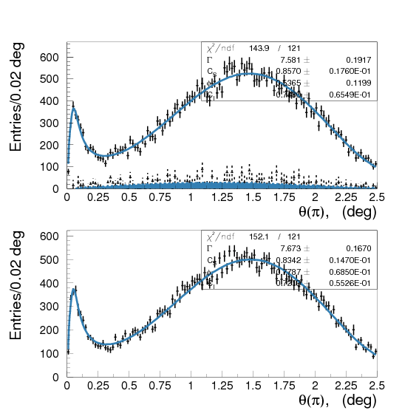
dN/dθ fit
Γ= 7.59 ± 0.19 eV
φ = 0.33 ± 0.12 rad.
Unconstrained
Difference
Constrained

Slide 18
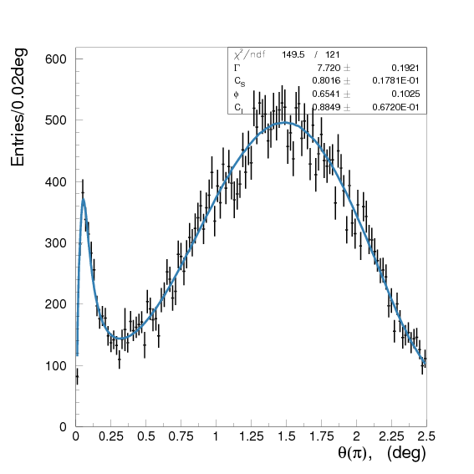
dN/dθ fit, ω subtracted
Γ= 7.72 ± 0.19 eV
φ = 0.65 ± 0.10 rad.
Unconstrained
Error budget contribution: 0.4%

