Slide 1
COMPTON ANALYSIS REPORT
PAWEL AMBROZEWICZ
NC A&T
OUTLINE:
Event Selection
Extraction Procedure
Yield Fits
Results
- Total Cross Section
- Total Cross Section (Large Statistics)
- Forward Solid Angle Cross Section
- Time Stability
- Uncertainties
Summary

Slide 2
COMPTON EVENT

Slide 3
SELECTION CUTS

Slide 4
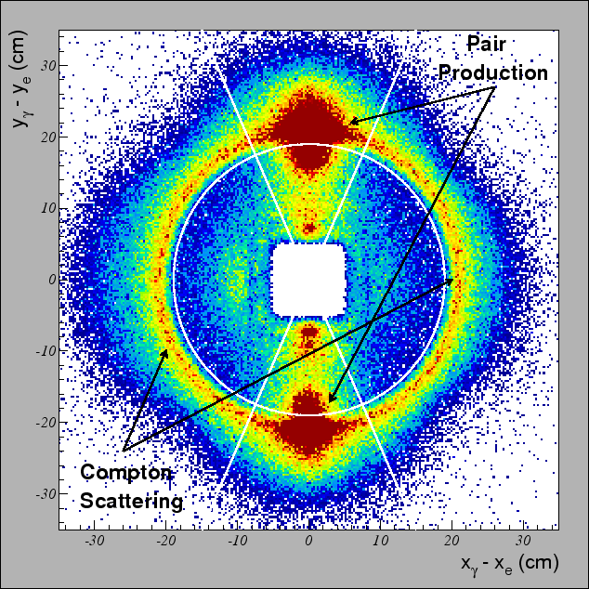
SELECTION CUTS

Slide 5
SELECTION CUTS

Slide 6
BACKGROUND MODEL

Slide 7
LINE SHAPE YIELD FITS

Slide 8


CROSS SECTION EXTRACTION PROCEDURE
TOTAL CROSS SECTION
(RADIATED)
FORWARD SOLID ANGLE
CROSS SECTION
(BORN LEVEL)

Slide 9
TOTAL CROSS SECTION

Slide 10
TOTAL CROSS SECTION

Slide 11
FORWARD SOLID ANGLE CROSS SECTION

Slide 12
TIME STABILITY

Slide 13
COMPARISON WITH THEORY

Slide 14
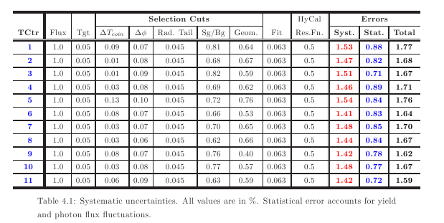
UNCERTAINTIES

Slide 15
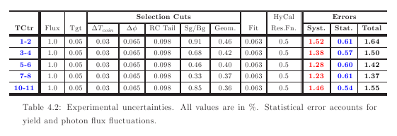
UNCERTAINTIES

Slide 16
UNCERTAINTIES

Slide 17
SUMMARY
Good control of systematics
Simulation of the background
would help reduce systematic uncertainties
Differential cross section needs serious work

