Slide 1
COMPTON ANALYSIS REPORT
PAWEL AMBROZEWICZ
NC A&T
OUTLINE:
Event Selection
Extraction Procedure
Yield Fits
Results
- Total Cross Section
- Total Cross Section (Large Statistics)
- Forward Solid Angle Cross Section
- Differential Cross Section
- Time Stability
- Uncertainties
Summary

Slide 2
COMPTON EVENT

Slide 3
SELECTION CUTS

Slide 4
SELECTION CUTS

Slide 5
SELECTION CUTS

Slide 6
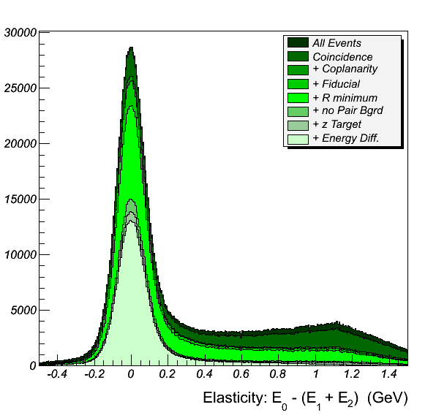
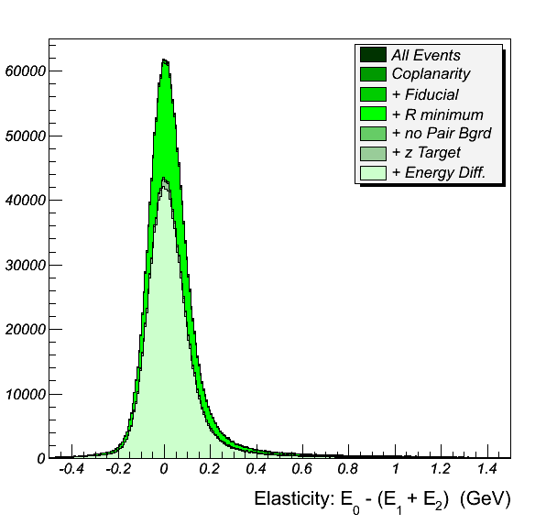
SELECTION CUTS

Slide 7
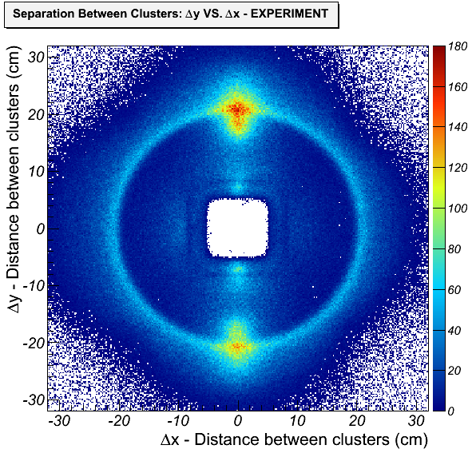
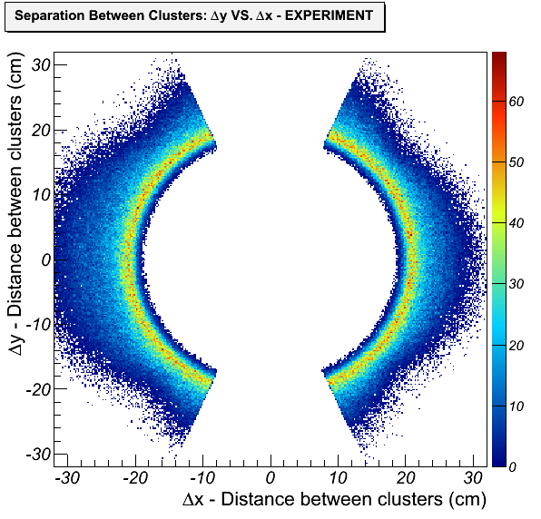
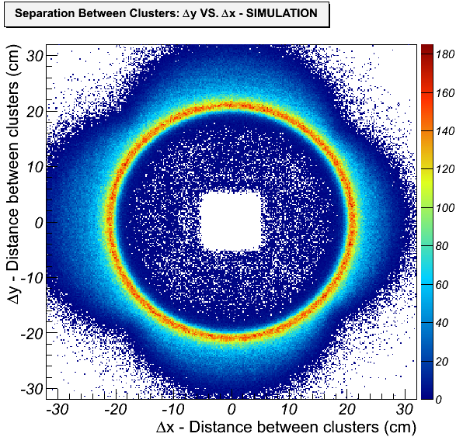
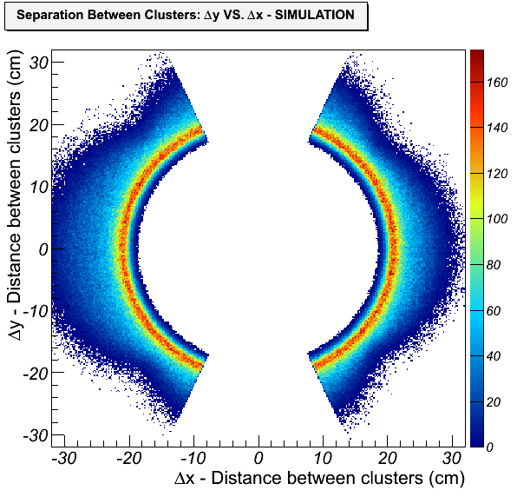
SELECTION CUTS

Slide 8
BACKGROUND MODEL

Slide 9
LINE SHAPE YIELD FITS

Slide 10


CROSS SECTION EXTRACTION PROCEDURE
TOTAL CROSS SECTION
FORWARD SOLID ANGLE
CROSS SECTION

Slide 11
TOTAL CROSS SECTION

Slide 12
FORWARD SOLID ANGLE CROSS SECTION

Slide 13
DIFFERENTIAL CROSS SECTION

Slide 14
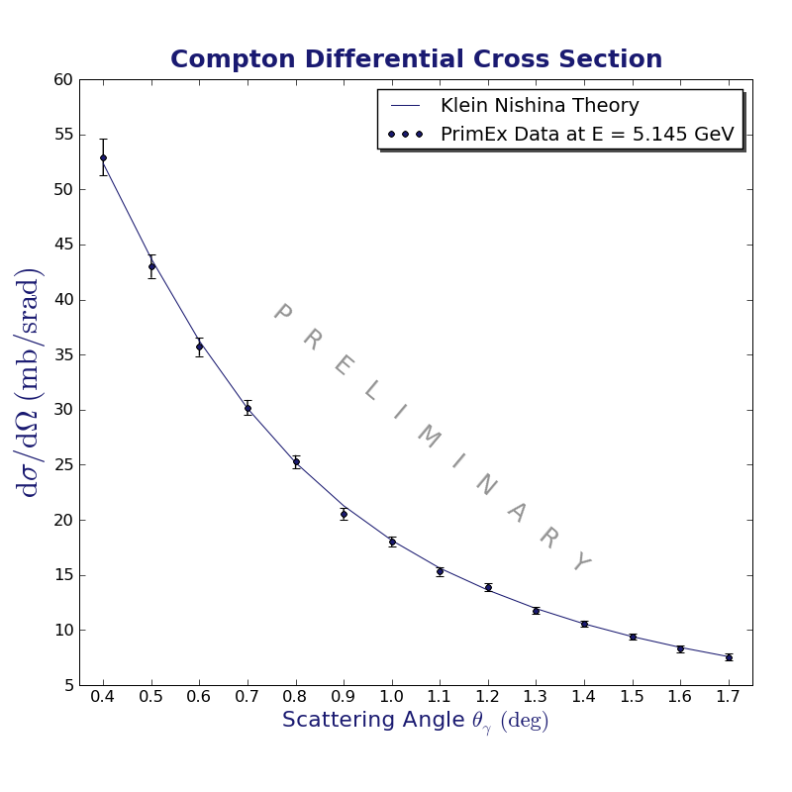
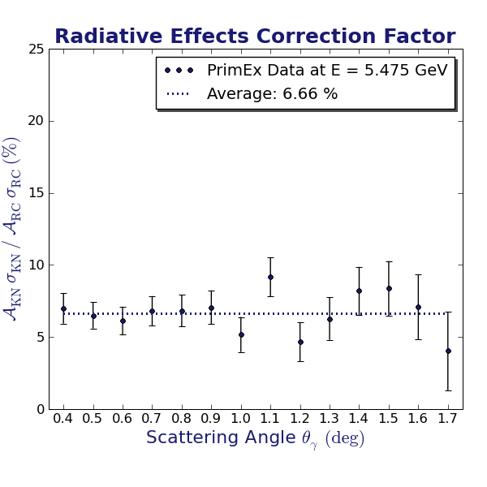
DIFFERENTIAL CROSS SECTION

Slide 15
TIME STABILITY

Slide 16
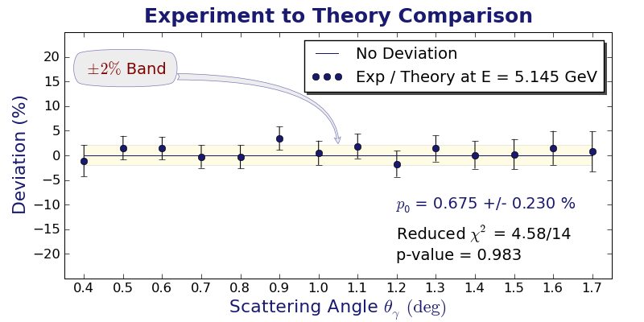
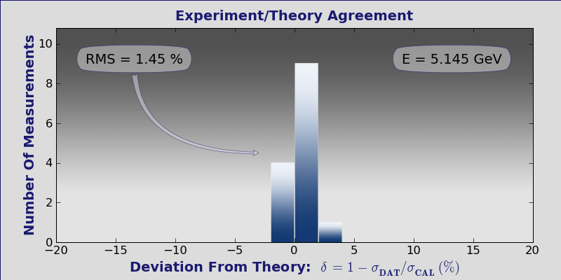
COMPARISON WITH THEORY
DIFFERENTIAL CROSS SECTION
TOTAL CROSS SECTION

Slide 17
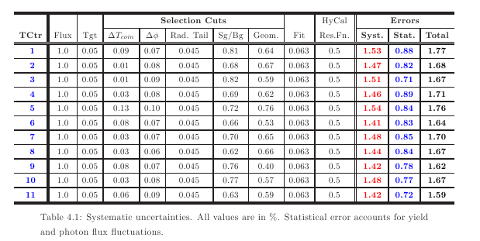
UNCERTAINTIES

Slide 18
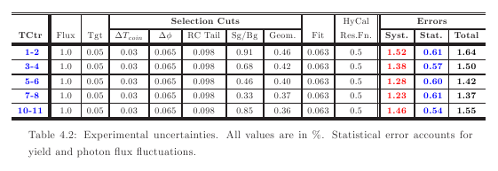
UNCERTAINTIES

Slide 19
UNCERTAINTIES

Slide 20
SUMMARY
This excellent data set provided:
Good control of systematics
Wide range of results:
- Total cross sections for 11 energy bins
- HyCal Solid Angle cross sections (11 energy bins)
- Differential cross sections
15 angle bins for each energy
Results compare very well with theory
Improvements:
Simulation of the background would help to:
- reduce systematic uncertainties
- increase control of systematics

