Slide 1
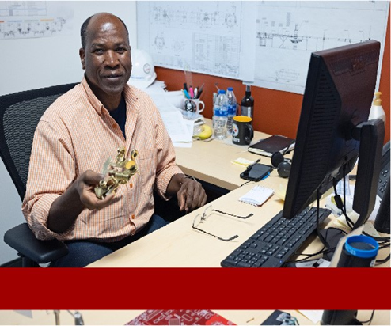
SLAC Lessons Learned and Improved Lab Safety
For QEWs and Others Impacted by Electrical Work
Welcome
Stuart Henderson

Slide 2
Agenda
Welcome by Stuart Henderson (est. 5 min)
Rick Adrover will provide an overview on SLAC (est. 20 min)
Bill Rainey will share ePAS and Management Safety Discussion updates (est. 20 min)
Closing by Stuart Henderson (est. 5 min)
Q & A (est. 10 min)

Slide 3
Why We Are Here
First, thank you!
As we continue to work across DOE, we are seeing an increase in safety events.
SLAC event offers us the opportunity to review how we can work safely.
Parallels to our 2019 electrical event.
In this meeting we want to:
Discuss this event: what we know and what we can learn.
Focus on your role as QEWs and others working in these roles.
Hear from you.
Outline the next steps.
When you come to work at Jefferson Lab, you should always remember that no work is so urgent or important that we will compromise the safety of our employees, our Users, our subcontractors, our visitors or our neighbors.

Slide 4
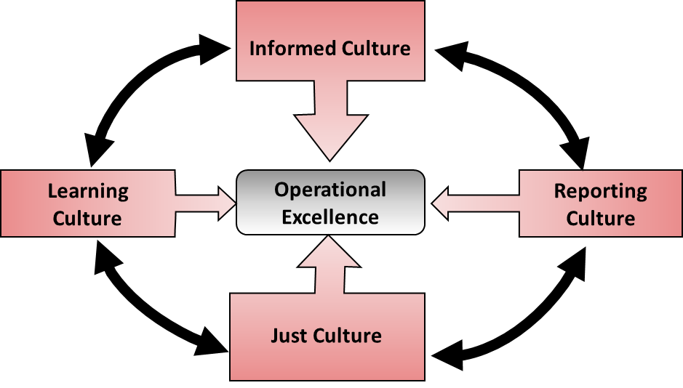
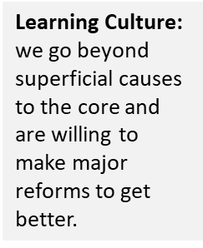
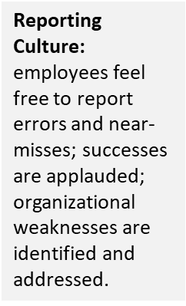
We Want to Embrace Important Cultural Elements of All High-Performing Organizations

Slide 5
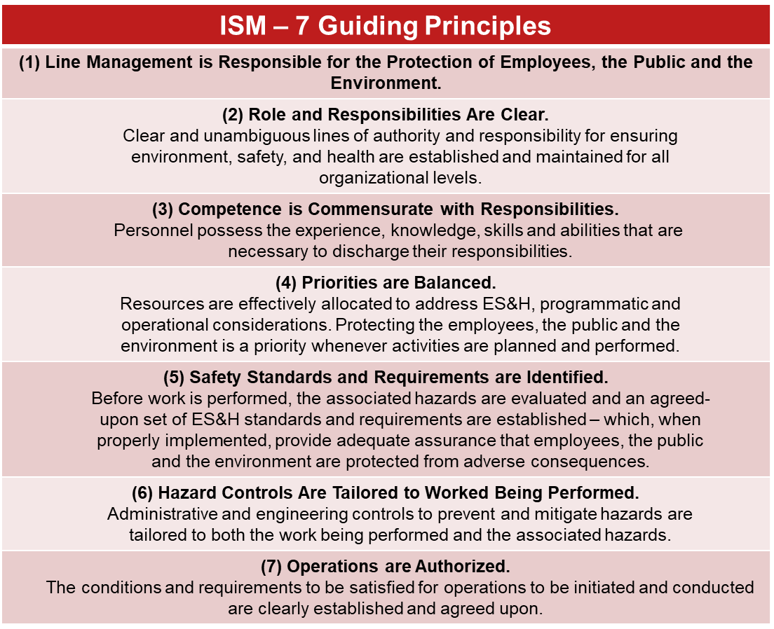
Integrated Safety Management; 7 Guiding Principles
We can be tempted to rush and not follow processes and procedures because we are mission-focused.
This can result in not only slowing down, but shutting down the mission.
Hold yourself and your teammates accountable for following policies and processes.
And remember the key tenets of Human Performance Improvement:
People are fallible. Even the best make errors.
Error likely situations are predictable and preventable.
Individual behavior is influenced by organizational processes and values.
People achieve high levels of performance based largely on the encouragement and reinforcement received from leaders, peers and subordinates.

Slide 6
SLAC Lessons Learned and Improved Lab Safety
For QEWs and Others Impacted by Electrical Work
Rick Adrover

Slide 7
SLAC Electrical Power Department
Chief Electrical Engineer
PM and Ops Support
Electrical Engineering and Design
Electrical Protection and Support
Electricians Low Voltage
Electricians High Voltage

Slide 8
Overview of the Job Site

Slide 9
Initial Board Observations
Outdated or incorrect electrical drawings.
Not following Hazardous Energy Control Program requirements and procedures.
Lack of supervisory oversight.
Inadequate pre-job brief.
Not able to effectively identify hazards and controls in the briefing.
Planning and execution of field work was overly dependent on individual capabilities rather than supervised procedural compliance.

Slide 10
SLAC Lessons Learned and Improved Lab Safety
For QEWs and Others Impacted by Electrical Work
Management Safety Discussions & ePAS
Bill Rainey & Diann Goodhand

Slide 11
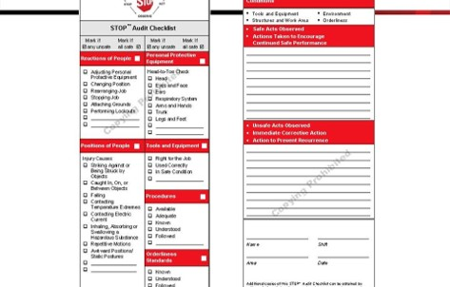
Safety Observations - History
Lessons from first 15 years and Human Performance Initiative at JLab provided an opportunity for rethinking and restructuring the SO process.
• Changed the process to move:
- Away from recording found conditions.
• The Safety Warden Inspection Program is the best way to resolve workplace conditions.
• Observed conditions do not substitute for human interaction.
- Toward building a culture of safety.
• Conversational interaction regarding approach to and conduct of work.
• Focus on human considerations.
• Work process design, error traps, distractions, safety consideration.
Former Safety Observation Program
- Started in mid 90’s as an outgrowth of
DuPont STOP training.
- Process and recording tool design based
on STOP pattern.

Slide 12
Management Safety Discussions (MSD)
Management Safety Discussion (MSD) Process and Data Recording Tool
New process piloted using a test group included line managers, ADs, non-
manager staff.
Feedback from test group incorporated into new process.
New process focuses on human performance aspects of manager-worker
interaction.
Process aimed at senior managers but available and useful for staff
interactions.
Mobile device friendly application uses device features (voice to text) to
facilitate data recording.
Streamlined the data collection for each interaction; data “filed in the field.”
Coupled to SO database.

Slide 13
SO / MSD Comparison Summary
Safety Observations
Based on DuPont STOP Program.
Promoted in-the-field interaction at two principal levels:
Manager-Worker
Worker-Worker
Promoted cross-division observers.
Looked for unsafe conditions and unsafe behaviors.
Promoted in-the-field correction of unsafe behaviors.
Recorded and characterized both in detail in after-action report.
Management Safety Discussions
Based on long SO experience.
Places premium on “in-the-field” Manager-Worker interaction.
The same training and same principles apply for any intentional workplace discussion on safety.
Focuses on Worker activities using HPI related discussion.
Recognize error-likely situations.
Identify error avoidance methods.
Encourage and positively reinforce safe behaviors.
Simple recording using mobile device web application.
ES&H Manual and website lists details and provides examples.
Promotes cross-division partnering.

Slide 14
MSD – How Does It Work?
See https://www.jlab.org/esh/mgtsafetydis for training materials/brochures, FAQs, data entry tool.
Conducting MSDs on-site:
- Solo or Team-up with partner.
Cross-divisional teams – bring “new eyes” on the work.
- Select a workplace location.
- Approach working individuals cautiously.
- Identify yourself and the purpose of your discussion.
- Dialogue - ask questions and listen.
- Reinforce the positive.
- Record.
Conducing MSDs remotely:
- Apply the same process.
- Workplace location is “Remote” - a Zoom or Teams Meeting.
- Work selection can be decided in advance.

Slide 15
A Few Dialogue Particulars
Request information about the task such as routine maintenance, diagnostic and emergent repair.
Get the person(s) to tell a story so that you can better understand the context of the activity.
What are the difficulties involved with this task?
What gets in your way? What are the workarounds?
How do you know things are going right? What are your cues that the process may be drifting?
How do you explain what can go wrong with this task to people unfamiliar with it? What is in place to prevent this task from going wrong? If it does go wrong, how can you recover?
Be sure to compliment the person or persons on things you see going well!
Remember, you can follow-up after the discussion using the data tool.

Slide 16
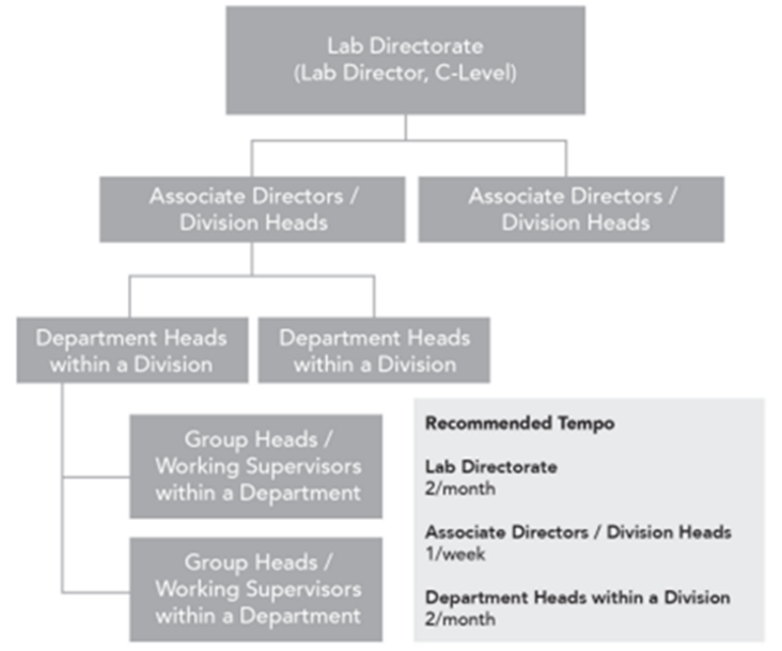
Who Should Do This?
Focus is on providing a process to bringing upper-level managers into the workplace.
Recommended frequency for different levels in a “generalized management structure” is found in the related ES&H Manual Chapter.
－Divisions/Departments have different
missions and priorities.
• Emphasis on certain elements depending
on division needs.
－Room for flexibility.
Anyone can conduct a MSD.
－Can be used for a general discussion
between two staff members.
－Feature of former SO process.

Slide 17
What Does This Mean For You?
MSDs focus on providing a process for bringing upper-level managers into workspaces.
If you are a Manager - in concert with DSO, your AD will:
Set expectations and priorities.
Routinely report and review results.
If you are Staff:
Be aware of the new process.
Understand the opportunity it presents for communication with management.
Participate in the process.
By your participation, help make the most of the time.
Conduct the process yourself.
Coordinate with your supervisor, review the materials, talk to your peers!
QEWs
Expect to engage in MSD in the field with your supervisors about your work as QEWs with some regularity.

Slide 18
Electronic Permitting Administration System (ePAS)
What is ePAS?
A single lab-wide software-based process for task hazard assessment and hazard mitigation, accessible through existing work planning platforms, for fabrication, repair, and maintenance activities.
Why should someone use ePAS?
Use of a (probability/severity) risk matrix resulted in subjective and inaccurate risk estimate and hazardous work planned and conducted without formal work control documents or proper pre-job briefings.
When should someone use ePAS?
Multi-year development and phase in across all lab activities.
ePAS Status
Initial “will it work” Phase 0 First Phase is completed.
Phase 1 software development, testing, uploading lab data, integration routines, training development, etc.
Phase 1 and preparation for Phase 2 based on continuous test group feedback.

Slide 19
ePAS, Continued
Welcome to Phase 2
Production version of ePAS software (plus a staging version “sand box” for trainees).
Specialized equipment and supplies in-hand.
Printers and tags for ePAS hazardous energy isolation as part of complex LOTO.
Training is competed and supporting documentation is in final comment and approval
cycle.
Division-specific rollout plans have been developed.
These are being refined now and DSOs are conferring on best way to use resources and track progress.
What’s Next?
Your DSO will let you know:
when your organizational unit is (and who) will receive training, including training videos plus a hands-on practical.
how (in what sequence and to what work ePAS will be applied during rollout).
If you have a question, ask your DSO about plans and schedules and use contacts
on the next page!

Slide 20
Contacts
MSD Contacts
Bob May x7632 may@jlab.org
Bill Rainey x7898 wrainey@jlab.org
https://www.jlab.org/esh/mgtsafetydis
ePAS Contacts
Bob May x7632 may@jlab.org
Diann Goodhand x7841 goodhand@jlab.org
https://www.jlab.org/esh/epas
This Photo by Unknown Author is licensed under CC BY-NC

Slide 21
SLAC Lessons Learned and Improved Lab Safety
For QEWs and Others Impacted by Electrical Work
Action Plan
Stuart Henderson

Slide 22
Action Plan
JLab put in place an “Action” Plan in response to the SLAC shock event consisting of;
Initial notification to staff – Completed 1/10/23.
Electrical Safety Committee + table top of JLAB similar jobs first meeting – Completed 1/31/23.
Departments to conduct rolling pauses of activities to discus work planning at the group level and any impediments to doing that work – Ongoing; due to AD’s by 2/23/23.
Supervisor Meeting to discuss SLAC event and rollout of Management Safety Conversation plan – Completed 1/26/23.
Electrical Worker (QEW’s) plus others impacted to discuss SLAC event and preliminary results of table top, lessons learned etc. Scheduled 2/7/23.
Performance Assurance will expand their ongoing assessment of oversubscription of resources as they relate to incidents across the lab. Scheduled 2/28/23.
Continuing ongoing projects related to the 2019 shock event at JLab and other process improvements.
ePAS rollout.
Management Safety Discussions.
Deploy two modules for lab’s supervisor fundamentals training including Safety fundamentals and updated HPI. 3rd quarter 2023.
ES&H Staff member is on the DOE investigation committee.

Slide 23
Questions & Answers
This Photo by Unknown Author is licensed under CC BY-SA

Slide 24
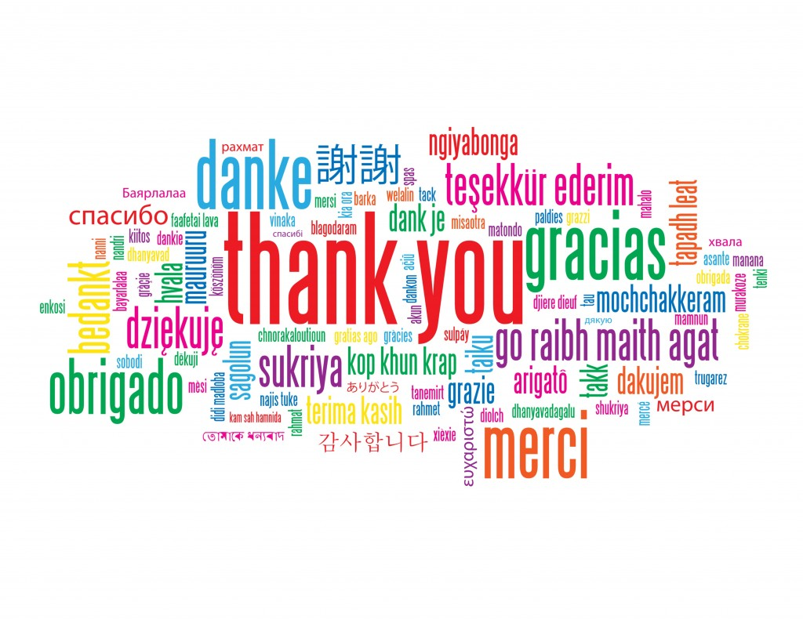
The End
This Photo by Unknown Author is licensed under CC BY-NC-ND

