Slide 1
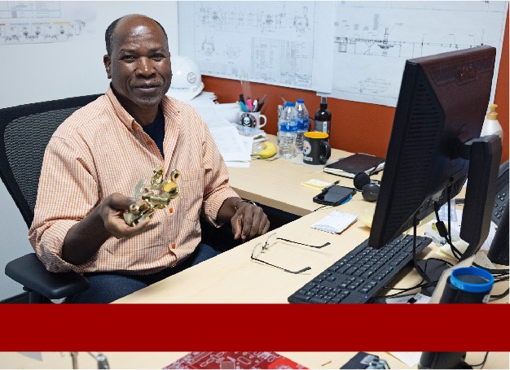
Management Safety Discussions
Supervisor All-Hands Meeting
Welcome
Stuart Henderson

Slide 2
Agenda
‘Why’ We Are Here
SLAC Event Overview
Management Safety Discussions
Example of Management Safety Discussion
Action Plan Going Forward
Q&A

Slide 3
‘Why’ We Are Here
• First, thank you!
• As we continue to work, across DOE, we are seeing an increase in safety
events
• SLAC event offers us the opportunity to review how we work safely
- Parallels to our 2019 electrical event
In this meeting we want to:
- Discuss this event: what we know, what we can learn
- Focus on the importance of supervisors engaging with their staff members,
- Hear from you,
- And discuss next steps
When you come to work at Jefferson Lab, you should always remember that no work is so urgent or important that we will compromise our employees’, our Users', our subcontractors’, our visitors’ or our neighbors’ safety.

Slide 4
We Want to Embrace Important Cultural Elements of All High-Performing Organizations

Slide 5
Integrated Safety Management 7 Guiding Principles
We can be tempted to rush and not follow processes and procedures because we are mission focused
This can result in not only slowing down, but shutting down the mission
Hold yourself and your teammates accountable for following policies and processes
And remember the key tenets of Human Performance Improvement:
People are fallible, even the best make errors
Error likely situations are predictable and preventable
Individual behavior is influenced by organizational processes, values
People achieve high levels of performance based largely on the encouragement and reinforcement received from leaders, peers and subordinates
ISM – 7 Guiding Principles
(1) Line Management is Responsible for the Protection of Employees, the Public and the Environment.
(2) Role and Responsibilities Are Clear. Clear and unambiguous lines of authority and responsibility for ensuring environment, safety, and health are established and maintained for all organizational levels.
(3) Competence is Commensurate with Responsibilities. Personnel possess the experience, knowledge, skills and abilities that are necessary to discharge their responsibilities.
(4) Priorities are Balanced. Resources are effectively allocated to address ES&H, programmatic and operational considerations. Protecting the employees, the public and the environment is a priority whenever activities are planned and performed.
(5) Safety Standards and Requirements are Identified. Before work is performed, the associated hazards are evaluated and an agreed- upon set of ES&H standards and requirements are established – which, when properly implemented, provide adequate assurance that employees, the public and the environment are protected from adverse consequences.
(6) Hazard Controls Are Tailored to Worked Being Performed. Administrative and engineering controls to prevent and mitigate hazards are tailored to both the work being performed and the associated hazards.
(7) Operations are Authorized. The conditions and requirements to be satisfied for operations to be initiated and conducted are clearly established and agreed upon.

Slide 6
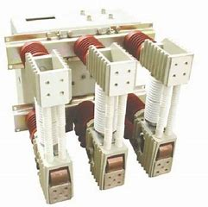
SLAC Shock Incident on 12-27-2022
Incident Summary
By Steven Hoey

Slide 7
SLAC Shock Incident on 12-27-2022
Summary of Preliminary Information:
Electrician in the HV Group sustained severe injuries from receiving a High Voltage shock
Electrician was part of a crew preparing multiple substations and downstream equipment for planned preventative maintenance during the holiday shutdown
He was performing a Zero Voltage Verification (ZVV) on a 12.47 kV switchgear
Crew was working under an approved Electrical Work Plan (EWP)
Crew was de-energizing and locking-out substation in accordance with the EWP which required three breakers to be opened, racked out, and LOTO lock and tag applied, and these steps were performed without incident
The energy isolation plan requires a 12kV ZVV to be performed on the switchgear
The electrician proceeded to perform the ZVV on the UPSTREAM side rather than the DOWNSTREAM side of the B626 main breaker
UPSTREAM 12kV feeder connected to the main breaker was outside the energy isolation boundary and was energized
Shock occurred

Slide 8
SLAC Shock Incident, Continued
Work Planning
Work Plans included an EWP with HV Switching Orders (SO’s) and Lockout Tagout (LOTO) Energy Isolation Plans (EIP’s) for (1) installation of a generator to support building and equipment impacted by the outage and (2) performing LOTO and Zero Voltage Verification prior to releasing substations to contractors who would perform the PM’s
Work Plan development included; Maintenance and Ops Support Group Leader (MOS GL) walked the job to write initial plans, MOS GL walked job with the electricians, MOS GL walked job again with subcontractor after job award
MOS Support Engineer walked job to verify breakers and Switching Orders
High Voltage Supervisor reviewed the EWP, verified drawings and switching diagrams available, walked down the job and authorized the work
Workers walked the job and felt comfortable with the plan and the plan was signed off by all applicable parties, including workers, acknowledging they would adhere to steps and hazard controls
Once the EWP was fully authorized, work was scheduled

Slide 9
SLAC Shock Incident, Continued
Day of Work
HV Crew (three electricians) attended 6:00 a.m. tailgate meeting with high voltage group personnel to discuss the EWP where workers confirmed that they understood the plan and felt comfortable with doing the work
6:30 a.m. electricians attended a broader tailgate to coordinate work for the day
Electricians started at B726 and B522 substations and visually verified breakers were racked out and applied LOTO in prep for ZVV planned for later in the day
Electricians were outfitted in NFPA Arc Flash Cat. 2 attire, (Arc rated long pants, long sleeve shirt, leather boots, hard hat and safety glasses) Cat. 2 PPE has a minimum Arc rating of 8 cal/cm2
Electricians proceeded to B626 where first ZVV was planned. Walked through a discussion of work planned including review of EWP, single line diagrams
EWP included a group LOTO on breaker 342 then a ZVV on three downstream breakers. 342 was opened, racked out and LOTO (deenergized substation B626) however the feeder to 342 from master substation 75 was energized

Slide 10
SLAC Shock Incident, Continued
Day of Incident
Injured worker did not change into a 100cal/cm2 suit as required by SLAC Policy. He remained in his Cat. 2 (8cal/cm2) attire. He was also wearing a raincoat (Arc rated?)
Worker approached the line side of breaker 342 (energized side fed from 75), proceeded to open a cubicle door and was lifting a boot off a test point when the shock occurred
Initial Issues/Causes Identified
A 100 cal/cm2 suit was not in use, although it is required
Zero Voltage Verification was attempted on an energized breaker rather than the de-energized breakers down stream
Early fact-finding efforts incidentally discovered outdated or incorrect electrical drawings in the SLAC drawing database indicating gaps in configuration management

Slide 11
Introduction to the Management Safety Discussion Tool
By Johnathon Huff

Slide 12
Background: Safety Observations to Management Safety Discussions
Safety Observation (SO) Process and Data Recording Tool
Approx. 15 years: >18,000 observations, >500 observers
Lessons from first 15 years:
Interaction between management and workers uniformly identified as high value support for safety culture by participants
Discussions viewed as interrupting work
Data recording cumbersome
Inconsistent implementation between divisions and within divisions
Human Performance Initiative at JLab provided an opportunity for
rethinking and restructuring the SO process
Notes:
Safety Observation (SO) Process and Data Recording Tool
Approx. 15 years: >18,000 observations, >500 observers
Lessons from first 15 years:
Interaction between management and workers uniformly identified as high value support for safety culture by participants
Ongoing work ‘interruptible for discussion’ hard to find/engage in the field; observations tended toward recording workplace conditions when discussion not ideal
Data recording cumbersome - required data entry at observer's desk after observation was over
Inconsistent implementation between divisions and within divisions
Human Performance Initiative at JLab provided an opportunity for
rethinking and restructuring the SO process

Slide 13
Background: Opportunities for Improvement
Analysis of 2009-19 Cause Codes for Notable Events indicated 42% of the ​
time we failed to Perform Work Within Controls – SO Process was not addressing key issues!

Slide 14
Background, Continued
ES&H had considerable feedback on SO process and data recording tool and initiated changes
Streamline data recording – mobile friendly
Updated the training materials to sharpen focus on HPI
Provided support for locating ongoing activity for engagement
Significant support from Communications Office
Produced training videos, re-worked/improved information content, improved website
ES&H Manual Chapter revision underway
End of January 2023 fanfare and rollout planned
Notes:
ES&H had considerable feedback on SO process and data recording tool and initiated changes
Partnered with IT on project to revamp SO process: streamline data recording –
update tool, incorporate HPI, shift focus back to manager-worker interaction
Updated the training materials to sharpen focus on HPI
Provided supports for locating ongoing activity for engagement
Incorporate key HPI considerations
Conducted training and observation process using test audience (Lab Managers
from ADs to Line Supervisors) and revised process
Pandemic conditions interrupted and subsided – Lab staff back at work
COO re-started effort end of CY 2022 to support workplace safety culture improvement
Significant support from Communications Office
Produced training videos, re-worked/improved information content, improved website
ES&H Manual Chapter revision underway
End of January 2023 fanfare and rollout planned

Slide 15
Management Safety Discussions
By Bob May

Slide 16
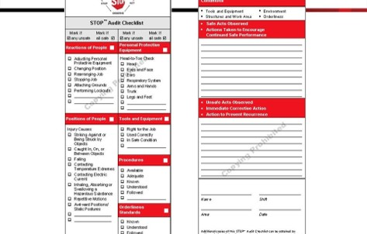
Safety Observations - History
• Lessons from first 15 years and Human Performance Initiative at JLab provided an opportunity for rethinking and restructuring the SO process
• Movement
- Away from recording found conditions
• The Safety Warden Inspection Program is the best way to resolve workplace conditions
• Observed conditions do not substitute for human interaction
- Toward building a culture of safety
• Conversational interaction regarding approach to and conduct of work
• Focus on human considerations
• Work process design, error traps, distractions, safety consideration
Safety Observation Program
- Started in mid 90’s as an outgrowth of
DuPont STOP training
- Process and recording tool design based
on STOP pattern

Slide 17
Management Safety Discussions (MSD)
Management Safety Discussion (MSD) Process and Data Recording Tool
New process piloted using Test Group included line managers, ADs, non-
manager staff
Feedback from Test Group incorporated into new process
New process focuses on human performance aspects of manager-worker
interaction
Process aimed at senior managers but available and useful for staff
interactions
Mobile device friendly application uses device features (voice to text) to
facilitate data recording
Streamlined the data collection for each interaction; data “filed in the field”
Coupled to SO database

Slide 18
SO / MSD Comparison Summary
Safety Observations
Based on DuPont STOP Program
Promoted in-the-field interaction at two principal levels
Manager-Worker
Worker-Worker
Promoted cross-division observers
Looked for unsafe conditions and unsafe behaviors
Promoted in-the-field correction of unsafe behaviors
Recorded and characterized both in detail in after-action report
Management Safety Discussions
Based on long SO experience
Places premium on “in-the-field” Manager-Worker interaction
Same training, same principles apply for any intentional workplace discussion on safety
Focuses on Worker activities using HPI related discussion
Recognize error-likely situations
Identify error avoidance methods
Encourage and positively reinforce safe behaviors
Simple recording using mobile device web application
ES&H Manual and website lists details and provides examples
Promotes cross-division partnering

Slide 19
MSD – How Does It Work?
See https://www.jlab.org/esh/mgtsafetydis for training materials/brochures, FAQs, data entry tool
On-site
- Solo or Team-up with partner
Cross-divisional teams – bring “new eyes” on the work
- Select a workplace location
- Approach working individuals cautiously
- Identify yourself and the purpose of your discussion
- Dialogue - ask questions and listen
- Reinforce the positive
- Record
Remotely
- Apply the same process
- Workplace location is “Remote” - a Zoom or Teams Meeting
- Work selection can be decided in advance

Slide 20
A Few Dialogue Particulars
Request information about the task such as routine maintenance, diagnostic, and emergent repair
Get the person(s) to tell a story so that you can better understand the context of the activity
What are the difficulties involved with this task?
What gets in your way? What are the workarounds?
How do you know things are going right? What are your cues that the process may be drifting?
How do you explain what can go wrong with this task to people unfamiliar with it? What is in place to prevent this task from going wrong? If it does go wrong, how can you recover?
Be sure to compliment the person or persons on things you see going well!
Remember, you can follow-up after the discussion
The data tool facilitates that

Slide 21
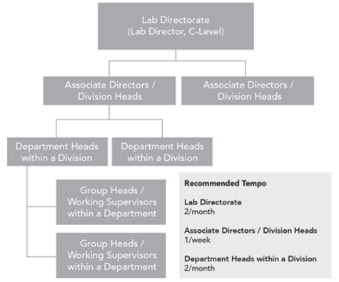
Who Is Expected To Do This?
Focus is on providing a process to bringing upper-level managers into the workplace
Recommended frequency for different levels in a “generalized management structure” is found in the related ES&H Manual Chapter
－Divisions/Departments have different
missions
－May have different priorities
• Emphasis on certain elements depending
on division needs
－Room for flexibility
Anyone can MSD process
－Can be used for a general discussion
between two staff members
－Feature of former SO process

Slide 22
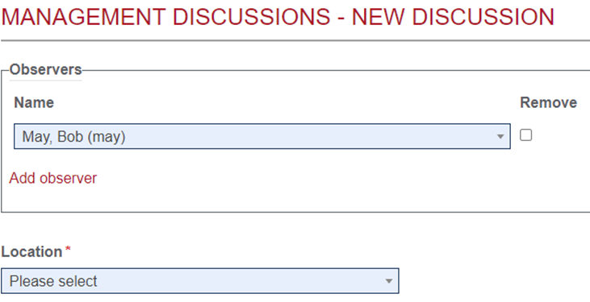
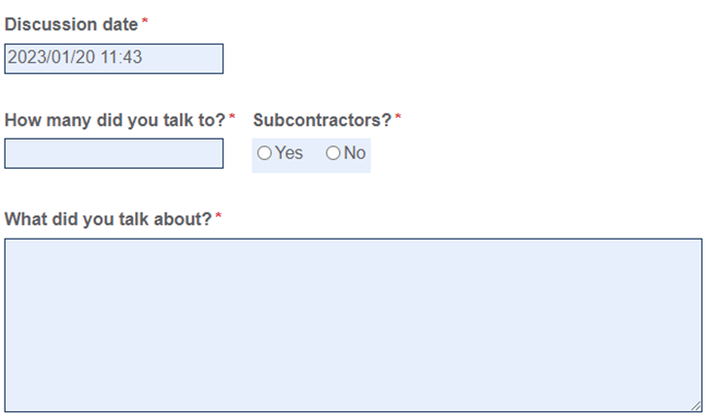
Recording Your Discussions
Enter who and where
Initiator(s) only
You can add participants and you both get credit for the discussion
Location is keyed to site-wide database of locations
Enter when and what
Default entry is current date and time
Enter number of folks you talked with
Enter a brief narrative of what you talked about
Voice to text feature of mobile device can be used to enter narrative
Caution: it’s not always an accurate translation

Slide 23
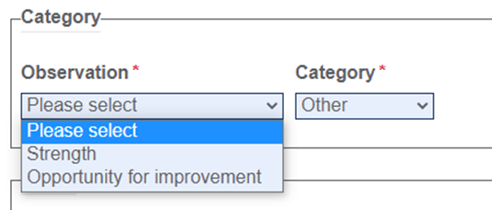
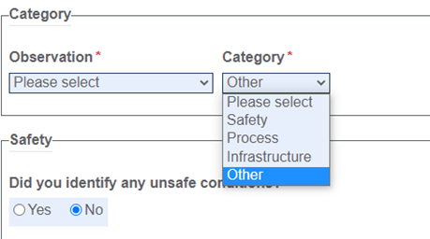
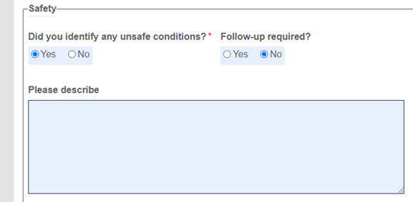
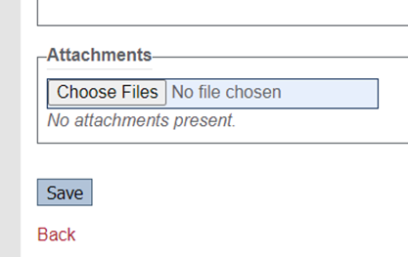
Recording Your Discussion, Continued
Enter Type of observation on the balance
Strength
Opportunity for improvement
Enter Category
Safety, Process, Infrastructure, Other
Describe “Other” in your narrative
Did you encounter any unsafe conditions
If yes, you’ll be asked to describe
Option for follow-up
You can add an attachment
Picture from your phone
Saved attachment viewable and editable by you and other named observers
Viewable by DSO as a default
Reports available - generating tool

Slide 24
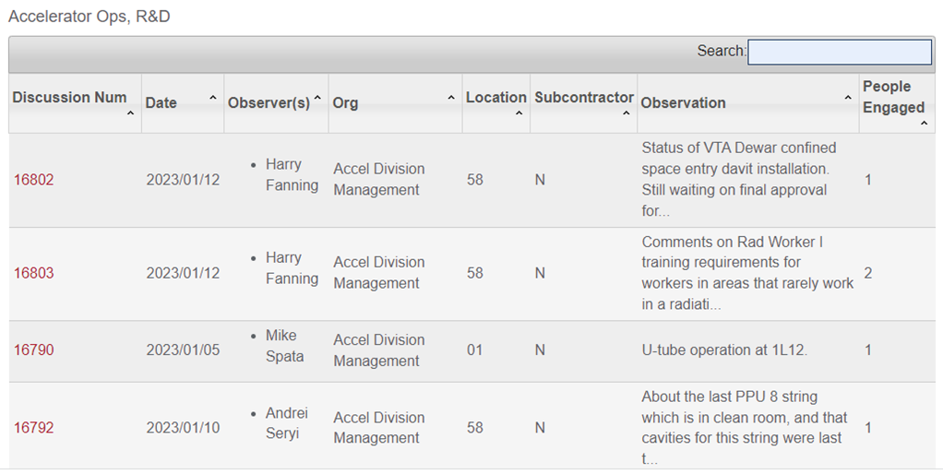
Summary
Safety Observation (SO) movement to Management Safety Discussions (MSD)
History
Shift in focus
Simplified process
Simplified recording tool
Overview of available information
Discussion of MSD process
Contact: Bob May - may@jlab.org
ext. 7632
This process has been successfully piloted and is already in use.

Slide 25
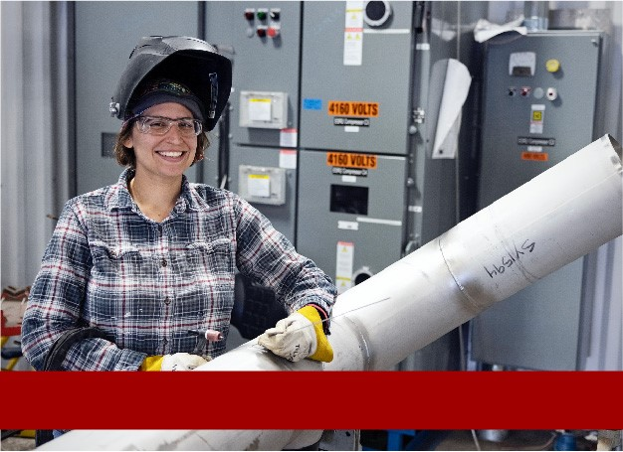
Leadership Experience Using MSD Tool
By Andrei Seryi

Slide 26
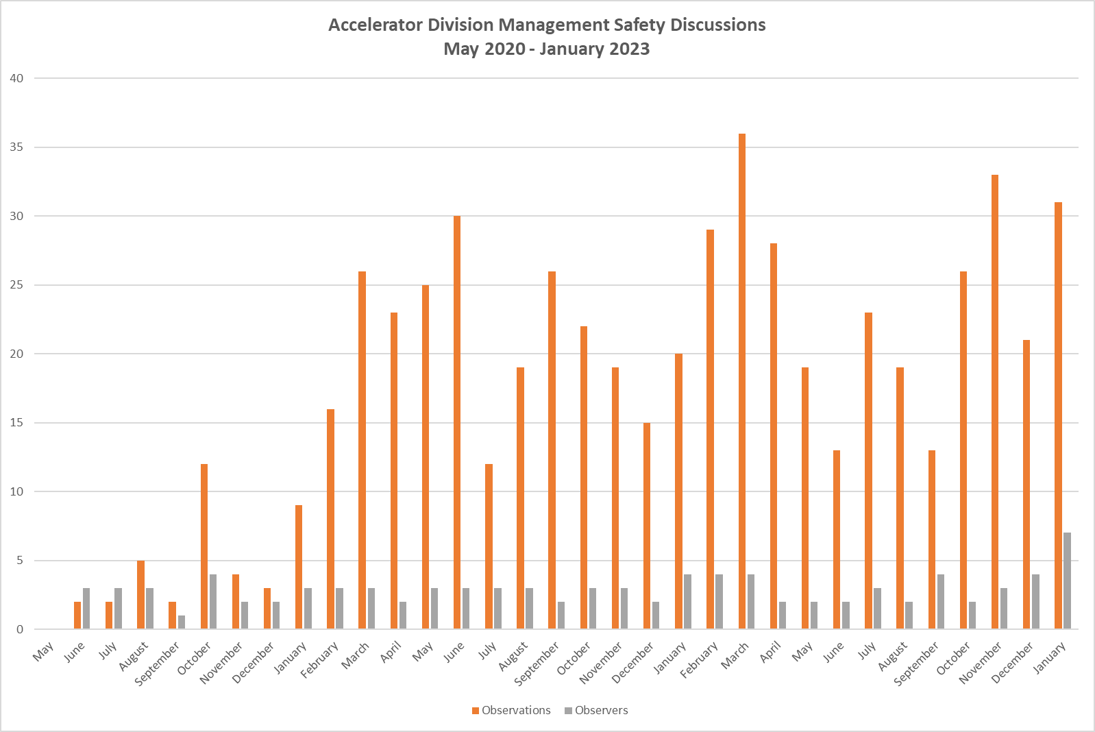
Accelerator Division Management Safety Discussions

Slide 27
Next Steps
By Stuart Henderson

Slide 28
Action Plan
Conduct an Electrical Safety Committee driven “Table Top” exercise on how we do High Voltage work (scheduled next week)
Departments/Division’s will conduct rolling pauses of activities to discuss their work planning processes at the work group level and any impediments to conducting work as per procedure and examine;
resources,
schedule,
off hours, emergency,
the HPI influences etc.,
remote workers and on-site workers,
using the proper PPE, and,
ensuring drawings are correct.
The Dept/Divisions shall report out via their respective AD via the Director's Council. Complete by February 23.

Slide 29
Action Plan, Continued
Performance Assurance will expand their ongoing assessment of oversubscription of resources as they relate to incidents across the lab.
Continue/finalize implementation of ongoing projects related to the 2019 hazardous energy events and other related process improvements at JLab;
ePAS Phase II Rollout – beginning mid-January
Management Safety Discussion Program - end of January rollout
ADs will flow down expectations to their teams
Subcontractor lifecycle process improvements – ongoing
Deploy two modules for JLab Supervisor Fundamentals Program
(Supervisors ES&H Training and Updated Human Performance
Training for supervisors) FY23 3rd quarter

Slide 30
Questions & Answers
Stuart is now taking questions
For additional questions regarding this new approach, visit the Management Safety Discussions website at
https://www.jlab.org/esh/mgtsafetydis or contact
Bob May at may@jlab.org or
Bill Rainey at wrainey@jlab.org

Slide 31
The End
Thank you for attending.

