Slide 1
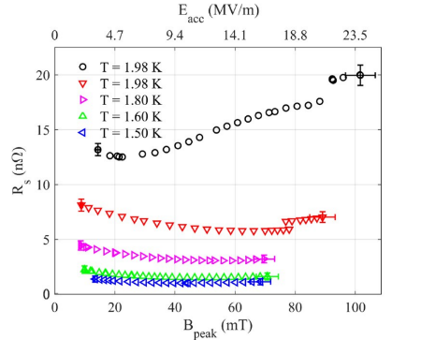
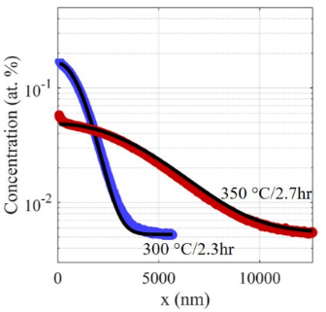
Surface Resistance Tuning of Nb via Thermal Diffusion of Its Native Oxide
Eric Lechner
O
Accelerator Seminar
June 3, 2021
1

Slide 2
Outline
Motivation
SIMS Results
Ciovati’s Model
RF Results
Benefits
Conclusions/Open Questions
Notes:
So the outline of todays talk will be the motivation for understanding the interstitial concentration of O in Nb, otherwise called O-alloyed Nb, our SIMS results on vacuum annealed Nb samples, a model to describe the dissolution of Nb’s native oxide and oxygen diffusion, as well as our RF results, benefits gained from such an alloying process and conclusions and open questions.

Slide 3
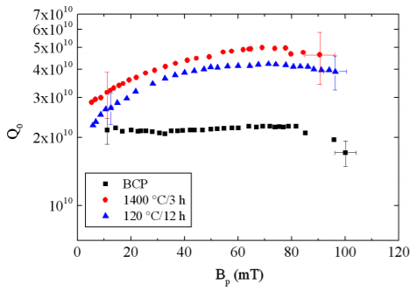
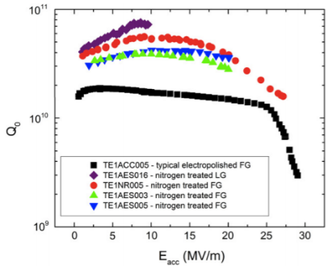
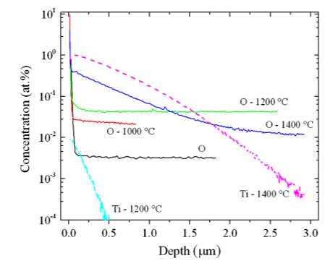
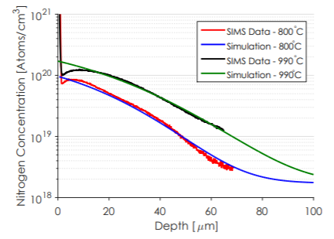
Motivation - Impurity Alloying
[1]
Ti-alloying
[2]
N-alloying
[3]
[1] P. Dhakal, et al. Phys. Rev. Spec. Top. Accel. Beams 16.4 (2013): 042001
[2] A. Grassellino et al. Supercond. Sci. Technol 26.10 (2013): 102001.
[3] D. Gonnella, Daniel, et al. Proceedings of IPAC2016, Busan, Korea (2016).
Notes:
Efforts to increase the efficiency of Nb SRF cavities via interstitial alloying with nitrogen [12-14], titanium [15,16], or other impurities [17] have yielded a significant reduction of the surface resistance, $R_{s}$, by a factor of 2–4. Shown below are atomic species concentration profiles made by secondary ion mass spectrometry whose acronym is SIMS. This technique is central to our results later on so I’ll describe this technique in more detail a bit later.

Slide 4
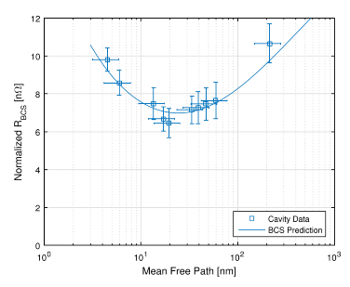
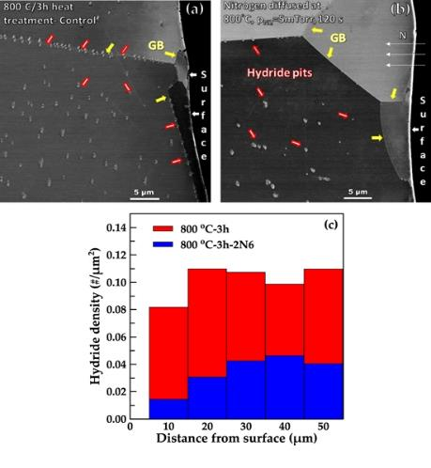
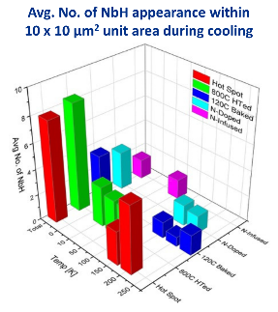
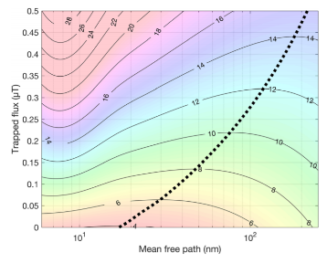
Motivation - Impurity Alloying: Benefits
Hydride blocking
[3]
Mean free path tuning
[1]
[2]
[1] Garg, P., et al. " Superconductor Science and Technology 31.11 (2018): 115007.
[2] Sung, Z. H., et al. Proceedings of the International Conference on RF Superconductivity SRF. 2019.
[3] Maniscalco, J. T., D. Gonnella, and M. Liepe. Journal of Applied Physics 121.4 (2017): 043910.
Notes:
Performance enhancement in alloyed cavities is inherently a complex multifaceted problem. One of the main benefits of impurity alloying is preventing the occurrence of normal conducting hydride phases from precipitating and reducing the quality factor. The effect of impurity alloying is most nicely seen when examining differently treated Nb by cryocooled cross section TEM. From the surface towards the bulk, the hydride density is suppressed in nitrogen alloyed samples which can be seen by the graph below. Among the common heat treatment recipes, this suppression is especially pronounced in the N alloyed, N infused, and 120C baked recipes. Simultaneously, the mean free path can be tuned to an optimal surface resistance. Here the BCS prediction exhibits a minimum in the surface resistance a function of mean free path which has been confirmed by various alloyed cavities. However the sensitivity of trapped flux increases with increasing doping so care must be taken to select an optimal mean free path as shown in the color plot on the right-hand side. The black dotted line is there to show the path of least surface resistance through this trapped flux - mean free path space.

Slide 5
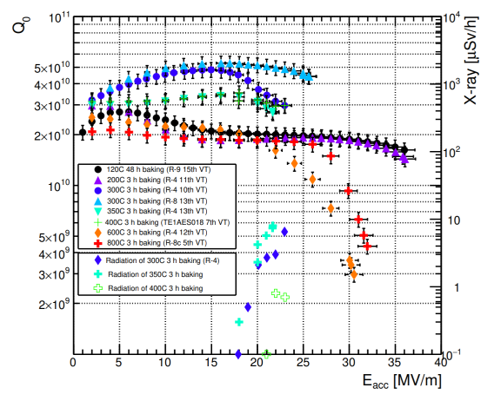
Motivation – Recent Experiments
[1]
Ito et al.’s cavity prep.
Reset Electropolish
High Pressure Rinse
Vacuum Anneal
High Pressure Rinse
RF Test
[1] H Ito et al. Progress of Theoretical and Experimental Physics, 2021;, ptab056
Notes:
Recently, Ito investigated the effect of vacuum heat treatment of Nb superconducting radio-frequency cavities between 200 °C and 800 °C for 3 hours. In the range of 300 °C to 400 °C, the cavities exhibited pronounced decrease of $R_{s}$ with field, extremely high quality factors, and reduced quench fields, all typical qualities previously associated with impurity-alloyed Nb cavities. Qualitatively, these effects were assumed to be due to oxygen diffusion from the native Nb oxide. Their process was to reset a cavity via 20 micron electropolish, high pressure rinse, vacuum anneal, HPR and then assemble for RF test.

Slide 6
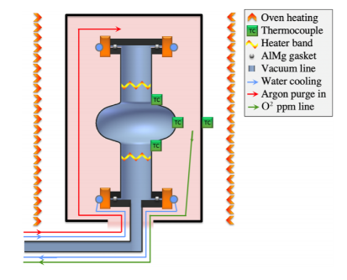
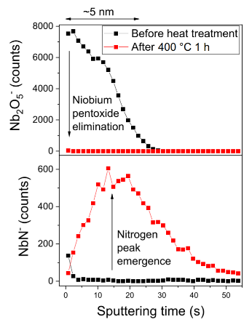
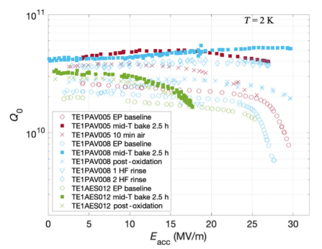
Motivation – Similar Experiments
[1]
[2]
[1] Posen, S., et al. Physical Review Applied 13.1 (2020): 014024.
[2] Romanenko, A., et al. Physical Review Applied 13.3 (2020): 034032.
Notes:
Ito’s work is strikingly similar to the work done at Fermilab, where cavities were vacuum annealed around 300C for a 2.5 hours, and in some instances exposed to nitrogen, then RF tested without exposure to atmosphere. Using this recipe, they were able to achieve high quality factors, but reduced accelerating gradients. Qualities typical of alloyed cavities. Their secondary ion mass spectrometry measurements by observed Nb₂O₅ dissolution and a qualitative increase in nitrogen concentration near the surface ~10 nm deep. From these observations they assumed that nitrogen was the primary diffusant. However, they noted explicitly in their work that their conclusions on the quality factor enhancement were in disagreement with the oxygen dissolution and migration results of previous works.

Slide 7
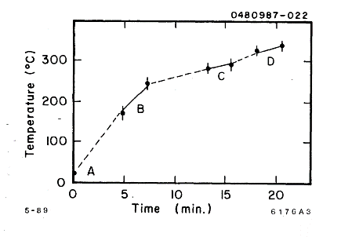
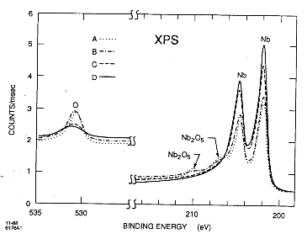
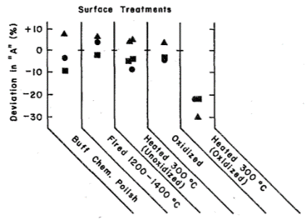
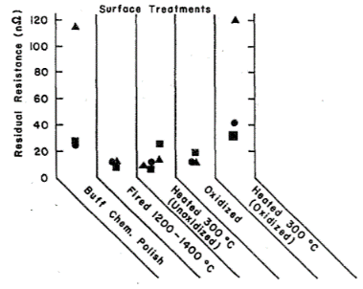
Motivation – Previous Works
[1]
[2]
[1] F. Palmer, R. Kirby, F. King, and E. L. Garwin, Nucl. Instrum. Methods. Phys. Res. A: 297, 321 (1990).
[2] ] F. Palmer, IEEE Transactions on Magnetics 23, 1617 (1987).
Notes:
In previous works, vacuum annealing SRF cavities at 300 Celsius for a few minutes resulted in a decomposition of the native oxide and resulted in the lowering of the BCS surface resistance, consistent with the effect of impurity alloying. However, it was found that the residual resistance increased substantially; effectively washing out any benefit of $BCS$ surface resistance reduction.

Slide 8
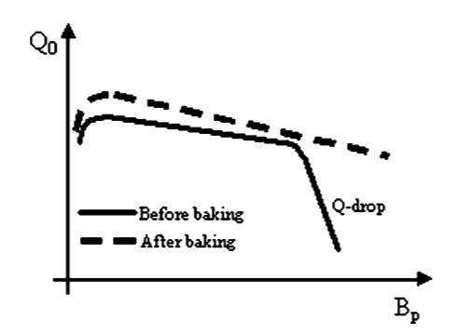
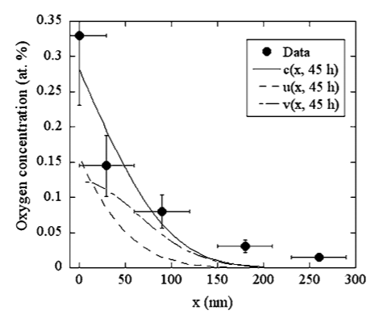
Motivation – Previous Works
[1]
[1] Ciovati, Gianluigi. Applied physics letters 89.2 (2006): 022507.
Notes:
Later, experiments showed that vacuum annealing cavities around 100 °C improved performance by mitigating high field q slope. To describe the migration of oxygen, an oxide dissolution and diffusion model was introduced by Ciovati [44] However, some dissolution and diffusion parameters in that model were too unconstrained for predictive O alloying for higher temperature vacuum heat treatments.

Slide 9
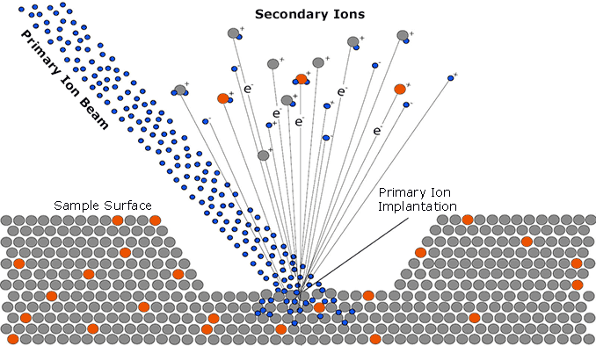
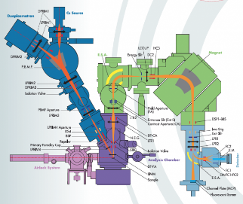
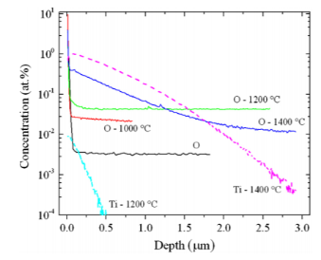
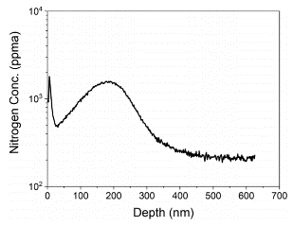
SIMS Results - Secondary Ion Mass Spectrometry
[1]
[2]
[3]
[4]
[1] https://www.cameca.com/products/sims/technique
[2] Cameca: IMS 7f-GEO www.cameca.com/instruments-for-research/ims7fgeo.aspx
[3] P. Dhakal, et al. Phys. Rev. Spec. Top. Accel. Beams 16.4 (2013): 042001
[4] Angle, Jonathan W., et al. J. Vac. Sci. Technol. B 39.2 (2021): 024004.
Notes:
So, what exactly is going on? Which impurities are contributing to the alloying effects seen in RF measurements? To address this question directly, secondary ion mass spectrometry measurements can be taken to understand impurity concentrations as a function of depth into the material. It uses a primary ion beam that is accelerated towards the sample. The impact of which produces secondary ions which are then sent to a mass spectrometer for measurement. Here the secondary ion yield is dependent on a few things like the sample matrix, primary ion used and the ionization potential of the secondary ion. To properly quantify the impurity concentrations, we must go from the SIMS signal intensity and convert that to a concentration. This calibration can be achieved by measuring an implant standard of known impurity concentrations.

Slide 10
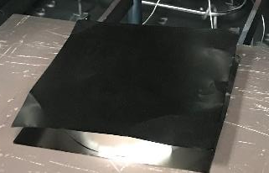
SIMS Results – Sample Preparation
Anneal (Grain Growth)
6 mm
Nano-polish
H-degas
10 mm
Electropolish
Vacuum Anneal
Notes:
Samples were prepared following a similar process to the one outlined by Ito [36]. The samples were cut from Tokyo Denkai Nb stock. The samples were first vacuum annealed at 900°C to promote grain growth following the same procedure as the 1.3 GHz single-cell cavity, used for RF validation described later on. After annealing, each sample was nano-polished (NP) by a vendor to provide sufficiently flat samples for SIMS measurements. After nanopolishing, the samples received a 600°C/10hr heat-treatment to remove bulk hydrogen caused by the mechanical polishing before a 20 µm electropolish with the typical HF/H₂SO₄ solution at 13°C [47]. During each heat treatment, the samples were housed in a double-walled Nb foil container to minimize any furnace contamination [48].

Slide 11
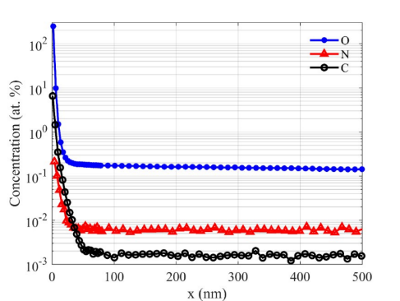
SIMS Results – Shallow Depth Profile
300 °C/2.3 hours
Clean Nb should have C,N,O impurity concentrations at ~0.005 at. %
After vacuum annealing at 300 C for 2.3 hr we find a large enhancement in O.
C and N have diffusion coefficients 2-3 orders of magnitude less than O
Notes:
So we heat treated samples at different times and temperatures to investigate what was going on. Shown here is a typical calibrated SIMS depth profile of a sample vacuum heat treated at 300 °C for 2.3 hours which presents a large enhancement in oxygen with minor amounts of carbon and nitrogen near the surface. The impurities most likely to be alloyed into Nb during a vacuum thermal diffusion process are oxygen, nitrogen and carbon, however, in the temperature range probed here between 100-350 Celsius, nitrogen and carbon have diffusion coefficients at least 2–3 orders of magnitude less than oxygen. This is strongly suggestive that oxygen is the main species causing the quality factor enhancement. So how can we model this process for predictive oxygen alloying?

Slide 12
Ciovati’s Native Oxide Dissolution and Diffusion Model
Nb
Nb
O
O
O
O
O
O
O
O
O
O
O
O
O
O
*Nb₂O₅
O
O
O
O
O
NbO_{x}
Nb₂O₅
NbO_{x}
Δ
O
O
O
O
O
Add heat
O
O
O
O
O
O
O
O
O
O
O
O
O
O
*Oxides not to scale
One-dimensional diffusion equation [1]
$$\frac{∂c\left(x , t\right)}{∂t}=D\left(T\right)\frac{∂^{2}c\left(x,t\right)}{∂x^{2}}+q\left(x,t,T\right).$$
$$c\left(x,t\right)= v\left(x,t\right)+u\left(x,t\right)$$
Solutions to the diffusion equation
Arrhenius equations
$v\left(x,t\right)=\frac{v_{0}}{\sqrt{πD(T)t}}e^{−x^{2}/(4D(T)t)}+c_{∞}$ $−superficial dissolved oxygen$
$$D\left(T\right)=D_{0}e^{−{E_{aD}}/RT} −oxygen diffusion$$
$$k\left(T\right)=Ae^{−{E_{ak}}/RT}− oxide dissolution$$
$$u\left(x,t\right)=\frac{u_{0}}{\sqrt{πD(T)}}\int_{0}^{t}{\frac{k\left(T\right)e^{−k\left(T\right)s}}{\sqrt{t−s}}e^{−x^{2}/(4D(T)(t−s))}ds} −oxide dissolution$$
[1] Ciovati, Gianluigi. Applied physics letters 89.2 (2006): 022507.
Notes:
Ciovati’s model accounts for an native oxide dissolution from a finite source and diffusion into a semi-infinite slab of Nb with an initial concentration of interstitial oxygen at the surface. When this system is exposed to heat, the pentoxide layer dissolves and oxygen from that process is free to migrate towards the bulk. This system is described by the one-dimensional diffusion equation with a source term. The solution to the one-dimensional diffusion equation can be separated into solutions for the initial interstitial oxygen concentration $v\left(x,t\right)$ and oxygen introduced into the system due to oxide dissolution $u\left(x,t\right)$ such that $c\left(x,t\right)= v\left(x,t\right)+u\left(x,t\right)$. Those solutions to this system are shown on the left. Where $v_{0}$ is the initial interstitial concentration near the surface and $u_{0}$ quantifies the oxygen contribution from the oxide layer dissolution. Both the oxide dissolution rate constant and the diffusion coefficient are assumed to have Arrhenius behavior such that $D(T)=D_{0}e^{−E_{aD}/RT}$ and $k(T)=Ae^{−E_{ak}/RT}$. $c_{∞}$ is the background bulk concentration of interstitial oxygen

Slide 13
Ciovati’s Model – SIMS O Concentration Depth Profiles
$$superficial dissolved oxygen$$
$$oxide dissolution$$
$v_{0}$ = 8.4 O % nm
$u_{0}=$198 O % nm
$E_{aD}$ = 119.8 kJ/mol
$E_{ak}$ =133 kJ/mol
$D_{0}$ = 0.073 cm²/s
A = 1.3 ×10⁹­ 1/s
Notes:
So we vacuum annealed several samples at various temperatures and times and measured them with SIMS. From the least-squares fit of Ciovati’s model to all O concentration depth profiles using shared parameters, $v_{0}$ was found to be in agreement with previous estimates. The diffusion activation energy 119.8 kJ/mol which is about 10kJ/mol larger than typically reported. This increase in the oxygen diffusion activation energy may be due to interactions between interstitial oxygen atoms which have been observed in internal friction measurements .The diffusion coefficient prefactor Dnaught is in agreement with measurements of similar activation energies. Reported values for the frequency factor,$A$, and dissolution activation energy varies substantially from report to report. Some groups have estimated the oxygen dissolution activation energy as low as 58 kJ/mol or 71 kJ/mol [61,62] and others have estimated it much higher at ~135 kJ/mol. The surface probes used in those studies cannot reliably determine the activation energy and frequency factor of oxide dissolution into the metal, because the amount of oxygen entering the surface is on the order of 0.1%, often below any meaningful detection limit with only a few nm probe depth. We find an activation energy of 133 ± 3 kJ/mol for oxide dissolution into the bulk in agreement with the pentoxide dissolution activation energy measured and implemented by others [44,63,64]. The frequency factor 1.3 ± 0.8 ×10⁹­ 1/s is also in approximate agreement with the value reported by Ciovati [44] and close to the upper limit of niobium pentoxide dissolution estimated by King [64]. The extreme sensitivity of dynamic SIMS is required to determine the activation energy and frequency factor of oxygen dissolution. The oxygen contribution from the oxide layer dissolution, $u_{0}$, was measured to be 198 ± 2 O % nm which provides the first experimental determination of this parameter and is significantly different from its initial estimation [44].

Slide 14
RF - Results
120C/12hr
300C/2.6hr
Notes:
To confirm the effect of interstitial oxygen alloying in Nb, an SRF cavity was vacuum heat treated at 300 °C for 2.6 hours. The temperature ramp rate was approximately 3 °C/min with a total pressure better than 1.1×10⁻⁶­ Torr during heating. The cavity cooled under vacuum to room temperature before venting. Subsequently, the cavity was subjected to a 70% nitric acid soak for 1 hour then electropolished 180 nm 7 °C by standard process in order to exclude any contributions to the impurity profile due to shallow migration of other interstitials like C or N. RF measurements before and after vacuum annealing are shown in the figure on the right. Before interstitial O alloying, the cavity was quench limited at peak magnetic field of 170 mT with a minimum surface resistance of 13. After O alloying and electropolishing removal of 180 nm the RF test at 2 K showed a reduction of surface resistance (pronounced $Q_{0}$ rise) with a minimum surface resistance of 5.8 nΩ at 70 mT and a quench field of 90 mT. The field reduction of surface resistance with the removal of 180 nm via electropolishing demonstrates that the surface resistance reduction effect here is due primarily, if not exclusively, to oxygen diffusion into the surface. The modeling shown previously, along with calibrated SIMS results and RF cavity measurements, show the intermediate-temperature (300–400 °C) vacuum heat treatment processes of Ito and fermilab may be fully explainable in terms of oxygen as the alloying diffusant.
Interestingly, the role of adventitious oxygen in RF surfaces exposed to nitrogen at modest (200–400°C) temperatures (sometimes termed “nitrogen infusion”) may have been underestimated. Near surface oxygen is observed to be nearly two orders of magnitude greater than bulk background [68-72]. Future analysis will seek to clarify if indeed oxygen is the dominant agent in such circumstances.

Slide 15
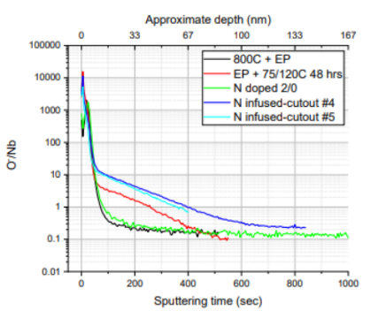
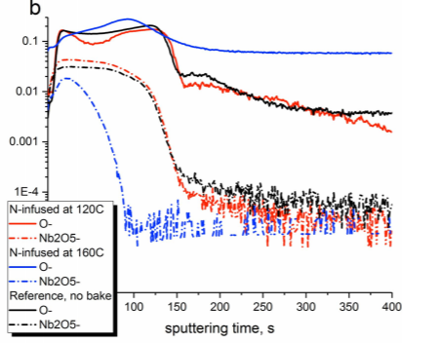
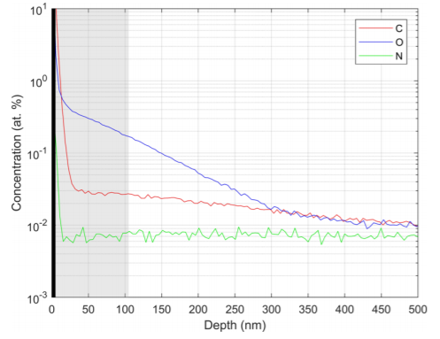
Role of Oxygen in Infusion Recipes
[1]
[2]
[3]
[1] A. Romanenko, , in 19th International Conference on RF Superconductivity (JACoW, Dresden, 2019).
[2] A. Grassellino et al., Superconductor Science and Technology 30, 094004 (2017).
[3] J. Maniscalco, et al., in 19th International Conference on RF Superconductivity (JACoW, Dresden
Notes:
Interestingly, the role of adventitious oxygen in RF surfaces exposed to nitrogen at modest (200–400°C) temperatures (sometimes termed “nitrogen infusion”) may have been underestimated. Near surface oxygen is observed to be nearly two orders of magnitude greater than bulk background [68-72]. Future analysis will seek to clarify if indeed oxygen is the dominant agent in such circumstances.

Slide 16
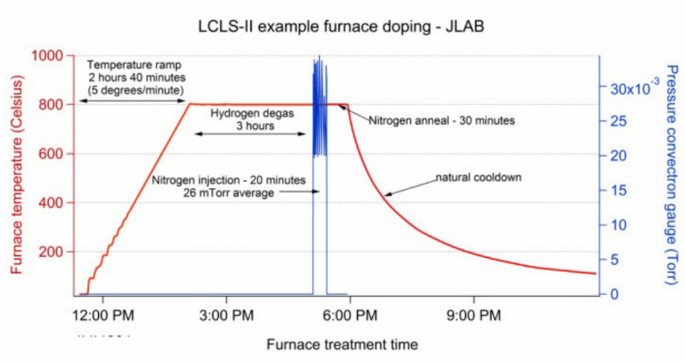
Benefits – Modeling
Could this be due to the post dope annealing step or cooldown?
$c_{n}=C_{n}^{′′} −{(C}_{n}^{′′}−C_{n}^{}(∞))erf⁡(x/2\sqrt{D_{n}t})$ - Nitride Conc.
$$c_{m}=C_{m}^{′} −\frac{C_{m}^{′′}−C_{m}^{′}}{\operatorname{erfc}\left(γ_{n}\sqrt{φ}\right)}\operatorname{erfc}\left(\frac{x}{2\sqrt{D_{m}t}}\right)\text{− }\text{Metal} \text{Conc}\text{.}$$
The simple 1-D model can never explain a non-monotonic decay. Additional numerical methods are required.
[1]
Temperature
Ramp
H-degas
N-dope
Post dope anneal
Cooldown
[1] Clenny, James T., and Casimir J. Rosa. Metallurgical Transactions A 11.9 (1980): 1575-158
Notes:
The modeling for O alloying is relatively simple, but with nitrogen alloying, a near surface depletion of interstitial N has been observed which means that either nitrogen is leaving through the surface during cooldown or precipitating on the surface as nitrides. It seems likely that such a decrease could come from the post alloy annealing phase and the cooldown phase of nitrogen doping. In both of these places, the nitrogen should still mobile, but subject to a new boundary conditions. Simulating this decrease requires additional modeling parameters and numerical solutions. So comparatively O-alloying is easier to understand.

Slide 17
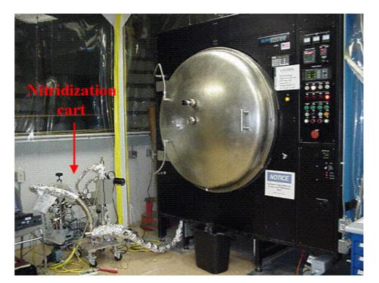
Benefits – Furnace
[1]
[1] Ciovati, G., et al. Physical Review Special Topics-Accelerators and Beams 13.2 (2010): 022002.
Notes:
Furnace temperatures are significantly reduced and the ingress of carbon and nitrogen is essentially halted. Additions of gaseous alloying sources are not required. The cavity’s native oxide IS the oxygen source.

Slide 18
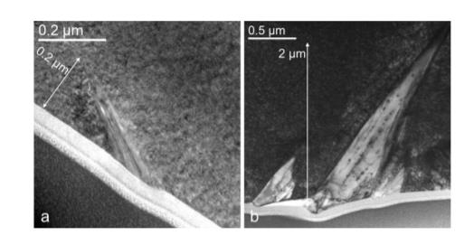
Benefits - No post-treatment chemistry required
[2]
[1] Cross-section TEM
No post-alloying chemistry performed!
[1] Y. Trenikhina Proc. of SRF2015, Whistler, BA, Canada (2015)
[2] H Ito et al. Progress of Theoretical and Experimental Physics, 2021;, ptab056
Notes:
When compared with nitrogen alloying, nitrogen alloying precipitates lossy nitrides on the surface and must be removed. To deal with these lossy structures an additional chemistry step must be performed. This chemistry step is not necessary with O-alloyed nb as shown from the results of Ito and Fermilab. As an added benefit, the concentration profiles for O-alloyed Nb can be relatively small, a few microns in depth and large removals of 40 micrometers + is not necessary. This could help reduce labor costs.

Slide 19
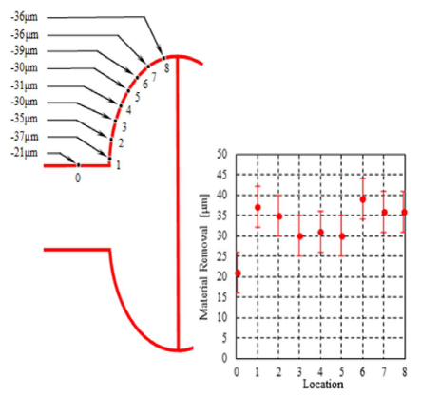
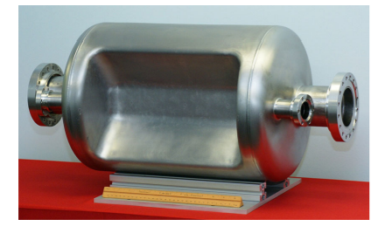
Benefits – Cavity Geometry
[1]
[2]
[1] Crawford, Anthony C. Nucl. Instrum. Methods. Phys. Res. B 849 (2017): 5-10.
[2] De Silva, S. U., and Jean R. Delayen. Physical Review Special Topics-Accelerators and Beams 16.8 (2013): 082001.
Notes:
In the case of N-alloying, the extra chemistry step required for nitride removal leaves the cavity open to inhomogeneities in the mean free path which is critical for producing high quality factors. This is because even for relatively simple geometries like elliptical cavities, electropolishing does not remove material uniformly; meaning the impurity profile across the cell will not be uniform. This problem may be even more severe in shapes of significantly higher complexity. O-alloying does not require this chemistry step and therefor can keep a uniform electron mean free path across the surface.

Slide 20
Conclusions/Where next?
Conclusions
Using SIMS, we measured O concentration depth profiles and quantified unknown parameters crucial in modeling the native oxide dissolution and diffusion process.
RF and SIMS measurements confirmed that the alloying effect of vacuum annealing is due primarily to oxide dissolution and diffusion rather than N alloying
Constrained a model of native oxide dissolution for predictive O-alloying
Demonstrated a method for examining oxide dissolution and diffusion using SIMS which may be applicable to other metals.
Where next?
Heat treat additional cavities to evaluate performance
Explore the role of tailored impurity diffusion profiles within the RF penetration depth
Explore multiple dissolutions or multi-step temperature profile
Apply recipe to cavities with a more complex geometry

Slide 21
Acknowledgements
Virginia Tech (SIMS)
Jonny Angle
Michael Kelley
NCSU
JLab
Ari Palczewski
Charlie Reece
Fred Stevie
JLab Staff
Notes:
I’d like to acknowledge all of those that made this work possible. Ari and Charlie, our SIMS experts at Virginia tech and NCSU Jonny, Michael and Fred and of course none of this could be possible without the JLab staff that supported us along the way. Thank you.

Slide 22
Thanks for your time!
Questions?
Notes:
Thanks for your time, are there any questions?

