Slide 1


Strong Female Lead:
STFC contribution to PIP-II
Anna Shabalina (she/they)
Opinion shared today is my own and may not represent the entire STFC PIP-II team.
Technical information is objective.

Slide 2
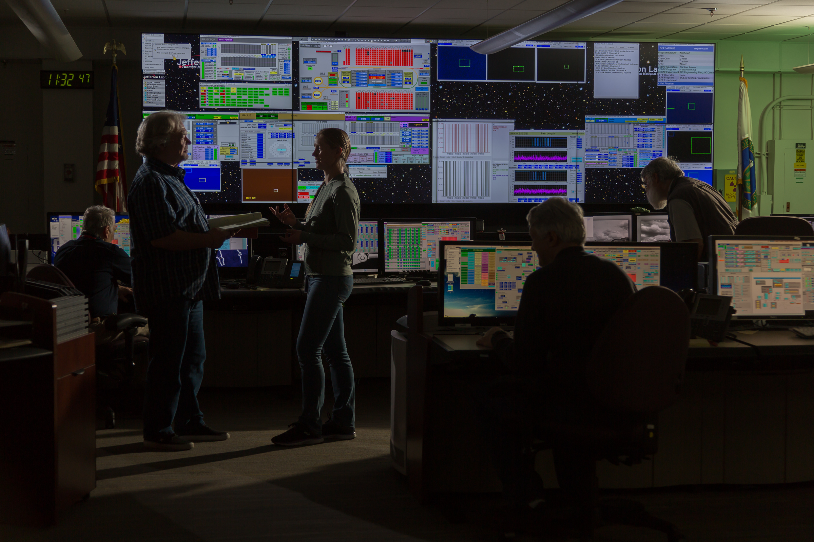

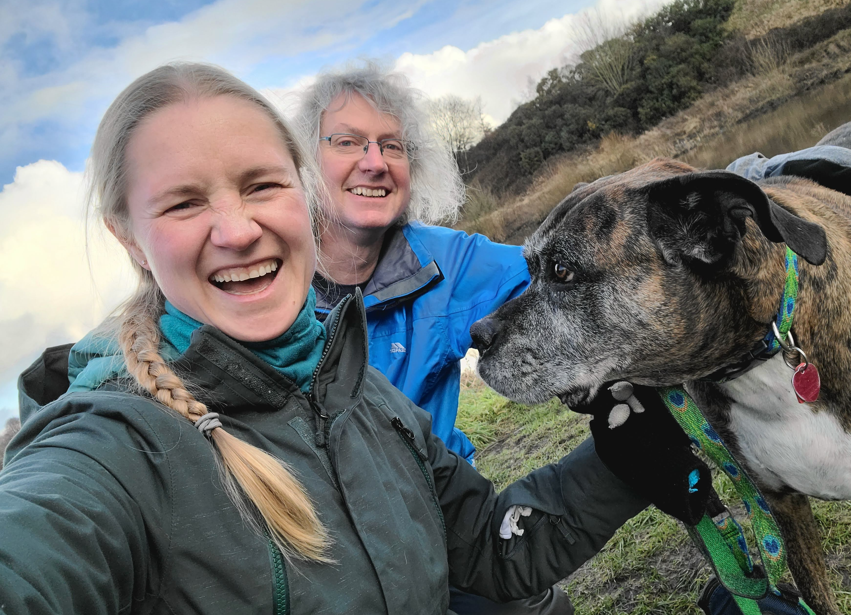
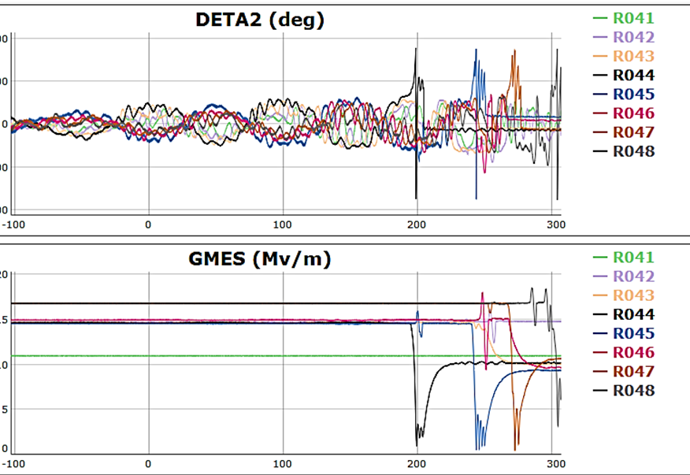
Who am I and why should you listen to me
CEBAF accelerator operator 2011-2017
Jefferson Lab SRF Ops, LCLS-II test engineer-I (temp), 2017 – 2018
Jefferson Lab SRF Ops, SRF test engineer-II (perm), 2019– 2021
STFC Daresbury Lab (UK) Senior SRF engineer, PIP-II HB650 cavity WP lead, 2021 – present
C100 gradient optimization lead, LDRD “ML for cavity fault classification” PI/PM, “AI for CEBAF” FOA.
Established WISE event at the LINAC conference series
Your local raging feminist

Slide 3
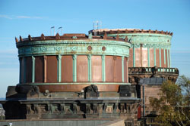

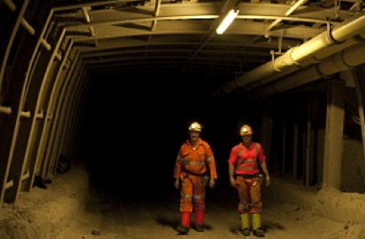
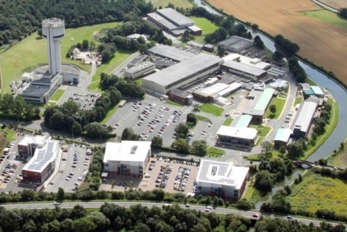
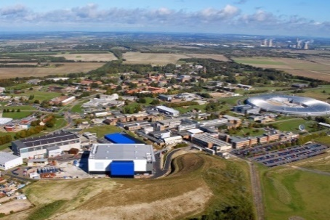
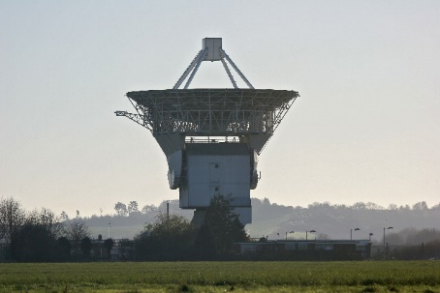
STFC National Laboratories
STFC (Science & Technology Facilities Council) are one of the research bodies which make up UKRI
STFC provides the ‘Big Science’ infrastructure which is uneconomic for individual academic or industrial parties to establish and operate
We use our faculties, technology and skills to the benefit of society and industry
We are funded by public money and as a result can offer support to all businesses in a neutral way
Astronomy Technology Centre
Boulby Underground Laboratory
Daresbury Laboratory
Rutherford Appleton Laboratory
Chilbolton Observatory

Slide 4

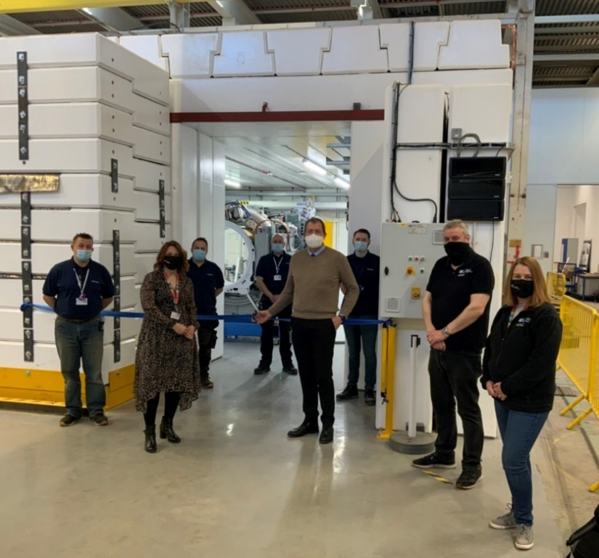
Who are STFC?
STFC (Science & Technology Facilities Council) are one of the research bodies which make up UKRI
STFC provides the ‘Big Science’ infrastructure which is uneconomic for individual academic or industrial parties to establish and operate
We use our faculties, technology and skills to the benefit of society and industry
We are funded by public money and as a result can offer support to all businesses in a neutral way

Slide 5
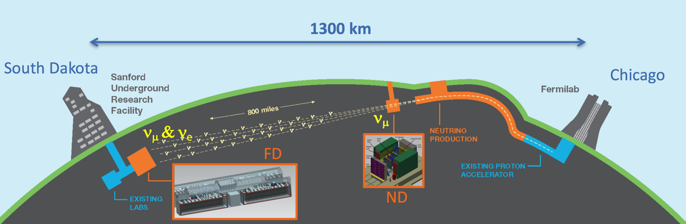
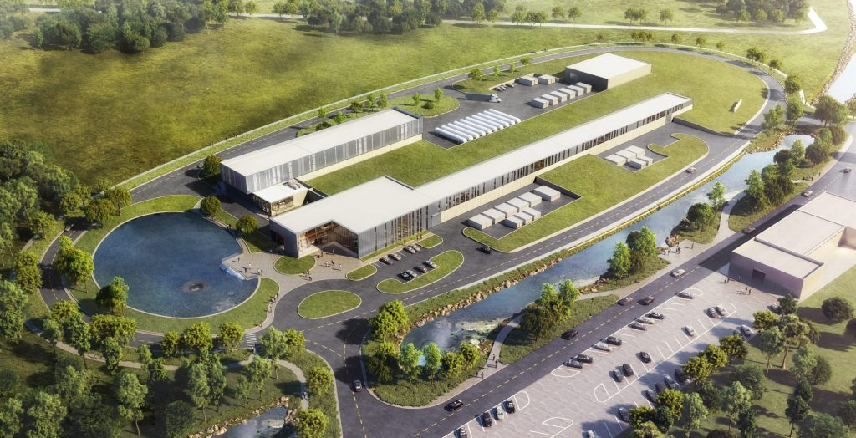
LBNF / DUNE / PIP-II
Powerful proton beams (PIP-II)
  1.2 MW upgradable to multi-MW, 60-120 GeV proton beam to enable world’s most intense neutrino beam with wideband capability
Dual-site detector facilities (LBNF)
  Deep underground cavern (1.5 km) to support liquid argon detectors
  A long baseline (1300 km) neutrino beam
Deep Underground Neutrino Experiment (DUNE)
  Liquid Argon – the next-generation neutrino detector
PIP-II ACCELERATOR

Slide 6





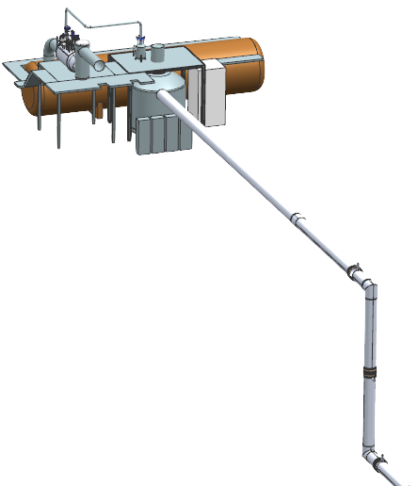





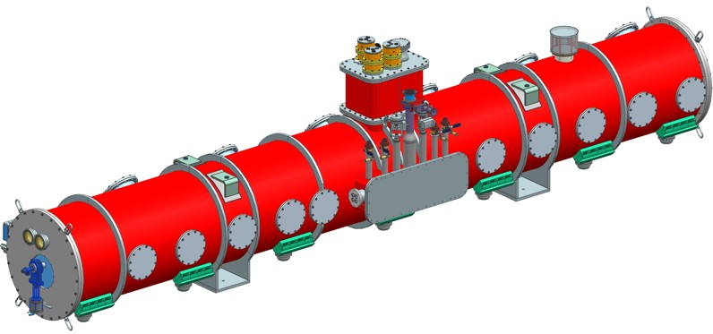
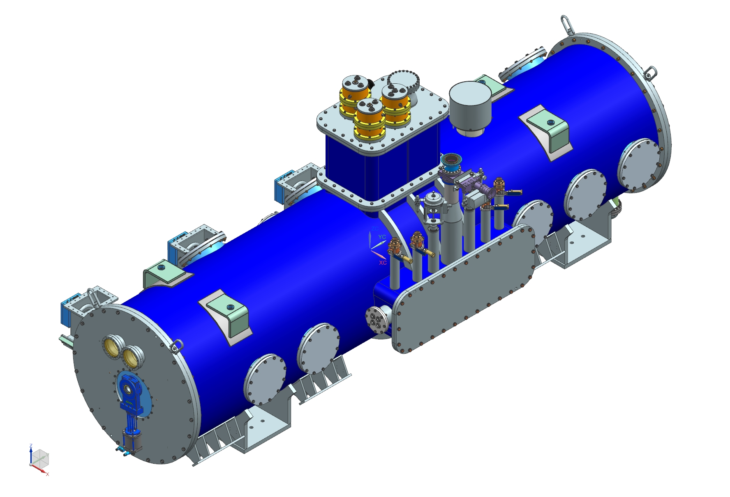

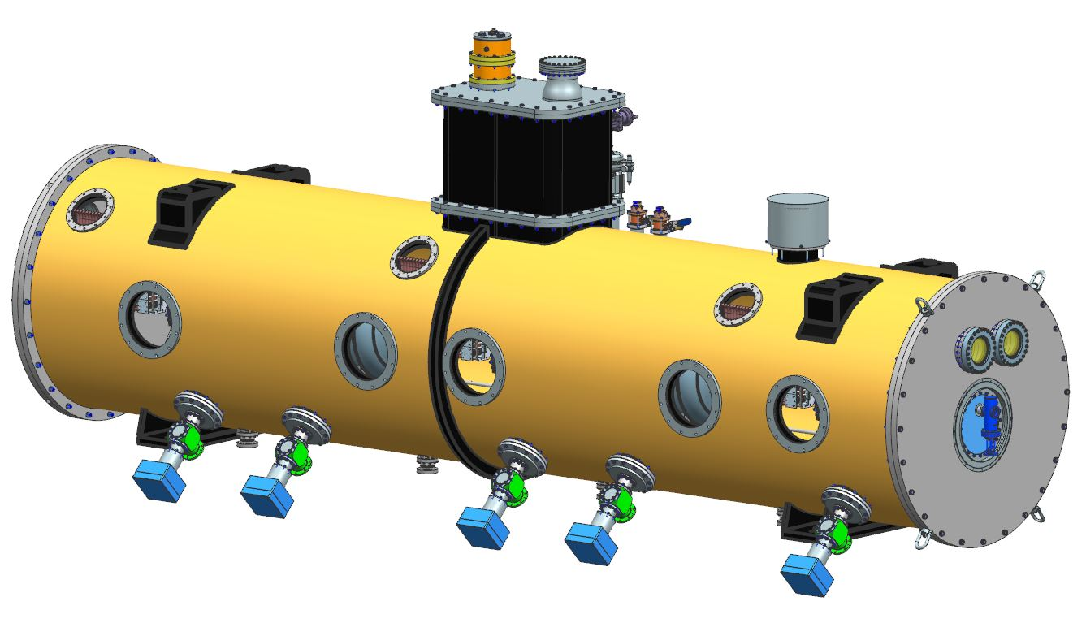
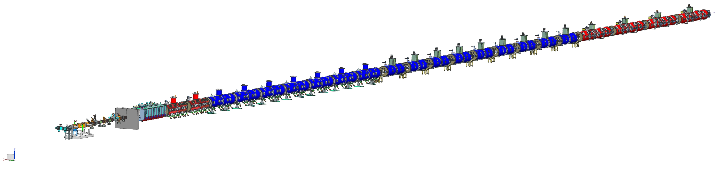
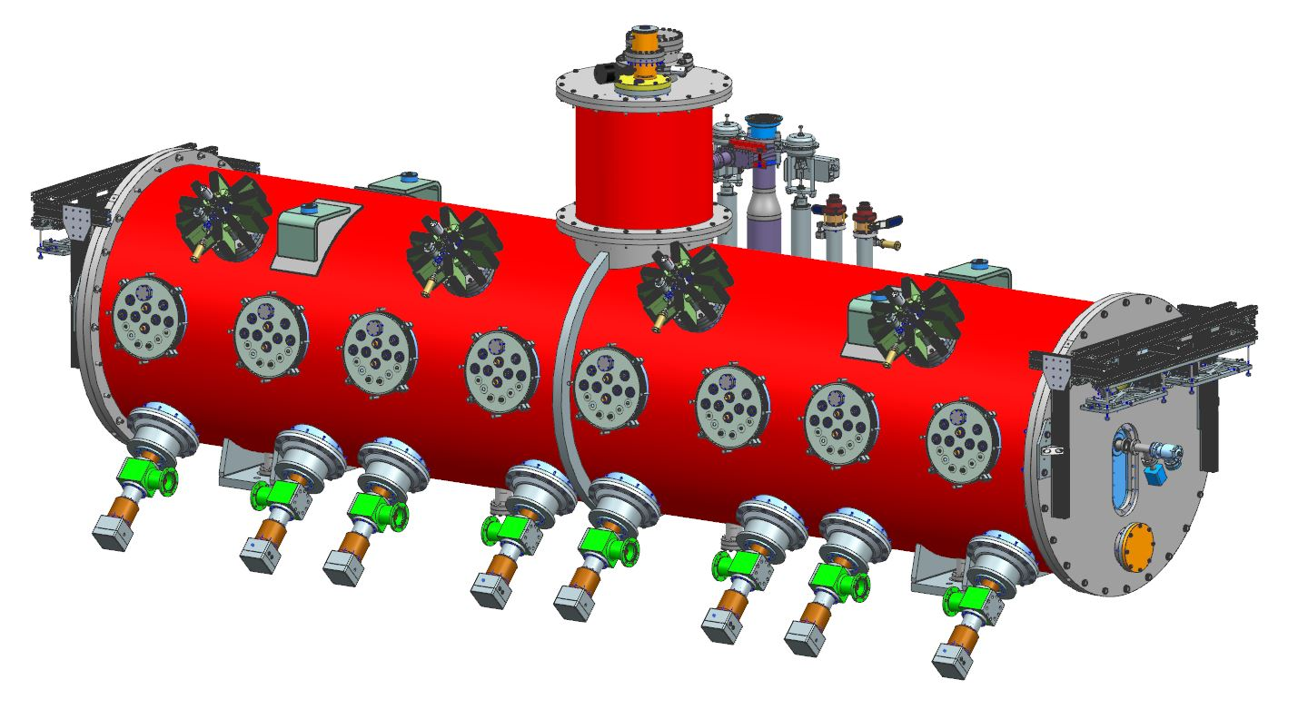

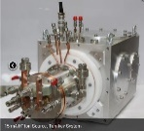
STFC/UKRI In-Kind Contribution to PIP-II
The first US accelerator to be built with major international contributors.
STFC
Elliptical
HB650 X 4
24 Cavities
650 MHz
Cryoplant
Elliptical
LB650 X 9
36 Cavities
650 MHz
Single Spoke
SSR1 X 2
16 Cavities
325 MHz
Single Spoke
SSR2 X 7
35 Cavities
325 MHz
HWR
8 Cavities
162.5 MHz
CDS
833 MeV
H- Ion source
516 MeV
177 MeV
Superconducting
RFQ
10 MeV
32 MeV
2.1 MeV
800 MeV SRF LINAC, five types of cryomodules
Room Temperature

Slide 7
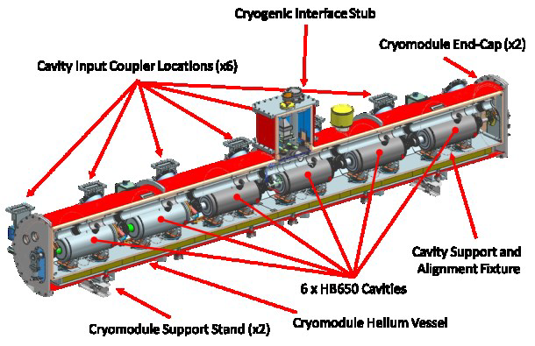
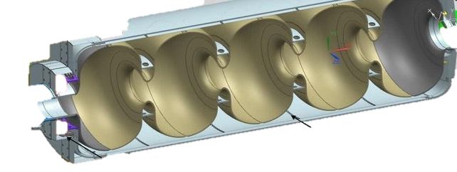
HB650 Cryomodule and cavity
HB650 Cryomodule
HB650 Cavity
Coupler interface
Helium jacket
5-cell high-purity
Niobium cavity
Tuner
Cavity
Frequency (MHz) | 650
Cavity Beta | 0.92
Gradient (MV/m) | 18.8
Quality Factor Qo | 3.0 x 10¹⁰ (N2 Doped)*
Number of Cells | 5
Cavity Dynamic Load (W) | <22.5
Cavity Length (m) | 1.4
Number of Cavities | 18 (+2)
Cryomodule (CM)
Operating Temperature (K) | 2
Number of Cavities | 6
Energy Gain (MeV) | ~110
Dynamic Load (W) | 130
Static Load (W) | 32
CM Length (m) | 9.9
Number of Cryomodules | 3
*Qo expectation is actually 3.3 x 10¹⁰ in CM and 4 x 10¹⁰ in VTS bare/jacketed.

Slide 8
STFC Scope/Delivery Dates
WP5.1 SRF Infrastructure
Provision of all preparation, testing and assembly facilities.
WP5.3 Cavity Qualification
Qualification of 18 (+2) x HB650 cavities to FNAL specifications.
WP5.4 Cryomodule Integration
Assembly of 3 x HB650 cryomodules to FNAL specifications.
WP5.2 UK Industry Development
Demonstration of UK PIP-II cavity demonstrator fabrication.
Extensively modify existing SRF facilities and provision of new cleanroom.
Implementation of new cryomodule vessel assembly fixtures.
Development of EBW processes for Nb material.
Provision of all SRF cavity fabrication facilities.
Procurement of Niobium material and cavity fabrication from industry.
Integration into testing infrastructure and validate.
Prepare HB650 cavities and assemble cavity string in cleanroom.
Integrate cavity string into HB650 cryomodule vessel and acceptance test.
Safely transport integrated cryomodules to FNAL and acceptance test.
Signing ceremony: Mark Thomson (STFC-UKRI) and Nigel Lockyer (FNAL)
May 11th 2021.
STFC UKRI Deliverables | Acceptance Early Date
HB650 CM1 | Jan-2025
HB650 CM2 | Jul-2025
HB650 CM3 | Dec-2025

Slide 9
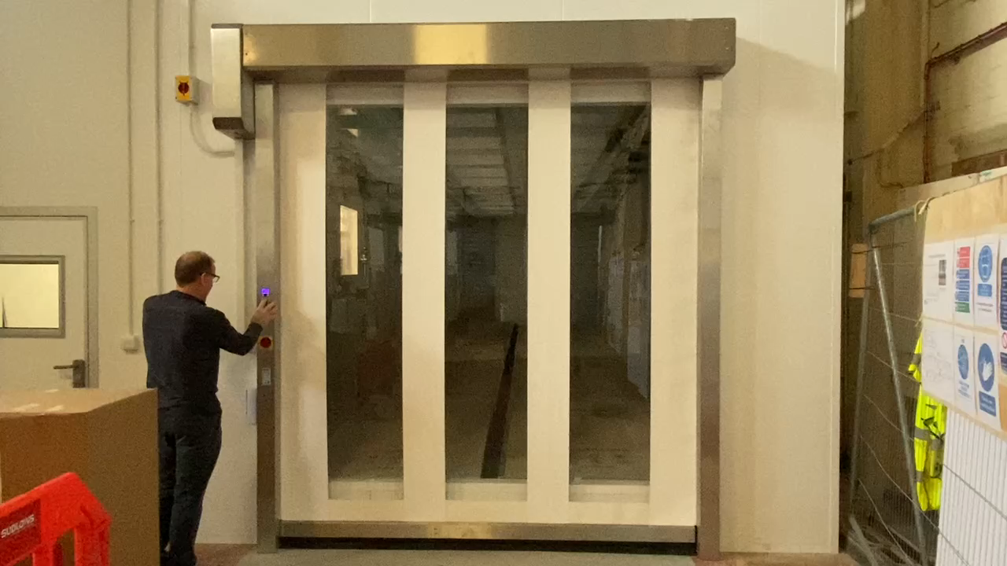
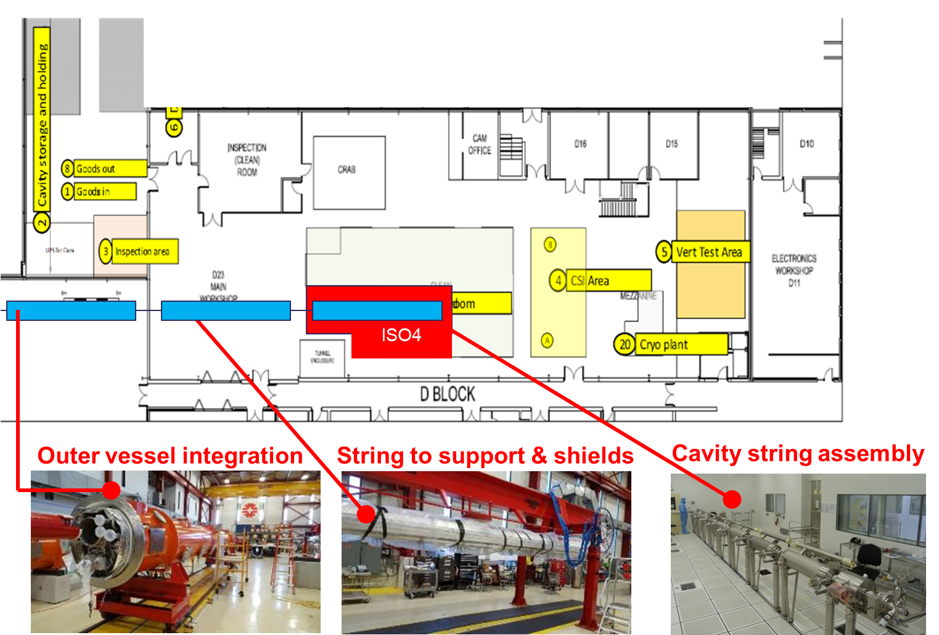
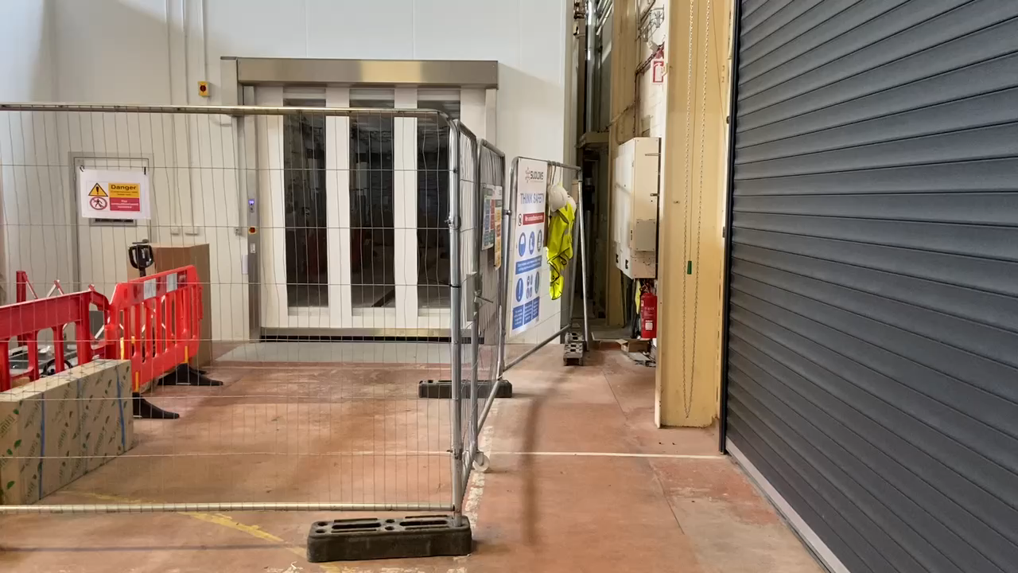
WP1 – PIP-II SRF Infrastructure
New ISO4 cleanroom 14m x 5m.
  Expect to be completed Jul 22, final stage installation and commissioning underway.
New High Pressure Rinse
CM assembly workstations
Storage

Slide 10
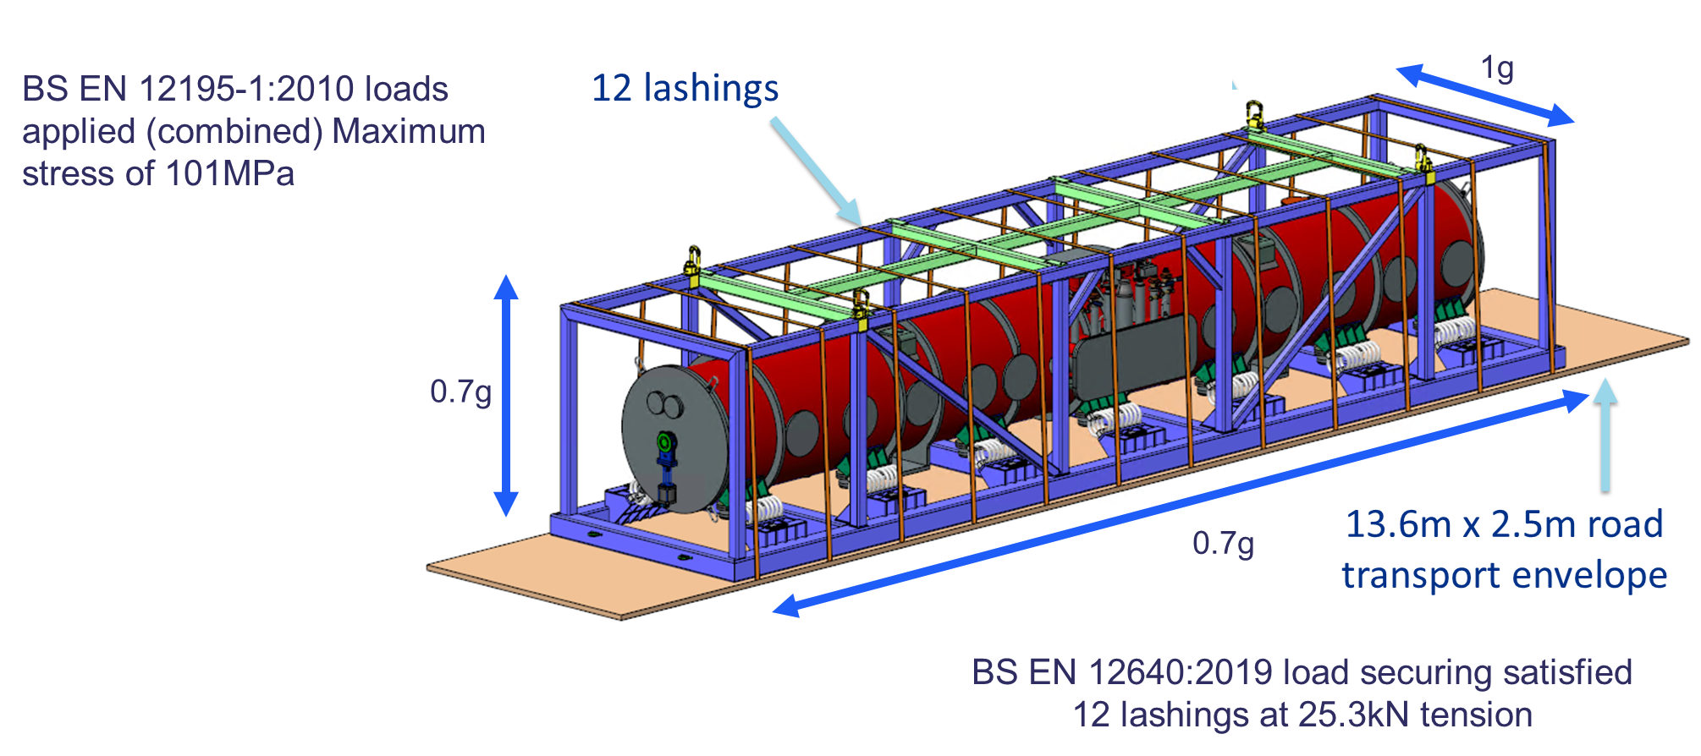
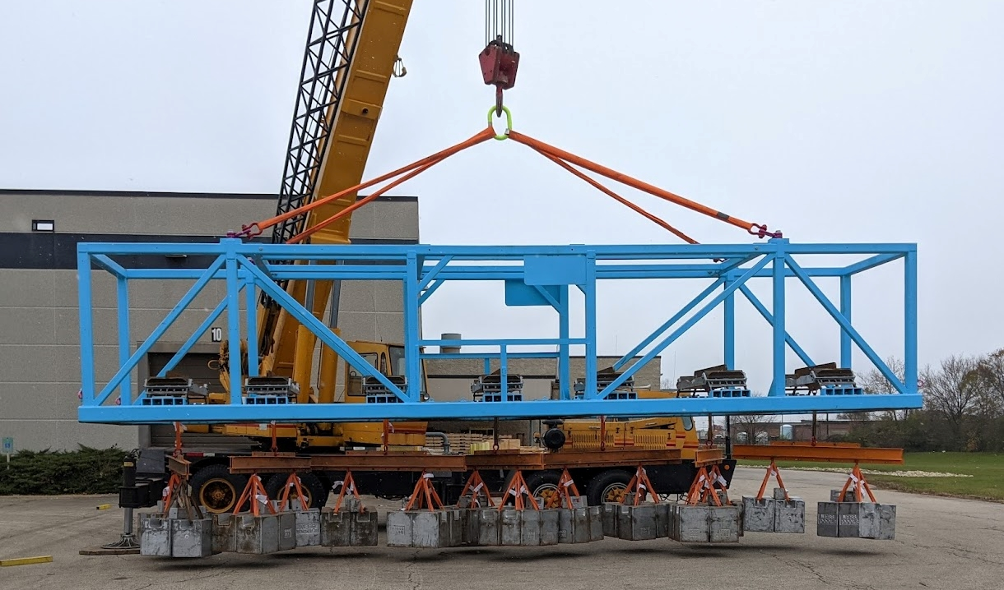
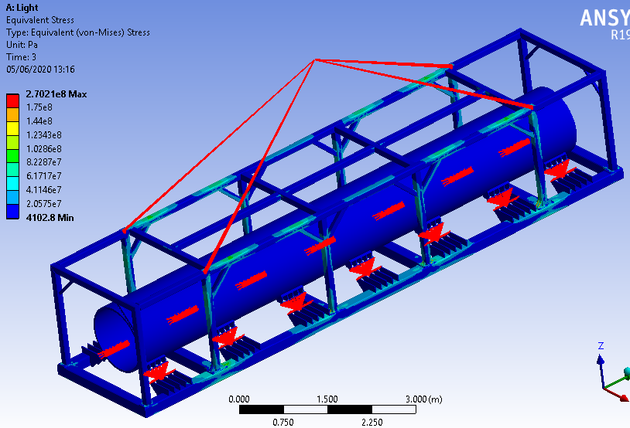
WP4 – Cryomodule Integration
Cryomodule Transport Frame
STFC designed frame and completed Final Design Review (FDR) in Sept 20.
Frame Validation Methodology
STFC frame is manufactured by FNAL for use with the HB650 prototype cryomodule (pCM):
pCM will be operationally tested at FNAL – end 2022 (delayed by 6-months)
pCM shipped to STFC, provisional acceptance tests – visual, mechanical, RF and vacuum.
pCM shipped back to FNAL – retested to verify its operational performance.
First frame tests performed at FNAL in April, exceeded load/stress verification by factor of 2

Slide 11
WP3 - Production Niobium procurement
Manufacturing specifications adjustments
  Hardness
  Elongation
  Strain Hardening Coefficient
Tender exercise
  OTIC – cheap and fast
  ATI – cheap and slow
  TD – expensive and very slow
Eddy Current Scanning
  100% of half-cell material
  Done by DESY’s team
And then there was BREXIT
  (Not so) obvious admin rules
  Which laws are we under?
  COVID times logistics
  DDP, DAP, soft DAP, ex-works… forwarder what??
11

Slide 12
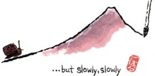
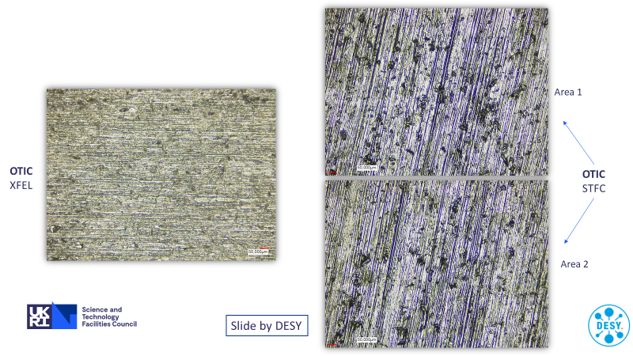
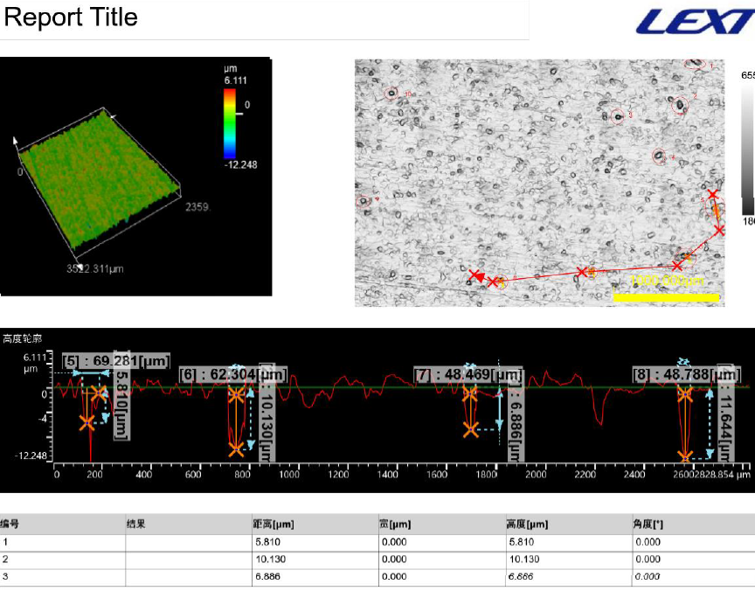
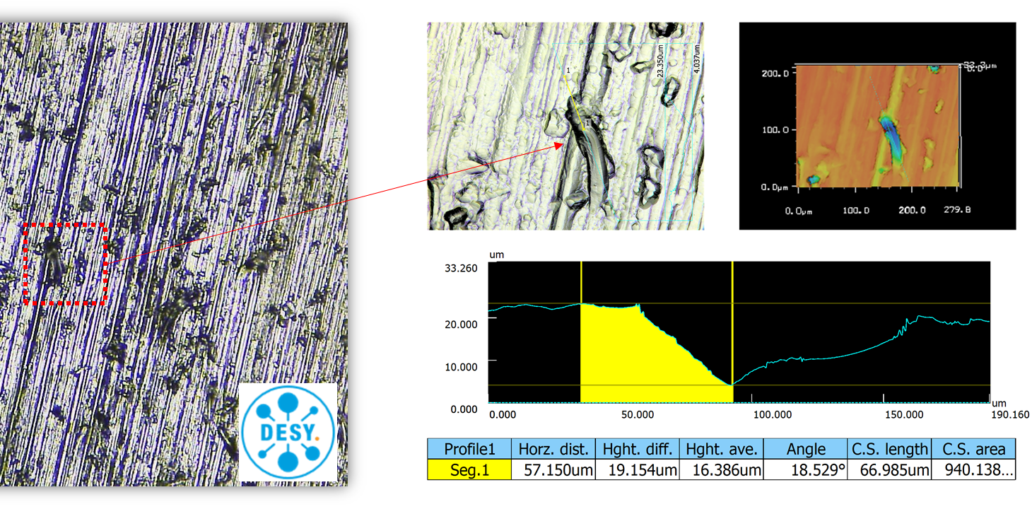
Production Niobium Procurement
Surface quality issues
  Identified during Eddy Current Scanning (ECS) at DESY late September 2021
At least 10-30 μm by 40-70 μm surface defects on all sheets (225 disks)
  Uniformly distributed on the entire surface
  Definition of a defect caused some friction with the vendor
Widespread problem
  All orders since May 2021 were affected, including PIP-II and SHINE projects
  At least 500 sheets checked by November’21

Slide 13
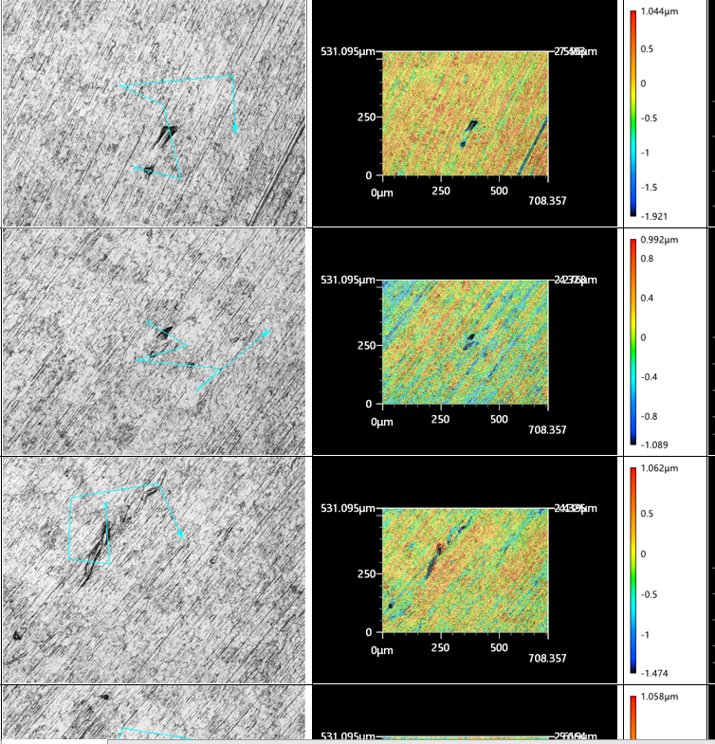
Production Niobium procurement
Resolution hindered
  Miscommunication
  Travel restrictions
  Proprietary information
  Lack of transparency
Proposed repair methods verified by ECS at DESY
  Samples of PIP-II and SHINE material
  Various etching and polishing combinations
  Acceptable recipe found ~January 2022
  Final adjustments made in May 2022

Slide 14
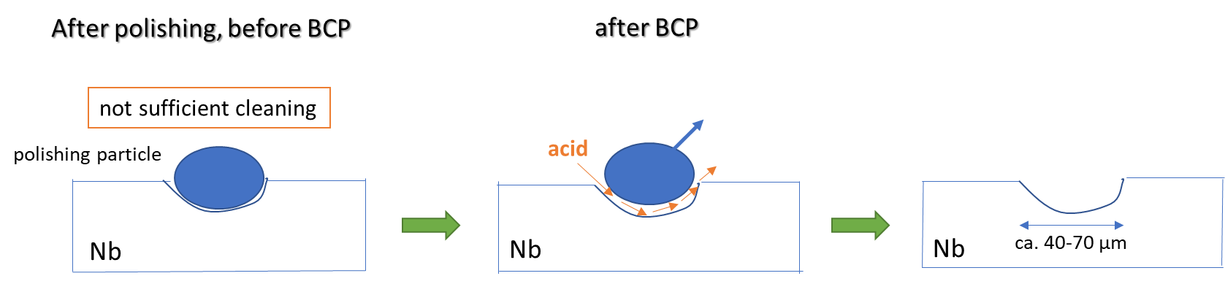
Production Niobium procurement
Current status: 45 disks tested, 35 accepted.
  90% success rate for reworked sheets
  75% success rate for the first batch of new disks
  Only 3/187 of reworked sheets are expected to be unrecoverable
  First batch of 88 reworked disks arrived at DESY last week
Surface investigation | 35 new disks | 10 reworked disks
Areas inspected by 3D microscopy | 91 | 3
Average | 2.6 | 0.3
Element analysis performed | 4 | -
Root cause
  Excessive BCP of a dirty surface
14

Slide 15
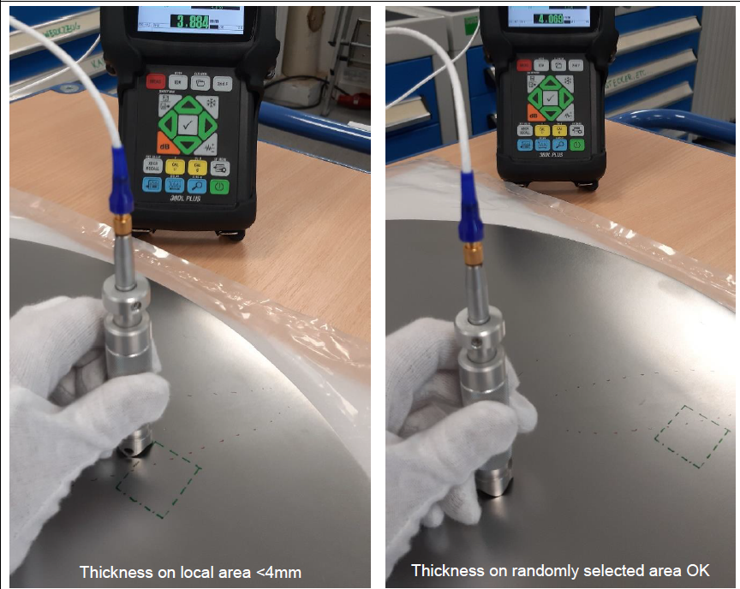
Production Niobium: QC
Extra measures
3D scans of randomly selected areas on both sides
Local thickness measurements after local grinding
Improvements at OTIC
New 3D microscope being commissioned
New ultrasonic thickness measurement device

Slide 16
Production Niobium: Final Repair recipe
Surface treatment process | 10 reworked disks | Remaining disks
Polishing with 400 mesh abrasive belt | 15μm | 25μm
BCP | 10μm | 10μm
Surface treatment process | Process before 2021 | 35 new disks | Remaining new disks
Polishing with 180 mesh abrasive belt | 50μm | 50μm | 50μm
240 mesh | 25μm | 25μm | 25μm
320 mesh | 15μm | 15μm | 15μm
BCP | 10μm | 25μm | 10μm
400 mesh |  | 10μm | 10μm
BCP |  | 10μm | 10μm
Back to the original process
PLUS
One extra belt polishing
NEW

Slide 17
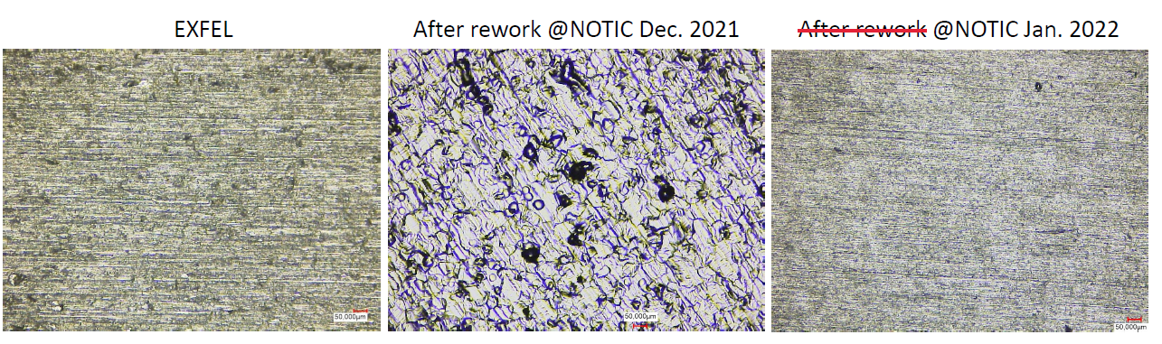
Production Niobium Procurement

Slide 18
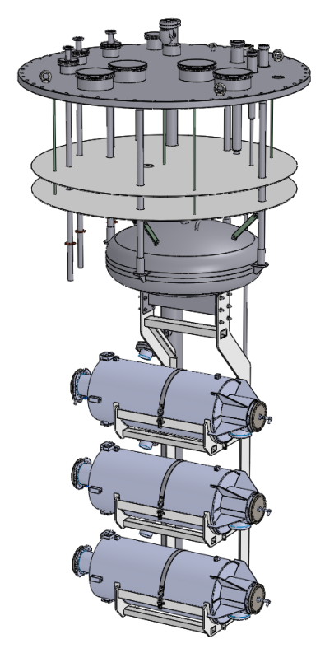
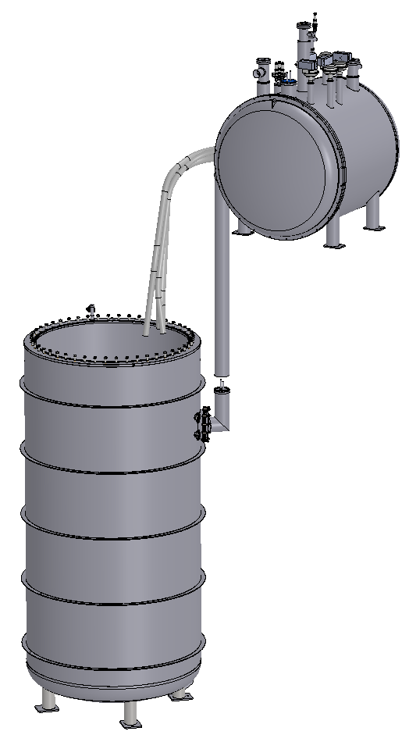
STFC Test Facility
Individual Liquid Helium jackets
  End groups are not immersed
Uses ~70% less Helium than an immersion cryostat
  Approximately 1500 L per test.
Cryostat sized to accommodate horizontal cavity mounting
  Closer to cryomodule configuration
  Up to 3 cavities can be tested per cooldown
Magnetic shielding
  2 active coils, one more to be added soon
  Static shield
  Three 3-axis magnetic field probes
Cavity Support Insert (CSI)

Slide 19
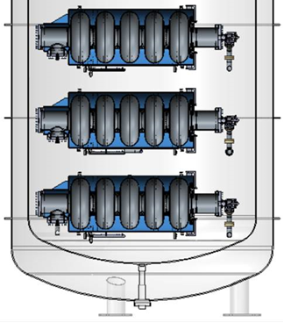
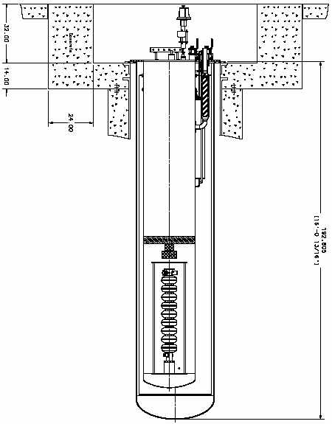
STFC Test Facility: radiation detectors
STFC Test Stand
FNAL Test Stand
Dose Rate & Energy Spectrum Detectors
Dose Rate Detectors
Detector - Canberra GP110 probe
Dose Rate & Energy Spectrum Detectors
Dose Rate Detectors
1.5” SS plate
~2.9m
Dose Rate & Energy Spectrum Detectors
Dose Rate Detectors
0.25” SS dished head
~ 0.25 m
~ 0.3 m
Wall thickness 10-25mm
Dose rate detectors added in January 2021
Detector - Canberra GP100M probe
0.5” SS dished head
~ 1.8 m
Cross-calibration with FNAL and partners
  Exchange detectors
  Test the same cavity
Add lateral radiation detectors
~ 0.8 m

Slide 20
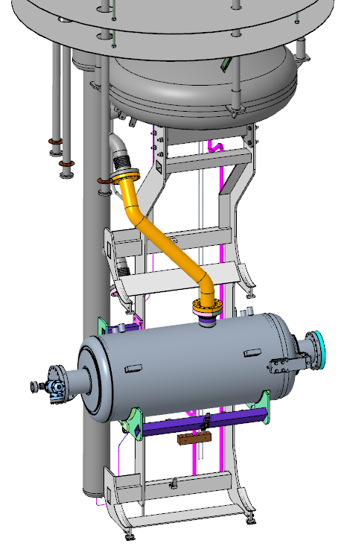
HB650 Cavity scope
2 pre-series cavities: Vendor validation
  Bare cavities will be tested at FNAL
  Tested at STFC after jacketing
18 series cavities
  Tested jacketed at STFC one cavity at a time
  Cryomodule integration at STFC
Supporting high Qo
  Fast CoolDown
  Enhanced magnetic hygiene
Documentation
PIP-II test stand

Slide 21
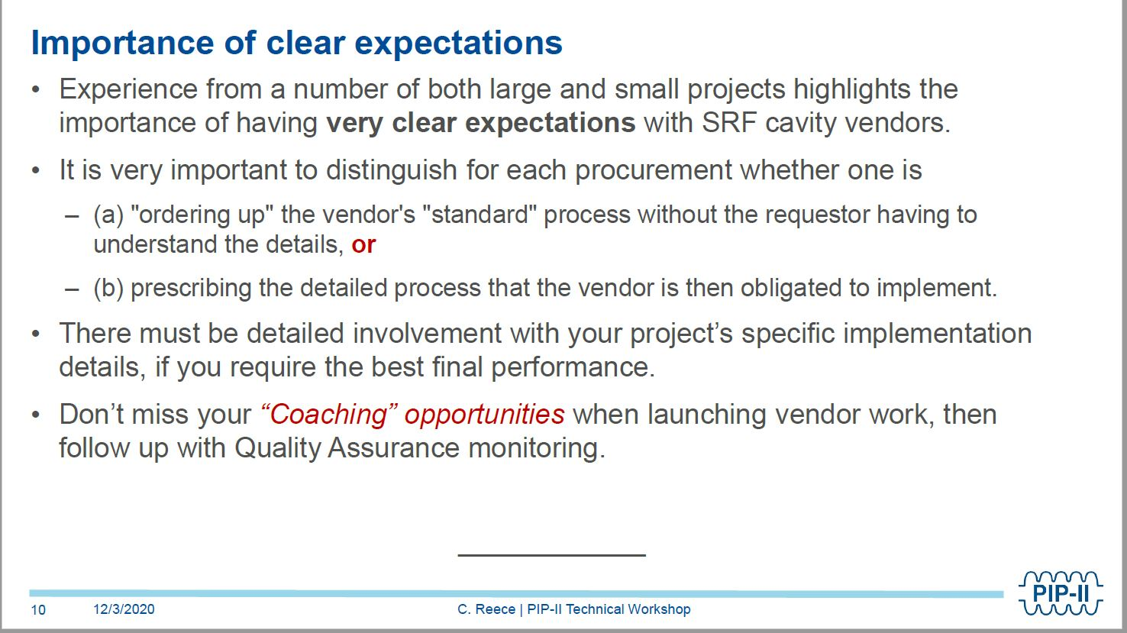
HB650 cavity procurement

Slide 22
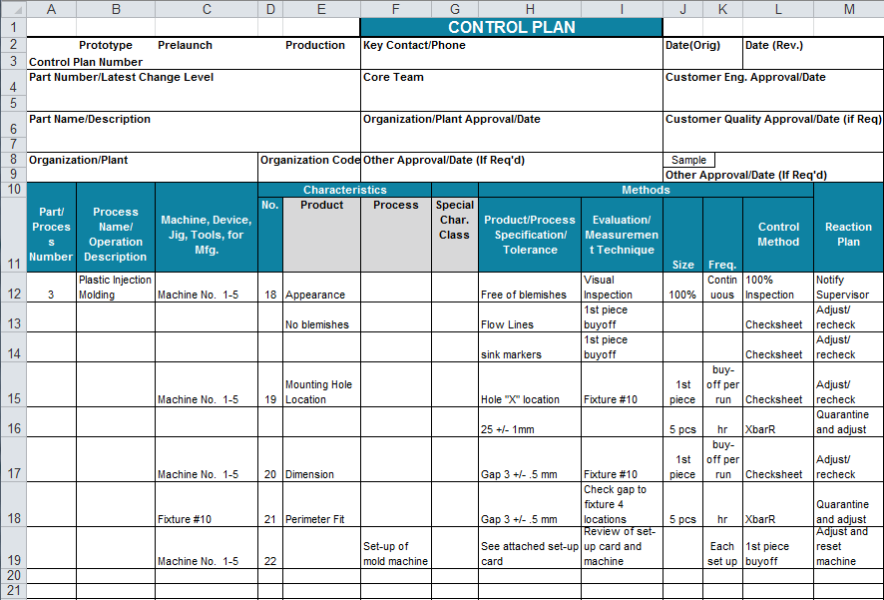
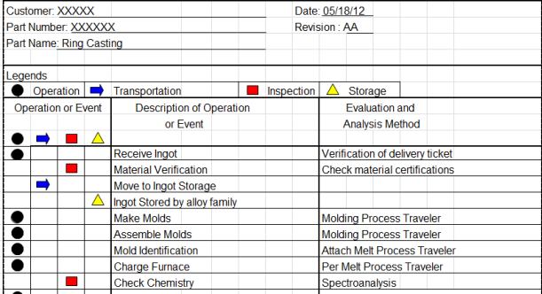
HB650 Cavity: QA/QC
APQP – Advanced Product Quality Planning
Technical Specifications and Vendor Qualification: APQP-inspired.
  Early engagement: setting QC expectations
  Product and process Key Characteristics
  Process flow (PF) development
  Control plans (CP) development
  Reaction plans development
Pre-series cavities
  Very detailed and involved QC
  Fine-tuning PF and CP
  Verifying recipes and techniques
Series cavities
  Benefit from vendor qualification activities
  Minimize start/stop of the production
  Optimize data review
Fermilab
input
EXAMPLE
22

Slide 23
HB650 cavity procurement
Market survey
  Specifications overview
  Sets expectations and “brackets”
  Requests vendors input
Manufacturing specifications
  Highlight Key Characteristics
  Incorporated information and lessons learned from other projects (ESS, LCLS-II, SNS PPU, CEBAF upgrades)
  Use the LB650, SSR1 and HB650 prototype experience
  Award questionnaire designed to draw out the level of vendor’s interest in the project
Cavity manufacturing
  FNAL experts will be involved with the STFC’s chosen vendor from the start
  QC, MIP, and NCR processes will be developed in close collaboration with the vendor
23

Slide 24
Cavity procurement strategy
Specifications development
  APQP approach
  Key characteristics
  The “what”, not the “how”
  Document readability and flow
Award questionnaire
  The “how”
  Strategy depends on the potential bidders
  No generic boiler plate submissions – prove they’ve read my requirements.
  “Show and tell”: bind them to a commitment to meet the specs with a yes/no question, ask to prove it in the next one
  Page limit for answers – it is harder to summarize, vendors need to think of what’s important

Slide 25
Cavity procurement strategy
Confirm your ability to meet the specs – flexibility for the vendor to suggest changes and relax some requirements, freedom for me to reject and still be sure they can make it
Provide a statement outlining the technical challenges of this project, and opportunities for improvement – vendors need to analyze the specs and show me they know which parameters are critical
Can you meet the schedule – pre-series focuses on quality, series focuses on the delivery rate, vendors need to prove it with a schedule management plan
Capacity for performing work – do they have the machinery, how busy is the plant going to be, equipment redundancy
Necessary skillset – staff availability through the life of the project, understanding of the necessary skillset, plan for unexpected loss of expertise
Quality Assurance and Control plan example and statement – requires distilling the QA/QC manual to a couple of lines per topic from our specs, assesses vendor’s attention to details

Slide 26
Cavity procurement strategy: current status
Now
  Tender is closed
  Winner is identified
  Standstill period until July 25th.
Next
  Work out pricing schedule
  Refine delivery schedule
  Review proposed design changes
  Work with the vendor to develop QC tools
Expecting Manufacturing Readiness Review in late September

Slide 27
Why I am bringing gender into a technical talk
People move jobs “from” or “to” – either running away from the old, or the new job is much more attractive.
Women leave when a pile of small things reaches critical mass (WISE panel at LINAC’20)
In STEM, the extra burden on women is very high
  Women are taken less seriously than men
    Women’s decisions are questioned more
  Women are interrupted more than men
  Women’s ideas are often ignored until a man repeats it, often without proper credit
  Male leadership style is valued and expected, but if a woman adopts it, she is too bossy
  Women deal with both malicious and unintentional sexism
All the above leads to a feedback loop of self-doubt and lower confidence
All the above takes extra time and effort to overcome
  And it’s not just men – other genders are biased towards women too!
! Women here means anyone who identifies as a woman !

Slide 28

Why I am bringing gender into a technical talk
Women are swimming against the current men just don’t feel. We waste time and energy fighting it:
Triple-checking the facts in each email
  So we don’t get it wrong and strengthen the stereotype
Convincing people that we know what we are talking about
Addressing the “are you sure?” comments
Restarting after an interruption
  Each “Mr. Vice President, I’m speaking” takes ~3 seconds
Addressing inappropriate behavior
Persuading people to do the work
  Extra fun when women don’t have an institutional authority over them
Consequences for cost and schedule: the gender authority gap is expensive
  The above adds up to hours of unproductive time per week
  An ignored idea or disregarded decision can lead to days spent going down a wrong path

Slide 29
A fun example

Slide 30
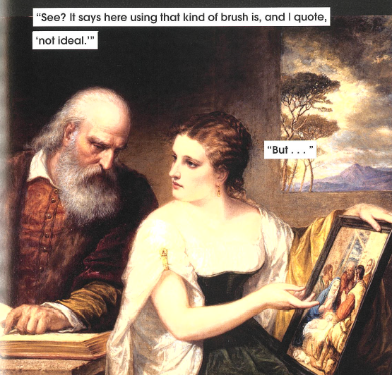
Production Niobium Procurement
I presented this information not too long ago. The first comment was that ECS is useless, the time we spent resolving the problem was wasted, and the surface would have been fine: the pits would go away after standard cavity chemical polishing – that’s all repair we did to the disks anyway, he told me right after I finished.
Uhm… no. That’s not what happened, I literally just said the repair required belt sanding. And of course I checked if I could just etch the pits away before I made a decision to send all my material back to China. My decisions were based on evidence, clearly led to a successful resolution of the problem, yet I still waste my time defending them.
I moved on to the cavity procurement strategy.
The same guy said that complex procurement can be very difficult to manage, am I sure I can handle the cavity supplier?
Not even 10 minutes after I described how I managed a disastrous Niobium contract…

Slide 31
Next time you dismiss, question, or judge a woman,
ask yourself:
Would you do the same if she was a man?
the answer may be uncomfortable

Slide 32


Thank you
Thanks to:
Kevin Jordan and Tony Reilly for making the talk happen
Jon Lewis, Peter McIntosh, Mitchell Kane, and all unidentified team members I pulled the slides from
Camille Ginsburg, for the glorious art book
JLab people who still talked to me after I left
FNAL people who disregarded the “food chain” with me to get things done.
Mike D for setting the managerial standard and “I will crush them” text.
Jon L, for bringing me in, lifting me up, and having my back, always.
My partner Steven Jamison and pole sisters Jennifer Bonetti and Nikki Eggleston for keeping me sane(-ish) all this time.
Juno

Slide 33
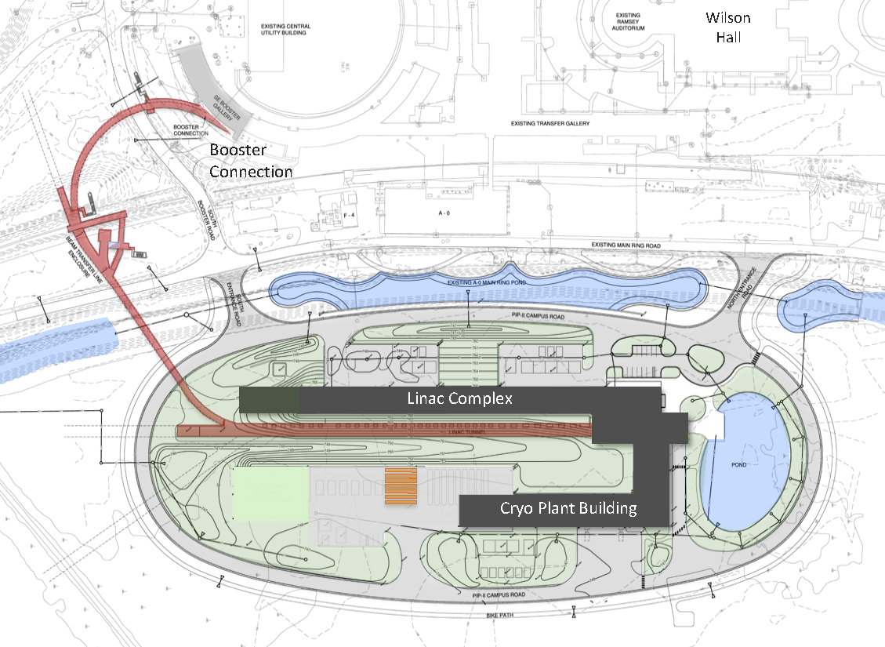
PIP-II Scope Overview
800 MeV linac
  Warm Front End
  SRF section
Linac-to-Booster transfer line
  3-way beam split
Upgraded Booster
  20 Hz, 800 MeV injection
  New injection area
Upgraded Recycler & Main Injector
  RF in both rings
Conventional facilities
  Site preparation
  Cryoplant Building
  Linac Complex
  Booster Connection
The PIP-II scope enables the accelerator complex to reach 1.2 MW proton beam on LBNF target.

Slide 34
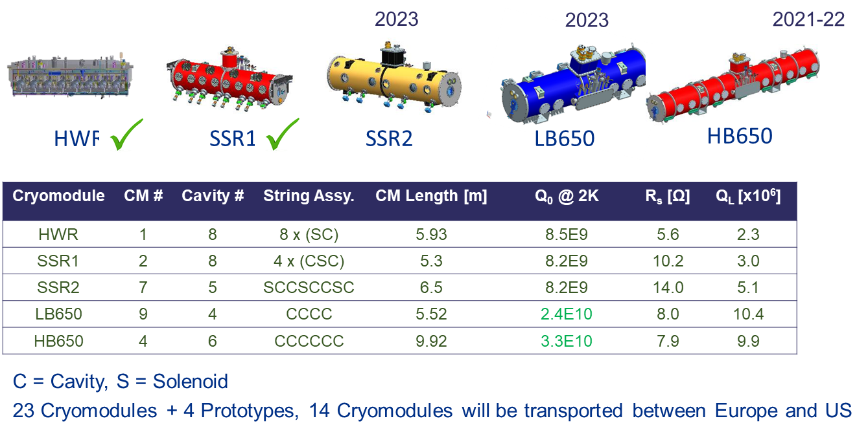
PIP-II SRF Cryomodules

Slide 35



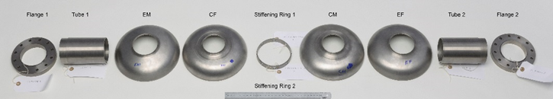
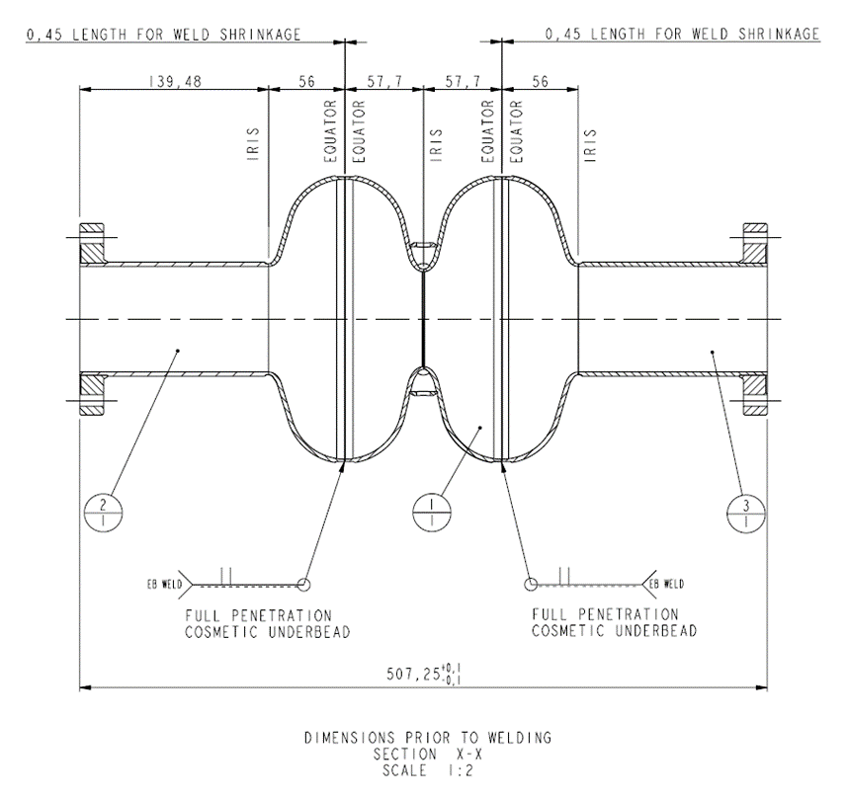
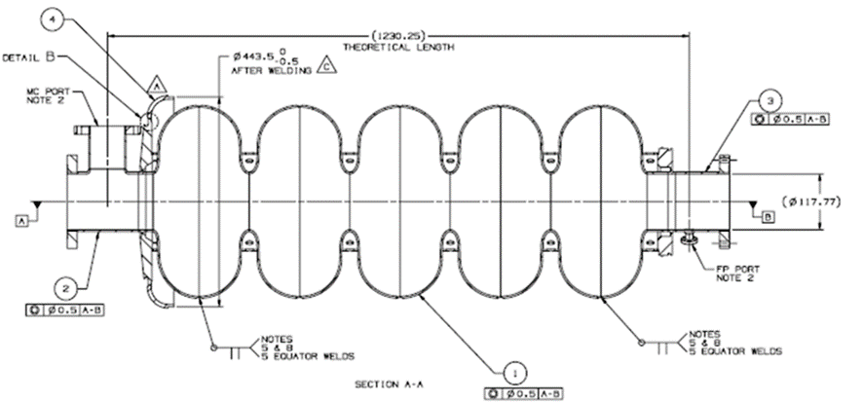
WP2 – UK Industry Development
Components supplied to TWI to manufacture 2-cell test cavity
New Steigerwald
Electron Beam Welder installed and commissioned at TWI (Dec 2020)
2-cell test cavity
Deliverable D1 (1.3 GHz)
5-cell ‘Demonstrator’ cavity
Deliverable D2 (650 MHz)
35

Slide 36
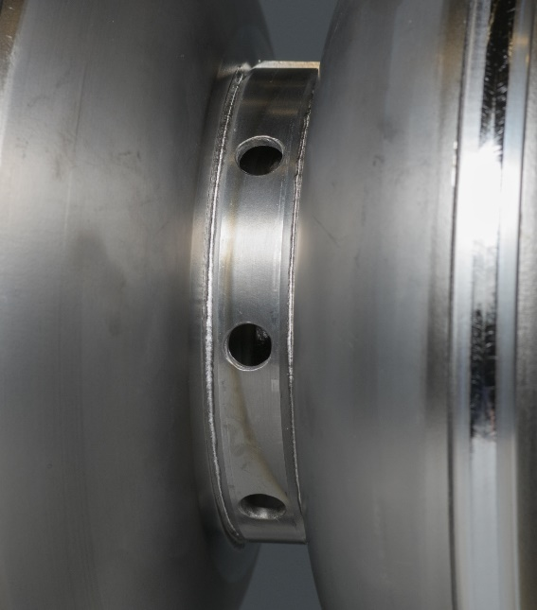
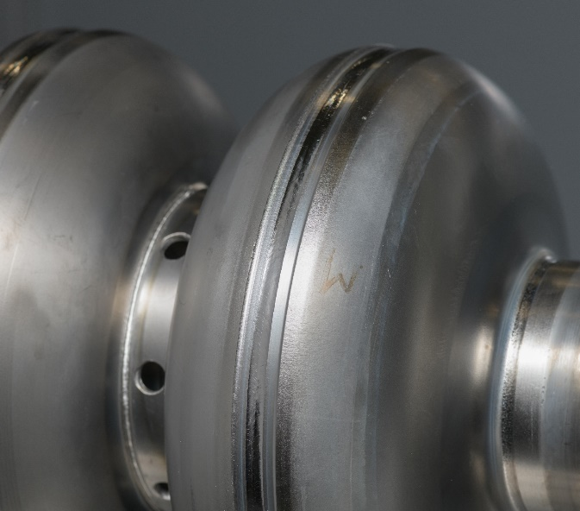



WP2 – UK Industry Development – D1 Cavity
D1 Stiffening Ring
Dimensional issues with stiffening ring strips required remanufacture.
D1 Post-EBW Checks
Digital dial gauge use to record equator run-out vs angular position.
Equator 1 and Equator 2 both tested.
Total length:
Theoretical - 506.35mm
Measured - 501.24mm
Flange face parallelism:
Measured 0.66° off axis
~1.7mm across the full flange
Not expected to be problematic for RF testing – ready to ship to FNAL for N2-doping & tests.
36

