Slide 1
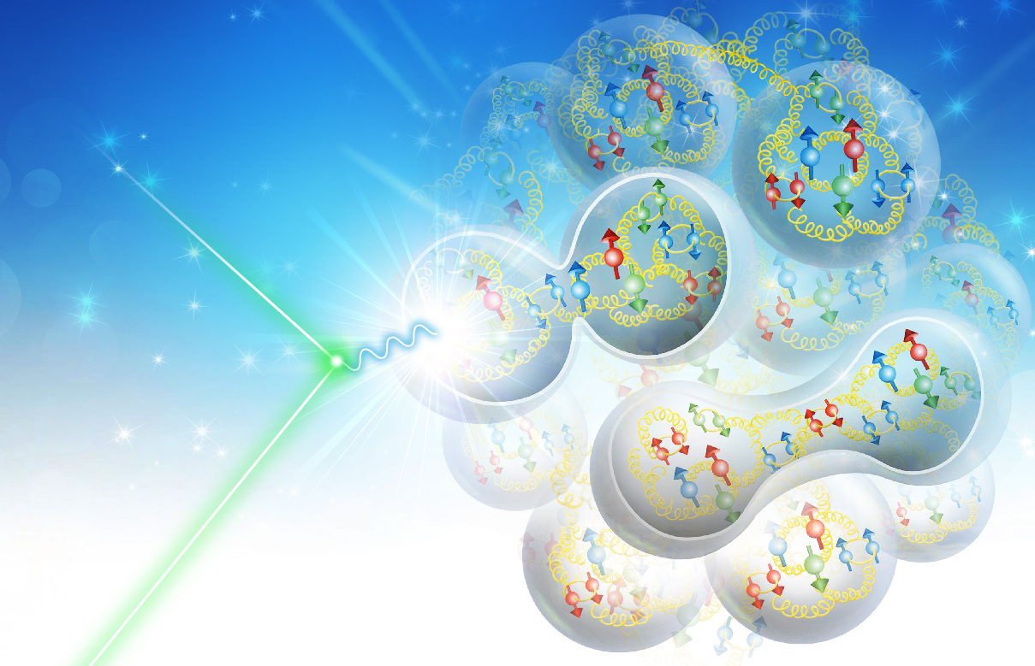

Spin Transparency Method for Spin Control of Hadron Beams in Colliders
V.S. Morozov
Accelerator Seminar, Jefferson Lab, August 27, 2020

Slide 2
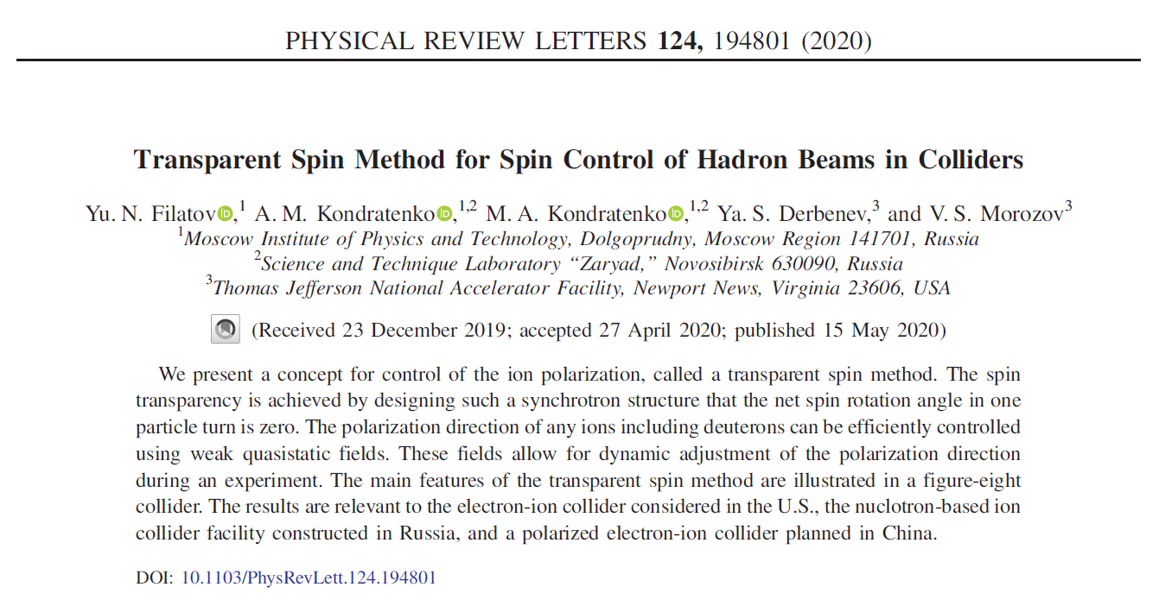
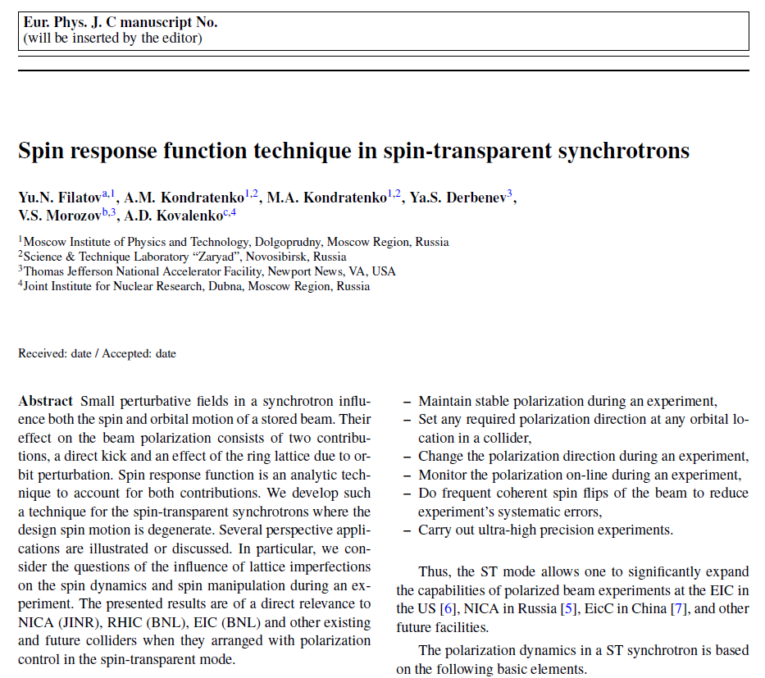
Outline
Spin transparency concept
Spin response function formalism
as analysis technique
(accepted for publication in EPJC)

Slide 3
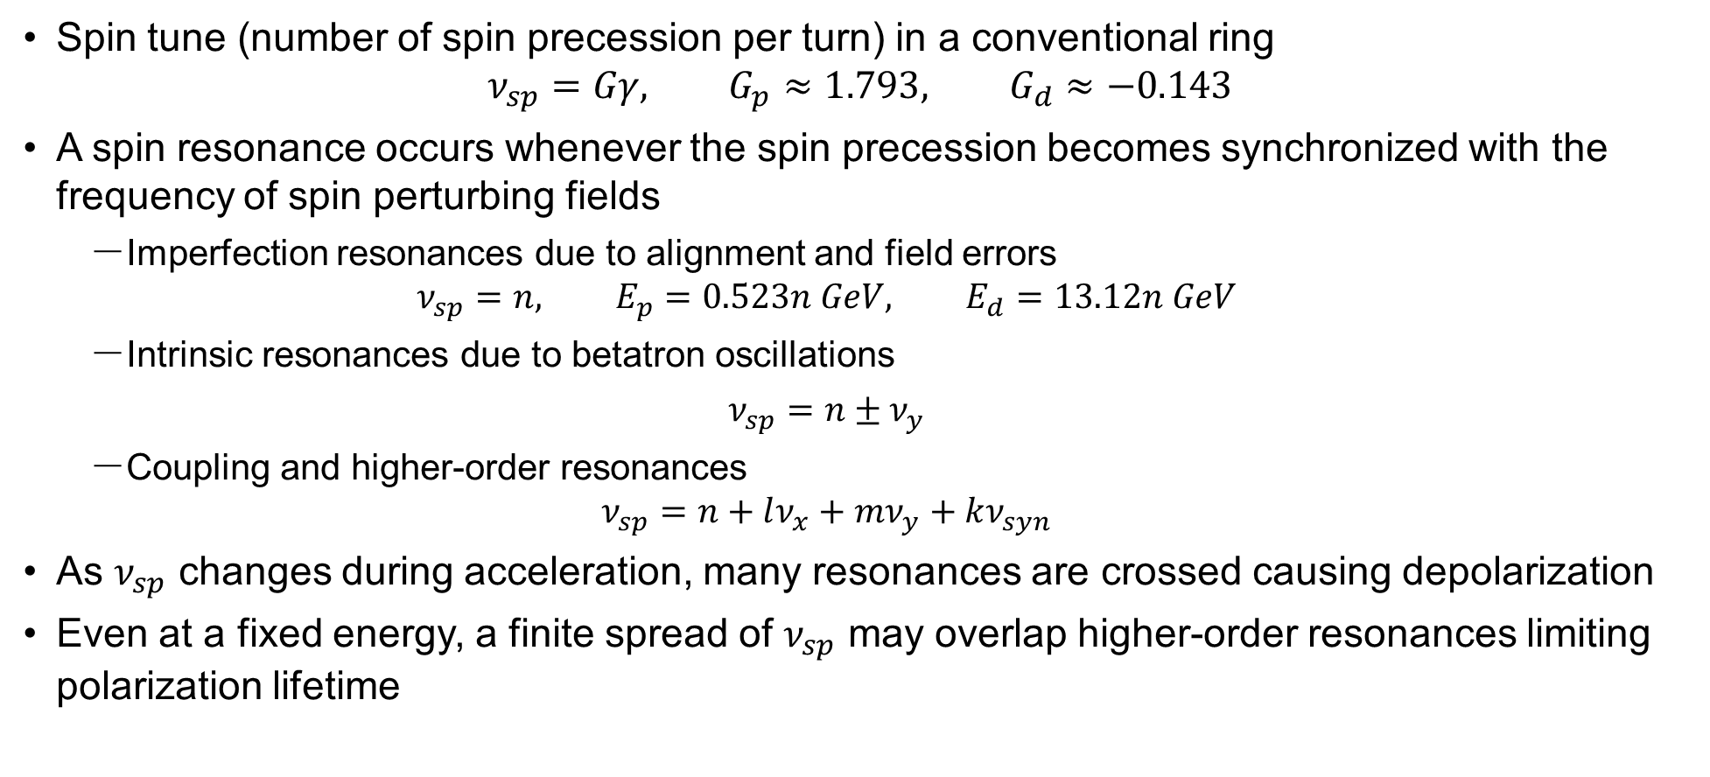
Challenges with Preserving Beam Polarization: Spin Resonances
Spin tune (number of spin precession per turn) in a conventional ring
$ν_{sp}=Gγ, G_{p}≈1.793, G_{d}≈−0.143$
A spin resonance occurs whenever the spin precession becomes synchronized with the frequency of spin perturbing fields
  Imperfection resonances due to alignment and field errors
  $ν_{sp}=n, E_{p}=0.523n GeV, E_{d}=13.12n GeV$
  Intrinsic resonances due to betatron oscillations
  $$ν_{sp}=n±ν_{y}$$
  Coupling and higher-order resonances
  $ν_{sp}=n+lν_{x}+mν_{y}+kν_{syn}$
As $ν_{sp}$ changes during acceleration, many resonances are crossed causing depolarization
Even at a fixed energy, a finite spread of $ν_{sp}$ may overlap higher-order resonances limiting polarization lifetime

Slide 4
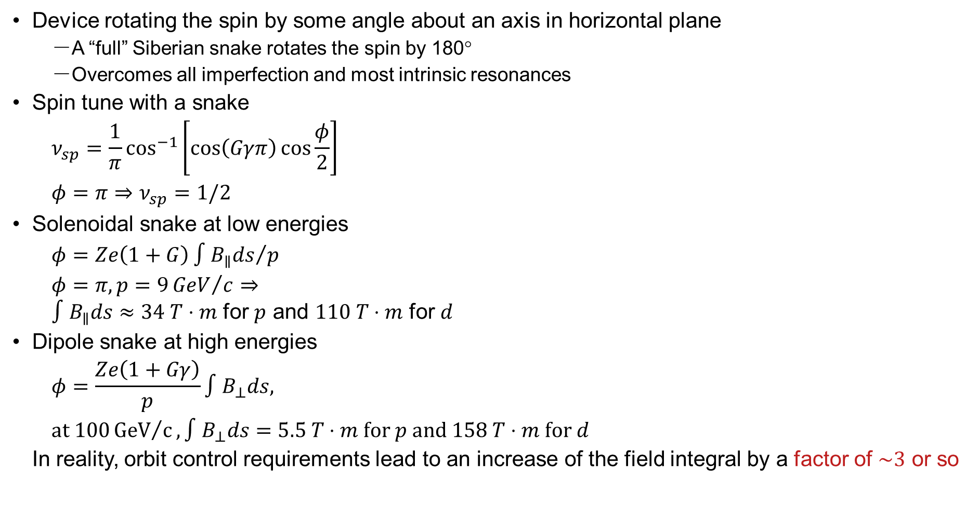
Nearly Universal Solution: Siberian Snake
Device rotating the spin by some angle about an axis in horizontal plane
  A “full” Siberian snake rotates the spin by 180°
  Overcomes all imperfection and most intrinsic resonances
Spin tune with a snake
$$ν_{sp}=\frac{1}{π}\cos^{−1}\left[\cos\left(Gγπ\right)\cos{\frac{φ}{2}}\right]$$
$$φ=π⇒ν_{sp}=1/2$$
Solenoidal snake at low energies
$$φ=Ze\left(1+G\right){∫B_{∥}ds}/p$$
$$φ=π, p=9{GeV}/c⇒$$
$∫B_{∥}ds≈34 T⋅m$ for $p$ and $110 T⋅m$ for $d$
Dipole snake at high energies
$$φ=\frac{Ze\left(1+Gγ\right)}{p}∫B_{⊥}ds,$$
$$\text{at} 100{GeV}/c, ∫B_{⊥}ds=5.5 T⋅m \text{for} p \text{and} 158 T⋅m \text{for} d$$
In reality, orbit control requirements lead to an increase of the field integral by a factor of $\sim 3$ or so

Slide 5
Some of the Remaining Issues
Implementation of full Siberian snakes may still be a challenge especially in the medium energy range due to their orbital effects
Full deuteron Siberian snakes are not practical starting with medium energies
Control of the polarization direction requires high field integrals comparable to those of Siberian snakes
Resonant spin flipping results in a non-negligible polarization loss

Slide 6
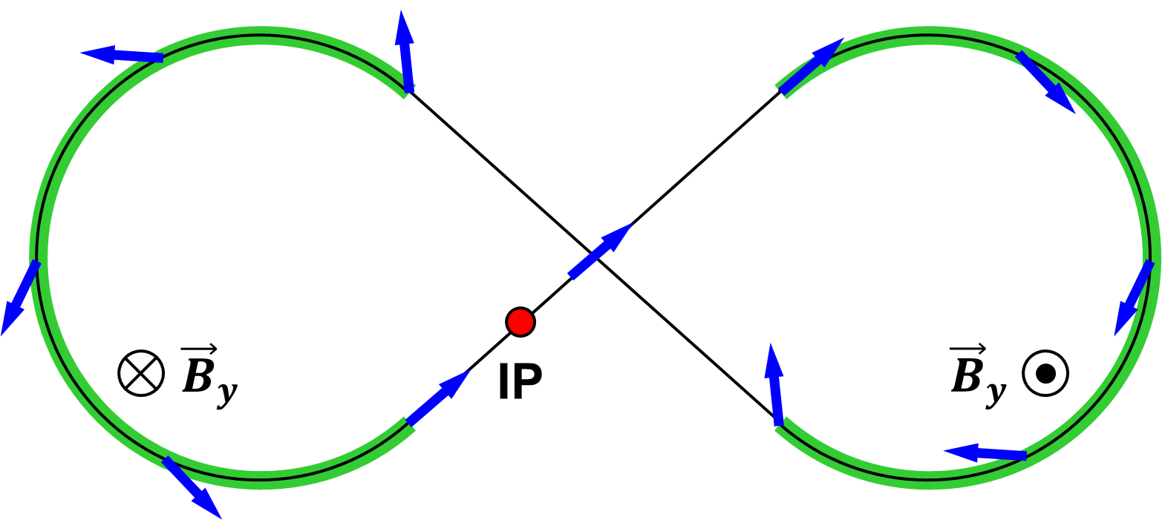
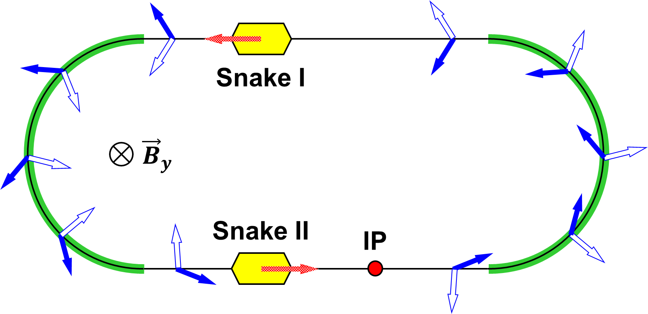

Spin Transparency Concept
No net spin effect in one turn
along the design orbit, $ν_{sp}=0$
Figure-8 ring
Racetrack with two identical
Siberian snakes separated by ${180}^{∘}$ bends
One arc cancels the spin rotation of the other

Slide 7
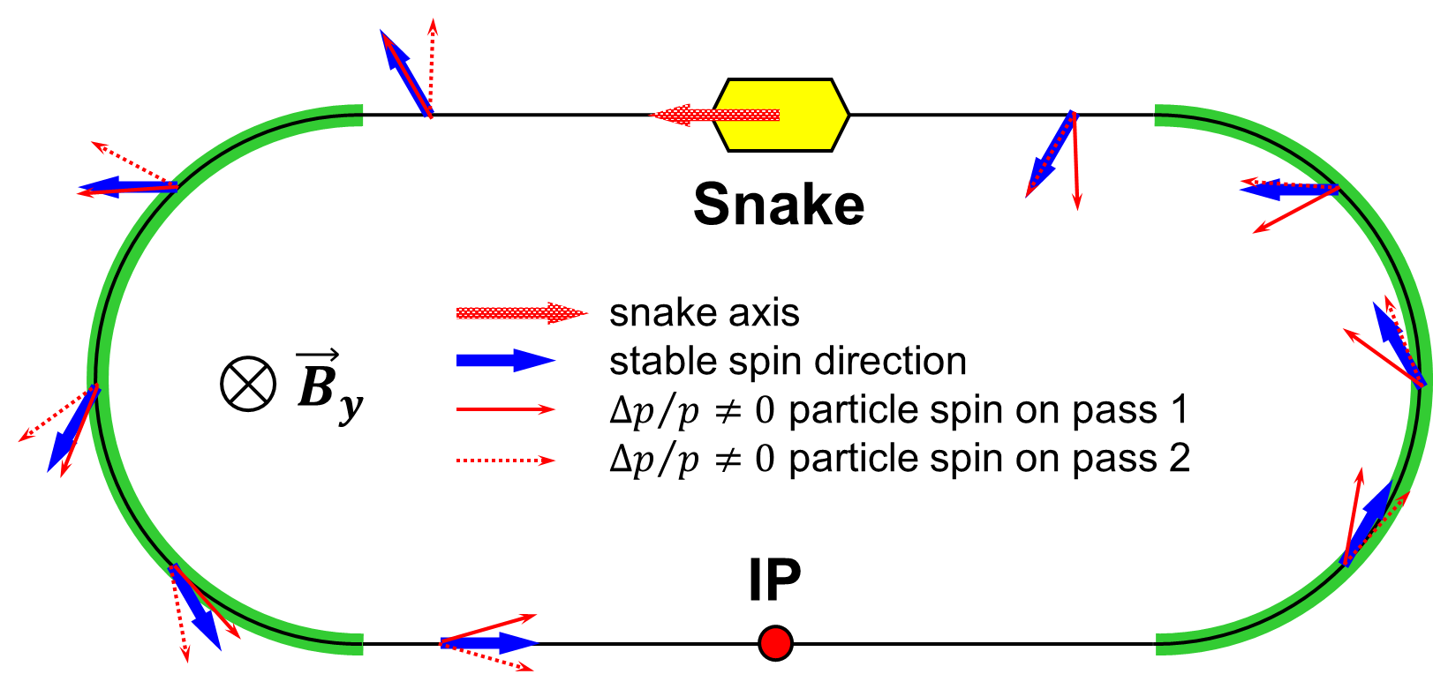
Spin Echo
Siberian snake eliminates the dependence of the spin tune on energy
Spin smear accumulated in one turn is removed on the second turn
In the spin transparency mode, the spin smear is compensated in one turn by the spin echo effect

Slide 8
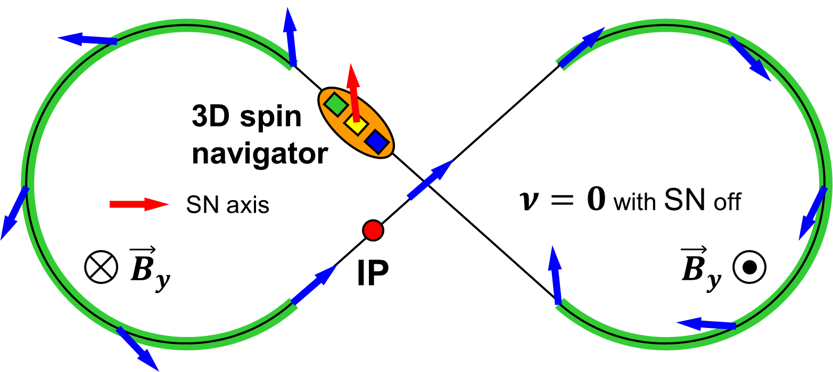
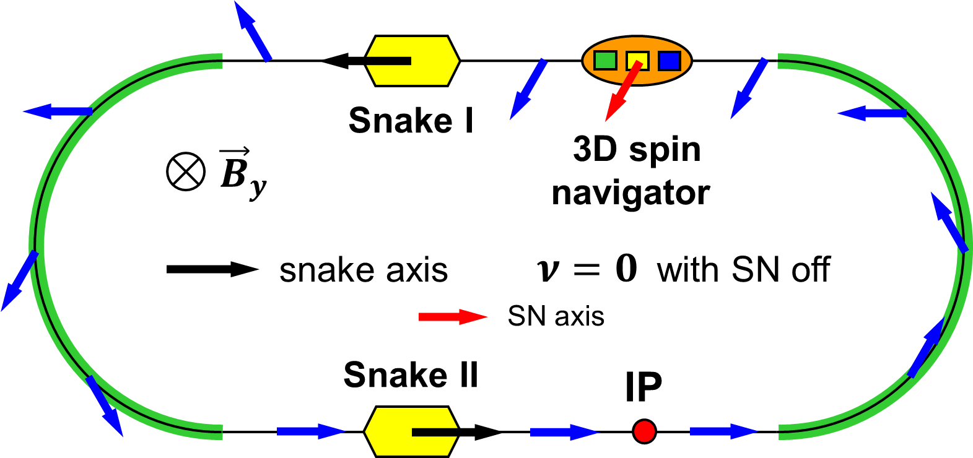

Polarization Stability Criterion
In the spin transparency mode, the spin is highly sensitive to small perturbing fields
On the other hand, this sensitivity makes it easy to control the spin by low magnetic field integrals
A device called a spin navigator (SN) is introduced to rotate the spin by a small angle $2πν_{N}$ per turn
Stable polarization direction is along the SN rotation axis at the SN location
Polarization is under control if this induced spin rotation dominates over the spin rotation $2πω$ due to imperfections and beam emittances
$ν_{N}≫ω$
where $ω$ is the spin transparency resonance strength

Slide 9
Features of Spin Transparency Mode
Polarization stability due to energy-independent spin tune
Without additional fields, spin rotation is a priori unknown and occurs only due to closed orbit excursion and beam emittances
Spin stabilization by small fields: ~3 Tm vs. ~1200 Tm for deuterons at 100 GeV
  Criterion: induced spin rotation >> spin rotation due to orbit errors
3D spin rotator: combination of small rotations about different axes provides any polarization orientation at any point in the collider ring
No effect on the orbit
Polarized deuterons
Frequent adiabatic spin flips

Slide 10
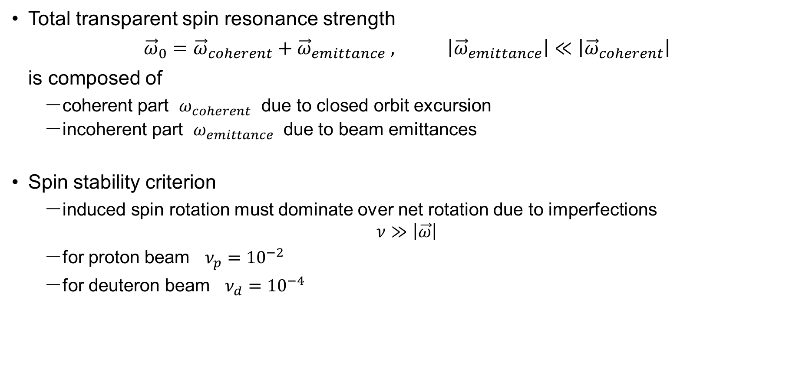
Spin Transparency Resonance Strength
Total transparent spin resonance strength
$${\vec{ω}}_{0}={\vec{ω}}_{coherent}+{\vec{ω}}_{emittance} , \left|{\vec{ω}}_{emittance}\right|≪\left|{\vec{ω}}_{coherent}\right|$$
is composed of
  coherent part $ω_{coherent}$ due to closed orbit excursion
  incoherent part $ω_{emittance}$ due to beam emittances
Spin stability criterion
  induced spin rotation must dominate over net rotation due to imperfections
  $$ν≫\left|\vec{ω}\right|$$
  for proton beam $ν_{p}={10}^{−2}$
  for deuteron beam $ν_{d}={10}^{−4}$

Slide 11
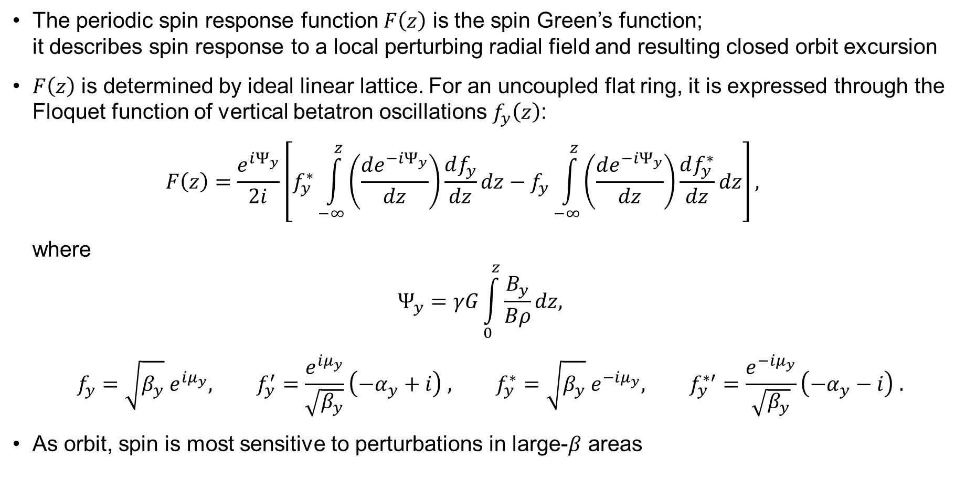
Spin Response Function
The periodic spin response function $F\left(z\right)$ is the spin Green’s function;
it describes spin response to a local perturbing radial field and resulting closed orbit excursion
$F\left(z\right)$ is determined by ideal linear lattice. For an uncoupled flat ring, it is expressed through the Floquet function of vertical betatron oscillations $f_{y}\left(z\right)$:
$$F\left(z\right)=\frac{e^{iΨ_{y}}}{2i}\left[f_{y}^{∗}\int_{−∞}^{z}{\left(\frac{de^{−iΨ_{y}}}{dz}\right)}\frac{df_{y}}{dz}dz−f_{y}\int_{−∞}^{z}{\left(\frac{de^{−iΨ_{y}}}{dz}\right)}\frac{df_{y}^{∗}}{dz}dz\right],$$
where
$$Ψ_{y}=γG\int_{0}^{z}{\frac{B_{y}}{Bρ}}dz,$$
$$f_{y}=\sqrt{β_{y}} e^{iμ_{y}}, f_{y}^{′}=\frac{e^{iμ_{y}}}{\sqrt{β_{y}}}\left(−α_{y}+i\right) , f_{y}^{∗}=\sqrt{β_{y}} e^{−iμ_{y}}, f_{y}^{∗′}=\frac{e^{−iμ_{y}}}{\sqrt{β_{y}}}\left(−α_{y}−i\right) .$$
As orbit, spin is most sensitive to perturbations in large-$β$ areas

Slide 12
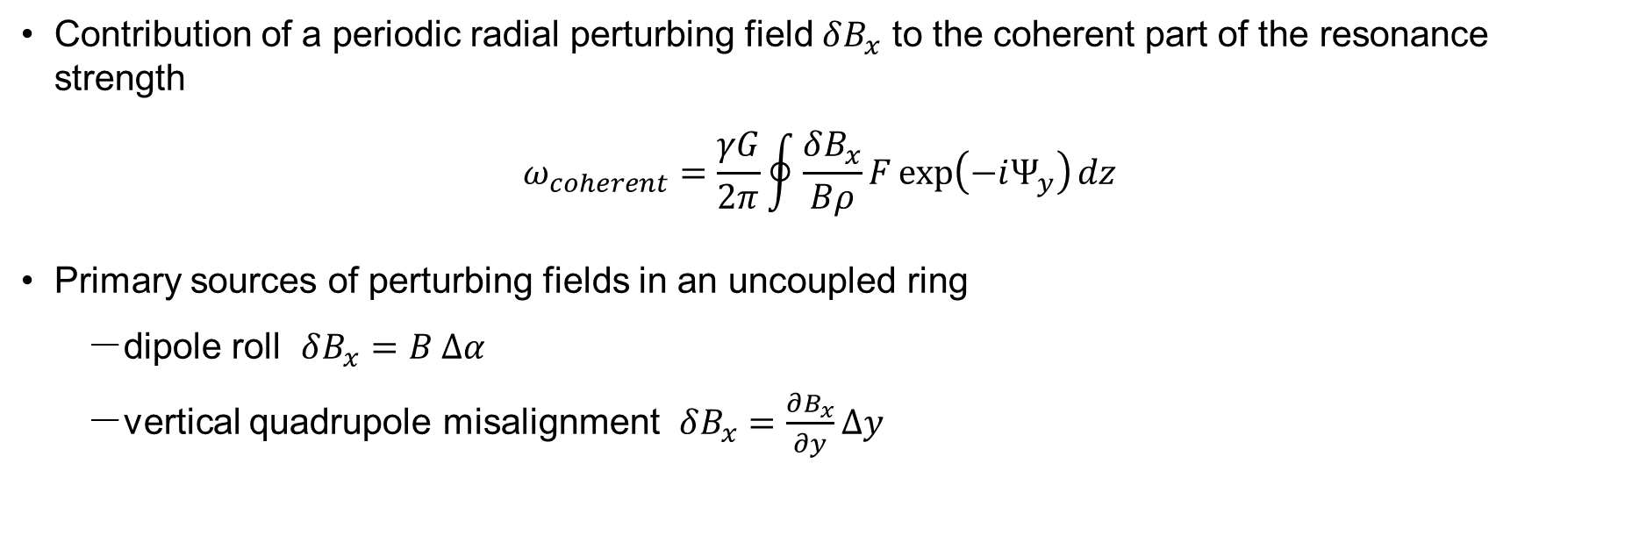
Spin Transparency Resonance Strength
Contribution of a periodic radial perturbing field $δB_{x}$ to the coherent part of the resonance strength
$$ω_{coherent}=\frac{γG}{2π}\oint{\frac{δB_{x}}{Bρ}F\exp\left(−iΨ_{y}\right)dz}$$
Primary sources of perturbing fields in an uncoupled ring
  dipole roll $δB_{x}=B Δα$
  vertical quadrupole misalignment $δB_{x}=\frac{∂B_{x}}{∂y}Δy$

Slide 13
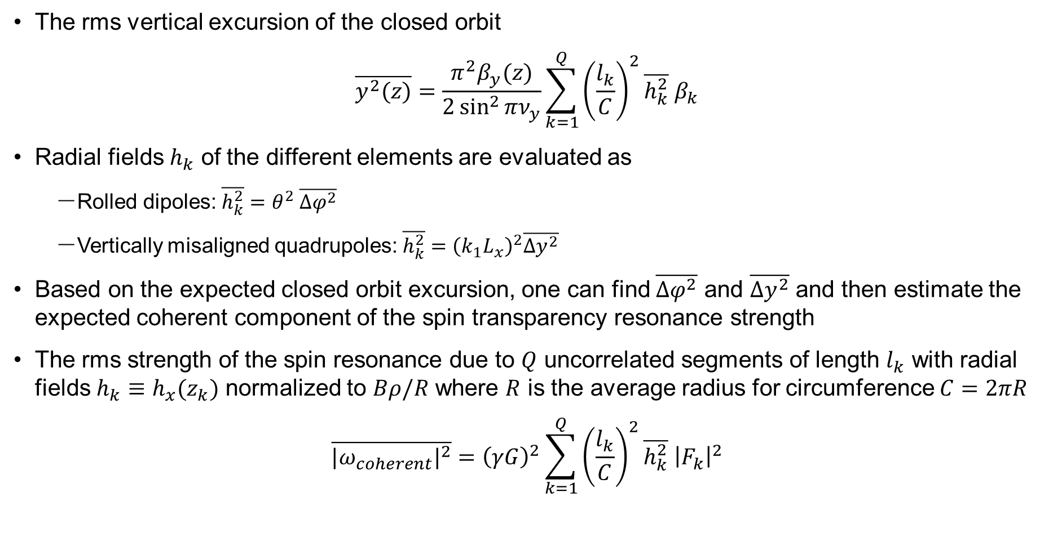
Statistical Model
The rms vertical excursion of the closed orbit
$$\overline{y^{2}(z)}=\frac{π^{2}β_{y}(z)}{2\sin^{2}{πν_{y}}}\sum_{k=1}^{Q}{{\left(\frac{l_{k}}{C}\right)}^{2}\overline{h_{k}^{2}} β_{k}}$$
Radial fields $h_{k}$ of the different elements are evaluated as
  Rolled dipoles: $\overline{h_{k}^{2}}=θ^{2} \overline{{Δφ}^{2}}$
  Vertically misaligned quadrupoles: $\overline{h_{k}^{2}}={\left(k_{1}L_{x}\right)}^{2}\overline{{Δy}^{2}}$
Based on the expected closed orbit excursion, one can find $\overline{{Δφ}^{2}}$ and $\overline{{Δy}^{2}}$ and then estimate the expected coherent component of the spin transparency resonance strength
The rms strength of the spin resonance due to $Q$ uncorrelated segments of length $l_{k}$ with radial fields $h_{k}≡h_{x}(z_{k})$ normalized to $Bρ/R$ where $R$ is the average radius for circumference $C=2πR$
$$\overline{{{|ω}_{coherent}|}^{2}}={\left(γG\right)}^{2}\sum_{k=1}^{Q}{{\left(\frac{l_{k}}{C}\right)}^{2}\overline{h_{k}^{2}} {\left|F_{k}\right|}^{2}}$$

Slide 14
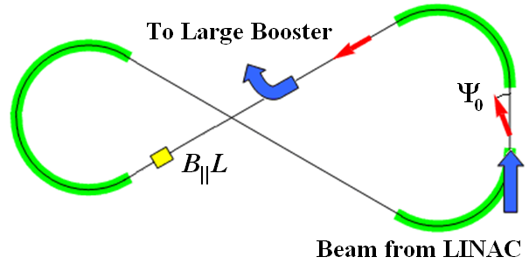

Figure-8 Boosters
Polarization in Booster stabilized and preserved by a single weak solenoid
  0.6 T⋅m at 8 GeV/c
  $ν_{d}/ν_{p} = 0.003/0.01≫ω$
Longitudinal polarization in the straight with the solenoid
Conventional 8 GeV accelerators require B||L of ~30 Tm for protons and ~100 Tm for deuterons
B_{II}L
Booster
beam from Linac
to Collider Ring

Slide 15
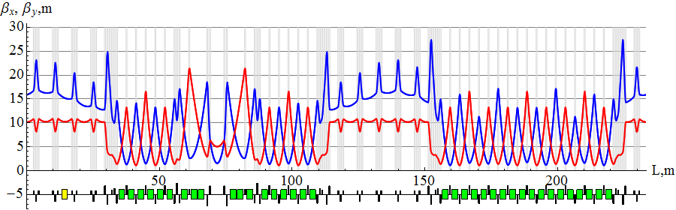
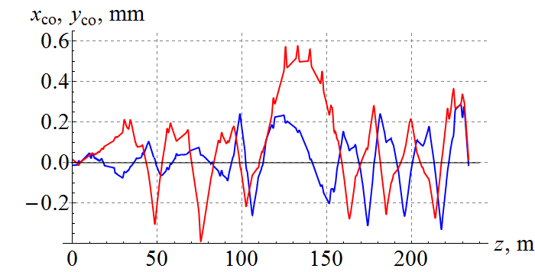
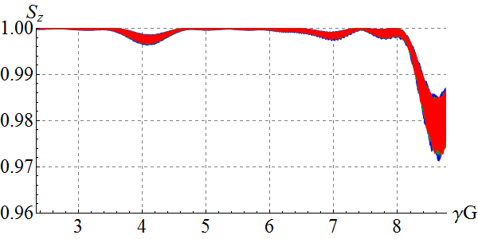
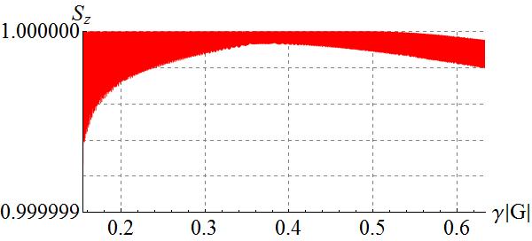
Spin Dynamics in Booster
Acceleration in figure-8 booster with transverse quadrupole misalignments
0.3 Tm (maximum) spin stabilizing solenoid
Spin tracking simulation using Zgoubi
protons
x₀ = y₀ = 1 cm
Δp/p = -0.1%, 0, +0.1%
deuterons
x₀ = y₀ = 1 cm
Δp/p = 0

Slide 16
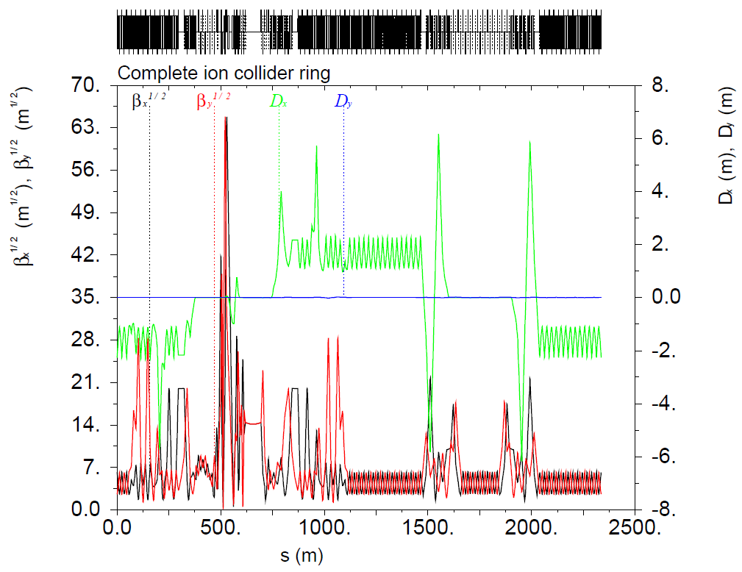
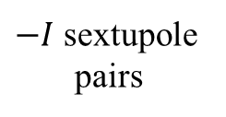
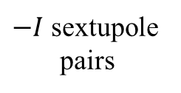
Figure-8 Collider Ring Optics
Local chromaticity compensation scheme
Crab cavities
IP
$−I$ sextupole
pairs
$−I$ sextupole
pairs

Slide 17
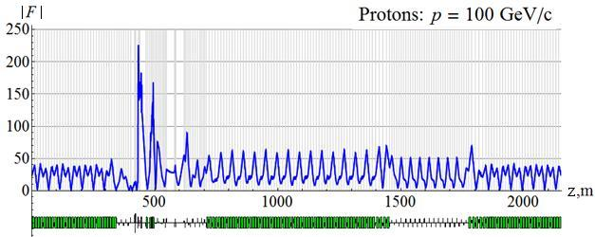
Spin Response Function of JLEIC Ion Collider Ring

Slide 18
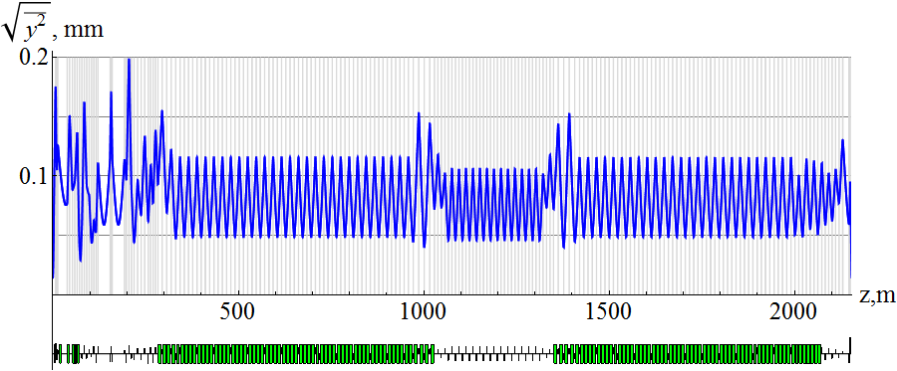
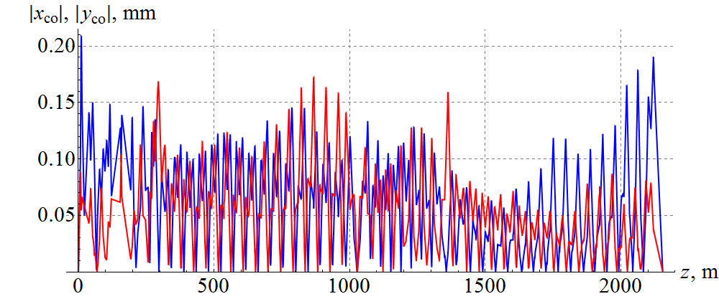
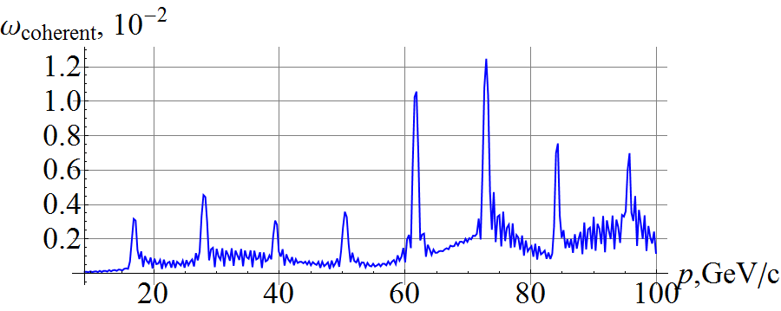
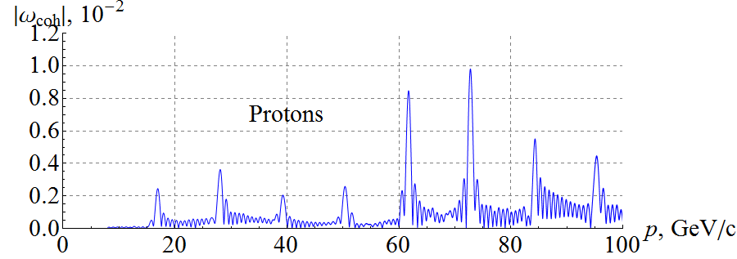
Analytic and Numerical Calculations of Resonance Strength
Statistical model
Zgoubi simulation using random quadrupole misalignments

Slide 19
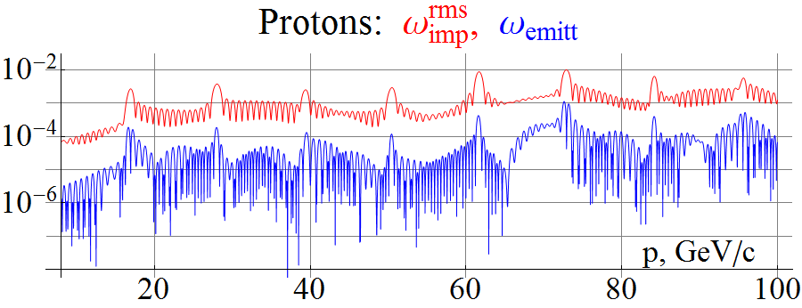
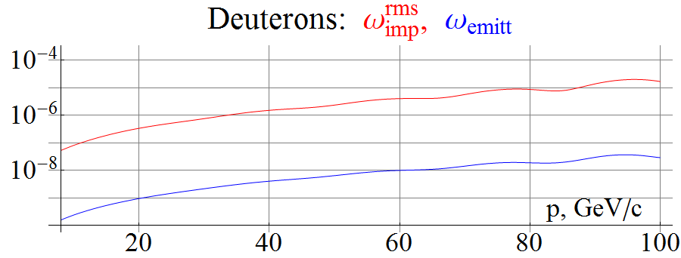
Incoherent Part of Spin Transparency Resonance Strength
Incoherent part is one to two orders of magnitude lower than the coherent part

Slide 20
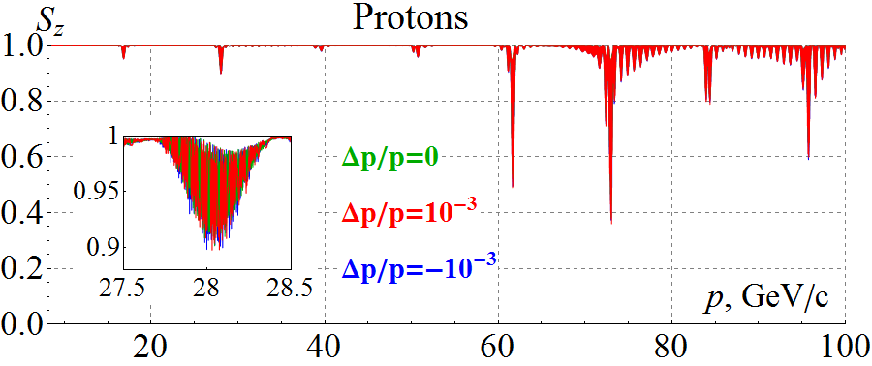
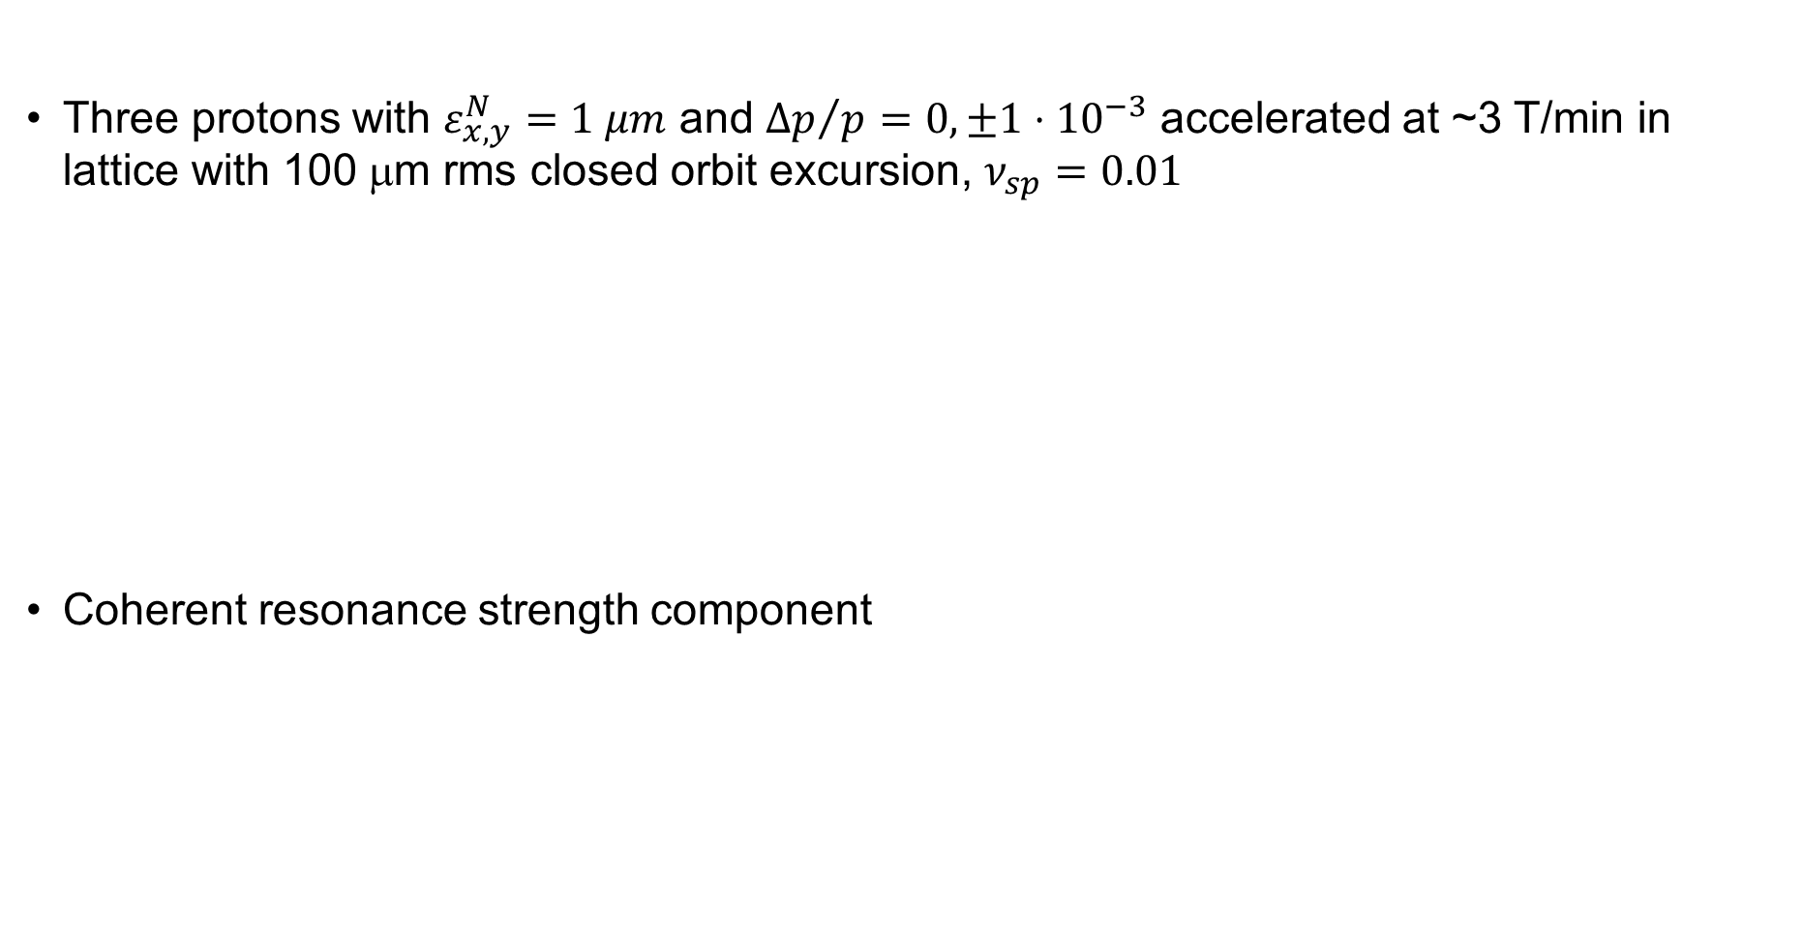
Start-to-End Proton Acceleration in Ion Collider Ring
Three protons with $ε_{x,y}^{N}=1 μm$ and ${Δp}/p=0, ±1⋅{10}^{−3}$ accelerated at ~3 T/min in lattice with 100 μm rms closed orbit excursion, $ν_{sp}=0.01$
Coherent resonance strength component
Zgoubi
simulation
Analytic prediction
Zgoubi simulation

Slide 21
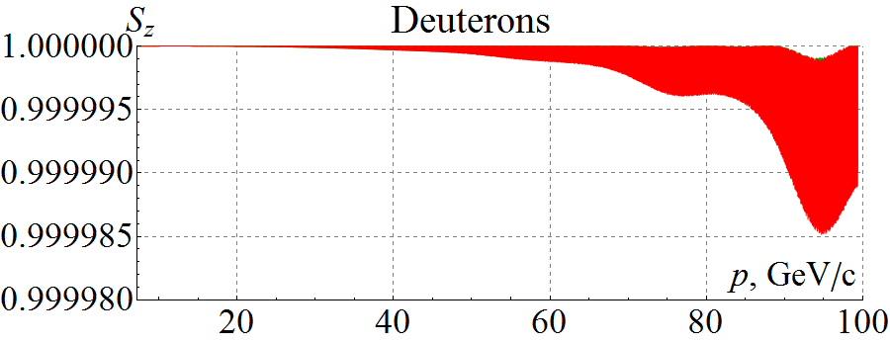
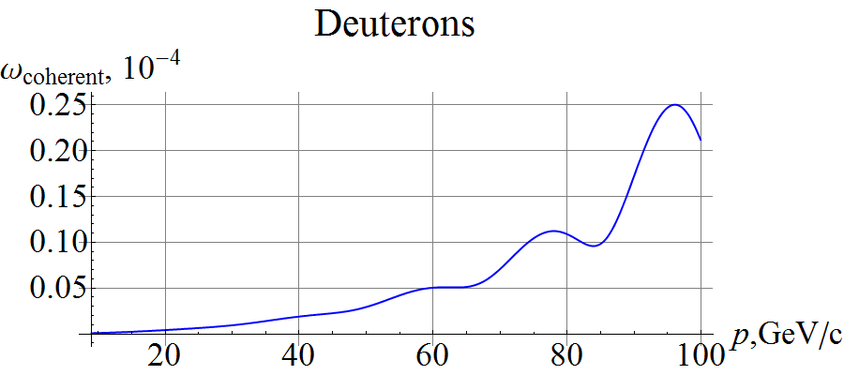
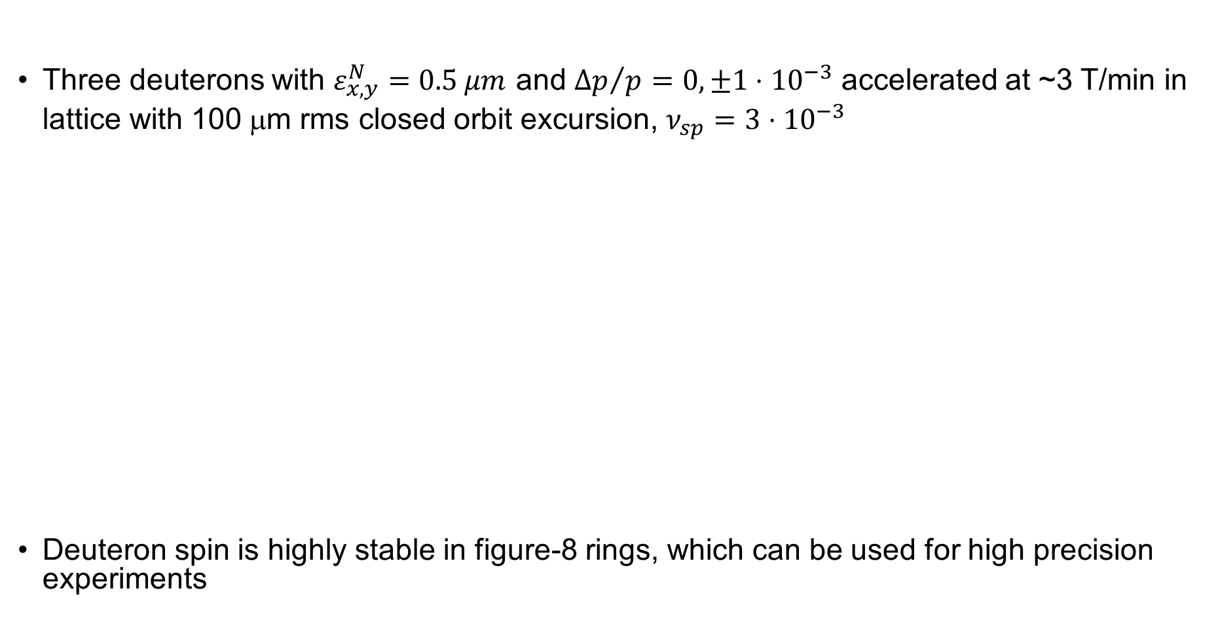
Start-to-End Deuteron Acceleration in Ion Collider Ring
Three deuterons with $ε_{x,y}^{N}=0.5 μm$ and ${Δp}/p=0, ±1⋅{10}^{−3}$ accelerated at ~3 T/min in lattice with 100 μm rms closed orbit excursion, $ν_{sp}=3⋅{10}^{−3}$
Deuteron spin is highly stable in figure-8 rings, which can be used for high precision experiments
(Zgoubi simulation)
Analytic prediction

Slide 22

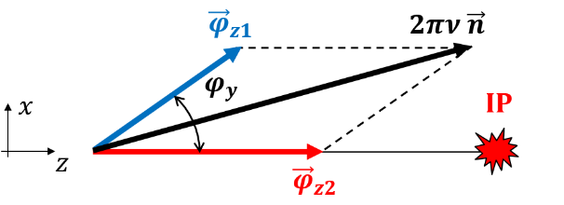
Adjustable–Axis Spin Rotator Concept
Stable spin direction controlled in the collider ring by adjusting the spin rotator axis and therefore the stable polarization direction at this location

Slide 23
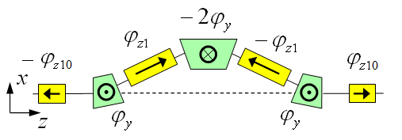
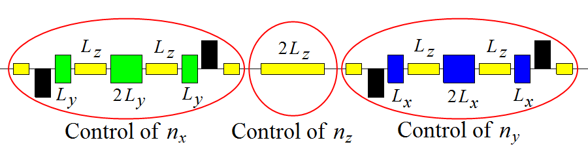
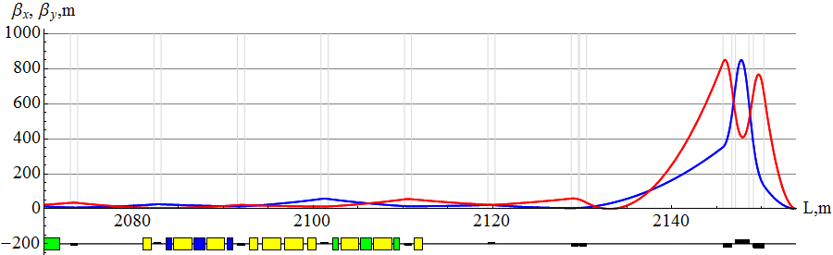
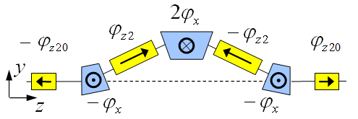

3D Spin Rotator in Collider Ring
Provides control of the radial, vertical, and longitudinal spin components
Module for control of the radial component (fixed radial orbit bump)
Module for control of the vertical
component (fixed vertical orbit bump)
Module for control of the longitudinal component
3D spin rotator
IP
ions

Slide 24
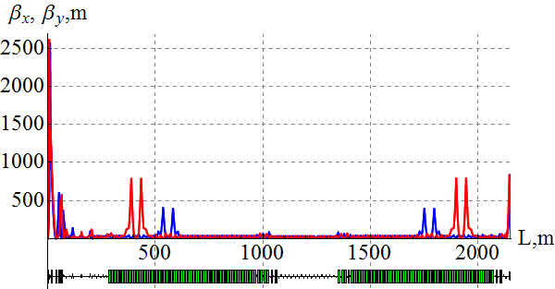
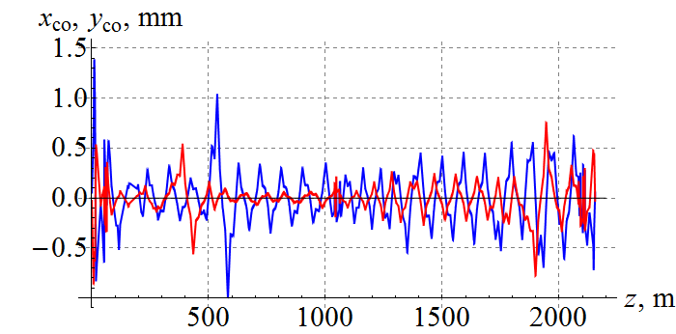
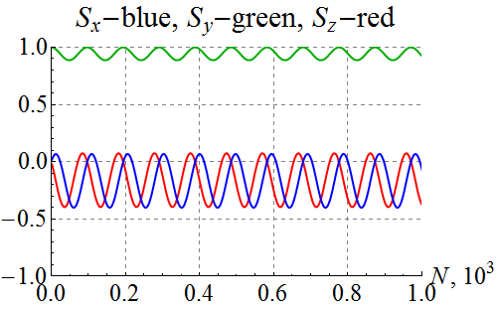
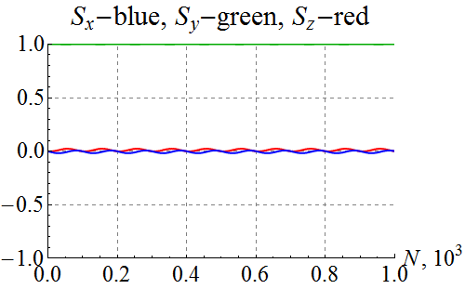

Polarization Control in Collider Ring
100 GeV/c figure-8 ion collider ring with transverse quadrupole misalignments
Example of vertical proton polarization at IP. The 1st 3D rotator: $ν={10}^{−2}$ , $ny=1$. The 2nd 3D rotator is used for compensation of coherent part of the zero-integer spin resonance strength
1st 3D rotator
for control
2nd 3D rotator
for compensation
without compensation
with compensation

Slide 25
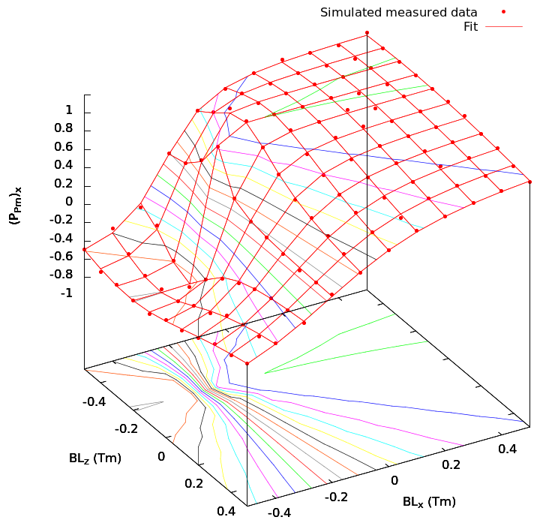

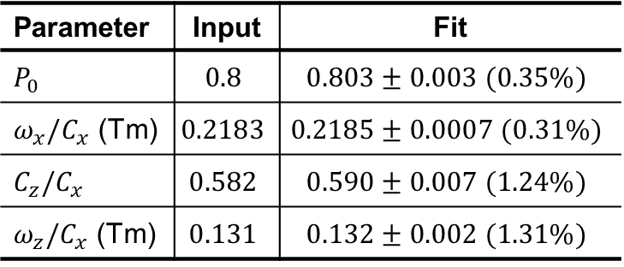
Spin Rotator Calibration
Radial polarization at a polarimeter in terms of spin rotator solenoid field integrals
$${\left(P_{Pm}\right)}_{x}=P_{0}\frac{BL_{x}+{ω_{x}}/{C_{x}}}{\sqrt{{\left(BL_{x}+{ω_{x}}/{C_{x}}\right)}^{2}+{\left({BL_{z}C}_{z}/C_{x} +{ω_{z}}/{C_{x}}\right)}^{2}}}$$
Assume typical parameters of a 100 GeV/c proton beam
Assume that polarization is measured with a random error
of 0.02 rms
Fit randomly generated data to ${\left(P_{Pm}\right)}_{x}$ formula and extract
input parameters
Parameter | Input | Fit
$$P_{0}$$ | $$0.8$$ | $$0.803±0.003 (0.35\%)$$
$ω_{x}/C_{x}$ (Tm) | $$0.2183$$ | $$0.2185±0.0007 (0.31\%)$$
$$C_{z}/C_{x}$$ | $$0.582$$ | $$0.590±0.007 (1.24\%)$$
$ω_{z}/C_{x}$ (Tm) | $$0.131$$ | $$0.132±0.002 (1.31\%)$$

Slide 26


Spin Transparency Resonance Strength at High Energies
Assuming RMS closed orbit distortion of ~200 μm
Above ~100 GeV/c, the 3D spin rotator strength may not be sufficient to control polarization ⇒ consider a 3D spin rotator based on transverse fields
Protons
Deuterons

Slide 27



Proton Spin Rotator Utilizing Transverse Fields
Longitudinal Polarization at IP
Radial Polarization at IP

Slide 28



Spin Flipping
Adiabaticity criterion: spin reversal time must be much longer than spin precession period ⇒
$τflip≫ 1$ ms for protons and 0.1 s for deuterons
Vertical ($hy$) & longitudinal ($hz$) spin field components are adjusted adiabatically while keeping $ν_{sp}=\sqrt{h_{y}^{2}+h_{z}^{2}}≈Const$. Polarization direction follows $\vec{h}$.
$N$ is the number of particle turns, $N_{0}=50⋅{10}^{3}$

Slide 29




Spin Flipping Simulation
Vertical & longitudinal components of proton polarization vs time at 100 GeV/c
Deuteron polarization at different rates
$$\vec{P}:↑ → ↓ ← ↑$$
Zgoubi
simulation
$$N_{0}=50⋅{10}^{3}$$

Slide 30



Analysis of Beam-Beam Effect
Similarly to how colliding bunches impact each other’s orbital dynamics, the magnetic fields the two bunches impose on each other can impact their polarization dynamics
Response function can be used to estimate the beam-beam effect on the spin at the linear level
$$φ_{spin}= \frac{γG}{Bρ}{|F}_{IP}|\int_{collision}{B\left(\vec{x}\right)dz}≈\frac{γG}{Bρ} {|F}_{IP}|B_{bunch}L_{bunch}$$
Response function depends only on the linear optics and can be made small at the IP but adjusting the optics therefore reducing the beam-beam effect in the leading order
An example response function and its zoomed in graph around 53 GeV

Slide 31



Simulation of Beam-Beam Effect
2 cm long radial dipole with a field strength
of $2⋅{10}^{−3} m^{−1}$ at the IP
Two energy points:
  51.32 GeV/c with $\left|F\right|=$ 0.0322
  52.94 GeV/c with $\left|F\right|=$ 1.329
Analytic prediction:
  $φ_{spin}^{E1}≈2π⋅2.01⋅{10}^{−5}$
  $φ_{spin}^{E2}≈2π⋅8.56⋅{10}^{−4}$
Zigoubi simulation
$$φ_{spin}=\frac{2π}{N_{turns}^{spin period}}$$
  $φ_{spin}^{E1}≈2π⋅1.85⋅{10}^{−5}$
  $φ_{spin}^{E2}≈2π⋅8.54⋅{10}^{−4}$
Illustrated impact of energy and potential
for response function optimization

Slide 32





Generalized Spin Response Function
Account for contribution of each perturbing field component to each component of the spin field
$\vec{ω}=\frac{1}{2π}\int_{0}^{L}{\left[\frac{ΔB_{x}}{Bρ}{\vec{F}}_{x}+\frac{ΔB_{y}}{Bρ}{\vec{F}}_{y}+\frac{ΔB_{z}}{Bρ}{\vec{F}}_{z}\right]dz}$
NICA in Dubna, Russia: spin transparent ring
Setting spin tune $ν$
${\left(BL\right)}_{∥}≈\frac{2πν}{F_{z}}Bρ \text{or} {\left(BL\right)}_{⊥}≈\frac{2πν}{F_{⊥}}Bρ$

Slide 33





Potential Benefits of Spin Transparency Mode to EIC
Hadron collider ring configured in the spin transparency mode using two identical Siberian snakes
  Eliminate the need for spin rotators at certain energies
  Longitudinally polarized deuterons at certain energies
Electron collider ring configure in the spin transparency mode using electron spin rotators and additional snake
  Same lifetimes of the two spin states
  Simplified spin matching
Spin rotator
$$⋅$$
Spin rotator
IP
$$×$$
$$\vec{P}$$
$$\vec{P}$$
$$⋅$$

Slide 34

Deuteron Magic Energies
The number of deuteron spin precessions per single turn around the ring is
$$ν_{sp}=G_{d}γ\text{, }G_{d}≈−0.143$$
Local spin rotators for control of the polarization direction at IPs are not practical for deuterons
Must select energies where the number of spin precession per turn is an integer
$$\left|ν_{sp}\right|=\left|G_{d}γ\right|=k$$
At these energies, the spin dynamics becomes degenerate, or the ring becomes transparent to the spin
This transparency is not identical to the figure-8 case because the ring is not transparent to off-momentum particles
In the transparent mode, the spin direction can be set by relatively small fields (like in a figure-8) that only have to overcome the spin effect of ring imperfections and beam momentum spread

Slide 35



Deuteron Magic Energies Continued
Which magic momenta fall into the EIC deuteron
momentum range?
The two IPs are separated by 1/6th of the ring.
If spin is longitudinal at one IP, it will be longitudinal
at the second IP if the spin precession between the
two IPs in an integer number of $π$
$$\frac{2πGγ}{6}=kπ ⇒ Gγ=3k$$
$$Gγ$$ | $$p_{nucleon}^{d}$$ | Within range? | Longitudinal at both IPs?
6 | 39.3 | Yes | Yes
7 | 45.9 | No | No
8 | 52.5 | No | No
9 | 59.0 | No | Yes
10 | 65.6 | No | No
11 | 72.1 | No | No
12 | 78.7 | No | Yes
13 | 85.3 | No | No
14 | 91.8 | No | No
15 | 98.4 | No | Yes
16 | 104.9 | Yes | No
17 | 111.5 | Yes | No
18 | 118.0 | Yes | Yes
19 | 124.6 | Yes | No
20 | 131.2 | Yes | No
21 | 137.7 | No | Yes

Slide 36


Stabilization of Deuteron Polarization at Magic Energies
𝐺𝛾 from $−1.6$ to $−20.9$
19 imperfection resonances
  With rms orbit error of 0.3 mm, the strongest
  resonance strength is less than 0.0015
A partial snake to overcome imperfection
resonances
  The required partial snake strength is 0.22%
  15 Tm warm solenoid
  Spin rotators around an IP as partial snake

Slide 37

Experimental Test of Spin Transparency Mode in RHIC
RHIC already has all of the necessary ingredients
Make snake axes parallel at $0^{∘}$
to set RHIC in the transparent spin mode
3D spin rotator
  Small angle between the snake axes
  = vertical module
  Mismatch of the snake strengths from $π$
  = longitudinal & radial modules
Existing polarimeter with
fast measurement time
Can test many of the features of
the spin transparency mode and
3D spin rotator

Slide 38




Model of RHIC with Snakes
Accurate Zgoubi model of RHIC with snakes exists (F. Méot)
Each snake is represented by four individual field maps for the four helices
The snake is symmetric with respect to its center
Can adjust snake strength and axis by adjusting strengths of the outer and inner fields
Model includes orbit correction

Slide 39



RHIC Snake Adjustment
Full snake with ${45}^{∘}$ axis
It is optimal to adjust the snake axes to 0°
  Minimum field integral
  Minimum orbit excursion
No change in field and power supply polarities
Full snake with $0^{∘}$ axis

Slide 40

Extension of Spin Transparency Theory to Racetracks with Two Snakes
Periodic perturbing magnetic fields $Δ\vec{B}(z)$ violate spin transparency creating a TS resonance
$$\vec{ω}=\frac{1}{2π}\int_{0}^{L}{\left[\frac{ΔB_{x}}{Bρ}{\vec{F}}_{x}+\frac{ΔB_{y}}{Bρ}{\vec{F}}_{y}+\frac{ΔB_{z}}{Bρ}{\vec{F}}_{z}\right]dz}$$
where ${\vec{F}}_{i}$ is the spin response function determined by the linear lattice.
At high energy, without coupling, the TS resonance is dominated by
$$F=F_{x1}+iF_{x3}=\frac{γG}{2i}\left[f_{y}^{∗}\int_{−∞}^{z}{f_{y}^{′}\left(e^{iα\left(1−ζ\right)}\frac{d}{dz}e^{iΨ}\right)dz}−f_{y}\int_{−∞}^{z}{{f_{y}^{∗}}^{′}\left(e^{iα\left(1−ζ\right)}\frac{d}{dz}e^{iΨ}\right)dz}\right]$$
where
$$f_{y}\left(z\right)=\sqrt{β_{y}}\exp\left(i\int_{0}^{z}{\frac{dz}{β_{y}}}\right)$$
i.e. by radial perturbing fields

Slide 41


Optics and Spin Response Function of RHIC at Injection Energy

Slide 42



rms Vertical Closed Orbit and Resonance Strength
Statistically calculated closed orbit around the ring with an rms size of $200 μ$m
The resonance strength does not exceed 0.01 at least up to 100 GeV
Spin tune of 0.05 should be sufficient to control the polarization

Slide 43




Error Effect
Zero-length Siberian snakes
Lattice with dipole roll and quadrupole misalignments obtained from statistical model
rms closed orbit excursion is consistent with $200 μ$m
Spin precesses about spin field direction
Spine resonance strength of $3.0⋅{10}^{−4}$ extracted using
$$\overset{⃑}{P}\left(N\right)={\overset{⃑}{P}}_{i}\cos\left(2πω_{Coh}N\right)+\left(\overset{⃑}{n}×{\overset{⃑}{P}}_{i}\right)sin\left(2πω_{Coh}N\right)+ \overset{⃑}{n}\left(\overset{⃑}{n}∙{\overset{⃑}{P}}_{i}\right)\left[1−\cos\left(2πω_{Coh}N\right)\right]$$
agrees with a statistical prediction of $3.2⋅{10}^{−4}$
Spin field is nearly horizontal as predicted

Slide 44





Adjustment of Spin Transparency in RHIC
Snakes modeled using field maps
Separate optimization of snakes and orbit correction: resulting $ν_{sp}≈1.85⋅{10}^{−2}$
Simultaneous adjustment of snakes and orbit correctors: $ν_{sp}\sim 6⋅{10}^{−7}$

Slide 45



Experimental Procedure
Injection and acceleration
  Stable vertical polarization with a spin tune of about 0.05 is set by adjusting the angle between the snake axes to about ${10}^{∘}$
  Beam is injected vertically polarized and accelerated to different energies where polarization is measured
Polarization control using Siberian snake parameters only
  Angle between the snake axes $δα$ and offsets of the snake spin rotation angles from $π$ denoted $δμ_{1}$ and $δμ_{2}$
  Three orthogonal rotations are given by
  $${ ν}_{x}=\frac{δμ_{1}−δμ_{2}}{2π}\sin\left(γGπ/2\right), ν_{y}=\frac{δα}{π}, \\ ν_{z}=−\frac{δμ_{1}+δμ_{2}}{2π}\cos\left(γGπ/2\right)$$
  With $δμ_{1}=δμ_{2}$, vertical polarization
  component at the polarimeter
  $$n_{y}=ν_{y}/\sqrt{{ ν}_{y}^{2}+ν_{z}^{2}}$$
  At fixed $δμ_{1}=δμ_{2}$, polarization direction
  controlled by $δα$

Slide 46







Adiabatic Spin Flip
Direction of Snake 1 axis adiabatically changed from $−{10}^{∘}$ to $+{10}^{∘}$
Near $0^{∘}$, spin stabilized by shifting Snake 2 spin rotation angle from ${180}^{∘}$ to ${175}^{∘}$
Analytic prediction
$$δα=−{10}^{∘}$$
Zgoubi simulation
$$δμ_{2}=0→−5^{∘}$$
$$S_{y}$$
$$δα=−{10}^{∘}→+{10}^{∘}$$
$$δμ_{2}=−5^{∘}→0$$

Slide 47




Stabilizing Spin Field Component
No stabilizing spin field component
Instant turn on of the stabilizing
spin field component
$$δμ_{2}=−5^{∘}$$
$$δα=−{10}^{∘}→+{10}^{∘}$$

Slide 48







Adjustment of Longitudinal Polarization at IP
Adiabatic change of the spin direction by adjusting snake parameters
  Initial vertical spin: $δα=−{10}^{∘}$
  Final longitudinal spin: $δα=0^{∘}$, ${δμ_{1}=−5}^{∘}$, ${δμ_{2}=−5}^{∘}$
$$δα=−{10}^{∘}$$
Zgoubi simulation
$$S_{y}$$
$$S_{z}$$
$$δμ_{2}=0→−5^{∘}$$
$$δα=−{10}^{∘}→0$$
$$δμ_{1}=0→−5^{∘}$$
$$S_{y}$$

Slide 49
Conclusions
Spin transparency mode in a collider allows one to
  Control the polarization by weak magnetic fields not affecting the orbital dynamics
  Accelerate the beam without polarization loss
  Maintain stable polarization during an experiment
  Set any required polarization direction at any orbital location in a collider
  Change the polarization direction using a spin navigator during an experiment
  Monitor the polarization online during an experiment
  Do frequent coherent spin flips of the beam to reduce experiment’s systematic errors
  Carry out ultrahigh precision experiments
One can expand the capabilities of polarized beam experiments at the EIC
Spin response function formalism in application to spin transparent synchrotrons allows one to
  Calculate the spin field of the ST resonance caused by magnet field and alignment errors
  Design low-field 3D spin navigators for manipulation of the polarization direction during an experiment
  Compensate for chromatic spin tune spread caused by particular design elements of a ST synchrotron
  Suppress the depolarizing resonant effect of non-linear fields of the colliding beams
Design of a test experiment at RHIC is in progress

