Slide 1
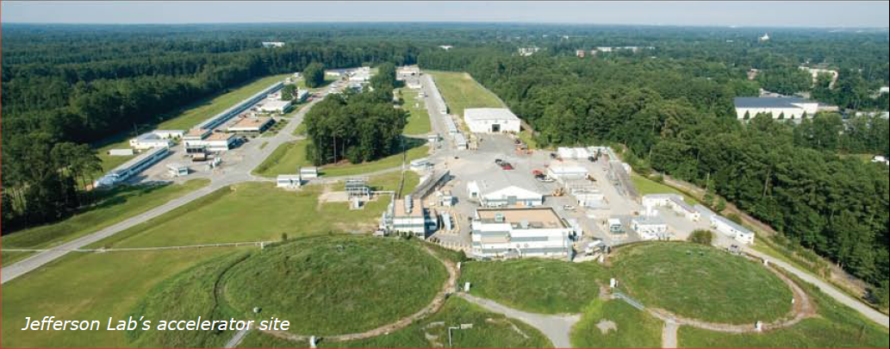
The Science Motivating a New EUV Light Source at JLab
Gwyn Williams
Deputy Director for Photon Science (retired)
Jefferson Lab
With material from DoE-BES, Claudio Masciovecchio, Bob Schoenlein
Accelerator Physics Seminar – May 28, 2020

Slide 2
Start with a grand overview then get into the weeds
Parallel story of advances in accelerators and of discoveries in science

Slide 3
April 2020

Slide 4
Dramatic Increase in Luminosity

Slide 5
Light Sources - Dramatic Increase in Brightness or Brilliance

Slide 6
Science at 30,000 feet
Most everyday physical properties of materials are controlled by the electrons (not density, isotope effect)
So we are talking exclusively about electromagnetic forces and dynamics
Important to note that there is function, which is this talk, and structure, which is related, but is another talk (think LCLS.)

Slide 7
Science at 30,000 feet
Need to measure interaction of matter with fields from DC to X-ray
Frequency-dependent conductivity in and especially out of equilibrium
Meaning energies of 1 – 1,000 eV (1-1000nm)
Photons are great probes, having no charge to perturb the situation
Develop theory so we can be predictive

Slide 8
Science at 30,000 feet
Our technology and understanding is largely based on the “coinage” metals and semiconductors discovered in the 50’s.
We don’t understand high temperature superconductors, nano-materials, or things like topological insulators.
We can’t even follow the dynamics in excitations of simple atoms and molecules, for one thing there are reaction intermediates and new quasiparticles.
Need tools that study the complex interplay between electronic, spin, vibrational/phonon excitations.
Need to study systems in real-time and out of equilibrium and be able to selectively excite the electrons and phonons and watch the relaxation dynamics.
Need new tools – most important is ultrafast EUV laser – since you can’t build it if you can’t measure it. Talking 1 – 1000 nm, 1 – 1000 eV.
Need to be able to apply a strong electromagnetic field of tailored wave-form to couple to the electrons and follow the dynamics.

Slide 9
Simplicity – materials physics 1940 - 1985

Slide 10
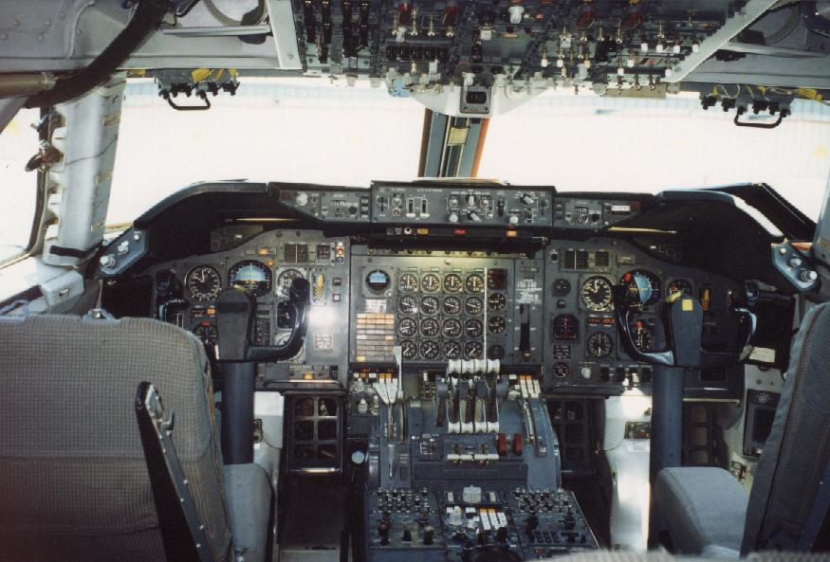
Complexity – materials physics 1985 - present

Slide 11
Emergent behavior…………….

Slide 12
And another…….

Slide 13
Another way of looking at it…….
reductionist approach
- electrons
- nuclei
emergence approach, collective excitations
- phonons,, magnons
- polarons, plasmons
(called quasiparticles)
from Marvin Cohen, Physics Today, June 2006, page 48.

Slide 14
Pump and Probe
Out of equilibrium dynamics using multi photons
Scope and scale quite overwhelming…….

Slide 15
Message
Dire need for EUV ultrabright, ultrafast light to access bonding and shallow core electrons
(10 eV to 900 eV; 100 nm to 1+ nm)
Need an FEL with 1 GeV or few 100 MeV Energy
BUT most XFEL facilities aim for 0.1 nm with multi-GeV beams

Slide 16
Courtesy of Bob Schoenlein, SLAC

Slide 17
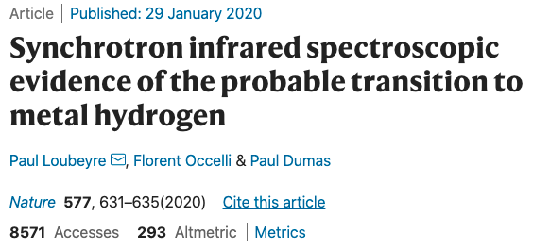
Science Drivers Continued
Matter Under Extreme Conditions
Pressure
Temperature
Nano Materials
Surfaces of Materials

Slide 18
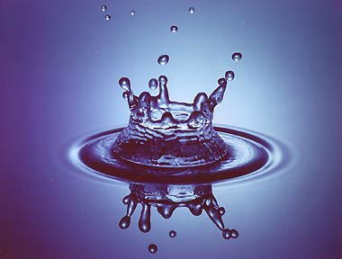
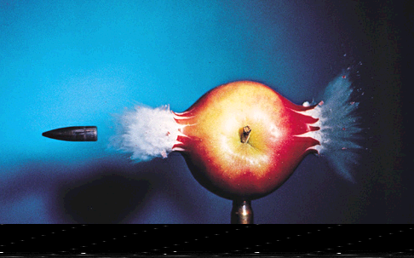
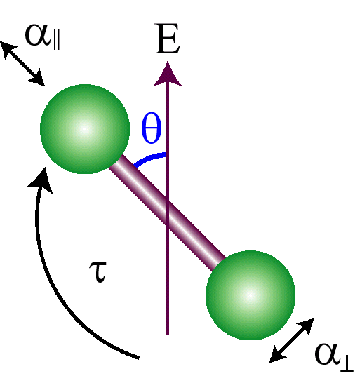
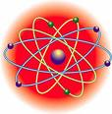
Characteristic time scales of nature
1 sec (1 s)
1 millisecond (10⁻³ s)
1 microsecond (10⁻⁶ s)
1 nanosecond (10⁻⁹ s)
1 picosecond (10⁻¹² s)
1 femtosecond (10⁻¹⁵ s)
1 attosecond (10⁻¹⁸ s)
1 zeptosecond (10⁻²¹ s)
clock tick
camera shutter
camera
flash
processor speed
data storage
rotations
bond breaking
vibrations
charge transfer
Sub picosecond to attosecond pulses can capture all motion in the natural world, even at the level of electrons
electron motions in atoms, molecules and materials
Notes:
The idea of using light or el to capture fast events has been around since the 19th century. But it was the advent of the laser that really made controlled probing and manipulation of very fast motion became possible
Interestingly, if one fires a very energetic electron at an atom or molecule, the interaction time can be incredibly fast, but the interaction is not controlled

Slide 20
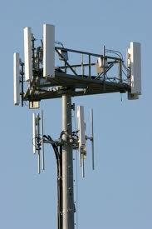
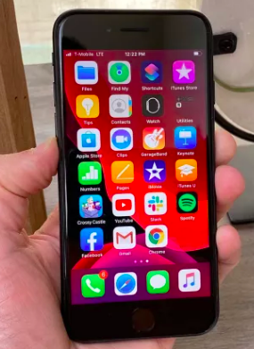
Same physics as a cell phone……
The Physics made Simple

Slide 21
Wiggle an electron and it radiates…..
accelerated charges = propagating field
e⁻
light
1 electron
(acceleration is a)
Asssume that the propagating electric field goes
linearly in the electric charge and the acceleration
- so intensity (power) goes like e²a²
Courtesy of Jack Kossler W&M

Slide 22
Wiggle an electron and – it radiates…..
e⁻
light
1 electron
(acceleration is a)
Now for an electric charge, force is
e²/L², so we can derive dimensions for e thus:
So e²a² has dimensions of ::ML³ T⁻²×L²T⁻⁴ = ML⁵T⁻⁶
And if we divide by c³, or L³T⁻³, we get ML²T⁻³.

Slide 23
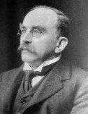
Radiation from accelerated charges
e⁻
light
1 electron

Slide 24
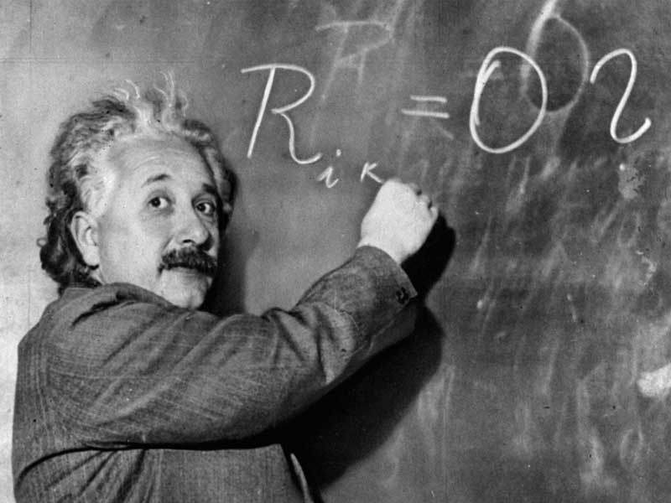
But – what if the electron is moving fast???
Really, really fast – close to the speed of light..
e⁻
light
1 electron
Power is ML²T⁻³
M goes like gamma
T goes like gamma
L goes like 1/gamma
So the relativistic version is :
where gamma = 1957 x E (GeV)
in the lab frame - Wikipedia

Slide 25
Radiation from accelerated electron
e⁻
light
1 electron

Slide 26
Radiation from accelerated electrons
2e⁻
light
2 electrons

Slide 27
Radiation from accelerated electrons
………aka longitudinal coherence
2e⁻
light
2 electrons
So 2 electrons give 4 times the power of 1 electron

Slide 28
Radiation from accelerated electrons
Ne⁻
light
2 electrons
So N electrons give N² times the power of 1 electron

Slide 29
Thus…..
Gain = 10¹² for relativity
Gain = 10⁸ for coherence

Slide 30
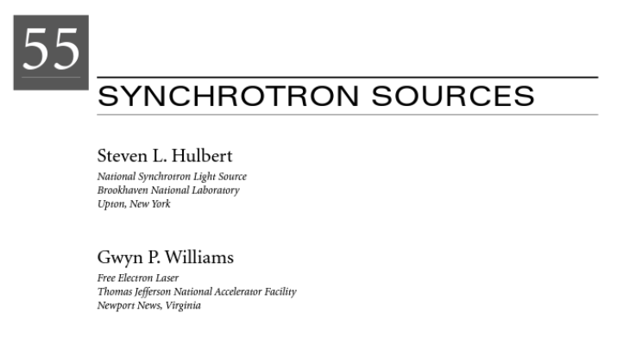
from Jackson “Classical Electrodynamics

Slide 31
Photons from Electrons – Universal Law for Coherent Light
“We derive the remarkable result that the emitted flux is independent of the photon energy, electron beam energy or bending radius….” and “the brightness is identical for all machines, provided the electron beam energy is high enough”
Photons/sec = 7.8 × 10¹⁴ × BW(%) × I(A)

Slide 32
Recap on Brightness Increase for Photon Sources

Slide 33
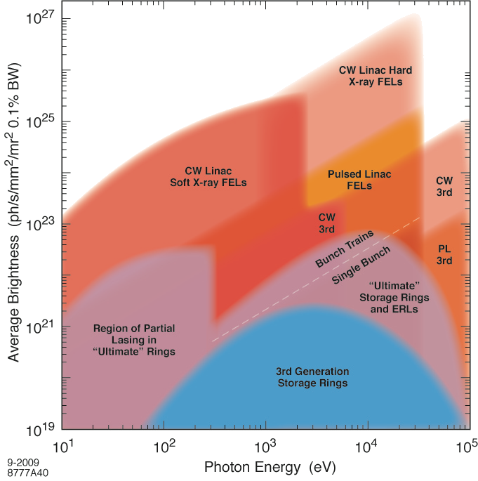
Average Brightness Landscape for Light Sources
ANL-08/39
BNL-81895-2008
LBNL-1090E-2009
SLAC-R-917
JLAB
opportunity
LCLS II
LCLS
FLASH/FERMI

Slide 34
Overview
So WHY build these?
- what are some specific examples of the science?

Slide 35
Courtesy of Bob Schoenlein, SLAC

Slide 36
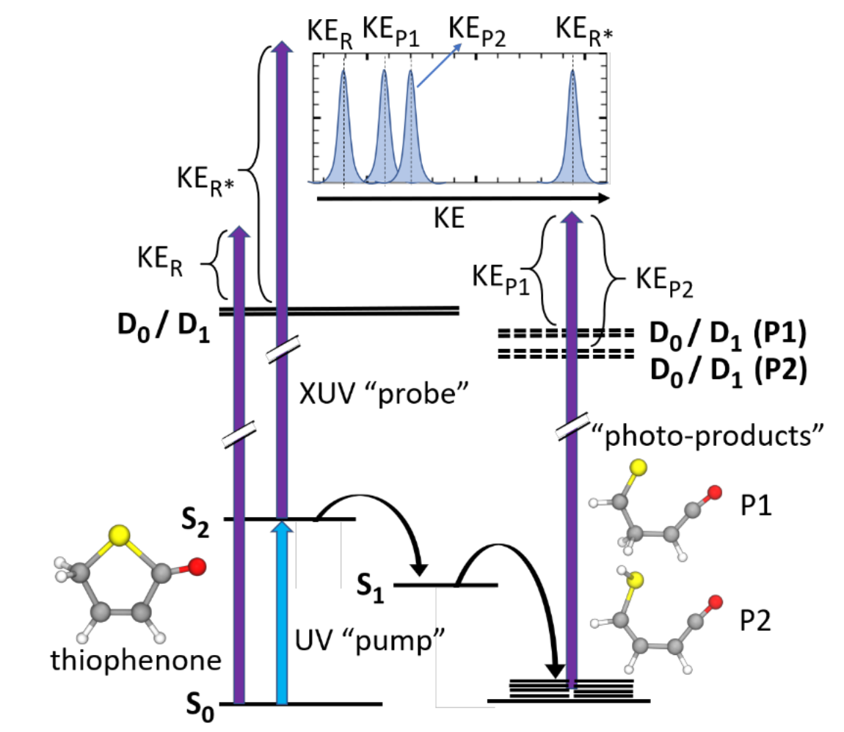
LDM beamline @ FERMI - Molecular and cluster dynamics from Claudio Masciovecchio
-0.5 0 0.5 1
delay [ps]
S. Pathak et al., Tracking the Ultraviolet Photochemistry of Thiophenone During and Beyond the Initial Ultrafast Ring Opening arXiv:1912.00531

Slide 37
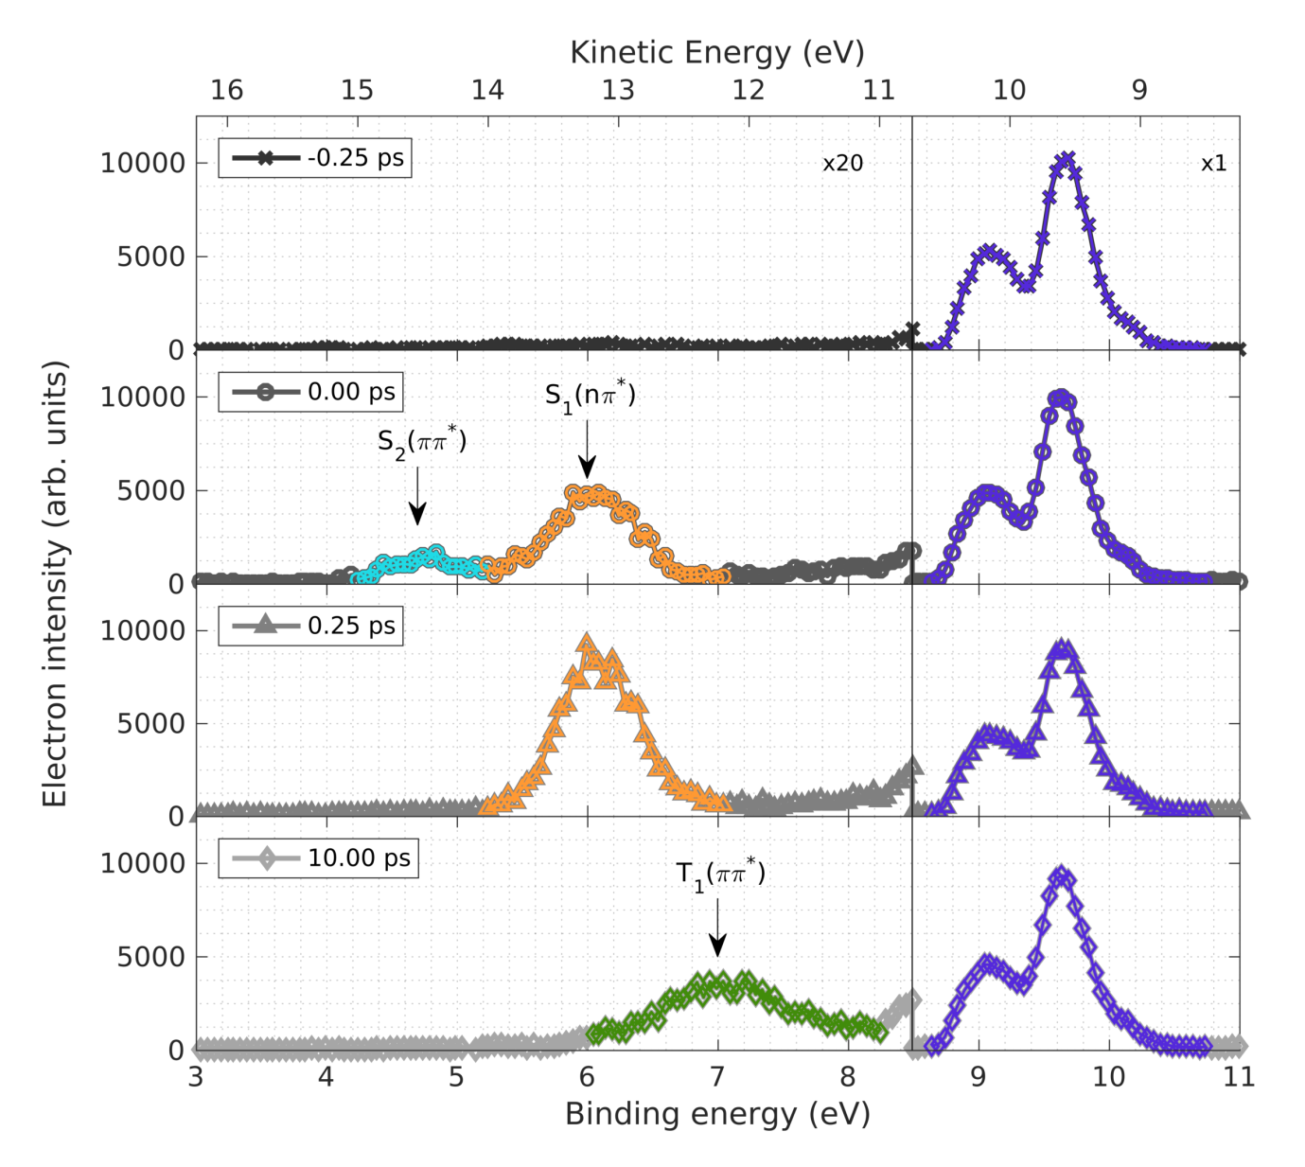
LDM beamline @ FERMI - Molecular and cluster dynamics from Claudio Masciovecchio
R. Squibb et al., Acetylacetone photo-dynamics at a seeded free-electron laser Nature Commun. 9, 63 (2018)

Slide 38
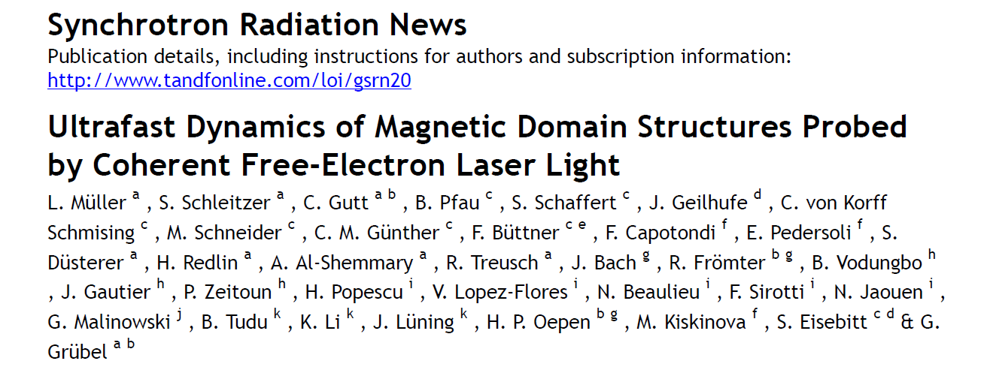
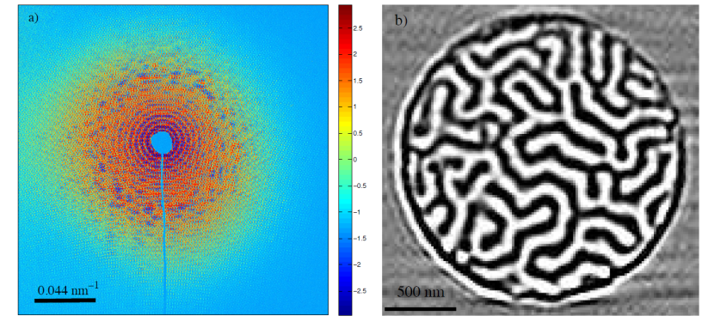
DIPROI beamline @ FERMI – Ultrafast Magnetic Dynamics from Claudio Masciovecchio
Co/Pt ML
Controlling ultrafast demagnetization using localized optical excitation
C. von Korff Schmising et al, PRL (2014)

Slide 39
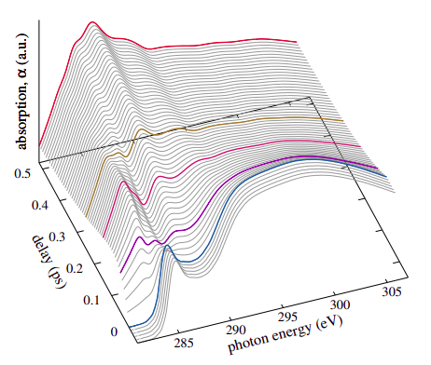
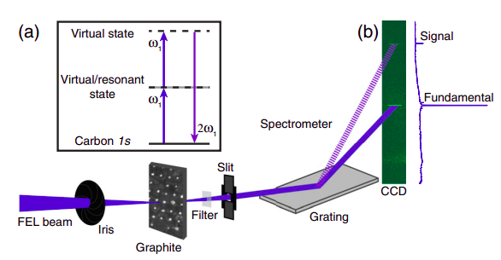
TIMEX beamline beamline @ FERMI – Ultrafast Dynamics & Non-linear from Claudio Masciovecchio
2nd harmonic generation from a carbon foil
600 eV
300 eV
Ultrafast melting of C
300 eV
High energy density matter dynamics
Time-resolved techniques: XAS, supercontinuum spectroscopy, Thomson scattering, VIS and IR reflectivity (pump-probe mode).
E. Principi et al., submitted to PRL (2020)
C. Fasolato et al. Accepted PRL (April 2020)
E. Principi et al. PRB 97, 174107 (2018)
F. Bisio et al. PRB 96, 081119 (2017)
Nonlinear interaction EUV-radiation/matter
Technique: XAS
R. Lam et al. PRL 120, 023901 (2018)
S. L. Raj et al., in preparation (2020)
C. Ferrante et al., in preparation (2020)

Slide 40
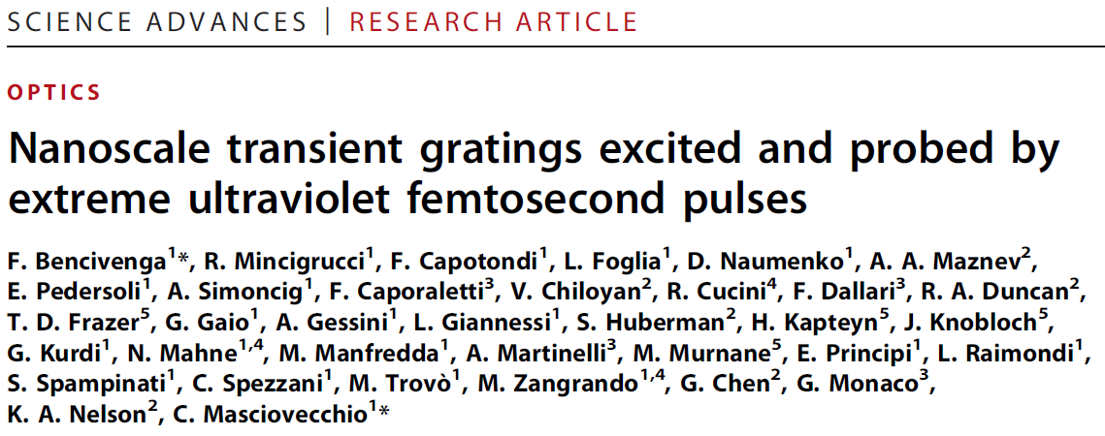
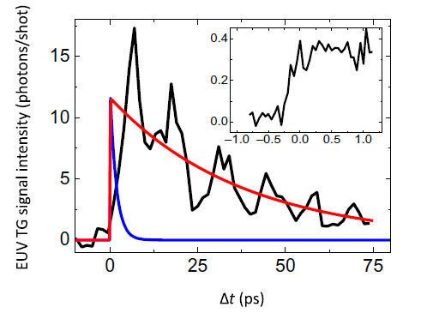
TIMER beamline beamline @ FERMI – Ultrafast Dynamics from Claudio Masciovecchio
Phonon modes in Disordered Systems
Charge Density Waves in High Tc Superconductors
Spin Ultrafast Dynamics and Diffusion
Heat Transfer at the Nanoscale
Nanoscale Dynamics in Condensed Matter
L. Foglia et al., PRL (2018)
A. Maznev et al., APL (2018)
F. Bencivenga et al., Science Adv. (2019)
G. Knopp et al., APL (2019)
R. Mincigrucci et al., NANO ACS (2019)
…..
…..
G. Monaco et al., in preparation

Slide 41
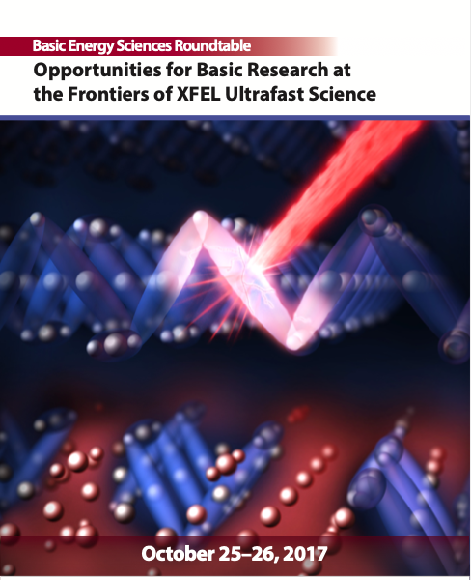
Opportunity for Jlab defined by recent DoE Basic Energy Sciences report

Slide 42
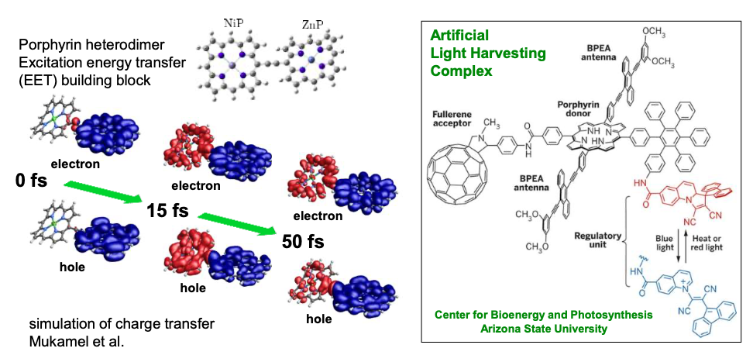
Priority Research Opportunity 1
Probing and controlling electron motion within a molecule
The heart of chemistry lies in understanding how molecules are formed and transformed through interactions among their constituent atoms and electrons. The complex rearrangement of the positions of atomic nuclei and electrons defines the process of chemical transformation.
Summary: Tracking the movement of electrons and the excitations associated with this motion through a molecule can provide a window into some of the most challenging and important issues in fundamental chemistry

Slide 43
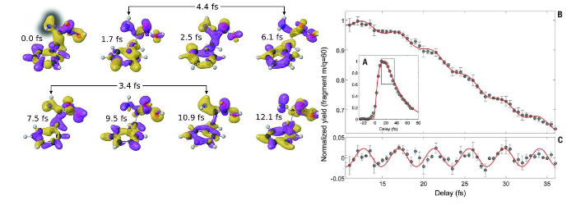
F. Calegari, et al "Ultrafast electron dynamics in phenylalanine initiated by attosecond pulses," Science 346, 336 (2014).
Key questions this PRO will answer:
How does electronic charge move from atom to atom in a molecular system?
How do electron-electron interactions and correlations alter this motion?
How do the atoms rearrange following this electronic motion and, conversely, how does this atomic motion affect the coherent electronic motion?
Can this coupled and correlated electronic motion be exploited to affect longer-timescale dynamics?

Slide 44
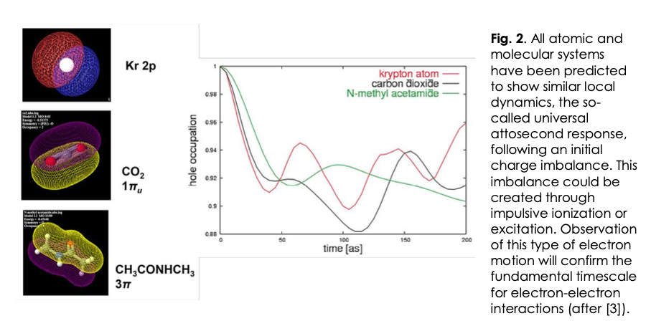
J. Breidbach and L. S. Cederbaum, Physical Review Letters 94, 033901 (2005).
Universal Attosecond Response to the Removal of an Electron

Slide 45
Priority Research Opportunity 2
Discovering novel quantum phases through coherent
light-matter coupling
A central issue in materials physics is understanding and controlling the diverse phases of matter – from topological insulators with conducting edge states to novel ultrathin semiconductors to superconductors. Although these varied phases of matter are the basis for current and future information and energy technologies, we currently cannot fully explain how and why they form.

Slide 46
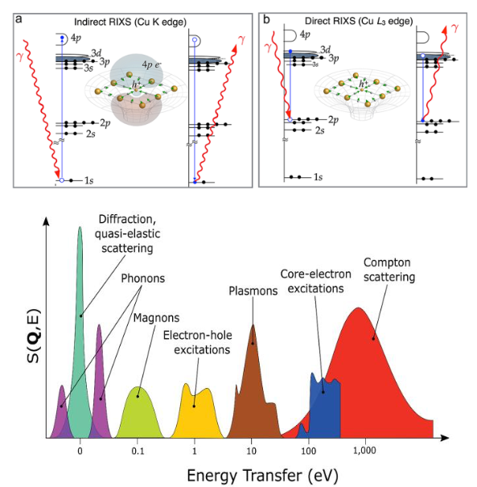
Resonant Inelastic Scattering

Slide 47
PRO 2: Discovering novel quantum phases through coherent light- matter coupling
Summary:
Ultrashort light pulses can generate novel transient states in solids, initiate phase transitions to states that are unattainable in equilibrium, and create and manipulate quantum topological states.
The use of ultrashort light pulses is a powerful approach for enabling the control of quantum states required
for implementing advances at the forefront of technologies in electronics, photonics, energy, and quantum information.

Slide 48
Scientific Impact
The discovery and manipulation of new quantum states of matter are the key grand challenges in condensed matter physics.
Ultrafast science presents a promising new frontier for such discoveries, but until recently has lacked adequate ultrafast structural and electronic characterization tools. This shortcoming can be addressed by the next generation of FELs and associated instrumentation.

Slide 49
Only two EUV/Soft X-Ray FEL User Facilities

Slide 50
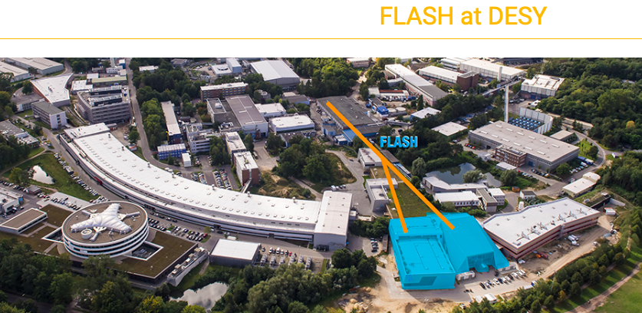
First Soft X-ray FEL as user facility started in 2005

Slide 51
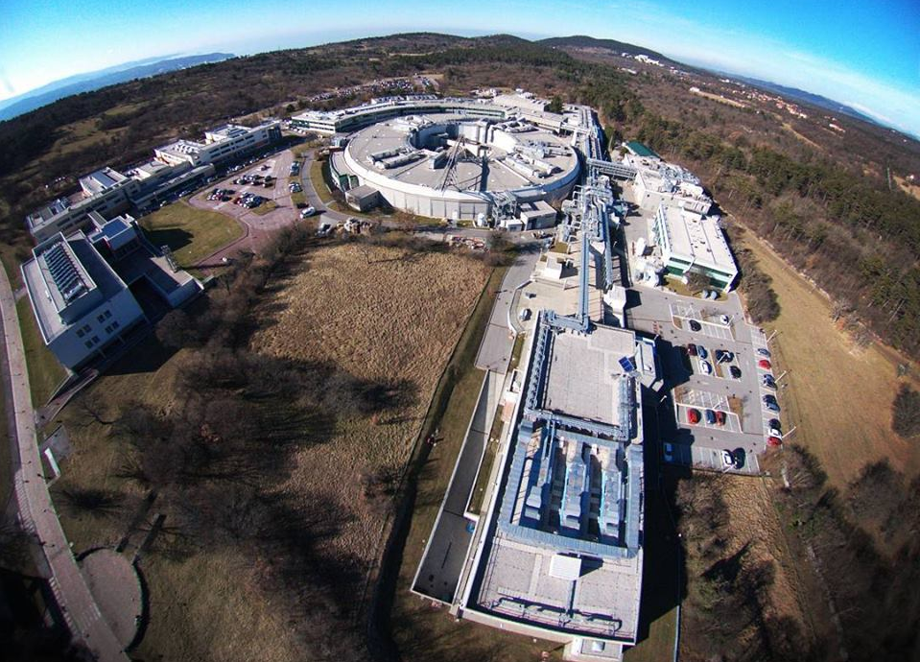
FERMI Free Electron Laser

Slide 52
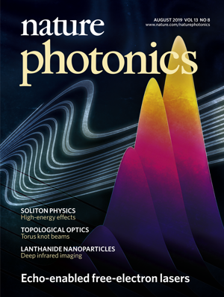
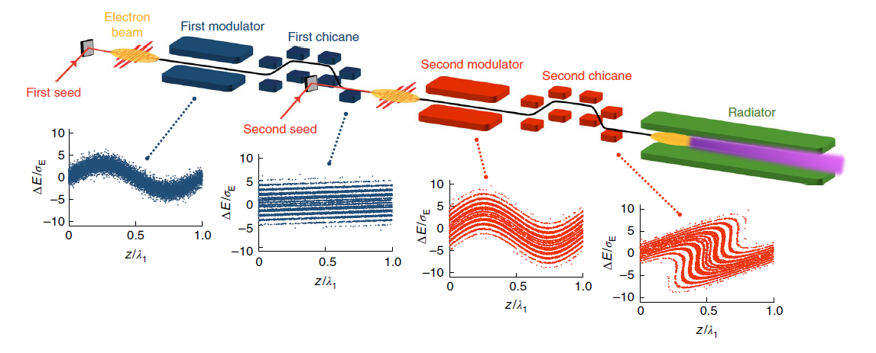
Echo Enabled Harmonic Generation @ FERMI
E. Allaria et al., Nat. Phot. (2019)
2019 FEL Prize to E. Allaria

Slide 53
Both FERMI and FLASH are oversubscribed by a factor of FIVE

Slide 54
Summary
Dire need for EUV ultrabright, ultrafast light
(10 eV to 200 eV; 100 nm to 4 nm)
Need an FEL with 1 GeV or few 100 MeV Energy
Perfect fit to JLab Site, both in size and technology
Scientific case already outlined need to find “champions” to make it happen.
Need a workshop! Leverage SURA!!

