Slide 1
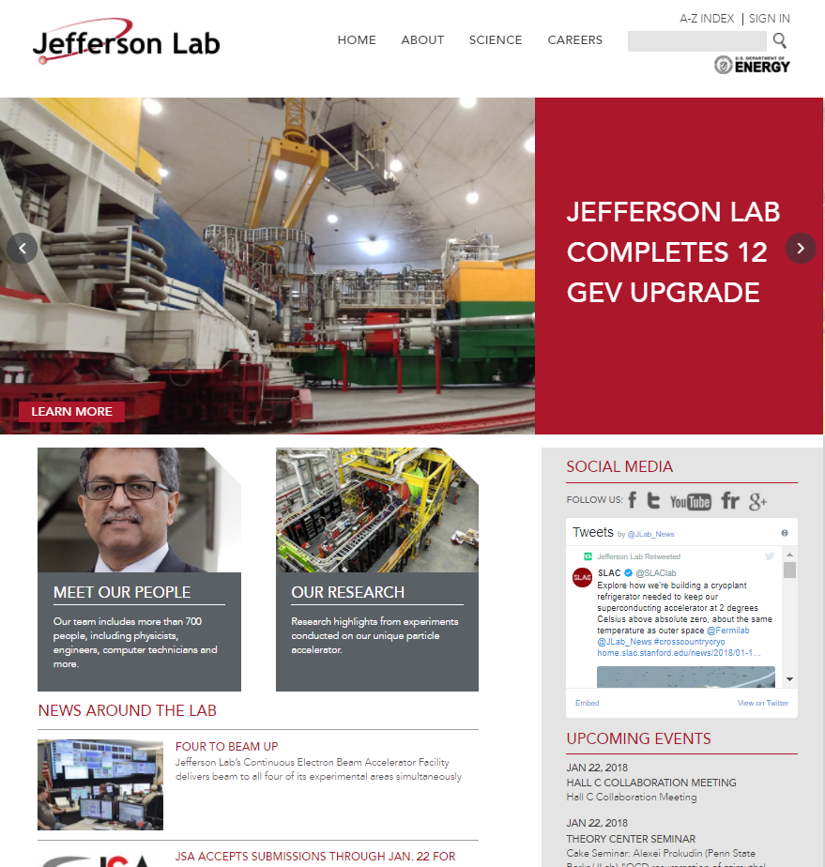
Welcome!
JLab.org Content Editor and Publisher Training
David Chopard

Slide 2

Agenda
The training course will be done in two sections:
  Section 1: Review the basic functionality of Drupal Editing and Publishing
  Section 2: You will complete, on your own, a project encompassing all of the techniques learned in Section 1.

Slide 3
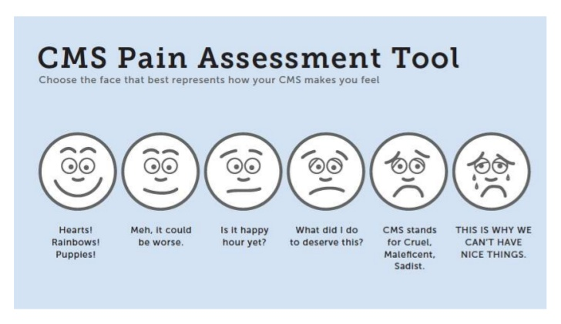
Things to Remember
There will be a lot to take in!

Slide 4

Things to Remember
All students progress at a different pace.
Those who finish quickly can help others.

Slide 5

Things to Remember
Expectations –
There is a lot to know!
Today, we are going to cover only the basics of Drupal.
Using today’s information, you should be able to start maintaining your area’s webpages.

Slide 6
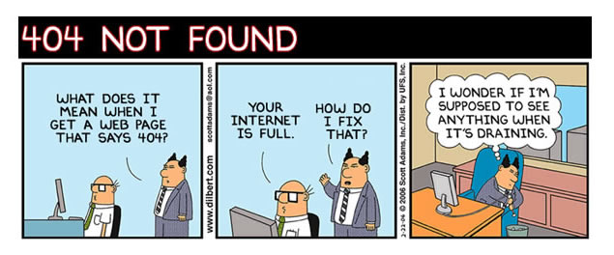
Things to Remember
Ask questions!
Don’t be afraid to say,
I don’t know...Help!

Slide 7

Section 1: Review Basic Functionality
    What is Drupal? A quick introduction to the software
    About Content, Content Types, and Nodes
    Creating Content: Front- and Backend
    Creating and Editing Content
    Users: Roles Permissions
        Editor vs. Publisher
    Open Discussion/Questions

Slide 8
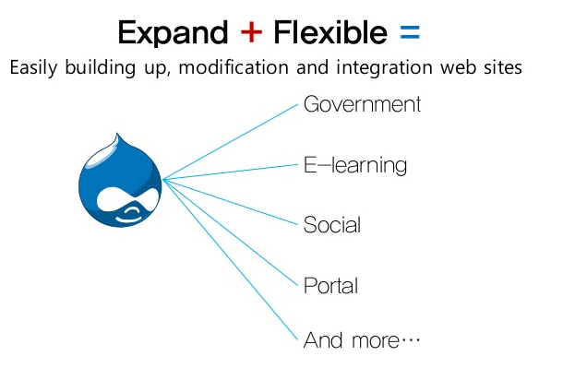
Drupal = Content Management System (CMS)
    Help’s you manage your website's content
    Open source = low maintenance costs
    Highly customizable

Slide 9
Content and Content Types
Content: The text, images, and other information on a web site.
Content Types: Enable you to organize, manage, and handle content in a consistent way across your website.
An action in the real world
ex: Hall D publishes a result!
Define a Content Type
ex: News Release
Add Content (Node)
ex:
Hall D’s QWeak Project strikes gold…

Slide 10
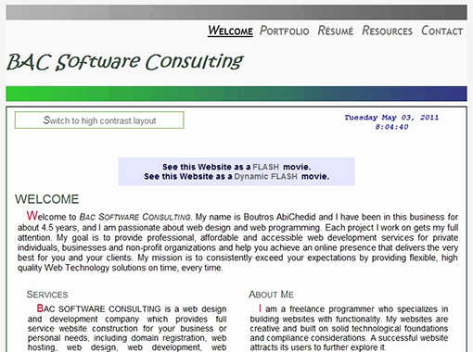

Content Types- General
Most CMS systems have only one content type- not Drupal!

Slide 11



Content Types- Drupal
In Drupal, there are many different kinds of content types to help you organize your different kinds of content more efficiently.
Event Planning Pages
(use calenders and registration forms)
Human Resources Pages
(uses personel forms and reference information)
Data Collection Pages
(uses charts, plots and fields for technical data)
Social Media Pages
(use facebook and twitter feeds)

Slide 12
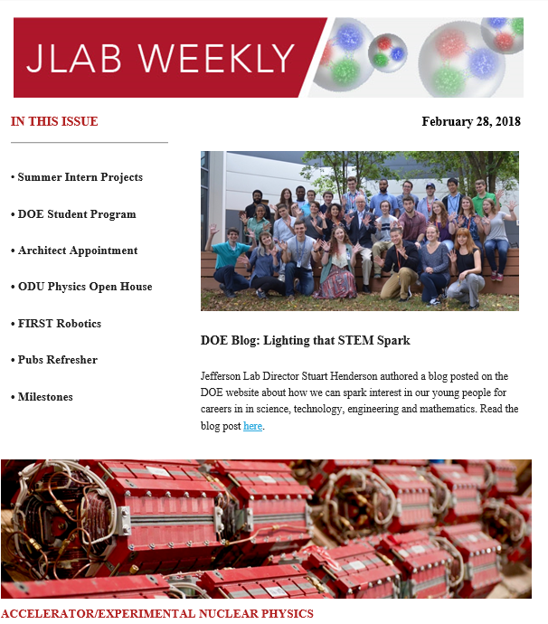
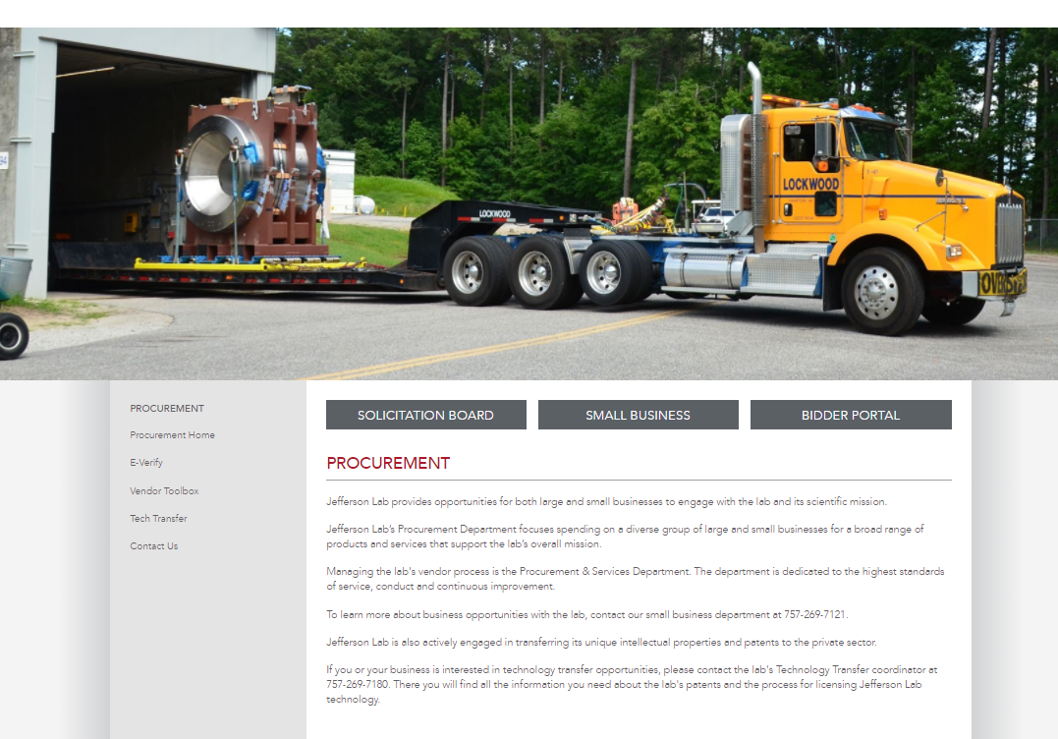

Drupal Nodes
Node = Content
A piece of content in Drupal, typically corresponding to a single page on the site, that has a title, an optional body, and perhaps additional fields. Every node also belongs to a particular content type.
Examples:
Weekly Briefs
Department Page
News Release

Slide 13
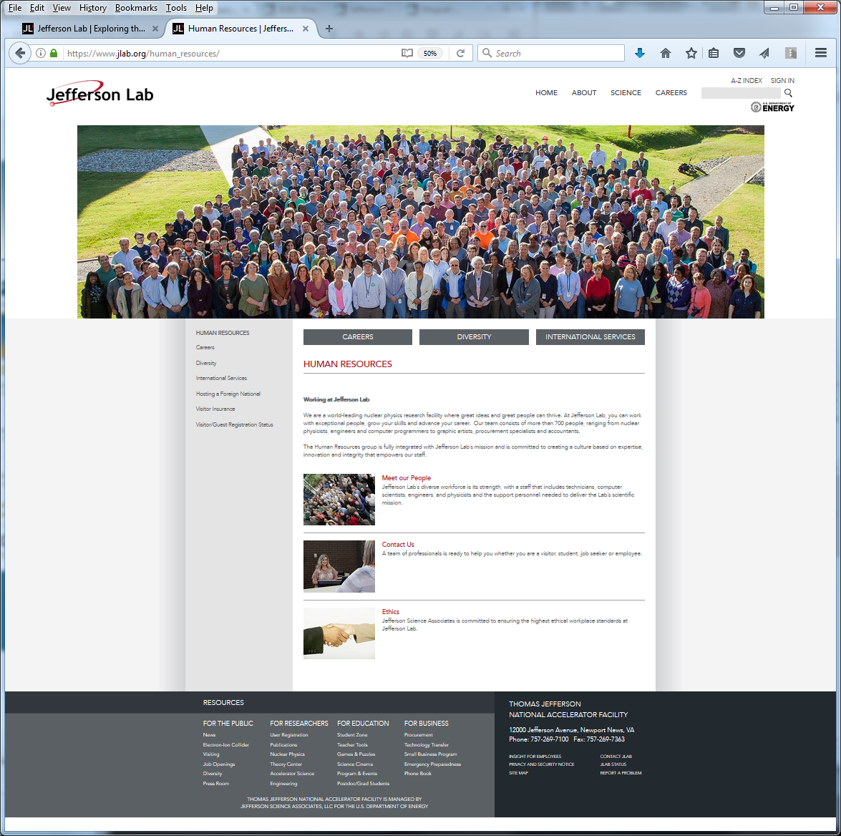
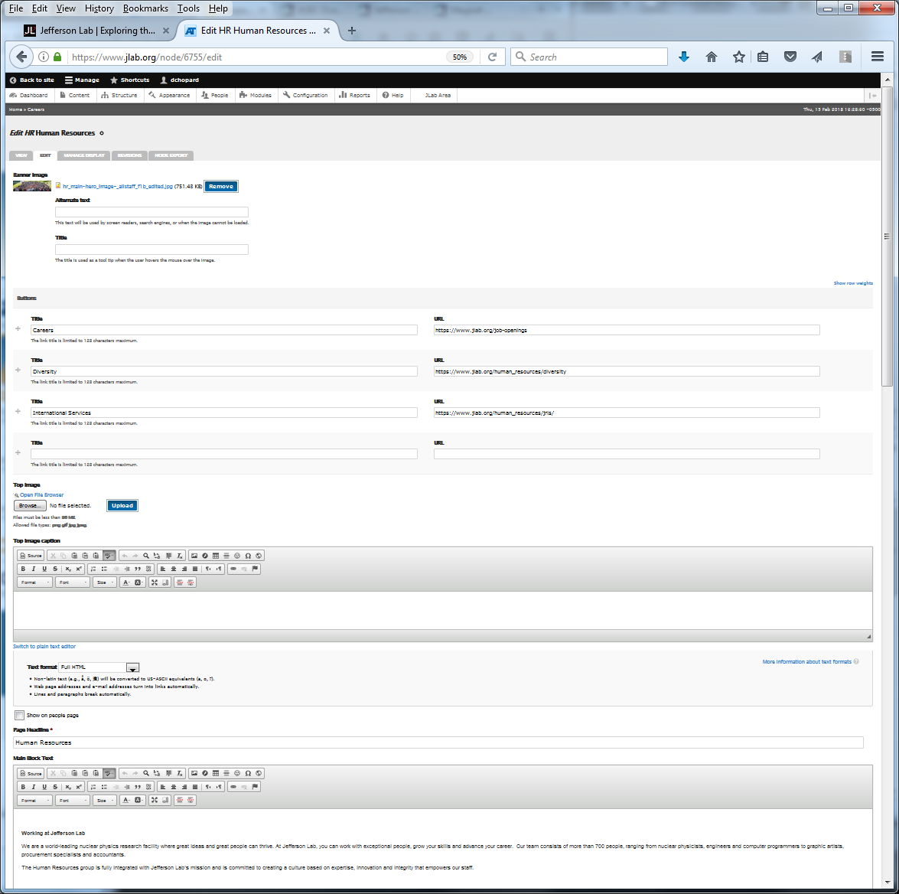
Creating Content: Front- and Backend Connections

Slide 14
Creating and Editing Content
How To Guide
Practice User Accounts:
    Admin Role:
      Username = Lsmith
      Password = lsmith34
    Editor Role:
      Username = HRosen
      Password = hrosen23
    Publisher Role:
      Username = MTakeda
      Password = mtakeda12

Slide 15

Users and Access
Roles
Permissions
User

Slide 16
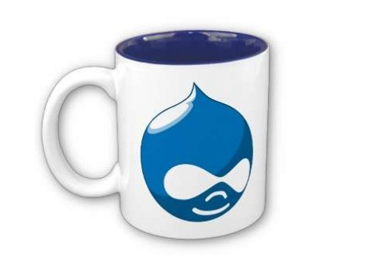
Drupal Break
Questions?

Slide 17
Section 2: Student Exercises
  During this time, you will do a comprehensive exercise using all of the skills from Section 1.

Slide 18
Practice Accounts
During this training you will use the following users:
    Admin Role:
      Username = Lsmith
      Password = lsmith34
    Editor Role:
      Username = HRosen
      Password = hrosen23
    Publisher Role:
      Username = MTakeda
      Password = mtakeda12

Slide 19
Welcome!
JLab.org Content Editor and Publisher Training
David Chopard

