Slide 1
Electronic Access Registration (EARS) Process
System overview and Screenshots
For US Citizens and Foreign Nationals

Slide 2
United States Citizen

Slide 3
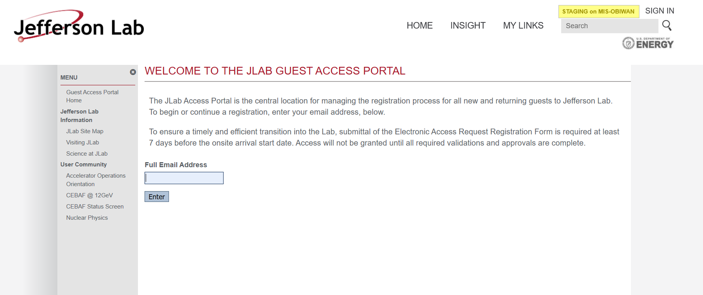

Slide 4
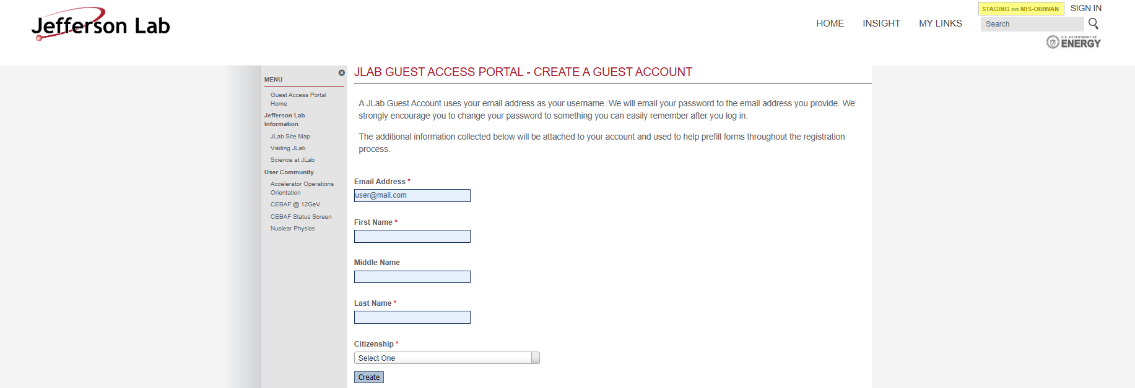

Slide 5
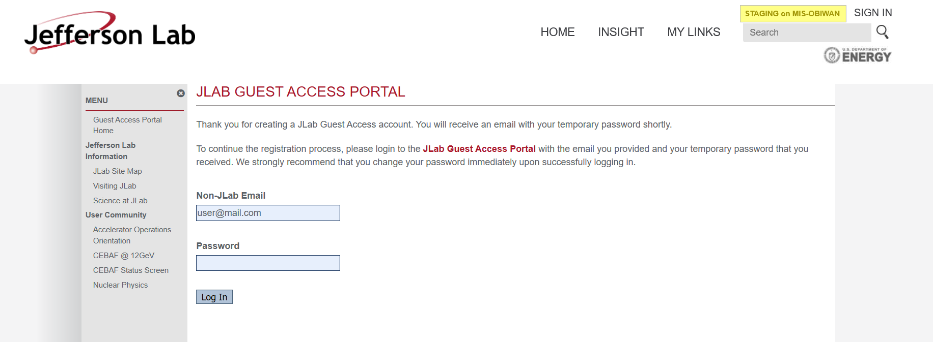

Slide 6
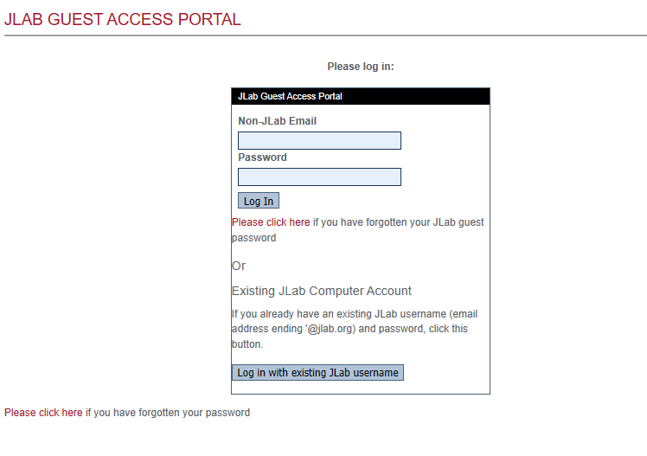

Slide 7
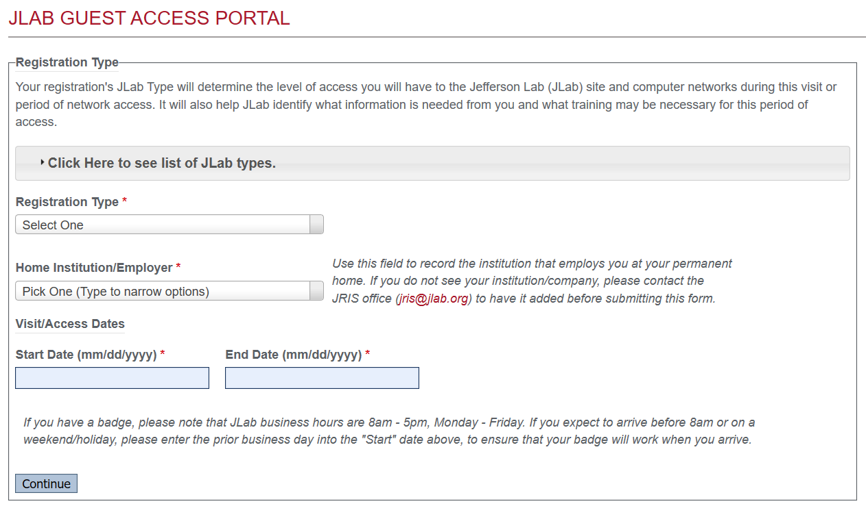

Slide 8
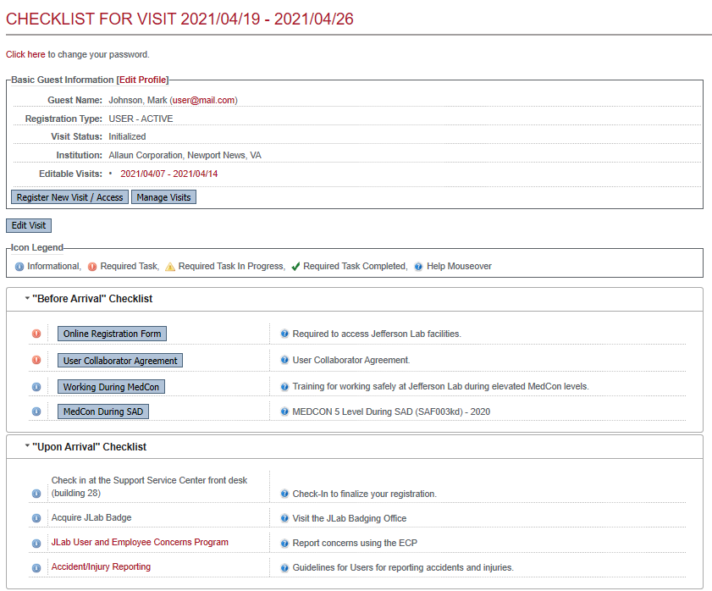

Slide 9
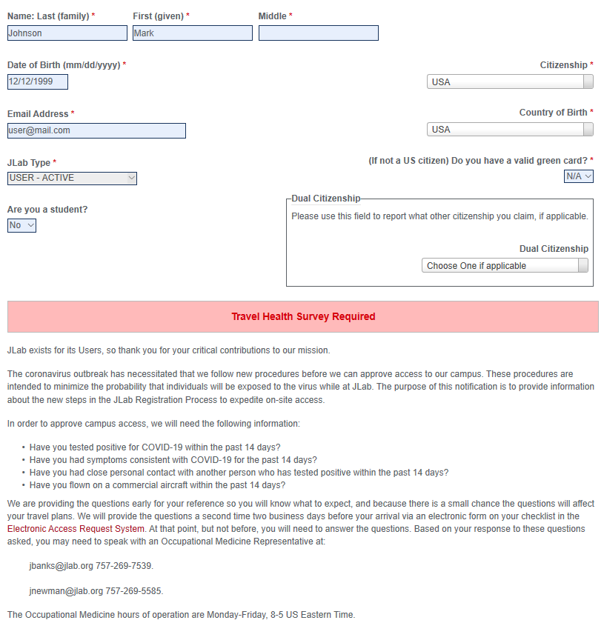

Slide 10
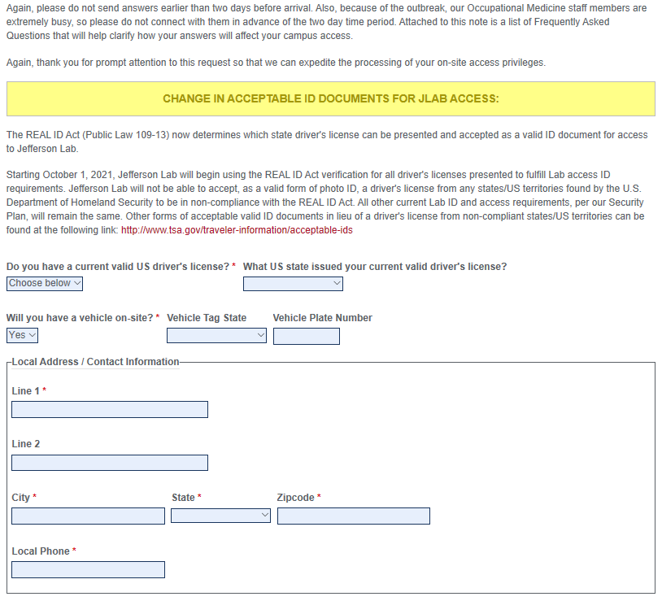

Slide 11
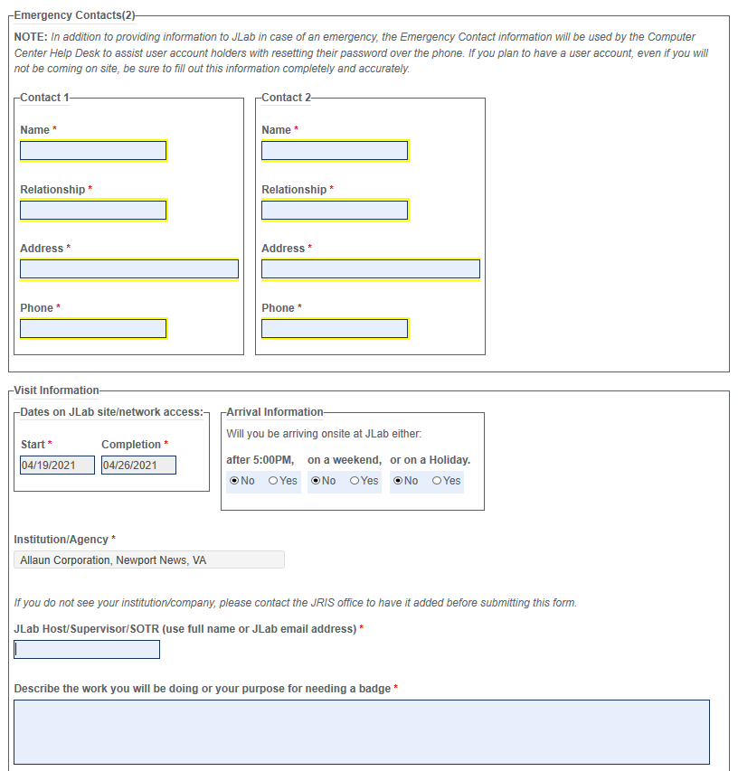

Slide 12
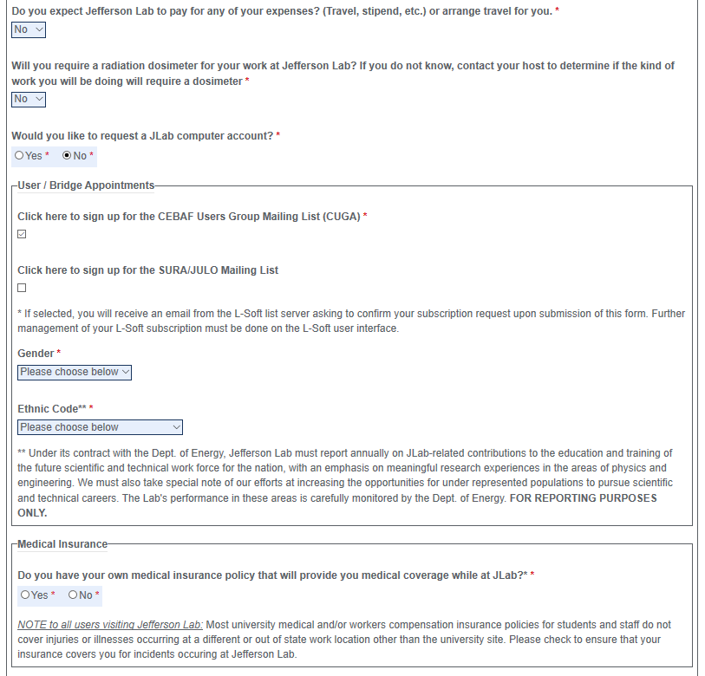

Slide 13
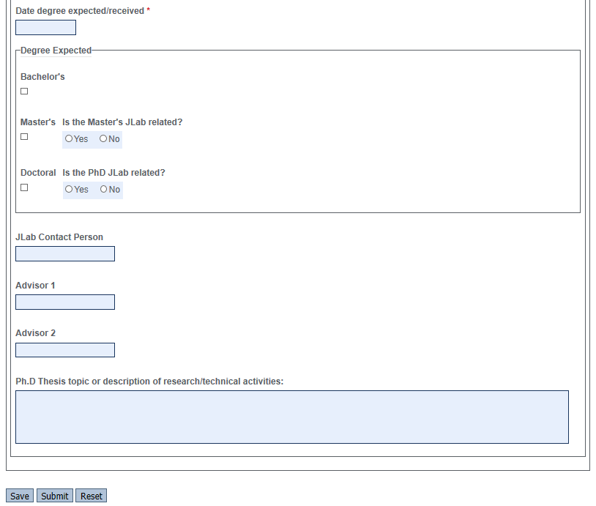

Slide 14
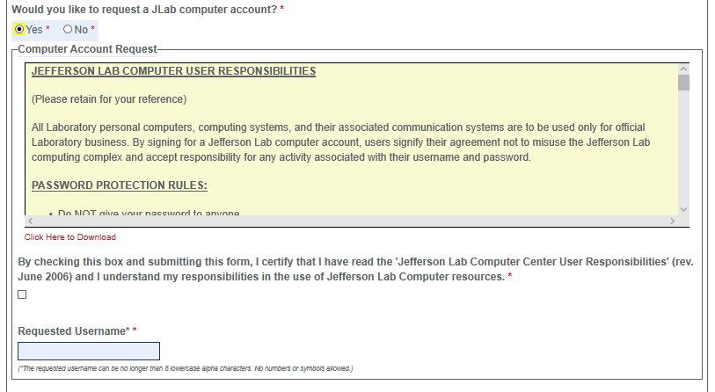
Requesting a JLab Computer Account

Slide 15
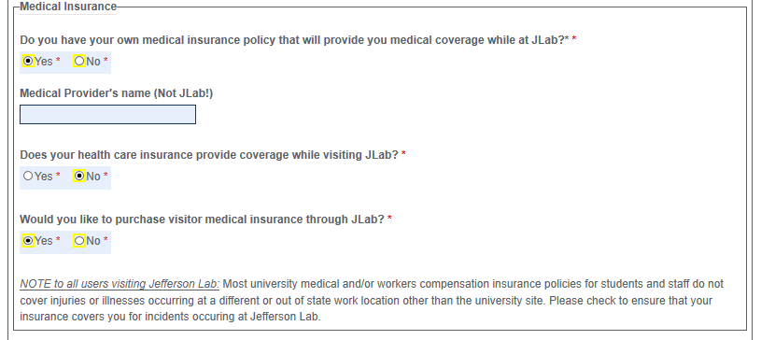
Medical Insurance Coverage

Slide 17
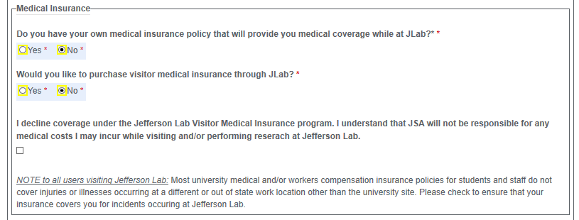

Slide 18
Completed

Slide 19
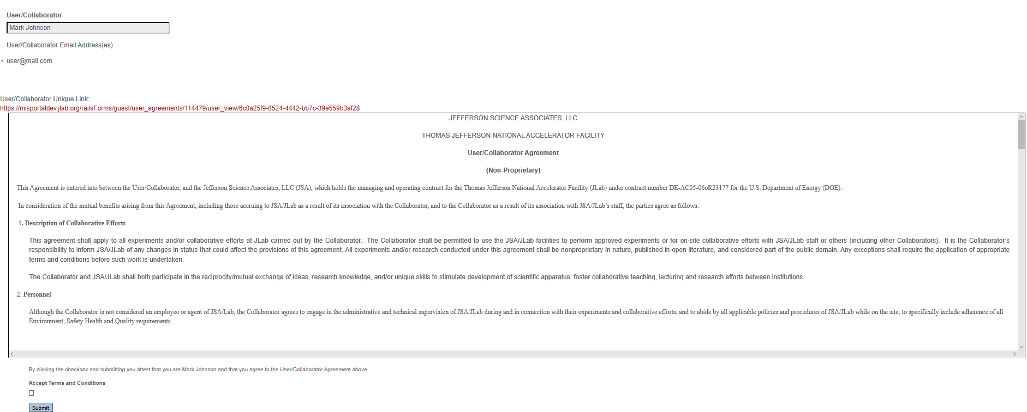
User/Collaborate Agreement

Slide 20
Working during MedCon

Slide 21
MedCon During SAD

Slide 22
Completed
Mandatory Trainings to be completed

Slide 23
Foreign National

Slide 29
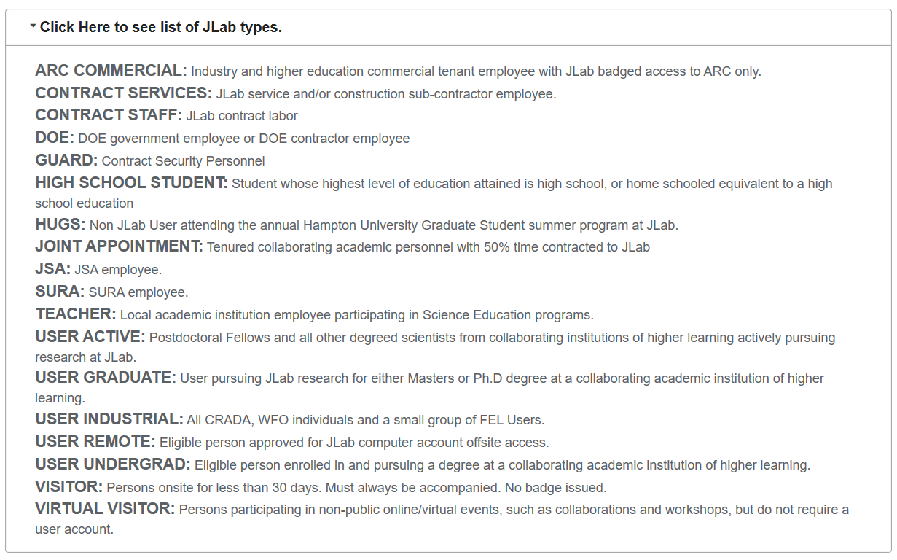

Slide 30
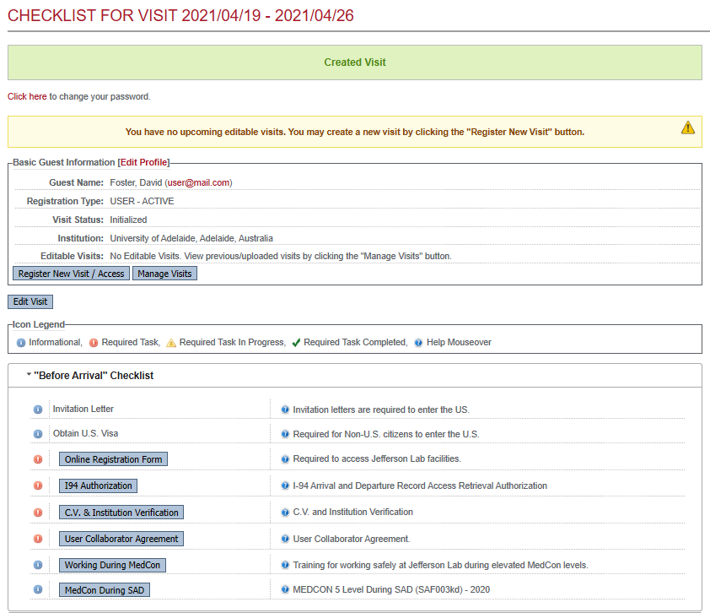

Slide 32
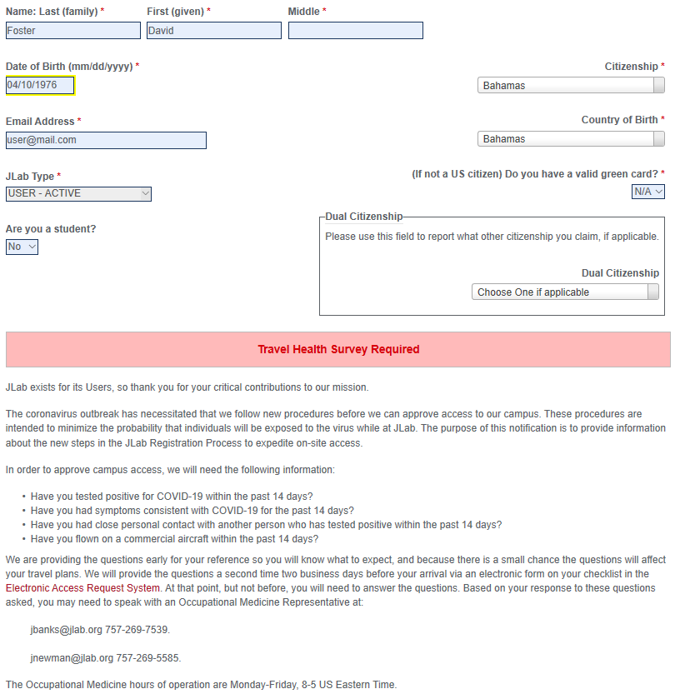

Slide 34
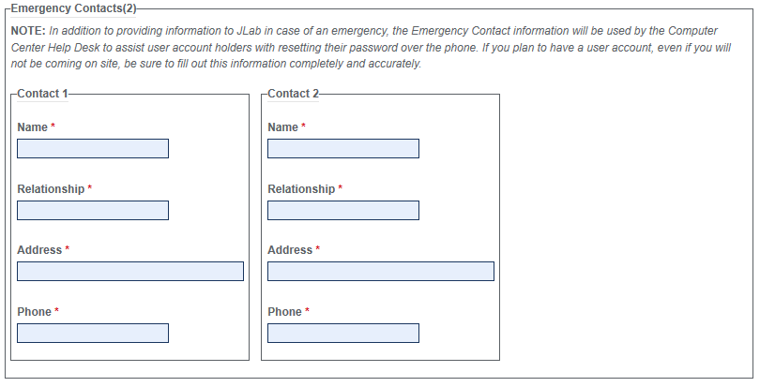

Slide 35
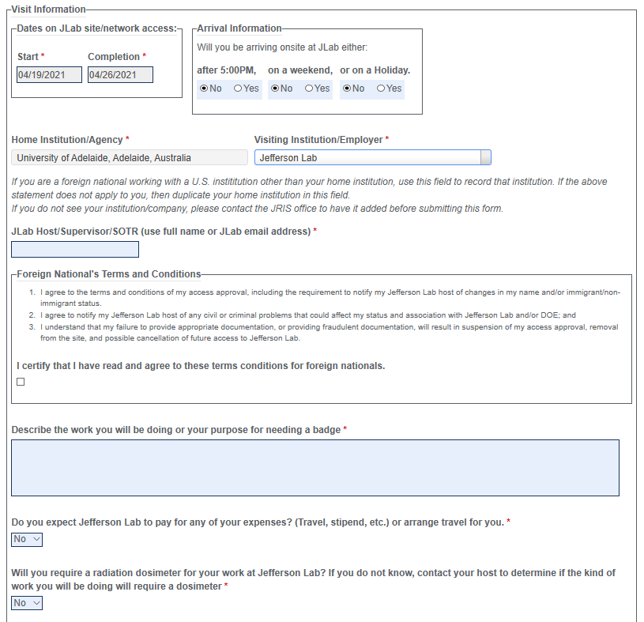

Slide 36
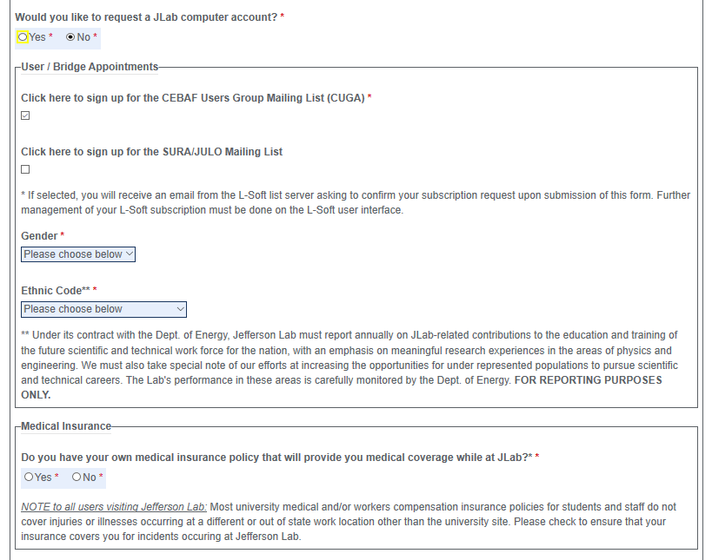

Slide 37
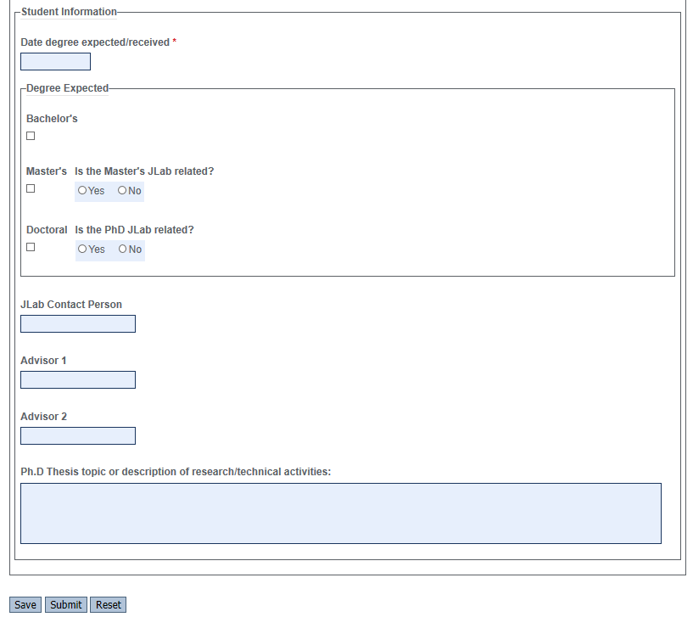

Slide 38
Requesting a JLab Computer Account

Slide 39
Medical Insurance Coverage

Slide 42
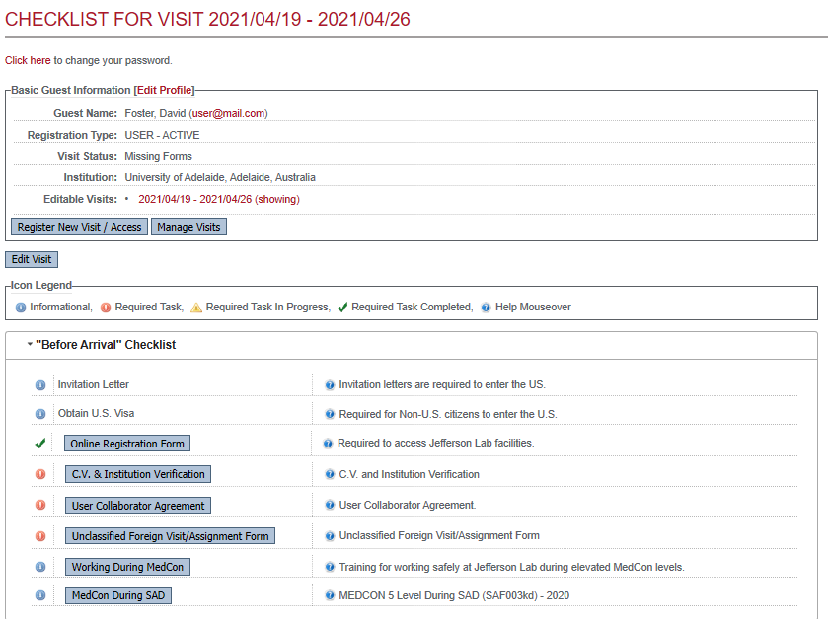

Slide 43
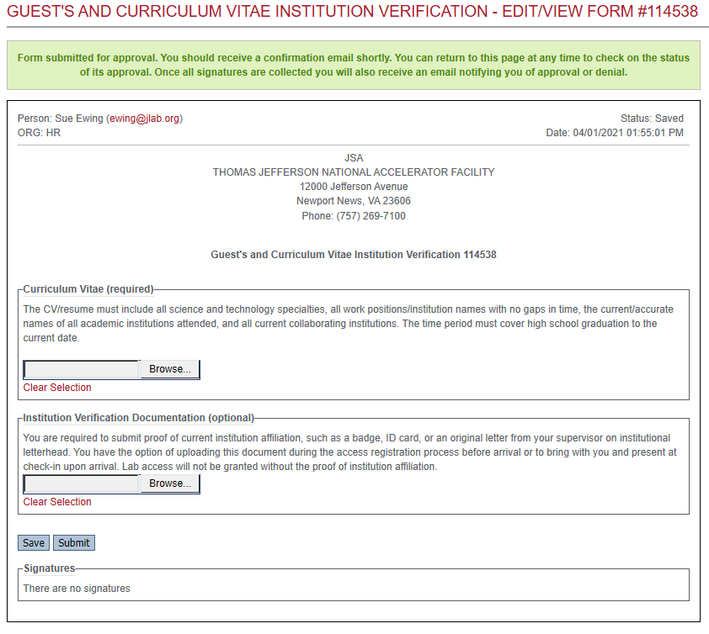
C.V. & Institution Verification

Slide 44
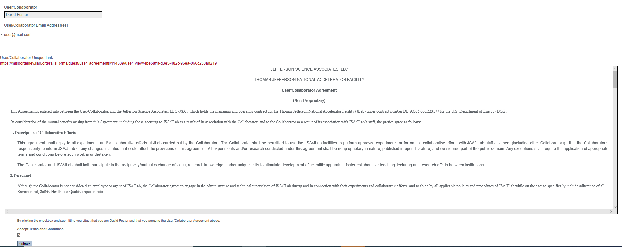
User/Collaborate Agreement

Slide 45
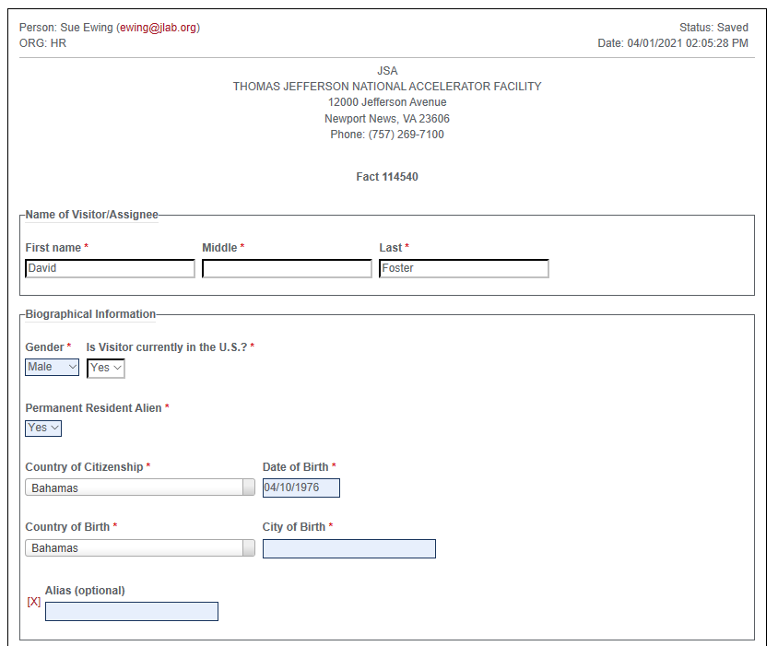
Unclassified Foreign Visit/Assignment Form

Slide 46
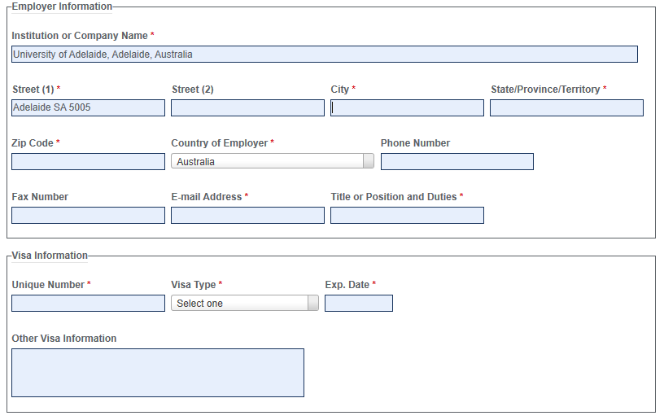

Slide 47
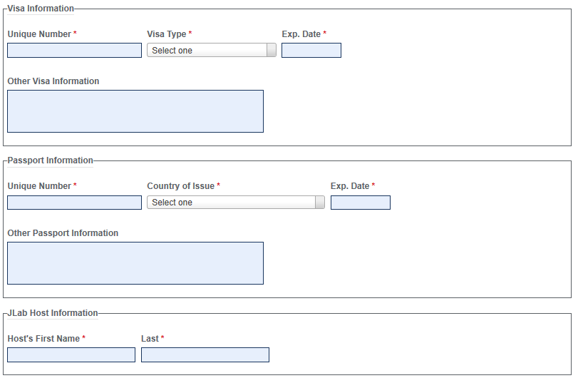

Slide 48
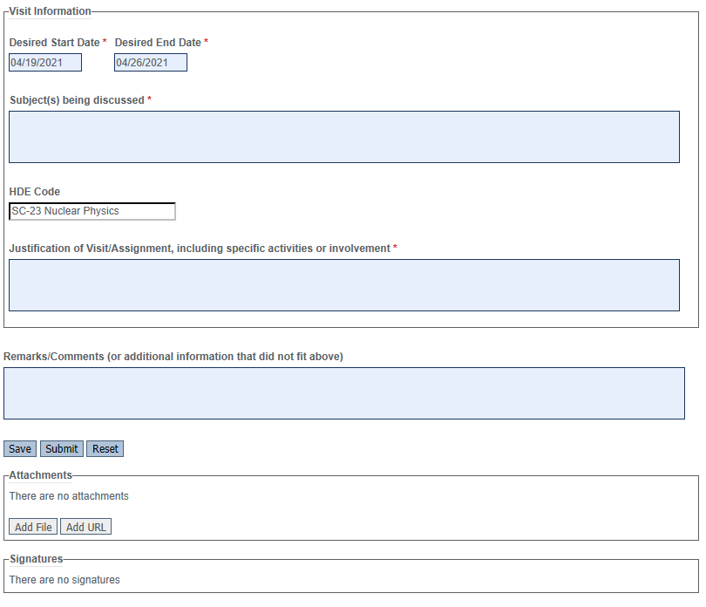

Slide 49
Working during MedCon

Slide 50
MedCon During SAD

Slide 51
