Slide 1
Electronic Access Registration Process
System Overview and Screenprints
For U.S. Citizens and Foreign Nationals
jris@jlab.org

Slide 2
United States Citizen

Slide 4
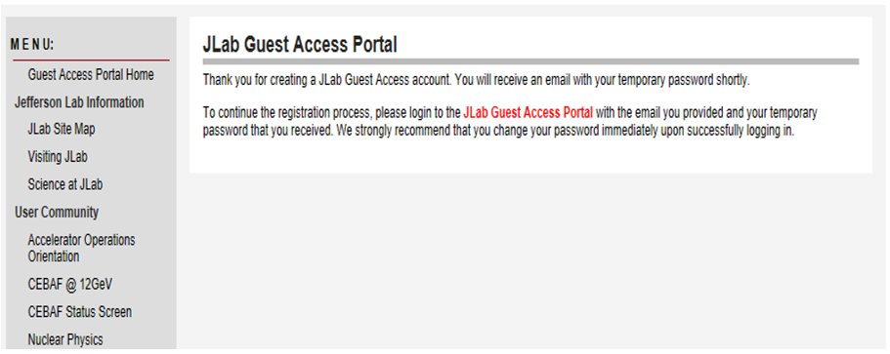

Slide 5
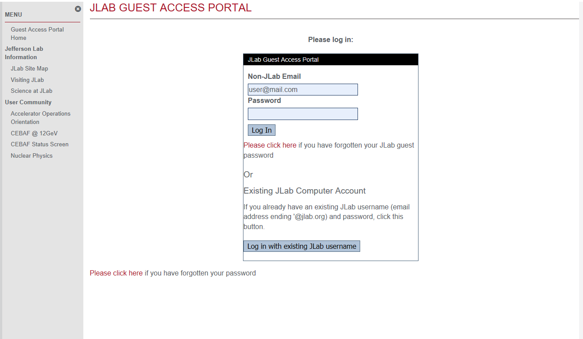

Slide 6
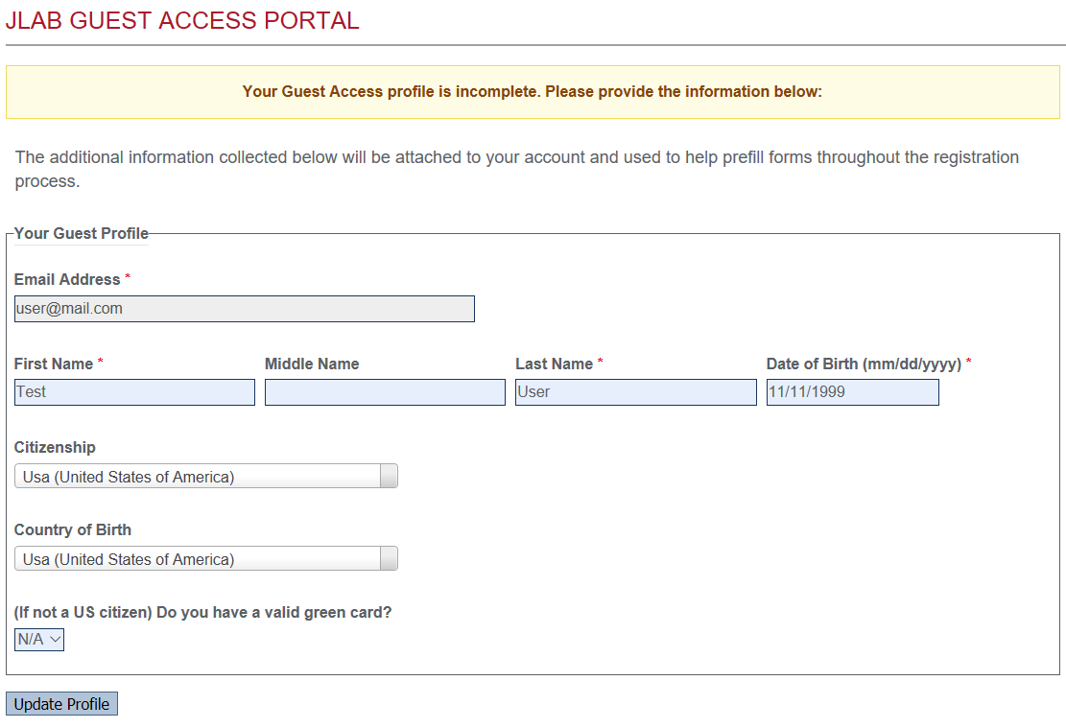

Slide 7
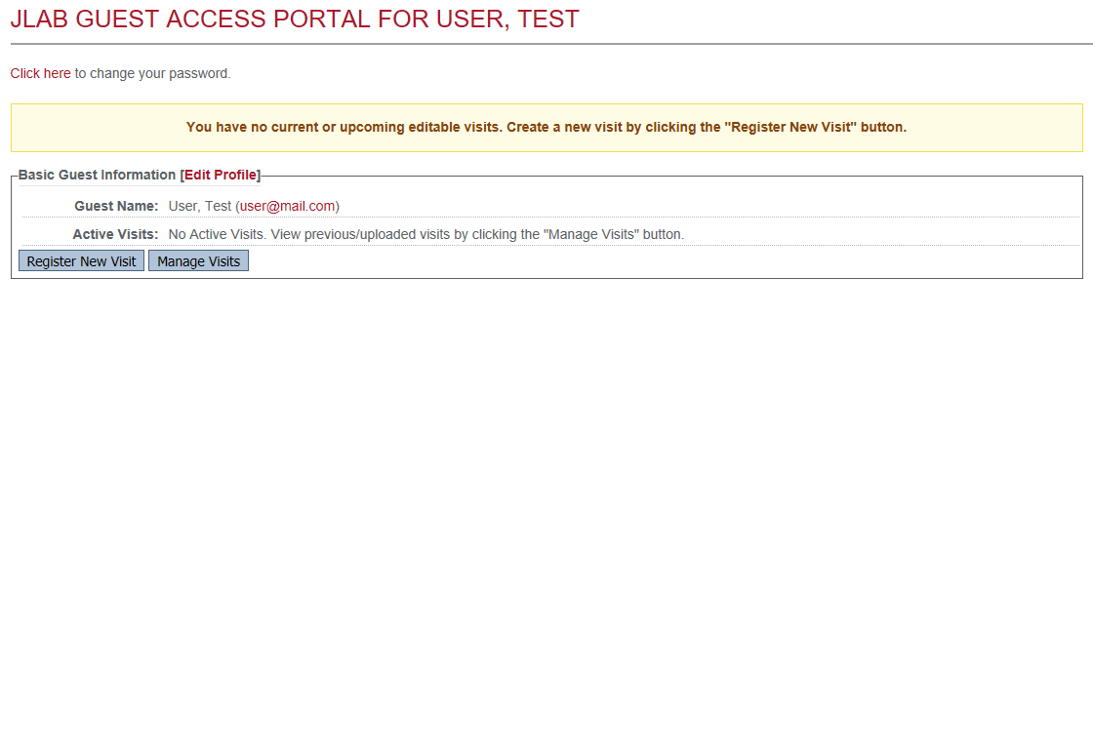

Slide 8
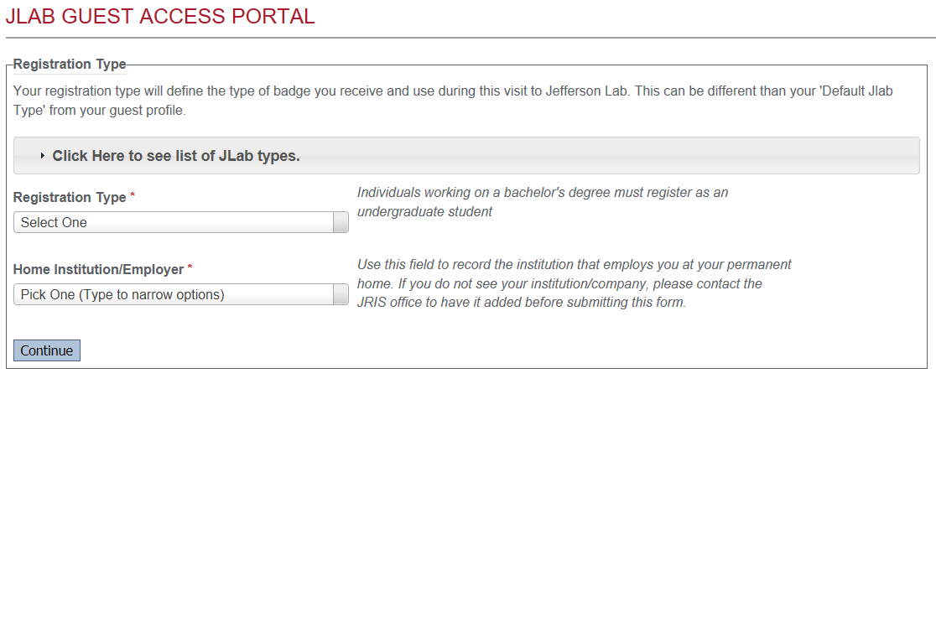

Slide 9
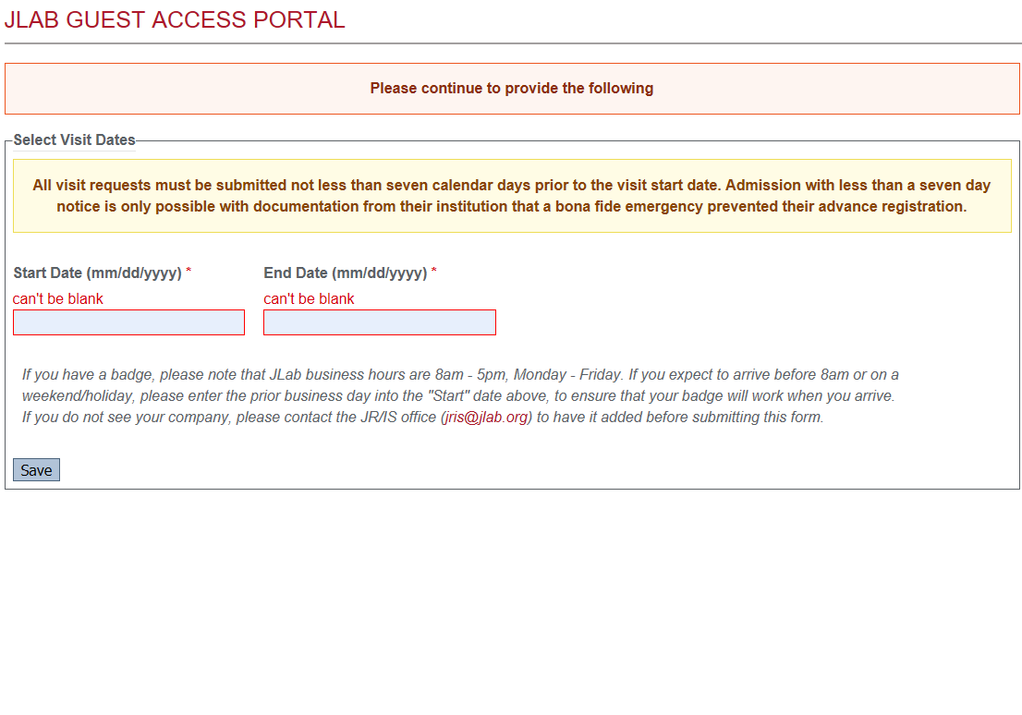

Slide 10
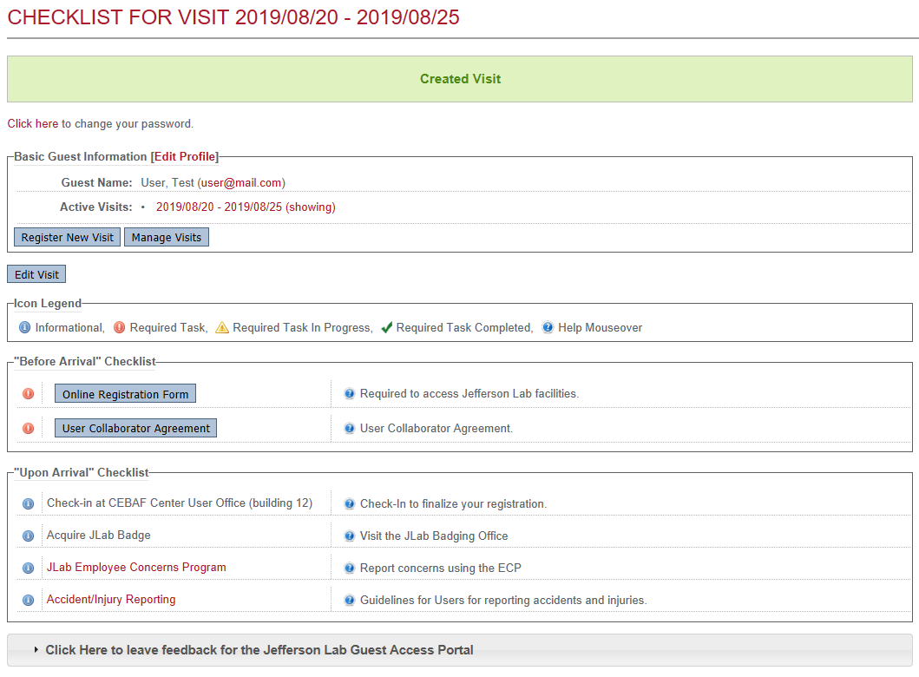

Slide 11
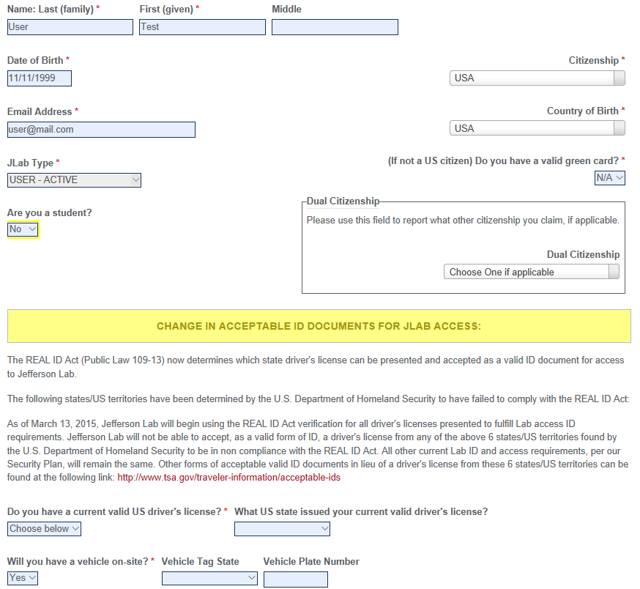

Slide 12
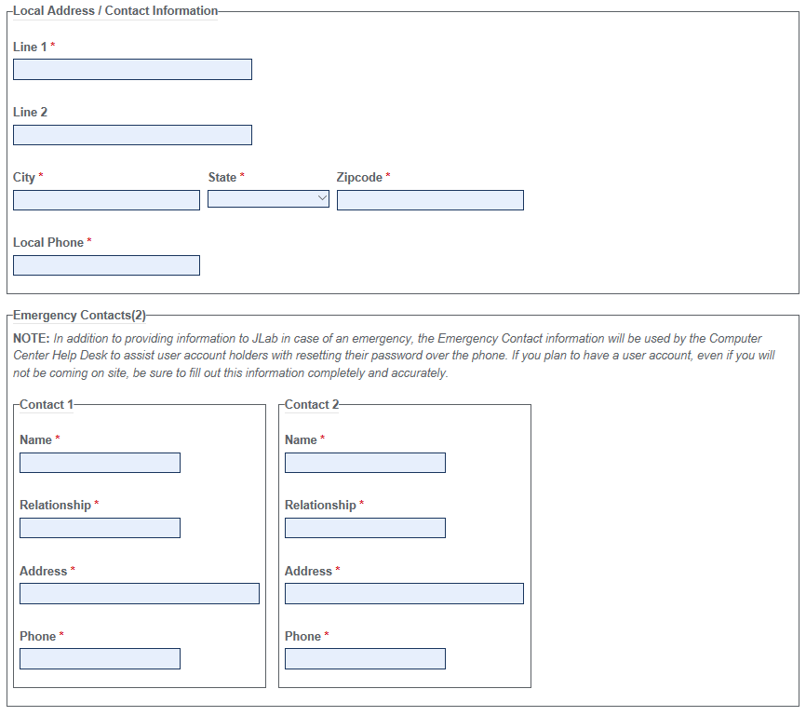

Slide 13
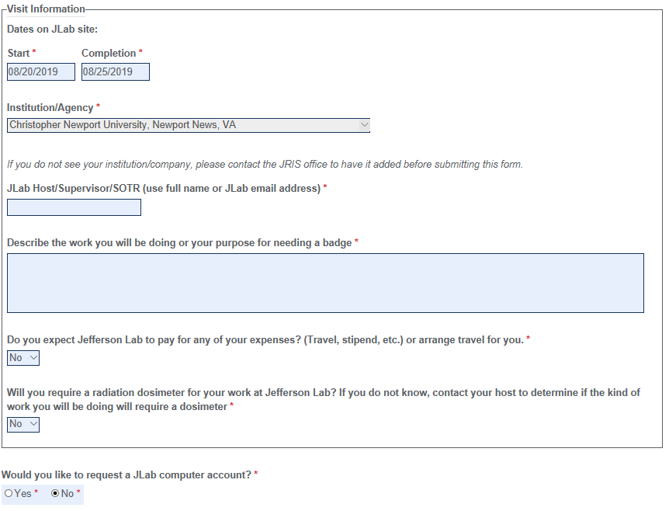

Slide 14
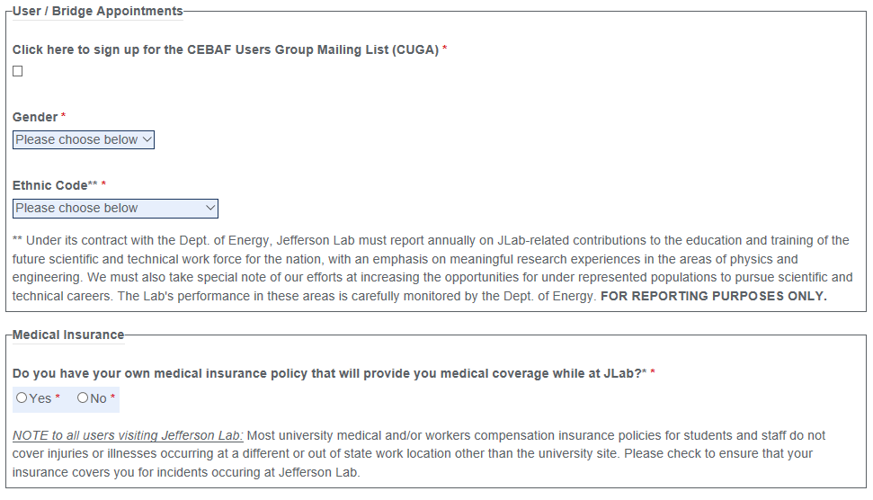

Slide 15
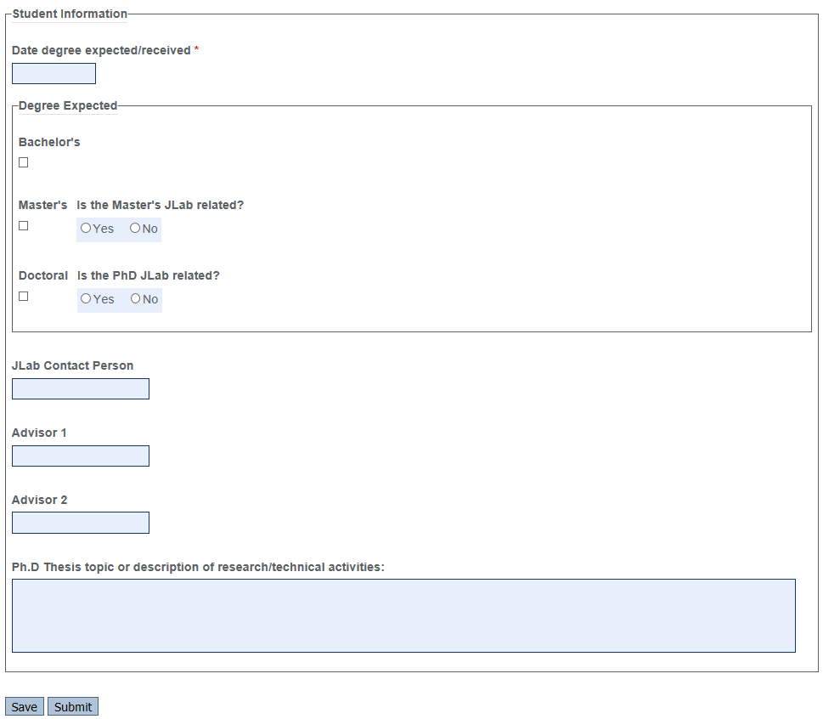

Slide 16
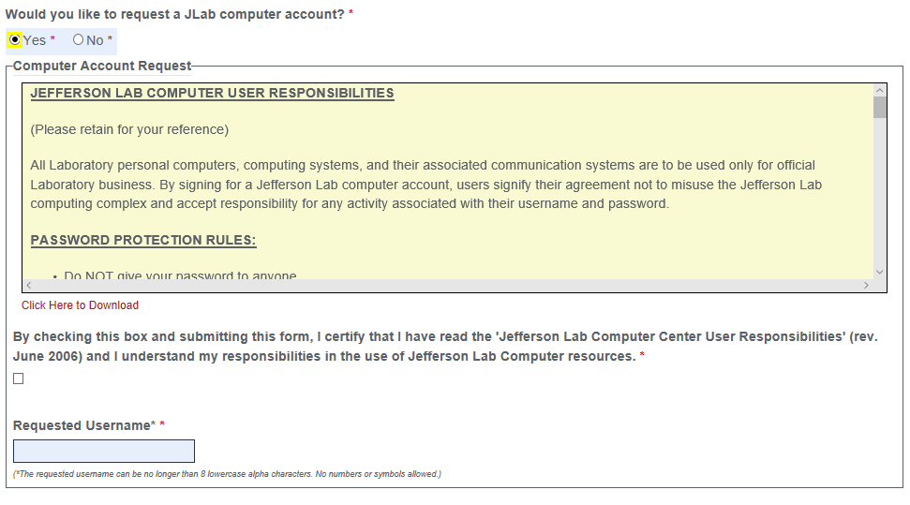
Requesting a JLAB Computer Account

Slide 17
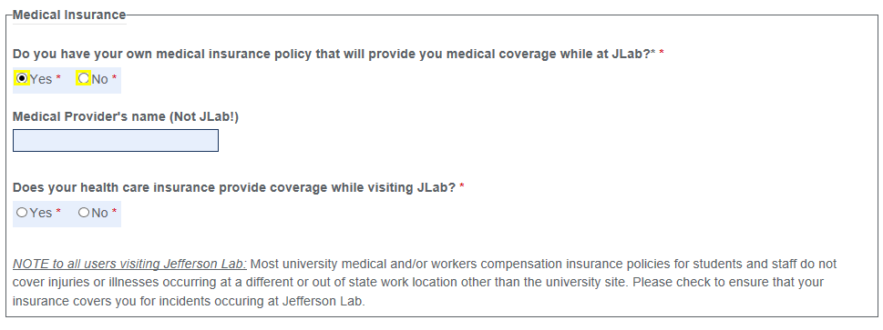
Medical Insurance Coverage

Slide 18
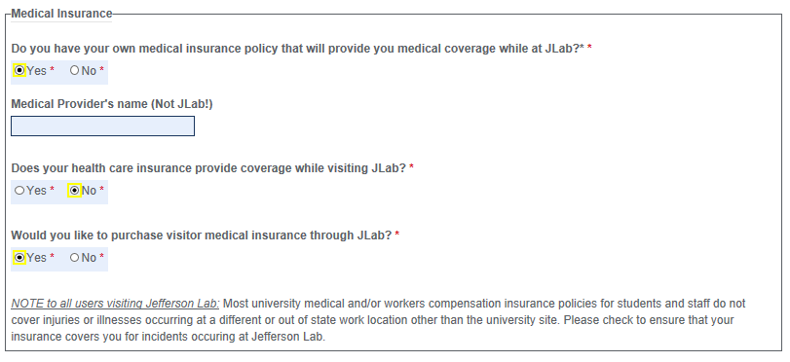

Slide 20
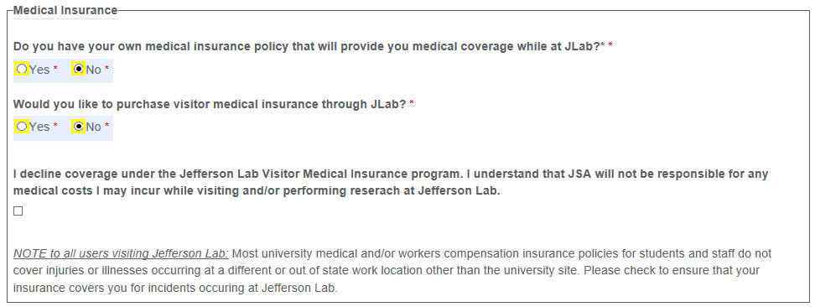

Slide 21
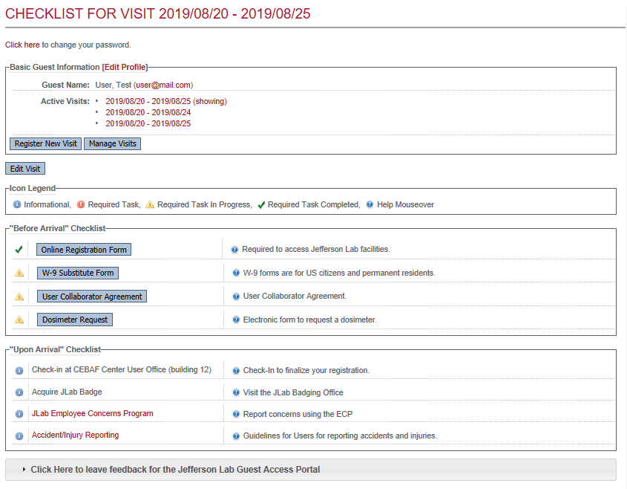

Slide 22
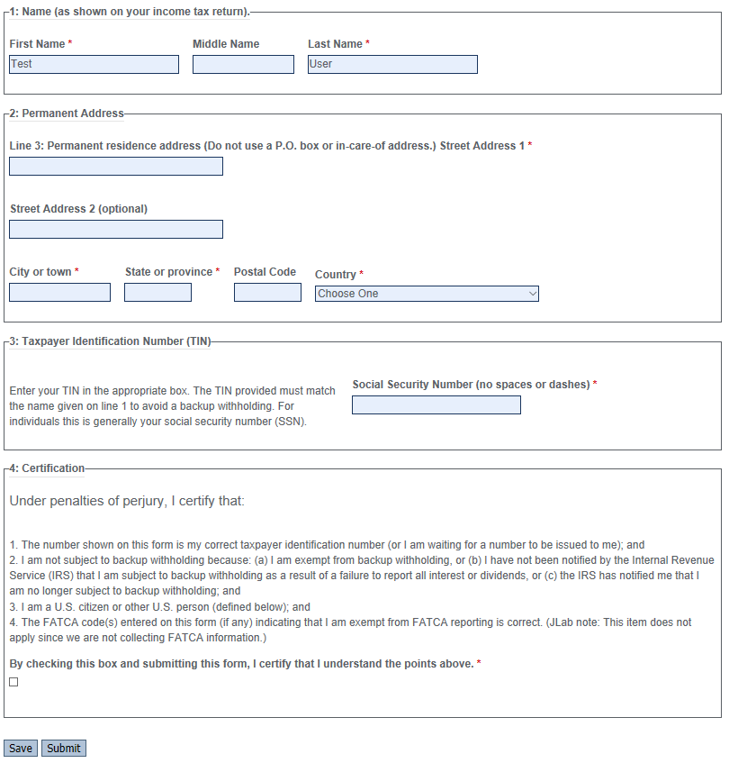
W-9 Tax Form

Slide 23
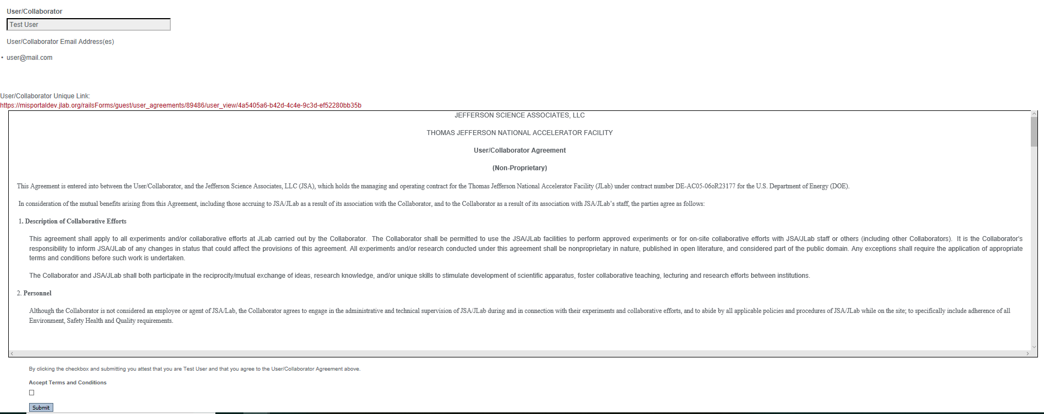
User/Collaborator Agreement

Slide 24
Dosimeter Request Form

Slide 25
Foreign National

Slide 29
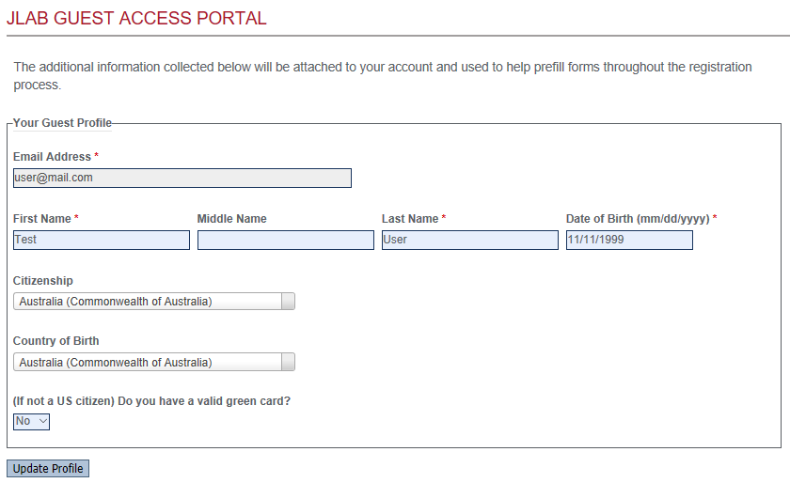

Slide 34
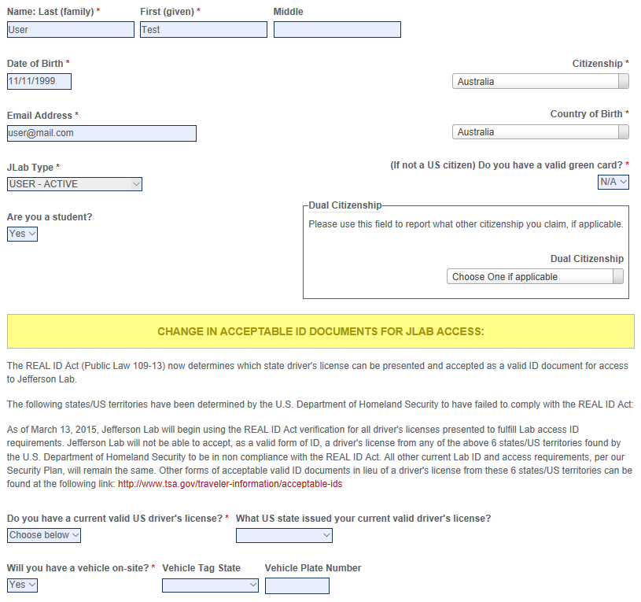

Slide 36
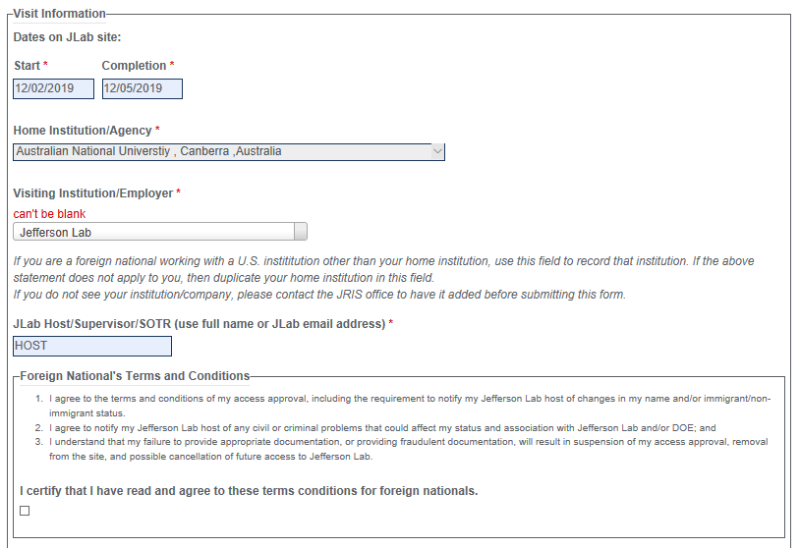

Slide 39
Requesting a JLAB Computer Account

Slide 40
Medical Insurance Coverage

Slide 41
Medical Insurance Coverage

Slide 42
Medical Insurance Coverage

Slide 43
Medical Insurance Coverage

Slide 44
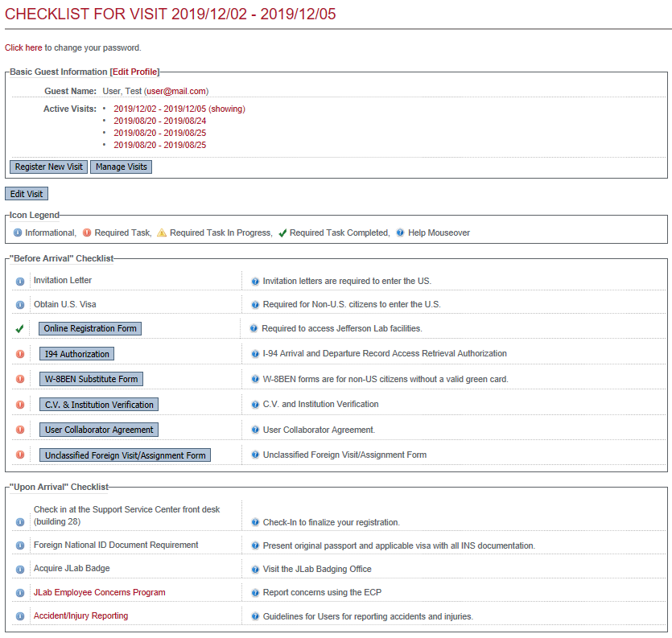

Slide 45
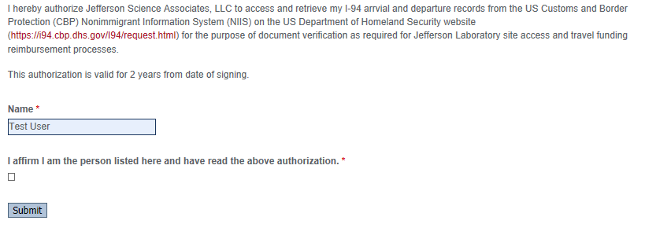
I-94 Authorization

Slide 46
W8-BEN Substitute Form

Slide 47
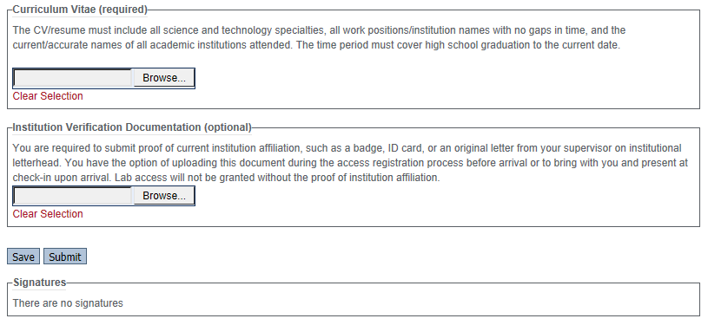
C.V. & Institution Verification

Slide 48
User/Collaborator Agreement

Slide 49
Unclassified Foreign Visit/Assignment Form

Slide 50
Unclassified Foreign Visit/Assignment Form

Slide 51
Dosimeter Request Form

