Slide 1
Large Transverse Momentum
Ted Rogers
Motivation
Survey of processes
JLab seminar, September 4th, 2019

Slide 2
Large and Small Transverse Momentum
Notes:
Where to look in this distribution
We would like to access the blue.

Slide 3

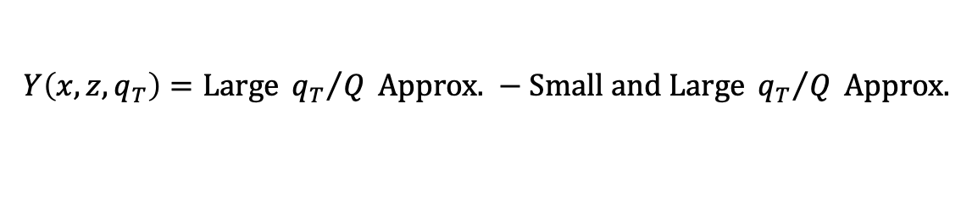
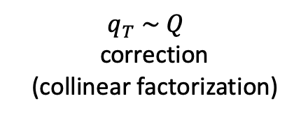
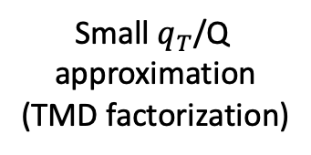
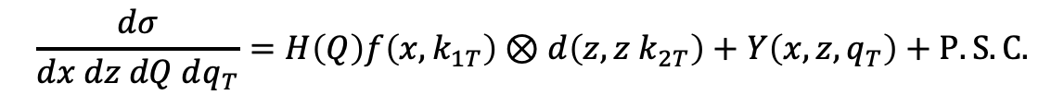
Large and Small Transverse Momentum
TMD pdfs in physical processes
  Small $q_{T}$/Q expansion
    Need to separate small and large
    Best if there is a region of overlap
    between large and small $q_{T}$/Q methods:
$$\frac{dσ}{dx dz dQ dq_{T}}=H\left(Q\right)f\left(x,k_{1T}\right)⊗d\left(z,z k_{2T}\right)+Y\left(x, z,q_{T}\right)+P.S.\text{C}\text{.}$$
Small${ q}_{T}$/Q
approximation
(TMD factorization)
$$q_{T} \sim Q$$
correction
(collinear factorization)
$$Y\left(x, z,q_{T}\right)=\text{Large} {q_{T}}/Q \text{Approx}\text{. }−\text{Small} \text{and} \text{Large} {q_{T}}/Q \text{Approx}\text{.}$$
Notes:
Generally, need to know where to switch

Slide 4
Why Large Transverse Momentum?
Notes:
Where to look in this distribution
We would like to access the blue.

Slide 5
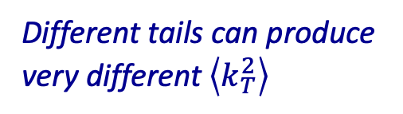
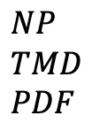

Why Large Transverse Momentum?
Example: Shapes of TMD distributions:
  Sea versus valence?
  Different flavors?
$$NP \\ TMD \\ PDF$$
Different tails can produce
very different $\left\langle k_{T}^{2}\right\rangle$
$$k_{T}$$

Slide 6
Why Large Transverse Momentum?
What is the mechanism for hadron production
when hard scales are not so hard?
T. Liu, J.-W. Qiu (2019)

Slide 7
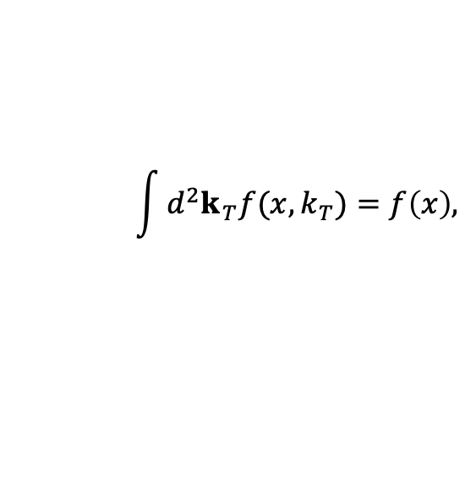
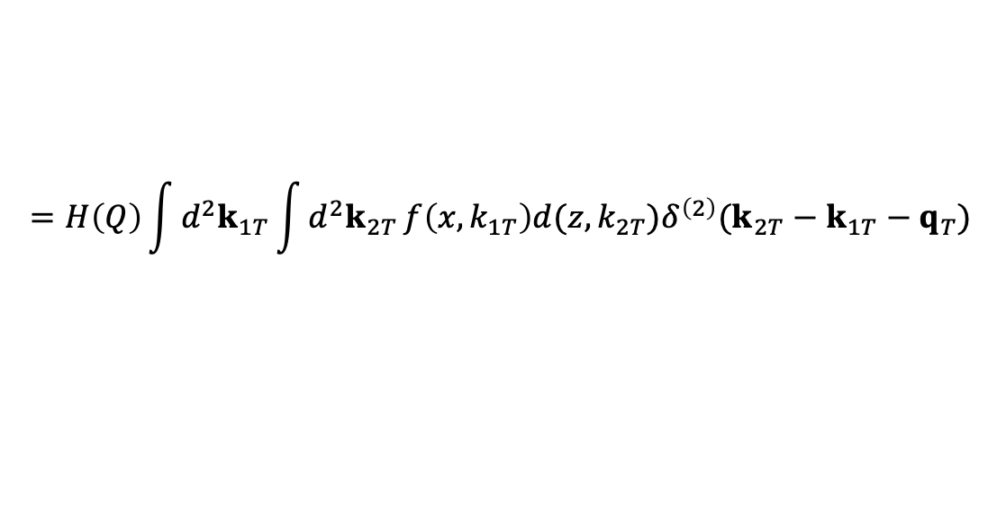
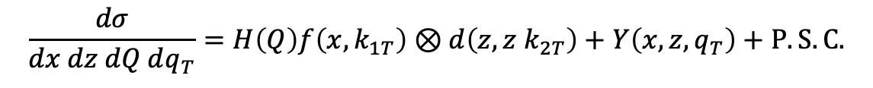

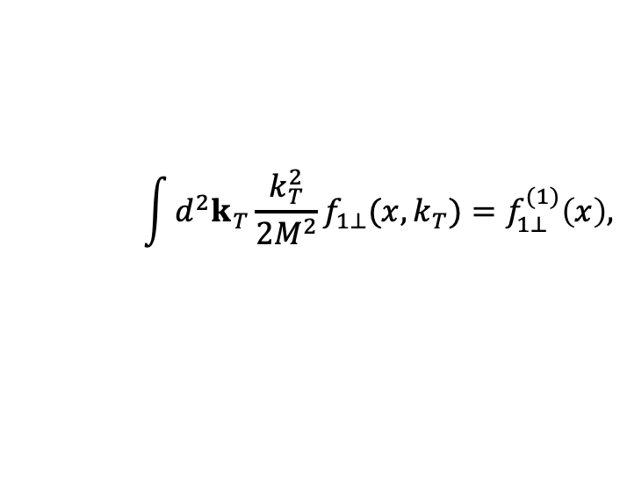
Why Large Transverse Momentum?
Interpretation of integrals
In generalized parton model:
$$\int{d^{2}k_{T}f(x,k_{T})}=f\left(x\right),$$
$$\int{d^{2}k_{T}{\frac{k_{T}^{2}}{2M^{2}}f}_{1⊥}(x,k_{T})}=f_{1⊥}^{(1)}\left(x\right),$$
$$⋮$$
$$\frac{dσ}{dx dz dQ dq_{T}}=H\left(Q\right)f\left(x,k_{1T}\right)⊗d\left(z,z k_{2T}\right)+Y\left(x, z,q_{T}\right)+P.S.\text{C}\text{.}$$
$$=H\left(Q\right)\int{d^{2}k_{1T}}\int{d^{2}k_{2T}}f\left(x,k_{1T}\right)d(z,k_{2T})δ^{\left(2\right)}(k_{2T}−k_{1T}−q_{T})$$
Assume all contributions to transverse momentum dependence are intrinsic
Notes:
Integrals are divergent…
Reflects the fact that they are not designed to deal with large q_T.

Slide 8
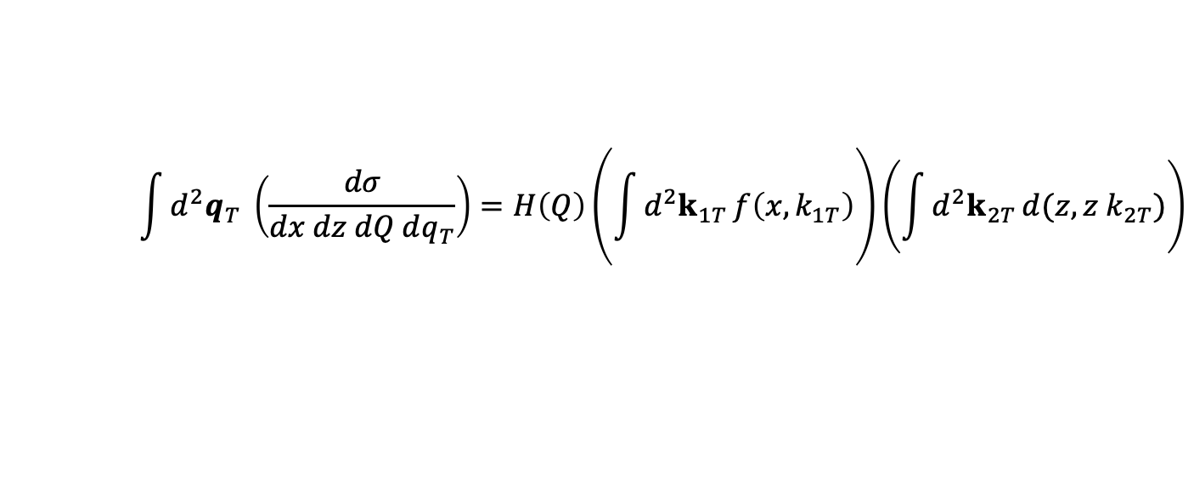
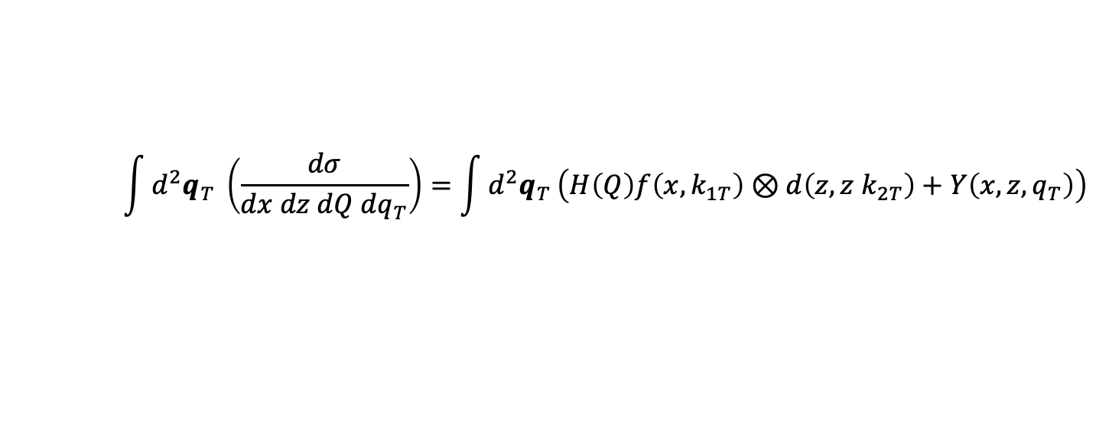

Why Large Transverse Momentum?
Integrated cross section in generalized PM:
Full integral
$$\int{d^{2}q_{T}} \left(\frac{dσ}{dx dz dQ dq_{T}}\right)=H\left(Q\right)\left(\int{d^{2}k_{1T}}f\left(x,k_{1T}\right)\right)\left(\int{d^{2}k_{2T}}d(z,z k_{2T})\right)$$
$$=H\left(Q\right)f\left(x\right)d(z)$$
$$\int{d^{2}q_{T}} \left(\frac{dσ}{dx dz dQ dq_{T}}\right)=\int{d^{2}q_{T}}\left(H\left(Q\right)f\left(x,k_{1T}\right)⊗d\left(z,z k_{2T}\right)+Y\left(x, z,q_{T}\right)\right)$$
Cutoff dependence cancels between terms
Notes:
If the correction can be handled perturbatively, then we can possibly translate the integral into something that can be
interpreted with the GPM
The transverse momentum integrals are divergent at large transverse momentum, so they need to be defined
Definition of integral must preserve predictive power and contact with phenomenology
Need theoretical control over large transverse momentum
Reflects the fact that they are not designed to deal with large q_T.

Slide 9
Simplest Processes with Transverse Momentum
Semi-inclusive DIS (JLab, EIC,…)
Drell-Yan
e⁺e⁻ annihilation (Belle)

Slide 10
SIDIS
Leading order contribution to large transverse momentum production

Slide 11
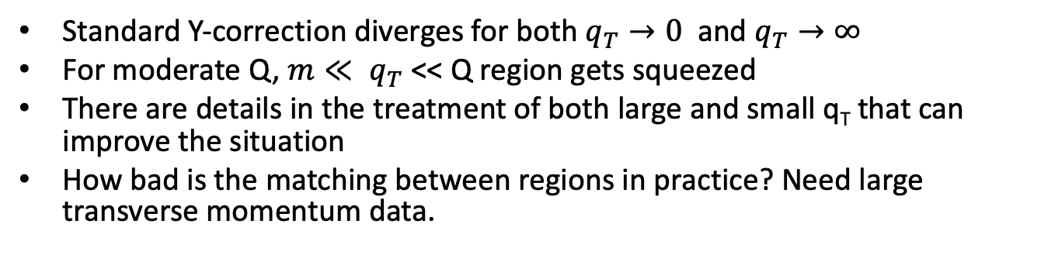
SIDIS
Boglione et al, JHEP 1502 (2015) 095:
Directly implement Y-term
Standard Y-correction diverges for both $q_{T}→0$ and $q_{T}→∞$
For moderate Q, $m≪ q_{T}$ << Q region gets squeezed
There are details in the treatment of both large and small q_{T} that can improve the situation
How bad is the matching between regions in practice? Need large transverse momentum data.
Notes:
What happens if you just do things by brute force.

Slide 12
SIDIS: Leading Order
Hard part
at large q_{T},
lowest order
Data from COMPASS:
(Phys.Rev. D 97, 032006 (2018))
Similar results with HERMES data
DSS fragmentation funcs.
CJ pdfs
J. O. Gonzalez-Hernandez, TR, N. Sato, and B. Wang Phys. Rev. D 98, 114005
Notes:
What happens if you just do things by brute force.

Slide 13
SIDIS
Collinear functions tend to be constrained by higher energy / less detailed observables
Refit collinear pdfs and ffs using large TM?
Large corrections from NLO
E. Berger et al, 1998 (For Drell-Yan)
Leading order
A. Daleo, D. de Florian, and R. Sassot, Phys. Rev. D 71, 034013 (2005)
Notes:
What happens if you just do things by brute force.

Slide 14
SIDIS
NLO study of the valence region.
B. Wang, J. O. Gonzalez-Hernandez, TR, N. Sato
Phys. Rev. D 99, 094029
Solid = NLO
Dotted = LO
Bands =
variation of RG
scale
Notes:
What happens if you just do things by brute force.

Slide 15
SIDIS
NLO study of the valence
region.
B. Wang, J. O. Gonzalez-Hernandez, TR, N. Sato
Phys. Rev. D 99, 094029
Notes:
What happens if you just do things by brute force.

Slide 16
Drell-Yan: Old Comparisons
Data = CFS coll.
“…estimates of
the perturbative large-p_{T} tail measured in fixed target Drell-Yan experiments give reasonable agreement with the data...”
- Ellis, Stirling, Webber
QCD and Collider Physics
Notes:
What happens if you just do things by brute force.

Slide 17
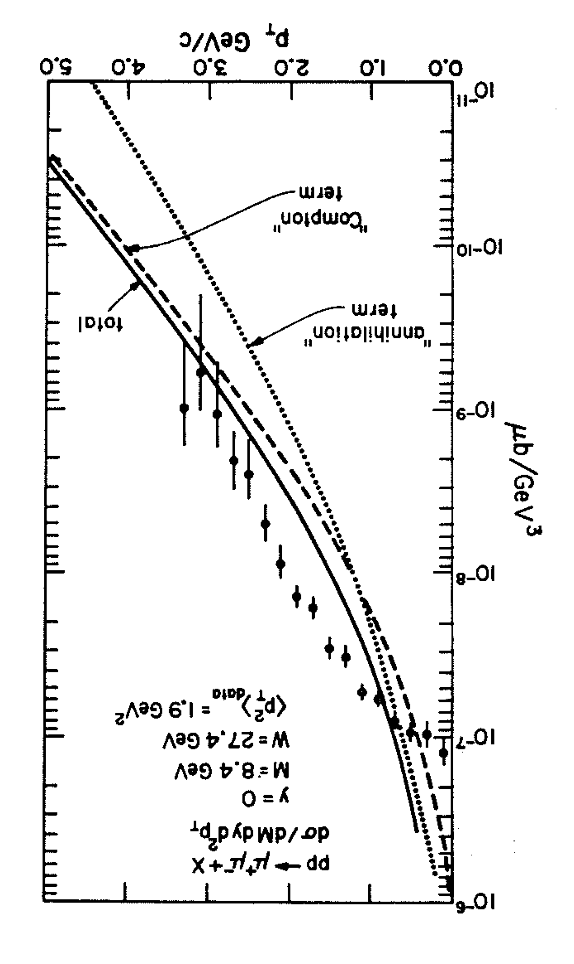
Drell-Yan: Old Comparisons
Data = CFS coll.
“…estimates of
the perturbative large-p_{T} tail measured in fixed target Drell-Yan experiments give reasonable agreement with the data...”
- Ellis, Stirling, Webber
QCD and Collider Physics
“The perturbative contributions are absolutely normalized and agree roughly with the data at large transverse momentum...”
- R. Field,
Applications of Perturbative QCD
Notes:
What happens if you just do things by brute force.

Slide 18
Drell-Yan: Old Comparisons
Data = CFS coll.
“…estimates of
the perturbative large-p_{T} tail measured in fixed target Drell-Yan experiments give reasonable agreement with the data...”
- Ellis, Stirling, Webber
QCD and Collider Physics
“Our procedure predicts normalization as well as the shape of the pr distribution, and therefore the agreement with the data for large values of p_{T} is a definite success of the theory...”
- Halzen & Scott, Phys. Rev. Lett. 40, 1117 (1978)
“The perturbative contributions are absolutely normalized and agree roughly with the data at large transverse momentum...”
- R. Field,
Applications of Perturbative QCD
Notes:
What happens if you just do things by brute force.

Slide 19
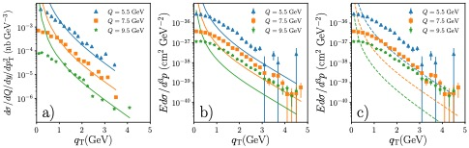
Drell-Yan: Old Comparisons
Past comparisons
Original Comparison
With corrected data
Corrected data
+ modern pdf set
Data from A. S. Ito et al.,
Phys. Rev. D23, 604 (1981)
Notes:
What happens if you just do things by brute force.

Slide 20
Drell-Yan: Old Comparisons
Past comparisons
Original Comparison
With corrected data
Corrected data
+ modern pdf set
Data from A. S. Ito et al.,
Phys. Rev. D23, 604 (1981)
Notes:
What happens if you just do things by brute force.

Slide 21
Drell-Yan: Old Comparisons
Past comparisons
Original Comparison
With corrected data
Corrected data
+ modern pdf set
Data from A. S. Ito et al.,
Phys. Rev. D23, 604 (1981)
Notes:
What happens if you just do things by brute force.

Slide 22
Drell-Yan: New Comparisons
Current status: Similar trend
Bacchetta et al., Phys.Rev. D100 (2019) no.1, 014018
Notes:
What happens if you just do things by brute force.

Slide 23

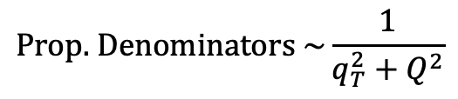

Electron-Positron Annihilation
E. Moffat, et al: To appear
$$\text{Prop}\text{. }\text{Denominators} \sim \frac{1}{q_{T}^{2}+Q^{2}}$$
$$\frac{q_{T}}{Q}$$
H_{B}
H_{A}
$$\frac{q_{T}}{Q}$$
Z
If q_{T} /Q is small, TMD fragmentation functions are needed.
If q_{T} /Q is large, there is recoil against a high momentum parton, and collinear factorization is needed:
Notes:
Totally inclusive

Slide 24
Electron-Positron Annihilation
Channels
= Hadron A
= Hadron B

Slide 25
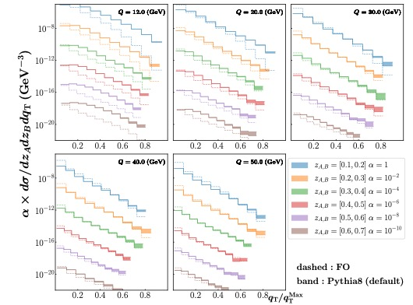
Electron-Positron Annihilation
Validate with event generator
Notes:
CS evolution is related to properties of Wilson loop.

Slide 26
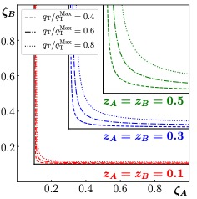


Small Transverse Momentum Approximations
$q_{T}/Q→0$ asymptotic limit of large $q_{T}$ computations
$$Q=12 GeV$$

Slide 27

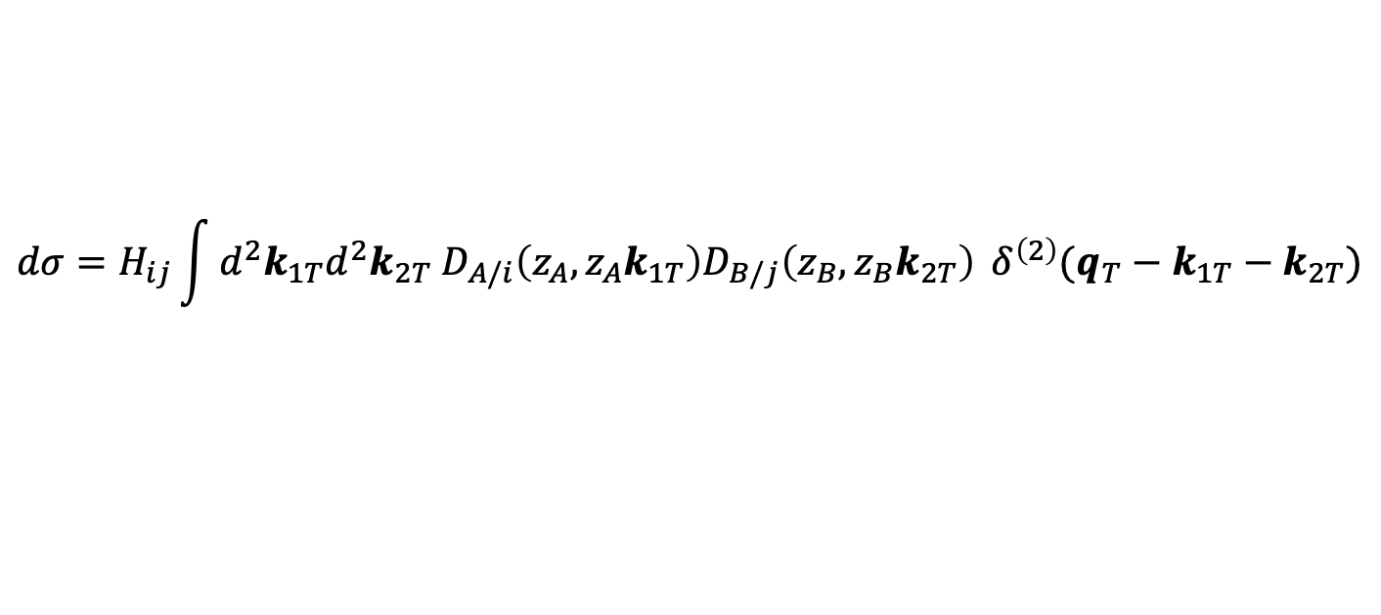
Transverse Momentum Dependent Fragmentation Functions
Factorization for $q_{T}/Q≈0$:
TMD ffs and evolution
$$dσ=H_{ij}\int{{d^{2}k_{1T}d^{2}k_{2T} D}_{A/i}\left(z_{A},z_{A}k_{1T}\right)D_{B/j}\left(z_{B},z_{B}k_{2T}\right)} δ^{\left(2\right)}(q_{T}−k_{1T}−k_{2T})$$
Non-perturbative input

Slide 28
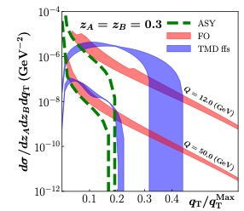

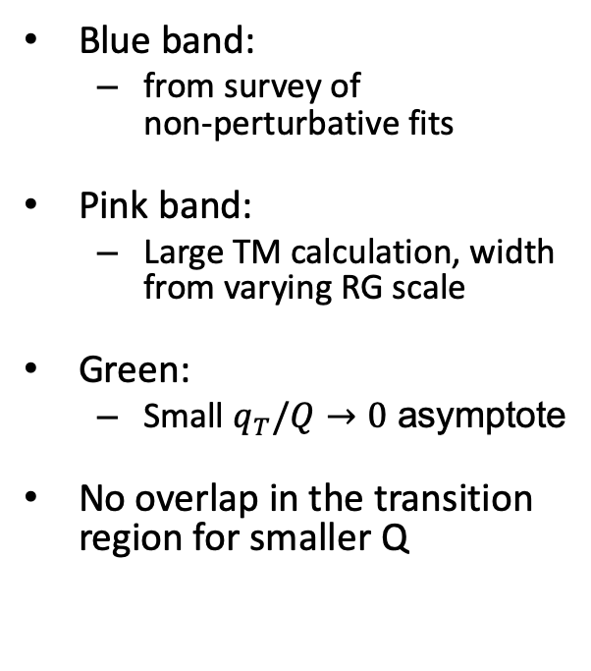
Electron-Positron Annihilation
Blue band:
  from survey of
  non-perturbative fits
Pink band:
  Large TM calculation, width from varying RG scale
Green:
  Small $q_{T}/Q→0$ asymptote
No overlap in the transition
region for smaller Q
$$q_{T}^{MAx}≈Q$$

Slide 29
Summary
Treatment of transverse momentum across the full spectrum needed for general TMD theory
A handle on the collinear factorization at large transverse momentum is needed
Evidence for tension with collinear factorization in three processes discussed
  Motivates new analyses of collinear factorization at large TM

Slide 30
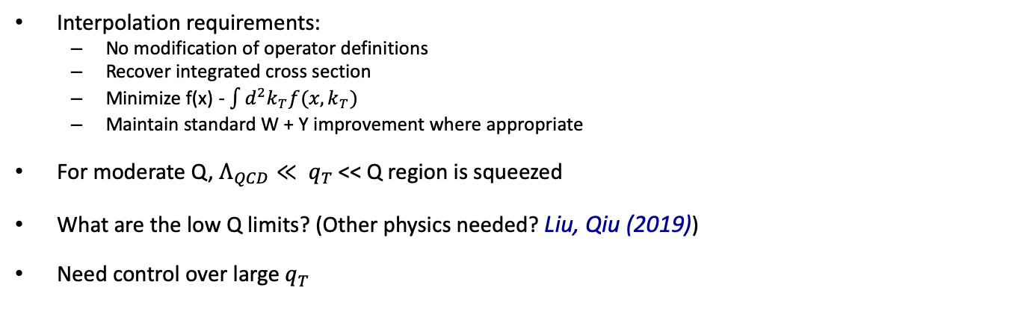
SIDIS
Collins et al, Phys.Rev. D (2016)
Interpolation requirements:
  No modification of operator definitions
  Recover integrated cross section
  Minimize f(x) - $\int{d^{2}k_{T}f(x,k_{T})}$
  Maintain standard W + Y improvement where appropriate
For moderate Q, $Λ_{QCD}≪ q_{T}$ << Q region is squeezed
What are the low Q limits? (Other physics needed? Liu, Qiu (2019))
Need control over large $q_{T}$
Notes:
Careful treatment of transition at moderate q_{T} is needed; generalize the Y-correction
Standard Y-correction diverges for $q_{T}→0$ and $q_{T}→∞$
Below some Q, it is reasonable to ask whether any of this is valid, but note that Q = 1.2 GeV is often used.
We attempted fix the regulators used in the calculation of large qT by minimizing the integral anomaly.
What happens if you just do things by brute force.

