Slide 1
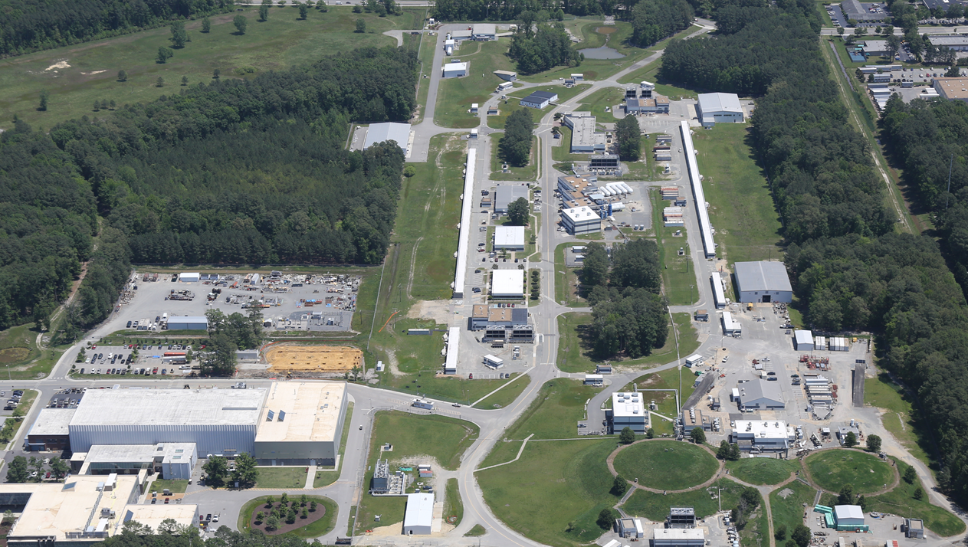
Cryogenics – An Overview and Cryo at JLab
David Kashy
August 21, 2019

Slide 2
Outline
Cryogenics - Definition
Cooling Modes – Refrigeration vs Liquefaction
JLab Cryogenic Facilities
Loads on our cryogenic systems
Some uses for cryogenic fluids
Dig a bit deeper into portions of our systems
Cryogenic Controls – 24/7 Operation -How does it all continue to Run
Distribution and Connections of cryogens
Cryo Tidbits

Slide 3
Cryogenics: Definition and Basics
To cool something below room temperature requires a refrigeration process that removes heat (energy) from a material and thus lowers its temperature. To be considered a cryogenic refrigerator, the temperature is not a firm number but it is generally accepted that -180C or 93K is the highest temperature for “cryogenics”.
What is the basis for this temperature?
  All common elemental gasses liquefy at ambient pressure at or below this temperature
  JLab runs Refrigerators at 4.5K, 2.0K and as low as 8.5mK using a dilution refrigerator in our HD Ice Laboratory
Fluid | Boiling point (K) | Freezing Point (K)
Helium 4 | 4.21 | None (unless at high pressure)
Hydrogen | 20.27 | 13.8
Neon | 27.09 | 24
Nitrogen | 77.36 | 64
Argon | 87.28 | 84
Oxygen | 90.18 | 54
* At atmospheric pressure

Slide 4
Cooling with Cryogens –Refrigeration vs Liquefaction
Cryogenic Plants (often called refrigerators) can cool systems in two different modes, refrigeration and liquefaction.
  Refrigeration is a process where a “refrigerator” takes the refrigerant (R13, Freon, Helium,…) cools it, then it goes to a “load”, cools that load, the refrigerant returns somewhat warmed to the refrigerator which recovers the energy of the cold gas and uses it to cool more refrigerant to be sent to the load
  Liquefaction also uses a refrigerant, this “fluid” sometimes a liquid and sometimes a gas, cools a load and instead of returning to the refrigerator cold returns at room temperature
  All of the cryogenic plants JLab have the ability to and indeed work in both modes depending on the needs of the users
  System design is a very complex topic and well beyond the scope of this lecture.

Slide 5
Cooling with Cryogens
Liquid helium has a heat of vaporization of 20J/g so boiling 1g/s of LHe provides 20W of cooling at 4K when returned the load is a liquefaction load
If the same 1g/s is returned to the cold end of the refrigerator, then recovery of the remaining enthalpy results in more available capacity for cooling the load
The input power to create 1g/s of liquefaction is roughly same as to create 100 W to 150W of refrigeration
This shows that it is highly desirable to run a system in refrigeration mode
Some JLab systems operating temperatures and modes
  Cyromodule heat shields: 35K refrigeration– return at 50K
  Cryogenic targets: 15K refrigeration- return at 20K
  Superconducting magnet vapor current leads, some target systems, magnet cooldown, dewar filling: 4K liquefaction–return at 300K
  Most superconducting magnets: 4K refrigeration ––return at 4K
  Linacs and Cryomodule testing: 2K refrigeration –– return at 2K
  Specialized Polarized Targets: 1K and below refrigeration – return at 1K
Many cryogenic devices have two type of heat loads,
  Static- always present
  Dynamic – only on when the system is “operating”
Devices that operate at Helium temperatures also have heat shields to reduce the power that goes to the 4K or 2K level, these typically these are between 40 and 80K

Slide 6
JLab Cryogenic Facilities
Presently Jlab has 5 operating Cryogenic Plants
  CTF – Cryogenic Test Facility –Supports cryogenics at the Test Lab including Vertical Dewars at 2K, Cryomodule testing, Injector testing and Superconducting Magnet testing.
  ESR – End Station Refrigerator – Supports cryogenics in Experimental Halls A, B, and C
  CHL1 – Central Helium Liquefier- Supports CEBAF Linac Operation, LERF and give additional capacity for ESR
  CHL2 same as CHL1
  HDR- Hall D Refrigerator, Supports Hall D solenoid and 4K liquefaction for the solenoid current leads
ESR2 – ESR replacement with more capacity – coming soon (we hope!)

Slide 7
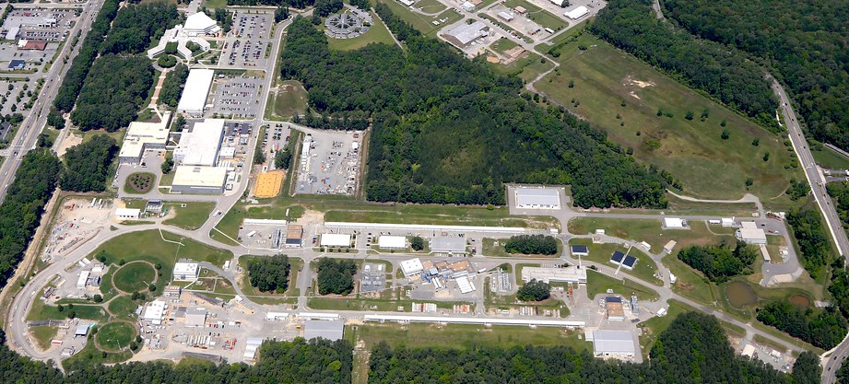
Ariel Tour
All of these facilities are connected warm gas lines and most are connected with cold gas lines (transfer lines)
CTF
HDR
ESR2
CHL1
ESR1
CHL2

Slide 8
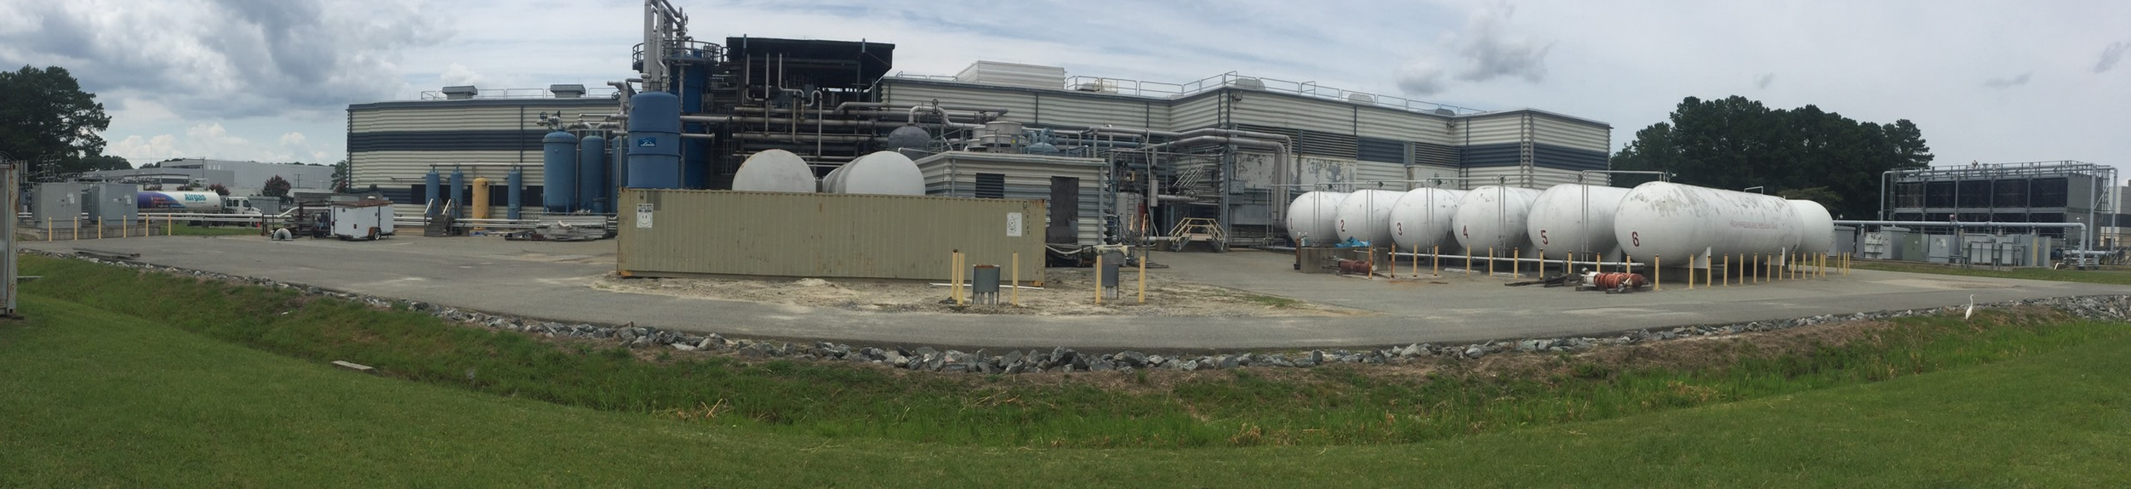
Back Side of CHL1 and 2 Buildings
Nitrogen Fill Station
CHL2 MCB Warm end
Lots of BIG Pipes
Cooling Water Towers
4160 Volt Power
CHL2
Oil Removal
Helium Gas Storage
Two Nitrogen Dewars

Slide 9
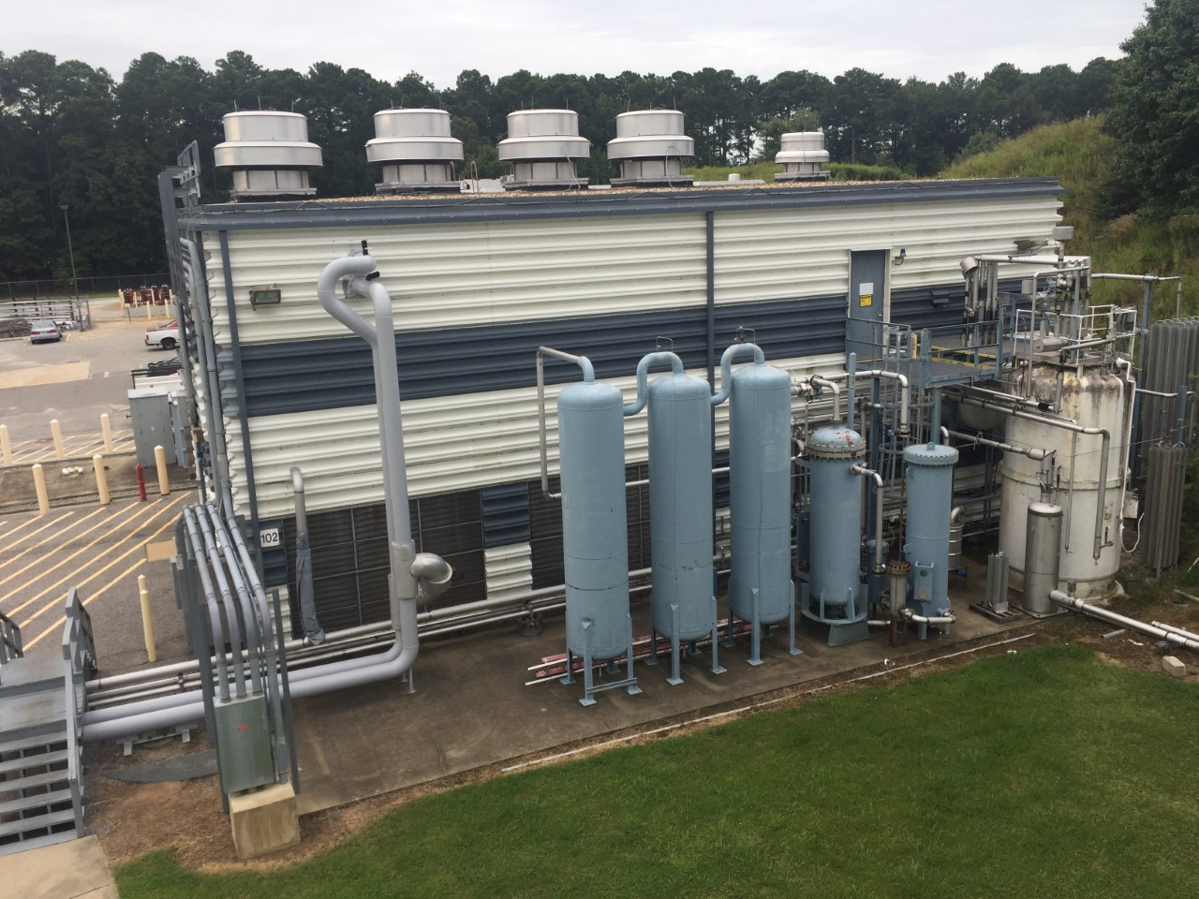
ESR Exterior
4 large fans above compressor room
Liquid He
4160V and 480V Feed
Oil Removal
Vaporizers
Cooling Water

Slide 10
Cryo Plant Capacities
Facility | Design Primary ref-liq | Other Primary ref/liq | Other modes
CTF | 1kW@35K 5g/s 2K liq
ESR | 1.5kW @4K | 11g/s liq | 800W@ 4K ~2kW@15K
ESR2 | 4.0kW – 0g/s | 2kW @4K 20g/s 4k liq | 500W@4K 5g/s 4K Liq ~3kW@15K
CHL1 | 4.6kW @2K +10g/s at 4K liq +12kW at 35K
CHL2 | 4.6kW @2K +25g/s at 4K liq +12kW at 35K
HDR | 200W @ 4K | 2g/s liq

Slide 11
Typical Cryogenic Loads
Superconducting Magnets
  3 to 100 W at 4K
    Large magnets should be run in refrigeration mode
    Small may be run in liquefaction mode because distribution loads can be more than the magnet itself
  Most JLab magnets have vapor cooled leads that require ~0.1g/s per pair per kA of operating current (a 4kA magnet would require about 0.4g/s of liquid helium this would use about 50W of refrigeration capacity)
Cryogenic Targets
  Halls A and C run targets between 500 and 1500W but future targets will be as high as 4kW
CEBAF Cryomodule Heat Loads to 2K*
  C20: 20W static, ~80W dynamic
  C50: 20W static, ~200W dynamic
  C100: 35W static, ~200W dynamic
  *Ref Telecon J.Benesch

Slide 12
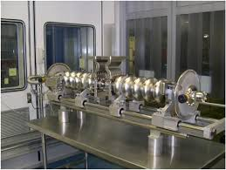
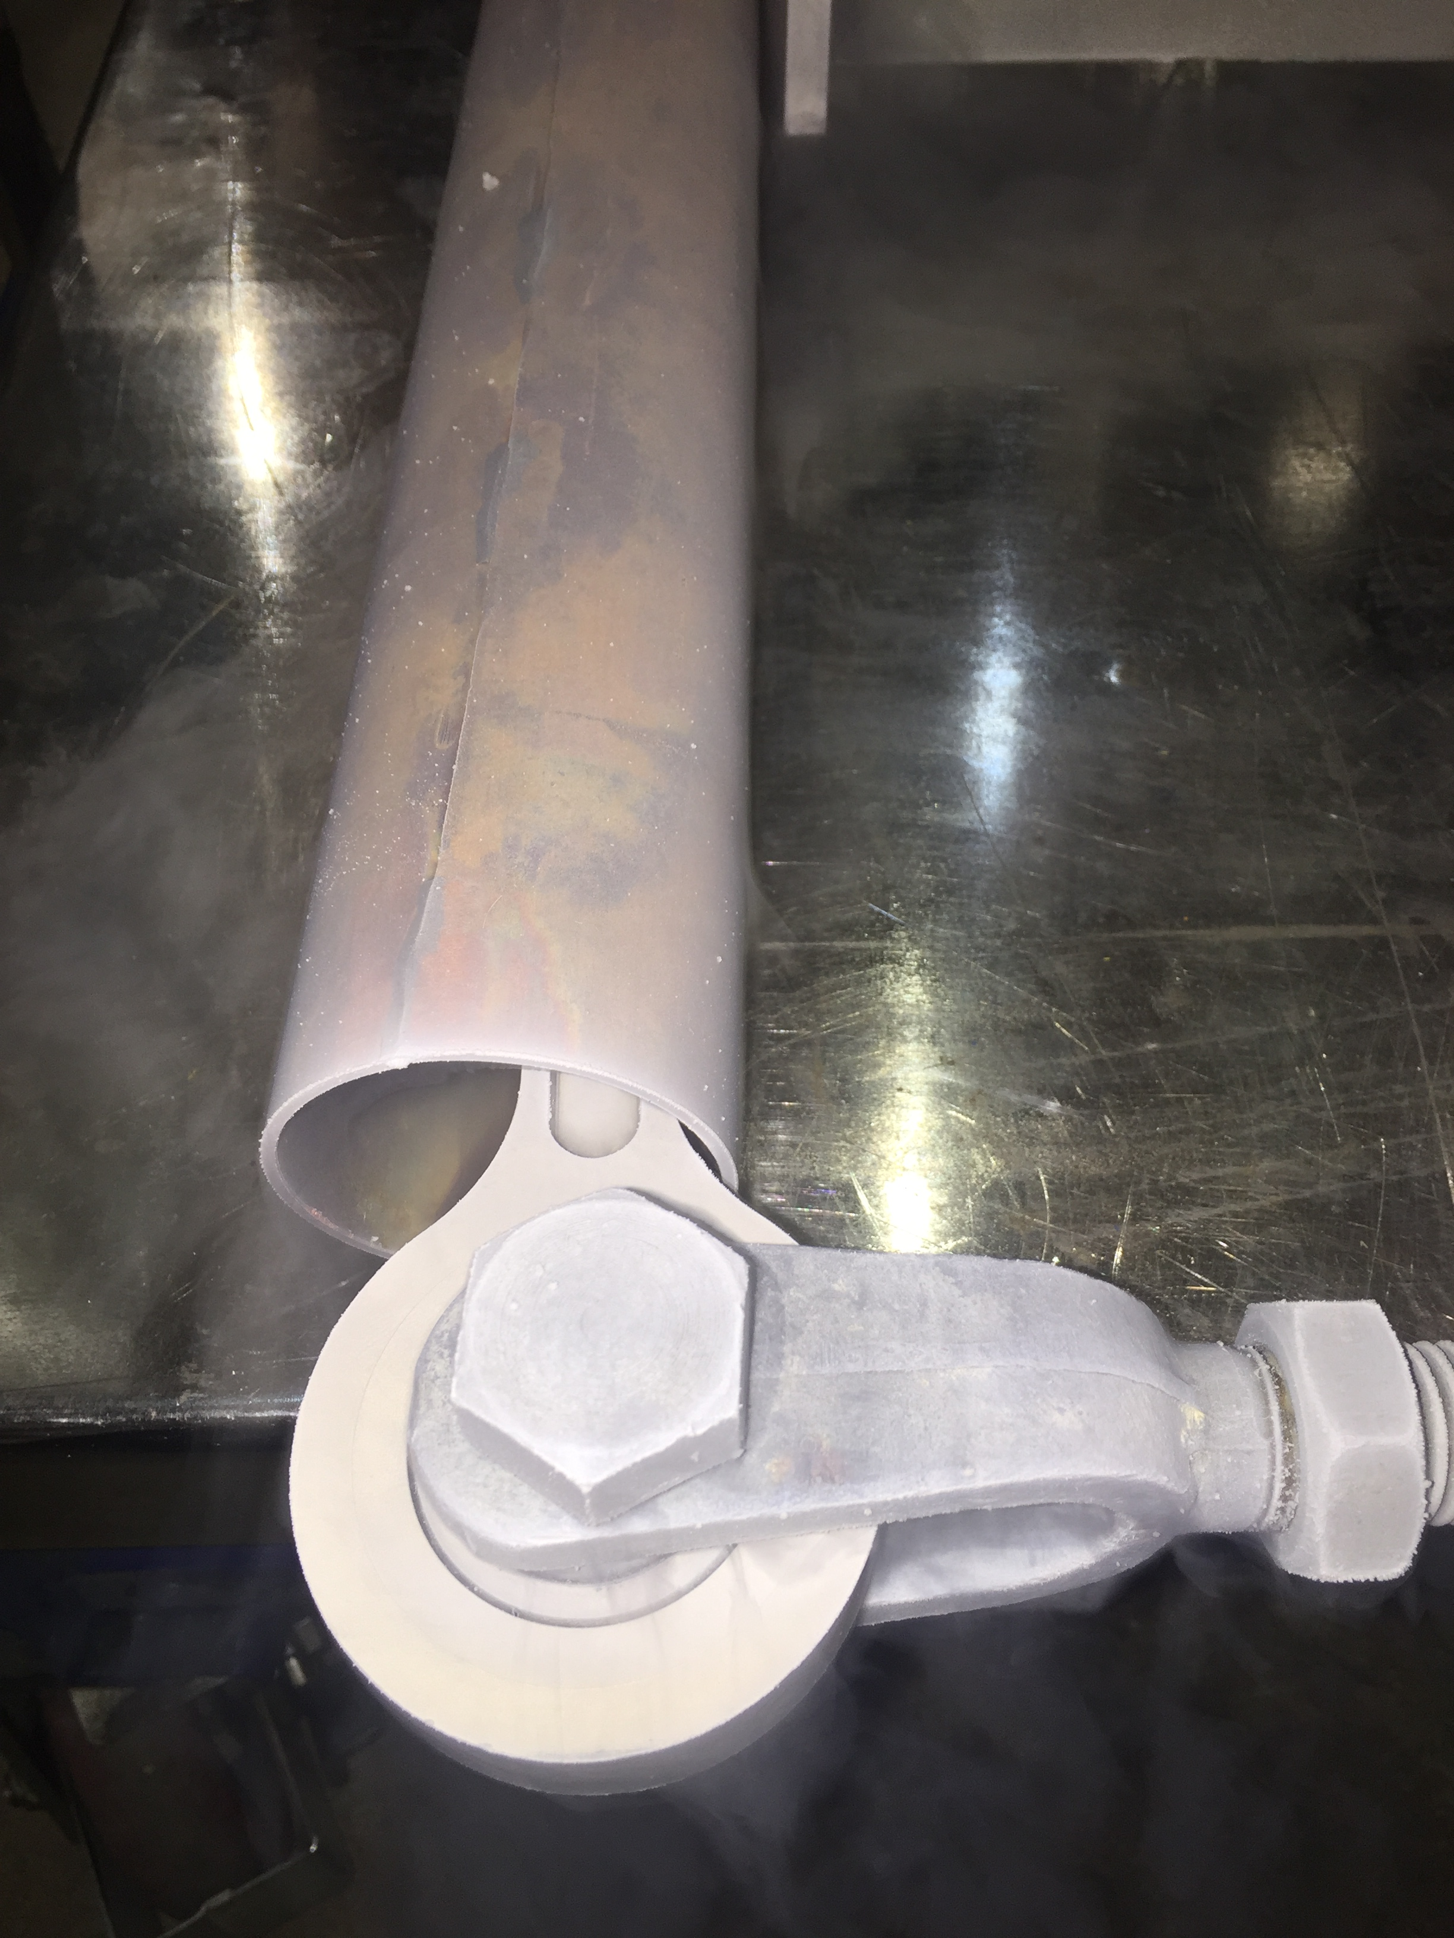
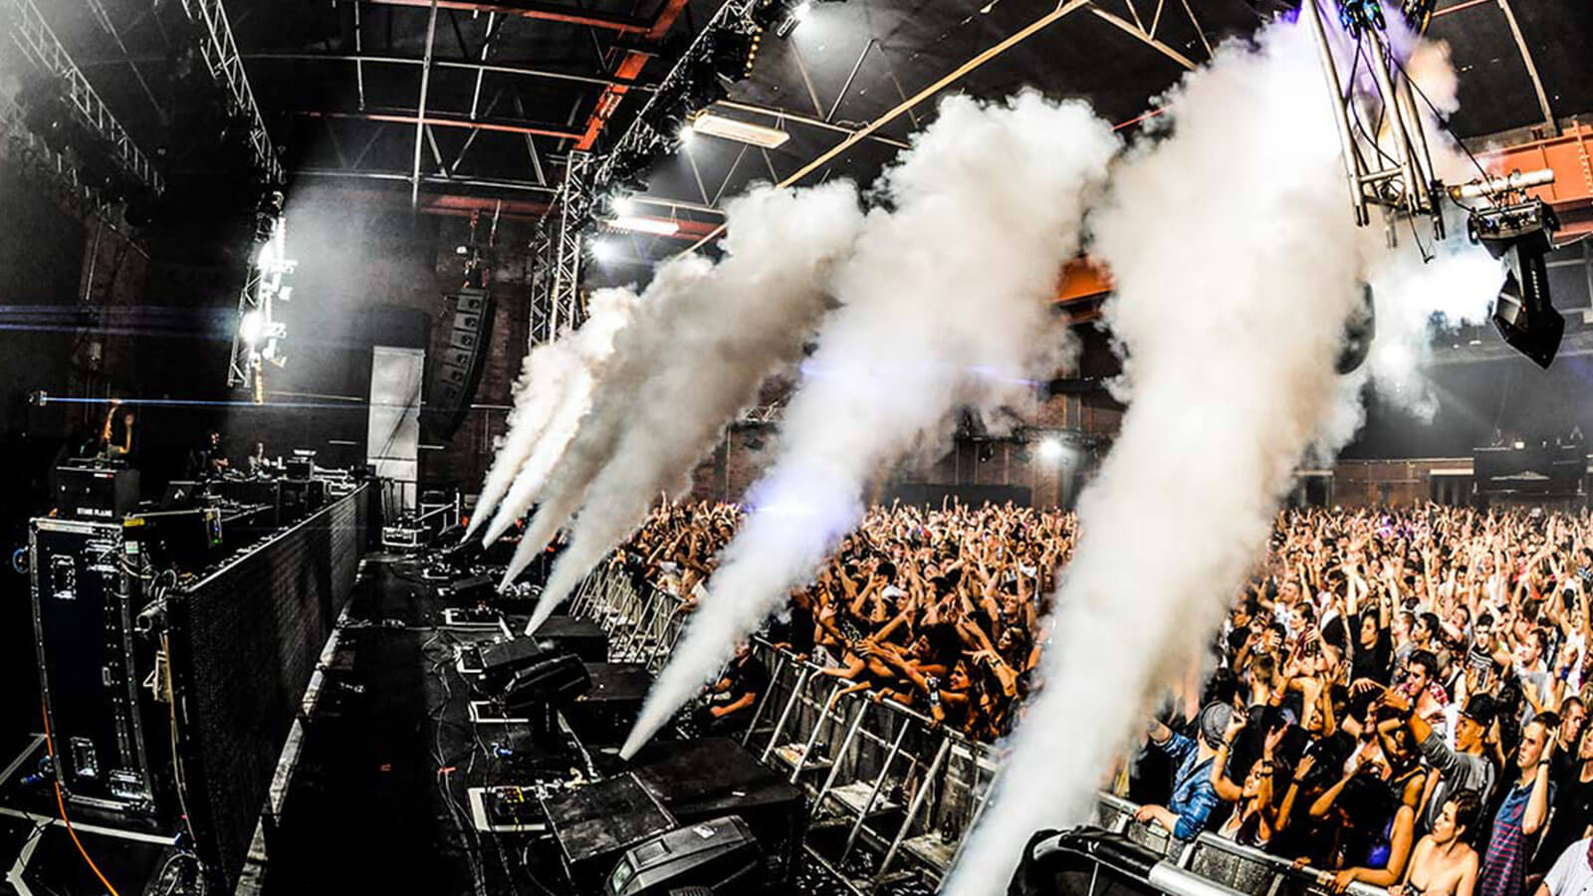
Some examples of uses of cryogenic fluids
Cooling materials to become superconducting
  Cavities for SC Accelerators
  Wires/Cables for SC magnets
Cryogenic pumping of gasses and vapors
  LN2 is a great pump for water
  LHe is a great pump for everything but Helium
Material testing
  Mechanical properties change as the temperature falls so study of this is critical to provide safe and reliable operation
    Typically materials get:
      Stronger
      Some get brittle
      Shrink but not linearly, most metals nearly stop shrinking around 80K
Fuel Storage/Transport
  LAr for welding and other pure gas storage
  LOx, LH₂ Rockets
  LNG tankers
Other:
  Cryosurgery
  Cryoelectronics
  Biological storage
  Food storage
  Fog for concerts

Slide 13
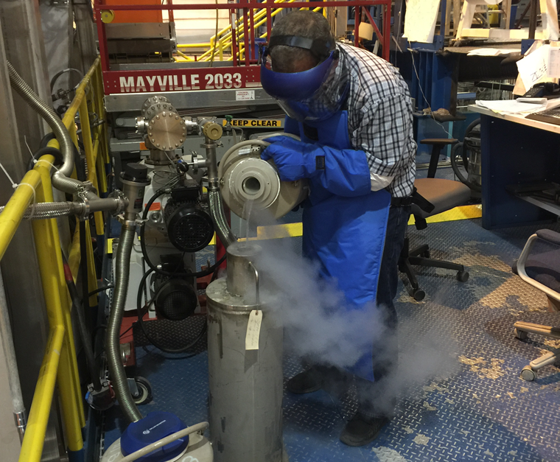
Cryogenic Pumping - Examples
Cryo-molecular Pump – Cryopump
  Basic principle is to condense or freeze a gas on a surface.
  Surfaces will eventually get “full” and the pump must be regenerated by isolating the load and warming the surface and removing the contaminate.
  LN2 can be used to very effectively pump water
1Pa=1E-5Bar=0.0075Torr

Slide 14
Cryogenic Targets
Cryo Target
  At JLab we use many different elements as targets in our experimental Halls
  Cryo Targets are essentially controlled cryopumps which take gas and covert it to liquid
    Cold helium is used to in a condenser to liquefy a gas
    The liquid collects and flows into a target cell
    Helium flow is controlled to match the heat load (power deposited by the electron beam) and heaters are used for stability control when the beam trips off, they also provide safety to prevent the liquid from freezing

Slide 15
Cryogenic Pumping example: Cryo-Target
Helium Supply
Helium Return
Gas Tank
Condenser w/heater
Pump
I
Target Cell
CEBAF
Supply valve opens and cold helium ~15K flows through the condenser
Hydrogen condenses on the cold surfaces and condenser fills
Tank pressure falls (gas is cryopumped)
Target Cell, Pump and Condenser fill all while the Tank pressure drops
Heater comes on to keep the liquid from freezing
Pump circulates the hydrogen through the cell
Beam comes through the cell and imparts power
Heater turns down to keep from boiling off all the liquid

Slide 16
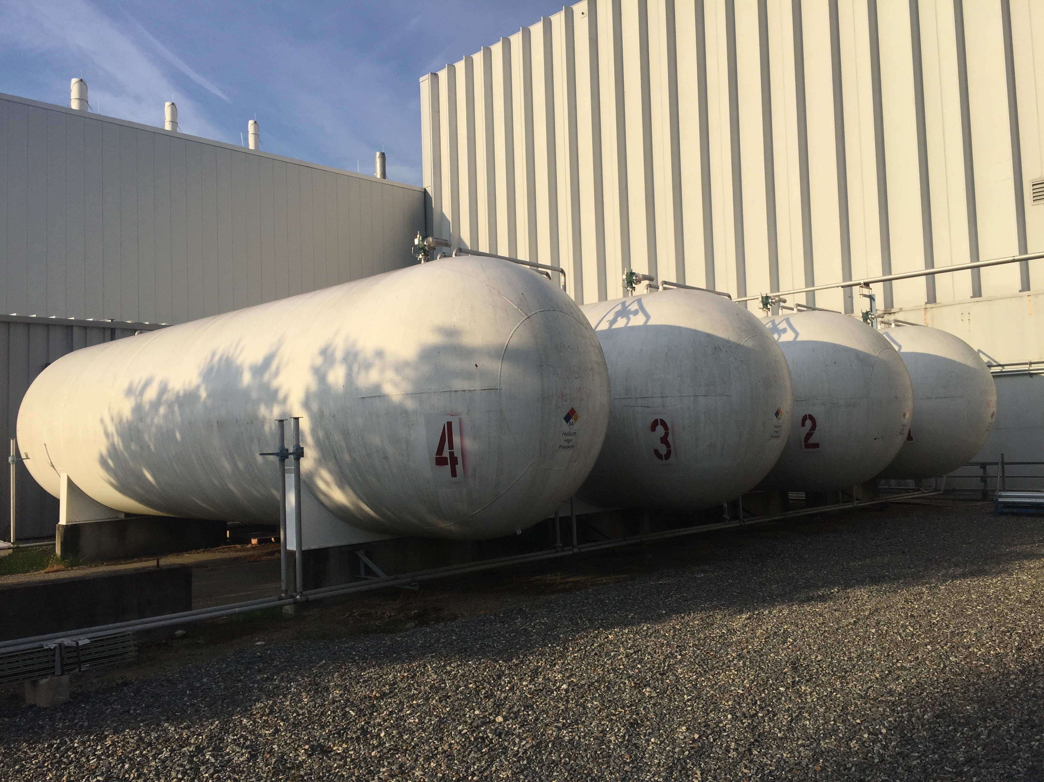
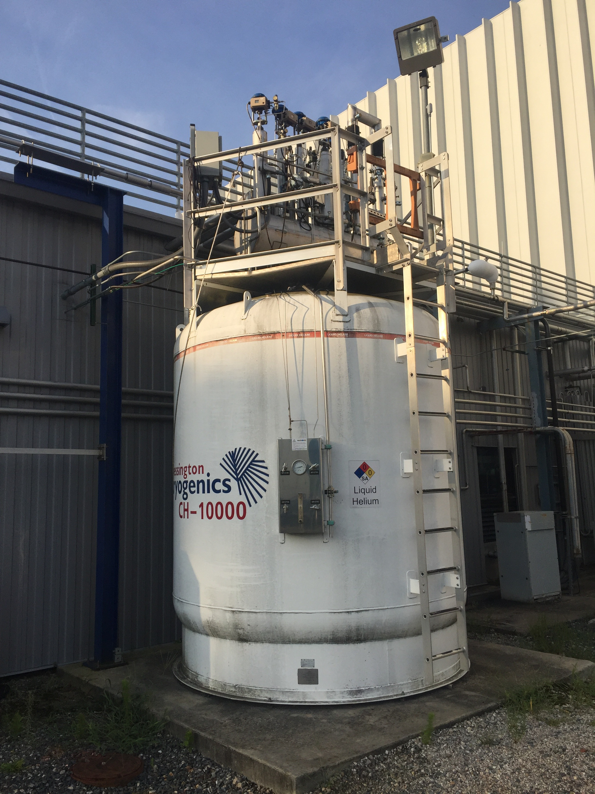
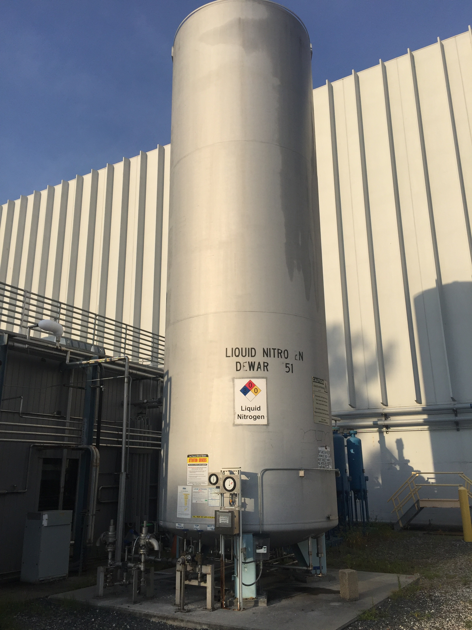
Cryogenic Refrigeration at JLab - Storage
JLab Cryogenic Refrigerators use Helium as the refrigeration fluid. (note fluid can be in either liquid or gaseous condition)
We store helium in both liquid and gas states
We also use Liquid Nitrogen to help in cooling the helium within the cold boxes
30,000gallon Helium Gas storage tanks: Ambient Temp x 1.2 to 20atm
10,000 liter
Helium Dewar:
1.2 atm x 4.4K
10,000 gallon
Nitrogen Dewar: ~5atm x 90K

Slide 17
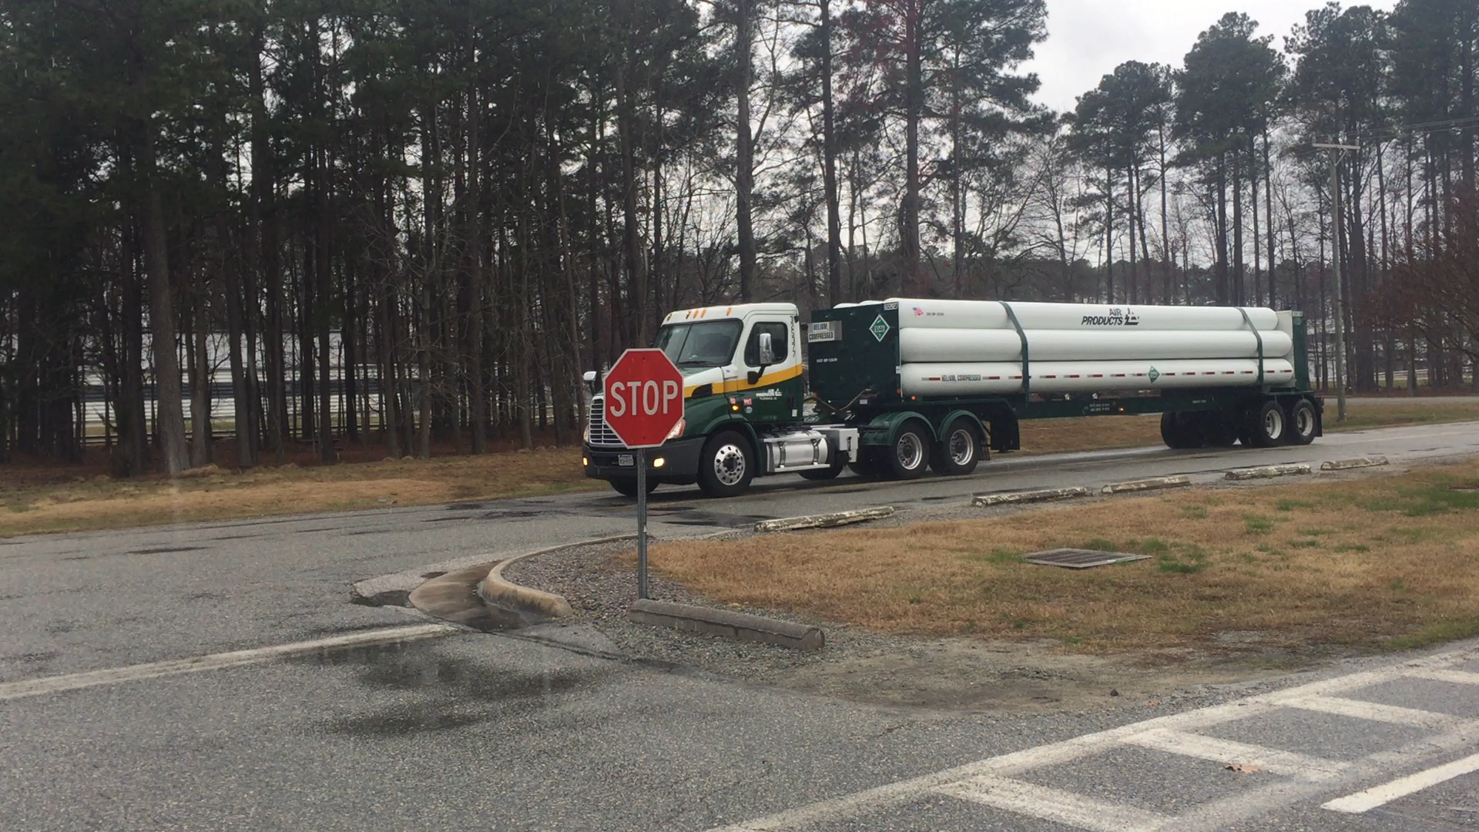
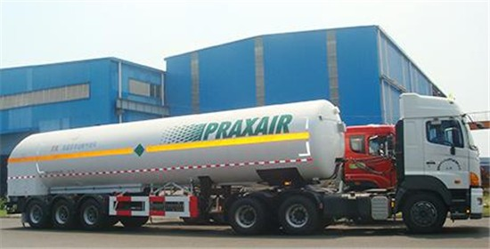
Cryogenic Refrigeration at JLab- Gas Procurement
Where do we get the liquids and gasses ?
Helium is brought in as gas in high (~3000psig) pressure tube trailers
Nitrogen arrives as liquid in mobile dewars

Slide 18
Cryogenic Refrigeration at JLab – Warm Gas Storage
The helium is off loaded to 30,000 gallon dirty tank then passed through the helium purifiers to remove any contaminates (Anything that is not Helium such as Water Vapor, Nitrogen or other Gas)
Tube Trailer
Helium Gas Storage
CHL 1 and 2 (Central Helium Liquefiers)
Test Lab and CTF (Cryogenic Test Facility)

Slide 19
Cryogenic Refrigeration at JLab – Helium Purification
What are purifiers
  Simply put they are LN2 cooled vessels that contain charcoal beds
  Pressurized Helium is cooled to 80K in a set of heat exchangers then flows through the cold charcoal bed (from top to bottom). All non-helium gasses “stick” to the carbon surface in a process called adsorption. The clean helium passes back through the HX to get warmed and then is used as needed. Typically it goes to a storage tank for future use.
  Purifiers are “regenerated” by heating, depressurizing, and pumping a vacuum on the beds
  There is lots of instrumentation involved,
    Pressure and differential pressure
    Temperature
    Flow
    Contamination
  There are many valves, some heaters, compressors and dehydrators
Why purify
  Non Helium gasses will freeze to solids below 20K and this “contamination” will eventually cause problems with the refrigeration process such as plugging pipes or misbalancing turbines

Slide 20
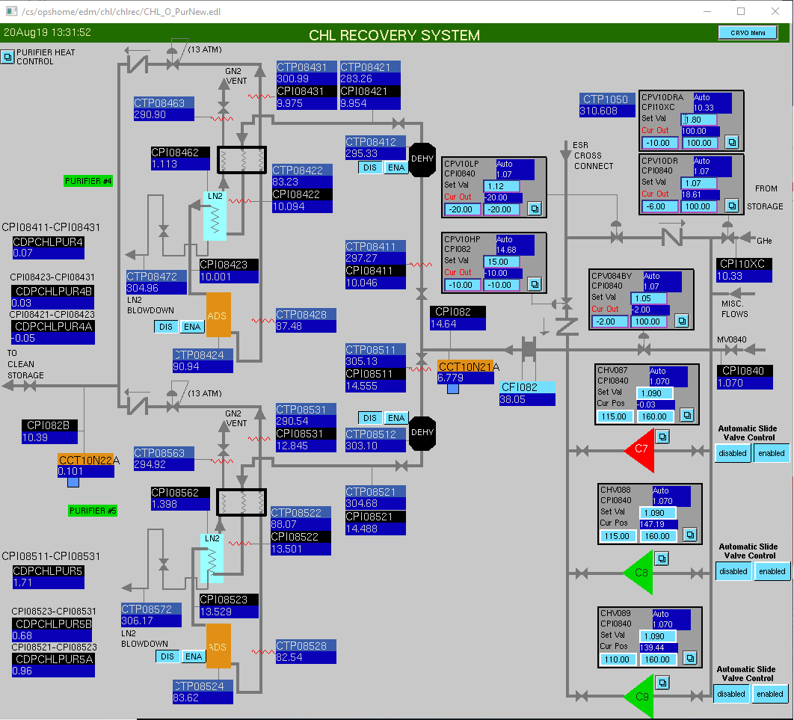
Cryogenic Refrigeration at JLab – CHL Purification Control Screen
Pressure Control Valve
Return from Halls
EPICS Control Screen
Desired contamination < 3ppm on outlet
Charcoal bed (Adsorber)
Small Helium Compressors (~30g/s)

Slide 21
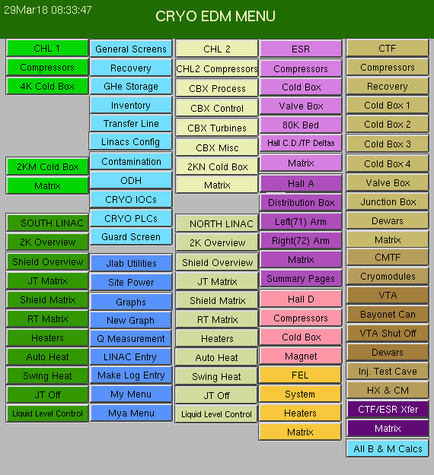
Cryogenic Refrigeration at JLab – Main Control Screen
Cryogenic systems at JLab
  CTF
  CHL1 & CHL2
  ESR
  Hall D Refrigerator
Users
  Halls A, B, C, D
  Cryogenic Targets
  Vertical Test Area
  Cryomodule Test Cave
  Injector Test Facility
There are hundreds of screens like the purifier screen shown on the previous slide

Slide 22
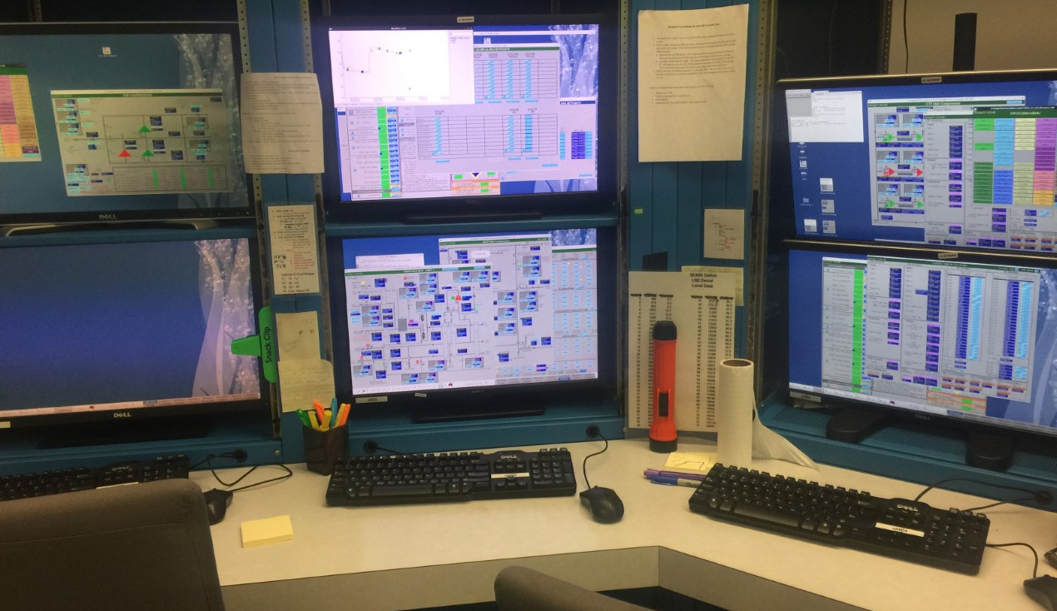
Cryogenic Refrigeration at JLab - 24/7
How does it all continue to run?
  All systems are setup to run w/o continuous human intervention
  Feedback loops with PID control adjust devices to keep the systems stable
  When important parameters get out of range automatic paging systems page system experts, or in cases of extreme deviation they shutdown the system(s).
What is PID Control?
  Next few slides will give a brief overview
CHL Control Room 2pm 8/20/2019
Unmanned

Slide 23


Cryogenic Refrigeration Process at Jlab – PID Control
PID stands for Proportional, Integral and Differential control
You yourself are pretty good at PID type control
  Say you want to fill your coffee cup. You follow a set of steps:
  First you start to pour slowly to be sure that you don’t miss the cup and that it does not splash
  Then you pour faster to get the cup full
  Then as the cup approaches its ideal level you slow then stop the pouring
  Each of these steps require looking at a process variable
    Position of fluid entering the cup
    Amount of splash
    Level
  We determine the rate of change of level and make adjustments to the pot location and angle

Slide 24
Cryogenic Refrigeration Process at Jlab – PID Control
Loops are used to control Process Variables (PV’s)
  Pressures
  Temperatures
  Liquid levels
  Flow rates
Control devices are:
  Valves
  Heaters
  Pump speeds (some target systems, cold or warm compressors,…)
PID controls can also operate in Manual Mode

Slide 25
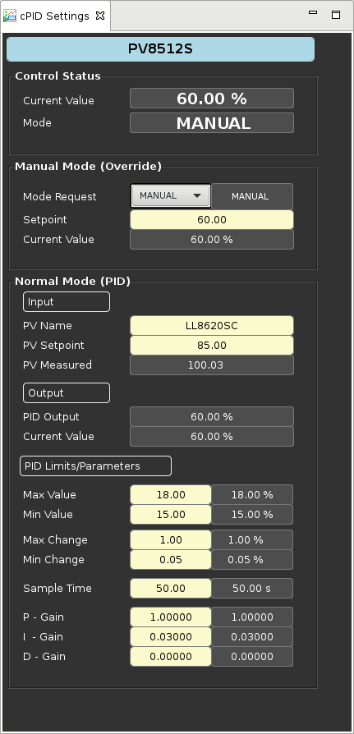
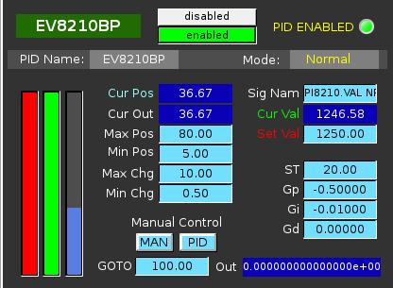
Cryogenic Refrigeration Process at Jlab – PID Control
Examples of PID loops and what is in them
Device to be controlled
Control Mode
(Manual or Normal)
Input Signal (Process Variable)
Process Variable Setpoint (desired value)
Process Variable Measured (current value)
Min and Max value
(not necessarily full range )
Min and Max Change (per Sample time)
Sample Time
Gains

Slide 26
Cryogenic Refrigeration Process at Jlab – PID Control
Gains can be positive or negative
Depending on the effect desired one may want a valve to close or open to effect the process variable being controlled
Examples
  If valve EV8115JT is used to control the pressure then it must open to increase the pressure,
  Whereas if EV8117BP is used it must close to increase the pressure.
  Thus the sign of the gains would be opposite
EV8115JT
EV8117BP
FI 8114
PI 8116

Slide 27
Cryogenic Refrigeration Process at Jlab – PID Control
It is important for stability that control devices are setup to control on “dependent” variables.
In the example below either valve could control based on either signal, but for system stability there is really only one proper setup.
  Small changes in EV8115JT would quickly effect the flow but small changes in EV8117BP would not.
Large Storage Tank
EV8115JT
EV8117BP
FI 8114
PI 8116

Slide 28
General Refrigeration Process
Compress the gas to ~15-20 atm with a compressor, oil sealed screw compressors are the most common, the oil creates the seal and also cools the helium during compression
Remove the oil with coalescers and filters
Gas goes to the cold box and is cooled by return gas and heat exchanger with liquid Nitrogen on one stream.
Then a series of heat exchangers and expanders.
Expanders remove energy from the fluid by having it do work. Ideally this is done in an isenthalpic (constant entropy) process.
Once cold enough the refrigerant goes to the load, where it is warmed or boiled off and then the cold return gas goes back though the HX’s
Once the gas is out of the cold box (nearly room temperature), it returns to the compressors

Slide 29
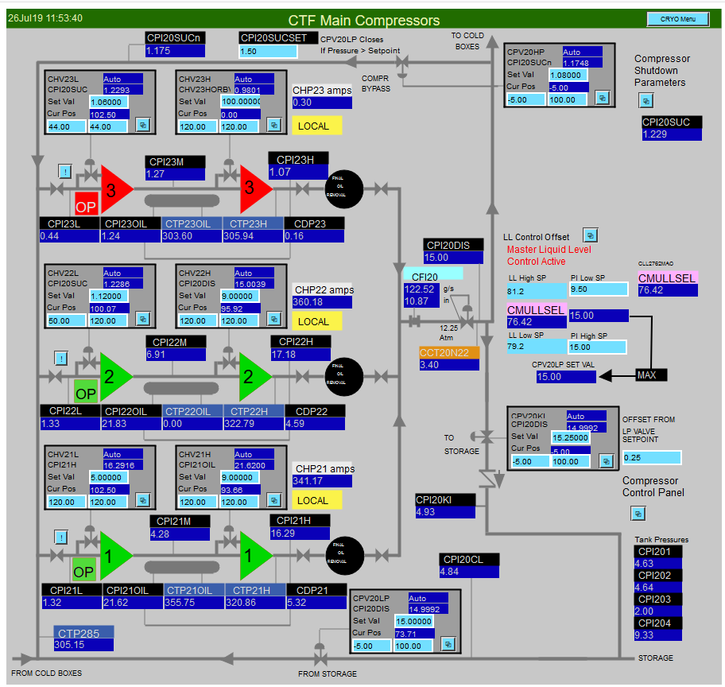
Refrigeration Process – CTF Main Compressor Screen
To Cold Box
Compressor Control Screen
Compressors have many controls
  Load valves
  Discharge pressure is adjusted to adjust system capacity to match the load, this saves power
  Gas flows into or out of storage tanks as needed
From Cold Box
To/From Storage

Slide 30
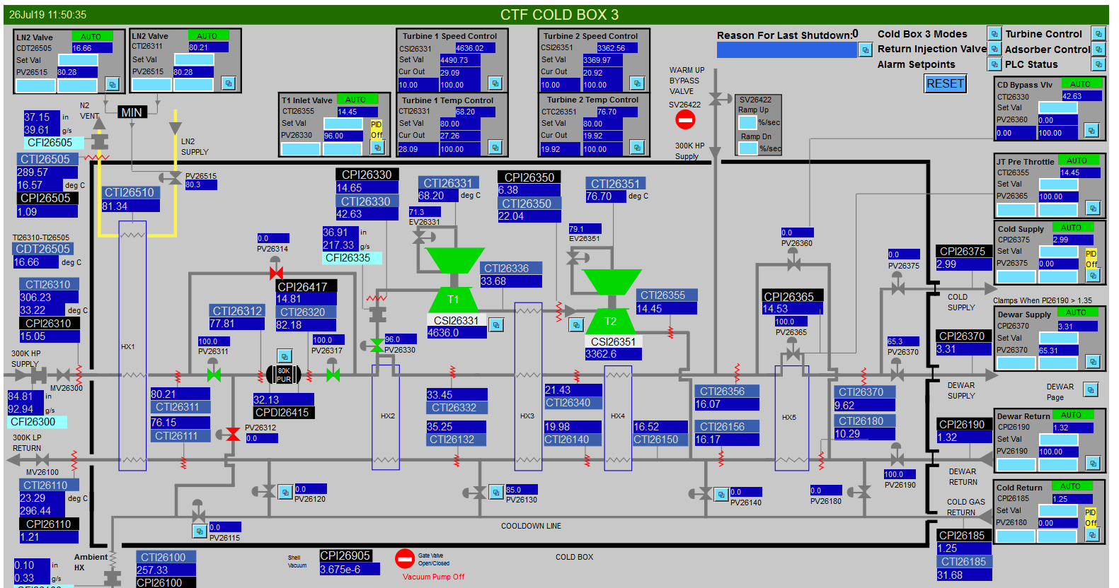
Refrigeration Process – CTF Cold Box 3
Cold box has controls on LN2 flow, Turbine inlet valve, Turbine brake valves and valves to the loads
In this case the flow through the Turbines does not go to the loads but to the return stream, this varies with cold box design.

Slide 31
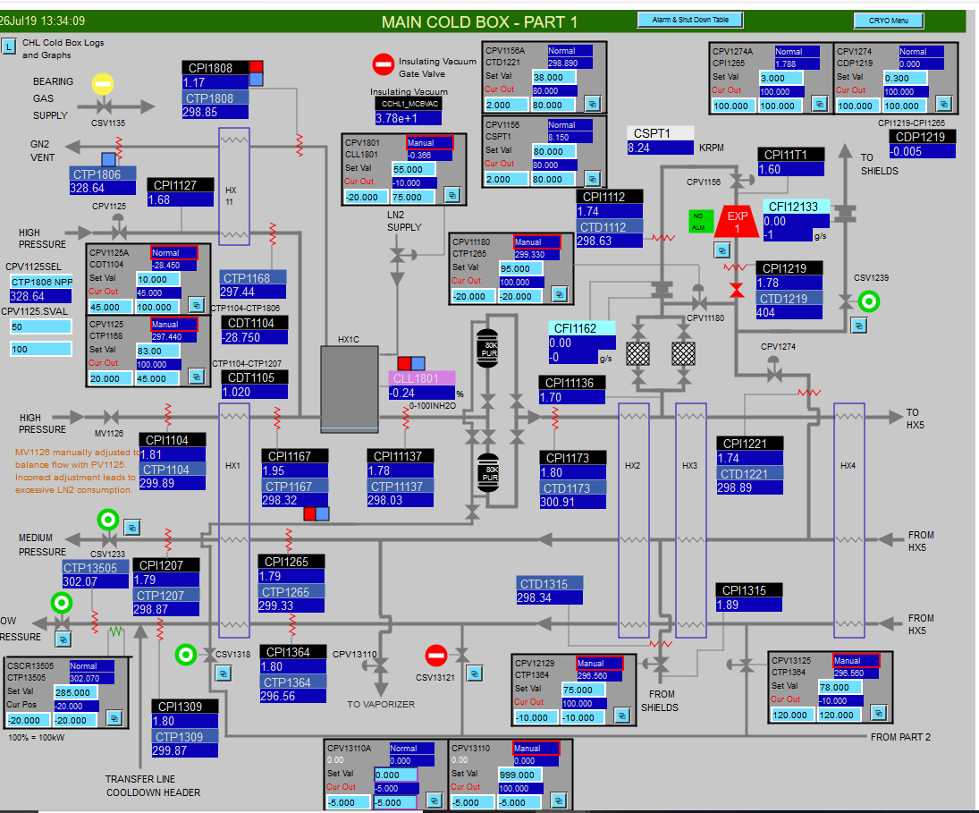
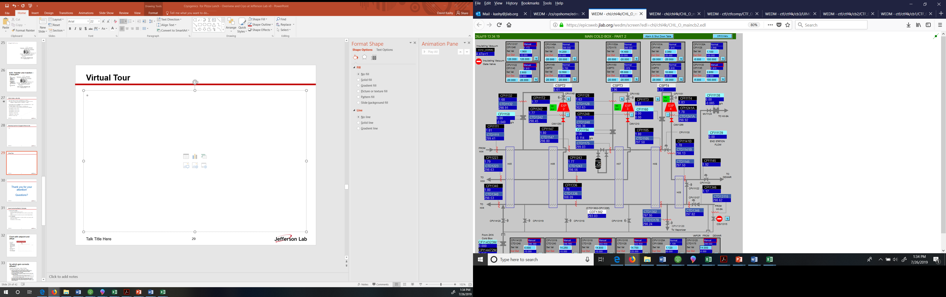
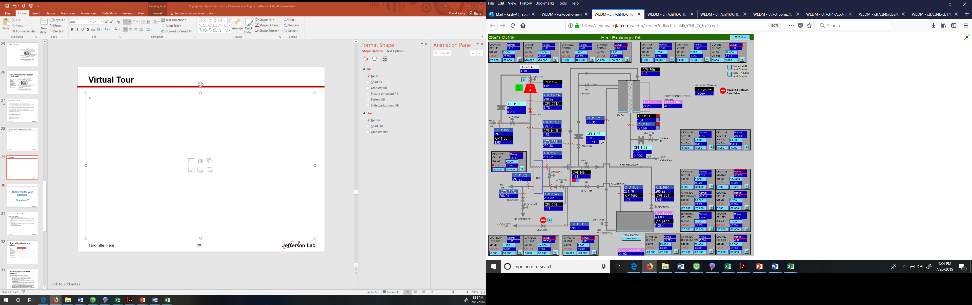
Refrigeration Process: CHL 1 4K Cold Box screens
The CHL1 MCB has 4 turbines, the main pages for control are displayed on 3 pages.
CHL2 MCB has 7 turbines to achieve higher efficiency.

Slide 32
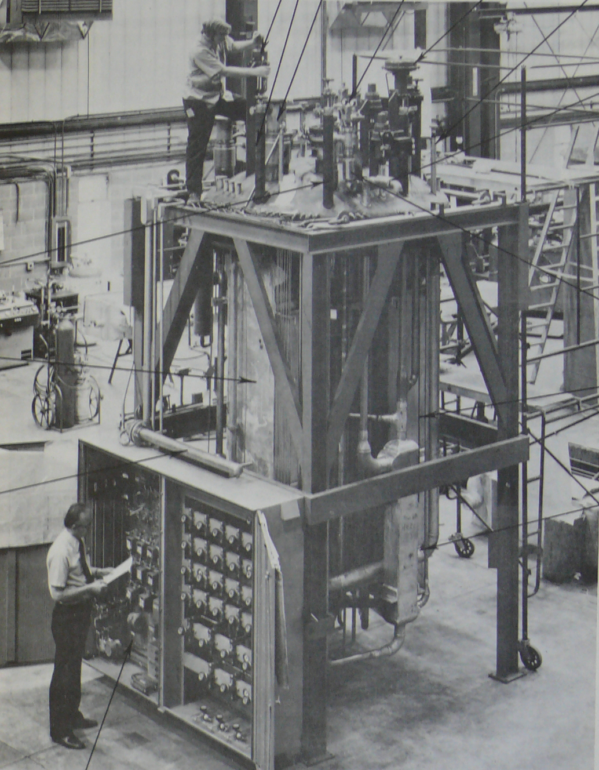
Typical Cold box - ESR1
This is a photograph of the 1.5kW ESR Cold box during initial fabrication.
It is vintage 1970’s and was commissioned at JLab in the early 1990’s
ESR 2 will use a 4kW coldbox from the SSC, JLab has 3 units on site so 2 will be used for spare parts.

Slide 33
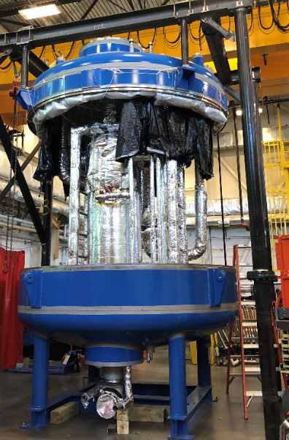
Refrigeration Hardware: New CHL1 2K Cold Box
Cold boxes are generally quite packed with hardware. Space is always at a premium and the larger the vacuum vessel the more it costs and the bigger the building needed to house it.
This is a photo of the new 2K cold box being constructed at JLab
Piping and large heat exchanger are covered with MLI to reduce the heat load

Slide 34
Cryogen Distribution
Distribution lines designs vary depending on:
  the loads which they support
  the space allowed for installation
  and even things like installation schedule and manpower
All have some similarities
  Vacuum spaces filled with MLI (multi-layer insulation)
  Low heat load spacers- G10 is often used
  Stainless Steel pipes
Quality welding and leak testing are critical

Slide 35
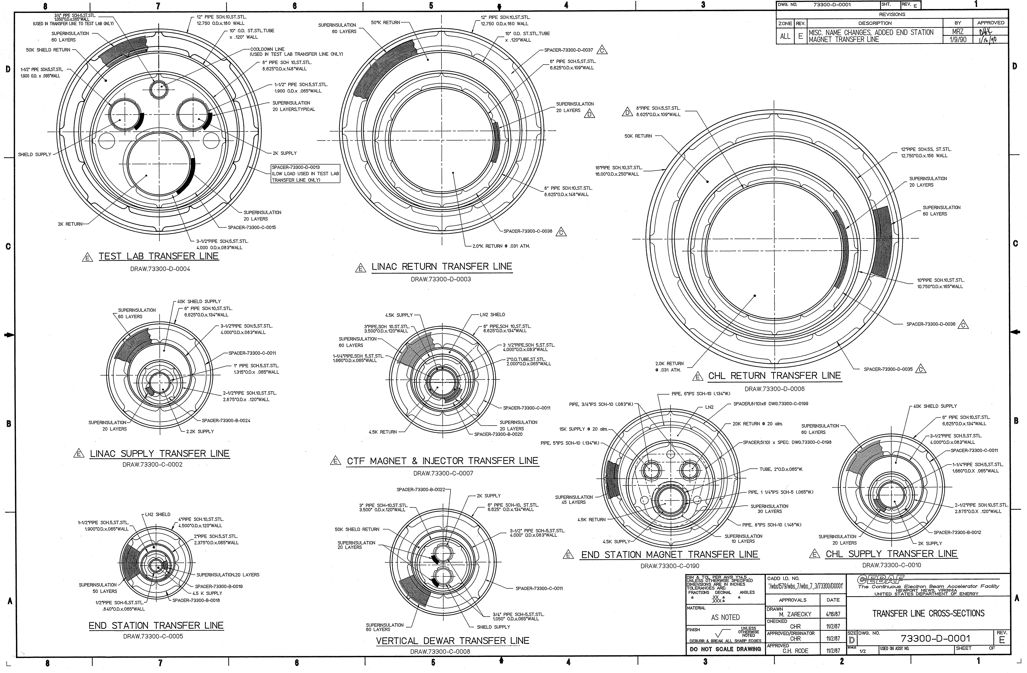
Some of the TL Cross-Sections at JLab
40.6cm
2K supply
2K RTN
Shield fluid
4K RTN
4K supply
2.1cm

Slide 36
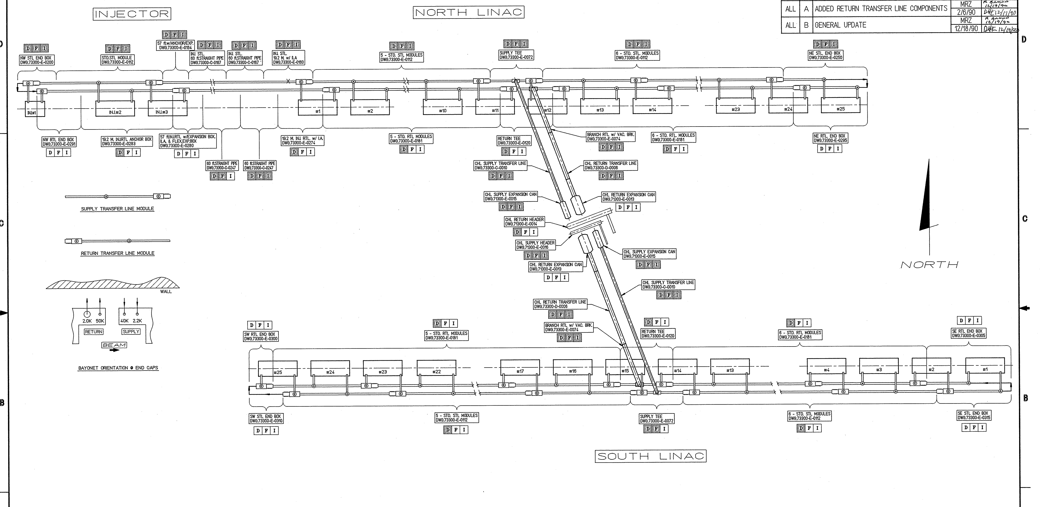
CEBAF Linac Distribution System
This system has about 1.4km of VJ transfer line. Entire site has over 2km

Slide 37
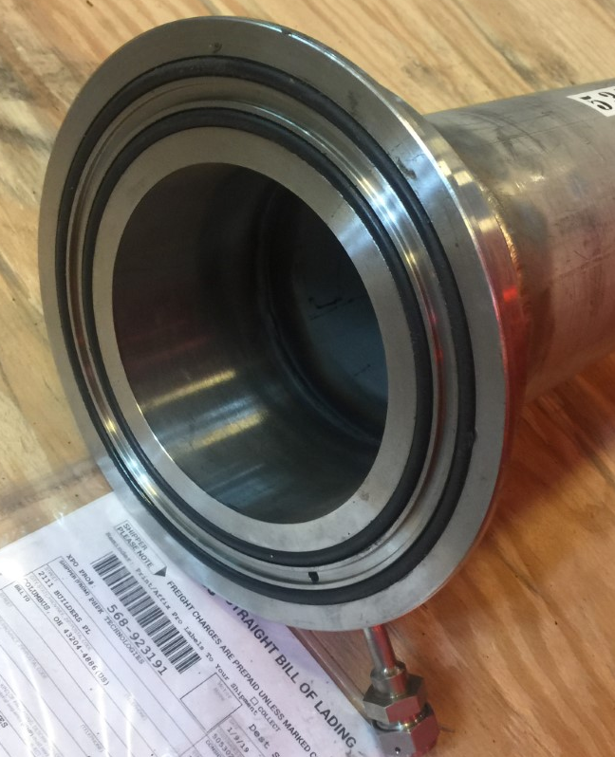
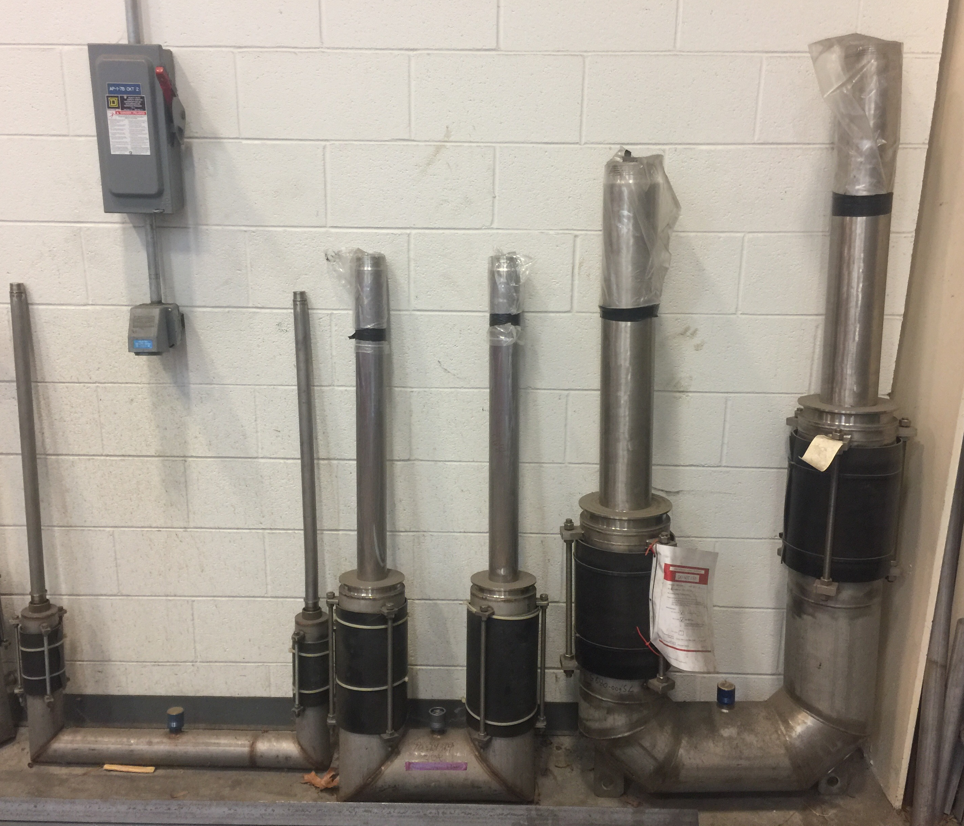
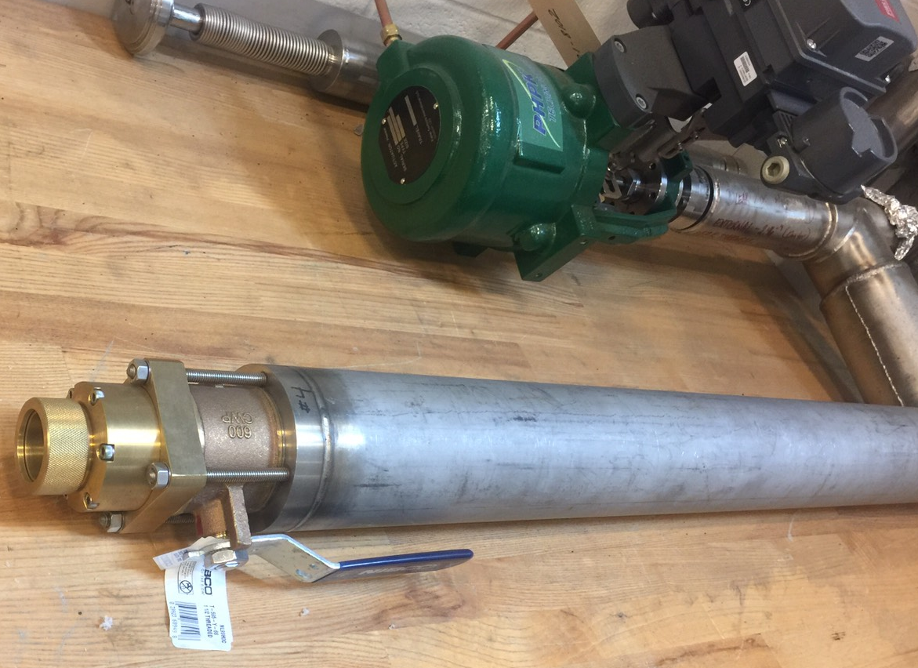
Cryogenic Distribution: Connections
Low heat load connection piping that is removable is very important to allow service or connecting different hardware for different experiments or changing out a Cryomodule for example
Bayonet connections are used
  They provide low heat load by having long thin wall tubes that are vertical to get both low conduction heat transfer and stable thermal gradients
  JLab has many standard bayonets depending on the flow rate and pressure drop allowed in the pipe system. They range from 1.5” to 9” diameter
  To assure thermal stability and allow clean removal from a load, two male bayonets are connected together into what is called a U-tube
U-tubes with 1.5, 3, and 5” male bayonets
Female bayonet with control valve in a piece of hardware
Female bayonet with double O-ring

Slide 38
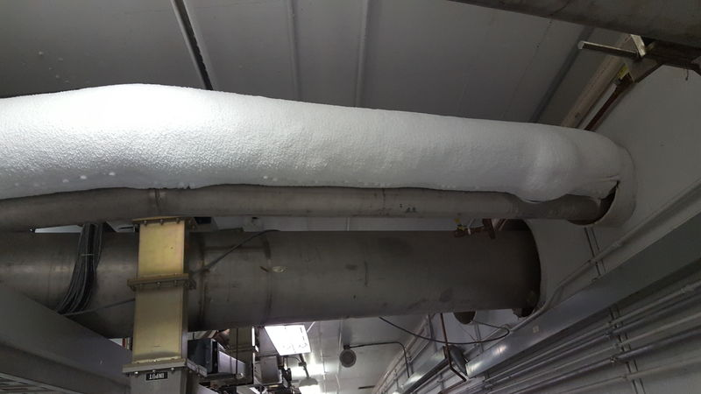
Cryogenic Distribution
Linac Tunnel X-section
Note room for Cryomodule replacement
Cryomodule
U-tube
Warm Gas lines
Supply and Return TL’s

Slide 39
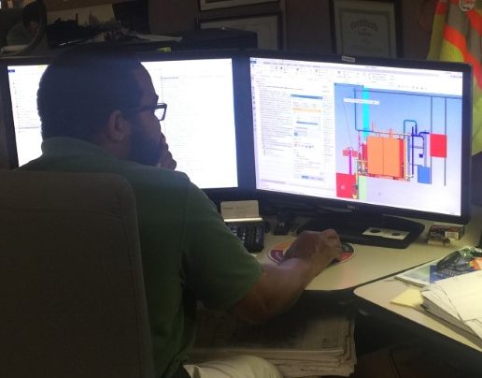
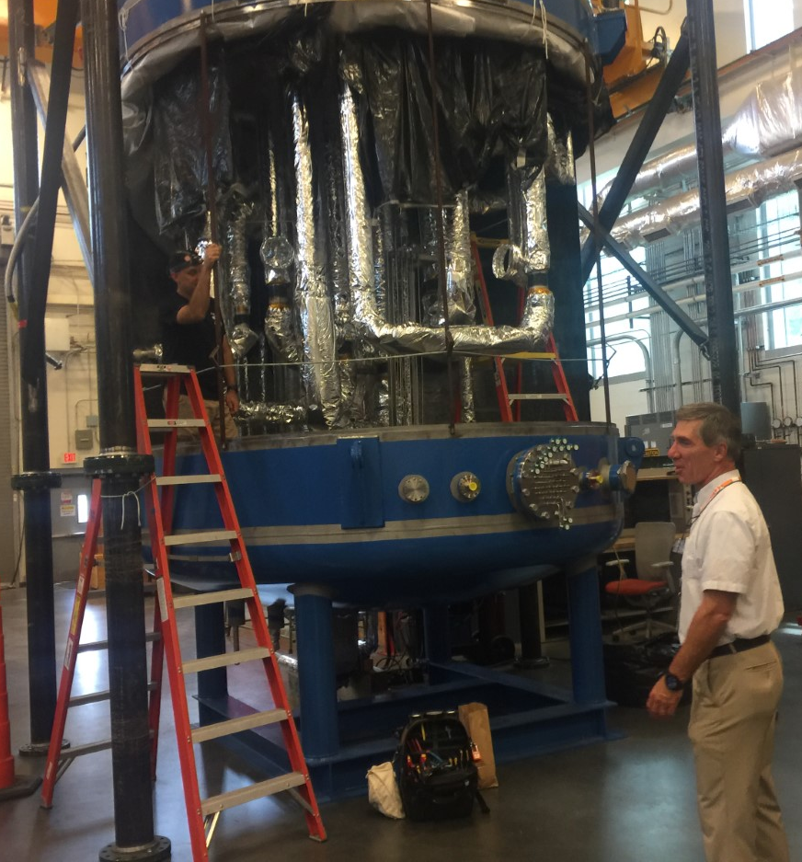
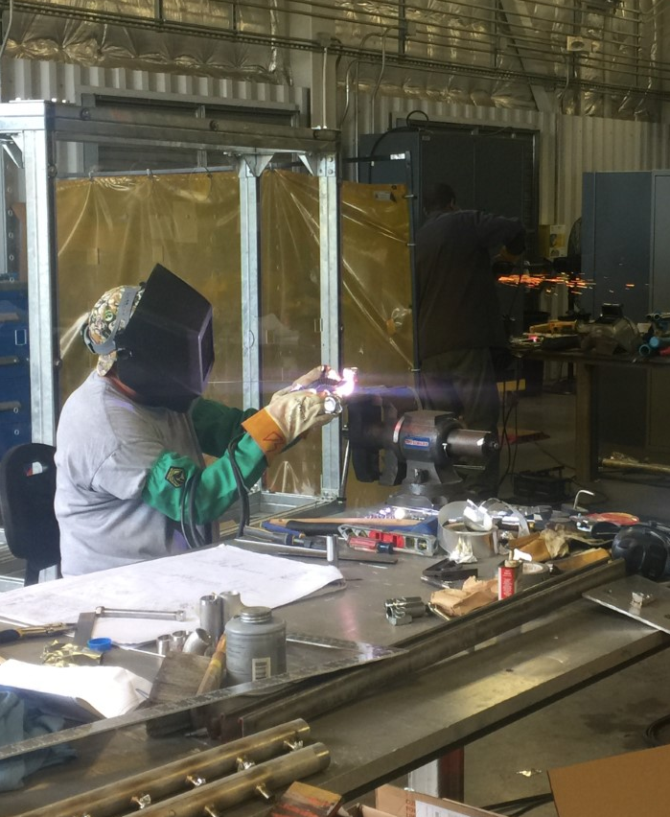
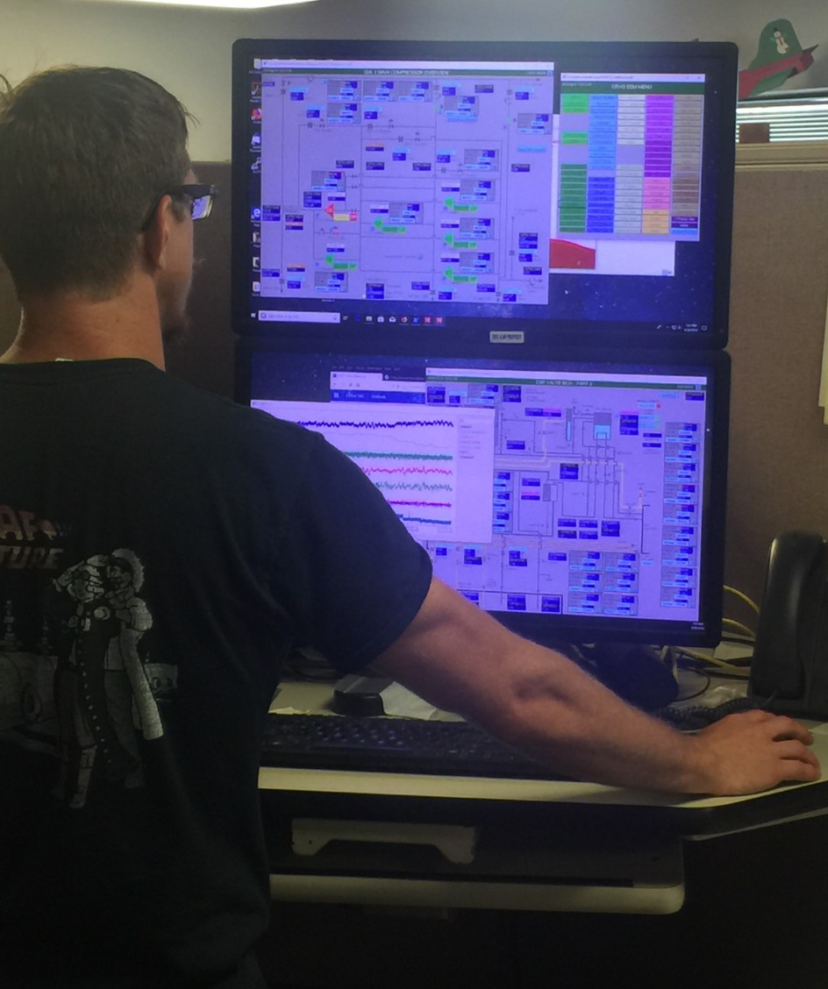
Annual cost of Cryogenics at JLab
Electrical power for all plants ~10MWatt ~5M$
LN2 pre-cooling ~ 1.2 M$
Helium ~0.8M$
Staff ~40 people (includes management, design, operations and fabrication)

Slide 40
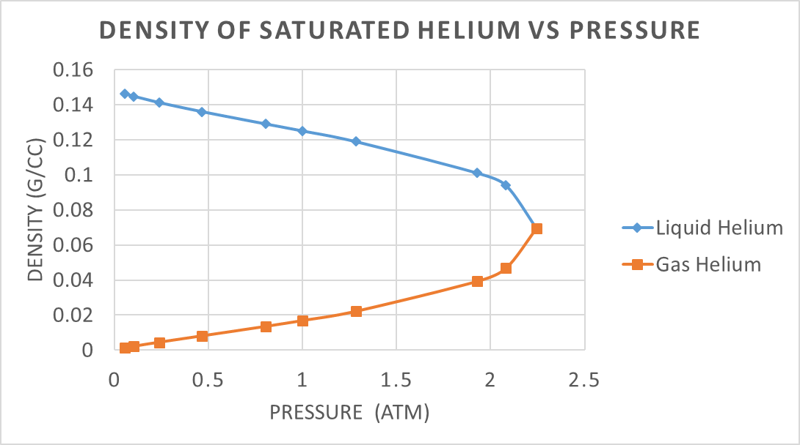
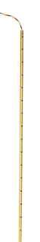
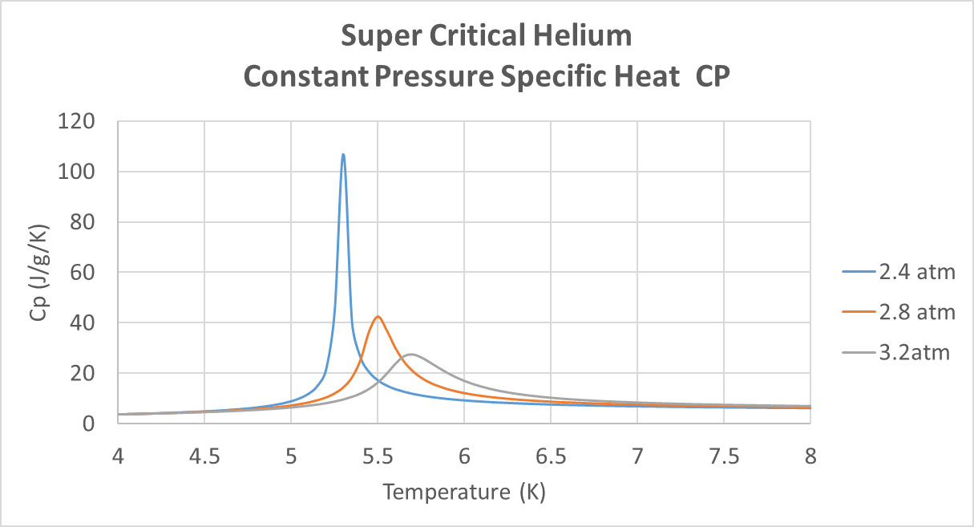
Cryo Tidbits – Helium Properties (not linear or constant)
Critical point
Critical point

Slide 41
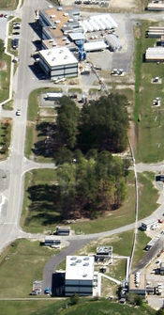
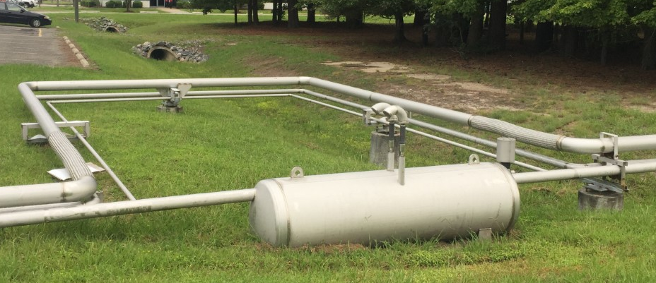
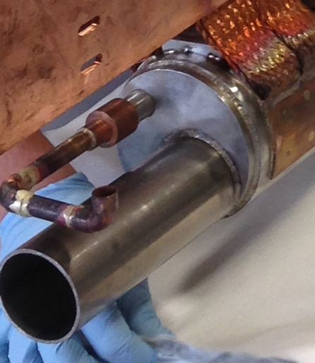
Cryo Tidbits
Most materials shrink significantly when cooled
Shrinkage when cooled from 300K to ~0K
Material | ΔL/L | %
Invar | 0.00042 | 0.04%
304 Stainless | 0.00304 | 0.30%
Copper | 0.00339 | 0.34%
Aluminum | 0.00431 | 0.43%
Nylon | 0.0145 | 1.45%
Teflon | 0.02695 | 2.70%
Distance between CHL and ESR is ~336m
336m x 0.00304 = 1.2m
Stress = E x ΔL/L = 28E6 psi x .00304= 85,120psi
Sy=30,000psi!
Can’t be solid pipe or it will fail

Slide 42
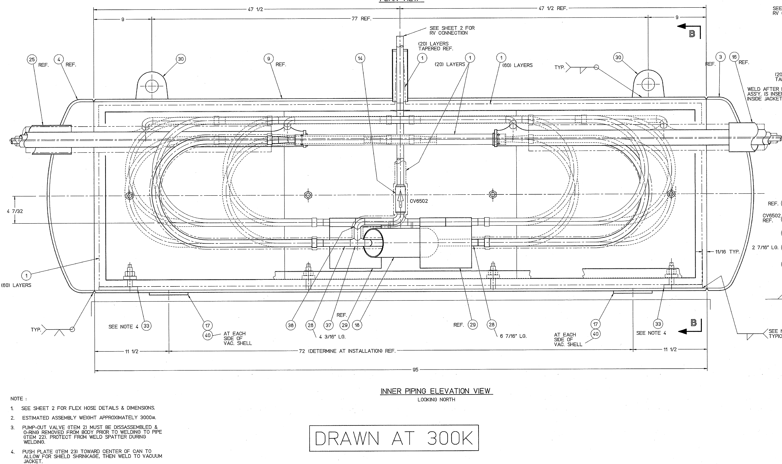
Cryo Tidbits – Built in Flexibility
ESTL Expansion Can Inner Piping
Temperature Range 4K to 367K (200F)

Slide 43
Cryogenics
It’s a complicated and fascinating subject
This talk went over lots of material, I hope I’ve given you a better understanding of JLab Cryo and Cryogenics in general.
The cryogenics group has a dedicated staff that is keen on supporting our physics program
There are many experts at JLab that can help to design or operate systems for you
Thank you for your attention!
Questions?

Slide 45
Cooling Power Examples
Target Refrigeration
10g/s of 15K gas to a cryogenic target
Specific Heat at this temperature is ~constant at 5.2J/g/K
Target returns the gas at 20K (temperature of LH2)
P=mdot x Cp x DT = 10g/s x 5.2J/g/K x 5K = 260W
Vapor Current Lead Cooling
Lead flow 0.3g/s each for two leads total flow =0.6/s
Mode Liquefaction
P= mdot x H_{fg} = 0.6g/s x 20g/J = 12 W (liquefaction load on the refrigerator)

Slide 46
Helium Costs – site wide
Site wide helium inventory ~163,000 liters or ~20tons
Site wide JLab loses about 350-400 liquid liters of helium per day.
  400l/day x 125g/l x day/24hr x hr/3600sec = 0.58g/s
Latest helium cost is: 5.17$/l plus trailer rental $2040/month – each tube trailer costs us ~$34,000
5.17$/l x 400l/day * 30day +2040 $ = 64,000$/month
From October 2017 to March 2018 we purchased the following:
OCTOBER-3 Trailers Tubes
NOVEMBER-4 Trailer Tubes
DECEMBER-2 Trailer Tubes
JANUARY-1 Trailer Tube
FEBRUARY-1 Trailer Tube
MARCH-2 Trailer Tube
Find and Fix your Leaks!!

Slide 47
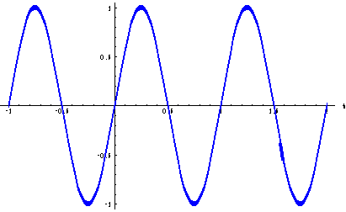
Cryogenic Refrigeration Process at Jlab – PID Control
Each system has its own frequency response
  A 500 liter dewar will not see a very quick level rise while a small piping system can see its pressure or temperature change quickly
One would like to see ~3-5 changes of the PID output every ¼ cycle of a “sinusoidal” oscillation this helps set the sample time
The ratio of the P-gain/(ST*I-gain) should be between 3 and 10 in most to cases (most of the time 3 is perfect, but could be up 20 but not often this high)
Gains should be small enough to not request max changes on each sample time
3-5 changes in this time span

Slide 48
Super Conducting Material - Examples
JLab SC RF Cavities
  Cooled with liquid helium to 2.1K
  Note this 2.1K is much colder than the 4.2K on previous slide. Why?
  External surfaces of cavities are put in a bath of liquid helium
JL SC Magnets
  Cooled with liquid helium to ~4.4K to 4.9K or even down to 2K
  Why such variety?
  Conduction vs bath cooling

