Slide 1
Cryogenics – The Basics
Lesson 5
Hall B DBX and Torus - LN2 Operation
D. Kashy

Slide 2
Lesson 5 - Topics
LN2 Supply from CHL/ESR
ESR Valve Box
Hall B Distribution Box (DBX) for LN2 Supply
Torus flow paths and controls
Return gas to vaporizers and vent
What to look for if called in and what to do next
Questions

Slide 3
Special NOTES
The slides in this presentation are a snapshot in time. They give general principles of operation.
The PID control loop settings may not be up to date so the operators must use the relevant spread sheets to verify recent and most proper settings.
M:\hallb_eng\CLAS12\Magnets\Operations\Cryogenic Operations

Slide 4
Hall B Torus N2 Operation
Liquid Nitrogen is supplied all the way from CHL via the ESTL (end station transfer line) which has a 4” vacuum jacket and 3”x2.5” IPS shield circuit that flow LN2. Inside that coaxial line is a 4.5K pipe that provides 3 atm supercritical helium boost for ESR
The LN2 feeds 3 Halls and the ESR cold box

Slide 5
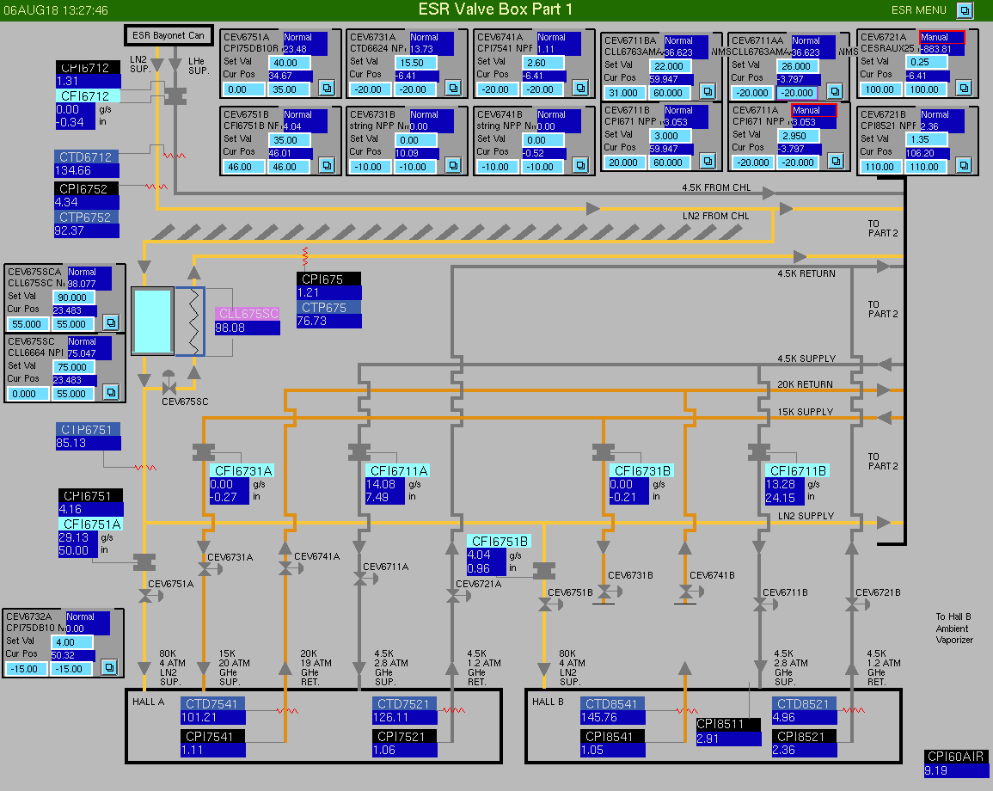
ESR Valve Box (part 1)
Nitrogen Sub-cooler to send 4atm liquid at 77K (subcooled liquid). When it reaches the Hall it is most of the time two phase.
LN2 supply flow meter, normal is ~0-30g/s)
4K Return Line with Cold Return Valve
CEV6721B (must be shut upon long ESR outages to facilitate Hall B magnet recovery

Slide 6
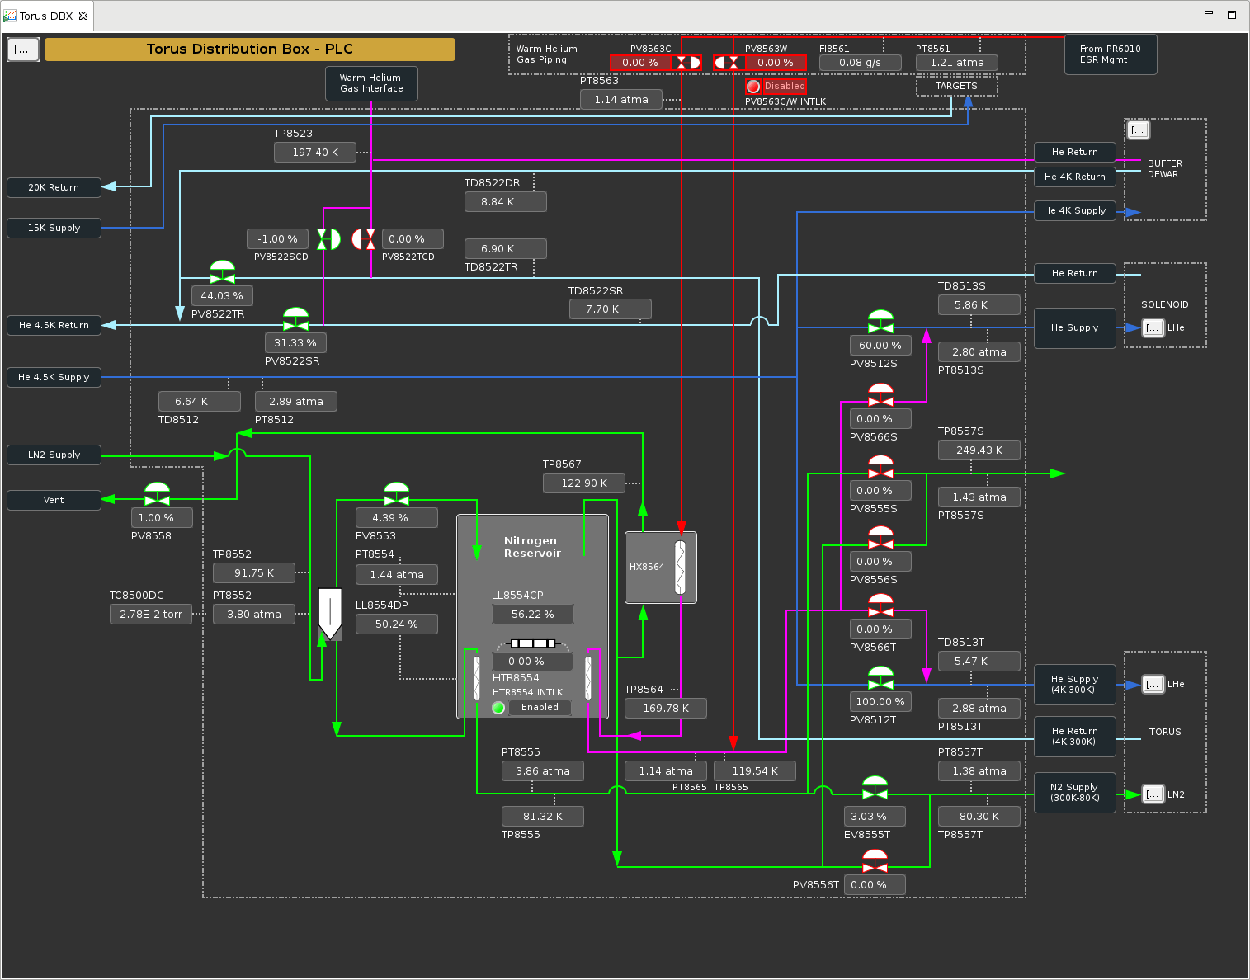
Hall B Distribution Box (DBX)
Green lines are Nitrogen lines. Nitrogen is used for cooling Helium to cool both the Torus, Solenoid from 300-80K and for the Torus shields
3 valves in the DBX are used during steady state operation of the entire N2 circuit of Hall B

Slide 7
Geometry is critical in LN2 system
The ESR supply is ~20ft above the DBX and the transfer line slopes down to the Hall.
This can and in Hall B does cause the transfer line to be “batch filled”
This is because the TL holds a large volume ofLN2 (~250liters)
Due to the heat load of the TL and the low use rate in Hall B, the sub-cooling of the valve box is not enough to keep the gas from boiling.
The boil off then occupies the volume that is removed from the bottom of the reservoir instead of filling it with new cold (subcooled) liquid.
This is why the flow rate is not constant

Slide 8
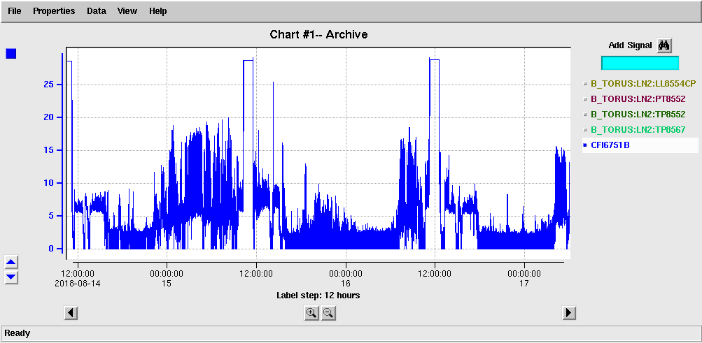
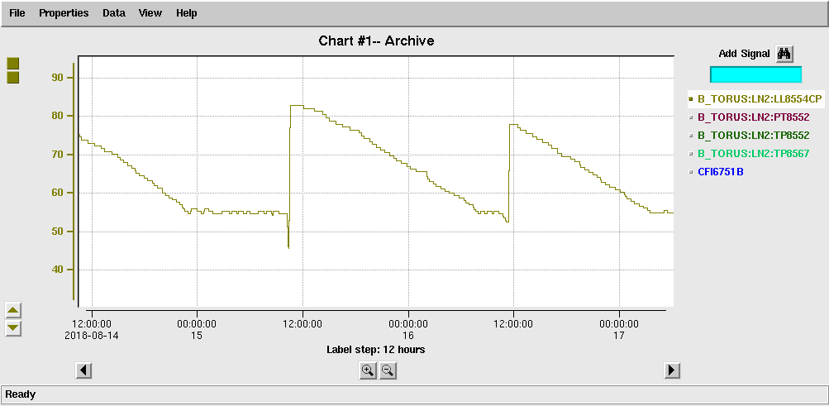
Supply Flow diagram
TL Volume 250Liters
CFI6751B
To
HX8558DC
On Catwalk
Then to vent behind ESR
CFI6751B
EV8553
DBX Reservoir 80 liters
LL8554CP

Slide 9
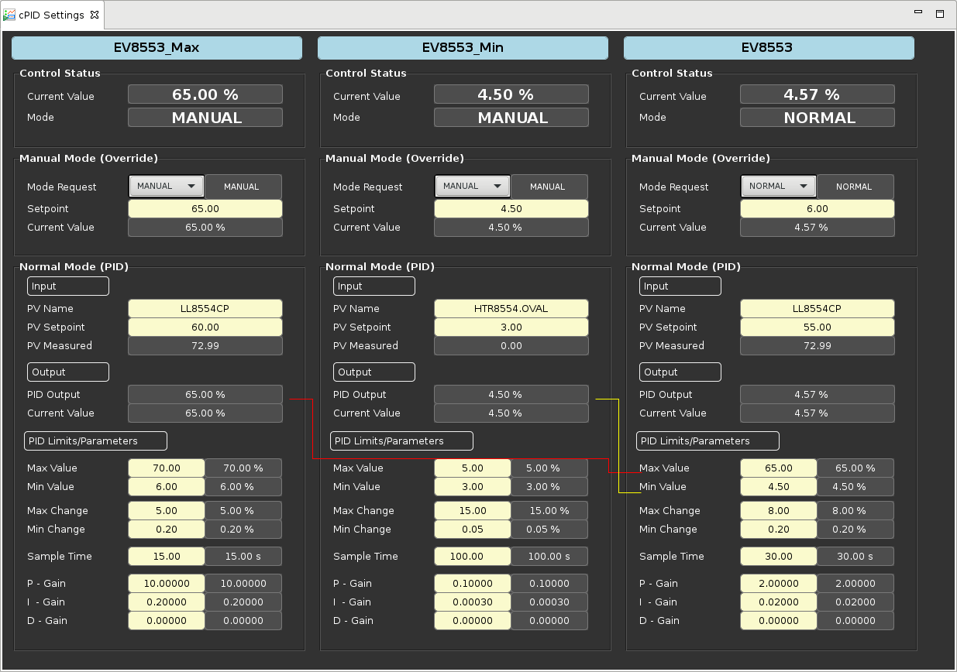
DBX LN2 Reservoir Supply Control – EV8553
Controls on LN2 level in the reservoir
Min is manual at 4.5% provides small continuous flow
Max is 65% sufficient to refill TL
This tune works for Steady State, Cool down and Parking!

Slide 10
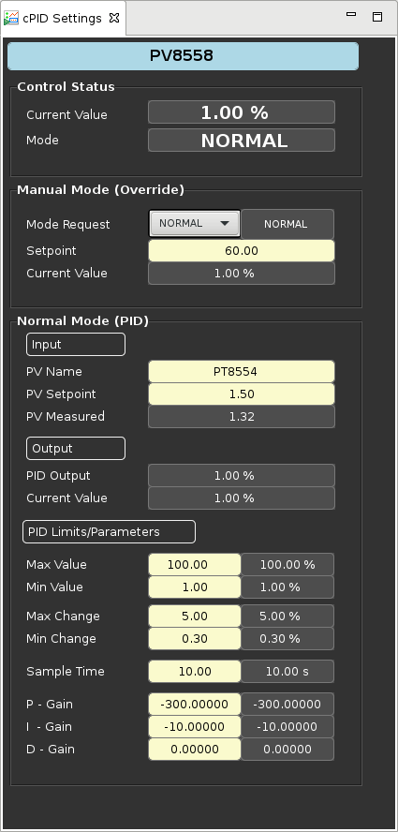
DBX LN2 Reservoir Pressure Control – PV8558
Controls on pressure in the reservoir at 1.5 atm,
Min is manual at 1% provides small continuous flow and helps not to get stuck
Max is 100 % sufficient to refill TL, typically opens to ~80% during batch fill
This tune works for Steady State and Parking, during 300K -80K shield cool down we ran it at 1.7 atm

Slide 11
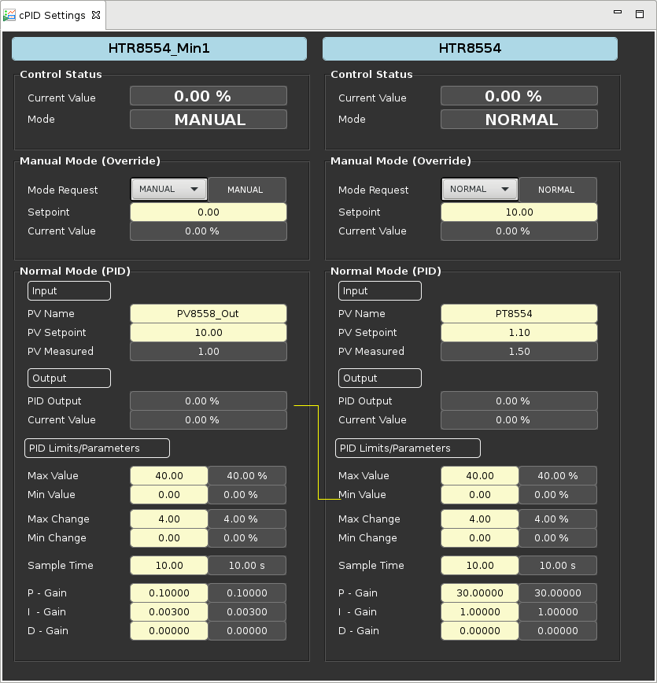
DBX LN2 Reservoir Heater Control – HTR8554
Controls on pressure in the reservoir at 1.1 atm,
Min is zero and max is 40% The purpose is to assure we have flow in the vent line to keep the N2 system clean. (It does not come on- WHY?)
This heater can also be used to boil LN2 during shield cool down from 300K (off topic here)

Slide 12
Torus Nitrogen supply Control – EV8555T
High pressure (4atm) nitrogen (gas or liquid) at ~92K goes through a coil in the reservoir
It is condensed or just cooled into sub-cooled liquid at ~4atm and 82K
EV8555T supplies the liquid to the Torus based on supply temperature and liquid level
Min PID controls on maximum allowable supply temperature at 92K to keep the U-tube from warming too much
Primary loop controls on Reservoir Level in the Torus (next slide)
This tune works for Steady State and Parking, Shield in Torus always runs unless warming to 300K!

Slide 13
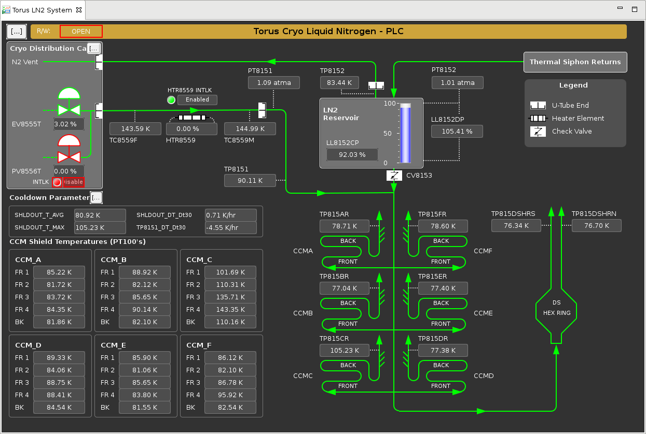
Torus Nitrogen cooled radiation shields
LN2 is supplied to the shields below a check valve under the reservoir
This allows cool down w/o an extra valve
Cooling was to be a thermosiphon, but works like forced flow with batch fill of tubes and reservoir
Nitrogen vent goes through the DBX directly to the vaporizer HX8558M on the North side of Hall B then to atmosphere via check valve outside ESR through same 4” line as DBX vent

Slide 14
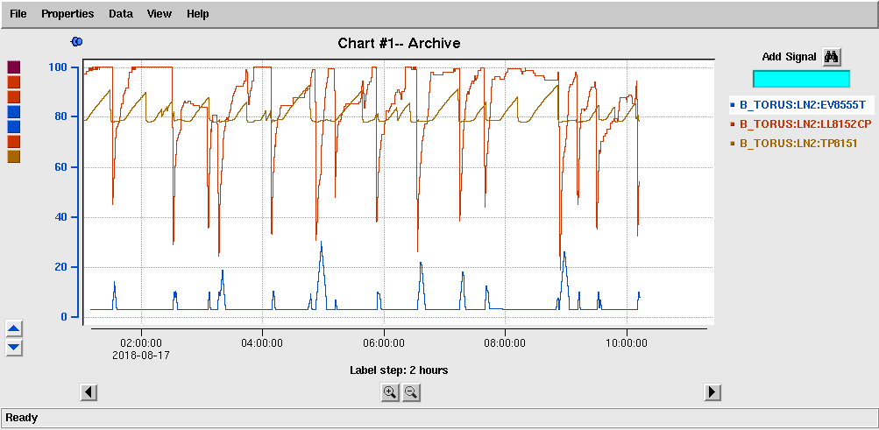
Typical parameters of N2 shield control

Slide 15
Torus Nitrogen cooled radiation shields - Details
8 parallel circuits each with its own return to the reservoir
Coil C operates warmer than the others, but this has not bothered the 4K operation or powering the magnet
Coil E showed similar warming during summer 2018 for a brief period but recovered
When magnet 4K is off the shields all cool off to 77K outlets

Slide 16
Supply Controls – EV8111CD

Slide 17
What to look for and do if called in
Check levels in DBX and Torus
Check to see trends of temperatures and valve positions
Go to Hall and look at vacuums of TL, DBX and U-tubes
Make sure vacuum pumps on Torus are running and vacuums are good
Call in experts if nothing can be found

Slide 18
N2 Summary
Not working quite as designed, BUT does work well!
No changes observed during any fast dumps
No tuning of PID loops has been required for nearly 1 year

Slide 19
Questions?

