Slide 1


TMDs at Small-$x$
M. Gabriel Santiago
Based on work with Yuri V. Kovchegov, Daniel Adamiak, and Yossathorn Tawabutr

Slide 2
Outline
Small-x Intro
  Gluon dominance at small-x
  Eikonal approximation: projectile-target interaction as Wilson lines and dipole amplitudes
  BFKL evolution – power law growth of gluon distribution
  BK/JIMWLK : saturation, unitarization and the CGC
Spin dependence through sub-eikonal corrections
  Spin-dependent operator insertions
  General fundamental representation polarized Wilson line
TMDs at small-x: Light Cone Operator Treatment
  TMD intro
  From operator definitions to polarized dipole amplitudes
  Evolution and double logs
  Results for asymptotic scaling in BFKL regime

Slide 3
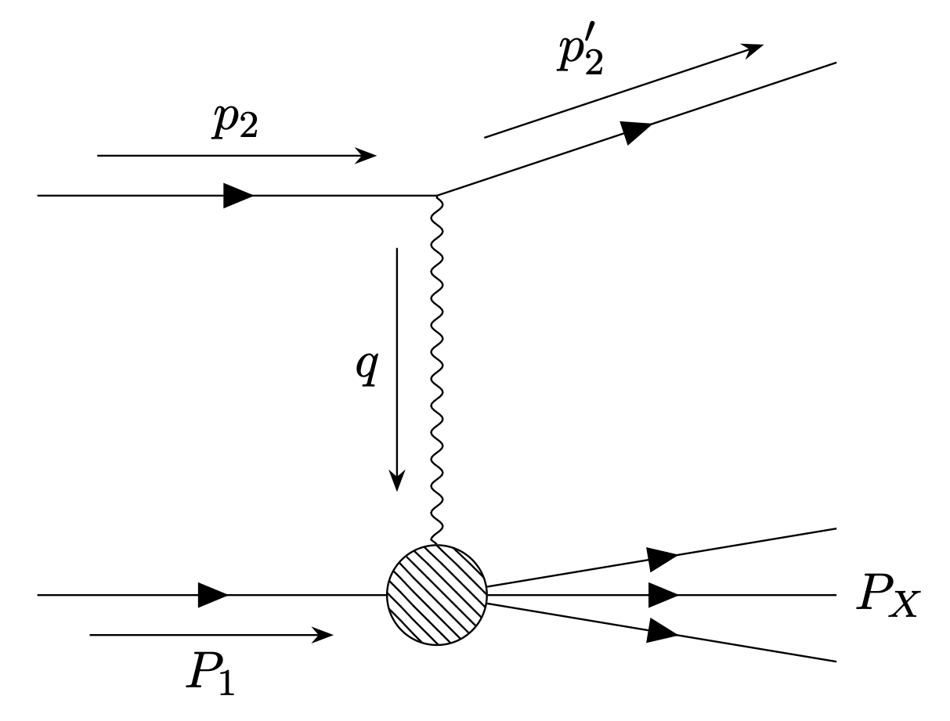
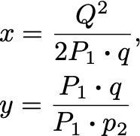




Small-x Introduction
Recall our usual DIS kinematic variables
At high fixed $Q^{2}$ and $y$ we see that small-$x$ implies high COM energy

Slide 4


QCD scattering at small-x
One can perform a general analysis to show $σ∼s^{n(j−1)}$ for spin $j$ particles in t-chanel exchange at high energy (Regge 1959, 1960)
In QCD the gluons will give the dominant contribution scaling as $s^{0}$
  Hypothetically gravitons in this analysis would scale as $s^{n}$ and blow up the cross section

Slide 5


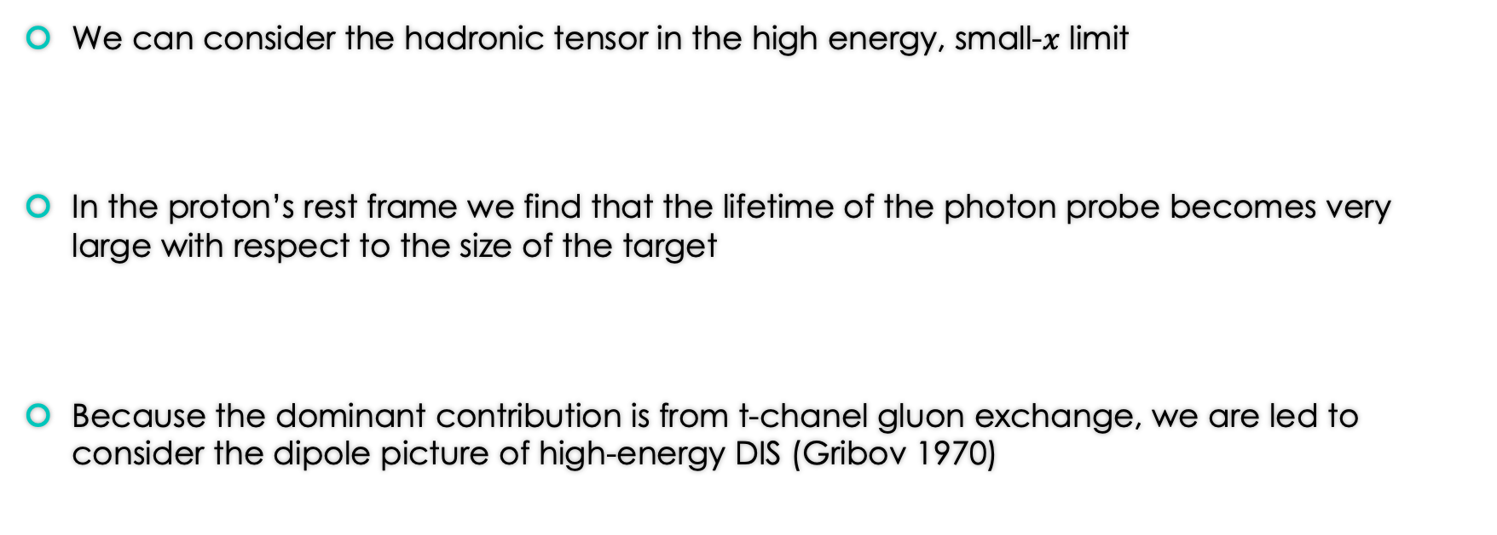
QCD scattering at small-x
We can consider the hadronic tensor in the high energy, small-$x$ limit
In the proton’s rest frame we find that the lifetime of the photon probe becomes very large with respect to the size of the target
Because the dominant contribution is from t-chanel gluon exchange, we are led to consider the dipole picture of high-energy DIS (Gribov 1970)

Slide 6
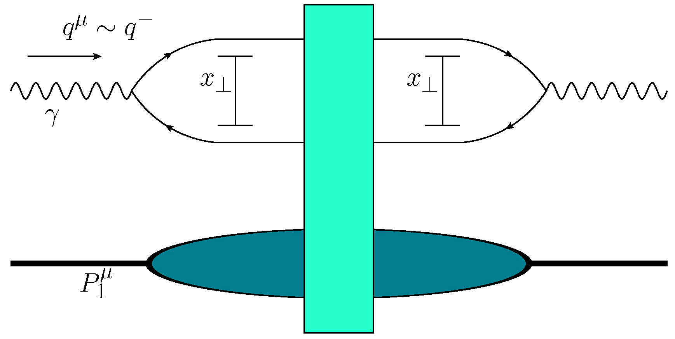
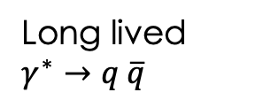
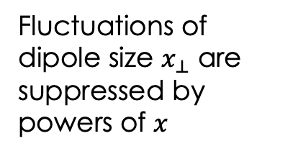
Dipole Picture
Long lived $γ^{∗}→q \overline{q}$
Fluctuations of dipole size $x_{⊥}$ are suppressed by powers of $x$
Interaction with the target occurs over very short time with respect to the dipole lifetime – we call this the shock wave

Slide 7


Dipole Spacetime Picture
$$x^{−}$$
$$x^{+}$$
‘Target’ hadron
‘Projectile’ quark

Slide 8
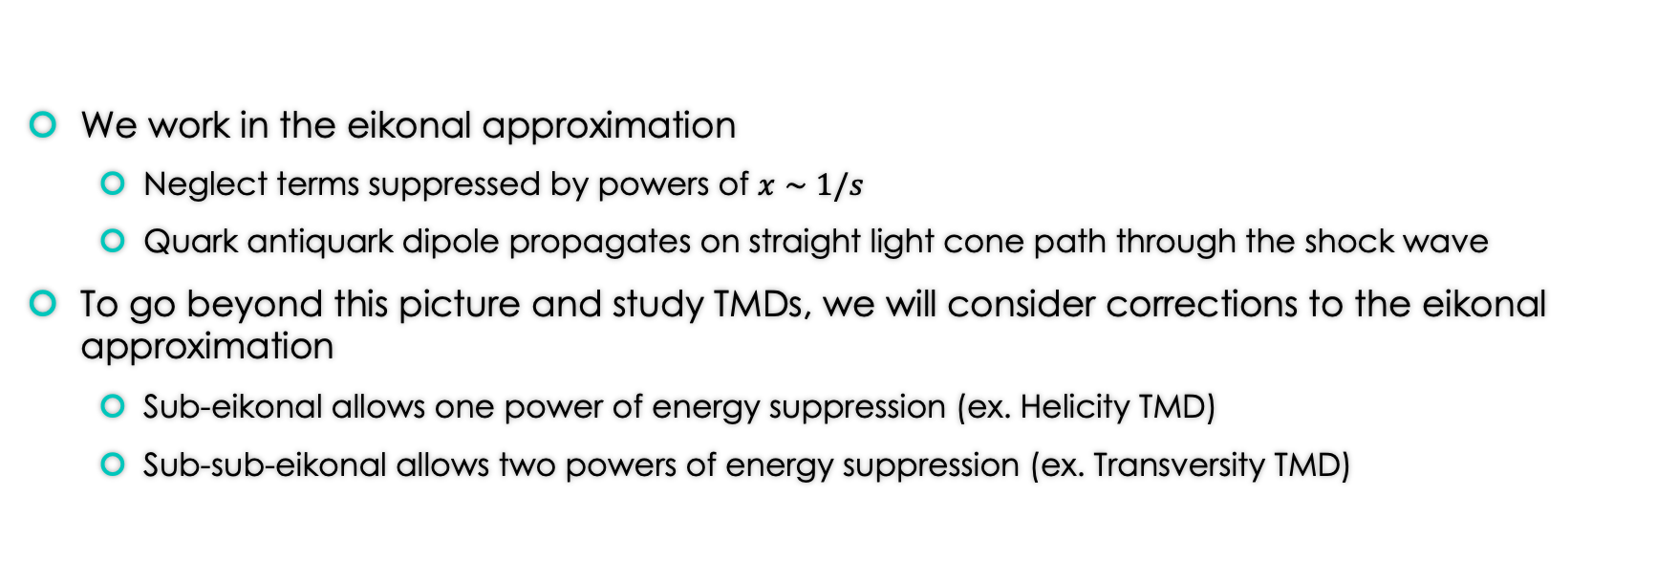
Dipole picture
We work in the eikonal approximation
  Neglect terms suppressed by powers of $x∼1/s$
  Quark antiquark dipole propagates on straight light cone path through the shock wave
To go beyond this picture and study TMDs, we will consider corrections to the eikonal approximation
  Sub-eikonal allows one power of energy suppression (ex. Helicity TMD)
  Sub-sub-eikonal allows two powers of energy suppression (ex. Transversity TMD)

Slide 9
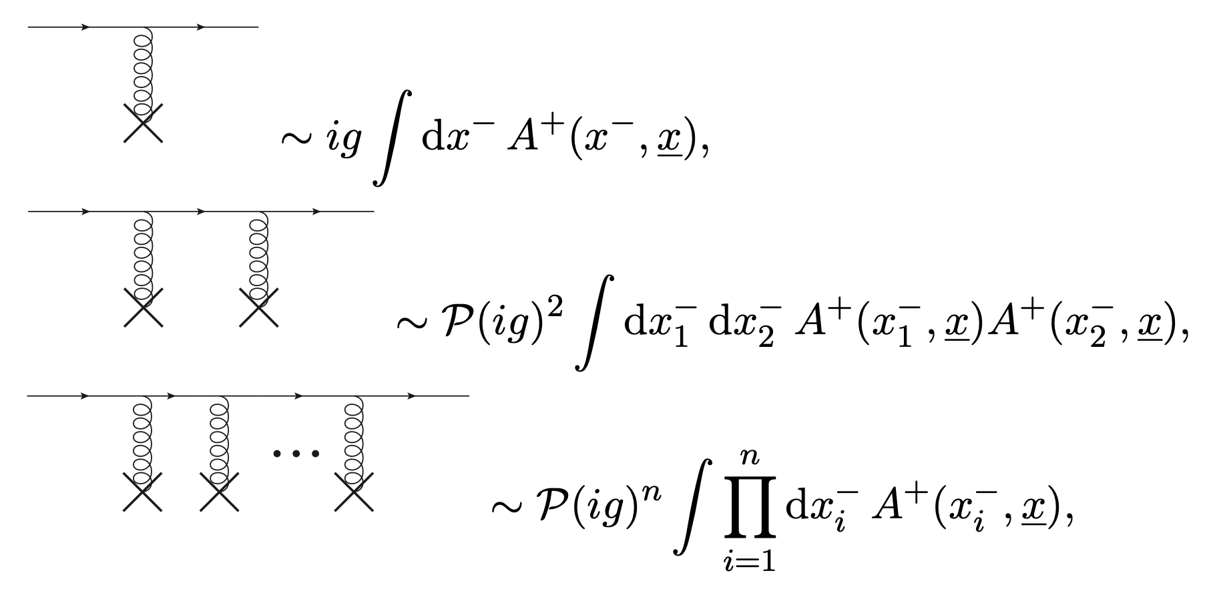
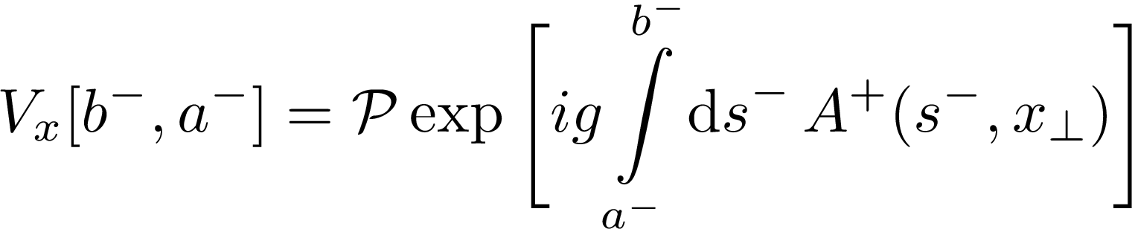

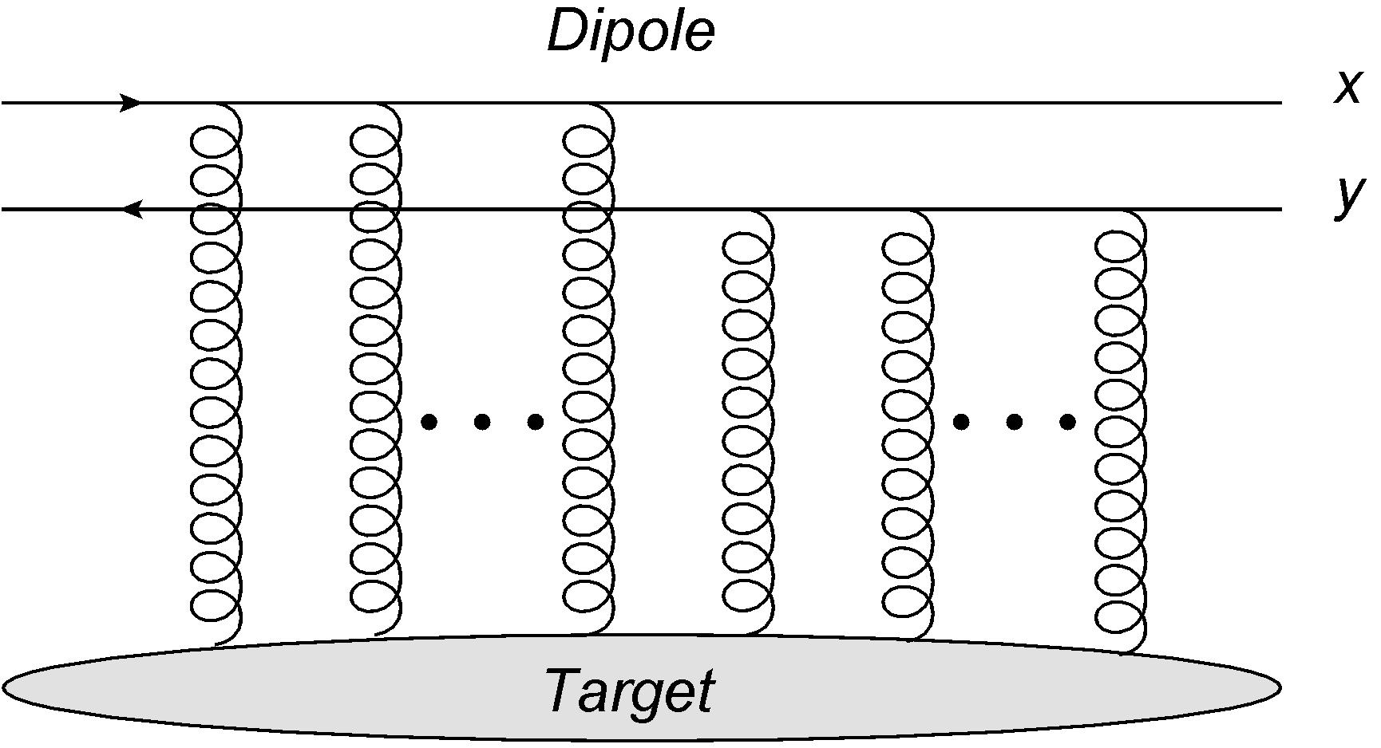


Dipole Picture: Wilson lines
Arbitrarily many t-chanel gluons still give $s^{0}$ contribution, so we must allow any number
Successive gluon exchanges in the eikonal approximation factorize into a simple form
Successive gluon exchanges sum into a path ordered exponential – light cone Wilson lines encode the high energy scattering! (Balitsky 1996)
Angle brackets denote average in the target state

Slide 10
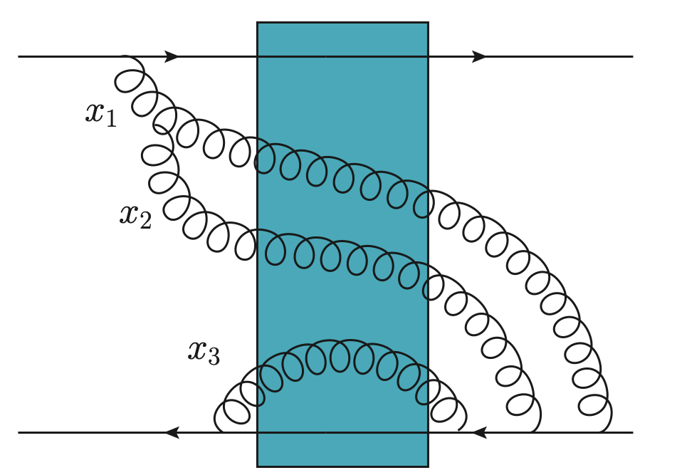

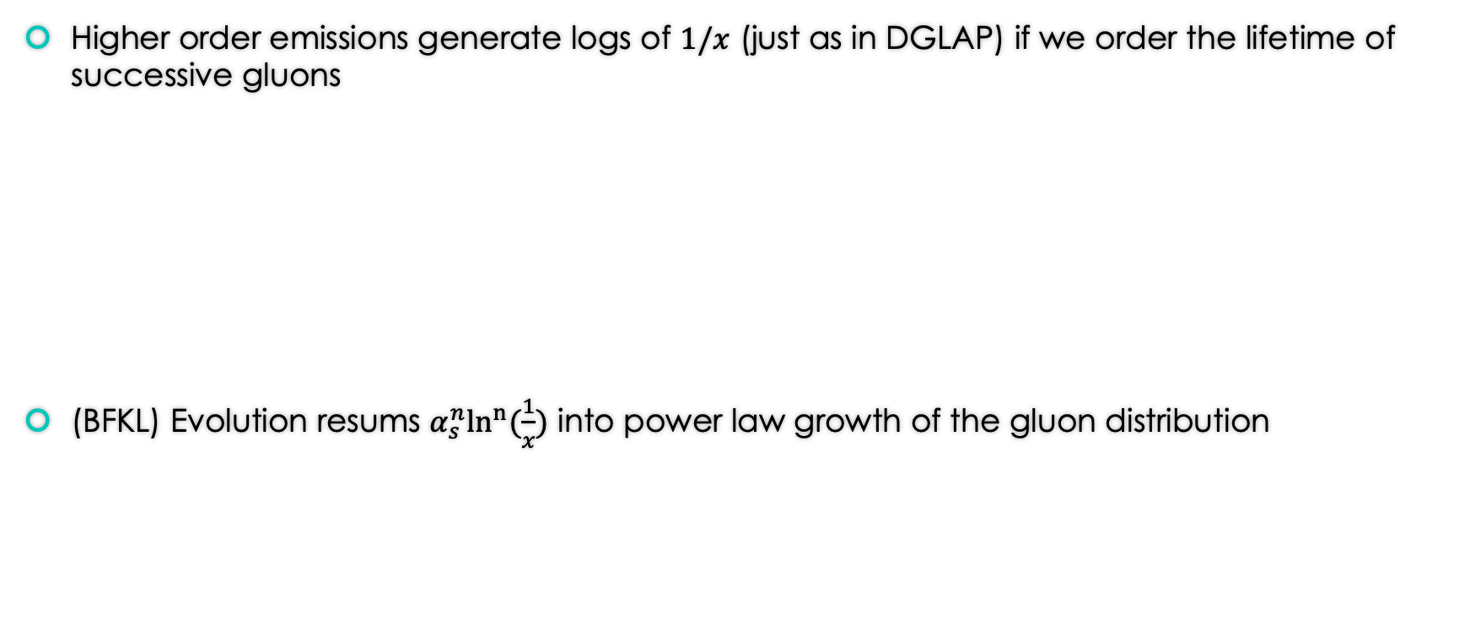
Evolution of the dipole amplitude
Higher order emissions generate logs of $1/x$ (just as in DGLAP) if we order the lifetime of successive gluons
(BFKL) Evolution resums $α_{s}^{n}\ln^{n}⁡(\frac{1}{x})$ into power law growth of the gluon distribution
(Fadin, Kuraev and Lipatov 1977, Balitsky and Lipatov 1978)

Slide 11
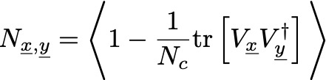


Non-linear corrections
As the gluon density becomes large compared to the transverse resolution for scattering, non-linear gluon recombination terms become important, giving in the large-$N_{c}$ limit
At a certain transverse resolution $1/μ^{2}$ the non-linear terms overwhelm the linear terms and saturate the evolution
We call this the saturation scale , and it is a function of $x$
Balitsky-Kovchegov equation (Balitsky 1996, Kovchegov 1999)

Slide 12

Saturation and Unitarity
Saturation slows the power law growth of the gluon distribution to obey unitarity saturate the black disk limit
Does not slow the growth of the cross section enough to solve overarching non-perturbative violation of Froissart-Martin bound

Slide 13
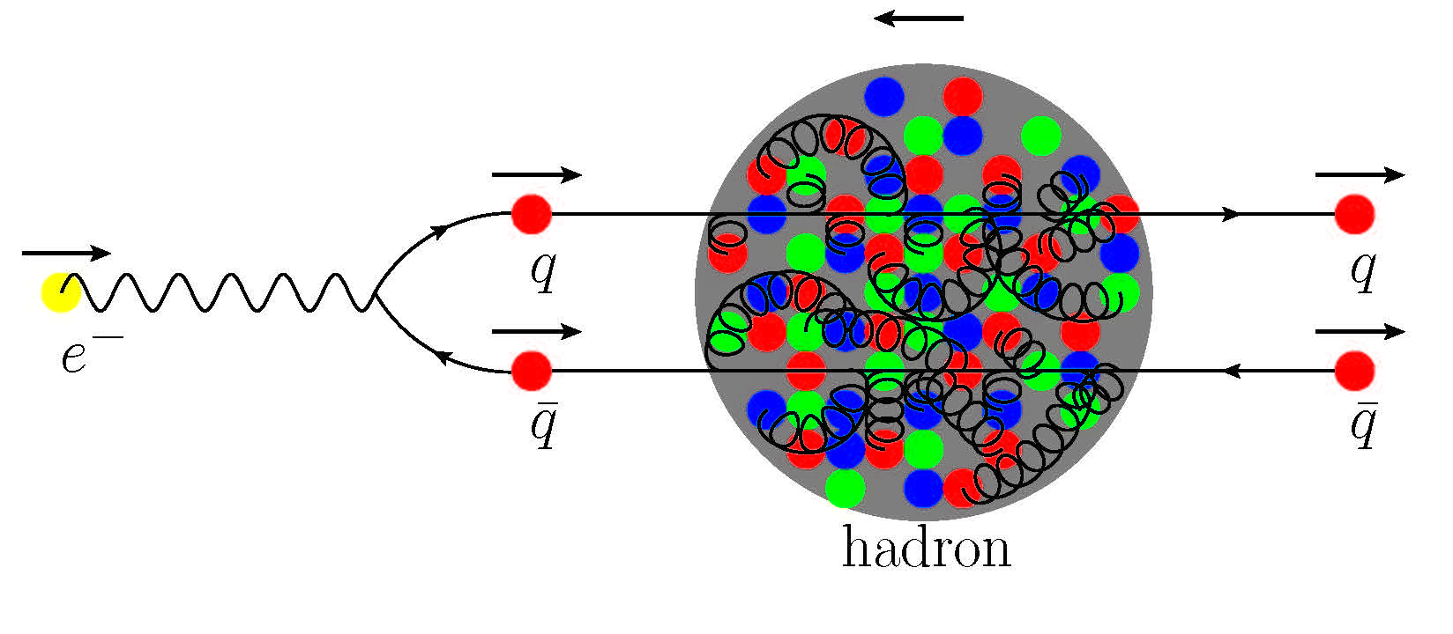
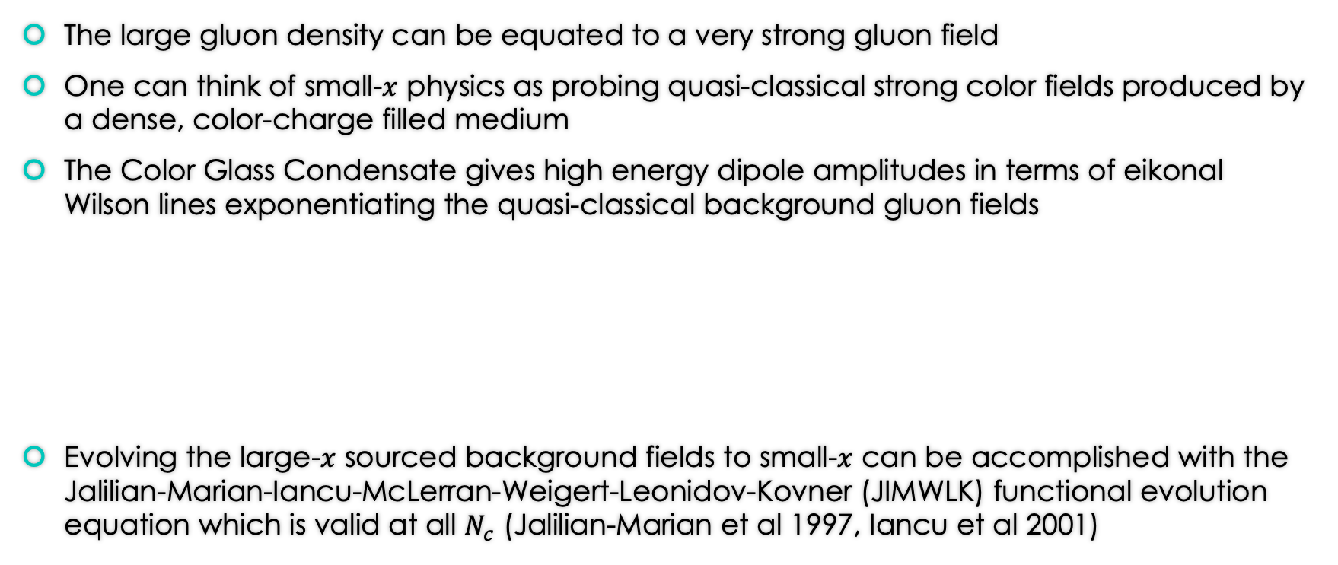
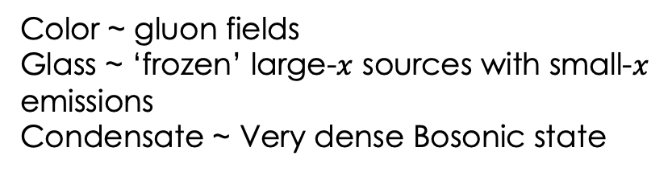
CGC picture
The large gluon density can be equated to a very strong gluon field
One can think of small-$x$ physics as probing quasi-classical strong color fields produced by a dense, color-charge filled medium
The Color Glass Condensate gives high energy dipole amplitudes in terms of eikonal Wilson lines exponentiating the quasi-classical background gluon fields
Evolving the large-$x$ sourced background fields to small-$x$ can be accomplished with the Jalilian-Marian-Iancu-McLerran-Weigert-Leonidov-Kovner (JIMWLK) functional evolution equation which is valid at all $N_{c}$ (Jalilian-Marian et al 1997, Iancu et al 2001)
Color ~ gluon fields
Glass ~ ‘frozen’ large-$x$ sources with small-$x$ emissions
Condensate ~ Very dense Bosonic state

Slide 14
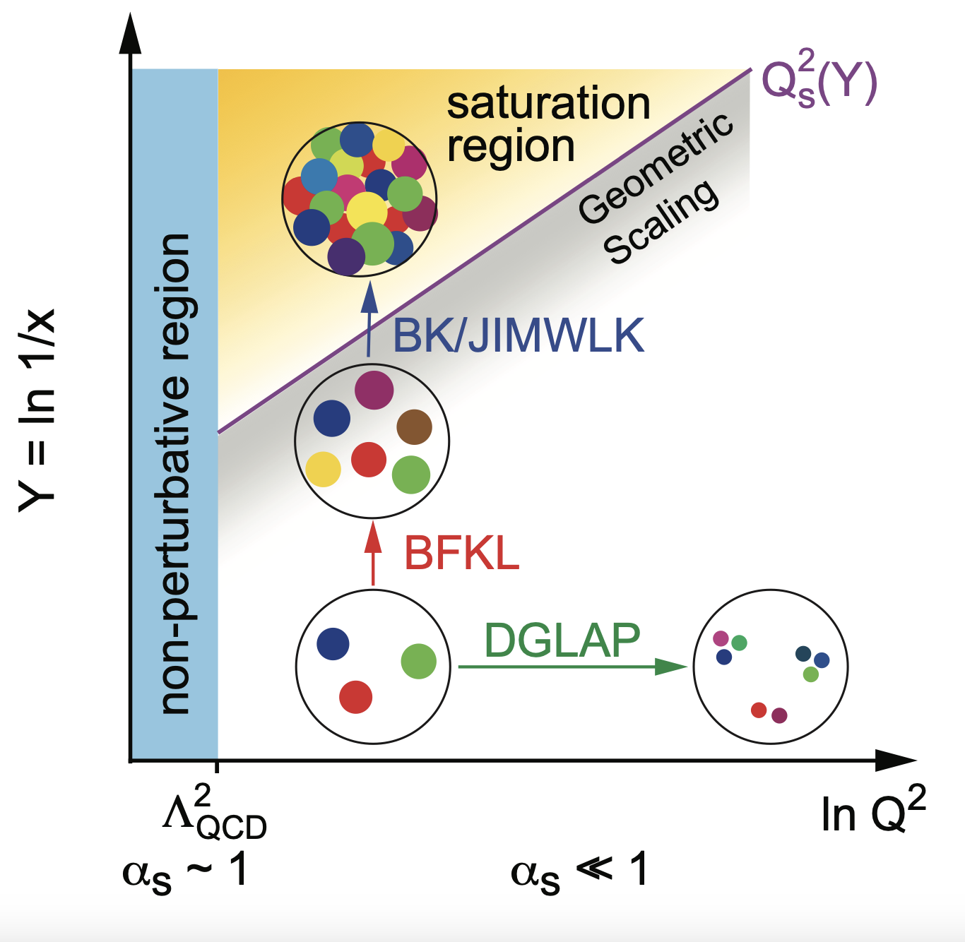
Map of High Energy QCD

Slide 15
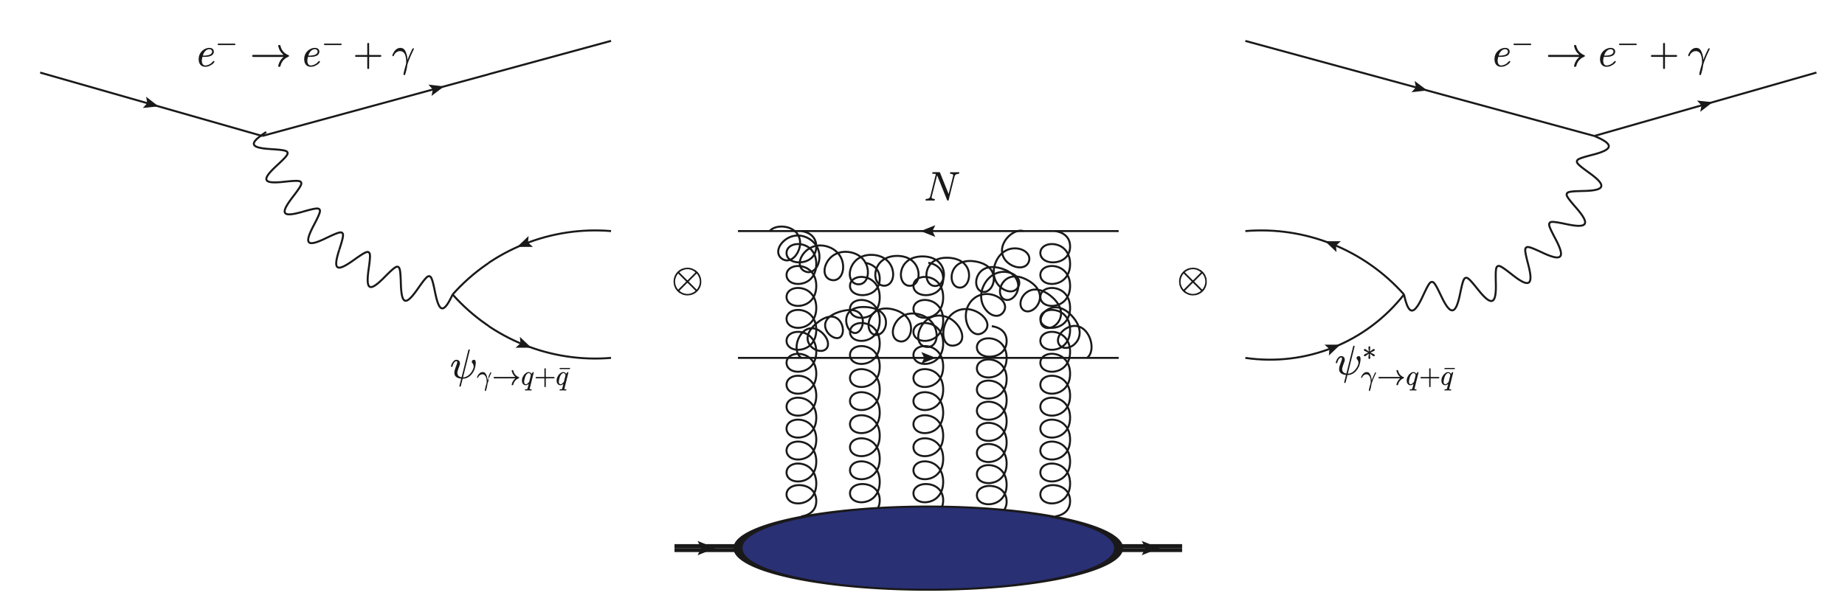
Recap of Small-x Dipole Picture
Primary degrees of freedom for scattering are eikonal light cone Wilson lines
Scattering only knows about color charge
Gluon emissions cause power law growth which slows once the saturation scale is reached

Slide 16
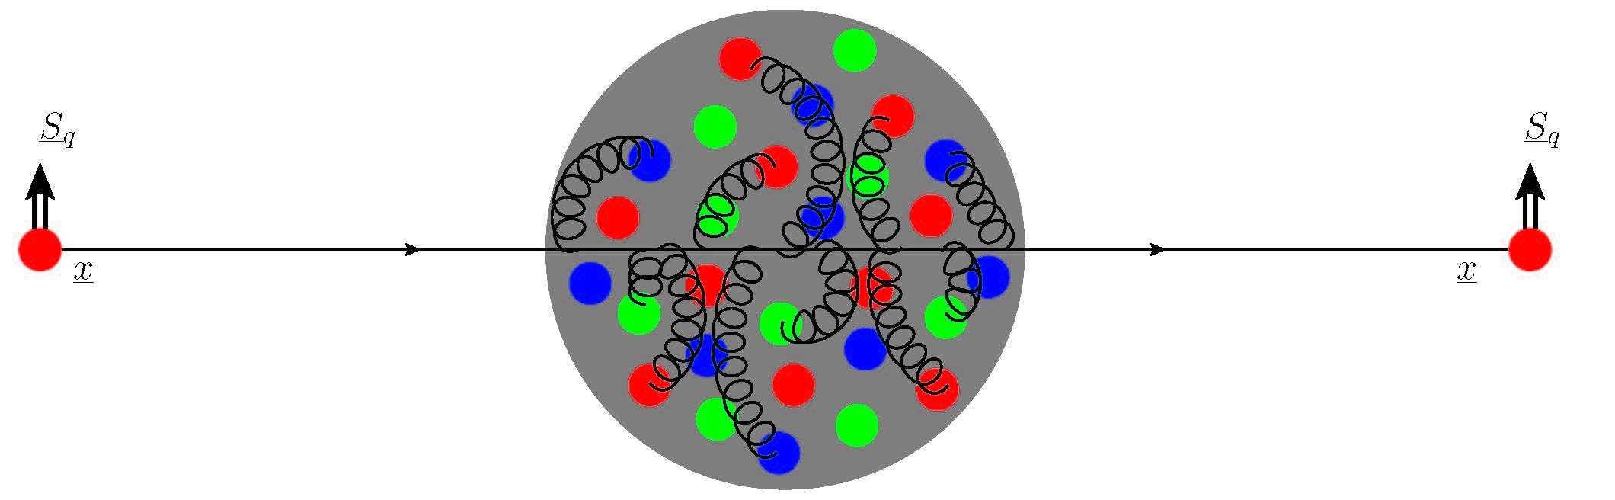
What about spin?
The eikonal approximation only sees the projectile’s color charge/representation
Spin-dependence can only enter in the target background fields – eikonal Sivers function!
Leading order scattering in center of mass energy
Spin and transverse position are unchanged

Slide 17
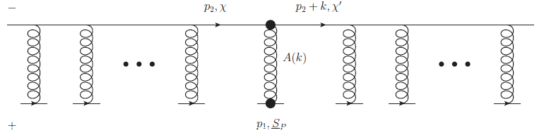



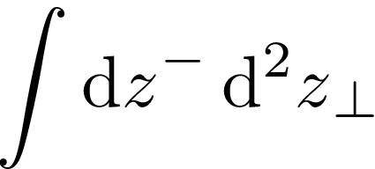

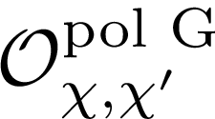


Polarized Wilson Line
Dependence on the spin of the quarks in the dipole requires the insertion of sub-eikonal operators in the Wilson lines
Add all possible operator insertions integrated over $x^{−}$ positions along Wilson lines

Slide 18
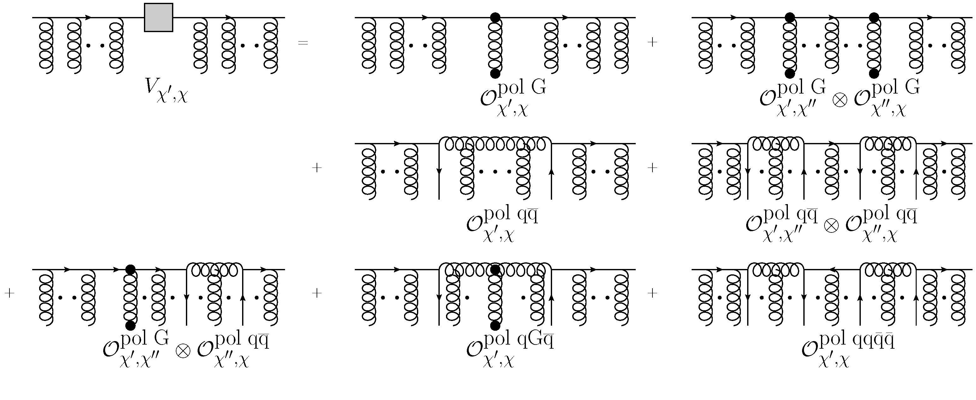
Polarized Wilson line
It has been shown that to account for longitudinal (Kovchegov, Pitonyak and Sievert 2016) and transverse spin (Kovchegov and Sievert 2019) one needs to include corrections out to sub-sub-eikonal order
We construct a general sub-sub-eikonal polarized Wilson line by adding all possible operator insertions

Slide 19
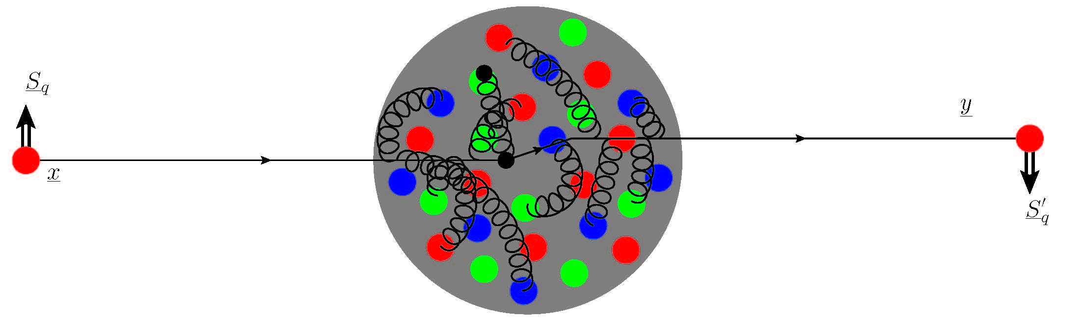
Polarized Wilson Line
Shifted transverse position!
Altered spin!

Slide 20
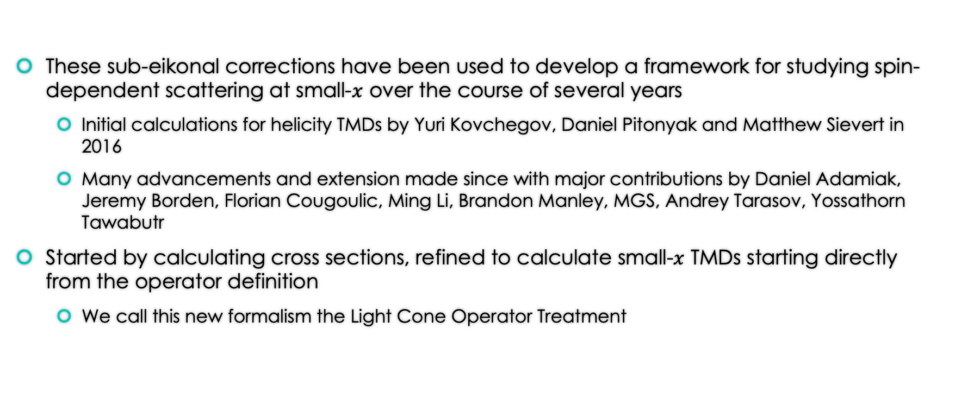
Light Cone Operator Treatment (LCOT)
These sub-eikonal corrections have been used to develop a framework for studying spin-dependent scattering at small-$x$ over the course of several years
  Initial calculations for helicity TMDs by Yuri Kovchegov, Daniel Pitonyak and Matthew Sievert in 2016
  Many advancements and extension made since with major contributions by Daniel Adamiak, Jeremy Borden, Florian Cougoulic, Ming Li, Brandon Manley, MGS, Andrey Tarasov, Yossathorn Tawabutr
Started by calculating cross sections, refined to calculate small-$x$ TMDs starting directly from the operator definition
  We call this new formalism the Light Cone Operator Treatment

Slide 21
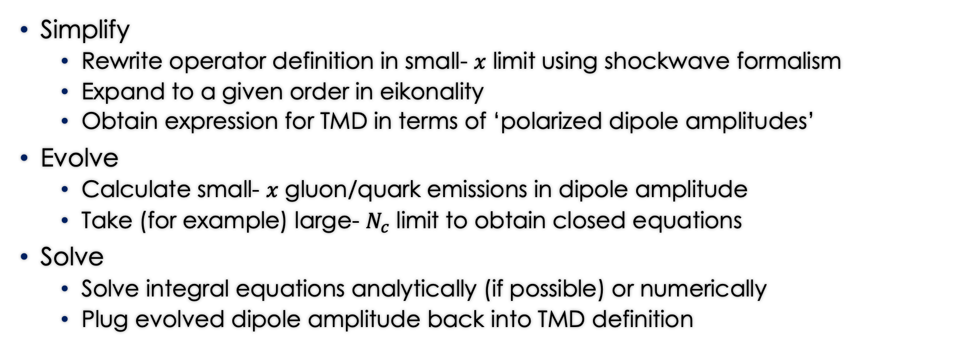
LCOT for TMDs
Simplify
  Rewrite operator definition in small- $x$ limit using shockwave formalism
  Expand to a given order in eikonality
  Obtain expression for TMD in terms of ‘polarized dipole amplitudes’
Evolve
  Calculate small- $x$ gluon/quark emissions in dipole amplitude
  Take (for example) large- $N_{c}$ limit to obtain closed equations
Solve
  Solve integral equations analytically (if possible) or numerically
  Plug evolved dipole amplitude back into TMD definition
‘Staple’ Wilson Line becomes a dipole amplitude!

Slide 22
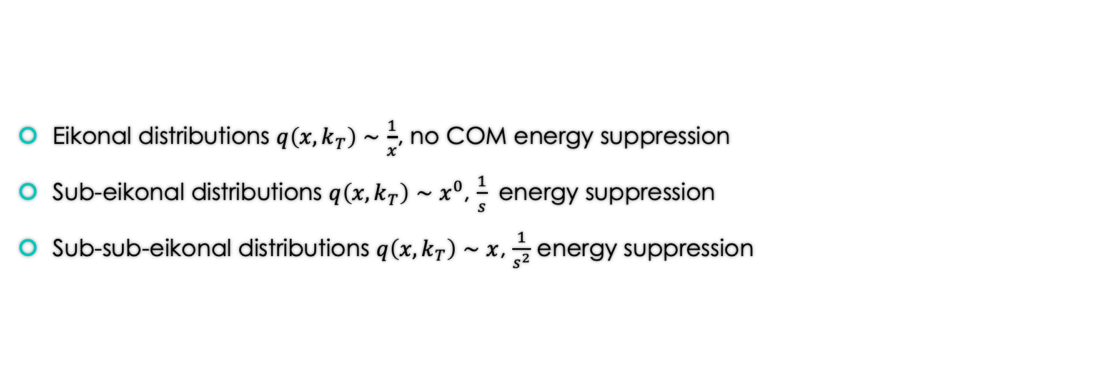
Sub-eikonal power counting
Eikonal distributions $q\left(x,k_{T}\right)∼\frac{1}{x}$, no COM energy suppression
Sub-eikonal distributions $q\left(x,k_{T}\right)∼x^{0}$, $\frac{1}{s}$ energy suppression
Sub-sub-eikonal distributions $q\left(x,k_{T}\right)∼x$, $\frac{1}{s^{2}}$ energy suppression

Slide 23
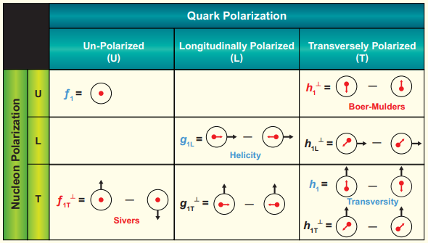


TMDs
The leading-twist quark TMDs give various correlations between the transverse momentum and polarizations of the quarks within a hadron with the polarization of the parent hadron
Their scale evolution in is given by the CSS equations, but the small- $x$ evolution is an ongoing effort

Slide 24
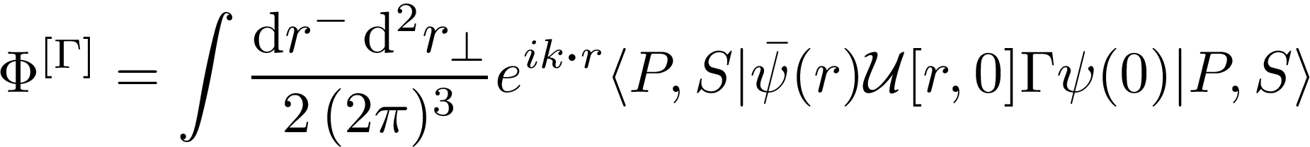


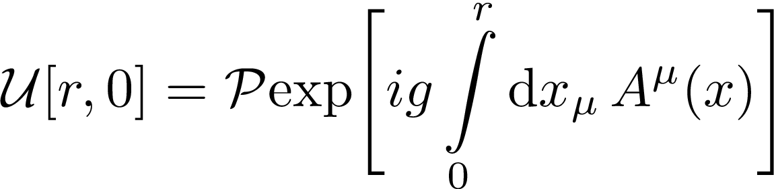




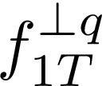

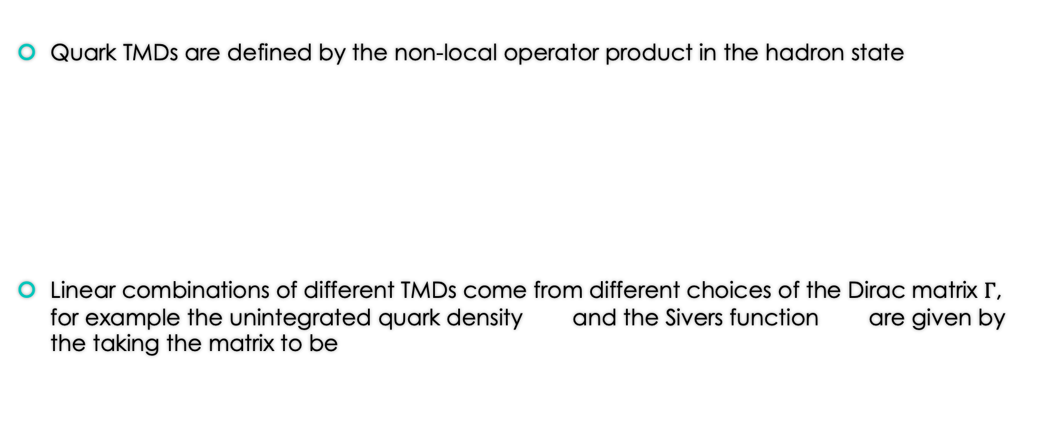
TMDs
Quark TMDs are defined by the non-local operator product in the hadron state
Linear combinations of different TMDs come from different choices of the Dirac matrix $Γ$, for example the unintegrated quark density and the Sivers function are given by the taking the matrix to be
SIDIS staple

Slide 25
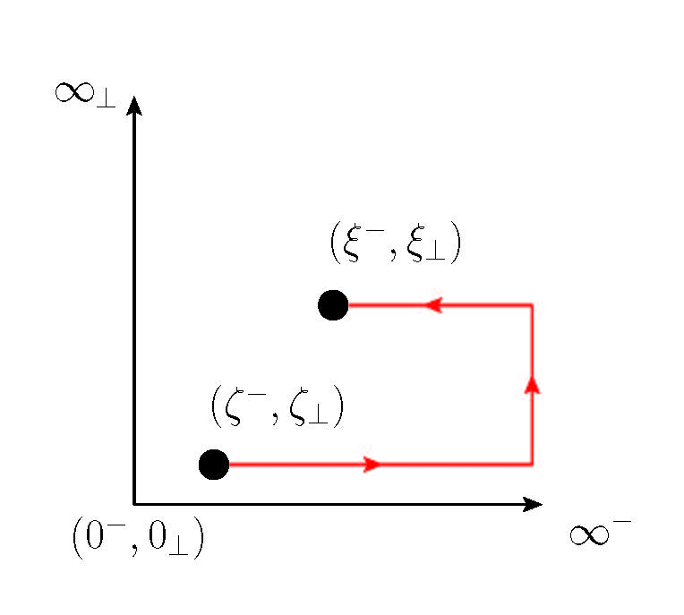
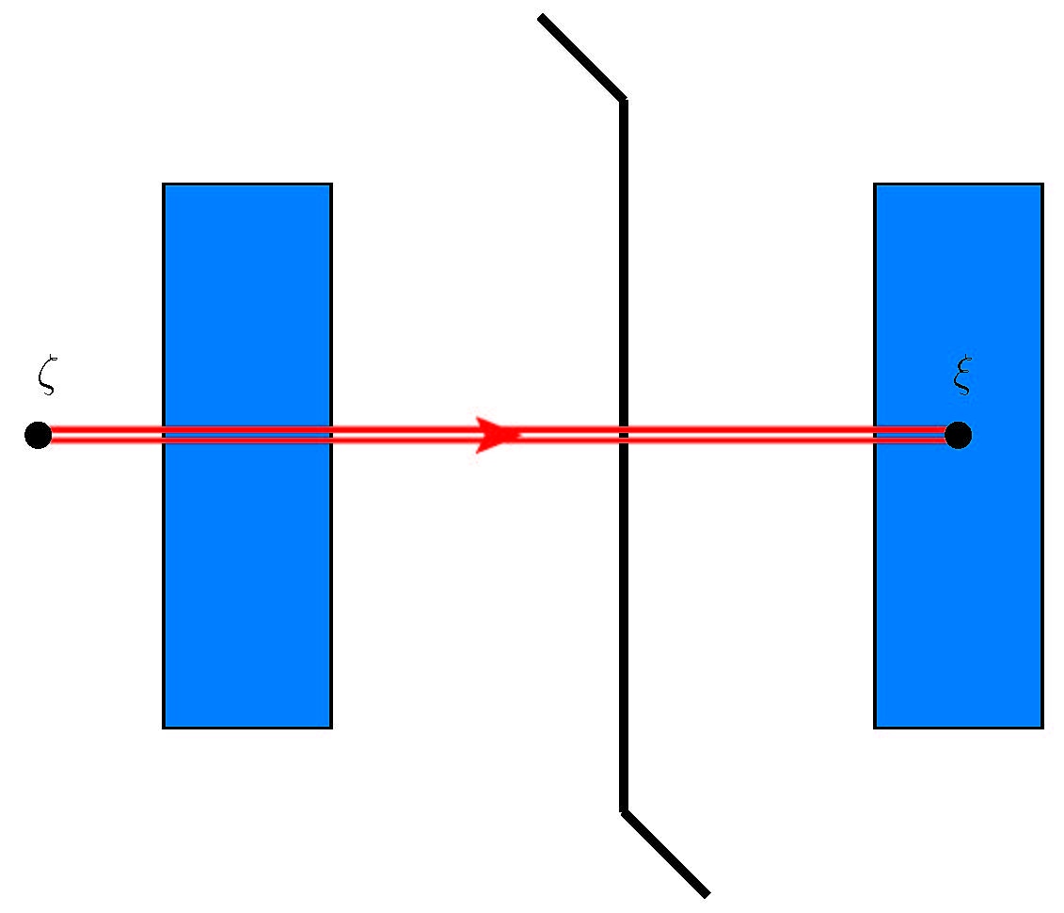
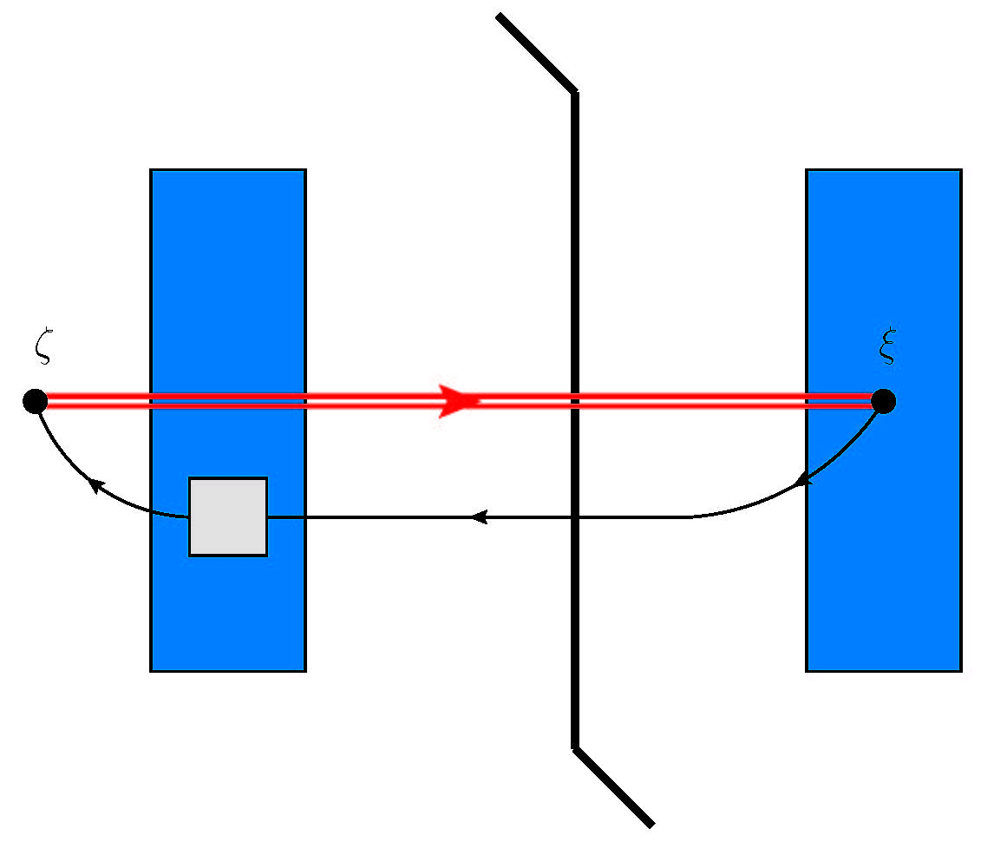
Simplify: Gauge link to dipole amplitude
Leading order correction

Slide 26
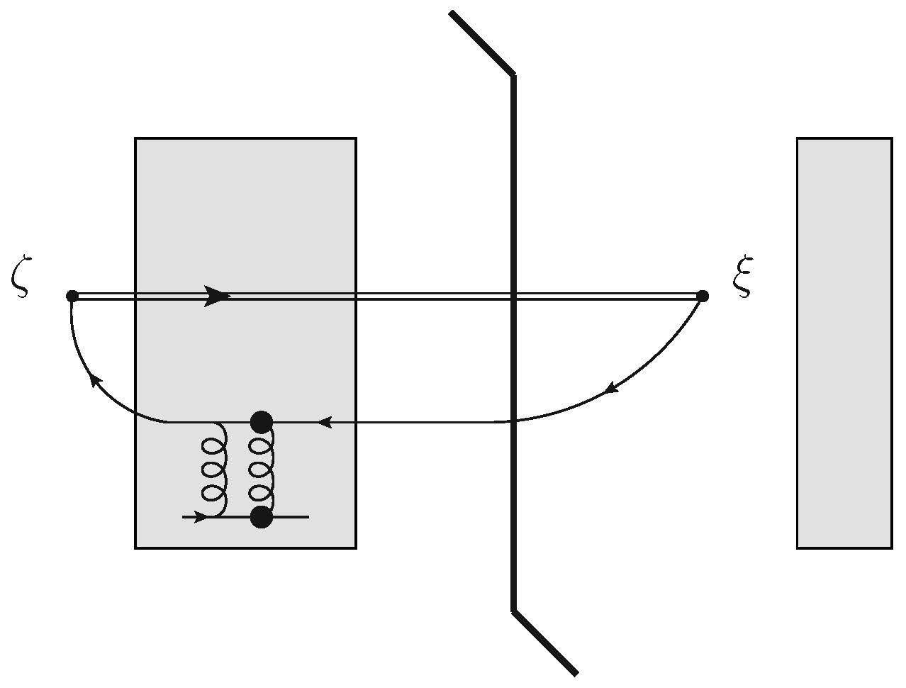


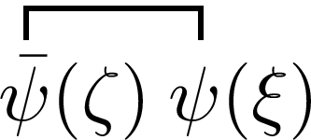
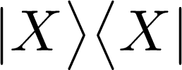
Simplify: Shock wave picture
By inserting a complete set of states, one can write the operator product as a sum over cut diagrams for the scattering of a quark on the shockwave of a target hadron

Slide 27
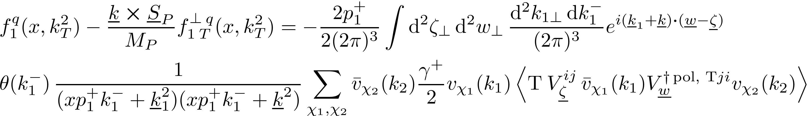
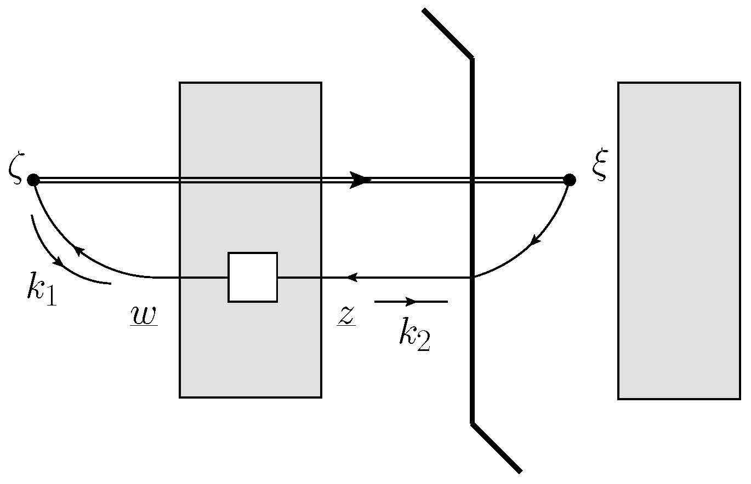
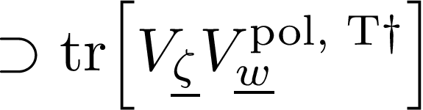
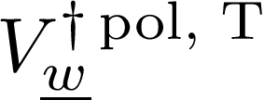
Simplify: Shock wave picture
Writing the antiquark propagator as a polarized Wilson line lets us write the operator product in terms of a polarized dipole amplitude

Slide 28
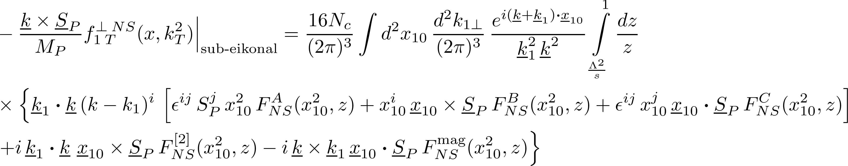
Simplify: Polarized Dipole Amplitudes
For a given TMD, at a given order in the sub-eikonal expansion, we define polarized dipole amplitudes

Slide 29
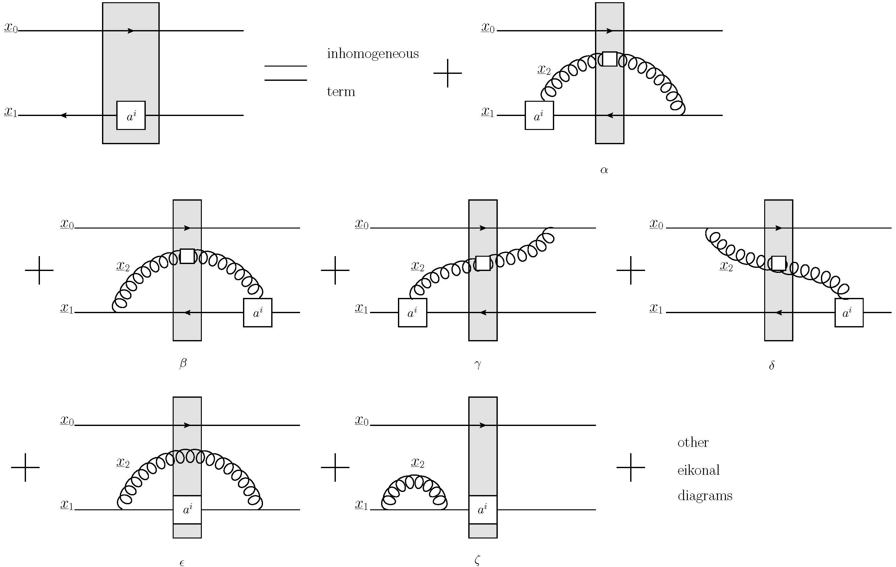

Small-x Evolution
Calculate gluon and quark emissions in the dipole amplitudes
Sum over relevant diagrams/operators to extract evolution in large-$N_{c}$ or large-$N_{c}$&$N_{f}$ limit
Obtain general operator level equations (in given approximation)

Slide 30





Linearized Large-$N_{c}$ DLA
We can obtain closed equations by considering the linearized large- $N_{c}$ evolution equations in the double logarithmic approximation
Can solve either numerically or sometimes analytically!
Lifetimes ordered and transverse size ordered – new double logs! $α_{s}^{n}\ln^{2n}⁡(\frac{1}{x})$

Slide 31

Results for flavor non-singlet outside saturation region
The diagonal TMDs all receive evolution contributions equal to that of the Reggeon (Kirschner and Lipatov 1983)
Unpolarized and helicity TMDs also studied in InfraRed Evolution Equation (IREE) framework (Ermolaev, Manaenkov and Ryskin 1996, Bartels, Ermolaev and Ryskin 1996)
Transversity TMD also studied previously (Kirschner, Mankiewicz, Schafer, and Szymanowski 1997)
The off diagonal terms receive no evolution power correction in their leading terms!
MGS 2024

Slide 32

Results for flavor singlet outside saturation region
Preliminary results, but table is almost completed!
Surprisingly, still have some off-diagonal TMDs with no linear evolution power corrections
Adamiak, Tawabutr and MGS in preparation

Slide 33




Protection from evolution?
One quite interesting feature is that multiple off-diagonal TMDs receive no corrections to their naïve power law
Based on the known spin-dependent Odderon contribution to the Sivers function (Boer et al 2016), we had previously speculated that there could be protection for T-odd TMDs
New results show that this protection applies to other TMDs, perhaps some other symmetry?
Bartel, Lipatov and Vacca 2000

Slide 34

Discussion
We now know the small-x asymptotics of all 8 leading-twist quark TMDs
Interesting patterns have emerged
Many equations ready for phenomenological implementation
  Significant progress made applying small-x for helicity TMDs by JAM (cf. JAM Adamiak et al 2023), also some work on the transversity TMD (JAM Cocuzza et al 2023)
All $N_{c}$ results require JIMWLK type evolution equation (cf. Cougoulic and Kovchegov 2019)
Results can be derived for gluon TMDs as well
Formalism can be extended to GPDs/GTMDs and potentially higher twist parton distributions
Polarized Wilson lines can be used to calculate more general spin-dependent processes at high energy

Slide 35
Conclusions
We have developed a general framework for including sub-eikonal effects into the small-x formalism
  Similar formalisms for sub-eikonal corrections have been developed by various other authors, cf. Altinoluk et al 2016-2021, Chirilli 2019-2021
We have obtained the small-x asymptotics for all eight leading-twist quark TMDs
More improvements and applications of the formalism are in progress!

Slide 36
Backup Slides

Slide 37


Classes of leading small-$x$ diagrams
General analysis shows that class B gives leading contribution

Slide 38

Sub-sub-eikonal Polarized Wilson Line

Slide 39

Sub-sub-eikonal Operators

Slide 40

Sub-sub-eikonal Operators

Slide 41

Sub-sub-eikonal Operators

Slide 42






Non-singlet Sivers function Polarized Dipole Amplitudes
Here with the internal longitudinal momentum fraction and the center of mass energy squared

Slide 43



Non-singlet Sivers function large-$N_{c}$ linearized DLA equations
Dipole evolution equations
‘Neighbor’ dipole evolution equations

