Slide 1
The EIC Project and involvement of JLab and the User Community
R. Ent
Electron Ion Collider

Slide 2
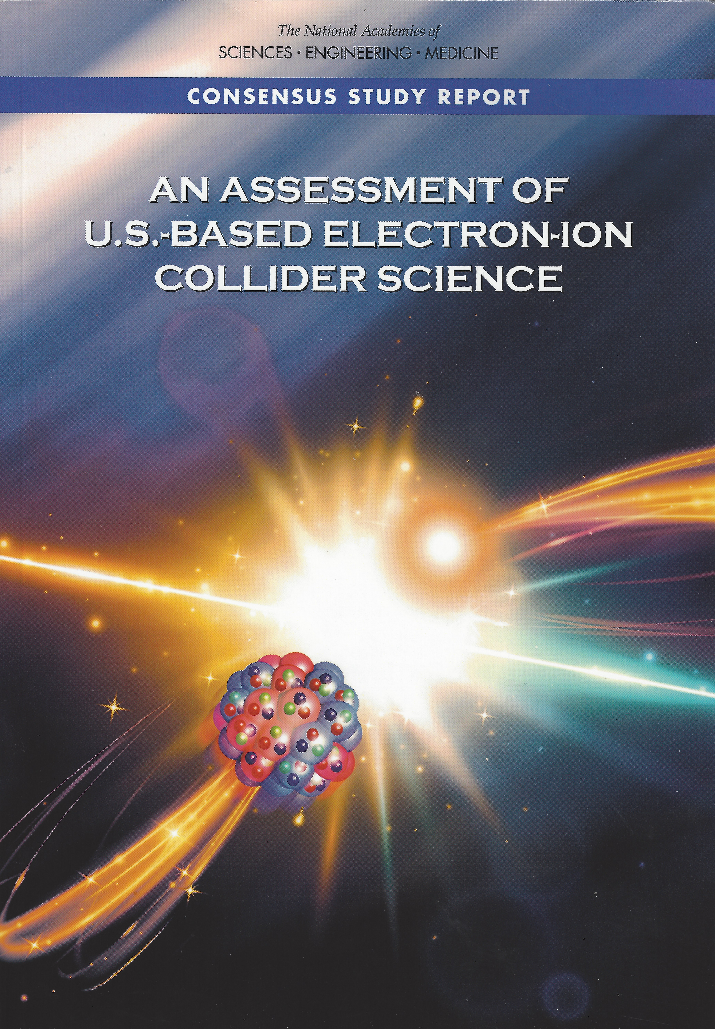
EIC Science – Findings of the NAS Committee
Finding 1: An EIC can uniquely address three profound questions about nucleons — neutrons and protons — and how they are assembled to form the nuclei of atoms:
  How does the mass of the nucleon arise?
  How does the spin of the nucleon arise?
  What are the emergent properties of dense systems of gluons?
Finding 2: These three high-priority science questions can be answered by an EIC with highly polarized beams of electrons and ions, with sufficiently high luminosity and sufficient, and variable, center-of-mass energy.
Finding 3: An EIC would be a unique facility in the world and would maintain U.S. leadership in nuclear physics.
Finding 4: An EIC would maintain U.S. leadership in the accelerator science and technology of colliders and help to maintain scientific leadership more broadly.
EIC science is compelling,
timely and fundamental
Developed by NAS committee with broad science perspective

Slide 3

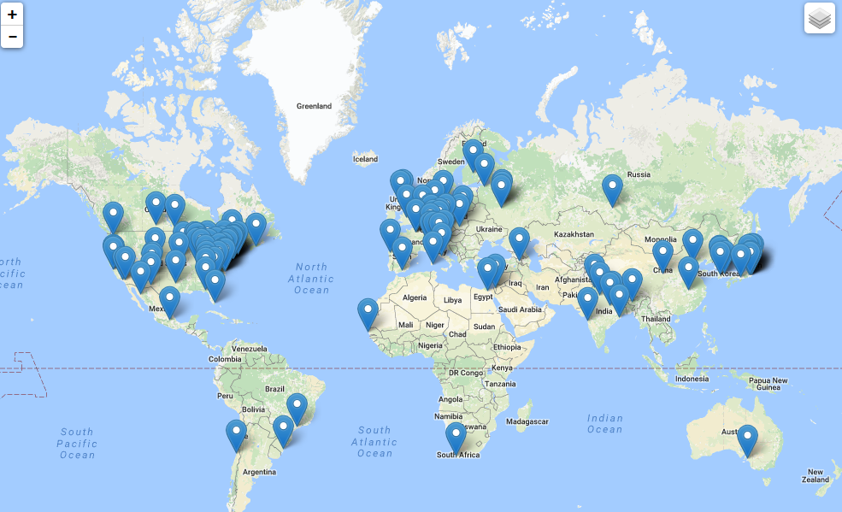
Worldwide Interest in EIC Physics
The EIC Users Group: EICUG.ORG
Formed 2016: 1081 collaborators, 31 countries, 224 institutions as of June 21, 2020
Map of institution’s locations
Annual EICUG meeting
2016 UC Berkeley, CA
2016 Argonne, IL
2017 Trieste, Italy
2018 Washington, DC
2019 Paris, France
2020 Miami, FL
2021 Warsaw, Poland

Slide 4
Growing Relevance of Accelerators Worldwide
From: Dr. Robert W. Hamm

Slide 5
EIC Recent History
Mission Need Statement Approved: January 22, 2019
Independent Cost Review (ICR) as required by DOE Order 413.3b completed July 31, 2019
Independent Electron Ion Collider Site Assessment: October 8-9th
CD-0 approved by DOE on December 19, 2019
Site Selection announced by DOE on January 09, 2020
FY 2020 Enacted Budget includes both TEC and OPC for EIC
BNL-JLAB Partnering Agreement signed May 7, 2020
Established JLAB EIC Project* organization under leadership of Allison Lung; Integrated BNL-JLAB team is being developed
* https://www.jlab.org/eic-partner-project

Slide 6
EIC Organization Structure
Organization structure is being assessed to benefit from TJNAF commitment and prospects for significant international and domestic partners
Electron Ion Collider Project (L1 of EIC Project)
  Jim Yeck (BNL)
  Ferdinand Willeke (BNL)
  Diane Hatton (BNL)
  Elke Aschenauer (BNL)
  Allison Lung (JLab)
  Andrei Seryi (JLab)
  Rolf Ent (JLab)

Slide 7
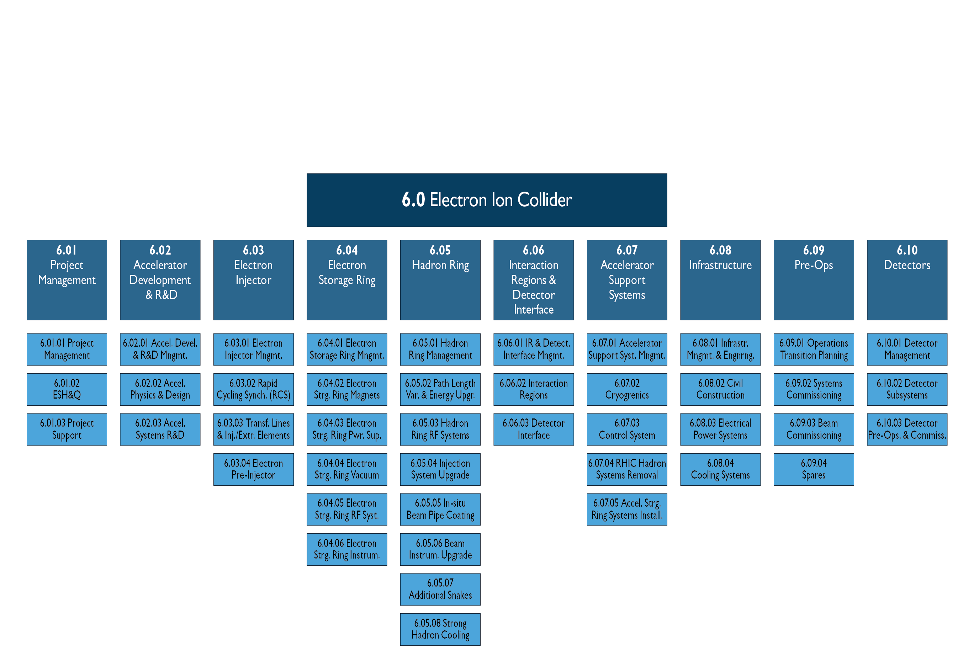
EIC Project Scope
JLab (Co-)Lead Role in some areas, still TBD: Detector Systems, IR & Detector Interface, Accelerator R&D, Electron Storage Ring, some Technical Systems (SRF, Cryogenics, etc.)

Slide 8
Reference Funding Profile
  CD-1: March 2021
  CD-2: September 2022
  CD-3: September 2023
  CD-4a: September 2029
  CD-4b: September 2031
  Staged Luminosity
    Operations Start CD-4a
    Full RF Power Installed by CD-4b
  $100M from New York State toward infrastructure

Slide 9
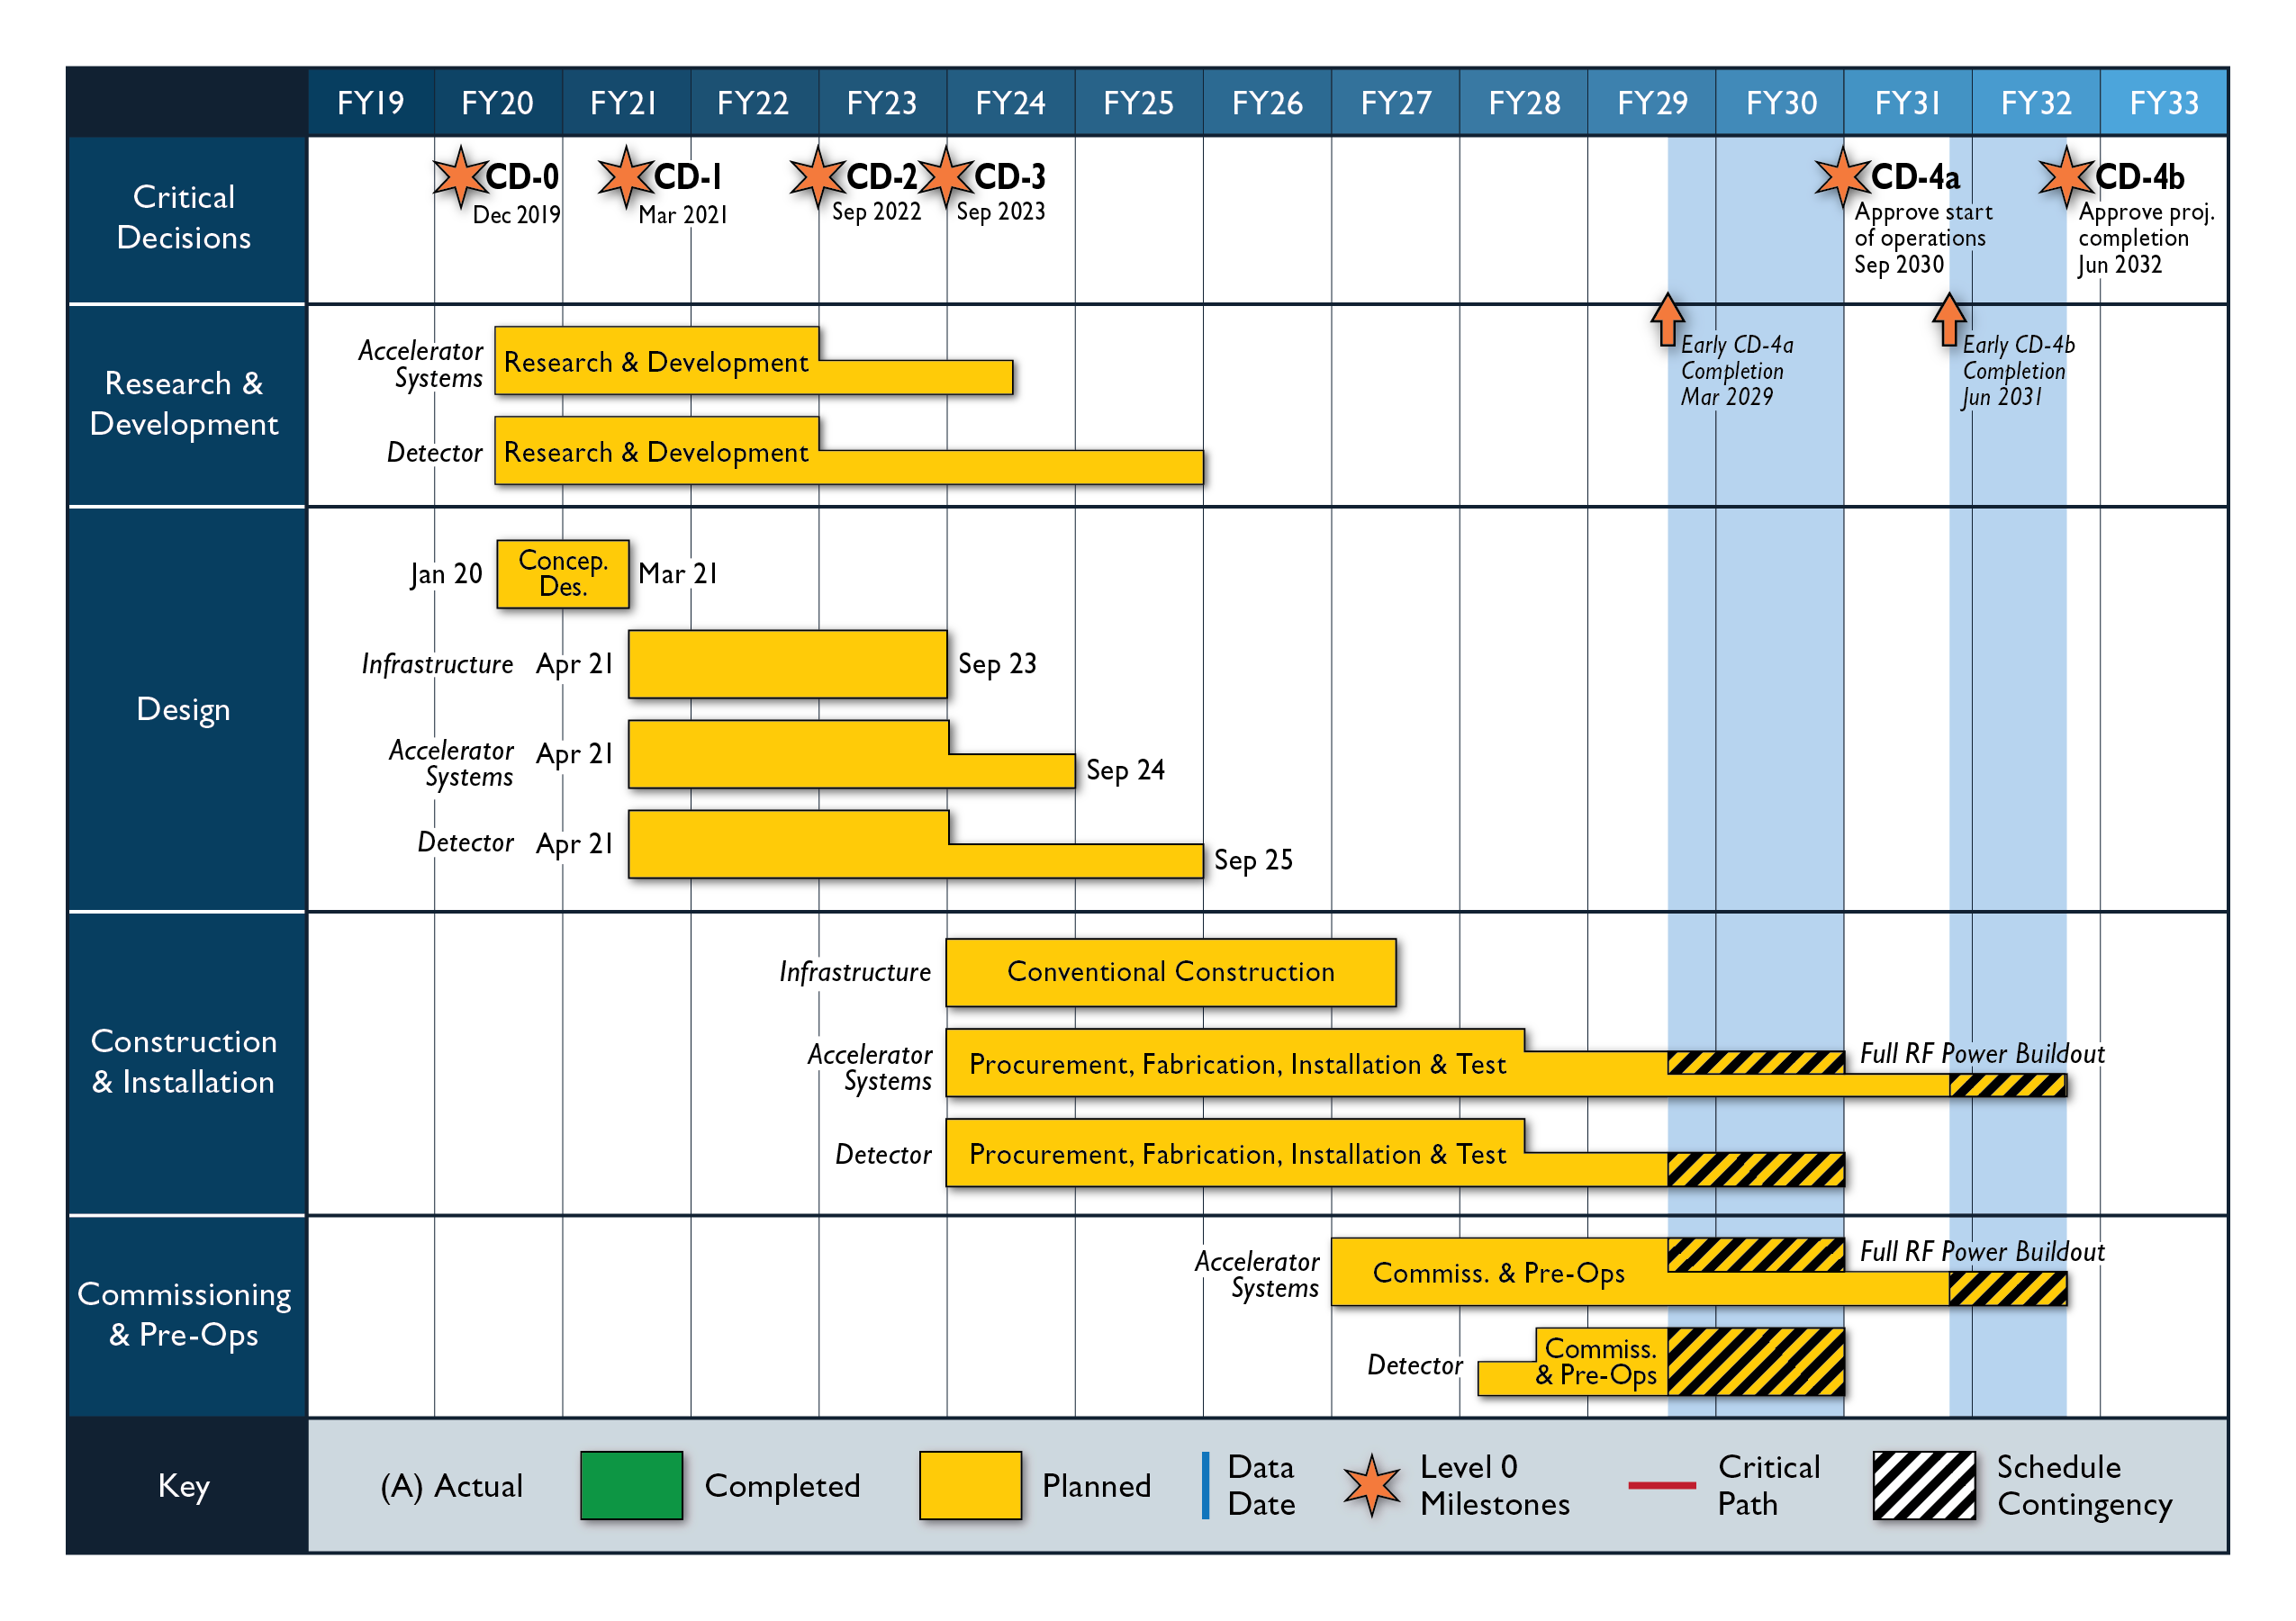
Reference Schedule

Slide 10
EIC Design Satisfies NSAC and NAS Requirements
Note: this is per definition, as these were the parameters given to the labs for the independent cost review and independent EIC site assessment.
Center of Mass Energies 20 GeV – 140 GeV
Maximum Luminosity 10³⁴ cm⁻²s⁻¹
Hadron Beam Polarization 80%
Electron Beam Polarization 80%
Ion Species Range p to Uranium
Number of interaction regions up to two

Slide 11
Detector planning
The DOE-NP supported EIC Project includes one detector and one Interaction Region in the reference costing. Reference cost is the BNL estimate prepared for the DOE CD-0 Independent Cost Review (ICR).
    See various talks at the 1st Yellow Report Workshop at Temple University (https://indico.bnl.gov/event/7449/timetable/#20200319)
Comprehensive general-purpose detector: rough costs (US project accounting) = ~$300M
This assumed in-kind contributions (non-DOE or reused equipment) of order $100M
Costs for one Interaction Region included in accelerator scope (US accounting) = ~$200M
The EIC is capable of supporting a science program that includes two detectors and two interaction regions.
  See the Yellow Report Initiative as spearheaded by the EIC User Group (http://www.eicug.org/web/content/yellow-report-initiative)
The purpose of the Yellow Report Initiative is to advance the state and detail of the documented physics studies (White Paper, INT program proceedings) and detector concepts (Detector and R&D Handbook) in preparation for the realization of the EIC. The effort aims to provide the basis for further development of concepts for experimental equipment best suited for science needs, including complementarity of two detectors towards future Technical Design Reports (TDRs).

Slide 12
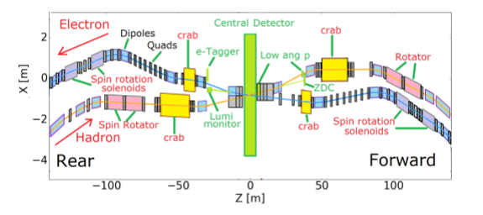
Pre-CDR Interaction Region
Extended IR including spin rotators for spin manipulation and orientation, and crab cavities for crab crossing angles, etc. Note that devices needed to illustrate collider performance, such as polarimeters and luminosity monitors, are listed under accelerator scope.

Slide 13
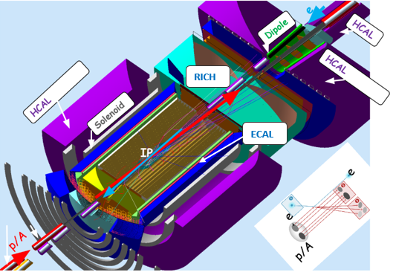
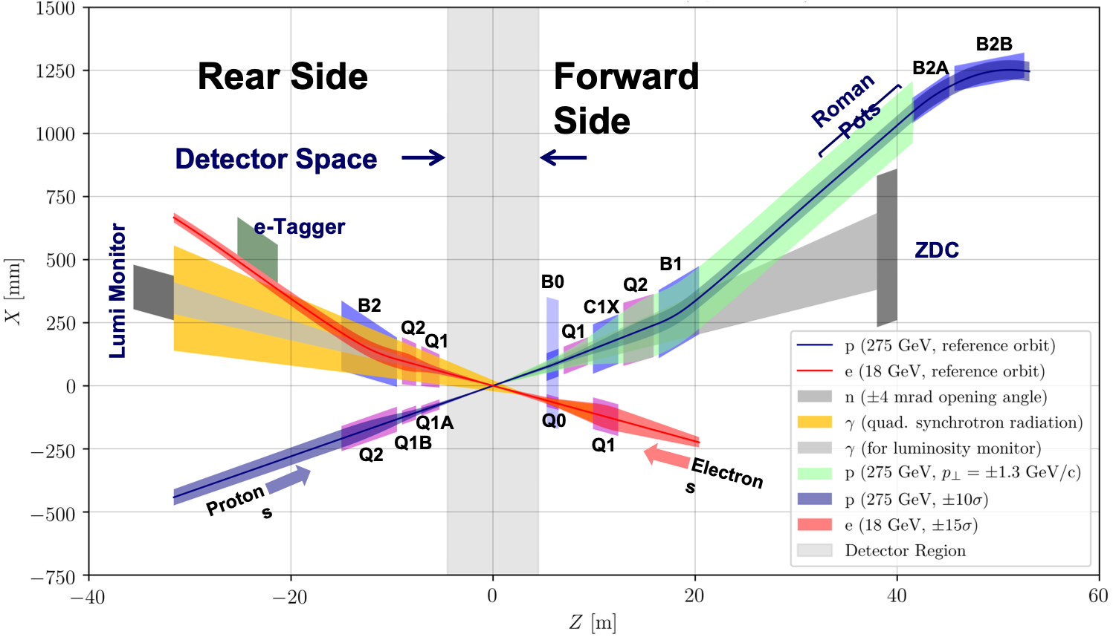
Highly integrated detector system
Total size detector: ~75m
1.Central detector: ~10m
2.Backward electron detection: ~35m
3.Forward hadron spectrometer: ~40m

Slide 14
EIC Detector Other Project Cost Activities
OPC Tasks for Experimental Equipment
These (five) activities, all done as joint BNL and JLab efforts, provide the basis for a “Path to CD-1” for the EIC Experimental Equipment, and more explicitly the information required for a CDR.
  Conceptual design of experimental solenoid
  Engineering concept for the full detector (incl. installation, maintenance)
  Interaction region (background, detector integration, vacuum)
  Evaluation of ASIC, PCB and FPGA needs
  Resource evaluation of the computing needs for a fully streaming DAQ
The activities are linked to the EIC Users Group-driven efforts towards a Yellow Report and their deliberations among various detector technologies and complementary detector choices.
Task Owners
Elke Aschenauer (BNL) and Rolf Ent (JLab)

Slide 15
Some more on the solenoid magnet
Two options: BABAR magnet with ~1.3 T, inner bore 2.8 m, and length 3.5 m, or a new magnet with field of 2 to 3 T, bore larger or similar, and similar length.
OPC Task Activity Goals
Study the feasibility of the existing BABAR magnet, and possible field mitigation, in terms of field strength at the position of possible electronics readout to guide the EIC User Group efforts (Detector Working Group, sub-group on Central Detector and Magnet Integration).
Document the limit of magnetic field distortions possible in the existing BABAR magnet or through mitigation, including any polar angle dependency, and balance against the EIC detector requirements.
Perform a risk analysis of use of the BABAR magnet in a 10- to 20-year timeframe.
Produce a summary report which can be used for demonstration of the BABAR magnet system as suitable EIC experimental equipment for the CDR.
Study the feasibility of a proposed new solenoid magnet with larger bore and central fields up to 3T in terms of peak field strength and coil design.
Develop a conceptual design of the SC solenoid magnet which would meet the EIC detector requirements, and in particular …

Slide 16
Luminosity versus E_{CM} center of mass energy
… the (infamous?) red curve makes quite some assumptions… (see talks of F. Willeke)
A joint JLab/BNL 2nd IR task force is studying possibilities on what can be realistically done.
Assume that at best we can optimize for IR#2 somewhere between the blue and red curves.
BNL EIC
Optimization for low E_{cm}
Annual Integrated Luminosity [fb⁻¹]
Peak Luminosity [cm⁻²s⁻¹]
10³⁴
10³³
10³²
BNL EIC
Optimization for high E_{cm}
100
10
1
Tomography (p/A)
Spin and Flavor Structure of
the Nucleon and Nuclei
Internal
Landscape of the Nucleus
QCD at Extreme Parton Densities-
Saturation
150
Center of Mass Energy E_{cm} [GeV]

Slide 17
Further detector (and IR!) planning
The EIC is capable of supporting a science program that includes two detectors and two interaction regions.
This is also the reason we asked for a separate workshop to discuss 2nd IR concepts early February 2021.
Ground rules:
  • A deliverable of the EIC is the possibility for a 2nd Interaction Region (IR) and detector.
  • Present EIC plans and budgets support only one IR and detector.
  • All stakeholders agree that a second IR and detector within the same timeline is desirable. Routes to make this possible are being explored.
  • The topic of the second detector is investigated by the US/DOE and EIC project in cooperation with the EICUG and may be handled as a separate project.
Ansatz:
Goals and schedule are driven by keeping open a possibility of a 2nd IR from day-one, and how it can be integrated into the EIC Project. If the realization of a 2nd IR would shift to a later time, a time-line to account for this would need to be developed. At this moment it seems the best strategy is to assume realization of the 2nd IR, be it significantly different or similar to the 1st IR, consistent with the EIC project schedule and to revisit the situation in a year from now.

Slide 18
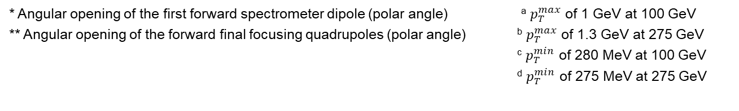
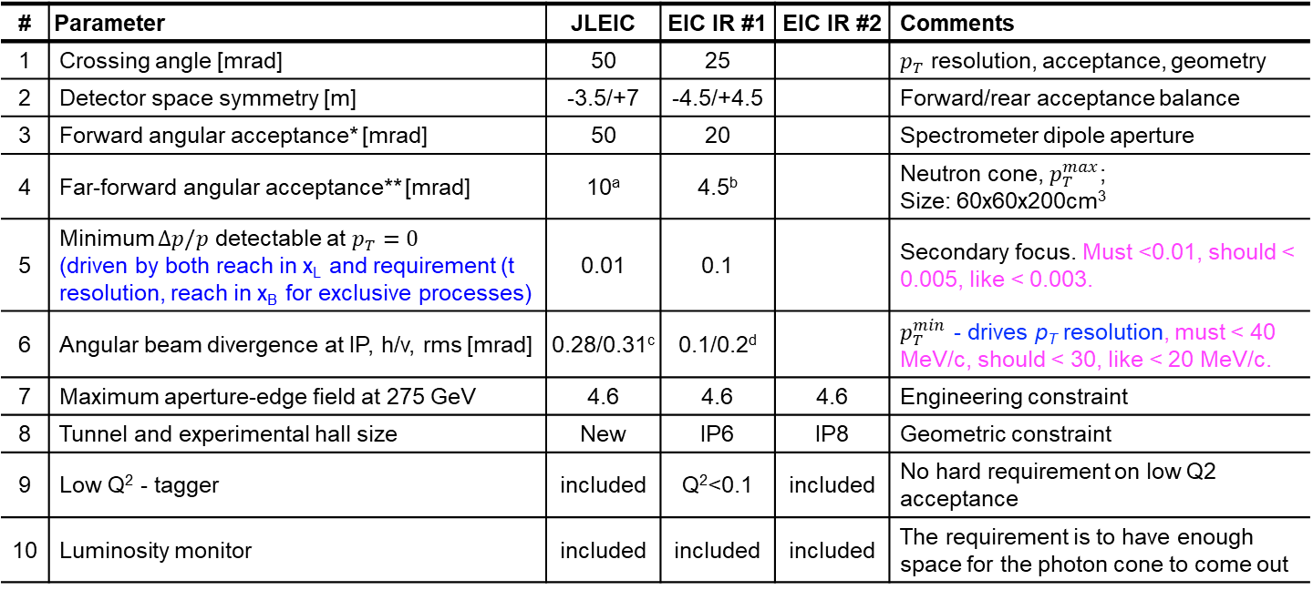
Suggested specification list of 2nd IR
2nd IR task force led by Vasiliy Morozov (JLab)
Pragmatically, likely best to let task force vary parameters and see where we end with luminosity, under the assumption we need a secondary focus and good p_{T} (or –t) resolution, while not introducing overly large technical risk or not being able to transport beams over full energy range
# | Parameter | JLEIC | EIC IR #1 | EIC IR #2 | Comments
1 | Crossing angle [mrad] | 50 | 25 |  | $p_{T}$ resolution, acceptance, geometry
2 | Detector space symmetry [m] | -3.5/+7 | -4.5/+4.5 |  | Forward/rear acceptance balance
3 | Forward angular acceptance* [mrad] | 50 | 20 |  | Spectrometer dipole aperture
4 | Far-forward angular acceptance** [mrad] | 10ª | 4.5^{b} |  | Neutron cone, $p_{T}^{max}$; Size: 60x60x200cm³
5 | Minimum $Δp/p$ detectable at $p_{T}=0$ (driven by both reach in x_{L} and requirement (t resolution, reach in x_{B} for exclusive processes) | 0.01 | 0.1 |  | Secondary focus. Must <0.01, should < 0.005, like < 0.003.
6 | Angular beam divergence at IP, h/v, rms [mrad] | 0.28/0.31^{c} | 0.1/0.2^{d} |  | $p_{T}^{min}$ - drives p_{T} resolution, must < 40 MeV/c, should < 30, like < 20 MeV/c.
7 | Maximum aperture-edge field at 275 GeV | 4.6 | 4.6 | 4.6 | Engineering constraint
8 | Tunnel and experimental hall size | New | IP6 | IP8 | Geometric constraint
9 | Low Q² - tagger | included | Q²<0.1 | included | No hard requirement on low Q2 acceptance
10 | Luminosity monitor | included | included | included | The requirement is to have enough space for the photon cone to come out
  * Angular opening of the first forward spectrometer dipole (polar angle) ª $p_{T}^{max}$ of 1 GeV at 100 GeV
  ** Angular opening of the forward final focusing quadrupoles (polar angle) ^{b} $p_{T}^{max}$ of 1.3 GeV at 275 GeV
  ^{c} $p_{T}^{min}$ of 280 MeV at 100 GeV
  ^{d} $p_{T}^{min}$ of 275 MeV at 275 GeV

Slide 19
Main EICUG objectives for the next 2 years
Detector requirements and design as driven by EIC Physics program defined by Community
  EICUG Yellow Report activity
  Different Physics (5) and Detector (8) WGs
  Provides critical input for detector proposals
    December 2019 Kick-off meeting at MIT
    March 2020 1st meeting at Temple
    May 2020 2nd meeting at Pavia/Italy
    July 15-17, 2020 remote EIC-UG Meeting (at Miami)
    September 2020 3rd meeting at CUA
    November 2020 4th meeting at UCB/LBL
    January 2021 completion Yellow Report
    February 2021 Topical meeting on 2nd IR?

Slide 20

Expression of Interest Timeline
(non-binding) Expressions of Interest (EoI) to get guidance on detector scope
Introduce concept and timeline for Call for Expressions of Interest March 2020
(introduce notion for Expressions of Interest for contribution to EIC
detectors in plenary talks at 1stYellow Report (remote) meeting at Temple)
Discussion Call for EoI for potential cooperation to EIC Detectors
initial discussion session at Remote EICUGM April 23 2020
final discussion at 2nd Yellow Report meeting at Pavia May 20 2020
Call for EoI for potential cooperation to EIC Detectors May 31 2020
issued after folding in feedback of EICUG @ Pavia meeting
Deadline EoI for potential cooperation to EIC Detectors November 1 2020
Status report at 4th (final) Yellow Report meeting at UCB/LBL November 19-21 2020
(Request for discussion session at 4th Yellow Report meeting
on 2nd IR ideas based on YR and Accelerator Task Force status)
Evaluate EoI and inform Call for Detector Proposal(s) February 2021
(complete after assumed January 2021 Yellow Report
completion, EoI can give guidance on detector scope)

Slide 21

Expression of Interest
Dear prospective Electron-Ion Collider users,
Brookhaven National Laboratory (BNL), in association with Thomas Jefferson National
Accelerator Facility (TJNAF), would like to invite interested groups to submit an Expression
of Interest (EOI) for their potential cooperation on the experimental equipment in support
of a broad and successful science program at the Electron-Ion Collider (EIC).
We encourage interested groups to work together within their country, their geographical
region, or as a general consortium, to submit such EOIs.
This call focuses on all detector components to facilitate the diverse EIC science program,
including those integrated in the interaction region.
Please visit https://www.bnl.gov/eic/EOI.php to see further details about this call and how
to submit an Expression of Interest.
Best regards,
Elke Aschenauer and Rolf Ent for the EIC Project Team
The received input will be made public here: https://indico.bnl.gov/event/8552/

Slide 22
EoI: More information
2 Questionnaires to upload
  one with info to become public one with info only for EIC Project
compiled FAQs

Slide 23
Timeline beyond Expression of Interest
Assumption: CD-1 aligned with accelerator timeline
Goal: CD-2 & CD-3 also aligned!
  Request Topical week-long workshop on 2nd IR early February 2021 (accelerator discussion and science discussion on 2nd IR goal and needs
  such that we can potentially integrate in Call for Detector Proposals)
Form EIC Collaboration(s)
  Issue Call for Detector Proposals March 2021
  (consistent with EICUGM assumptions of early 2021)
  Deadline for Proposals September 2021
  (roughly in phase with projected CD-1 date)
  Detector Advisory Committee Meeting November 2021
    (to guide work in TEC phase)
  Selection of Detector(s) December 2021
  (one or two, pending Expression of Interest response)
  CD-2 September 2022
  CD-3 September 2023
  (CD-2 and CD-3 dates assumed for planning purposes)
Note: time to complete >80% of the full engineering & design for detector at CD-3 is tight, so we need to keep the YR efforts in motion for completion in January

Slide 24



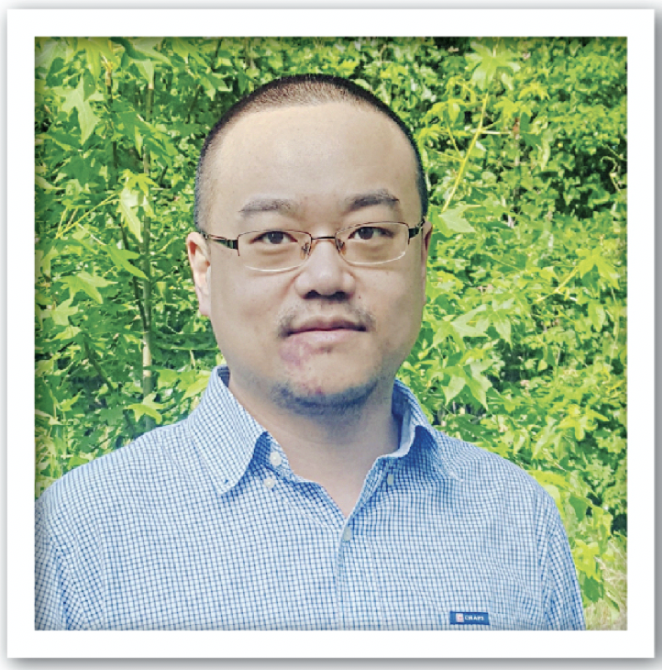
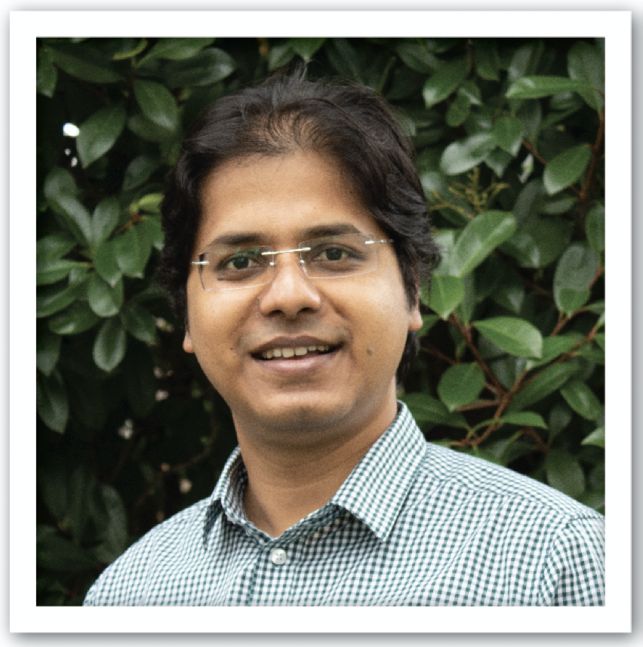


Charlotte Van Hulse
Orsay, France
Study of the detector requirements and optimal configurations for the study of parton distribution functions and fragmentation functions at the EIC.
Chiara Bissolotti
Pavia, Italy
Theoretical calculations of the integrated
transverse momentum distribution cross sections at next to leading order.
Wenliang (Bill) Li
William & Mary, Virginia
Simulation studies of EIC u-channel exclusive production and contributing to the forward tagging detector requirements and design.
Bhawin Dhital
Old Dominion University, Virginia
Accelerator project to study the two-energy storage ring cooler to improve the luminosity of the EIC.
Jennifer Rittenhouse West
SLAC, California
Theoretical studies of the dynamics of the novel color singlet and studying mechanisms to explain the EMC effect.
Jackson Pybus
MIT, Massachusetts
Study of deep inelastic scattering from short-range correlated pairs and determination of the requirements of the far forward detectors.
Slide courtesy Doug Higinbotham

Slide 25
Outlook/Summary
BNL and JLab have vested interest in EIC project and science, and both labs are firmly committed to EIC success. This is formalized in a partnering agreement.
The EIC is capable of supporting a science program that includes two detectors and two interaction regions.
  The call for expression of interest is a crucial step to get guidance on the EIC detector scope
  An early February 2021 “YR” workshop is under discussion related to 2nd IR accelerator and science considerations.
  Ultimately, the EIC community will be very influential in determining the trajectory of both detectors and interaction regions.
EIC Project work – “Other Project Cost” activities for experimental equipment have started, all (5) with joint BNL and JLab staff. These have strong synergy with the user-driven Yellow Report activities to provide the basis for a “Path to CD-1”.
Planning for both detectors will be integrated from the start in the EIC Project, and we plan to fold in users/collaborators as L3/L4 exp. contacts and/or as L4 owners.
CDR planning underway – will include a plausible scenario reference EIC (general-purpose) detector.
  An editorial committee for the experimental equipment has been assembled as a mix of BNL staff, JLab staff, and (international) users.

Slide 26
Backup

Slide 27
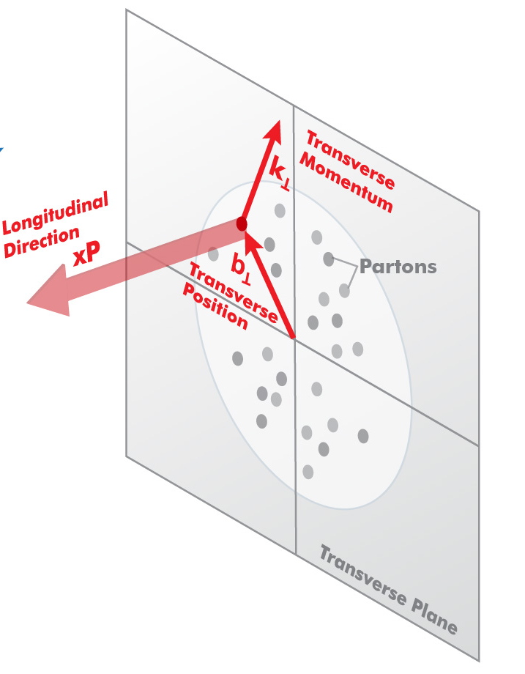
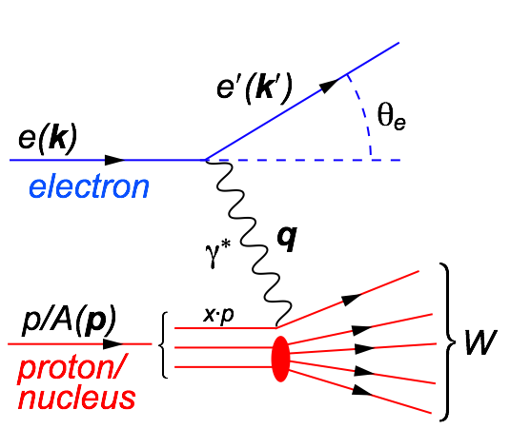
Experimental Challenge of the EIC
s=xyQ², s=4E_{e}E_{p}
s: center-of-mass energy squared
x: the fraction of the nucleon’s momentum carried by the struck quark (0 < x < 1)
Q²: resolution power
y: inelasticity
need energy range to unambiguously resolve partons over wide range in x and Q² → versatile center-of-mass energy energy √s: 20 – 140 GeV
need to resolve parton quantities (k_{t}, b_{t}) of order a few hundred MeV in the proton → high luminosity needed: 10³³-10³⁴ (and high polarization needed)

Slide 28
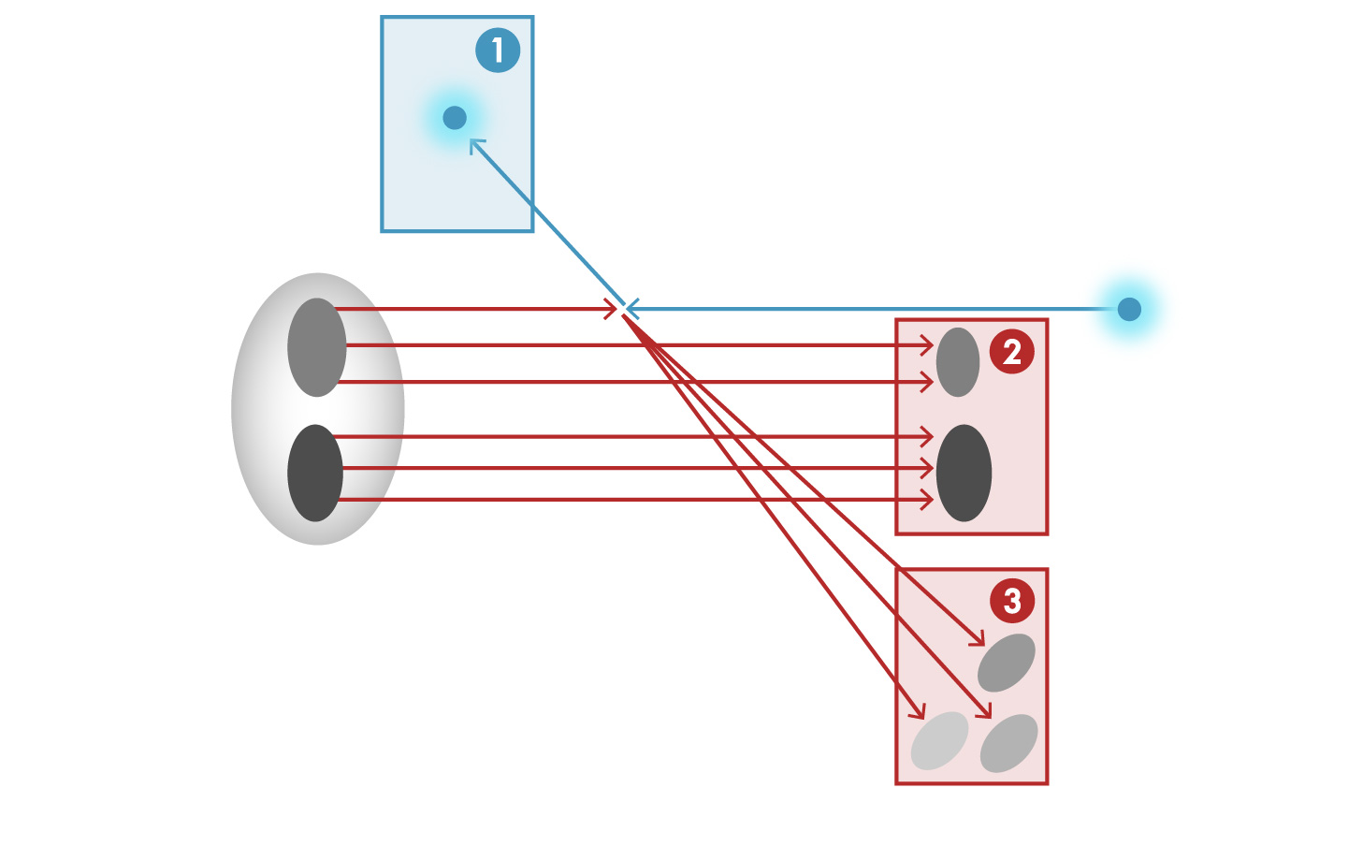


Detector Challenge of the EIC
e’, $ν$
Aim of EIC is nucleon and nuclear structure beyond the longitudinal description.
This makes the requirements for the machine and detector different from all previous colliders.
e
$γ,$Z,W
p/A
q
p remnant
“Statistics”=Luminosity × Acceptance
e’
EIC Physics demands ~100% acceptance for all final state particles (including particles associated with initial ion)
e
p/A
Ion remnant is particularly challenging
not a usual concern at colliders
at EIC integrated from the start with a highly integrated (and complex) detector and interaction region scheme.
Scattered electron
Particle associated with initial Ion
Particle associated with struck quark

Slide 29
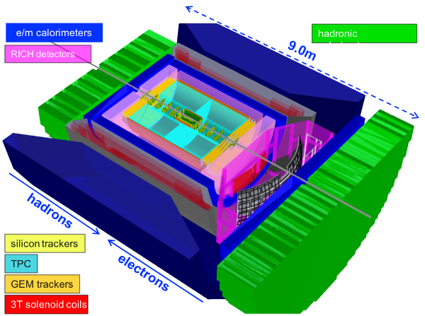
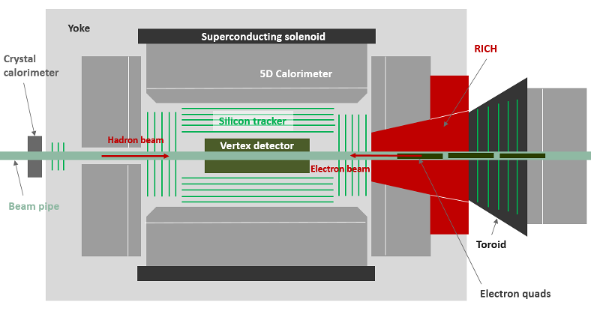
Main detector objectives for the next 2 years
Refine Detector Scenarios:
Any general purpose EIC Detector is complex
Brookhaven concept: BEAST
Overall detector requirements:
Large rapidity (-4 < η < 4) coverage; and far beyond in especially far-forward detector regions
High precision low mass tracking
  small (μ-vertex) and large radius (gaseous-based) tracking
Electromagnetic and Hadronic Calorimetry
  equal coverage of tracking and EM-calorimetry
High performance PID to separate π, K, p on track level
  also need good e/π separation for electron-scattering
Large acceptance for diffraction, tagging, neutrons from nuclear breakup: critical for physics program
  Many ancillary detector integrated in the beam line: low-Q² tagger, Roman Pots, Zero-Degree Calorimeter, ….
High control of systematics
  luminosity monitors, electron & hadron Polarimetry
Jefferson lab concept
Argonne concept: TOPSiDE

Slide 30
EIC General Purpose Detector: Concept
p: 41 GeV, 100 to 275 GeV
e: 5 GeV to 18 GeV
Endcaps critical because of
asymmetric beam energies
Large rapidity (-4 < η < 4) coverage
  → Detect from 2º to 178º
  and far beyond
    → Many detectors in backward + forward region
https://physdiv.jlab.org/DetectorMatrix/

Slide 31
Further planning for Conceptual Design Report
Recall at 1st Yellow Report meeting at Temple U:
  At CD-1 we need a plausible scenario reference design for any general-purpose detector (= one full detector to do the NSAC/NAS Report science)
CDR planning for experimental equipment ongoing
  Have assembled editorial board (mix of BNL staff, JLab staff, and users – taking strong advantage of ongoing Yellow Report activities)
  Section 2 Science and Requirements
  2.1 EIC Experimental Equipment Introduction
  (EIC Physics, Accelerator Requirements, IR and Detector Requirements)
  2.2 EIC Context and History
  2.3 The Science Goals of the EIC and Machine Parameters
  2.4 Summary of Machine Design Parameters for the EIC Physics
  2.5 Scientific Requirements for the Detectors and IRs
  2.6 Scientific Requirements for the Detectors
  2.7 Scientific Requirements for the Interaction Regions
  Section 3 (or later) The EIC Experimental Equipment – see next slide

Slide 32
Further planning for Conceptual Design Report
CDR planning for experimental equipment ongoing
  Have assembled editorial board (mix of BNL staff, JLab staff, and users – taking strong advantage of ongoing Yellow Report activities)
  Section 8 The EIC Experimental Equipment
  8.1 Experimental Equipment Requirement Summary
  8.2 Realization of the Experimental Equipment
  in the National and International Context
  8.3 EIC Kinematics
  8.4 Physics Requirements for an EIC Detector
  (Rates and Multiplicities, Detector Requirements, IR Integration and Backgrounds)
  8.5 Reference EIC Detector
  (Central Magnet Considerations, Detector Realization, A Model Detector, Ancillary Detectors, Computing and Software)
  8.6 Installation and Maintenance
  (Infrastructure and Integration, Installation, Maintenance)

