Slide 1
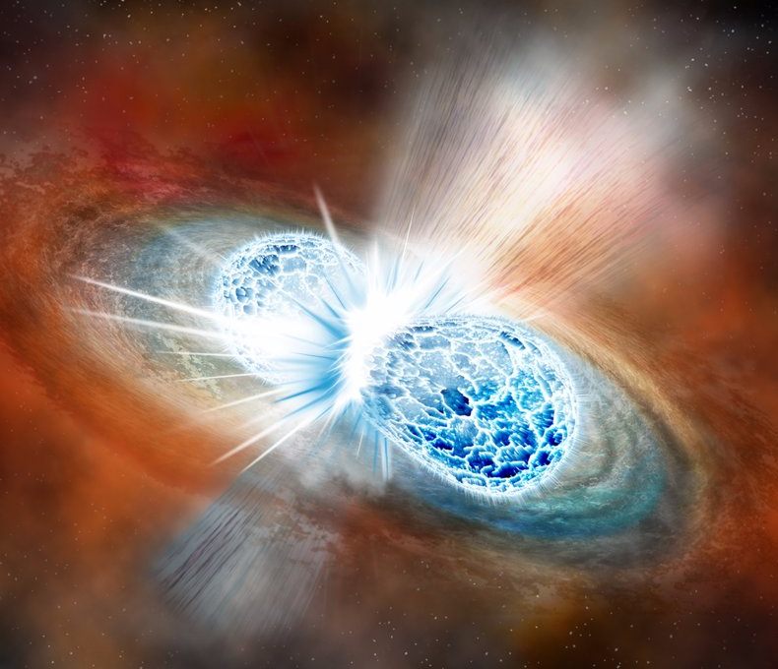

Implications of prex-2 on nuclear equation of state
Brendan Reed
Indiana University
reedbr@iu.edu

Slide 2
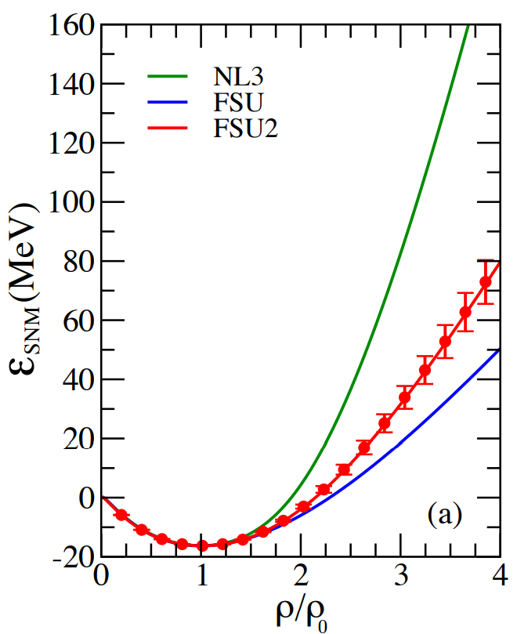
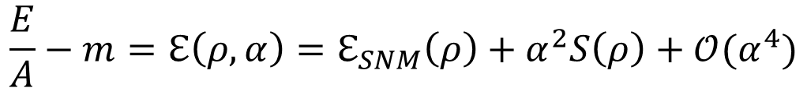
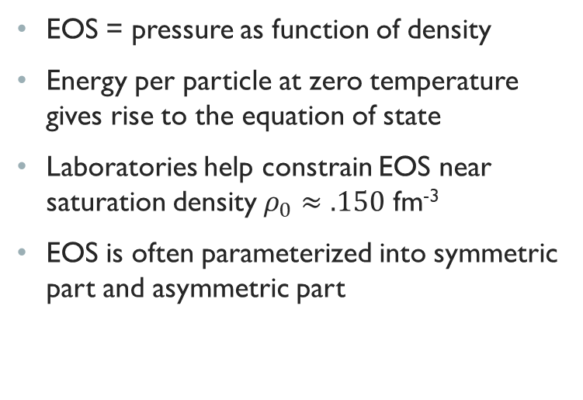
Nuclear equation of state
EOS = pressure as function of density
Energy per particle at zero temperature gives rise to the equation of state
Laboratories help constrain EOS near saturation density $ρ_{0}≈.150$ fm⁻³
EOS is often parameterized into symmetric part and asymmetric part
$$\frac{E}{A}−m=ℇ\left(ρ,α\right)=ℇ_{SNM}\left(ρ\right)+α^{2}S\left(ρ\right)+𝒪(α^{4})$$

Slide 3
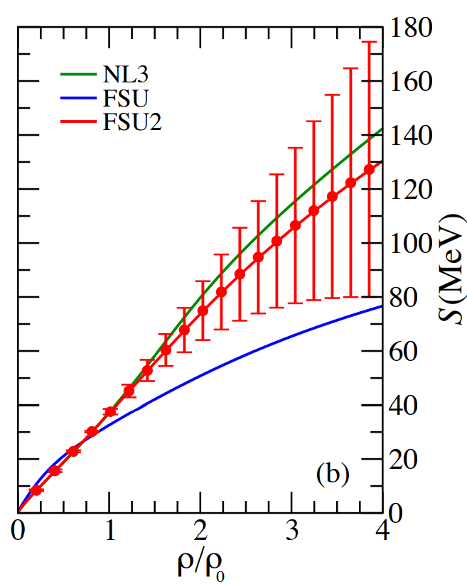
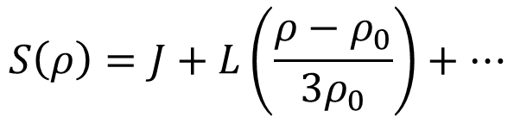
Symmetry energy
Symmetry energy describes the energy of asymmetric matter
Expanded around saturation
Slope parameter L strongly related to neutron skin
$$S\left(ρ\right)=J+L\left(\frac{ρ−ρ_{0}}{3ρ_{0}}\right)+…$$
$$L=3ρ_{0}\frac{∂S}{∂ρ}{\left.​\right|}_{ρ=ρ_{0}}$$
$$J=S(ρ_{0})$$

Slide 4
Symmetry energy

Slide 5
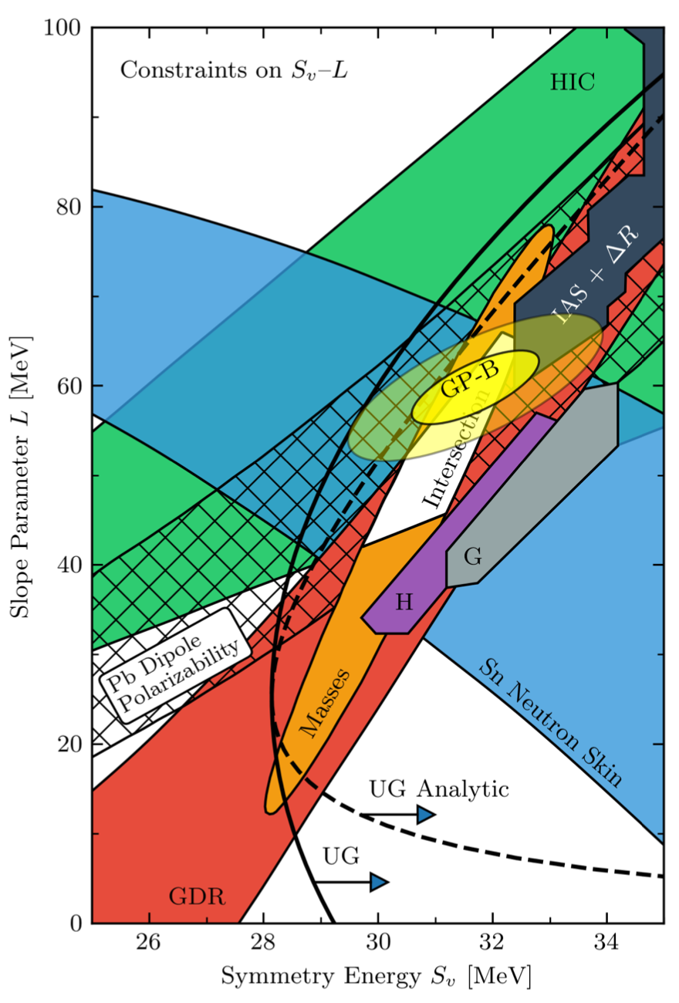
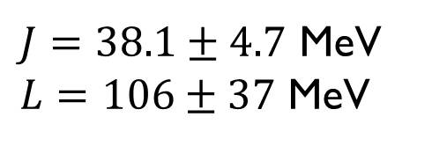
$J=38.1±4.7$ MeV
$L=106±37$ MeV
Suggests a moderately stiff EOS

Slide 6
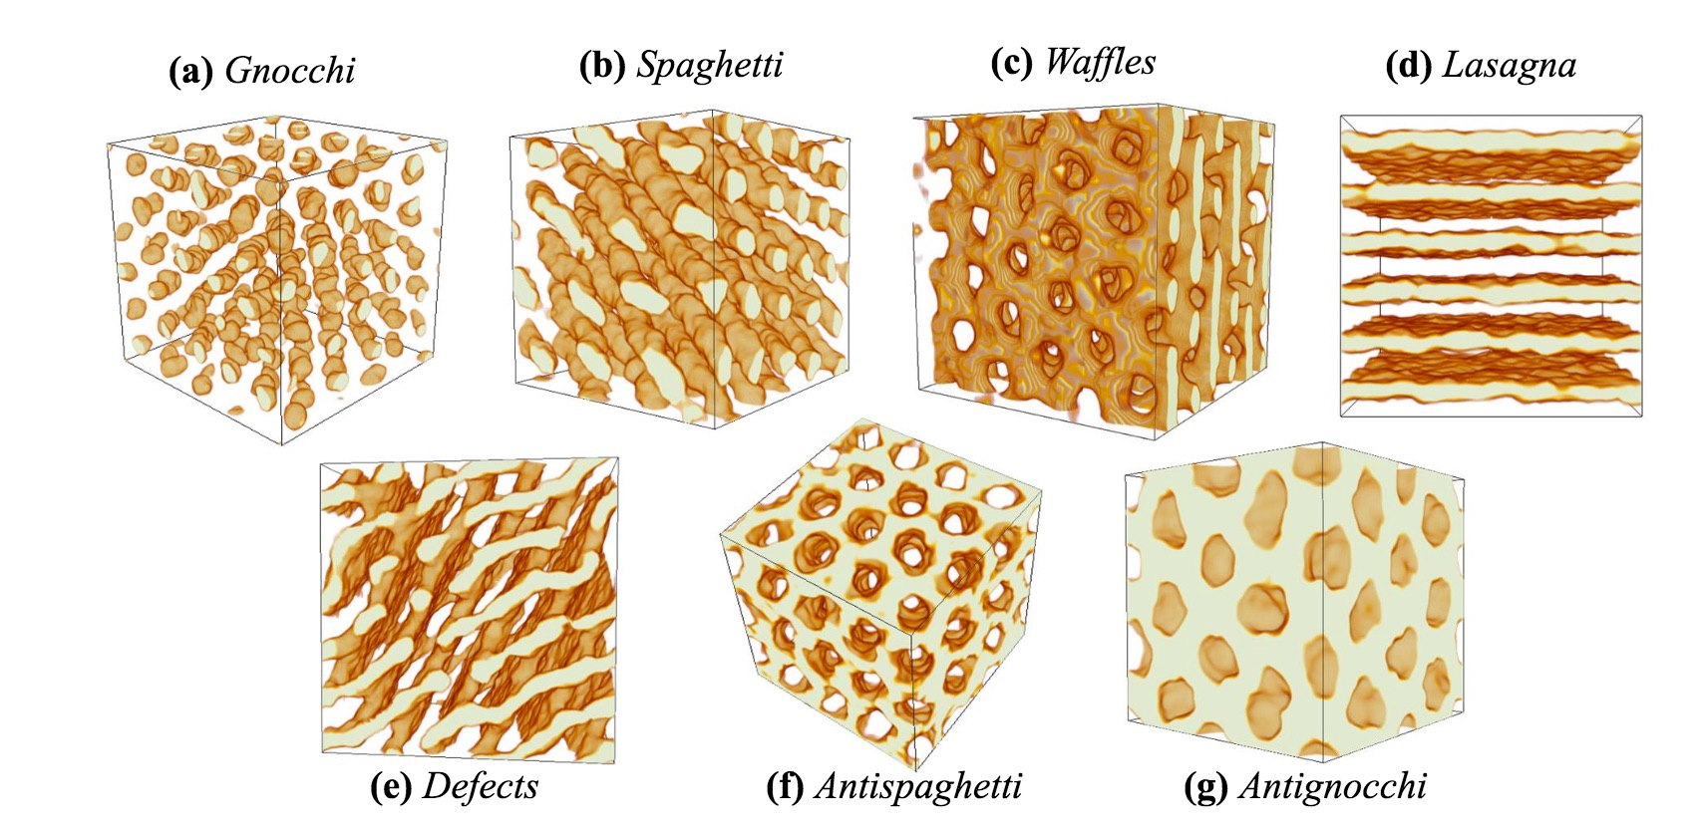
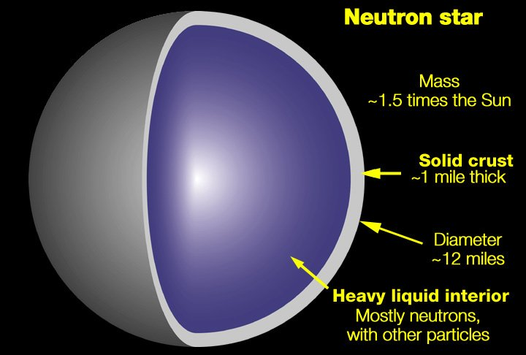
Structure of a neutron star
Core comprised of superconducting fluid of neutrons and protons in beta equilibrium
  Comprises majority of structure of star including its mass and radius
Inner crust has coulomb crystal of neutrons, neutron rich nuclei, and relativistic degenerate electrons
  Nuclear pasta!
Outer crust is coulomb crystal of neutron rich nuclei and relativistic degenerate electrons

Slide 7
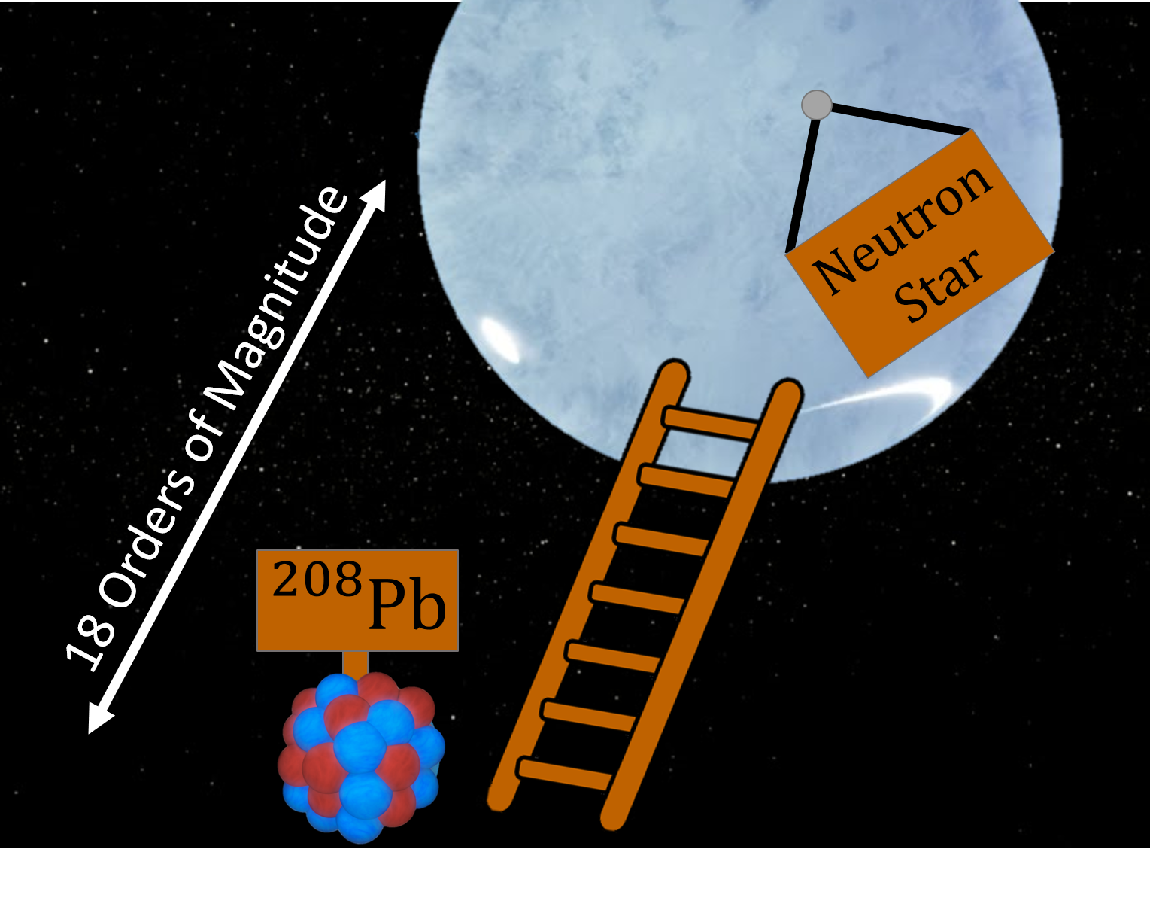
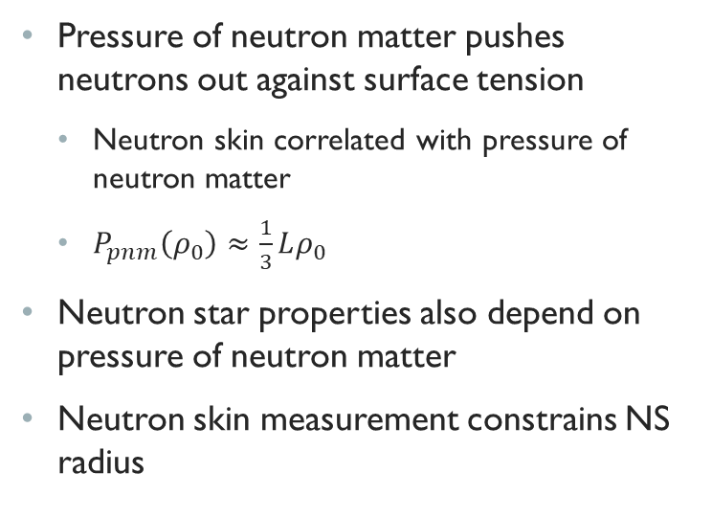
Neutron stars and Pb208
Pressure of neutron matter pushes neutrons out against surface tension
  Neutron skin correlated with pressure of neutron matter
  $P_{pnm}\left(ρ_{0}\right)≈\frac{1}{3}Lρ_{0}$
Neutron star properties also depend on pressure of neutron matter
Neutron skin measurement constrains NS radius
Notes:
18 orders of magnitude difference

Slide 8
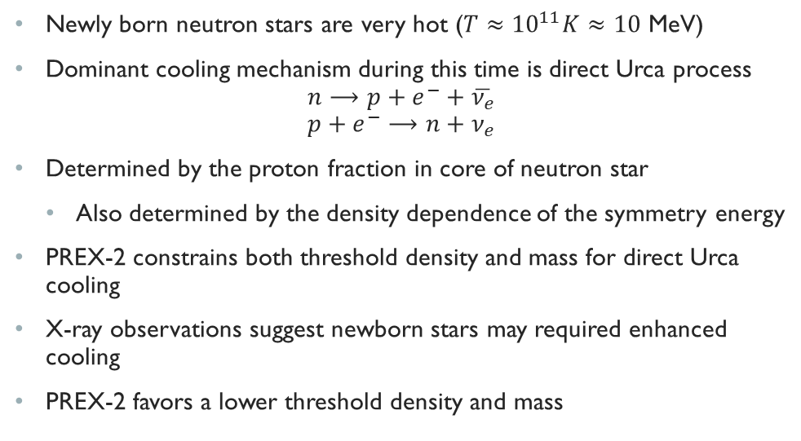
Direct urca process
Newly born neutron stars are very hot ($T≈{10}^{11}K≈10$ MeV)
Dominant cooling mechanism during this time is direct Urca process
$$n⟶p+e^{−}+\overline{ν_{e}}$$
$$p+e^{−}⟶n+ν_{e}$$
Determined by the proton fraction in core of neutron star
  Also determined by the density dependence of the symmetry energy
PREX-2 constrains both threshold density and mass for direct Urca cooling
X-ray observations suggest newborn stars may required enhanced cooling
PREX-2 favors a lower threshold density and mass

Slide 9
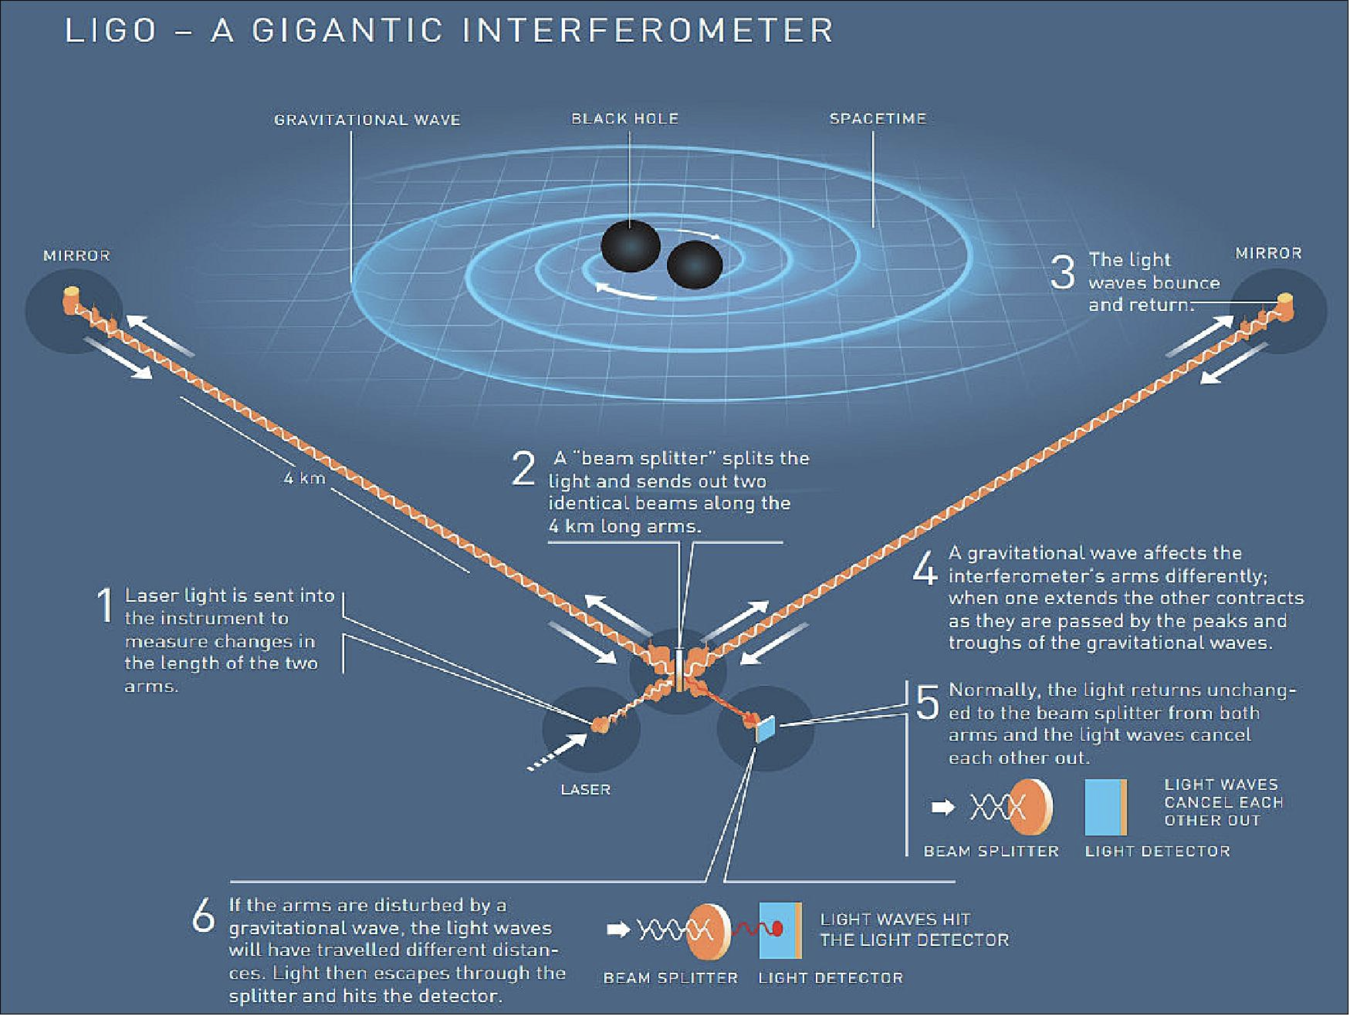

Slide 10
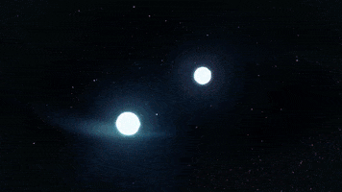
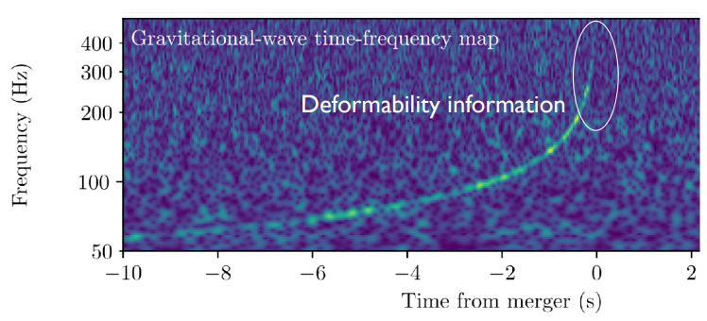
Gravitational waves
Aug. 17, 2017: merger of two NS observed by LIGO-Virgo gravitational wave detectors
Fermi and Integral spacecrafts independently reported a short gamma ray burst
Extensive follow ups observed this event at wavelengths in each part of EM spectrum
Abbot et al. (2017)

Slide 11
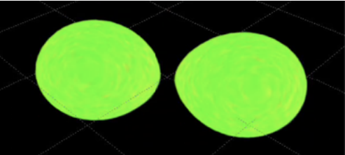
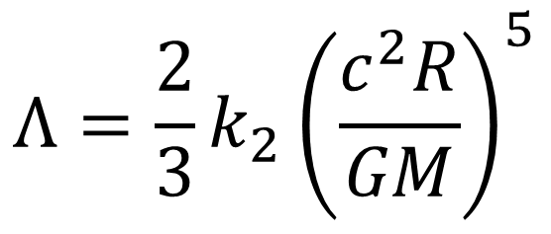
Tidal Deformability
Gravitational tides distort shapes of neutron stars just before merger
Similar to dipole polarizability of an atom, the mass quadrupole polarizability (tidal deformability) of a NS scales as powers of R
GW170817 set upper limits on combined deformability of stars 1 and 2
Analysis favors more compact stars
$$Λ=\frac{2}{3}k_{2}{\left(\frac{c^{2}R}{GM}\right)}^{5}$$

Slide 12
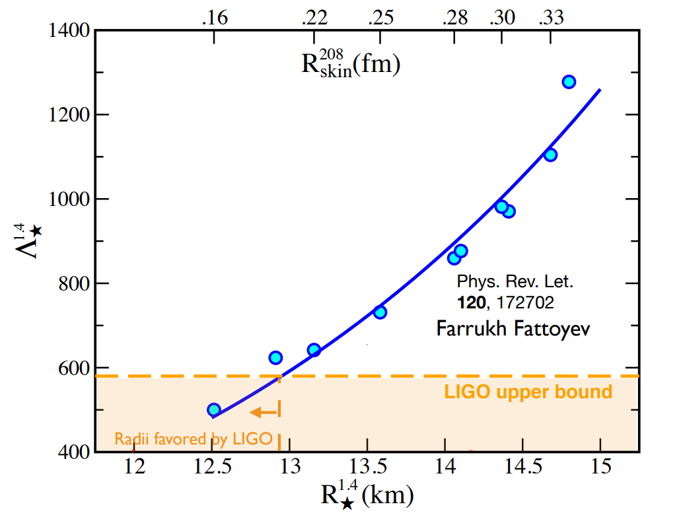

Slide 13
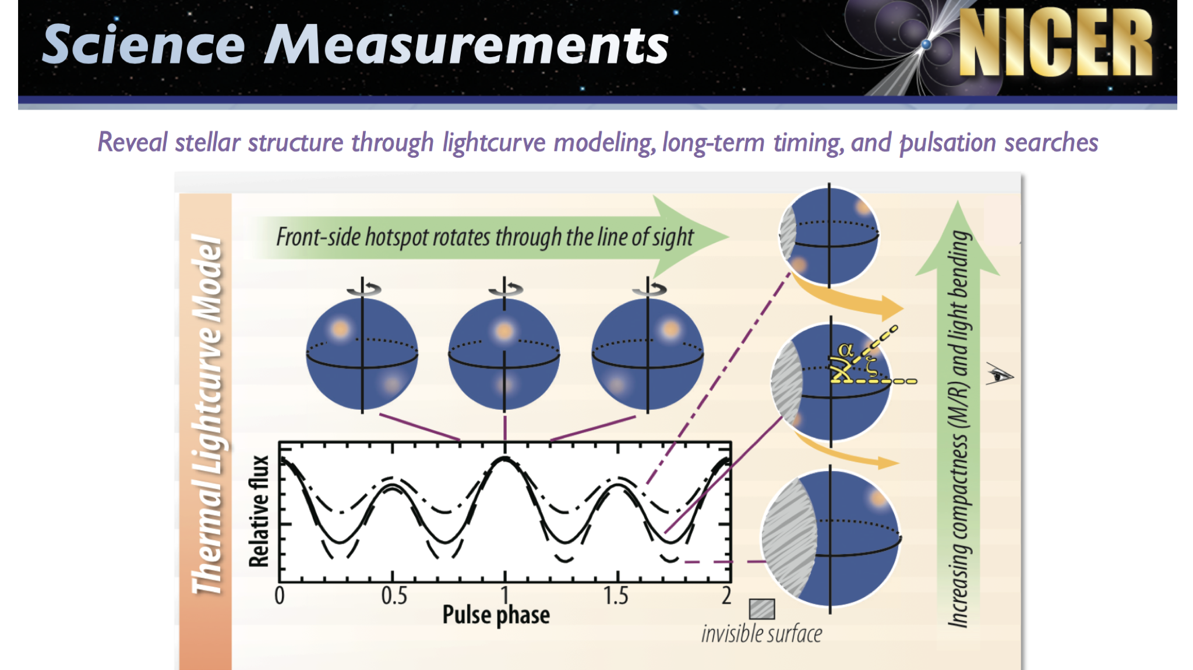

Slide 14
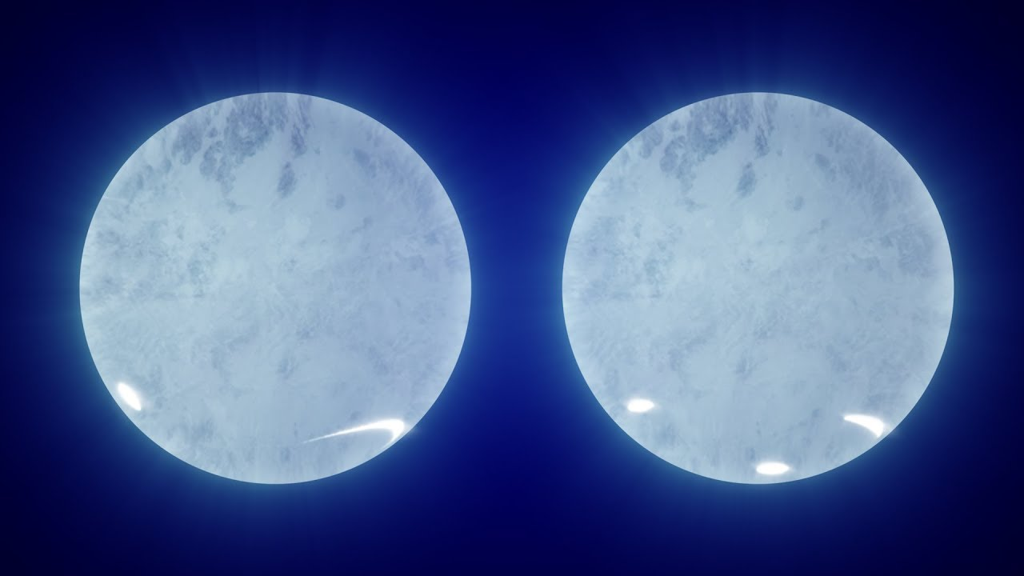
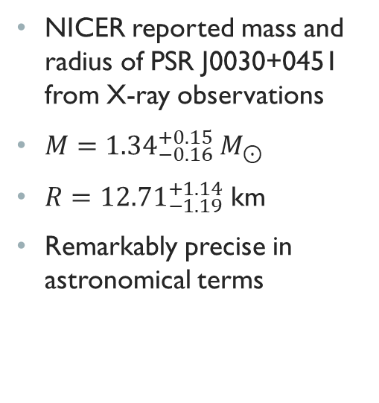
A nicer view of neutron stars
NICER reported mass and radius of PSR J0030+0451 from X-ray observations
$M={1.34}_{−0.16}^{+0.15} M_{⊙}$
$R={12.71}_{−1.19}^{+1.14}$ km
Remarkably precise in astronomical terms

Slide 15
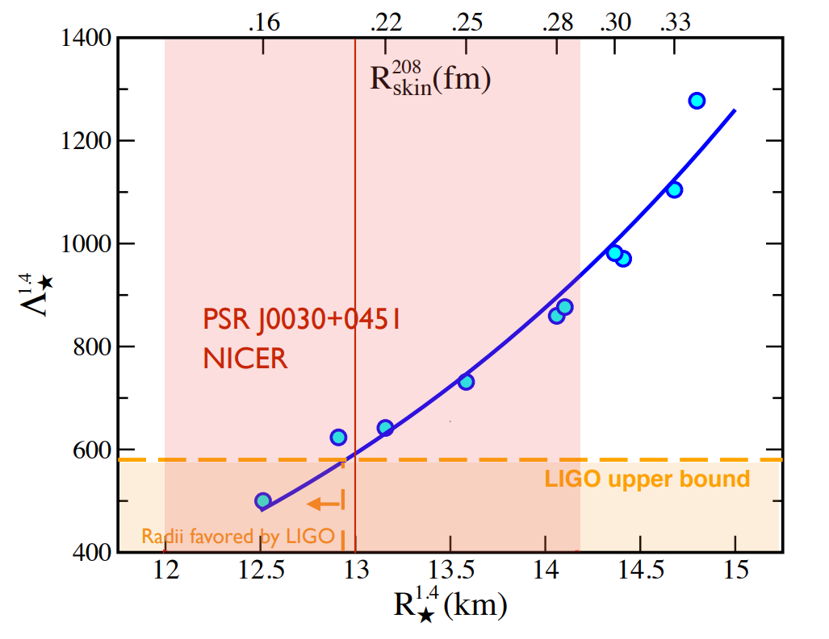

Slide 16
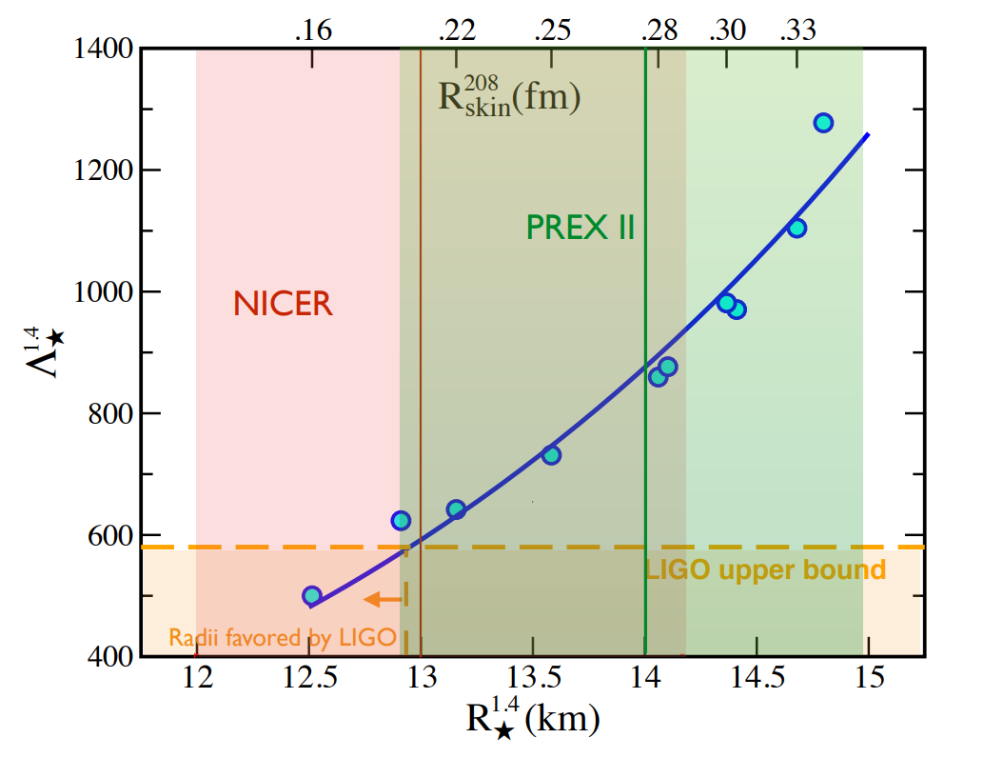
PREX-2 Favors moderately stiff EOS
LIGO favors NS radii < 13km
PREX2 favors > 13km radii
Consistent picture if NS radii are about 13km

Slide 17
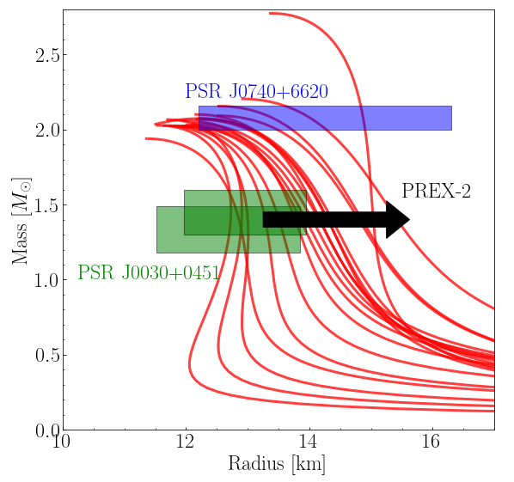
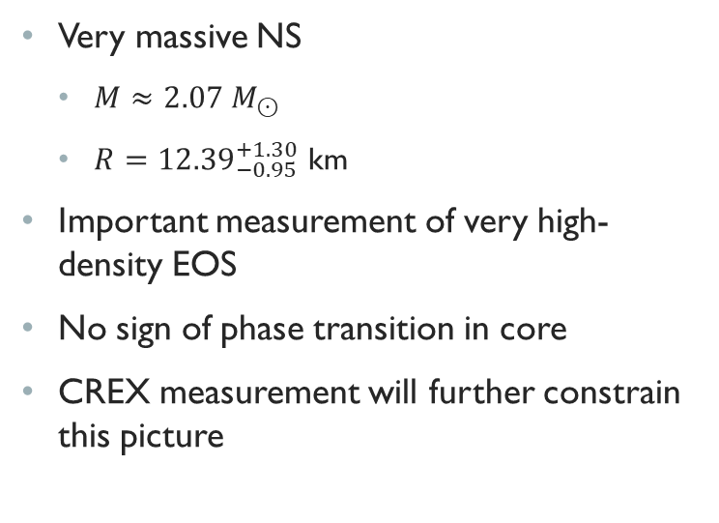
PSR J0740+6620
Very massive NS
  $M≈2.07 M_{⊙}$
  $R={12.39}_{−0.95}^{+1.30}$ km
Important measurement of very high-density EOS
No sign of phase transition in core
CREX measurement will further constrain this picture

Slide 18
conclusion
PREX-2 measurement has several implications on a variety of nuclear systems
Gravitational wave detections constrain neutron star structure
X-ray telescopes have constrained neutron star radii at different masses
PREX-2 suggests weak tension with GW observations, favors moderately stiff equations of state in neutron stars
Upcoming CREX results will shed more light on the slope of the EOS
Big thanks to my graduate advisor Charles Horowitz
Farrukh Fattoyev and Jorge Piekarewicz
All the people involved in the PREX-2 collaboration

