Slide 1
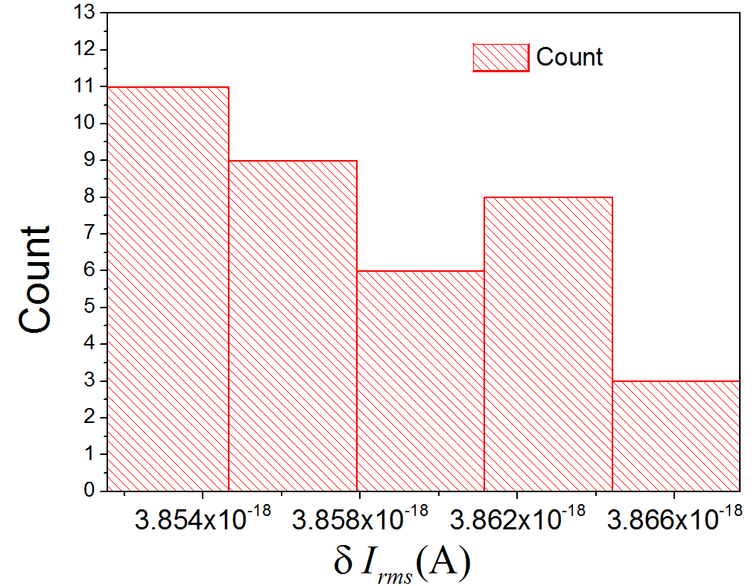

Title of your poster
Logo of your Institution
Add Author Names and Information
Include University or Department Names if Needed
Abstract
Data
Results
Poster size: make it 32 X 36 inches
You can change this by going to “Design” → ”Slide Size” or “File”→ “Page Setup”
Fonts: pick one and stick to it. Be consistent with formatting titles, bullet points, etc.
Titles look comically large when zoomed in. It’s ok to have a font size of over 90. Names and affiliations should be smaller.
This is about the smallest you would want text to be. It is size 40 or 32.
You can make them whatever you want. These are just suggestions.
Some general advice:
Don’t use sentences! People don’t read sentences. Try to use phrases and bullet points
Common Poster sections:
A short title - clearly state main topic
List authors with affiliations
Provide your contact information
Motivation or Introduction
Why should someone listen?
Theory/Method/Data
Analysis – Often separate from Data
Results
Conclusion
References
Acknowledgements/Logos – We got funds from …to attend
.
Measurement | Typical Value | Typical Uncertainty | Fractional Uncertainty
Voltage | 1.00V | 0.02V | 2 %
Resistance | 20000Ω | 200Ω | 1 %
Frequency Shift | 111000Hz | 4100Hz | 4 %
Temperature | 296.6K | 0.5K | 0.2 %
Results and Conclusion usually go on the right side of a poster. References will go at the bottom.
When you go to print, make sure you send a PDF because a PDF doesn’t change with what computer is looking at it.
Columns: You’ll notice I am writing in a column. Most posters are arranged into three equally sized columns.
Make the flow of the poster easy to follow:
Motivation > Background > Setup > Data > Analysis > Results > Conclusions > References
.
Uncertainty was reduced by taking several measurements
Uncertainty of calculated value $δq$ was calculated using the general formula.
$δq=\sqrt{{\left(\frac{∂q}{∂x}δx\right)}^{2}+⋯+{\left(\frac{∂q}{∂x}δx\right)}^{2}}$ Eq. 1
A poster is really just a visual guide for to reference while you speak. You should never think “Oh, I wish I had a figure which showed _____” those figures should be on your poster. To make sure you have all the figures you need, you must practice your poster explanation several times before printing
Introduction
Conclusions/Discussion
Background of your research question
You can draw on top of the pictures with arrows or whatever you need to make your point.
Anywhere on the poster you can insert an equation if it is needed. Please don’t use asterisks * for multiplication or carets ^ for powers. Use the equation editor.
$$P=σAe\left(T^{4}−{T_{o}}_{c}^{4}\right)$$
Make sure you define variables:
P = Power … etc.
This generic poster template can be helpful when you make your own poster. Remember to save as a PDF before you print!
Also, have others, such as a mentor, check over your poster before you print.
Graphs should be large and easy to read. Text under a graph which explains the graph can be helpful but is not always necessary.
Acknowledgements/References
Figure 1: If you want to add Figure captions, they can be small. Keep them short and simple.
Put any references that you have down here. Make sure to cite your sources. Any images you use should be cited if you didn’t draw them. Here is an example:
M. P. Brown and K. Austin, The New Physique, Publisher City: Publisher Name, 2005, pp. 25-30.

