Slide 1
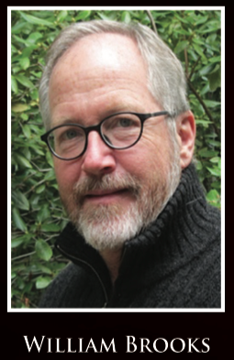
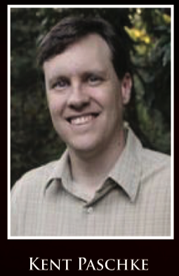
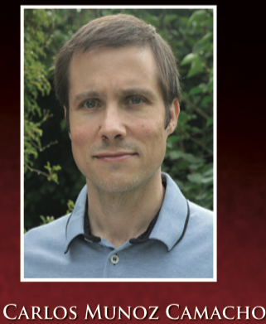
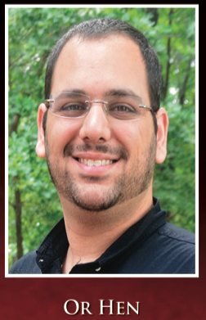
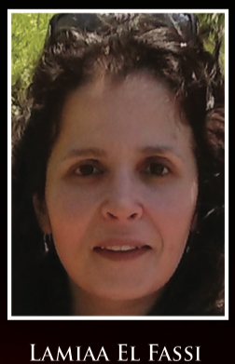
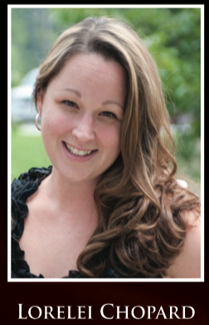
2019 JLab Users Organization meeting: JLab science around the world
Each day has an emphasis:
An international user community
Reaching the full potential of 12 GeV
From 12 GeV to the EIC: toward CD0
Many thanks to the organization committee:

Slide 2
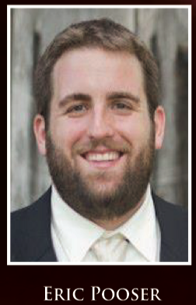
2019 JLab Users Organization meeting: Special events
Poster session / reception: Monday at 5:30 pm
Lunch seminars for junior scientists: room F113 starting at 12:20
Careers in Nuclear Physics and Beyond (T. Keppel),
Breaking the Myth of the "Non-Traditional" Physicist (D. Higinbotham),
Life at Jlab (W. Phelps)
free lunch !
Many thanks to the organization committee:

