Slide 1
CEBAF Operations
Arne Freyberger
Operations Department
Accelerator Division
Jefferson Lab

Slide 2
Outline
12 GeV Commissioning
Accelerator Readiness Review – 4
2017 Plans in support of completing 12 GeV Project (CD-4B)
CEBAF Reliability
Fall 2016 CEBAF performance
Multiple Hall Operation
RF separation woes
4-laser upgrade
Multi-hall operations constraints
Energy Reach
Fall 2016 performance
Future
Summary

Slide 3
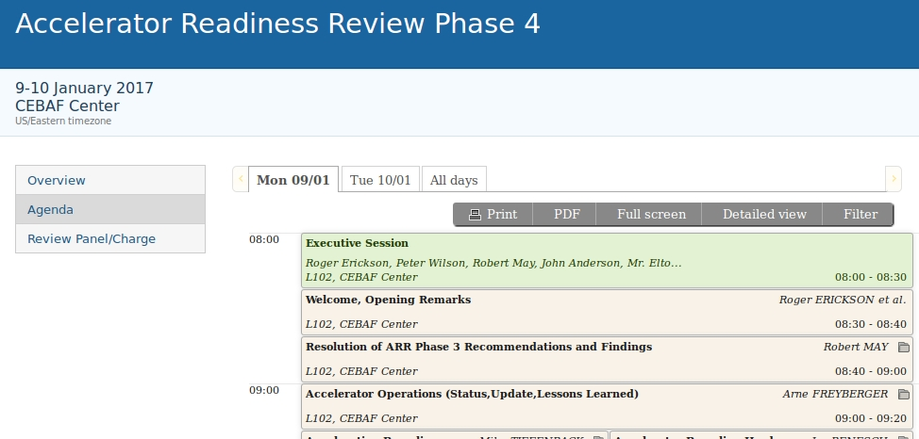
12 GeV Commissioning
Formal project deliverable, CD-4A, achieved Dec. 2014
Hall-D CD-4B Key Performance Paramenters (KPP) established Fall 2014.
Out-year Physics beam parameters (emittance, energy spread) at design energy (12 GeV) demonstrated Fall 2015.
Final Accelerator Readiness Review, Phase 4, on-going.
Emphasis on B & C readiness for beam operations in support of KPP
Hall-B & Hall-C KPP operations planned for Spring 2017

Slide 4
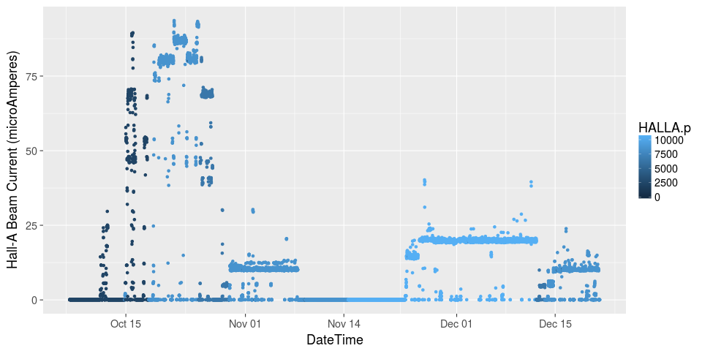
Fall 2016 Beam Operations
11 Weeks of Beam Operation, 2.1 GeV/pass
Hall-A completed scheduled portion of DVCS and GMP experiments
Delivered up to 80 μA, ~700 kW
Hall-D GlueX beamline setup for Spring 2017
Litany of major issues (Arc7 PS, 5-pass RF Separator) resulted in a single-user program for most of the period.
2-Hall operations successfully executed during the final week.

Slide 5
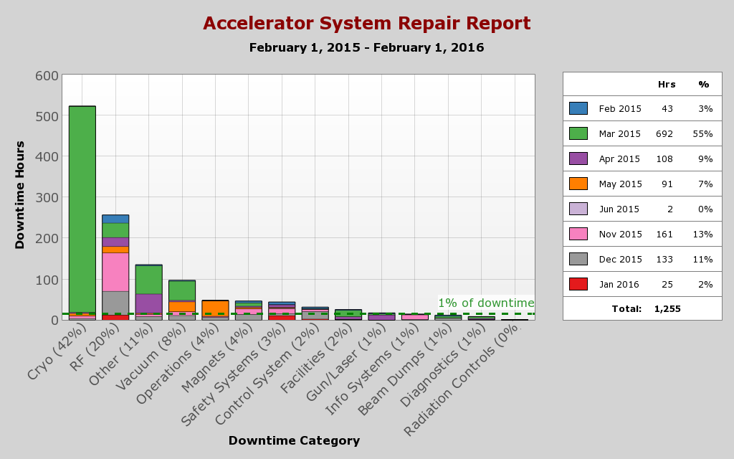
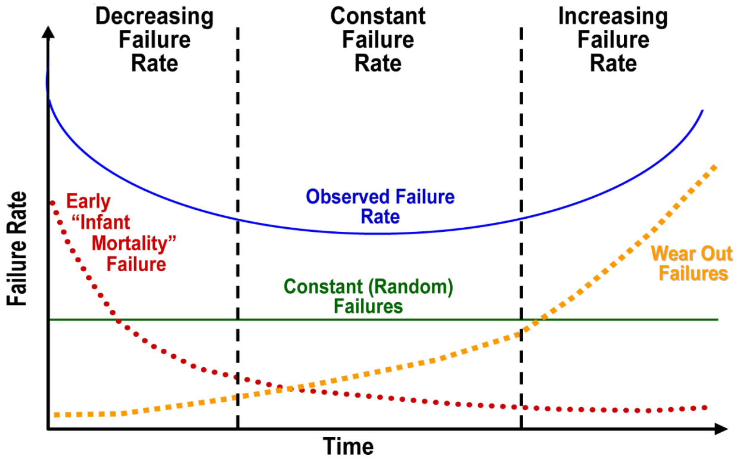
Reliability of Complex Systems
12 GeV CEBAF is a combination of new and old systems: Both sides of the “bathtub curve”.
All System downtimes > 5 min are tracked.
Downtimes > 4 hrs under go formal root cause analysis.
Downtime statistics are presented, reviewed and discussed weekly.
Downtime statistics are used to prioritize near term work and develop the annual work plan (AWP).
Downtime a mixture of old systems (bellows, cryo-plants) and new systems (magnet power supplies, Magnets, C100 operations).

Slide 6
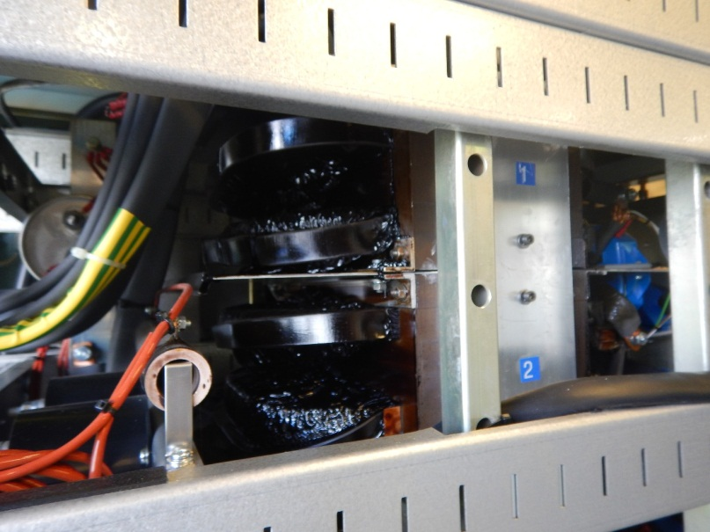
Fall 2016 Availability
Several major down (CEBAF down-hard > 24h) incidents
Arc7 PS failure -> change of program -> single user mode

Slide 7
Dec. System Availability

Slide 8
Multi-hall Operations: RF Separator Status
Pass 1,2,3,4 RF separators presently powered by three RF sources
Configuration time required to move power sources to appropriate cavity
Miscues during configuration change lead to frustration (pass-3 separation this fall)
New solid state amplifiers for pass-1 are part of the FY17 budget (in place by Fall 2017?) will restore dedicated RF sources for passes 1-4.
Pass-5 750 MHz separators
RF power increased summer 2016, expected improvement about 10%
Geometry change in summer 2016, expected improvement about 9%
Test in Nov. 2016 confirmed that the improvements were realized
Subsequent vacuum leak prevented beam operation using 5-pass separator
Repaired cavity to be installed tomorrow
Separators ready/configured for Spring 2017 program
3 & 4 pass RF separation used Fall 2016 (3-pass RF separation tested during the last 4h of beam operations).
1 & 2 pass RF separation used during previous runs.

Slide 9
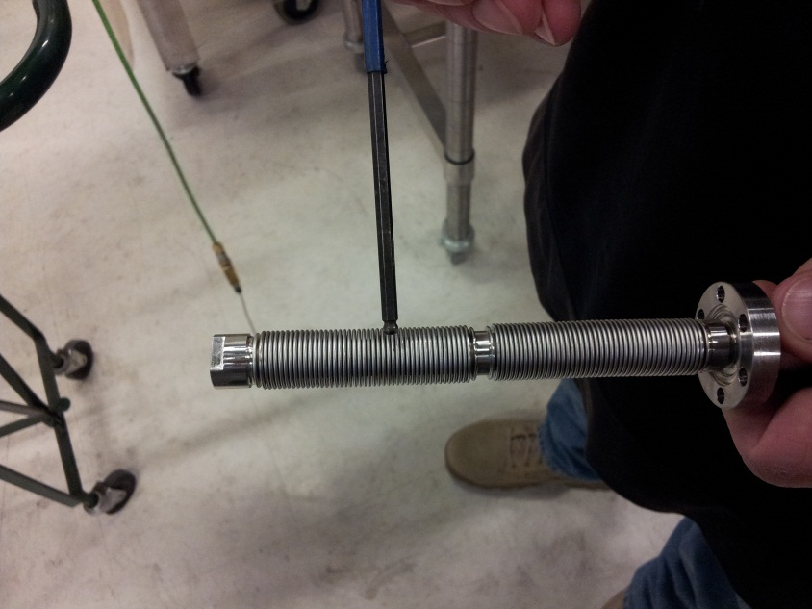
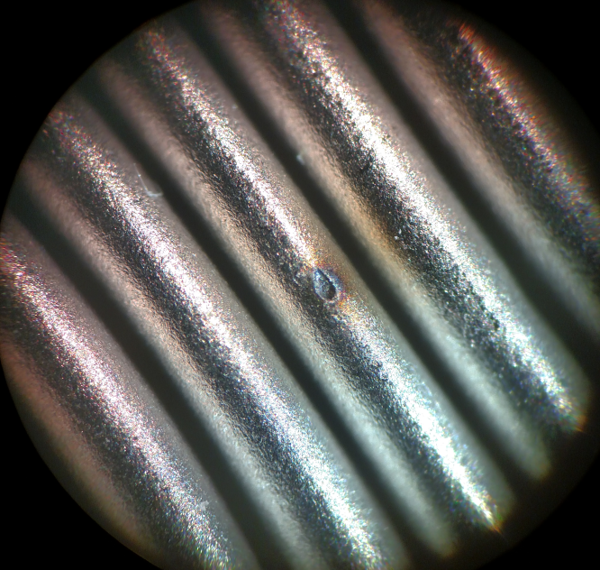
750 MHz Separator Leak
Leak in tuner bellows associated with some discoloration
Root cause of the leak still not identified
Bellows and near-by wall surface nominally at ground potential
No associated discoloration found on cavity wall

Slide 10
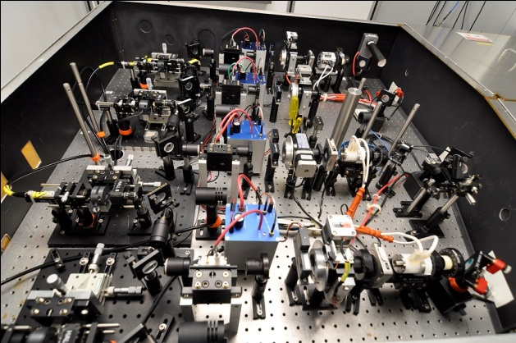
4-Lasers
4-Lasers installed on the laser table, aligned and produced beam
RF controls in progress, to be completed and tested this Spring/Summer

Slide 11
Fall 2016 RF Performance
One pass energy gain set to 2.1 GeV/pass
100 MeV/pass lower than 12 GeV design (-5%)
Availability during Spring 2016 Operations at 2.2 GeV/pass suffered due to lack of gradient margin.
~50 MeV/linac of gradient margin in Oct. 2016 (at 2.1 GeV/pass)
Program flexibility: by-passed troubled cavities in a few minutes and resume beam operations.
By Dec. margin was reduced to 25 MeV/linac due to by-passed cavities and other gradient reductions.
Most of this reduction will be recovered during Jan. 2017 SAD

Slide 12
Spring and Fall 2016 RF Trip Rate
Initially a low trip rate but significant C100 downtime:
FE related vacuum issues
C100 Gradients lowered Mar. 6th
Final weeks: robust, but high trip rate
More stable, low RF trip rate compared to Spring 2016.
Changes reasonably correlated with by-passed cavities
C100 trip rate factor 2 less than Spring 2016

Slide 13
Fall 2016 RF By-passed Cavities
Sufficient margin to by-pass an entire C50 zone in late Nov. and recover opportunistically during a Hall-A access
Enough margin to coast from Thanksgiving to the end of the run in the North Linac

Slide 14
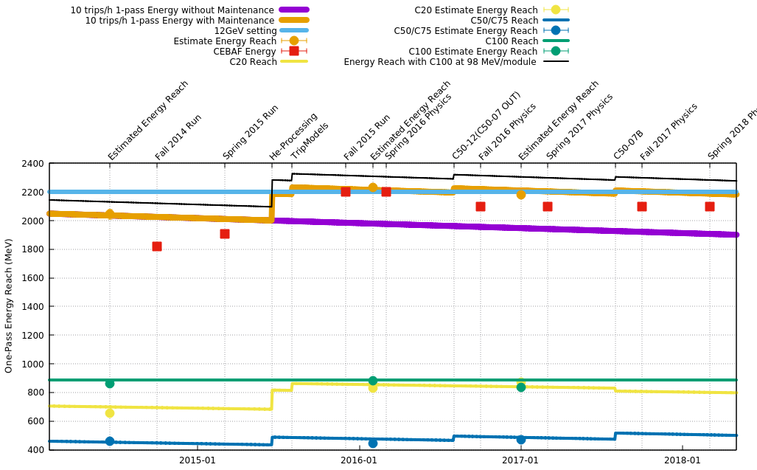
CEBAF Energy Reach

Slide 15
Summary
RF Performance in Fall 2016 was very good
RF trips < 5 trips/h
C100 trips factor two less than Spring 2016
Up 80 μA, 700kW delivered to Hall-A on 4th pass.
Support two-hall operations on the last week.
Month of Dec. had 80% overall availability
750 MHz separation improvement demonstrated (vacuum leak prevented further operation).
Root cause not as yet known
Repaired cavity to be installed today/tomorrow
Litany of hardware issues in Oct. and Nov.

