Slide 1
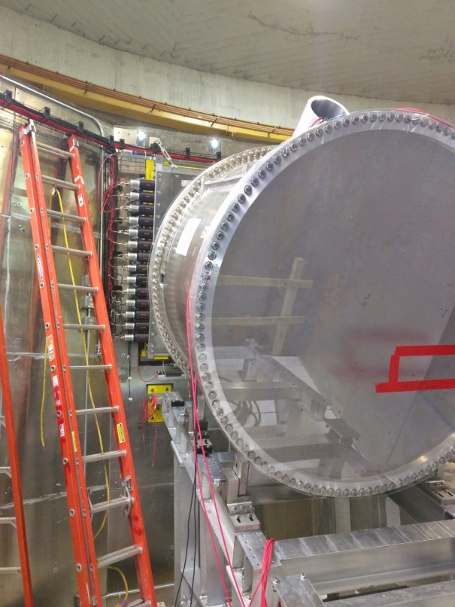
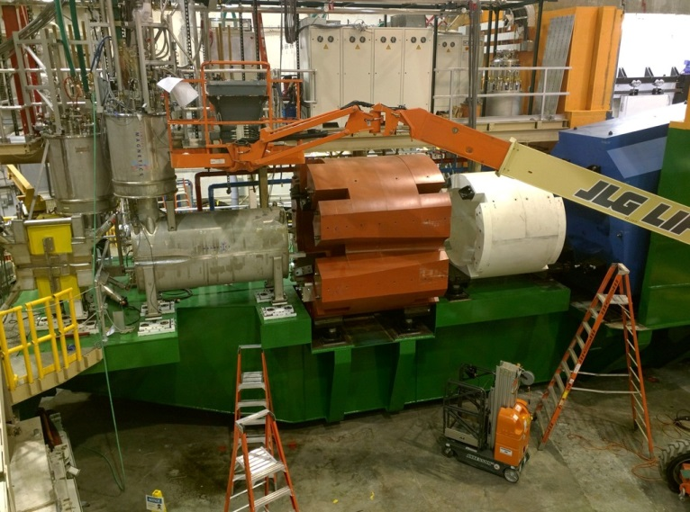
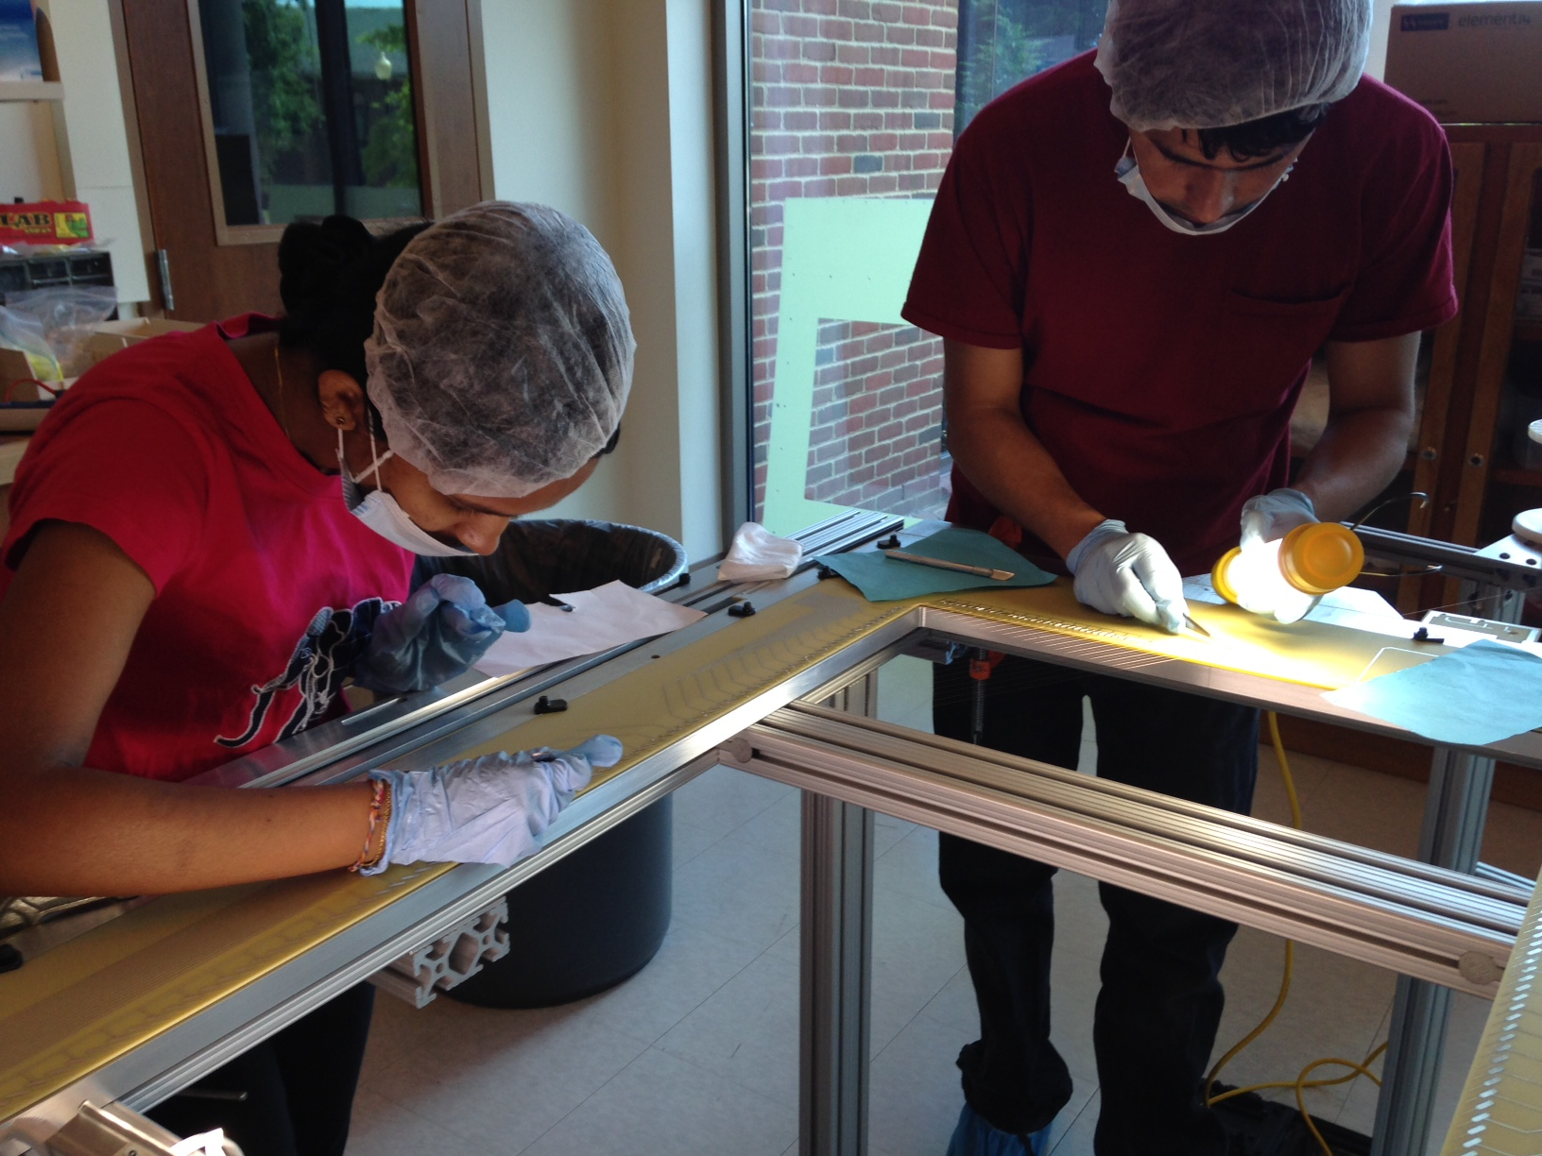
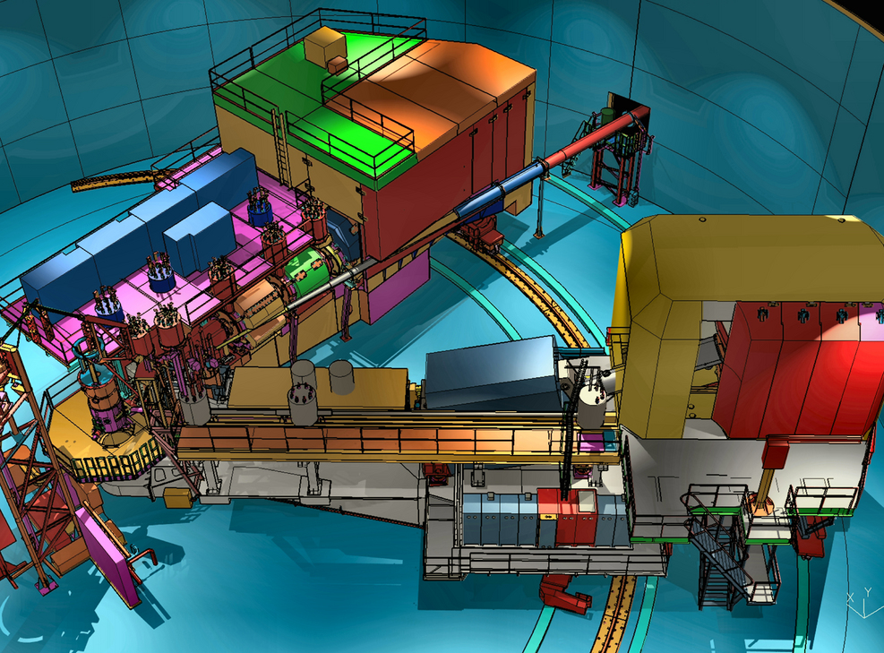
UGBOD
Meeting
January 10, 2017
Stephen Wood

Slide 2
Publications, Students, Postdocs
Precision Electron-Beam Polarimetry using Compton Scattering at 1 GeV
Phys. Rev X 5, 011013 (2016)
High Resolution Spectroscopy of ¹⁰_{Λ}Be
Phys. Rev. C 93, 034314 (2016) (E05-115)
Spectroscopy of neutron-rich hypernucleus, ⁷_{Λ}He by electron beam
Phys. Rev. C 94, 021302 (2016) (E05-115)
The Aerogel Cherenkov Detector for the SHMS magnetic spectrometer in Hall C at Jefferson Lab
Nucl. Instum. Meth. A426, 405 (2017)
A test of local Lorentz invariance with Compton scattering asymmetry
Mod. Phys. Lett. A 31, 1650220 (2016) (Compton Polarimeter)
Measurements of the Separated Longi.l Structure Function F_{L} from Hydrogen and Deuterium Targets at low Q²
ArXiv:1606.02614 (E00-002)
PhD’s in 2016:
Qweak: Fang Guo (MIT), Joshua Magee (W&M), Siyuan Yang (W&M)
Notes:
Polarimetry demostrate systematic error of 0.59%. Best except for SLD @ 45 GeV.
E00-0?? On arxiv, hypernuclear lifetime submitted.

Slide 3
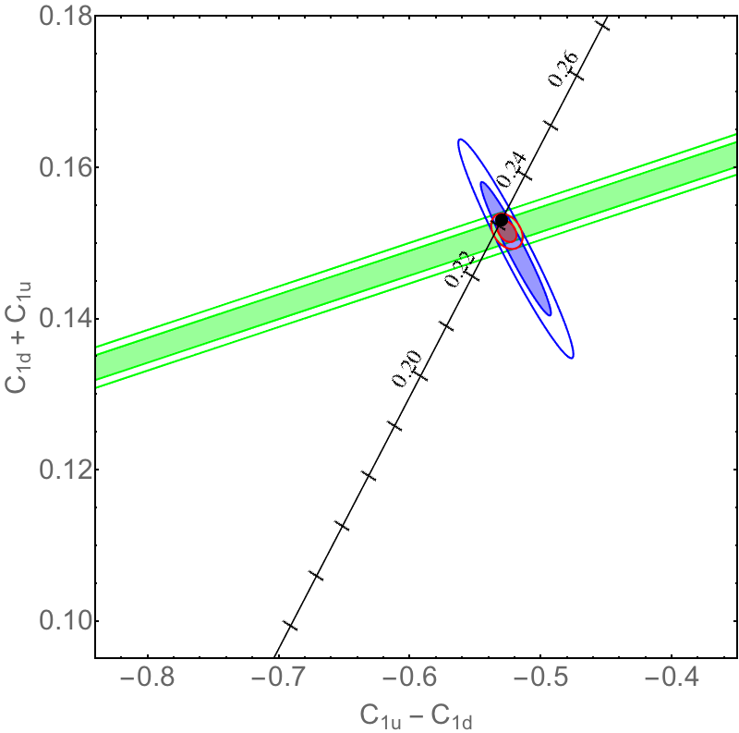
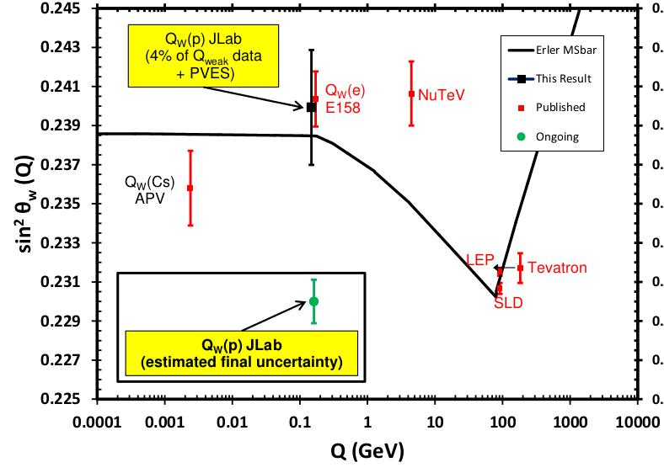
Qweak – Expect Unblinding ~ March 2017
International Collaboration: 23 institutions, 95 Collaborators (23 grad students,10 postdocs)
Parity-violating e-p analyzing power with high precision at Q² ~ 0.025 (GeV/c)².
Determine: Q^{p}_{W} - proton’s weak charge
Extract: C_{1u}, C_{1d}, sin² θ_{W}
Any deviation from SM prediction would be indication of new physics.
+ Numerous ancillary measurements to be
published separately.
“Statistical analysis” of all data done.
The measurement has 25 systematic corrections with their associated uncertainties.
Finalizing the last significant correction.
Final result expected to yield most precise low energy weak mixing angle and significantly improved quark couplings.
Sensitive to Vector Couplings C_{1u} & C_{1d}
Running Plot of Weak Mixing Angle
0.18
0.16
0.14
0.12
0.10
SLAC: D DIS
Boulder: Cs
C_{1u} + C_{1d}
Mainz: Be
(anticipated Qweak
CL assuming SM)
Bates: C
-0.8 -0.7 -0.6 -0.5 -0.4
C_{1u} – C_{1d}

Slide 4
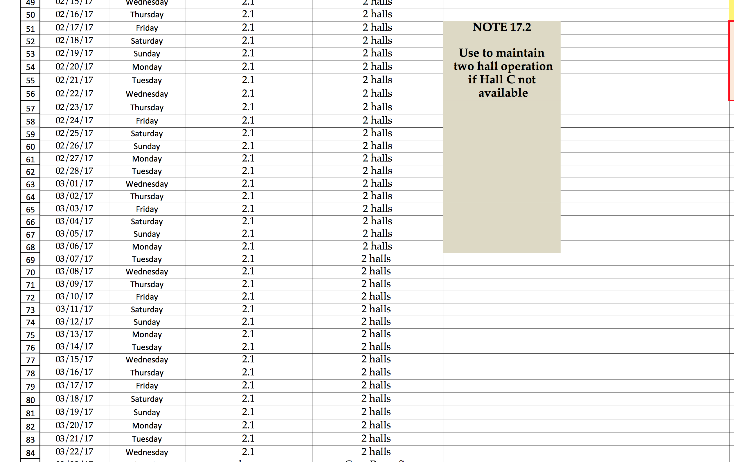
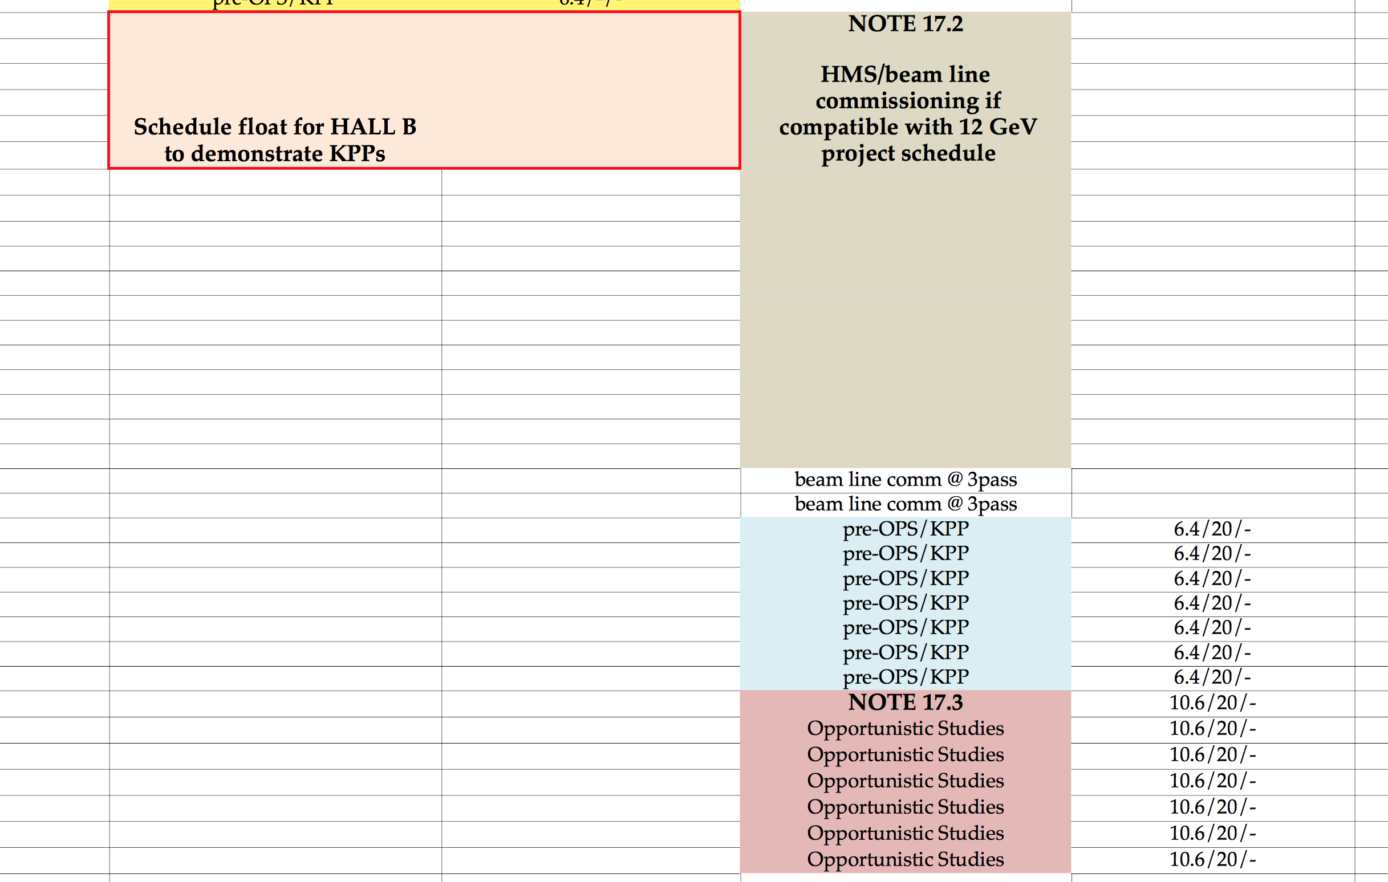
Published Schedule
2/17/2017 – 3/22/2017: (if compatible with 12 GeV project schedule)
Satisfy Key Performance Parameters (12 GeV)
Opportunistic commissioning and physics
10/2/2017 – 12/5/2017:
Early running – Phase 1
2018:
Early running – Phase 2
https://www.jlab.org/exp_prog/experiment_schedule/2016/12-16/BeamSchedule_20161216.pdf
2/17/2017
8

Slide 5
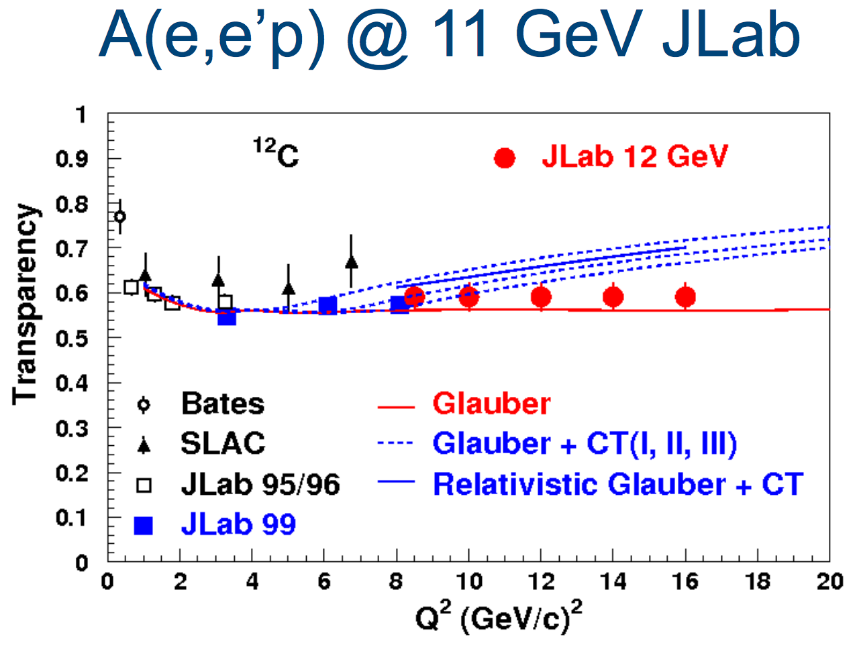
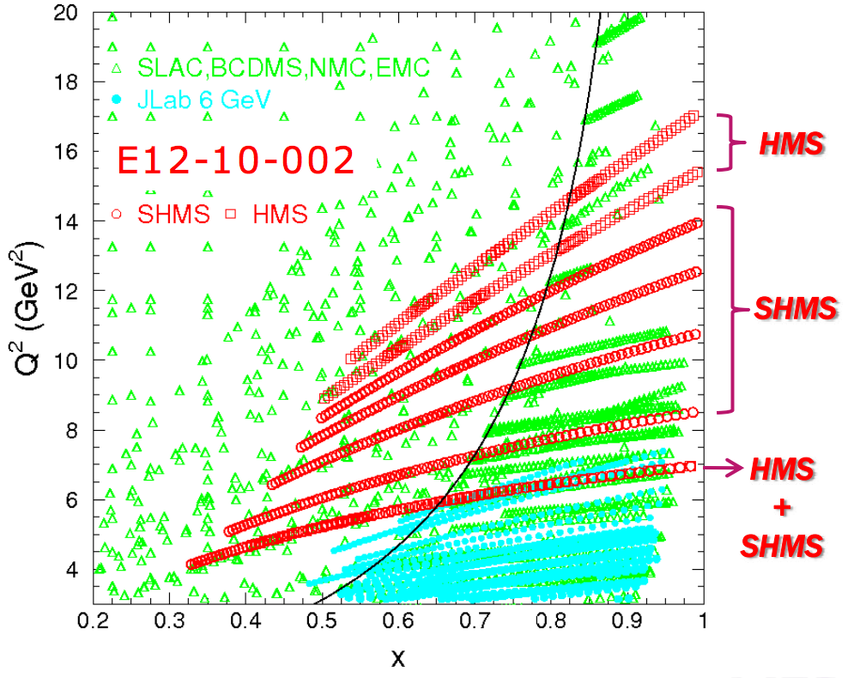
Commissioning/Early Experiments
Oct 2, 2017 – Dec 5, 2017 – Phase I
~25 PAC days – Commissioning “Experiment”
E12-06-107 search for color transparency
A(e,e’p) only – “easy” coincidence measurement
E12-10-002 F₂^{p,d} structure functions at large x
Momentum scans help understand acceptance
2 days E12-10-108 EMC Effect
Integrate light nuclei with F₂ run,
Point target helps acceptance studies.
3 days of E12-10-003 d(e,e’p)
Push to lower cross sections
2018 – Phase II
E12-09-017 P_{t} dependence of basic SIDIS cross sections
Push particle ID capabilities of SHMS
E12-09-002 Precise π⁺π⁻ ratios in SIDIS – Charge Symmetry Detector efficiencies
E12-09-011 L/T separated p(e,e′K⁺) factorization test
Easiest L/T separation
Notes:
F2 and C12 scans good for acceptance studies

Slide 6
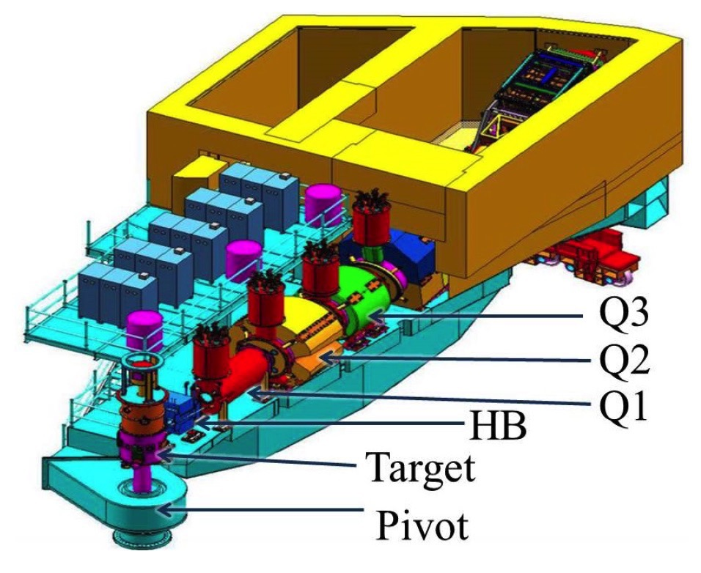
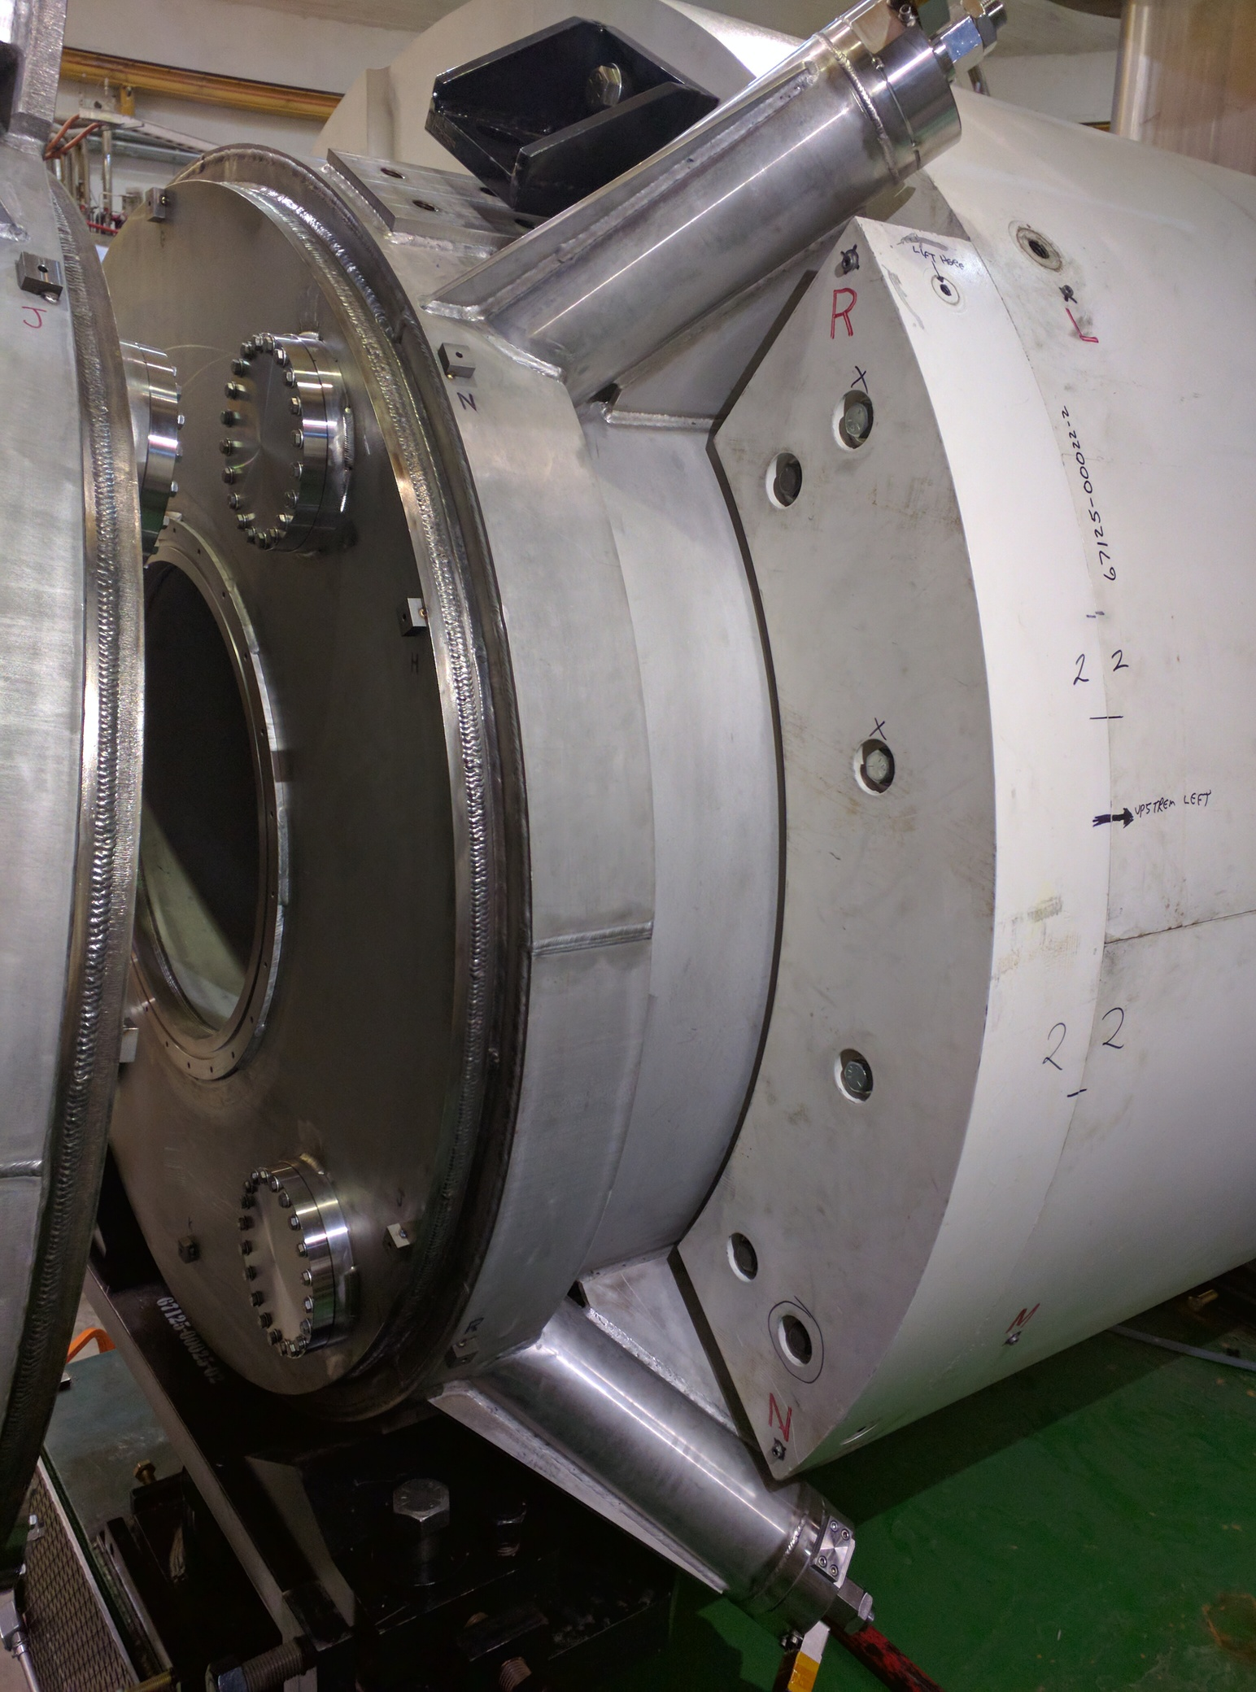
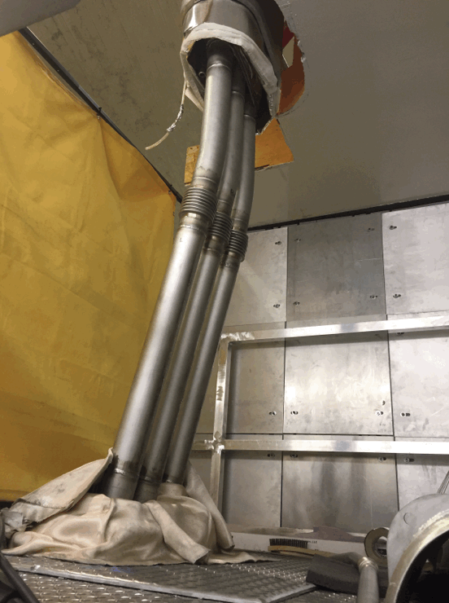
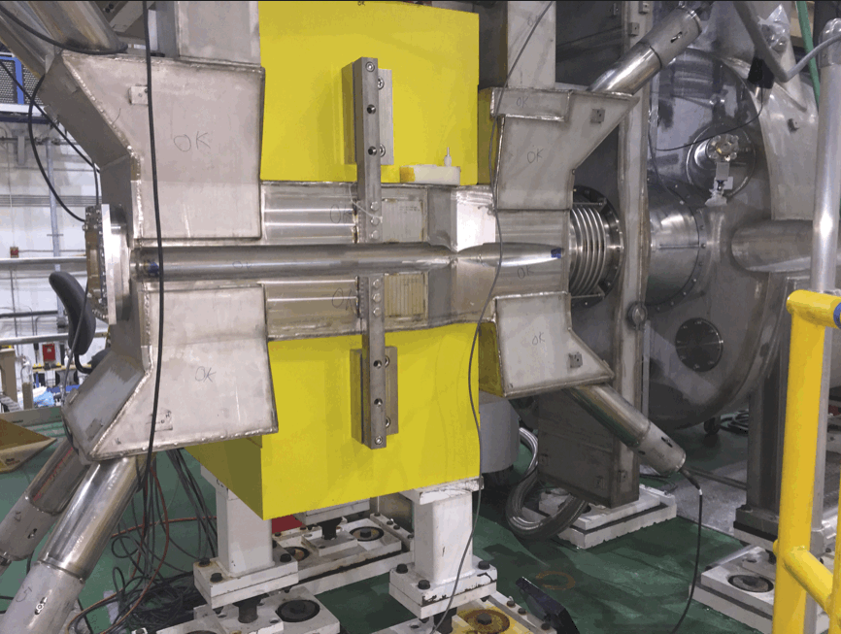
SHMS Magnets
5 SC Magnets: HB, Q1, Q2, Q3, D – All delivered and installed on SHMS
HB, Q1, Q2 testing complete, collimator box installed
Q3 leak check and instrumentation hook up in progress
Dipole service can being connected to coil
Q3, Dipole cooldowns in February
Dipole Valve
Can
Connection
HB
Q1
Q3

Slide 7
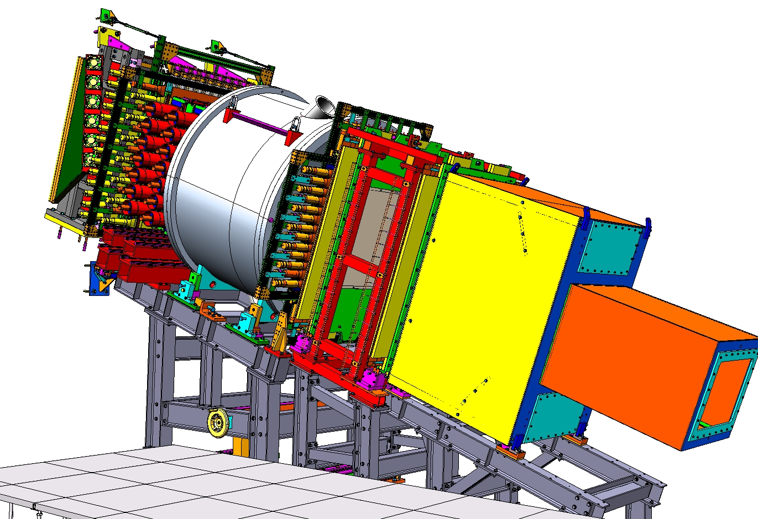
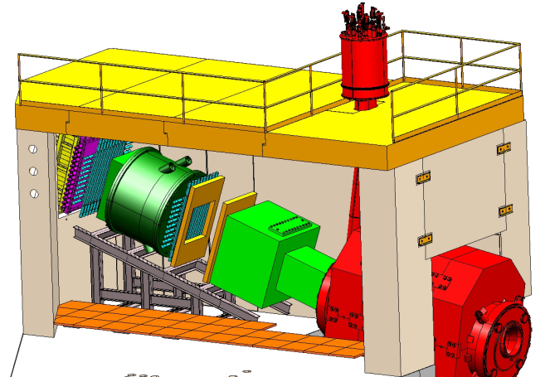
SHMS Detectors
Noble Gas Cerenkov
Drift Chambers
Trigger Hodoscopes
3 Planes Scintillator
1 Plane Quartz
Heavy Gas Cerenkov*
Calorimeter
Detector Frames
Aerogel
(Funding Color Codes)
12 GeV Project Funded
NSF MRI Funding
Gift from NIKHEF and ANSL
C₄F₈O Heavy Gas Cerenkov
Drift Chambers
*HGC is largely funded by NSERC grant to U. Regina
Ar/Ne Noble-Gas Cerenkov
Shower Counter
PreShower Counter
S2 Hodoscope
Aerogel Cerenkov
S1 Hodoscope

Slide 8
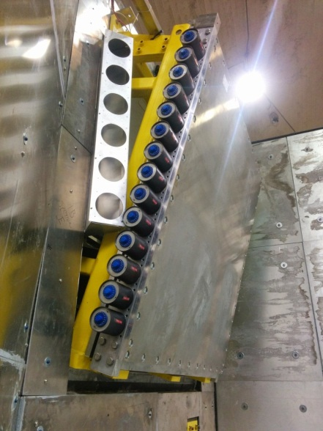
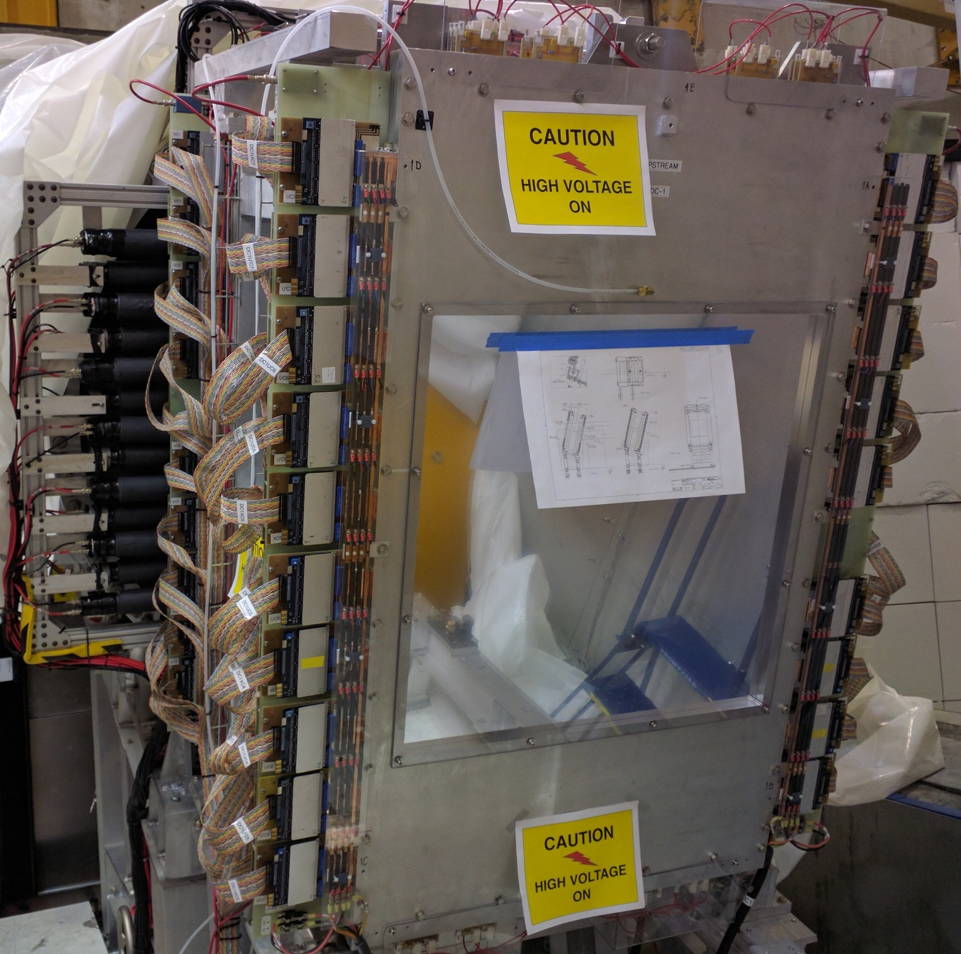
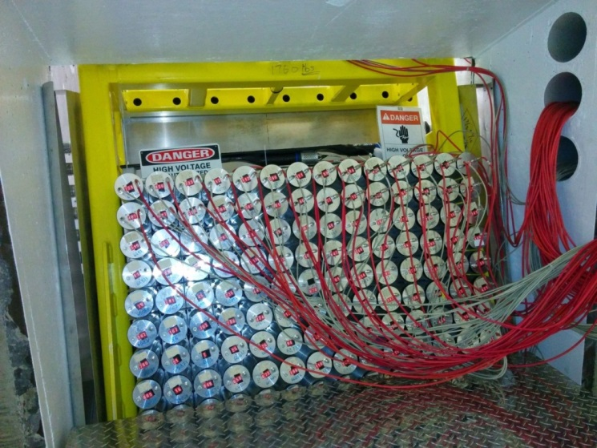
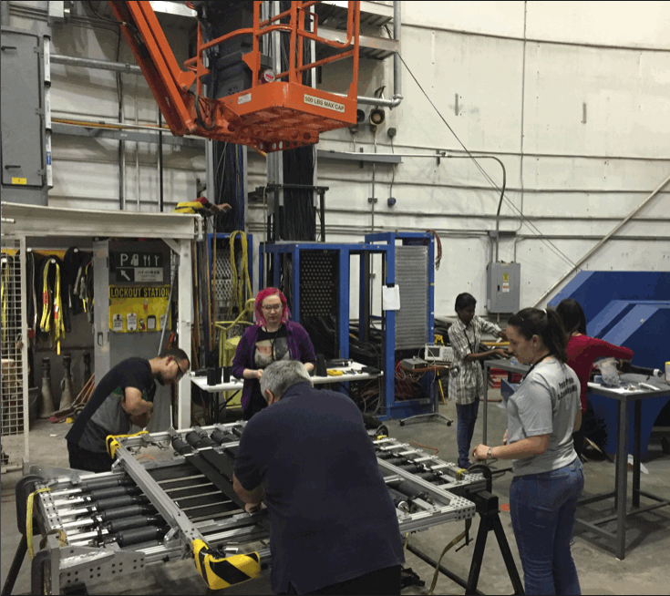
Detectors Installed
SHMS detectors and infrastructure installed:
Drift Chambers
Hodoscope – scintillator (3 planes) & quartz
Heavy Gas Cerenkov
Aerogel Cerenkov
Calorimeter pre-shower
Calorimeter shower array
Test fits done:
Noble Gas Cerenkov (not used for all expts)
Vacuum extension (when Noble not used)
Notes:
Student involvement in summer detector work

Slide 9
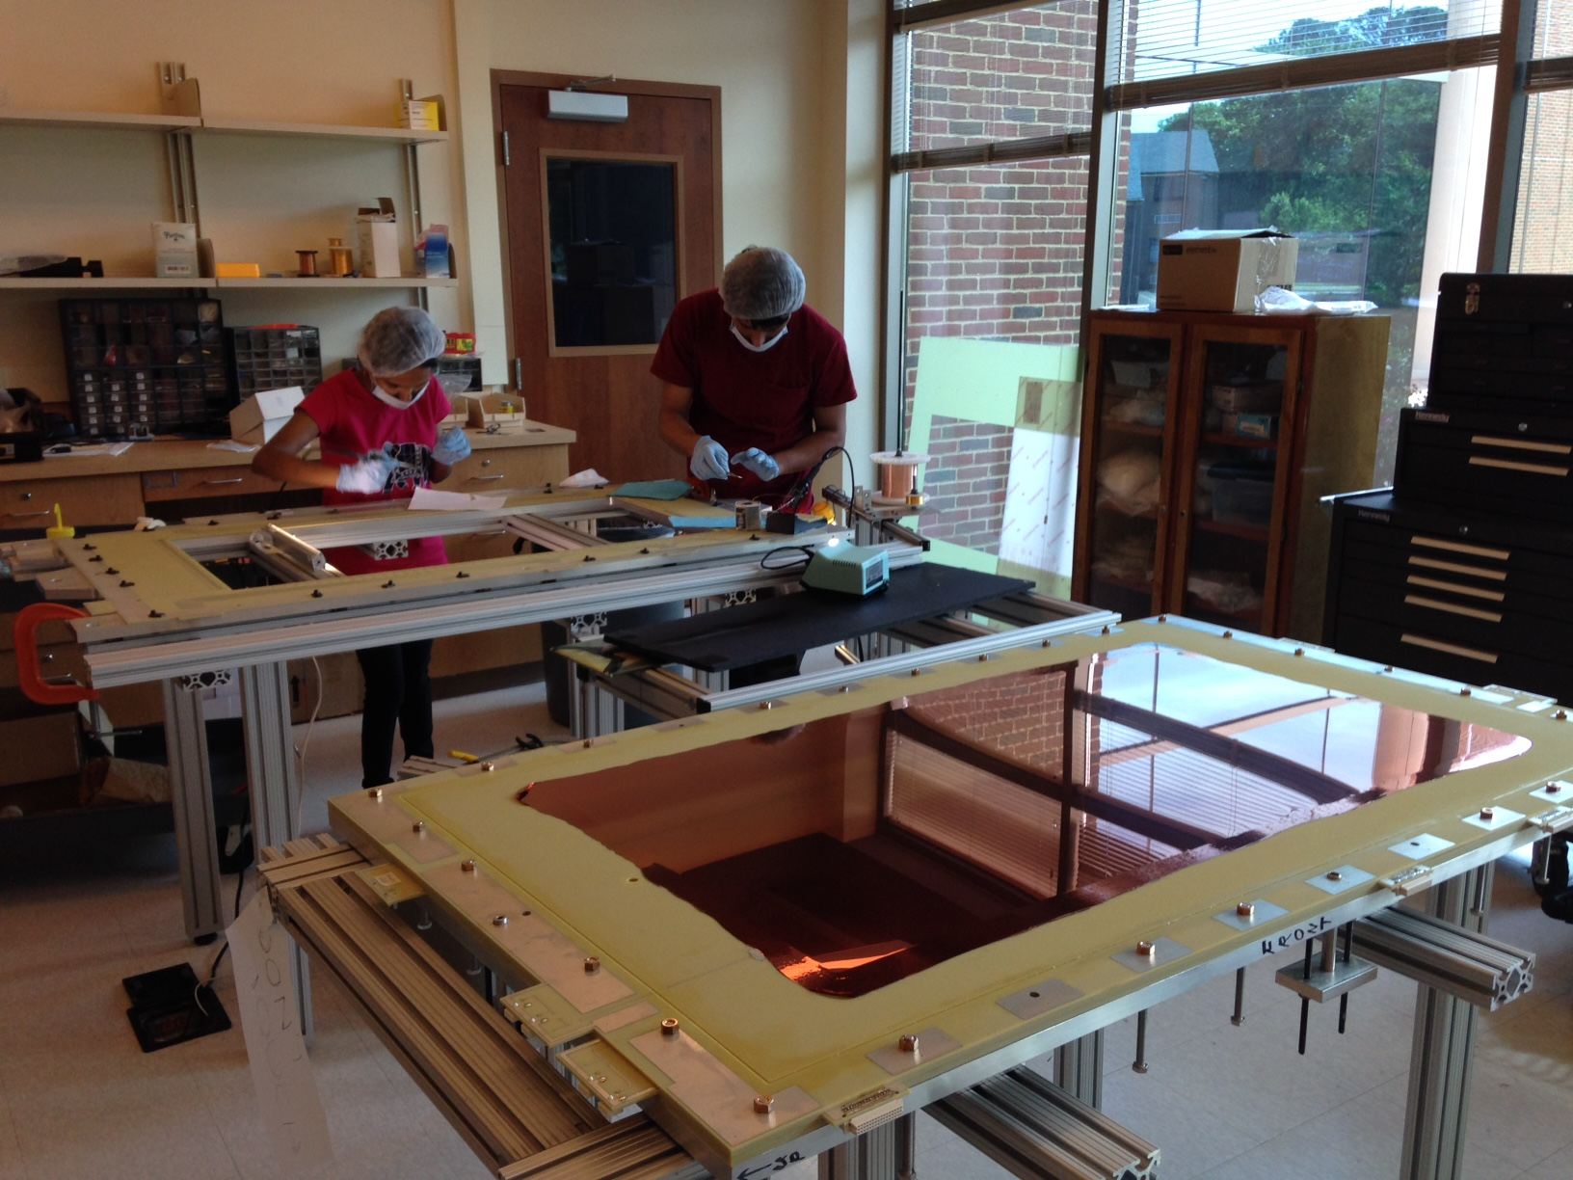
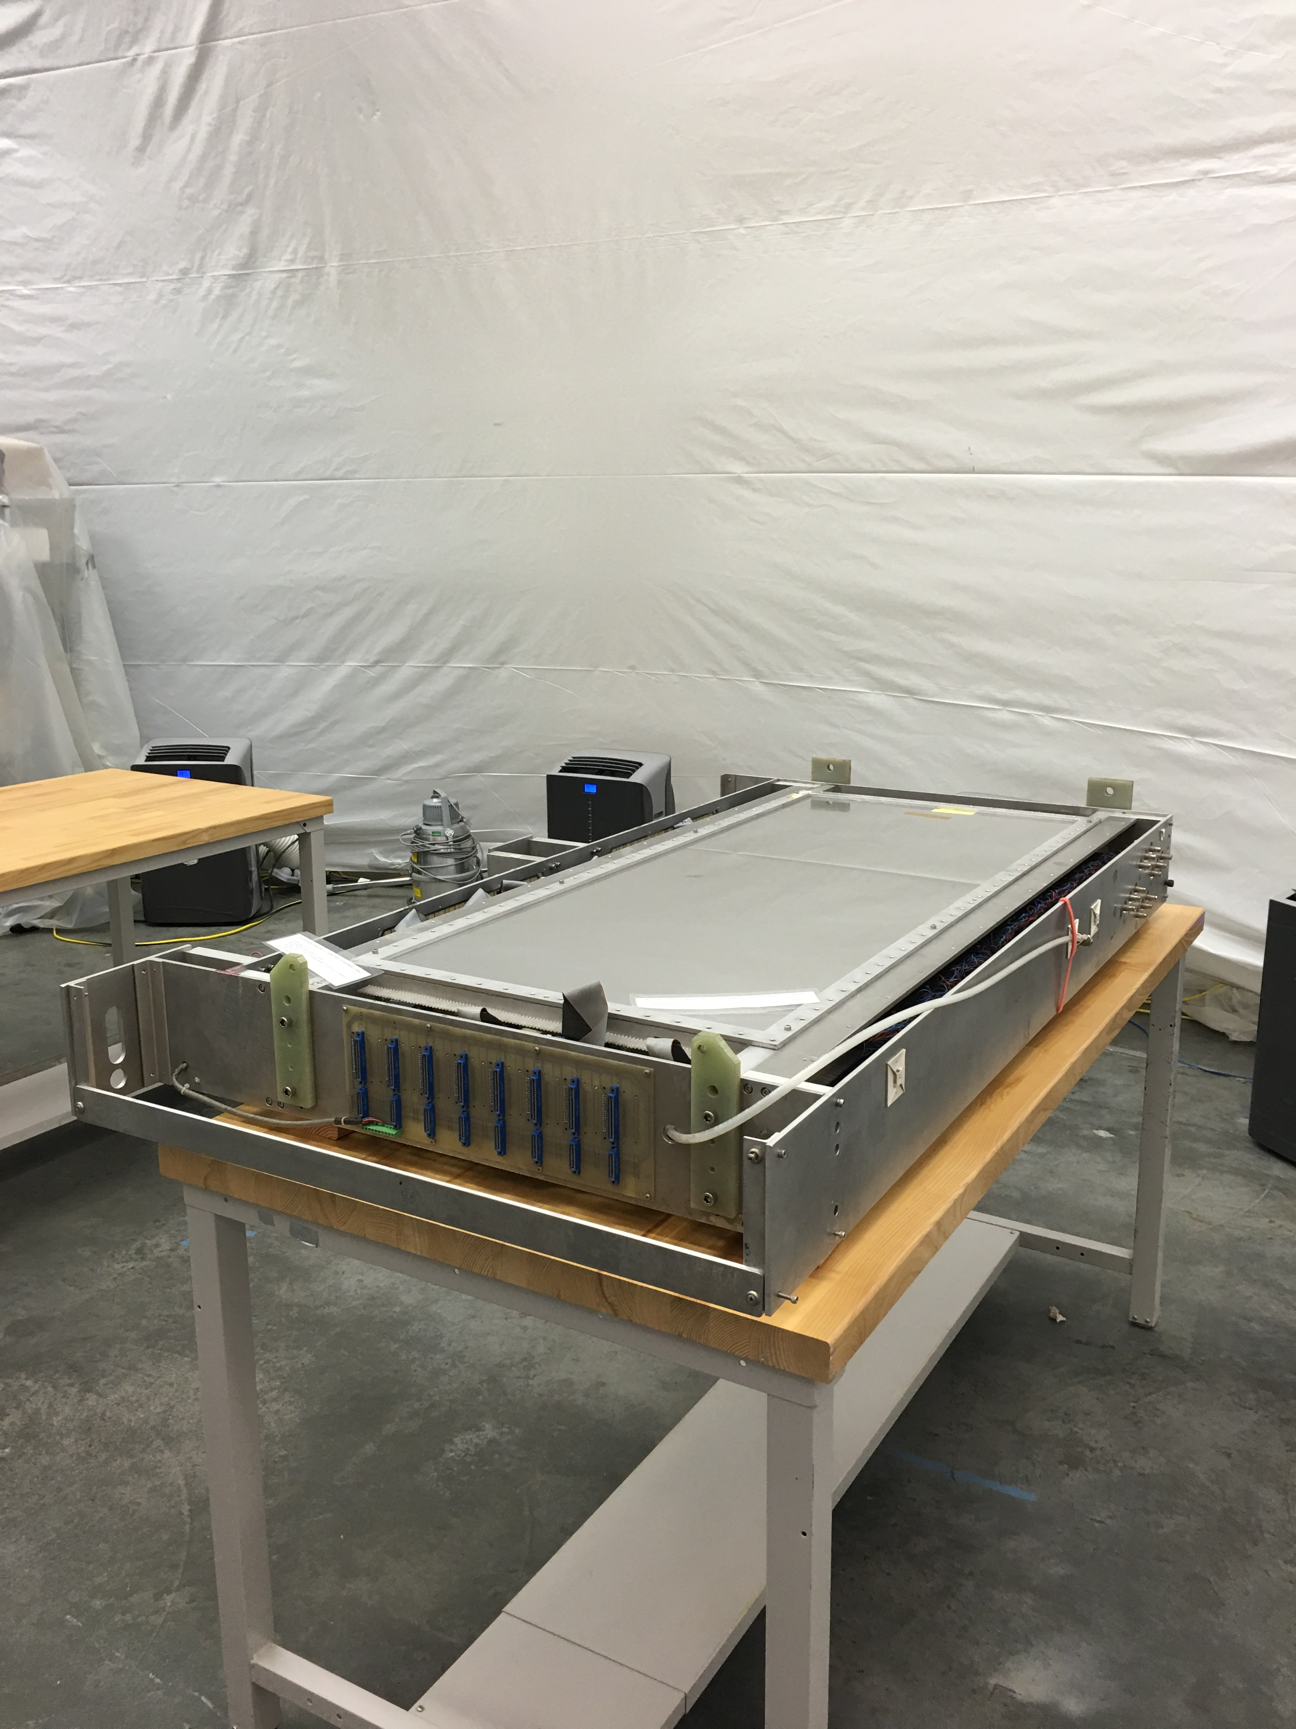
HMS Drift Chambers – repair and replacement
HMS Drift Chamber Chambers
One of two existing chambers had > 100 broken wires
Repaired in TEDF, reinstalled and tested
Replacement Chambers Built
Similar to SHMS design (XUV style)
Constructed at Hampton University
Undergoing testing in ESB (install in summer)

Slide 10
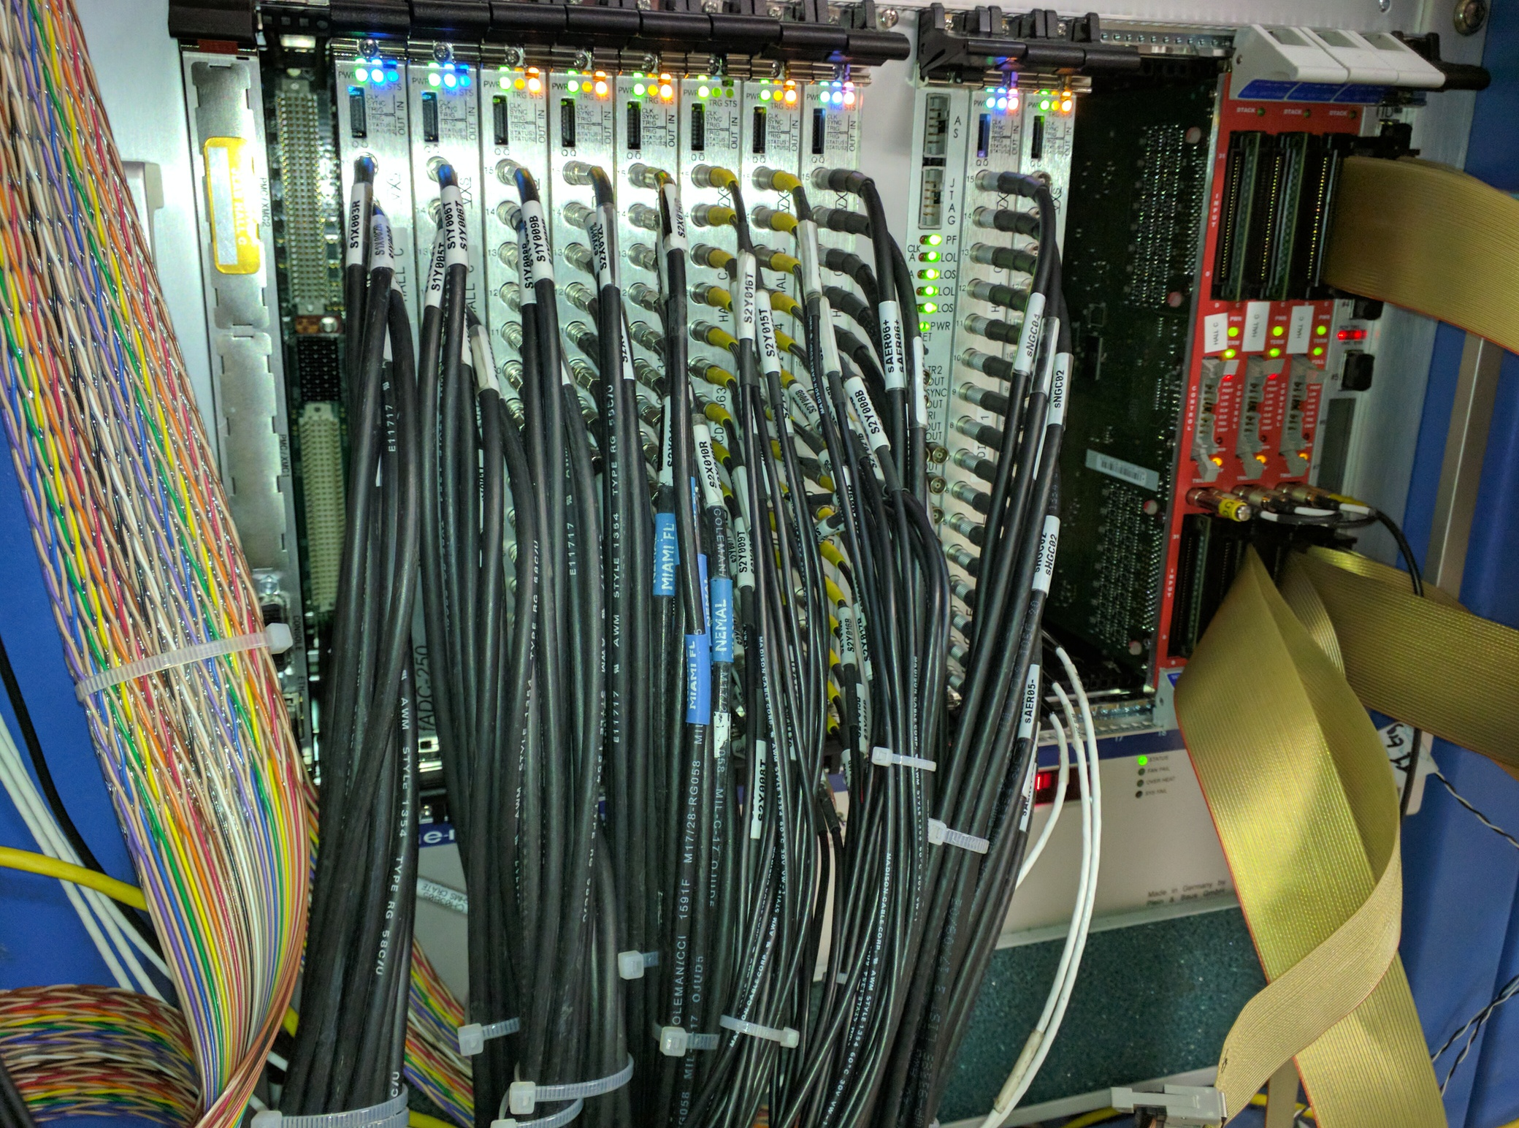
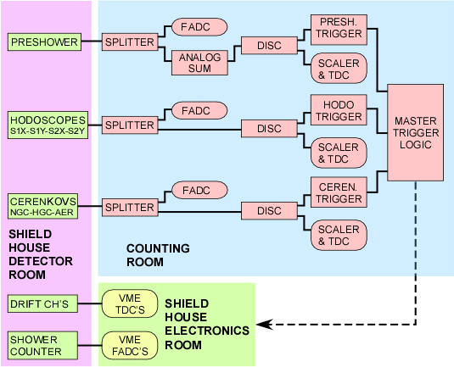
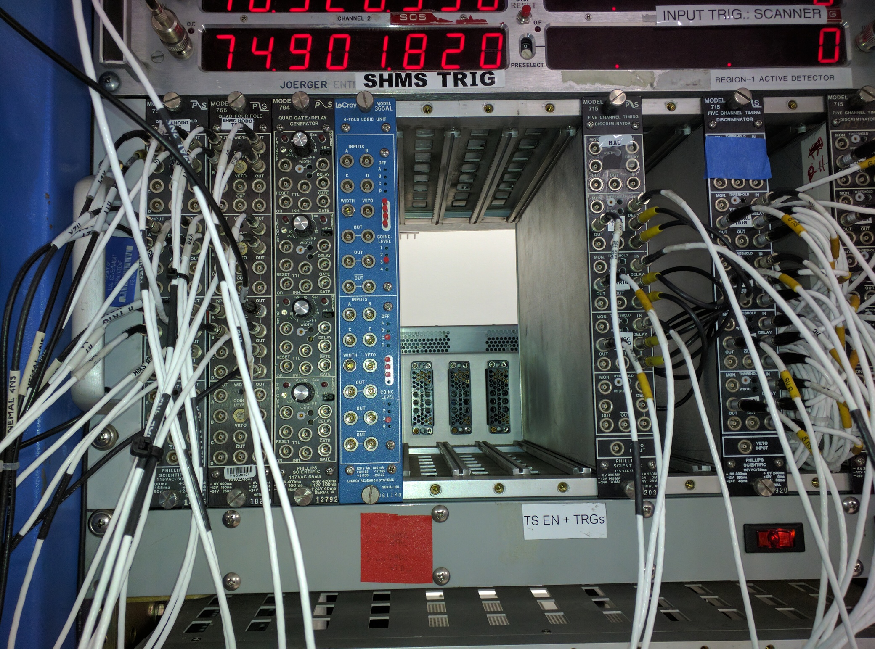
Data Acquisition / Trigger
All new DAQ hardware and rebuilt trigger
Trigger copy of 6 GeV design. Familiar to users
DAQ hardware used for single detector checkout for several years
Multi crate DAQ assembled for HMS and SHMS and undergoing testing
Computing and networking upgraded

Slide 11
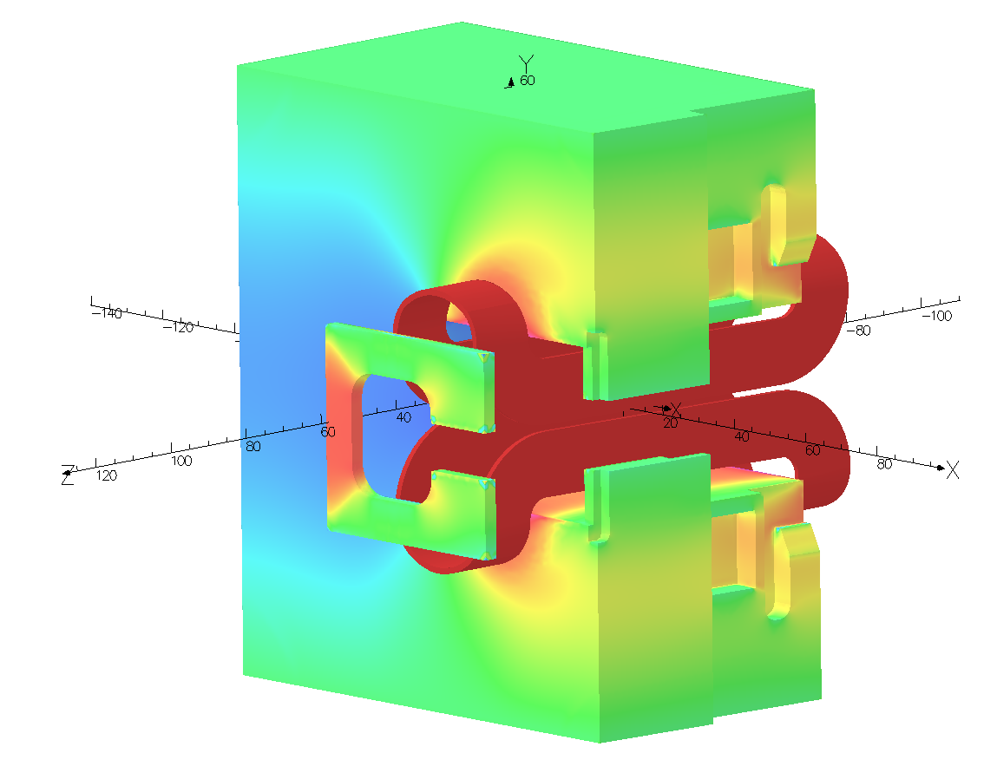
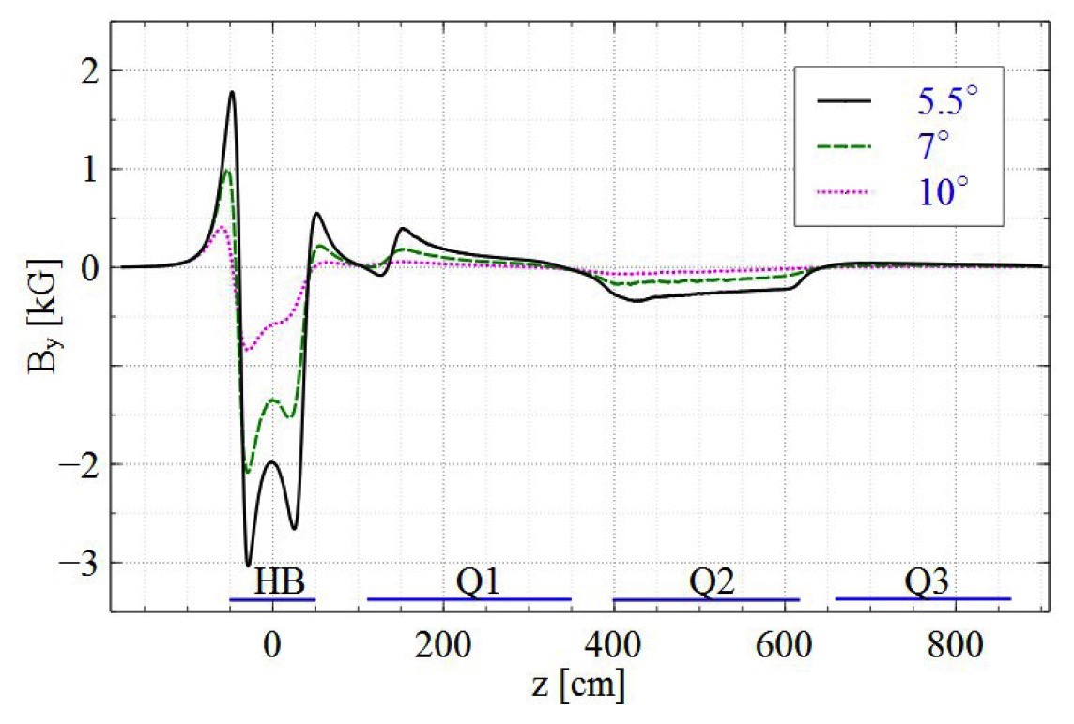
Modify HB (biggest contributor to beam deflection)
by Addition of Fe Pieces for
Contouring & Suppression of “Fringe Fields”
Additional Yoke Material
“Wedges”
Front Field Clamp

Slide 12
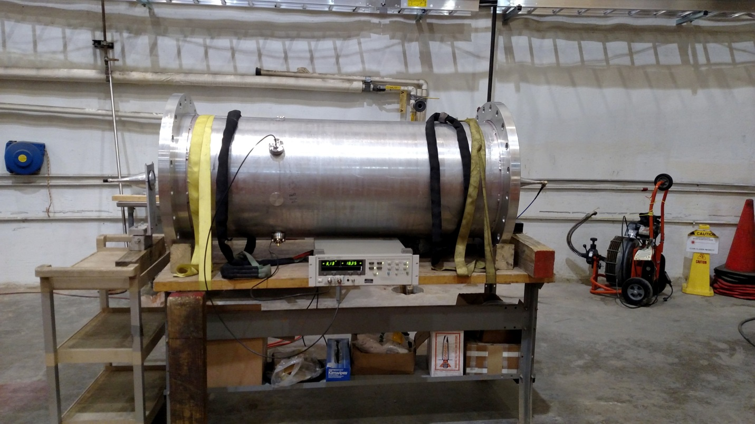
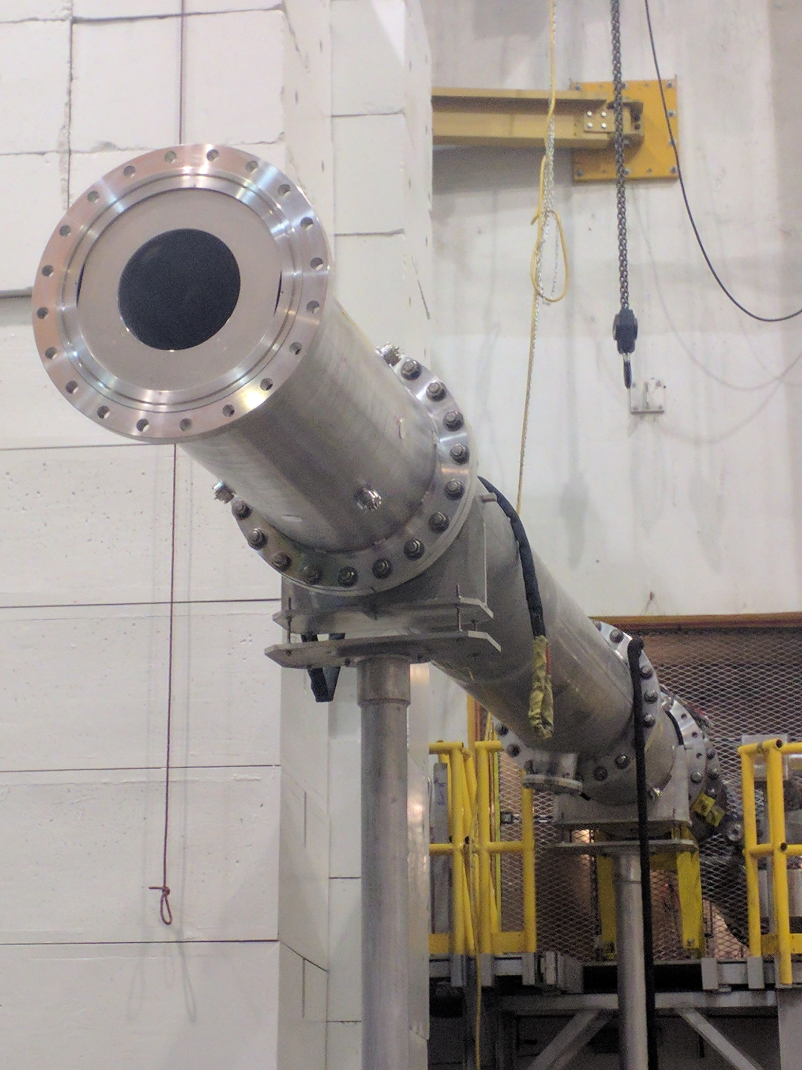
Prototype: Big BPM’s Downstream of Target
Additional real time knowledge (x,y,x’,y’) of full intensity primary beam after target desirable when SHMS configured for small forward angles.
Two prototype large diameter BPM’s installed in downstream beam line separated by drift space.
Designed to work with standard JLab BPM electronics (newest generation). Outputs appear like other BPM’s to MCC operators and facilitate straightforward tune up and augmented real time monitoring and provide separate verification of beam displacement at dump face.

Slide 13
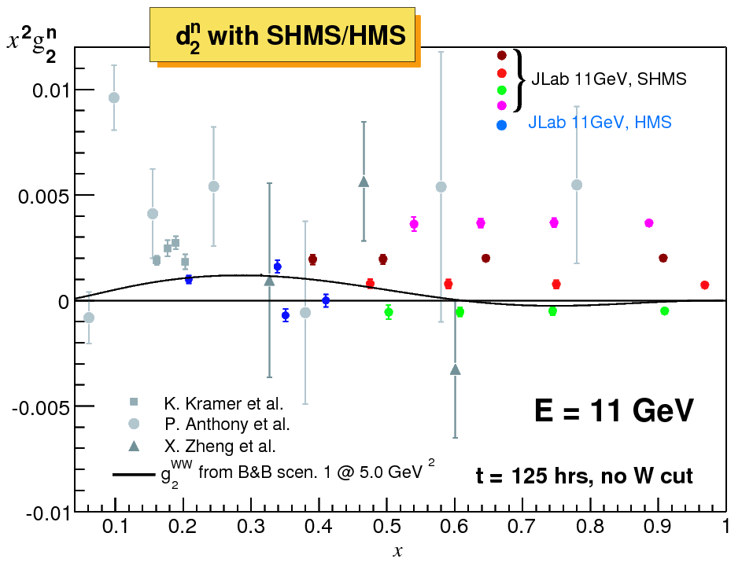
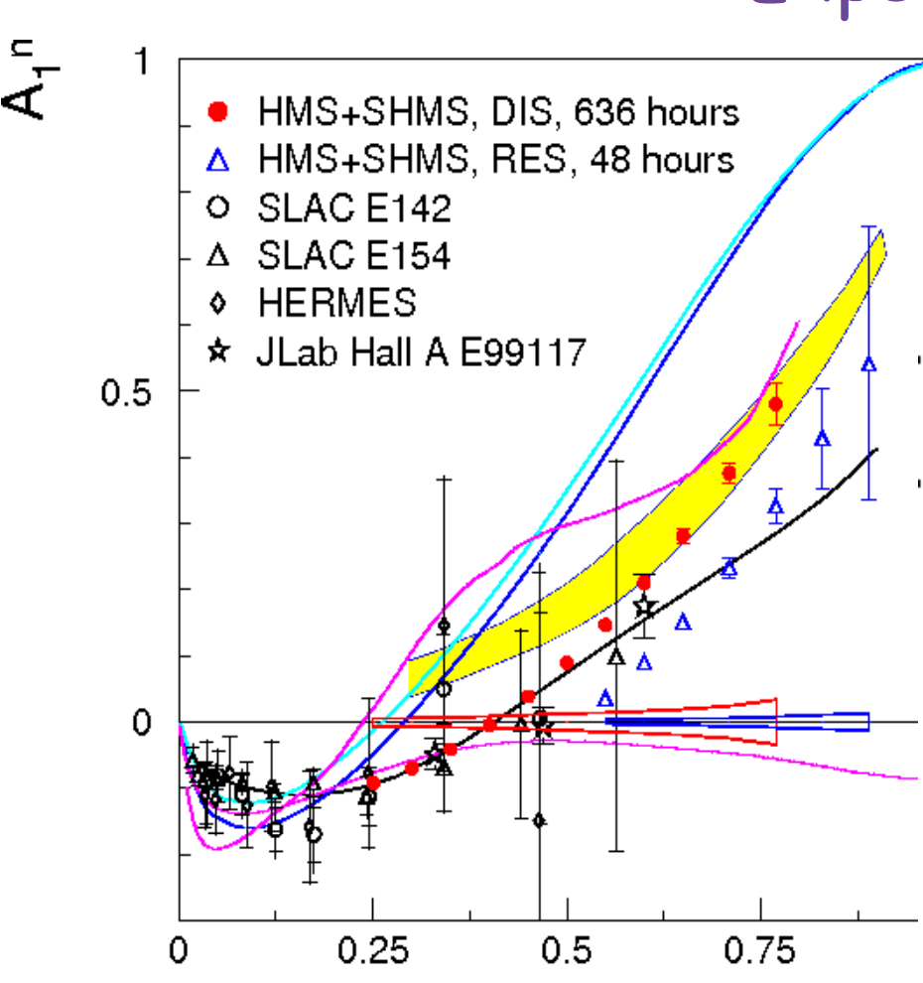
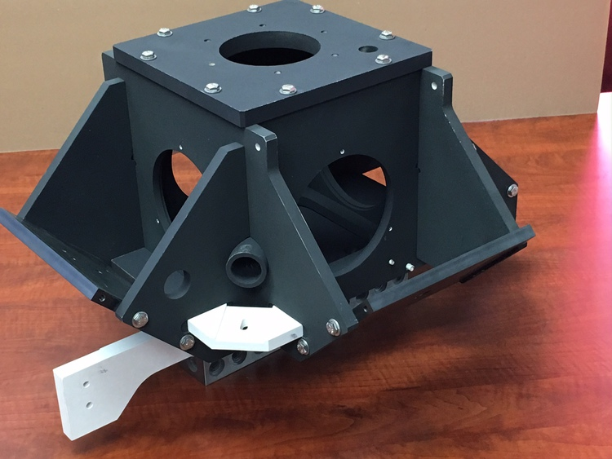
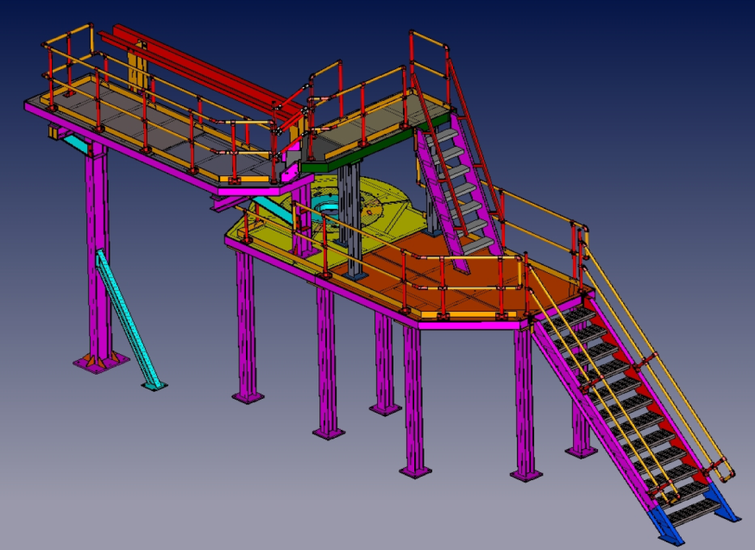
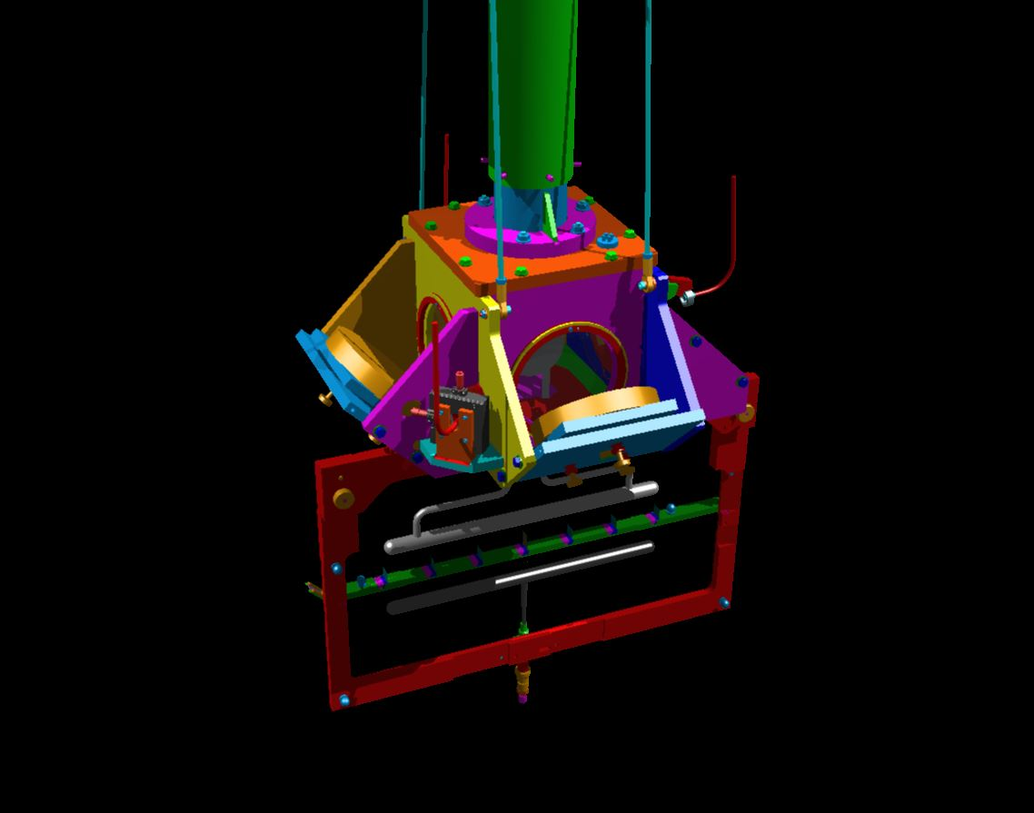
Polarized ³He
A₁^{n} (E12-06-110) and g₂^{n}/d₂^{n} (E12-06-121)
Preparations for polarized ³He target in Hall C
Cut and reassemble pivot post
Access platform in fabrication
Ceramic oven designed
First oven received

Slide 14
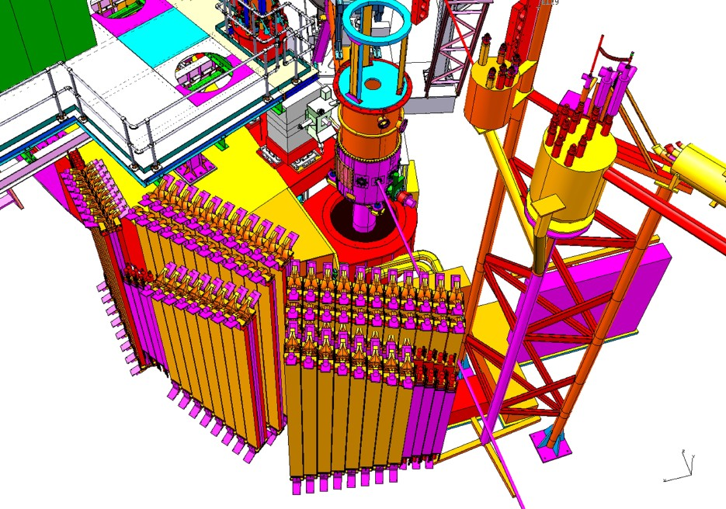
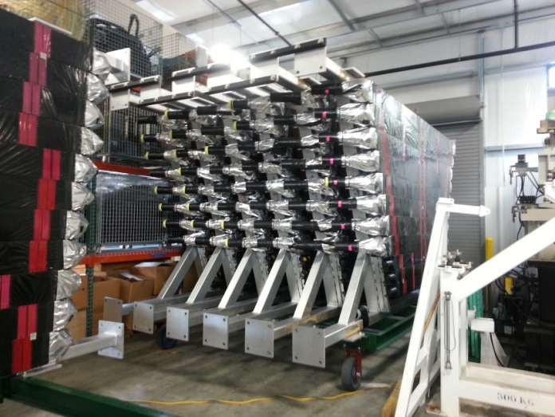
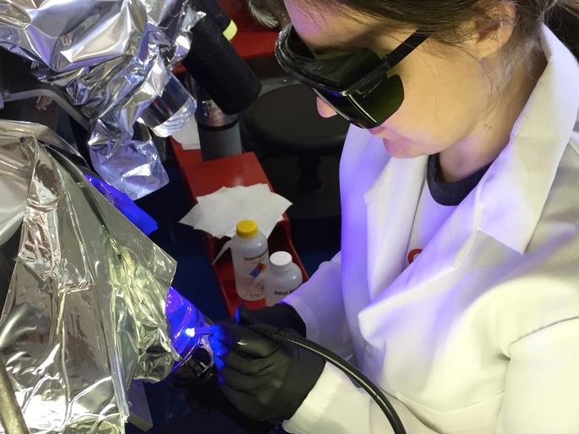
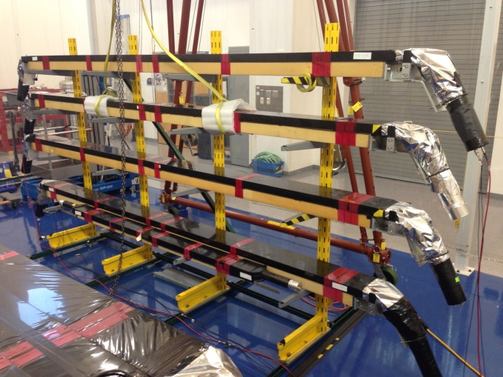
LAD – Large Acceptance Detector
E12-11-007: Deuteron EMC – d(e,e’ backward p)
Very large solid angle for L = 10³⁶ cm⁻² s⁻¹ and θ > 90º
Optimized for medium momentum nucleons
Built from old CLAS-6 TOF scintillators. Three planes refurbished @ODU by ODU, KSU, TAU, MIT, GWU. Fourth plane in progress.
Now only 5 planes needed [ d(e,e’n) -> Hall B ]
Notes:
How many have been refurbished.

Slide 15
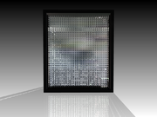
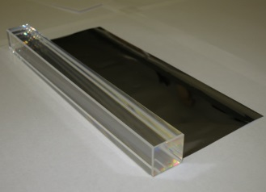
NPS Status
NPS
PbWO₄
Global design of a neutral-particle spectrometer between 5.5 and 60 degrees consists of a highly segmented EM calorimeter preceded by a sweeping magnet
2015 NSF/MRI funding proposal was selected for an award
Award will provide for NPS infrastructure, including the magnet, assuming existing crystals
In the ideal case the NPS would use new crystals
5 Experiments approved
E12-13-007: $$⁰ SIDIS
E12-13-010: DVCS and pi0 cross sections
E12-14-003: WACS at 8 and 10GeV
E12-14-005: Wide angle exclusive π⁰
E12-14-006: Initial state helicity correlation in WACS
Application for UK grant with emphasis on additional equipment aimed at WACS requirements submitted
Phys. Div. ordering ~300 PbWO4 crystals
Shared with Hall D
Upcoming Meetings
January 19: NPS Collaboration Meeting
Hall/Collaboration developing cabling (HV/Signal, 1200@) scheme for NPS and other detectors (GeN, LAD)
Sweep magnet steel delivered
February 6-7: High Intensity Photon Source workshop @ The Catholic University
More info in the NPS Wiki: https://wiki.jlab.org/cuawiki/
Notes:
Preparing to order physics division crystals. NPS collaboration meeting Jan 19. High Intensity Photon Workshop Feb 6-7 @ CUA

Slide 16
Physics Division Reviews
SHMS Magnet Experiment Readiness Reviews
Jan 2015 – Q1 magnet
Mar 2015 – Horizontal Bender
October 2016 – Q2, Q3 and Dipole
Hall C Experiment Readiness Review for first 7 experiments
August 24, 25, 2016
“Passed” with some recommendations that are being addressed.
Accelerator Readiness Review – Hall B & C
January 9, 10, 2017 - in progress

Slide 18
Hall C Approved Experiments - 1
High Impact Experiments (PAC41)
Notes:
Update for PAC34

Slide 19
Hall C Approved Experiments - 2
Notes:
Update for PAC34

