Slide 1
Computing Update User Group Board of Directors Meeting Amber Boehnlein IT Division Director
Outline
IT Division News
Other News

Slide 2
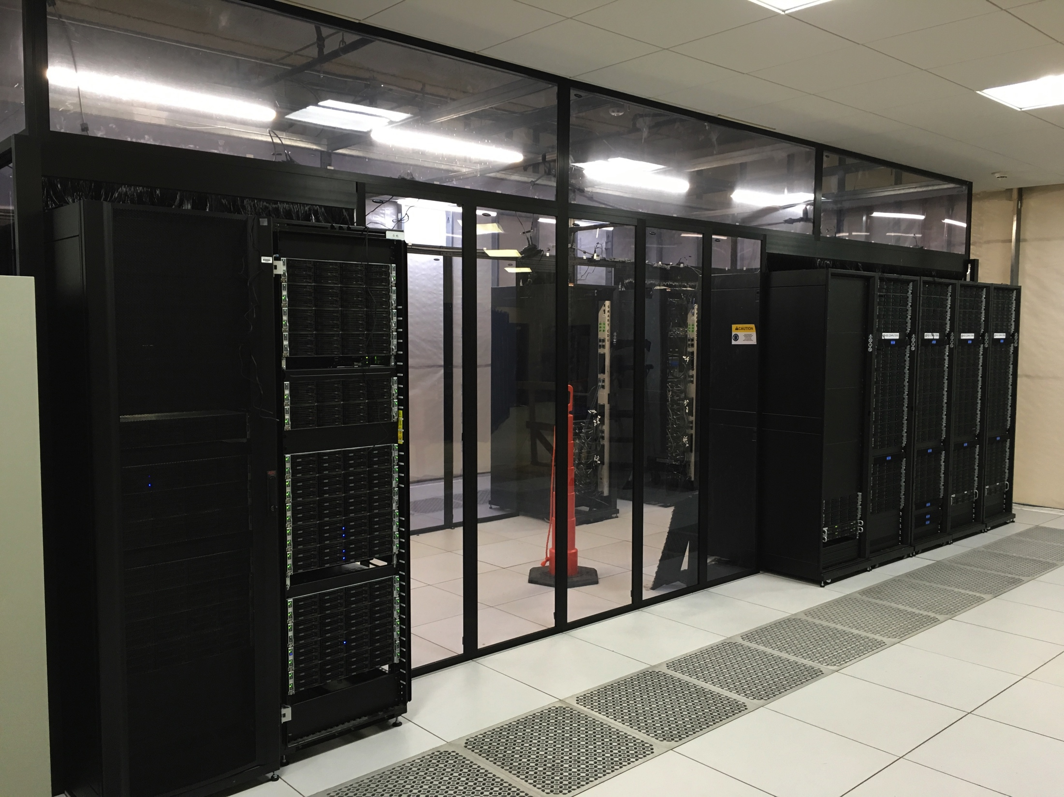
IT News
Multi Factor Authentication will complete by Feb 28, 2017
No impact on the user community.
PAC proposal submission will be streamlined
Public Access of Publications
JLAB met the DOE requirements to submit 85% of manuscripts
Publication process training continues
Computer Center Efficiency Upgrade Nearly complete
Computing Installed in Hot Aisle/Cold Aisle

Slide 3
SciComp News
SciPhi-XVI high performance computing cluster. The Intel Xeon Phi-based machine,
clocked in at #397 in the list of the world’s Top 500 fastest supercomputers
at #10 in the Green500, a compilation of the most energy efficient computers in the world.
Grid computing: have ordered a gateway node to facilitate Open Science Grid job submissions
Lustre
In 2016, purchased Intel supported version
Continue to see operational issues that impact users
Get reasonable support from Intel
Other sites also reporting

Slide 4
News
Working with User Group: Software Carpentry Workshop May 17-May 19. Topics in development
JLAB will host a second workshop Future Trends In Nuclear Physics Computing in May
IT and Physics continue hosting a computing round table to discuss common topics
Could use help and suggestions to arrange speakers and topics
SC Fourth ‘Software Review’ November 10-11, 2016
Useful for internal resource planning
Draft report is being ‘fact-checked’
Overall complimentary, with some helpful recommendations

Slide 5
Other News
Community Planning--Strategic Plan for a Scientific Software Innovation Institute (http://s2i2-hep.org)
HEP Software Foundation has initiated a project to produce a bigger picture Community White Paper with a roadmap for computing and software required for the HL-LHC era.
Workshop at UCSD Jan 23-26
Engagement is important since HEP tools are in wide use.
Exascale Computing Project-LQCD application funded (includes JLAB)
ASCR managed $1B/7 years
Timeline accelerated from 10 to 7 years

Slide 6
Hardware resources
Current State
830 servers
10,000 conventional Intel cores (6,000 LQCD, 5,000 Physics)
17,152 Xeon Phi KNL cores (LQCD; i.e. 200 KNL nodes)
328 Nvidia GPUs
12 Petabyte tape library (4 LQCD, 8 Physics)
2.2 Petabyte disk (1.2 LQCD, 1.0 Physics)

