Slide 1
Report to the JLab Users Group Board of Directors
January 10, 2017
Elizabeth L. Lawson
Chief Governance Officer / Principal JSA/JLab Liaison
SURA Corporate Secretary
JSA Board Liaison and Secretary

Slide 2
JSA Board of Directors
Jerry Draayer
President & CEO, SURA
Owner Representative
Board Vice Chair
Taylor Reveley
President, College of William & Mary
Board Chair
Karl Williams
President, PAE AT
Owner Representative
Board Vice Chair
William Harvey
President
Hampton University
Thomas Appelquist
Professor of Physics
Yale University
James Decker
Decker, Garman, Sullivan & Associates, LLC
Elizabeth Beise
Professor & Associate Provost / Academic Planning & Programs, University of Maryland
Michael Matteson
President, Syncom Space Services LLC
James Holt
Deputy General Manager,
Syncom Space Services LLC
Clinton Bickett
CFO, Technical Services Business Unit, PAE
Hugh Montgomery
JSA President /
Jefferson Lab Director
Compensation
J. Draayer, Chair
Science Council
T. Appelquist, Chair
Committee currently reports to both the SURA Board of Trustees and the JSA Board of Directors
Committee chair is both a member of the SURA Executive Committee and the JSA Board of Directors
SURA Board appoints a Steering Group, comprised of JSA Directors, SURA Trustees, Users Group past chair, to act for the Committee between meetings
Ad hoc groups of Committee members, both SURA trustees and non-trustees and user representatives, form to support the work of the Committee
Committee staff liaison is the chief governance officer of SURA and the Board Liaison to JSA
Operations & Safety
M. Matteson, Chair
JSA Programs
E. Beise, Chair
Finance & Audit
C. Bickett, Chair
Relations & Outreach
W. Harvey, Chair
Current SURA Board Chair
SURA Director Chair
PAE Director Chair
Users Group Board Meeting January 10, 2017
Elizabeth L. Lawson

Slide 3
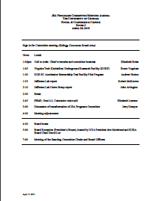
JSA Programs Committee
Over half of SURA member schools are represented
Arkansas – Catholic – CNU – Duke – Florida – Florida Atlantic – Florida Tech – Florida International – Florida State – GWU – Hampton – Houston – Idaho State – JMU – Louisiana Tech – UMD – MIT – Mississippi – NSU – UNC-CH – NC State – Ohio U – ODU – Regina – Richmond – South Florida – Southern Miss – Texas A&M – Tulane – UVa – Virginia State – Virginia Tech – W&M – UG Chair
Steering Group
Elizabeth Beise, UMD, Chair
Jerry Draayer, SURA/JSA
Paul Eugenio, FSU
Haiyan Gao, Duke
Tanja Horn, Catholic
Hugh Montgomery, JSA/JLab
Zisis Papandreou, Regina
Elizabeth Lawson, SURA/JSA
Full committee meets twice a year in conjunction with SURA Board of Trustees biennial meetings and SURA awards of Distinguished Friend of Science and Distinguished Scientist honors
Next meeting: April 18 at LSU (tour of LIGO facility)
Tanja voted by SURA Board to serve on Steering Group for 3-year term, starting Jan. 1, 2017
Responsibilities of the JSA Programs Committee:
Manage and administer the JSA Initiatives Fund
Foster relations and communications with users and community stakeholders
Advise SURA on the management and operation of the Residence Facility
Monitor performance of SURA as administrative and tax member and owner of JSA

Slide 4
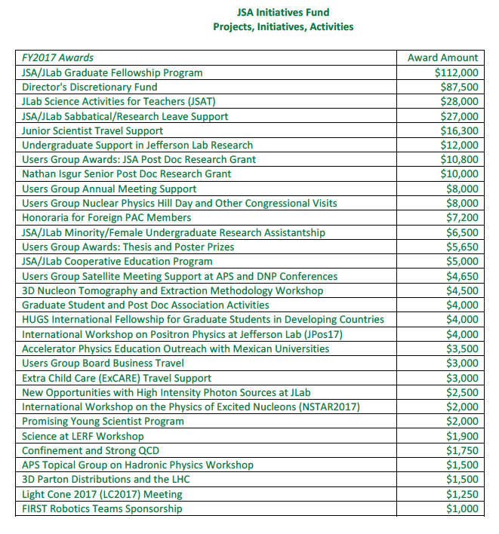
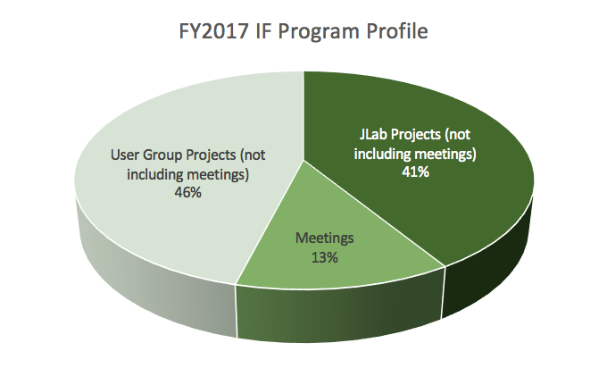
JSA Initiatives Fund Program – Community Building Initiative
http://www.jsallc.org/IF/IFProjects.html
Users Group projects (not meetings) $179.5K
JLab projects (not meetings) $160.7K
Meetings $ 49.8K
$390.0K
Over $450K in contributing funds of which 70% is from outside of JLab
Press release at http://www.jsallc.org/news/JSAIF20161208.pdf

Slide 5
Competitive IF Projects
JSA Outstanding Nuclear Physicist: Nominations due January 31. See http://www.jsallc.org/IF/17ONPAward.html
JSA/JLab Graduate Fellowship Program: Solicitation for AY2017-18 fellowships applications o/a mid-January
JSA/JLab Sabbatical/Research Leave Support: Solicitation for AY2017-18 applications o/a mid-January
Junior Scientist Travel Support: on-going. See http://www.jsallc.org/IF/IndexJSTF.html
JSA Post Doc Research Grant. Applications due January 27. See https://wiki.jlab.org/cugwiki/index.php/Annual_Postdoctoral_Prize
JSA/JLab Minority/Female Undergraduate Research Assistantship. Solicitation o/a mid-March
Users Group Thesis Prize: Applications due February 24. See https://wiki.jlab.org/cugwiki/index.php/Ph.D._Thesis_Prize
Users Group Poster Prizes: Competition conducted during UG Annual Meeting, June 19-21
HUGS International Fellowship for Graduate Students in Developing Countries: Contact PI’s Cesar Fernandez-Ramirez, UNAM (cesar.fernandez@nucleares.unam.mx) and Alberto Accardi, JLab/HU (accardi@jlab.org)
Accelerator Physics Education Outreach with Mexican Universities: Contact PI’s Carlos Hernandez-Garcia (chgarciar@jlab.org) and Matthew Poelker, JLab (poelker@jlab.org)
Extra Child Care (ExCARE) Travel Support: Ongoing. See https://wiki.jlab.org/cugwiki/index.php/JSA_Travel_Fund_for_Extra_Child_Care_(ExCARE)
Promising Young Scientist Program: Contact PI’s R. Beminiwattha, LSU (rakithab@jlab.org), E. Brash, CNU (brash@jlab.org), W. Deconinck, W&M (wdconinc@jlab.org), D. Dutta, MSU (ddutta@jlab.org), J. Mammei, Manitoba (crowder@jlab.org), D. McNulty (mcnulty@jlab.org), K Slifer, UNH (karl.slifer@unh.edu)

Slide 6
FY2018 IF Program – Schedule (draft)
o/a Jun 5: Call for proposals issued
o/a Jul 17: Proposals due
o/a Jul 31: Revised proposals received following JSA review
o/a Aug 31: Lab and UG BoD reviews conducted
o/a Sep 29: Evaluation committee review conducted
o/a Oct 31: Award decisions submitted to owners
mid Nov: Awards announced
post award: JSA debriefs PI’s re. proposals

Slide 7
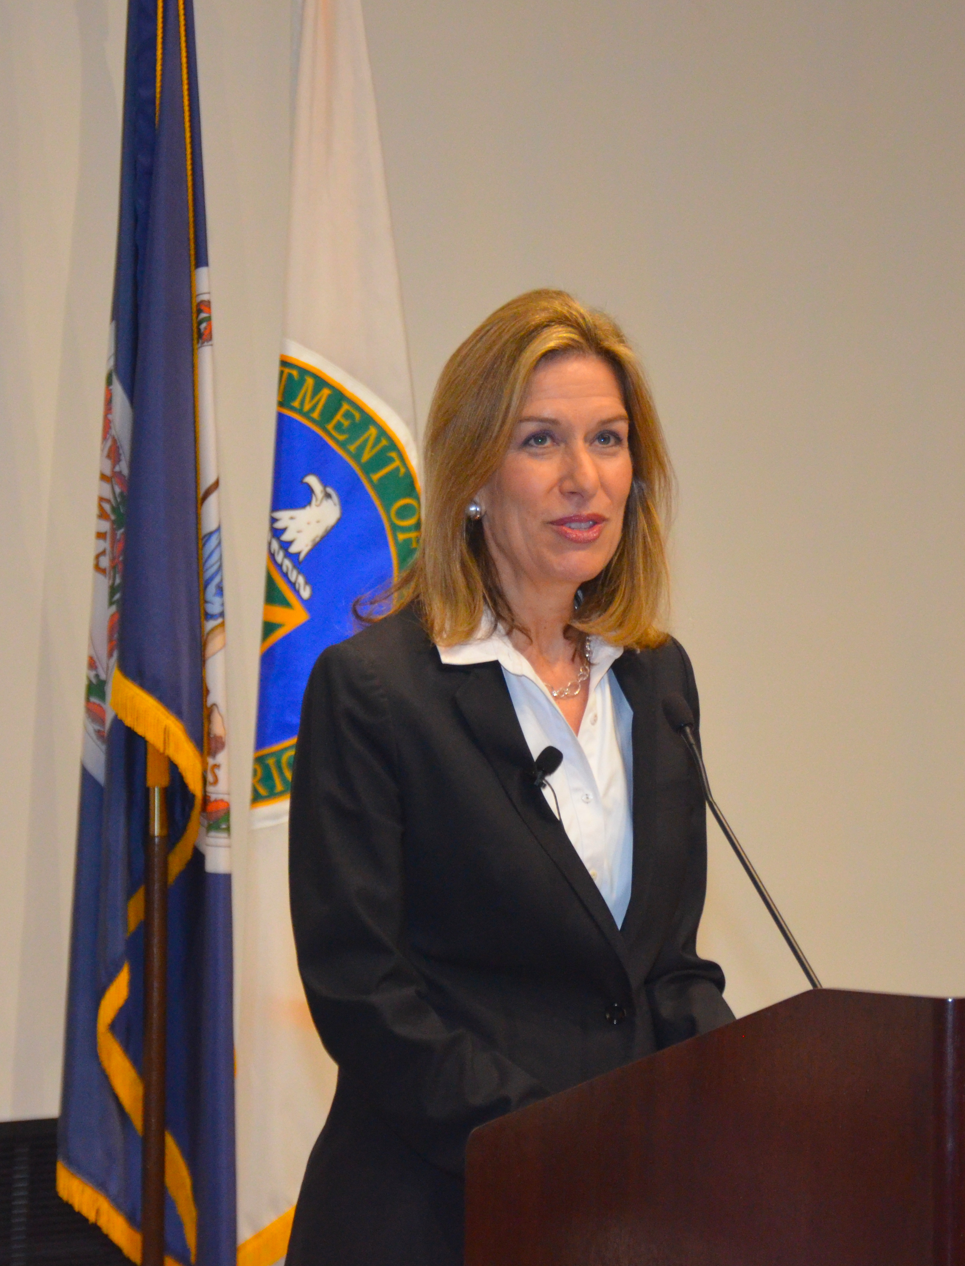
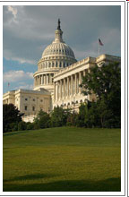
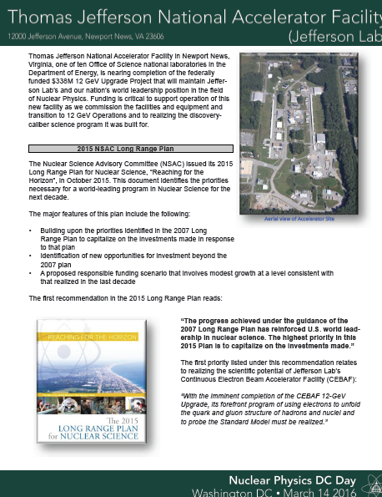
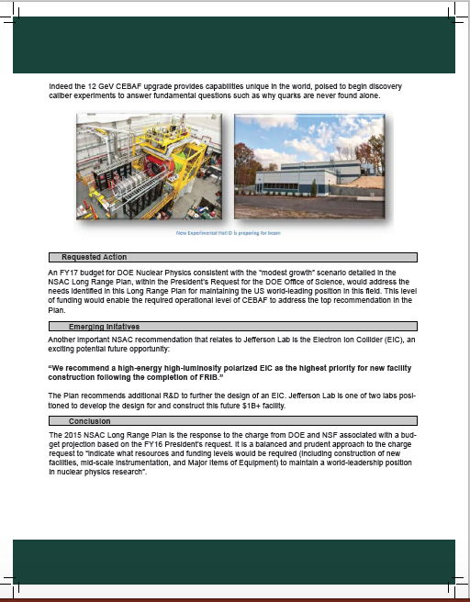
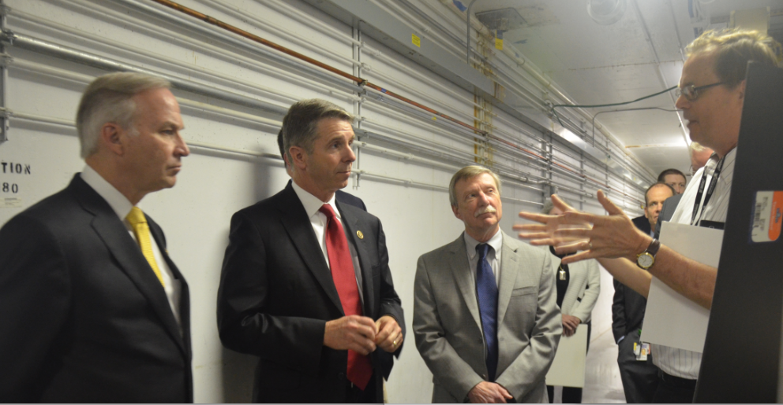
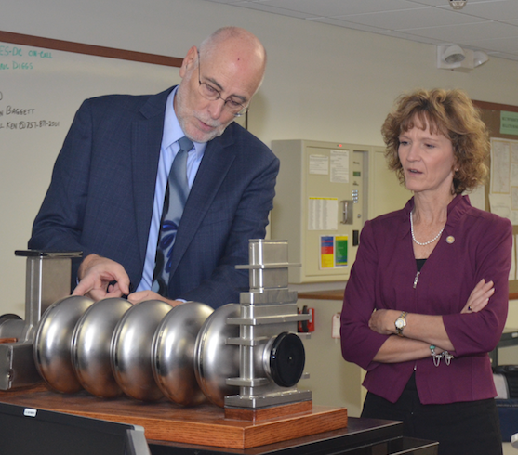
SURA’s Relations Program
Program and strategy supporting science in general and Jefferson Lab and its related and complementary activities in particular.
Annual value over $500K including engagement of relations firms at the federal and state levels, and SURA’s chief public affairs officers and others
Program also includes effective relationships with DOE officials, local and regional authorities, universities and industry/business leaders; and, support to JLab Users Group
Travel supported provided by JSA IF Program to 13 of the 24 user participants

Slide 8
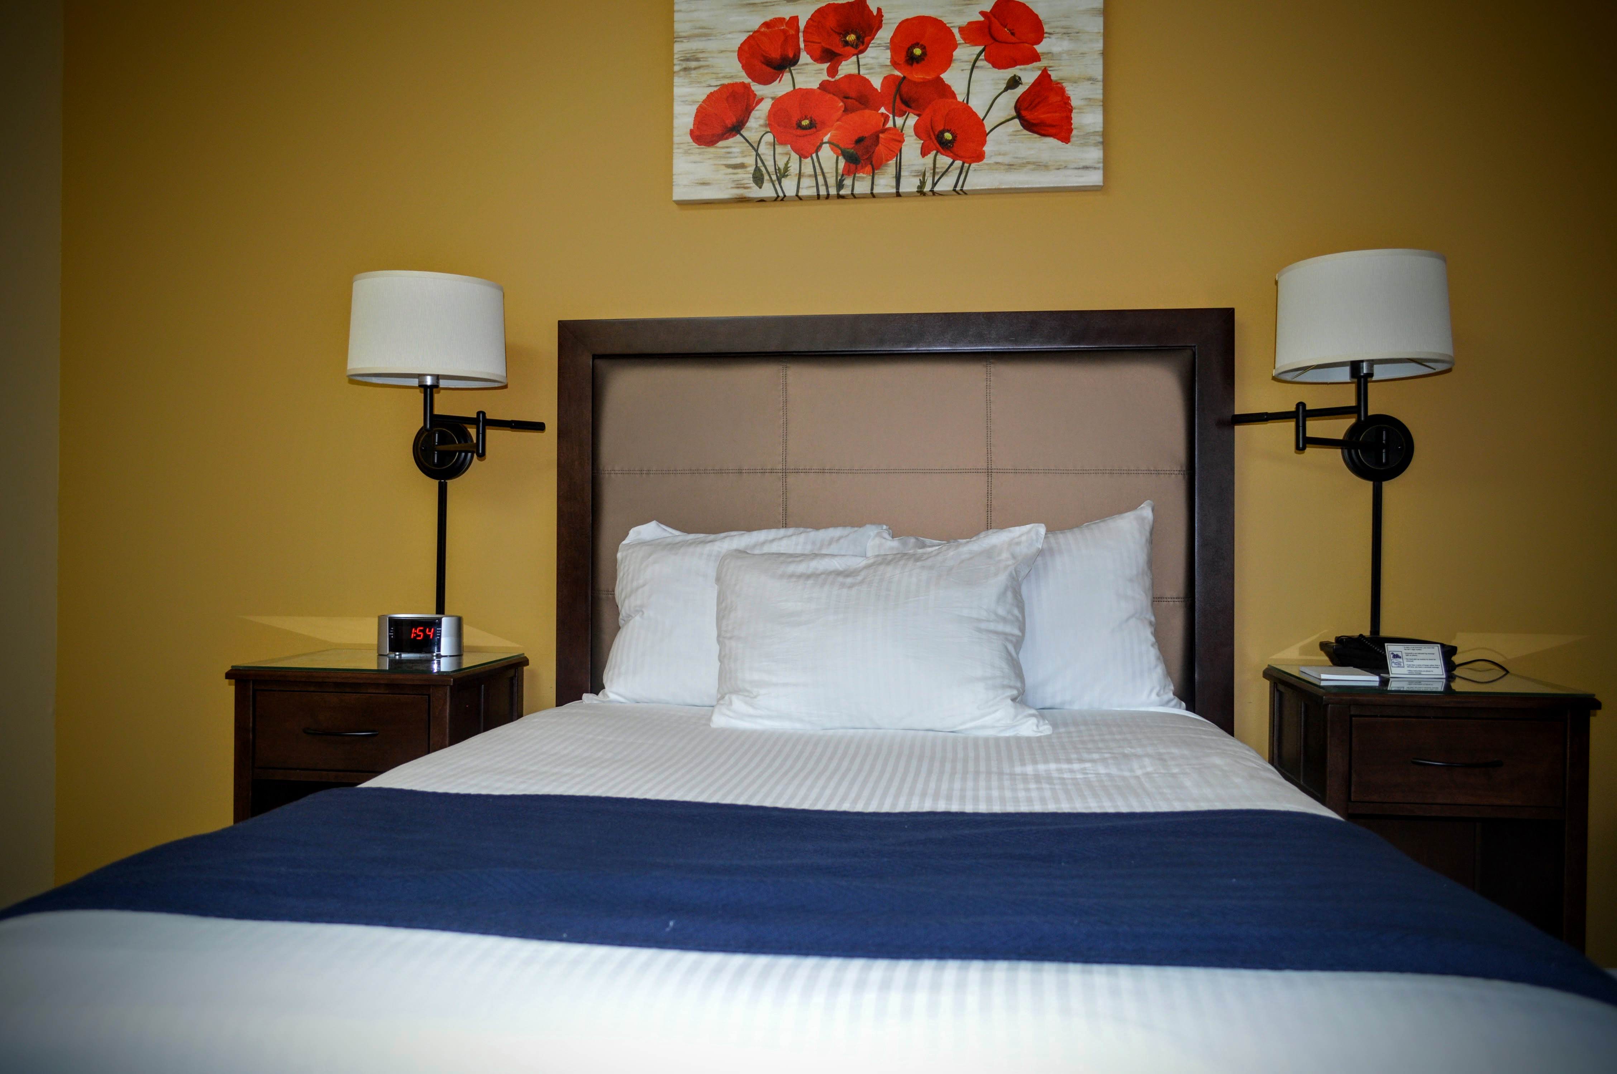
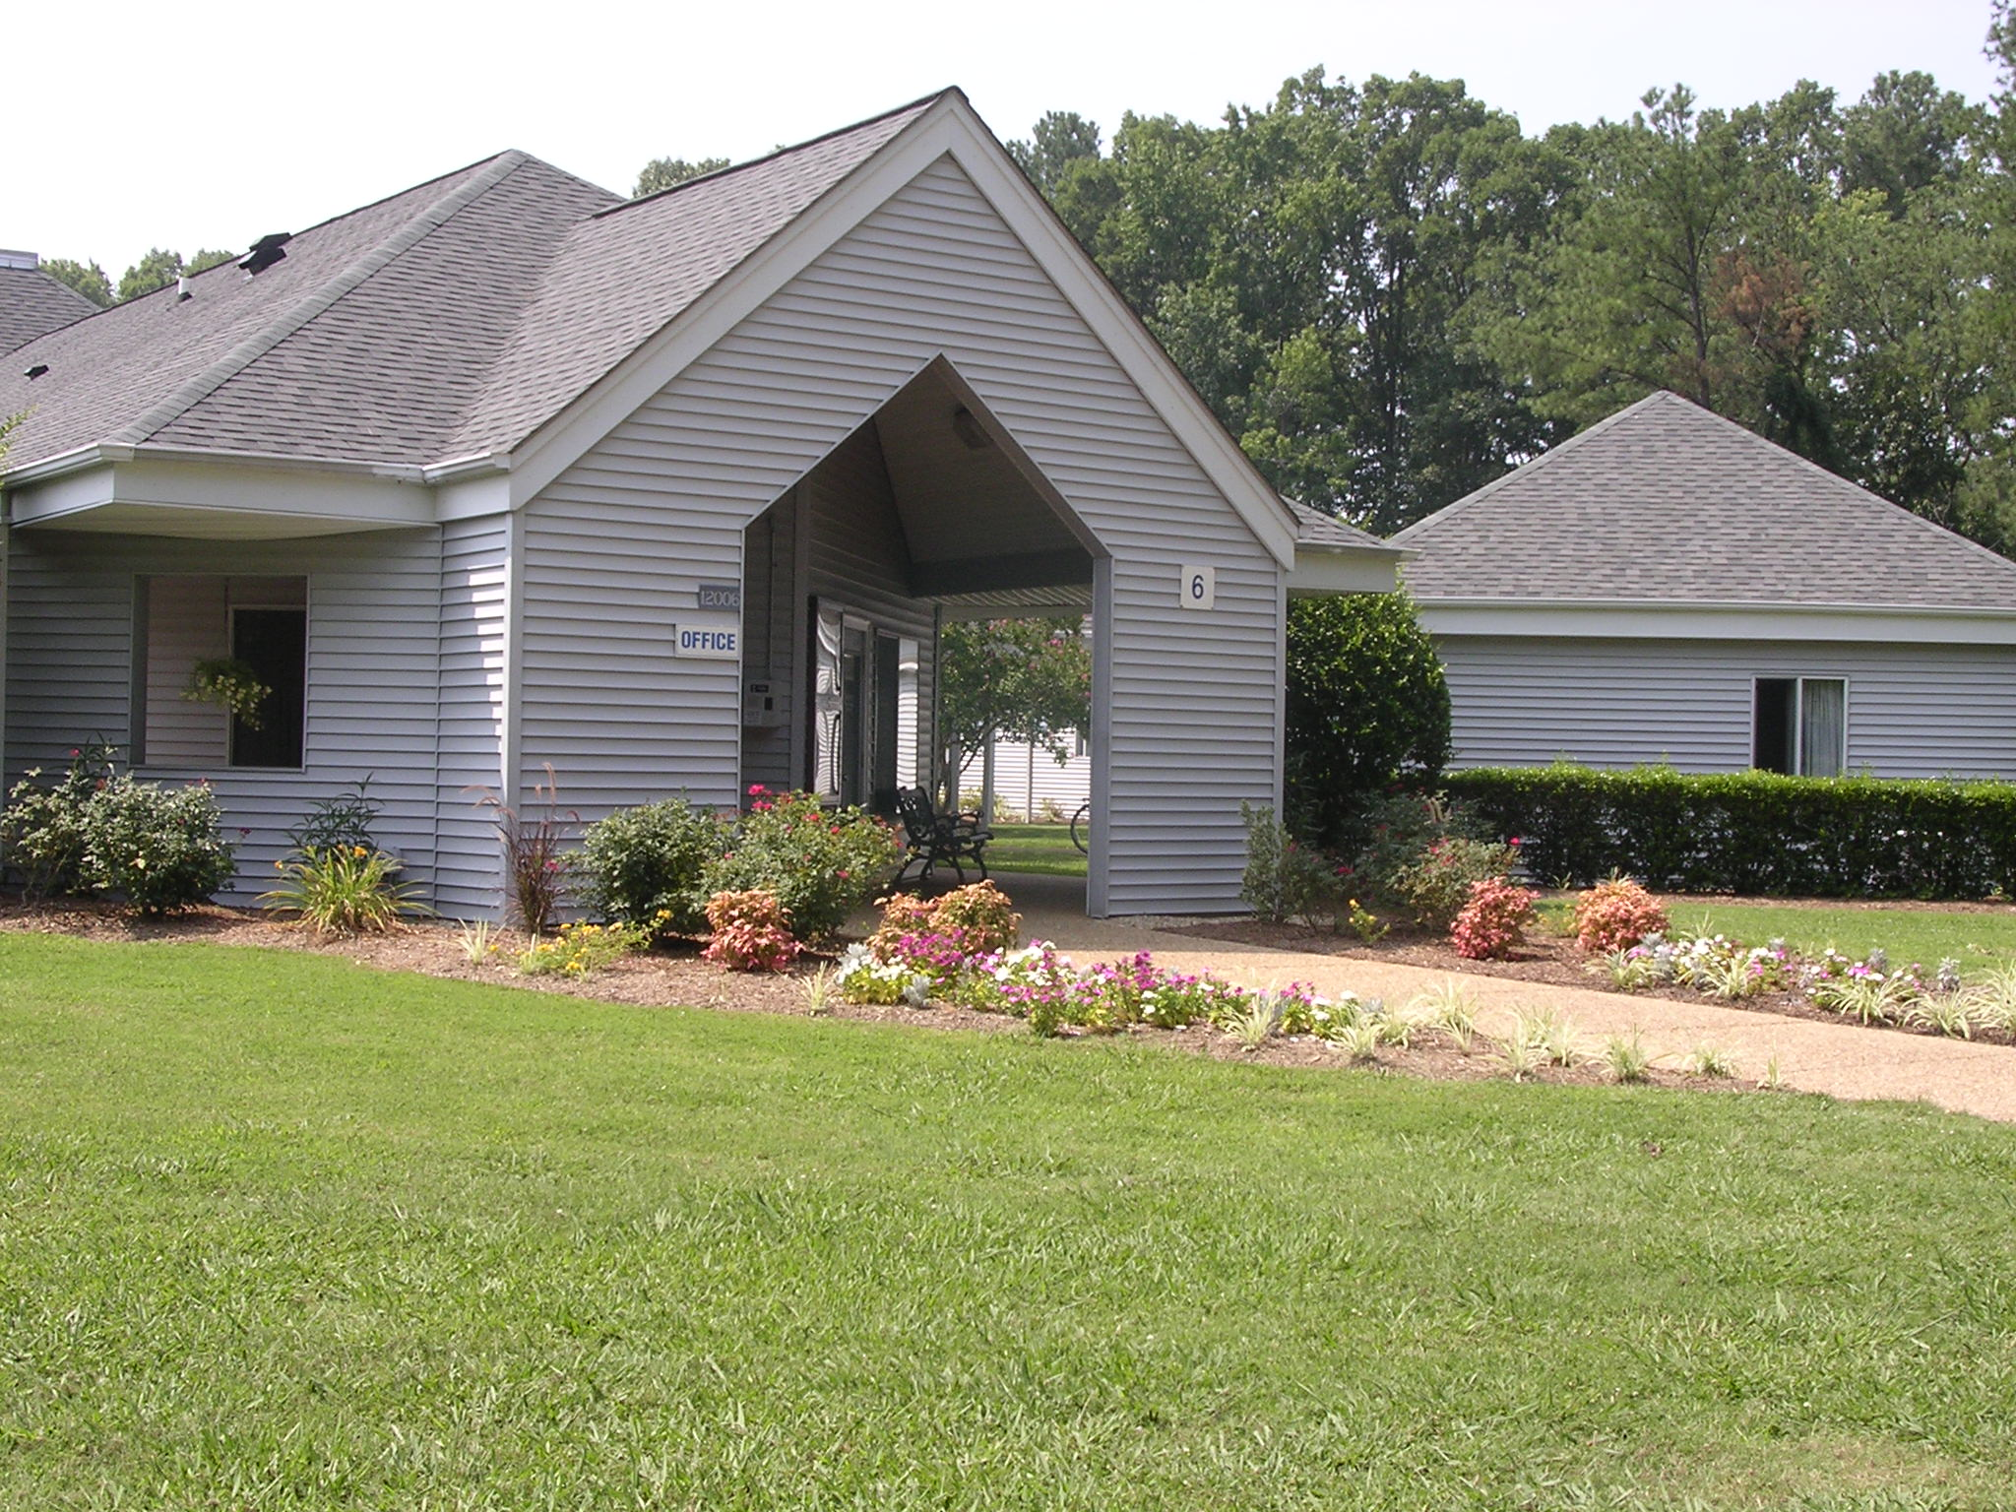
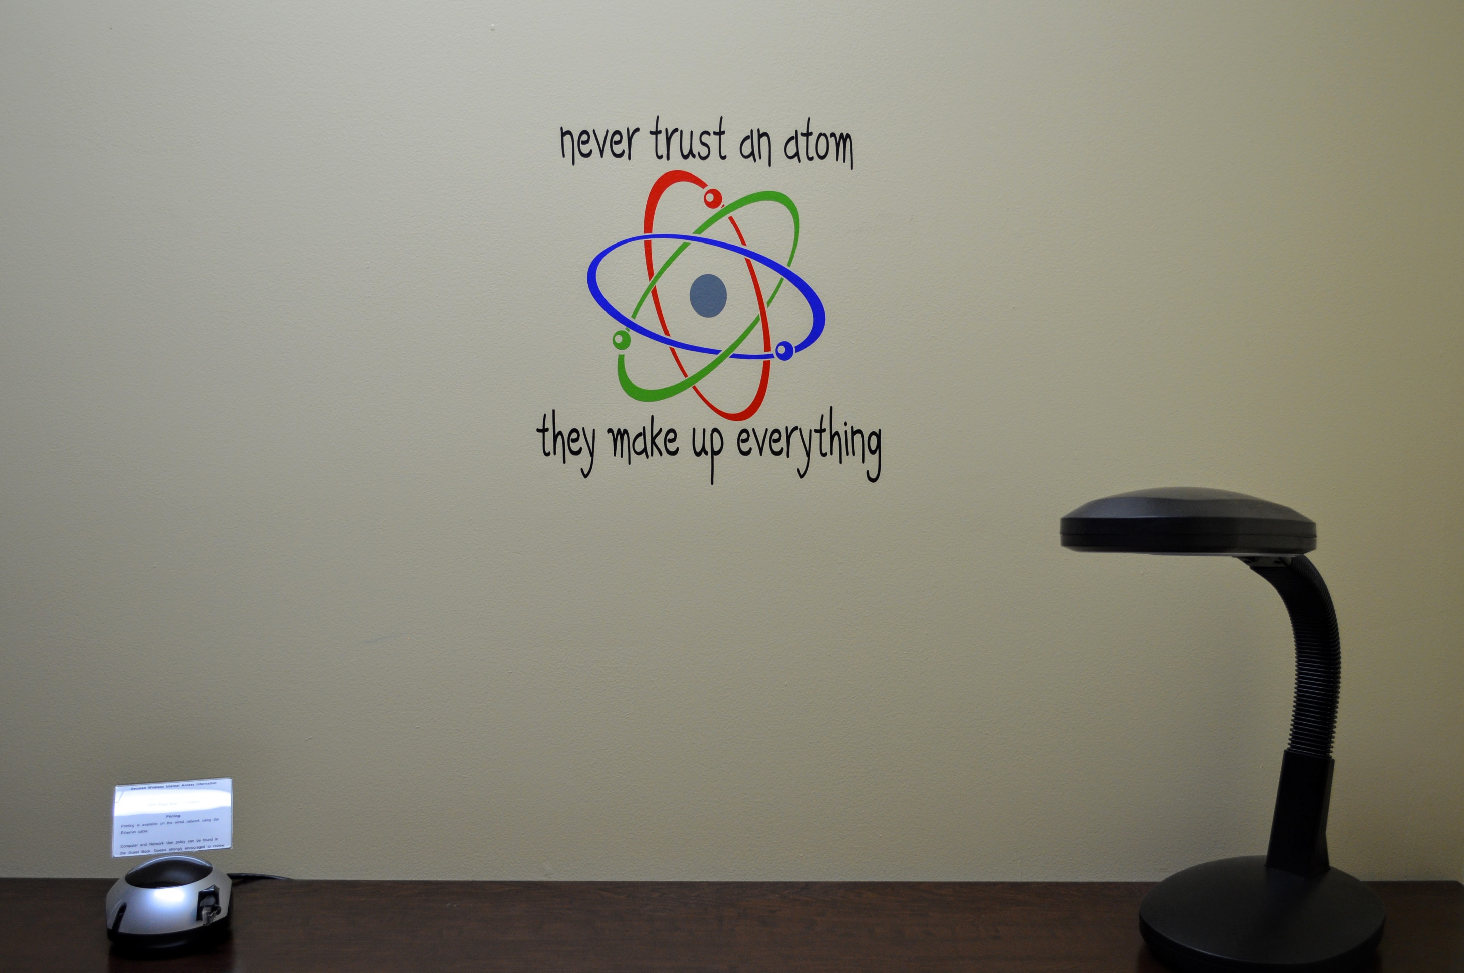
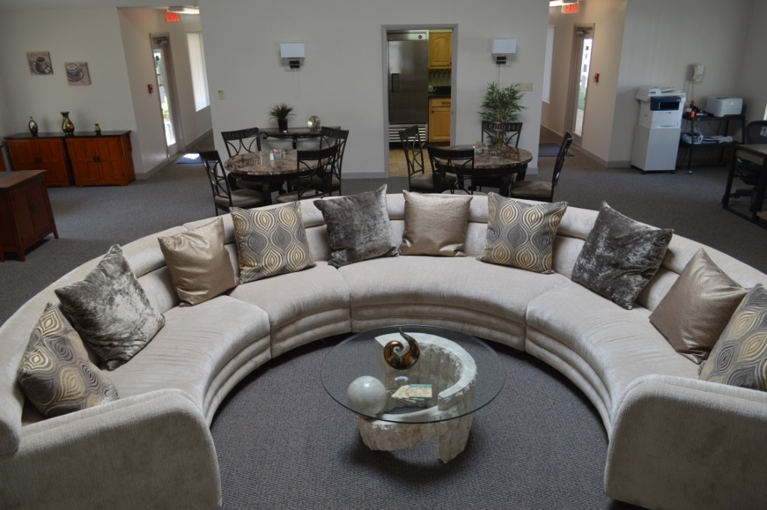
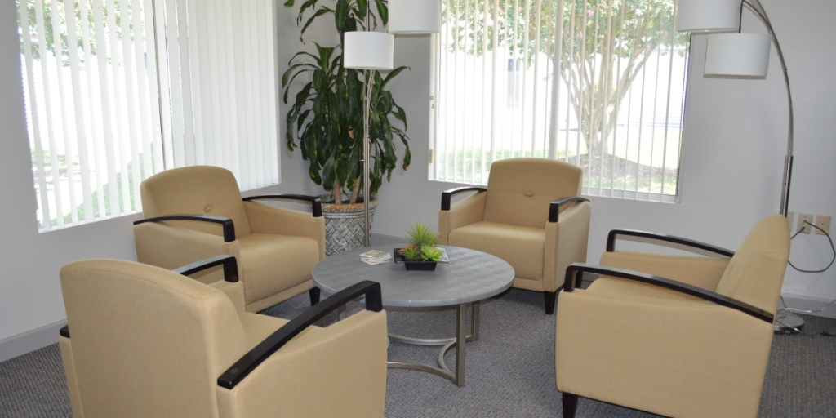
SURA Residence Facility
SURA continues to manage and operate the Residence Facility on a break-even basis for use by researchers and students at the Lab
Completed renovation of Main Building (Great Room) and Building 8 (4 rooms) on budget and in time for summer guests
FY2016 Operating results
Actual Budget
Rev $451.6K $431.9K
Exp (*) $467.1K $441.5K
Occup 54.3% 50.0%
ADR $58.84 (GSA lodging: $91 plus tax)
(*) 52% salaries/benefits; 14% depreciation; 14% utilities;
20% outsourced services; <1% other
Guest satisfaction remains high: 26% response rate, 87.3 on 100-pt. scale
Room rate increase effective April 1, 2017: $50/$60/$70
2017 capital budget includes renovation of Building 3 and replacement of roofs on Buildings 9, 10, &11

