Slide 1



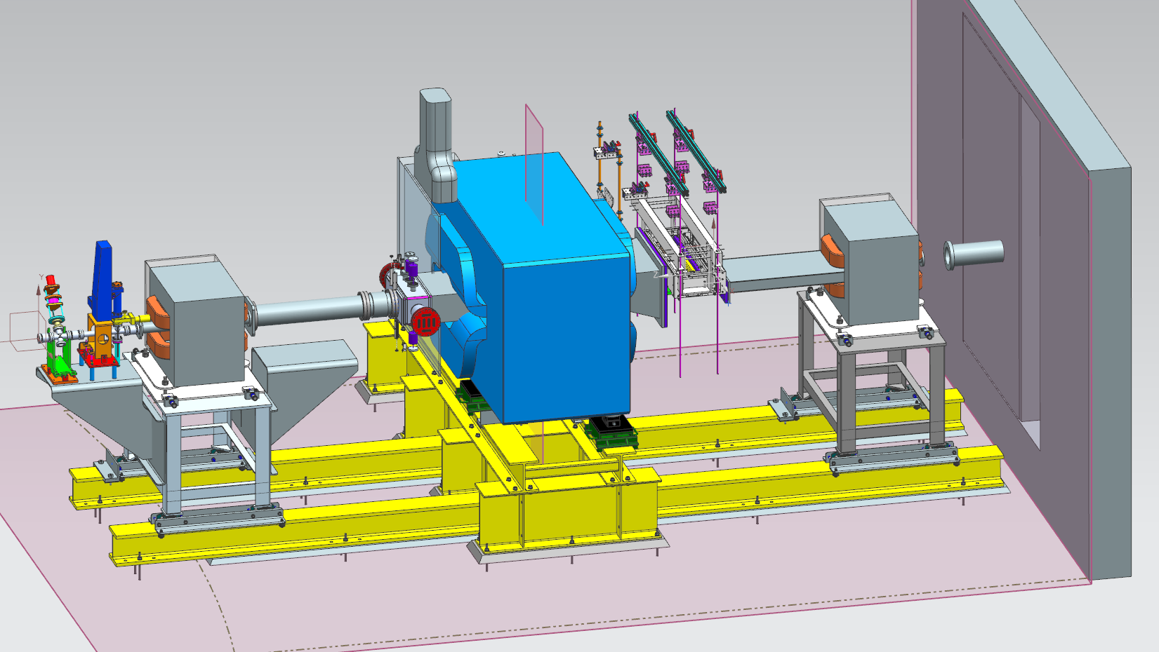
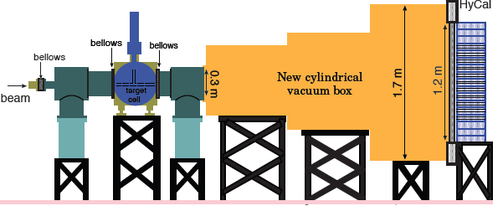
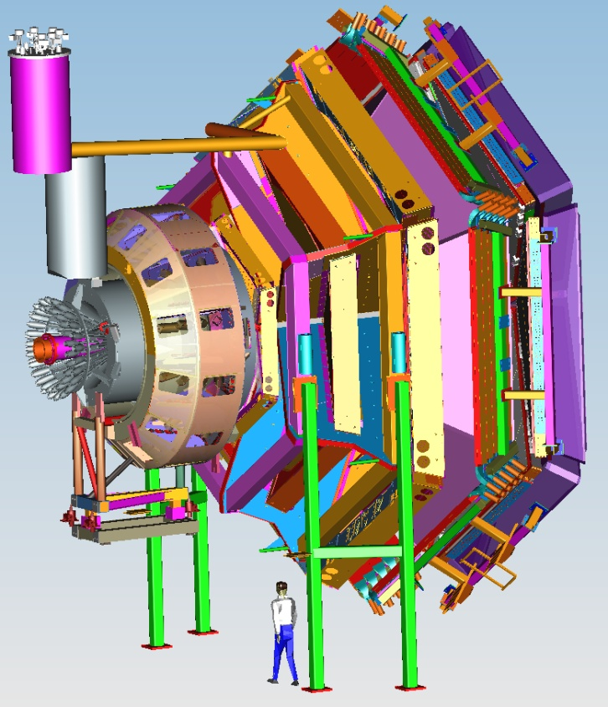


Status of Hall B
Volker D. Burkert
CLAS12
Publications
HPS & PRad
PAC44
CLAS12 status
detectors & magnets
2017 Schedule
Run Groups
Conclusions
User Group BoD Meeting
January 10, 2017

Slide 2
Physics Publications in 2016
A.V. Anisovich et al., Evidence for Δ(2200)7/2⁻ from photoproduction and consequence for chiral-symmetry restoration at high mass. Phys.Lett. B765 (2017), 1
P. Bosted et al., Target and beam-target spin asymmetries in exclusive pion electroproduction for Q² > 1 GeV², ep→epπ⁰, arXiv:1611.04987 [nucl-ex]
P. Bosted et al., Target and Beam-Target Spin Asymmetries in Exclusive Pion Electroproduction for Q² > 1 GeV², ep→eπ⁺n, arXiv:1607.07518 [nucl-ex] (PRC, accepted)
X. Zheng et al, Measurement of Target and Double-spin Asymmetries for the ep→eπ+(n) Reaction in the Nucleon Resonance Region at Low Q², Phys.Rev. C94 (2016) no.4, 045206
C. A. Paterson et al., Photoproduction of Λand Σhyperons using linearly polarized photon,
Phys. Rev. C.93.06520, 2016
V.I. Mokeev et al., New Results from the Studies of the N(1440)1/2+, N(1520)3/2−, andΔ(1620)1/2− Resonances in exclusive ep→epπ+π- Electroproduction with CLAS, Phys.Rev. C93, 025206, 2016
R. Dixon et al., Photoproduction of the f1(1285) Meson, Phys. Rev. C 93, 065202, 2016
P. Bosted et al., Target and Beam-Target Spin Asymmetries in Excl. π+ and π−Electroproduction with 1.6 to 5.7 GeV Electrons, Phys. Rev. C94 (2016) no.5
I. Senderovich et al., First measurement of the helicity asymmetry E inηphotoproduction on the proton, Phys.Letts. B755 (2016) 64

Slide 3

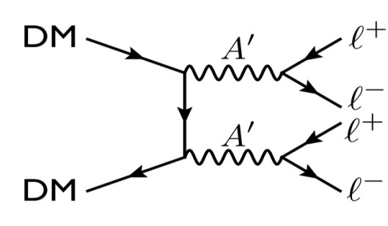
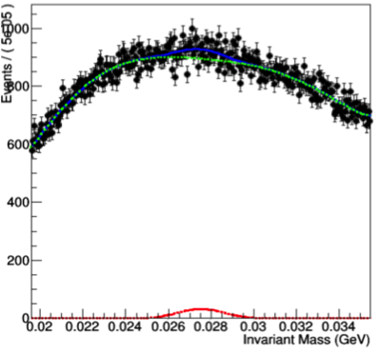
Analysis Status
Hall B
HPS Reach in mass and coupling
HPS has taken data in Engineering Runs during 2015 and 2016.
HPS was fully approved for 165 PAC days.
Upgrades planned for future running to extend reach
2 PAC days at 1 GeV
1 GeV
2.2 GeV
4.4 GeV
e⁺e⁻ mass spectrum for 4 hours (10%) run at 1.05 GeV. Green line: expected background from tridents. Red line: maximum deviation, very small probability.
3

Slide 4
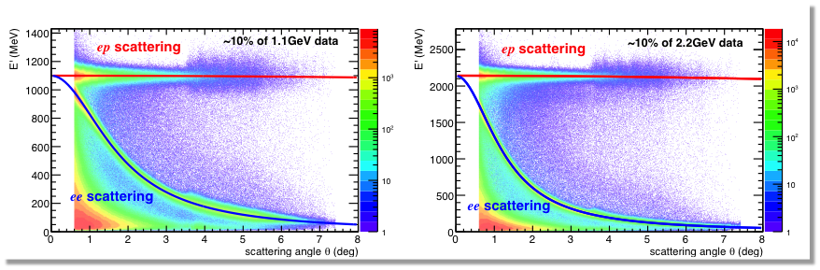
PRad Analysis Status
Hall B
HyCal: Energy resolution 2.6% for PWO, 6.2% for PbGl
Trigger efficiency: > 99.5% at Eγ > 500 MeV
GEM: Position resolution = 72μm, detection eff. ~ 92%
Analysis: Cross section extraction ongoing

Slide 5
PAC44
CLAS12
E12-06-108B M. Kunkel Transition Form Factor of the eta' Meson with CLAS12, M. Kunkel (RG A)
E12-06-109A, S. Niccolai Deeply virtual Compton scattering on the neutron with a longitudinally polarized deuteron target (RG C)
New RG K “Confinement & Strong QCD” Approved w/ 100 days
E12-16-010 A. D’Angelo A Search for Hybrid Baryons in Hall B with CLAS12
E12-16-010A D. Carman Nucleon Resonance Structure Studies Via Exclusive KY Electroproduction at 6.6 GeV and 8.8 GeV
E12-16-010B L. Elouadrhiri Deeply Virtual Compton Scattering with CLAS12 at 6.6 GeV and 8.8 GeV

Slide 6
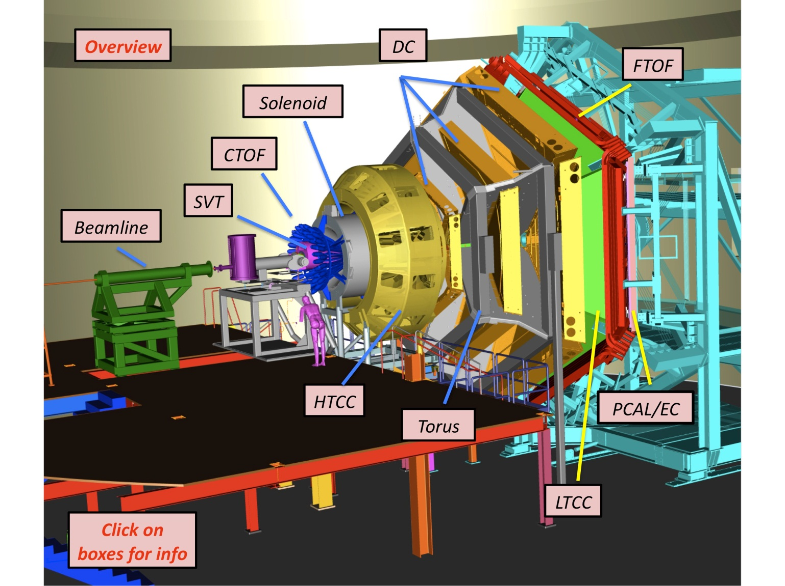
Complete configuration
CLAS12
Forward Tagger
Collaboration is fully involved in
development of:
detectors
calibration
software
commissioning
and First experiment
RICH
Forward Carriage
MVT
CND
Spaceframe
Subway
http://www.jlab.org/Hall-B/clas12-web/
Collaboration provided detectors

Slide 7
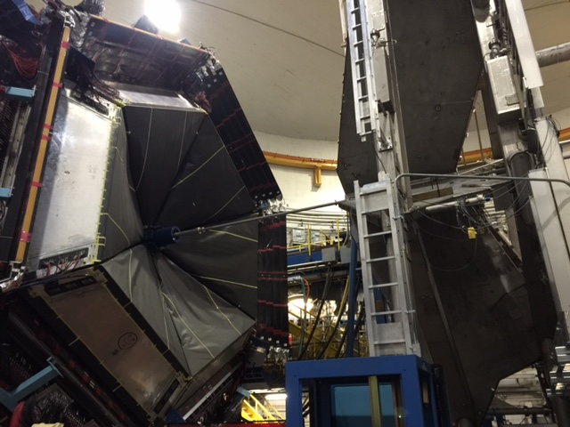
CLAS12
Hall B in June 2016
Hall B in February 2015
Hall B
Torus Magnet

Slide 8
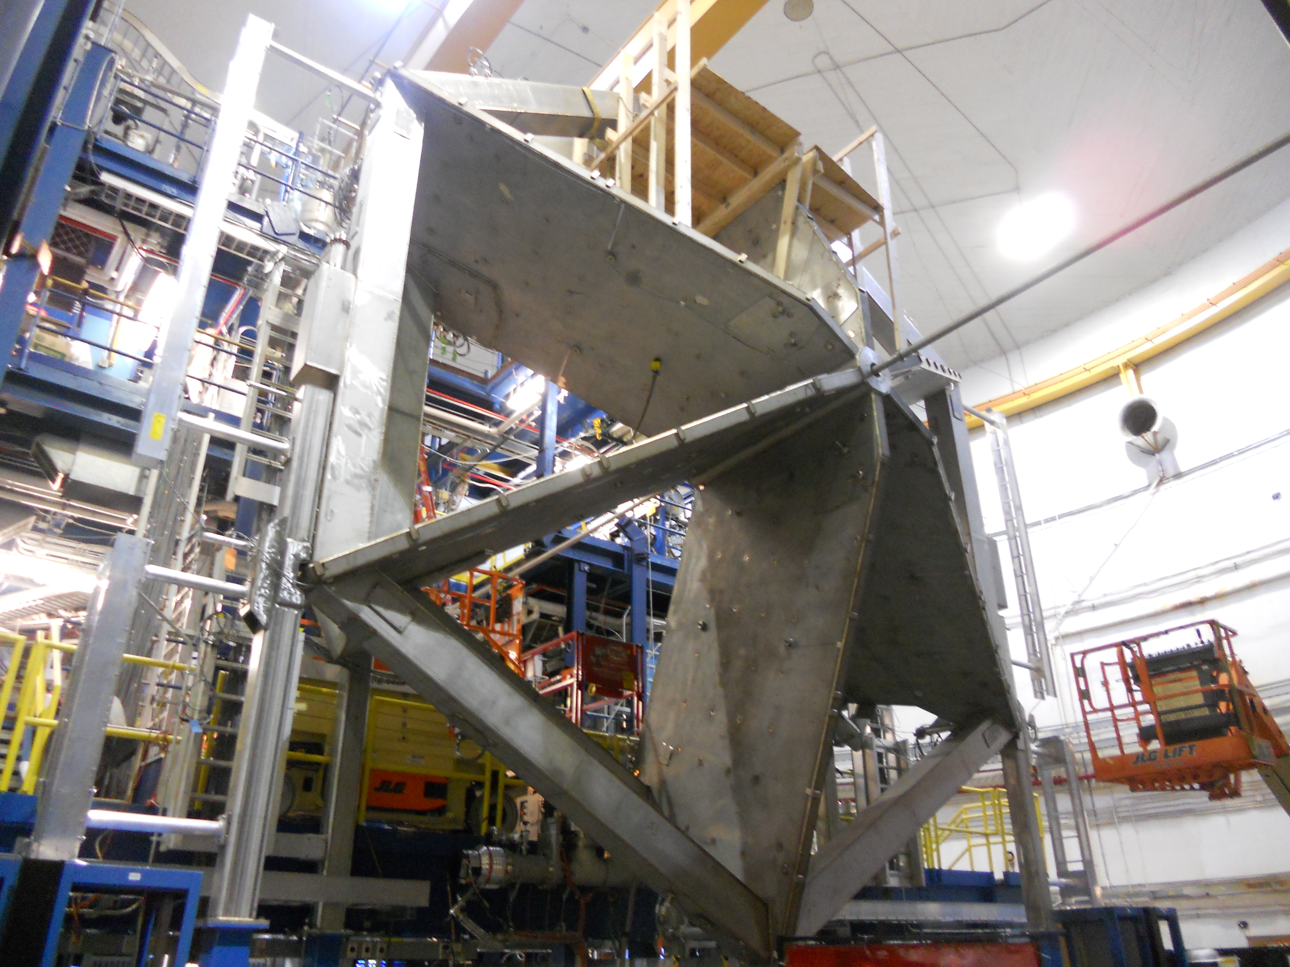
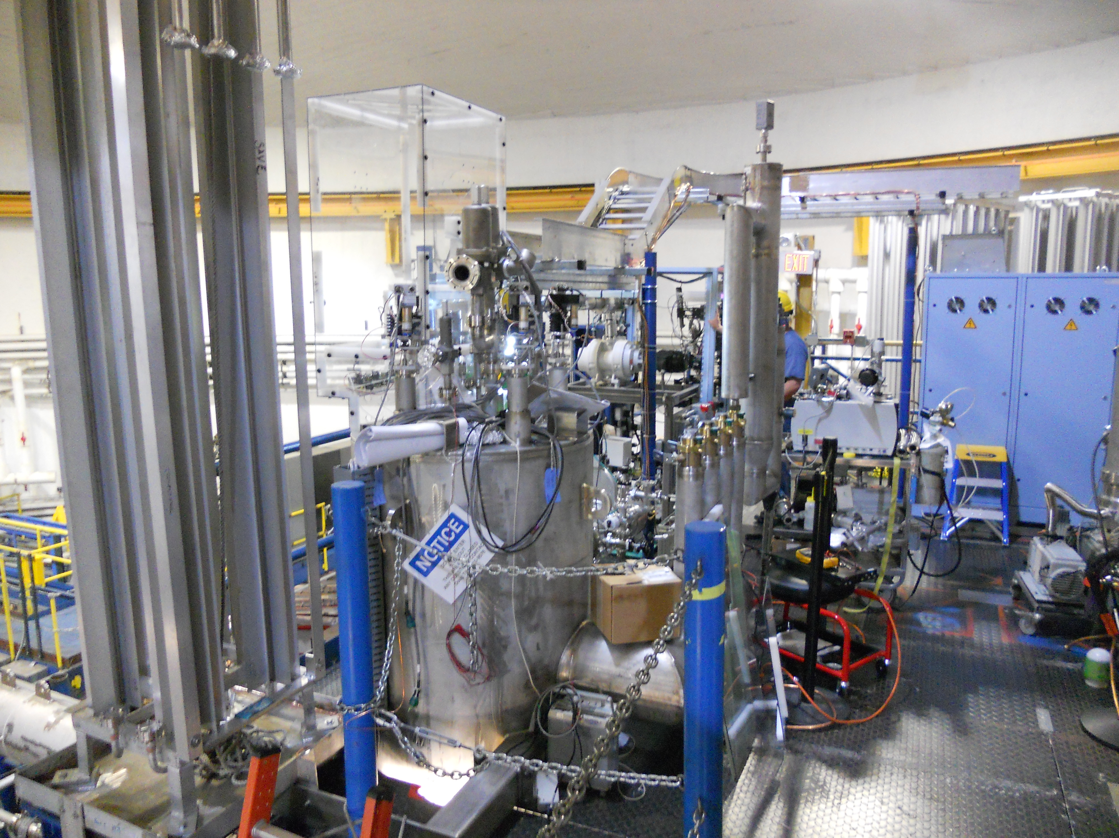
Torus magnet complete
CLAS12
Hall B
Torus in Hall B
July-August 2016
Leak checking; pump down
Finish plumbing and piping
Instrumentation and controls
Cool-down readiness review
September-October 2016
Cool-down to 4.5K
Power-up readiness review
November 2016
Power tests to design current
Field mapping
Cryogenic Distribution

Slide 9
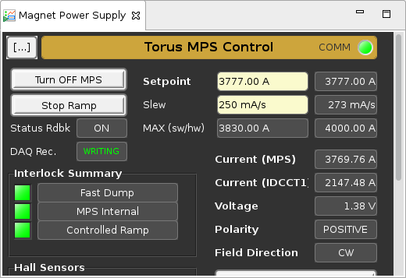
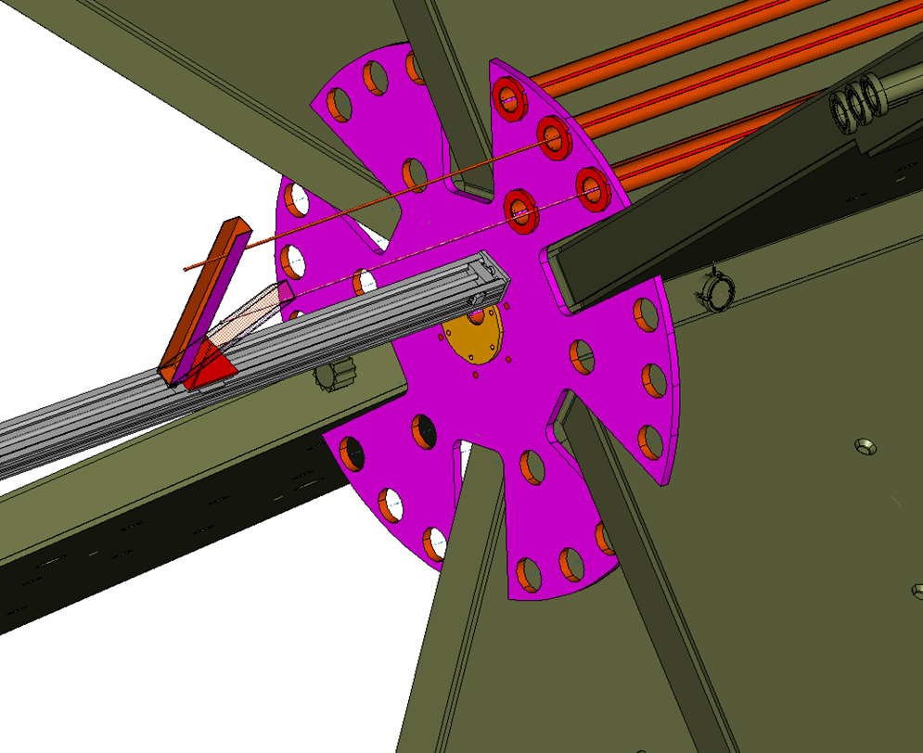
Torus magnet complete
CLAS12
Hall B
11/4/2017
D
A
C
B

Slide 10
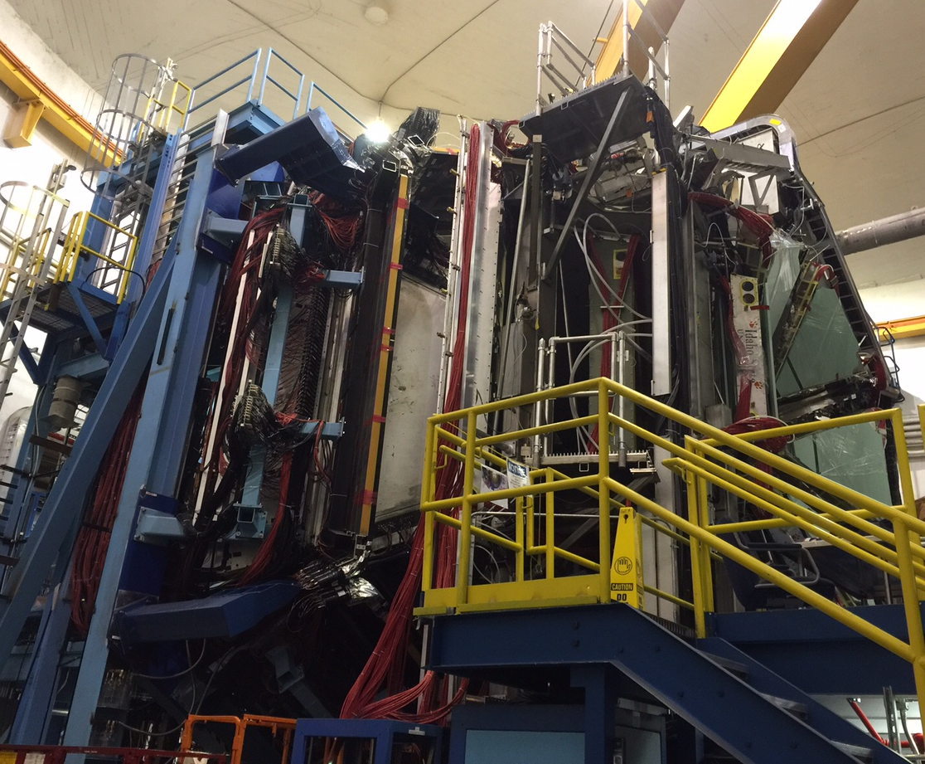
Hall B in January 2017
CLAS12
Hall B
2016
Forward systems
- EC & PCAL
FTOF 1a/b, FTOF 2
- LTCC
DC1, DC2, DC3
Torus magnet
2017:
Central detectors
Central TOF
Silicon Tracker
Solenoid Magnet
TORUS
FTOF
1a,1b,2
DC3
DC2
DC1
LTCC
EC & PCAL
12/16/16

Slide 11
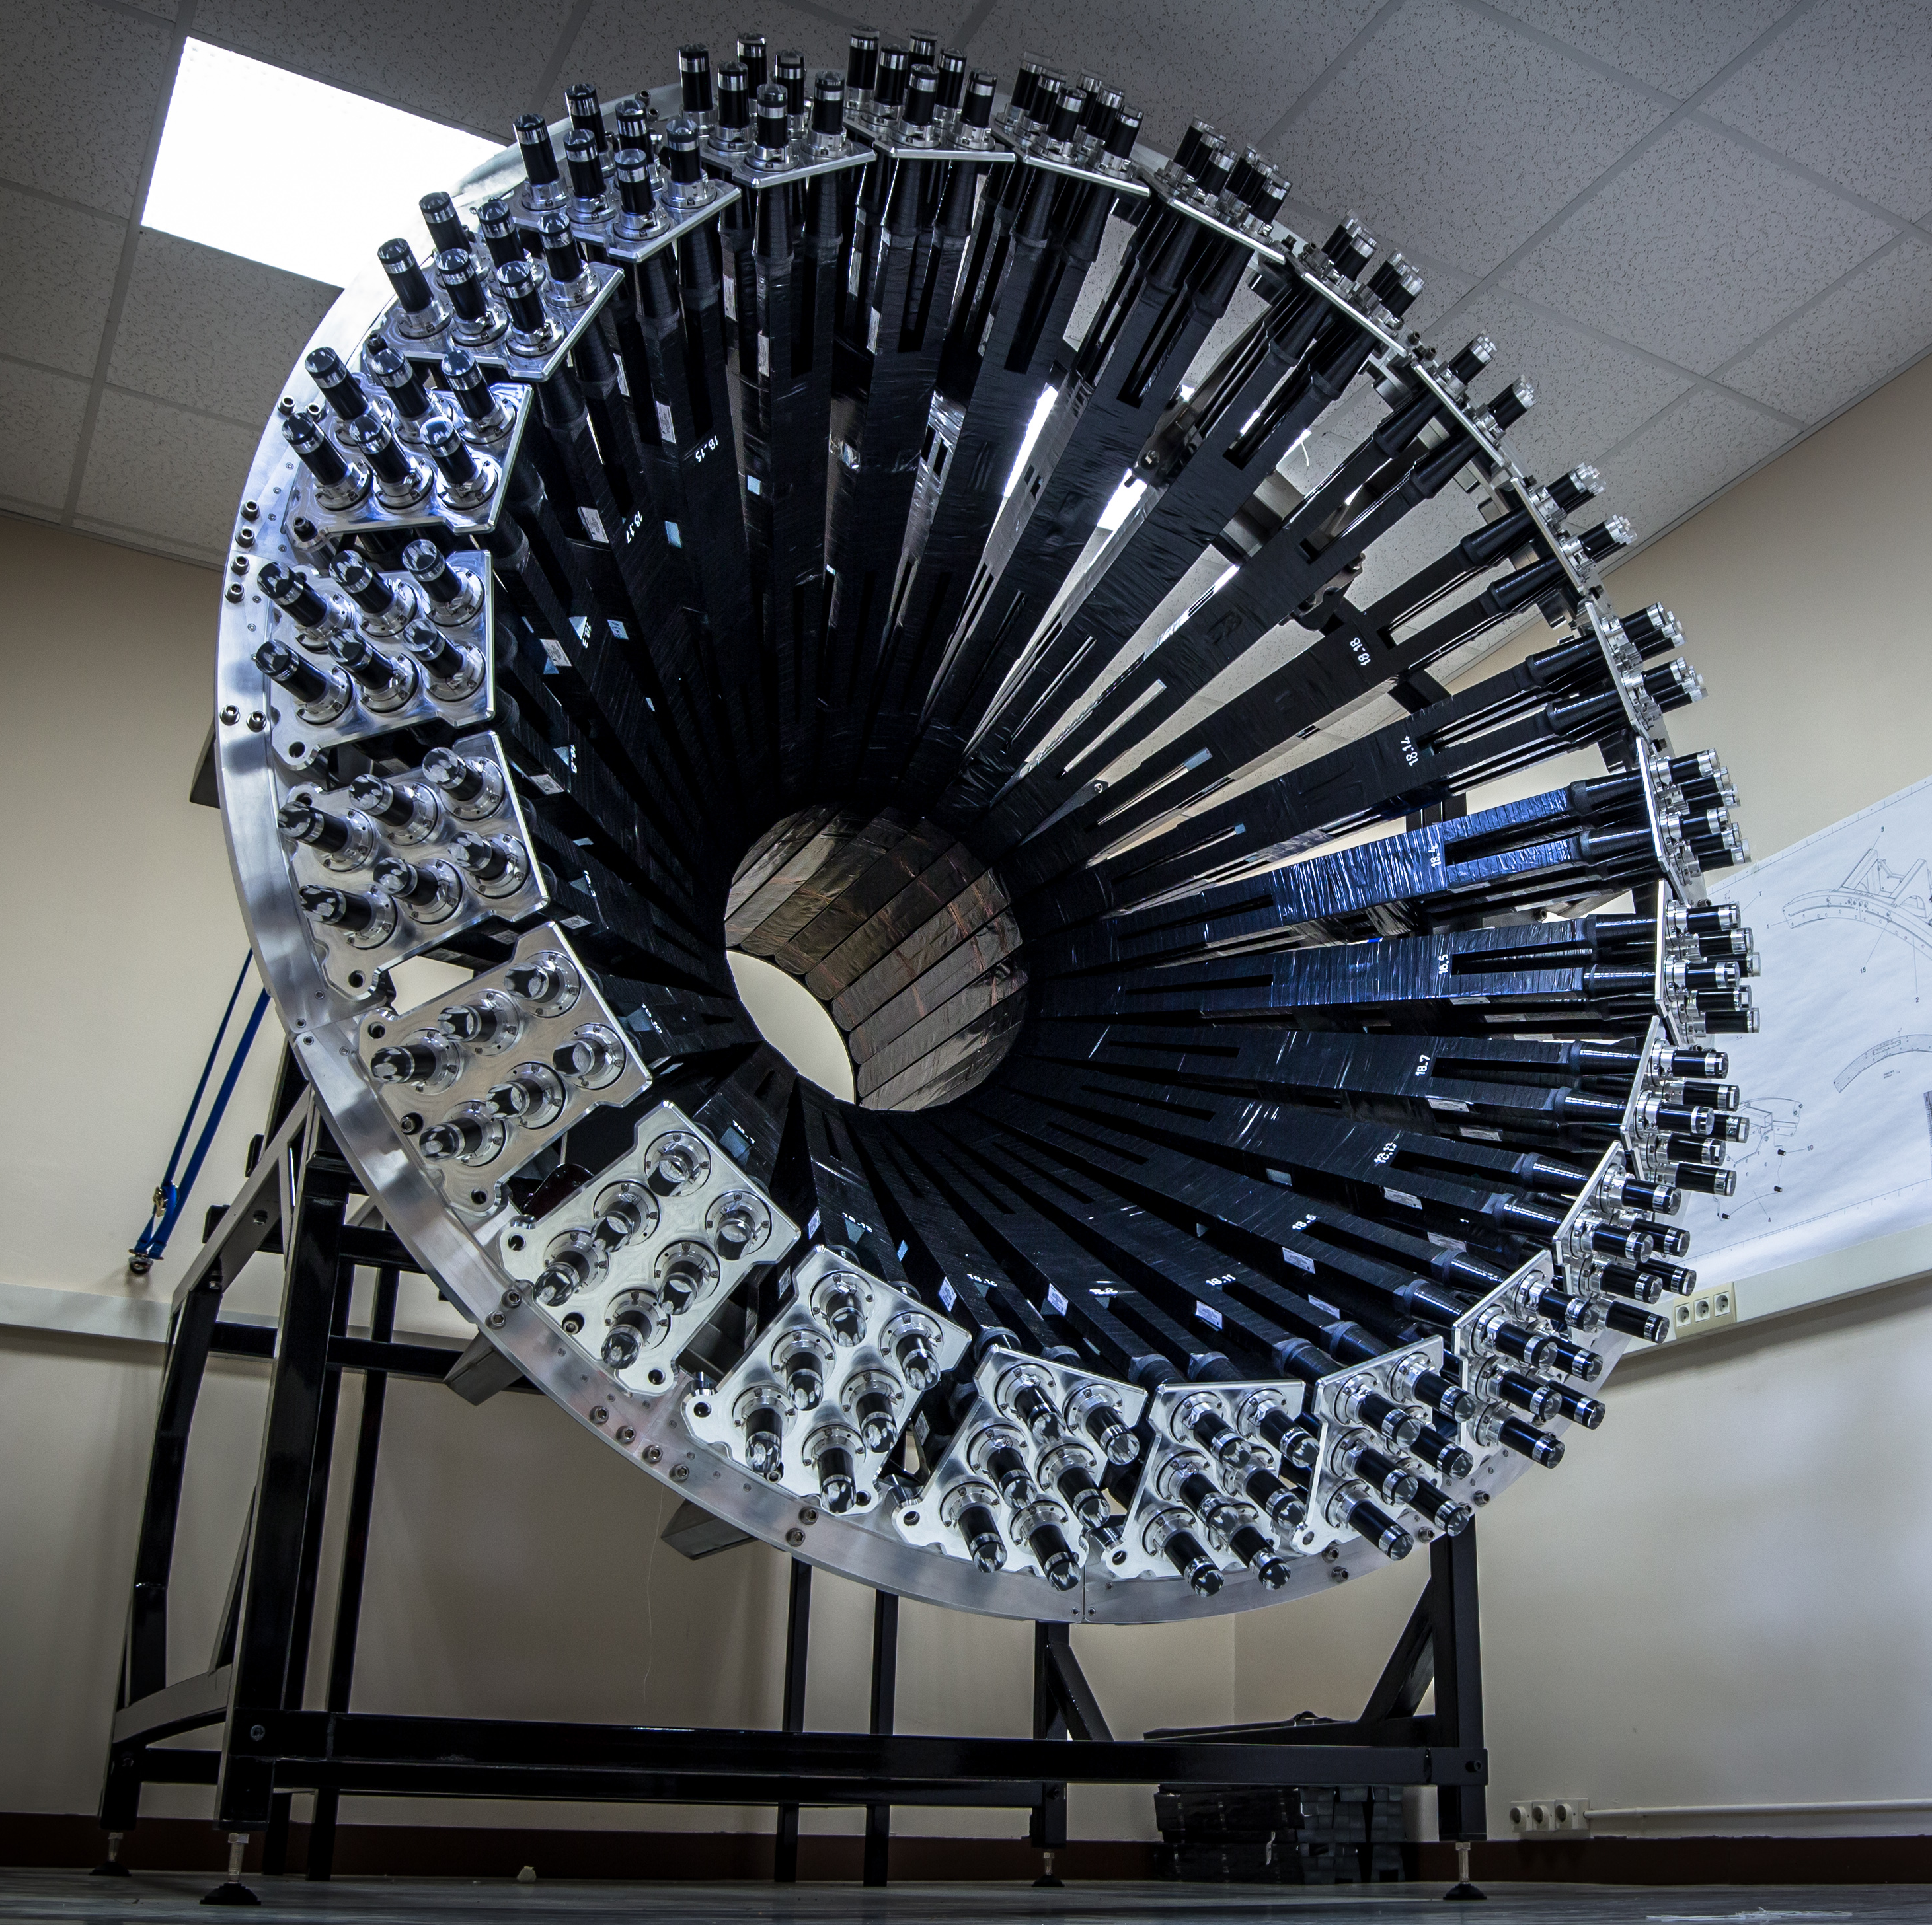
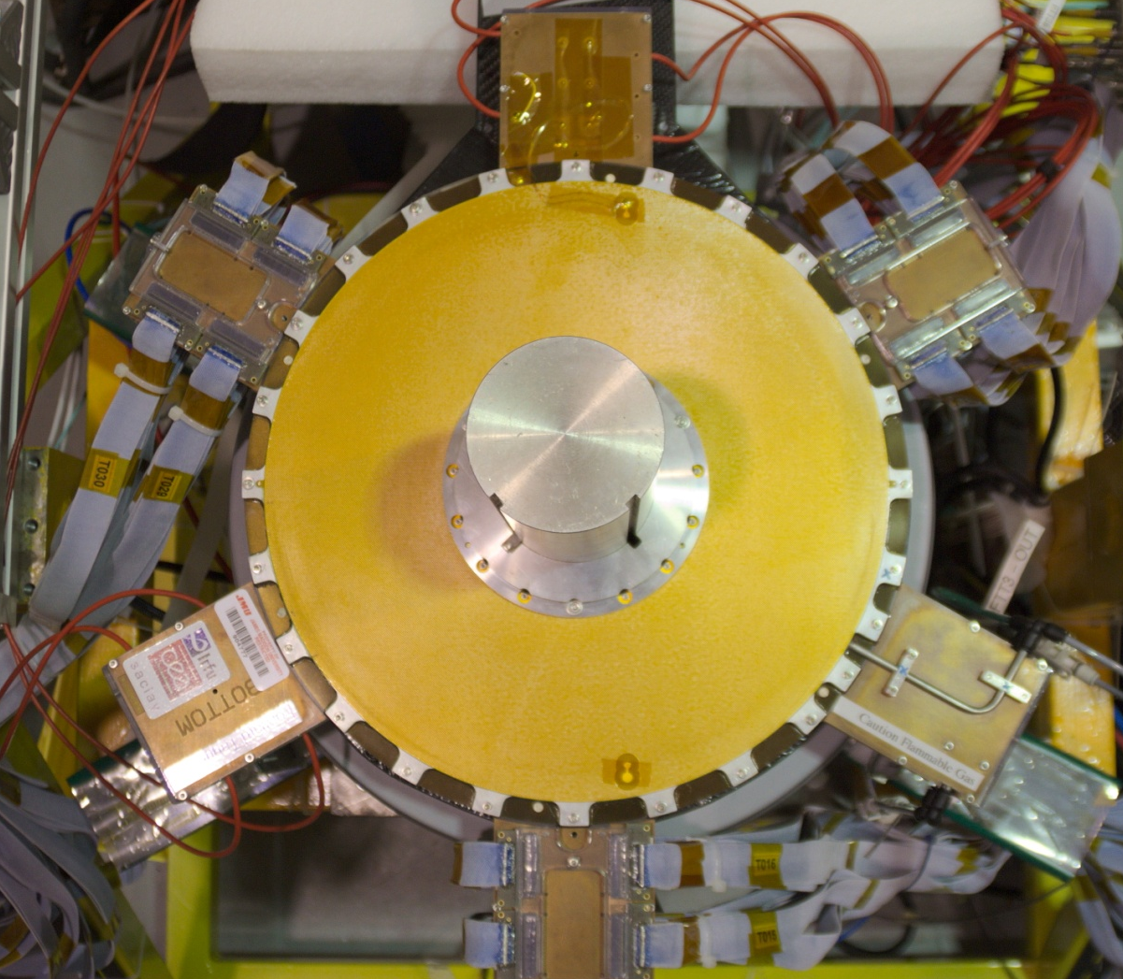
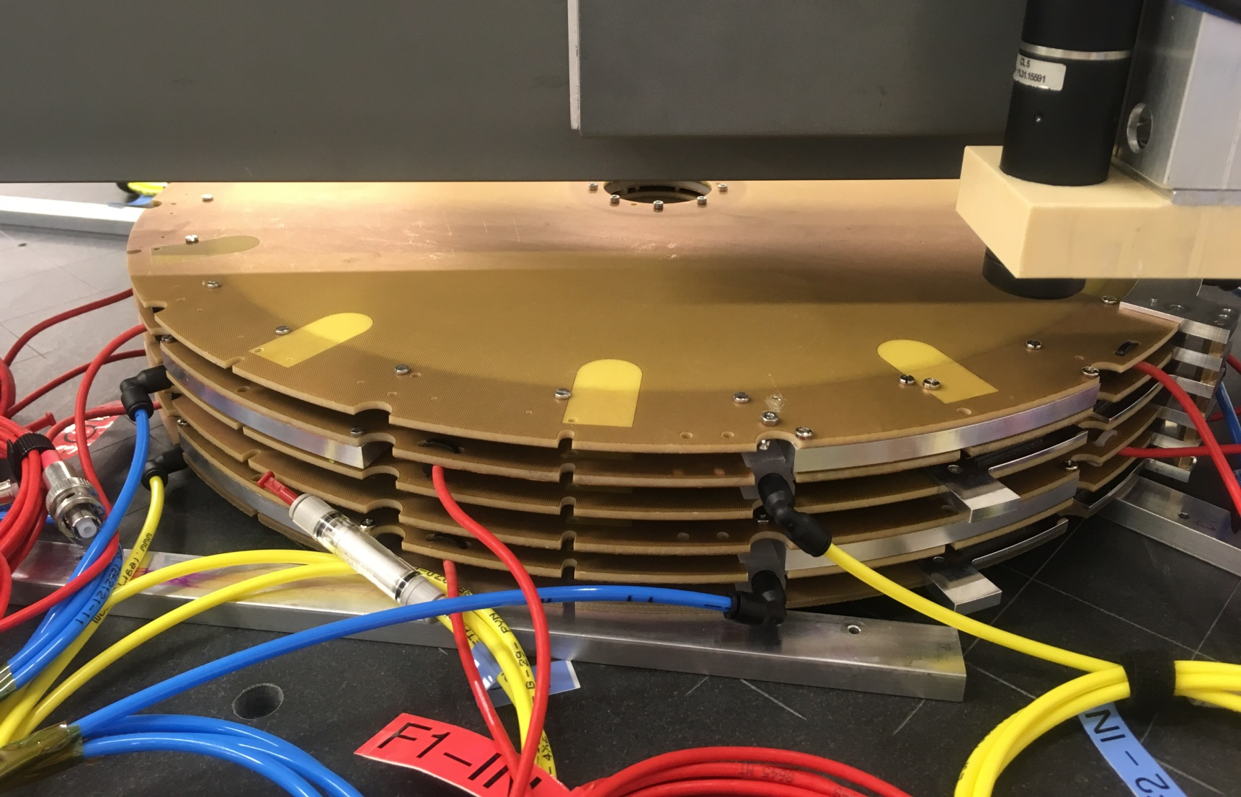
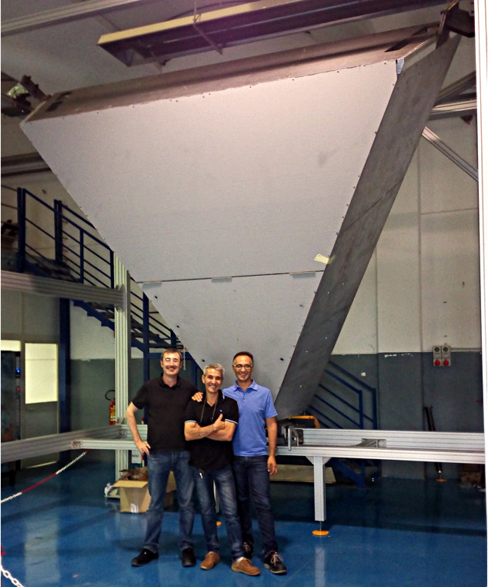
Detector Status
CLAS12
Hall B
All baseline detectors completed
  CLAS12 Forward Detectors installed
  High Threshold Cherenkov Counter (HTCC), Central Detectors & SVT, being installed on beam line
  Pre-ops run to demonstrate DOE key performance parameters (KPP)
  => Complete the detector part of the Hall B 12 GeV project
Ancillary detectors (ERR 6/16)
  Central Neutron Detector (CND) – completed,
  Forward Tagger (FT) – completed
  MicroMegas (BMT, FMT) – FMT completed, BMT 2 (of 6) layers finished, 4 in progress
  RICH (1 sector) - container assembly to start January 2017 at JLab, components (mirrors, aerogel, mapmt, readout electronics) in various stages of completion
CND
FT
FMT
RICH BOX

Slide 12
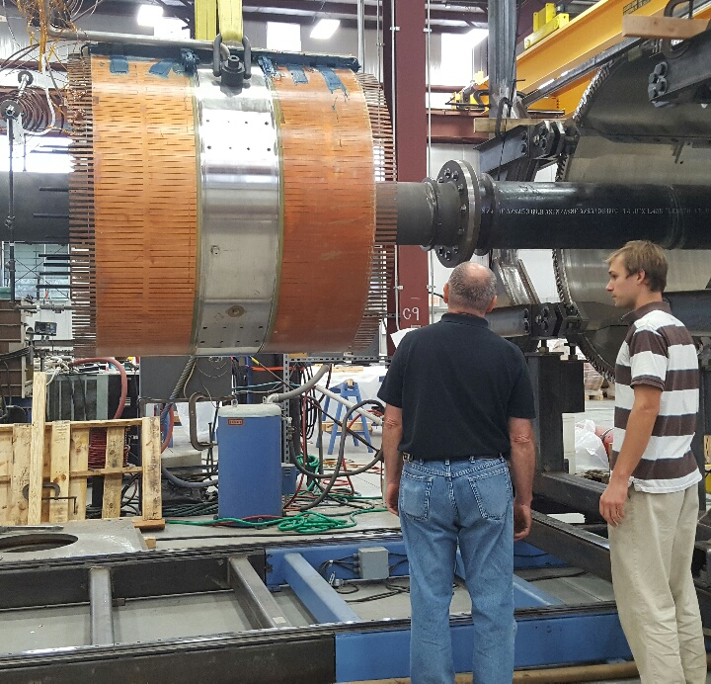
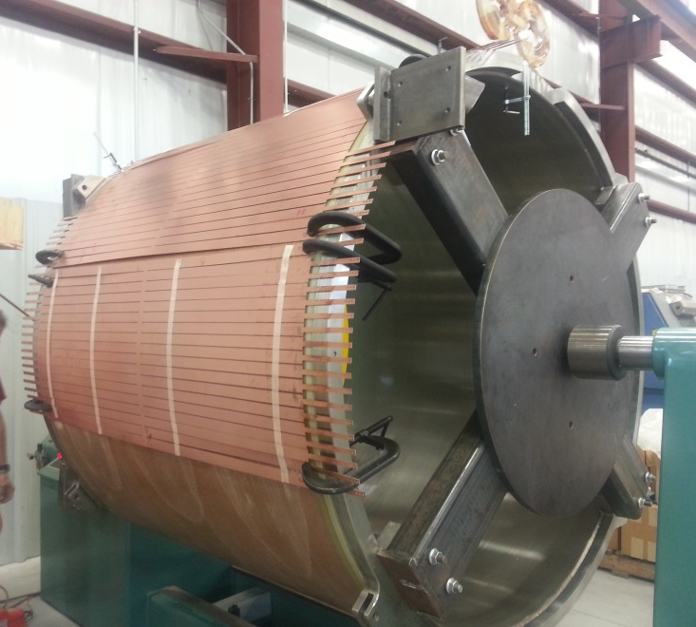
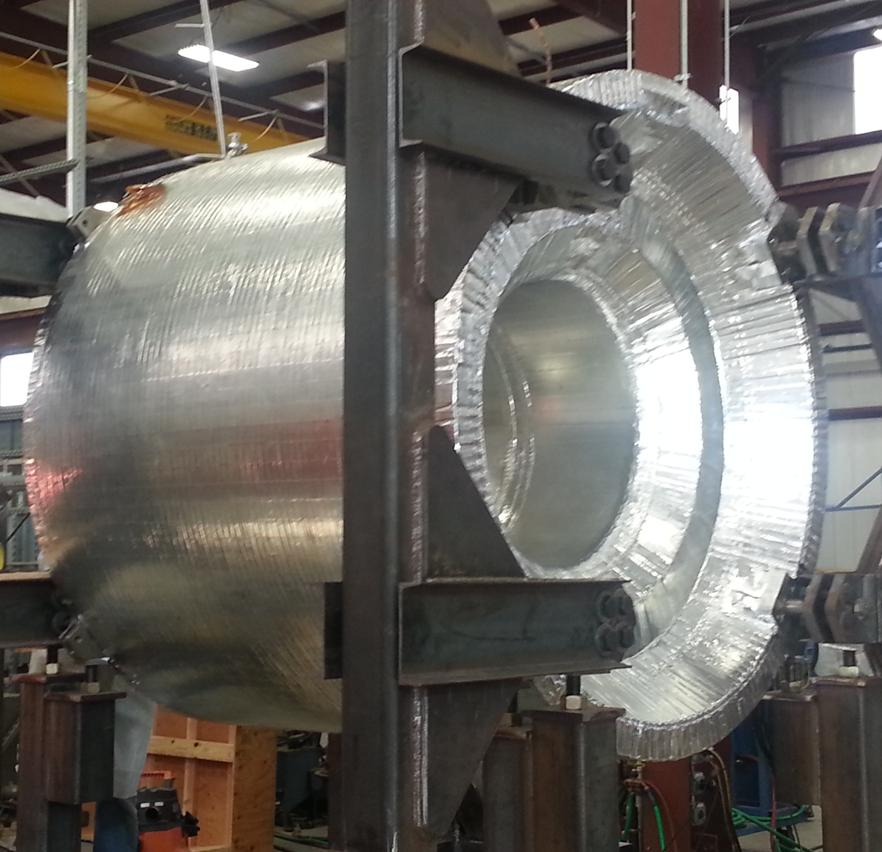
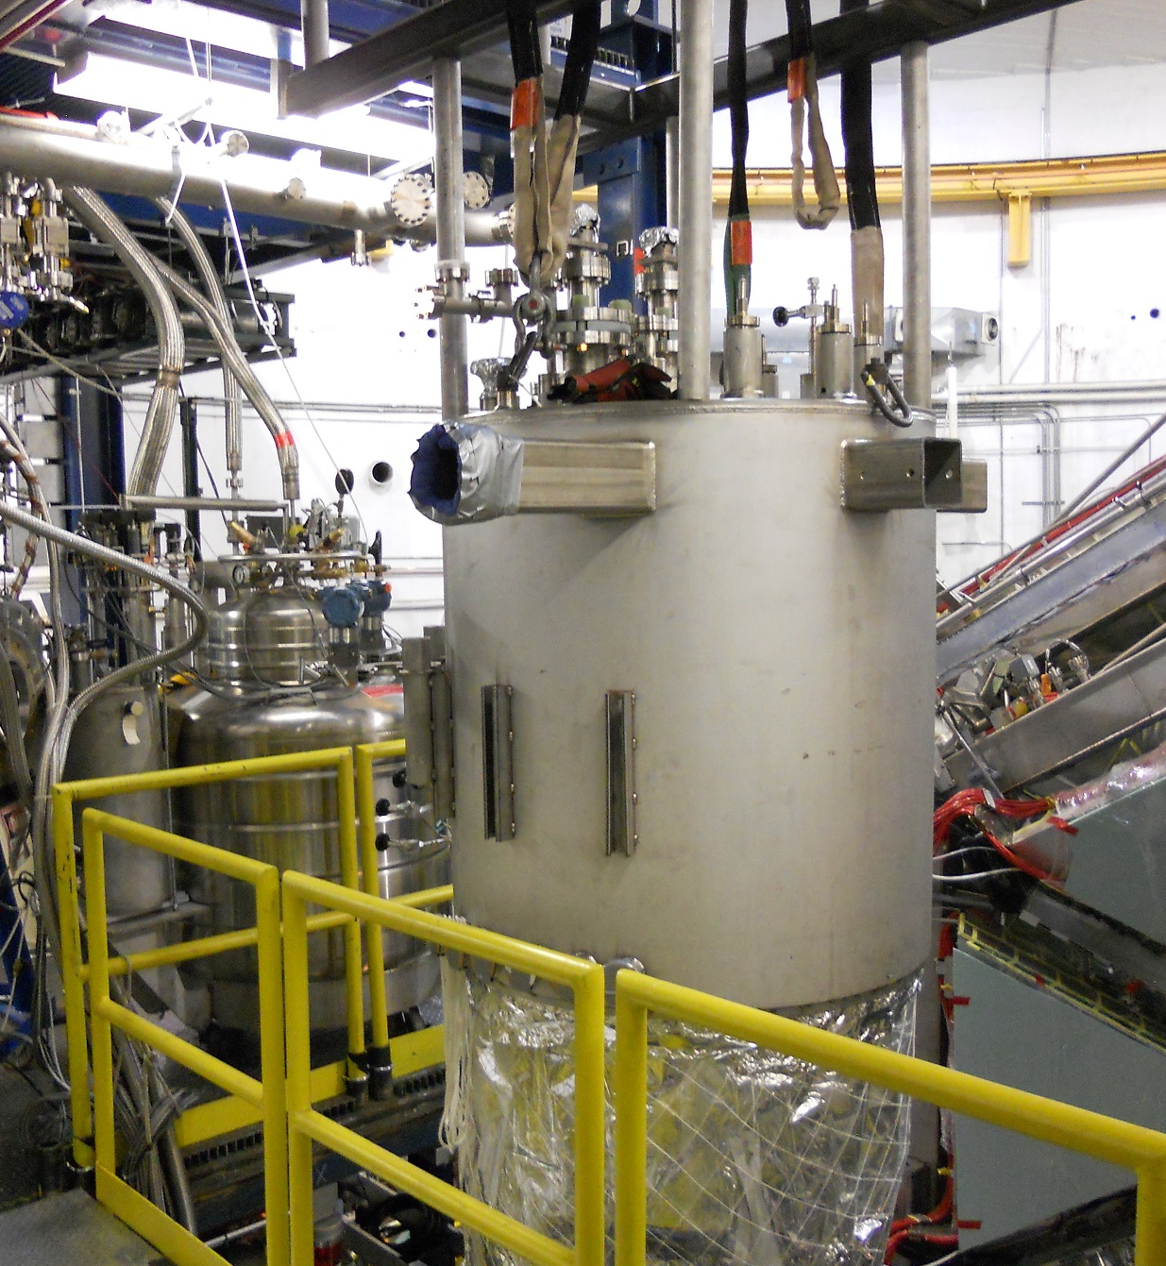
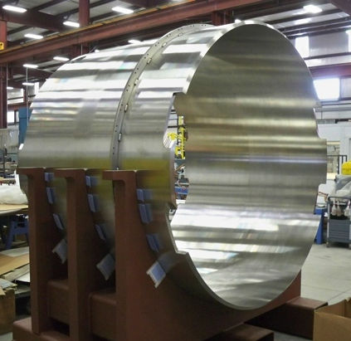
Solenoid Magnet Status
CLAS12
Hall B
Shield coil 5
Coil 1-5 assembly
Coil 1-4
9/29/16
12/01/2016
04/2017: Expected shipping to JLab
4/2017–7/2017: Add service tower, instrumentation and controls
7–8/2017: Cool-down, power tests, field mapping
Solenoid Service Tower
12/01/2016

Slide 13
2017 Timeline
 | 12/16 | 01/17 | 02/17 | 03/17 | 04/17 | 05/17 | 06/17 | 07/17 | 08/17 | 09/17 | 10/17 | 11/17 | 12/17
KPP configuration & demo
KPP
Install
KPP de-
Install
KPP software
Beam line &
KPP Run
CLAS12 Installation & commissioning
Solenoid
CD4B
Offline software
Install CD
CLAS12 Engineering run

Slide 14
Run Groups (RG)
Hall B
Group | Proposal Count | PAC days | RG days | RG days/PAC days
11 RGs | 37 | 2943 | 1036 | 0.35
6 RGs w/ single experiment | 6 | 412 | 412 | 1.0
5 RG w/ multiple experiments | 31 | 2531 | 624 | 0.25
RG A (LH2) | 12 | 939 | 139 | 0.15
RG B (LD2) | 7 | 416 | 80 | 0.19
RG C (NH3/ND3) | 6 | 546 | 185 | 0.34
RG H (HD) C1 | 3 | 330 | 110 | 0.33
RG K (lH2) | 3 | 300 | 100 | 0.33
With 27 weeks per year => 95 PAC days/year => 31 years to run all individual experiments, or 11 years for run groups.
  Provides significant subset of data to all groups early => split full amount of run time
  Operating luminosity - not well known at start - may affect schedule
  Jeopardy – most experiments will have significant fraction of data volume
  High impact experiments - need to get data early => PAC recommendations
  - When can run groups be put on schedule? New equipment requires ERR.

Slide 15
Summary
Hall B continues to produce important physics papers from CLAS
HPS and PRad experiments took low energy data that will lead to publications
CLAS12 Project made big progress with completion of all detector construction and with Torus magnet commissioning.
Ancillary detectors either completed (CND, FT) or in advanced stages (MM, RICH)
Preparation for KPP run in February 2017 to close out DOE 12 GeV detector project.
Solenoid magnet expected to arrive at JLab early April, 2017
Project still on track (at a very tight schedule) for completion by 9/30/2017 w/ CD4B.
Engineering/commissioning run scheduled for the October/November 2017 with full complement of CLAS12 equipment.

Slide 17
Hall B - Run Groups
Proposal | Physics | Contact | Rating | Days | Group | New equipment | Energy | Run Group | Target
E12-06-108 | Hard exclusive electro-production of π⁰, η | Stoler | B | 80 | 139 | RICH (1 sector) Forward tagger | 11 | A F. Sabatié | liquid H₂
E12-06-108A | Exclusive N*->KY Studies with CLAS12 | Carman |  | (60)
E12-06-108B | Transition Form Factor of the η’ Meson with CLAS12 | Kunkel |  | (80)
E12-06-112 | Proton’s quark dynamics in SIDIS pion production | Avakian | A | 60
E12-06-112A | Semi-inclusive Λ productiuon in target fragmentation region | Mirazita |  | (60)
E12-06-112B | Colinear nucleon structure at twist-3 | Pisano |  | (60)
E12-06-119(a) | Deeply Virtual Compton Scattering | Sabatie | A | 80
E12-09-003 | Excitation of nucleon resonances at high Q² | Gothe | B+ | 40
E12-11-005 | Hadron spectroscopy with forward tagger | Battaglieri | A- | 119
E12-11-005A | Photoproduction of the very strangest baryon | Guo |  | (120)
E12-12-001 | Timelike Compton Scatt. & J/ψ production in e+e- | Nadel-Turonski | A- | 120
E12-12-007 | Exclusive φ meson electroproduction with CLAS12 | Stoler, Weiss | B+ | 60
E12-07-104 | Neutron magnetic form factor | Gilfoyle | A- | 30 | 90 | Neutron detector RICH (1 sector) Forward tagger | 11 | B K. Hafidi | liquid D₂ target
E12-09-007(a) | Study of partonic distributions in SIDIS kaon production | Hafidi | A- | 30
E12-09-008 | Boer-Mulders asymmetry in K SIDIS w/ H and D targets | Contalbrigo | A- | 56
E12-09-008A | Hadron production in target fragmentation region | Mirazita |  | (60)
E12-09-008B | Colinear nucleon structuer at twist-3 | Pisano |  | (60)
E12-11-003 | DVCS on neutron target | Niccolai | A | 90
E12-11-003A | In medium structure functions, SRC, and the EMC effect | Hen |  | (90)
Beam time partial sum |  |  |  | 765 (1355) | 229
Experiment ending with A or B are run group experiments approved by the35LAS collaboration. They are running parallel to the experiments with same experiment number. Experiments ending with (a) and (b) take data with both run groups.

Slide 18
Hall B - Run Groups
E12-06-109 | Longitudinal Spin Structure of the Nucleon | Kuhn | A | 80 | 185 | Polarized target RICH (1 sector) Forward tagger | 11 | C S. Kuhn | NH₃ ND₃
E12-06-109A | DVCS on the neutron with polarized deuterium target | Niccolai |  | (60)
E12-06- 119(b) | DVCS on longitudinally polarized proton target | Sabatie | A | 120
E12-07-107 | Spin-Orbit Correl. with Longitudinally polarized target | Avakian | A- | 103
E12-09-007(b) | Study of partonic distributions using SIDIS K production | Hafidi | A- | 80
E12-09-009 | Spin-Orbit correlations in K production w/ pol. targets | Avakian | B+ | 103
E12-06-106 | Color transparency in exclusive vector meson production | Hafidi | B+ | 60 | 60 |  | 11 | D
E12-06-117 | Quark propagation and hadron formation | Brooks | A- | 60 | 60 |  | 11 | E | Nuclear
E12-06-113 | Free Neutron structure at large x | Bueltman | A | 42 | 42 | Radial TPC | 11 | F | Gas D₂
E12-14-001 | EMC effect in spin structure functions | Brooks | B+ | 55 | 55 | Pol. LiH target | 11 | G | _{LiH}
TOTAL CLAS12 run time (approved experiments) |  |  |  | 1468 (2118) | 631
Proposal | Physics | Contact | Rating | Days | Group | Equipment | Energy | Group | Target
C12-11-111 | SIDIS on transverse polarized target | Contalbrigo | A | 110 | 110 | Transverse target | 11 | H | HD
C12-12-009 | Transversity w/ di-hadron on transvere target | Avakian | A | 110
C12-12-010 | DVCS with transverse polarized target in CLAS12 | Elouadrhriri | A | 110
All CLAS12 transverse target proposals |  |  |  | 330 | 110
C12-11-006 | Heavy Photon Search at Jefferson Lab (HPS) | Jaros | A | 180 | 180 | Setup in alcove | 2.2, 6.6 | I | Nuclear
E12-11-106 | High Precision Measurement of the Proton Charge Radius | Gasparian | A | 15 | 15 | Primex | 1.1, 2.2 | J | H2 gas
Beam time request from CLAS12 C1 experiments + non-CLAS12 experiments |  |  |  | 525 | 305
Beam time from approved CLAS12 experiments (from previous table) |  |  |  | 1468 (2118) | 631
Beam time for Hall B experiments table 1 + table 2 (incl. 110 days of C1 approved exp.) |  |  |  | 1993 (2643) | 936

Slide 19
Hall B - Run Groups
Proposal | Physics | Contact | Rating | Days | Group | Equipment | Energy | Group | Target
E12-16-010 | A search for Hybrid Baryons in Hall B with CLAS12 | D’Angelo | A- | (100) | 100 | Forward Tagger | 6.6, 8.8 | K Confinement & Strong QCD | lH2
E12-16-010A | Nucleon Resonances in exc. KY electroproduction | Carman | A- | (100)
E12-16-010B | DVCS with CLAS12 at 6.6 and 8.8 GeV | Elouadrhiri | A- | (100)
Total Beam time of Run Group K |  |  |  | 100 (300) | 100
Beam time of approved & C1 approved CLAS12 experiments from table 1 + table 2 |  |  |  | 1993 (2643) | 936
Beam time for Hall B experiments table 1 + table 2 + table 3 |  |  |  | 2093 (2943) | 1036

Slide 20

Possible RG Schedule (straw man)
Run Group | Days | 2016 | 2017 | 2018 | 2019 | 2020 | 2021 | 2022 | Remain
All Run Groups | 1036^{#)} | 30 | 15 | 95 | 130 | 130 | 125 | 125 | 386
HPS | 180* | 15 |  | 35 | 35 | 35 | 30 | 30 | 0
PRad | 15* | 15 |  |  |  |  |  |  | 0
CLAS12 KPP |  |  | 3
RG-A + RG-K (proton) | 239* |  | 15/10 | 20/15 25 |  | 35 | 20 |  | 114*
RG-B (deuteron) | 90* |  |  |  | 40 |  |  |  | 50*
RG-F (BoNuS) | 42* |  |  |  | 20 |  |  |  | 22
RG-C (NH₃) | 120 |  |  |  | 35 | 25 |  |  | 60
RG-C-b (ND₃) | 65 |  |  |  |  | 35 |  |  | 30
RG-E (Hadr.) | 60 |  |  |  |  |  | 35 |  | 25
RG-H (Transv. Target) | 110* |  |  |  |  |  | 40 | 20 | 50
RG-D (CT) | 60 |  |  |  |  |  |  | 40 | 20
RG-G (LiD) | 55 |  |  |  |  |  |  | 35 | 20
^{#)} incl. RG-H

