Slide 1
12 GeV Upgrade Project Status
Glenn R. Young
Hall B CAM for 12 GeV Project
UGBOD Meeting
Jefferson Lab
January 10, 2017

Slide 2
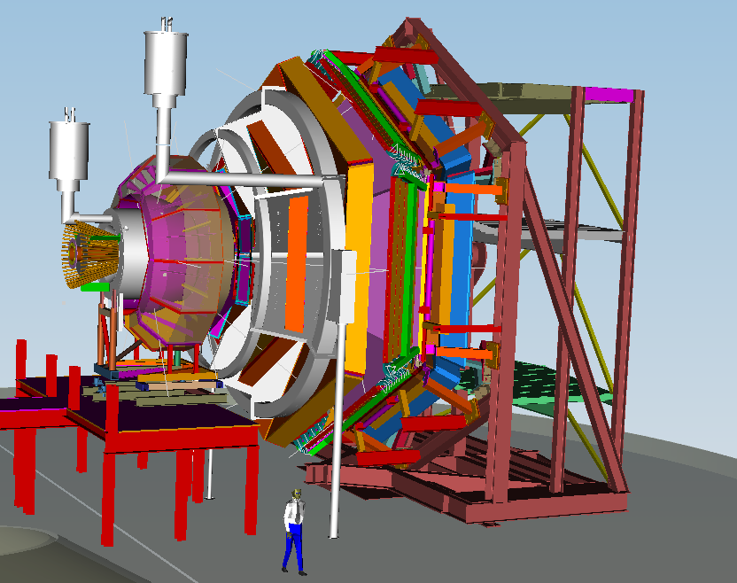
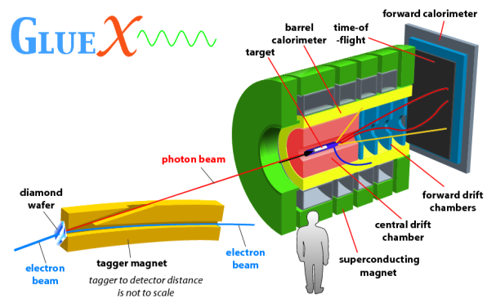
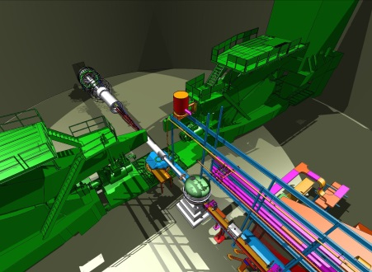
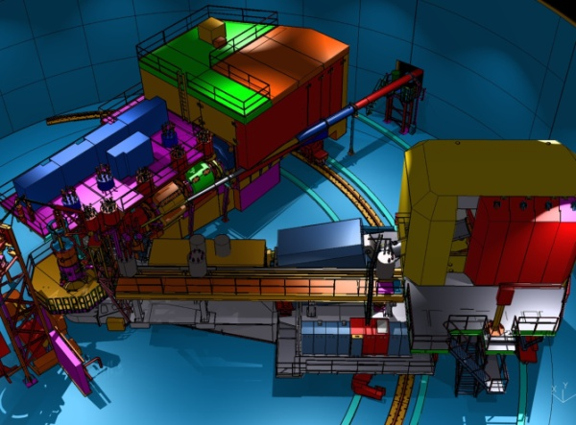
Physics Driving the 12 GeV Upgrade
Explore the physical origins of quark confinement (GlueX) New and revolutionary access to the spin and flavor structure of the proton and neutron Discovering the quark structure of nuclei Probe potential new physics through high precision tests of the Standard Model
Hall B – understanding nucleon structure via generalized parton distributions
Hall D – exploring origin of confinement by studying exotic mesons
Hall A –
form factors, future new experiments (e.g., SoLID and MOLLER)
Hall C – precision determination of valence quark properties in nucleons /nuclei

Slide 3
Detector Technical Requirements
Hall D | Hall B | Hall C | Hall A
excellent hermeticity | luminosity 10 x 10³⁴ | energy reach | installation space
polarized photons | hermeticity | precision
E_{γ}~8.5-9 GeV | 11 GeV beamline
10⁸ photons/s | target flexibility
good momentum/angle resolution |  | excellent momentum resolution
high multiplicity reconstruction |  | luminosity up to 10³⁸
particle ID

Slide 4
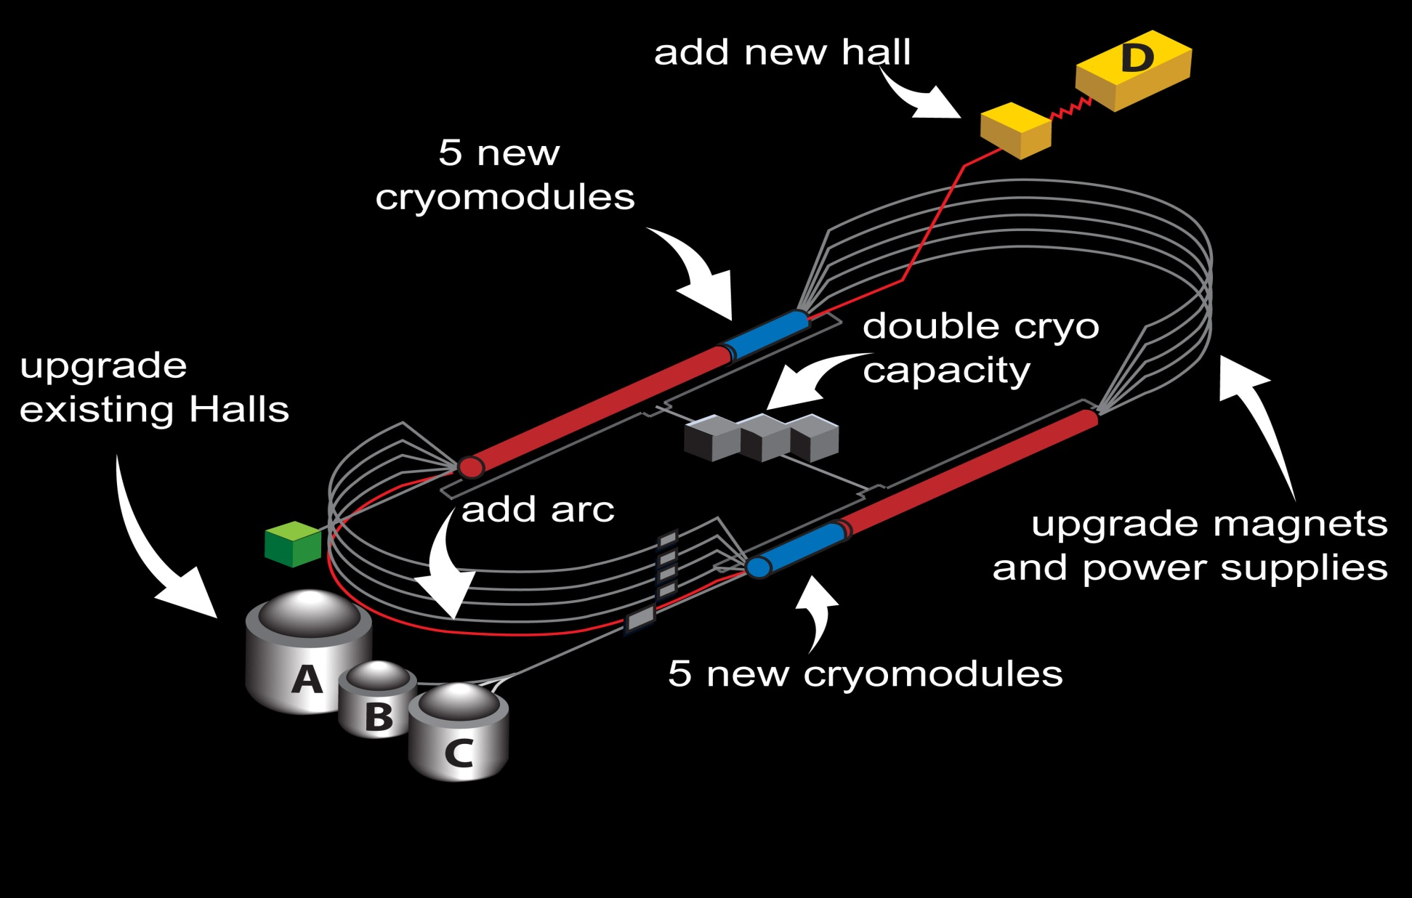
12 GeV Upgrade Project
Project Scope (~99% complete):
Doubling the accelerator beam energy – DONE
Civil construction including utilities - DONE
Beam line upgrade Hall A - DONE
New experimental Hall D - DONE
Upgrades to Experimental Halls B & C ~98%
  Halls B & C Detectors – DONE
Total Project Cost = $338M
Estimate To Complete = ~$4M

Slide 5
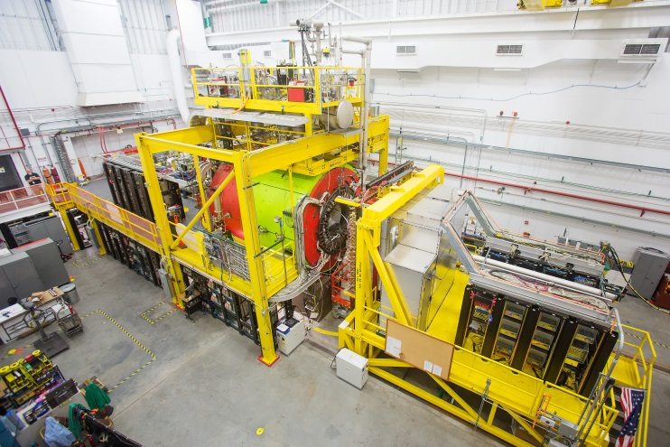
Hall D: GlueX Commissioning
New experiment to study quark confinement
Commissioning complete
Detector functioning well
Production data-taking started
  Poised to discover exotic hybrid mesons
Mini-Symposia at DNP (Oct 2016)

Slide 6

Hall B Equipment: CLAS12
Forward Detector (FD)
  - TORUS magnet
  HT Cherenkov Counter
  Drift chamber system
  LT Cherenkov Counter
  Forward ToF System
  Pre-shower calorimeter
  E.M. calorimeter
Central Detector (CD)
  SOLENOID magnet
  Silicon Vertex Tracker
  Central Time-of-Flight
Beamline
  Cryo Target
  Moller polarimeter
  - Shielding
  Photon Tagger
MM
CND
FT
Upgrade to the baseline
- Neutron Detector (CND)
  MicroMegas (MM)
  Forward Tagger (FT)
  RICH detector
  Polarized target (long.)
RICH
Channel Count: 61,826 (Baseline)

Slide 7
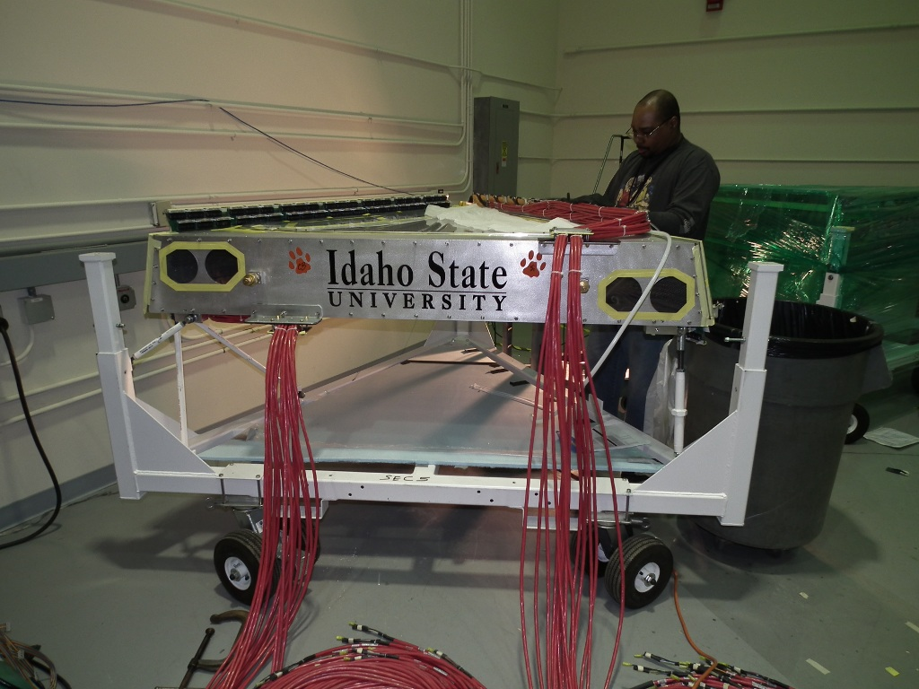
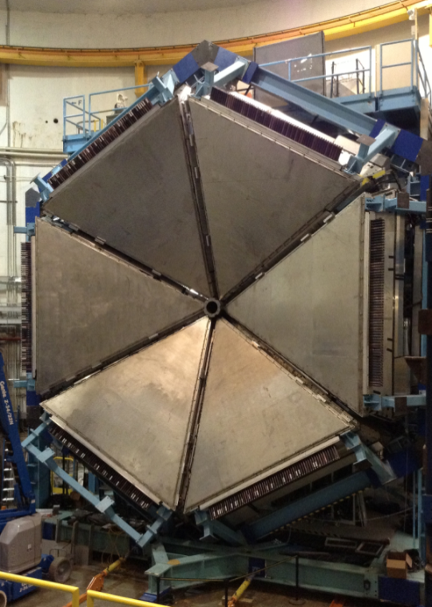
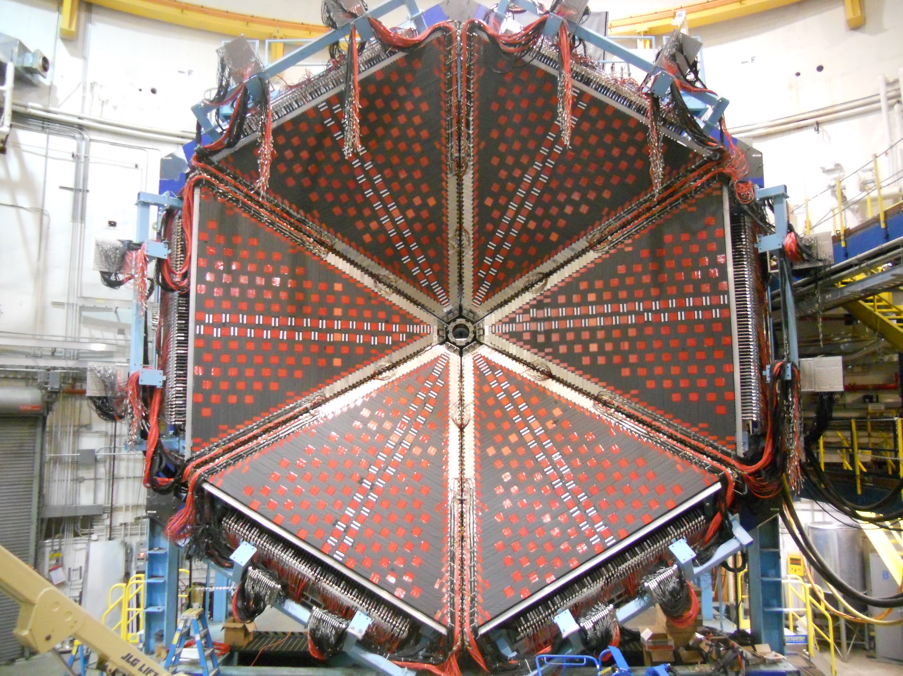
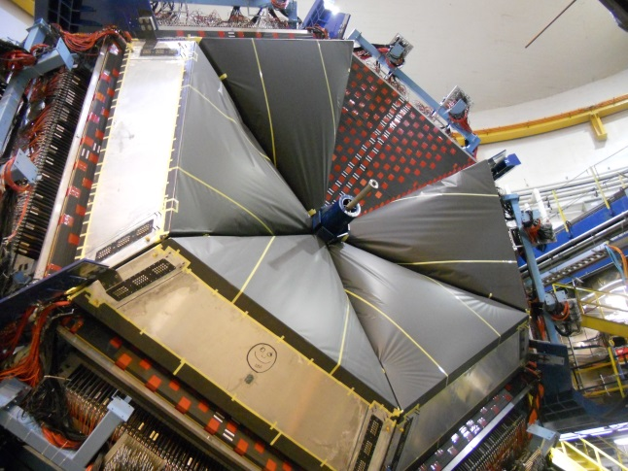
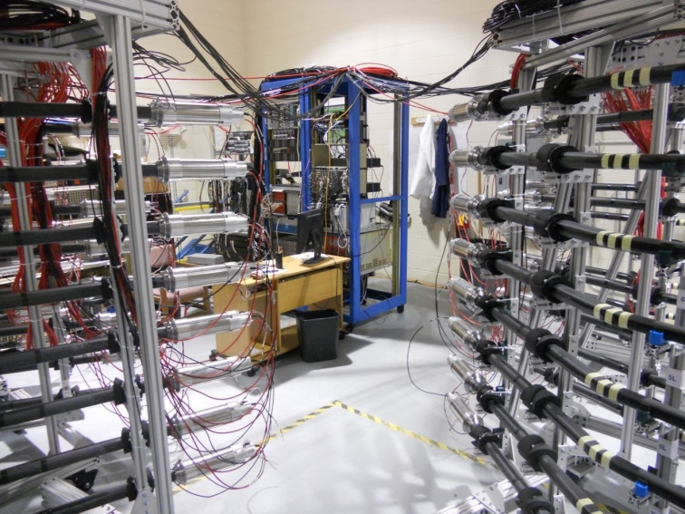
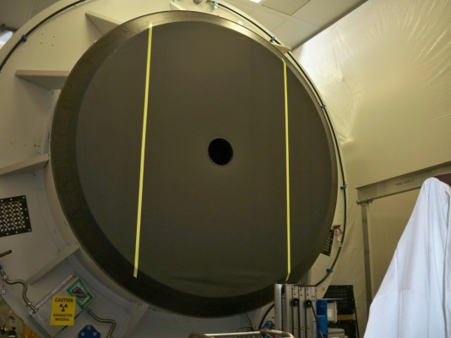
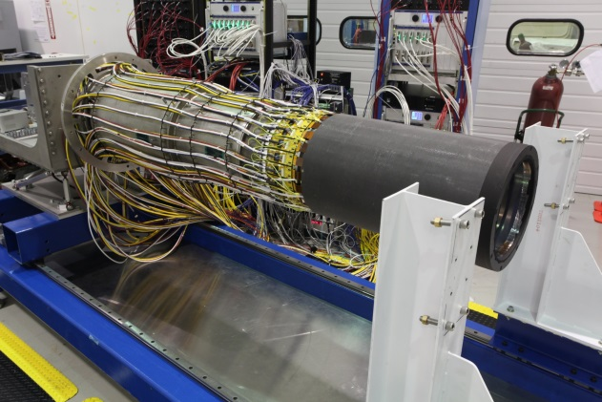
Hall B – CLAS12 Detectors Complete
Complete
Complete
Drift Chambers
Complete
Complete
FTOF 1-a, 1-b Installed
Complete
PCAL Installed
LTCC – 5th Box Being Installed
Complete
Complete
CTOF Counters Under Test
HTCC
SVT All 4 Regions

Slide 8
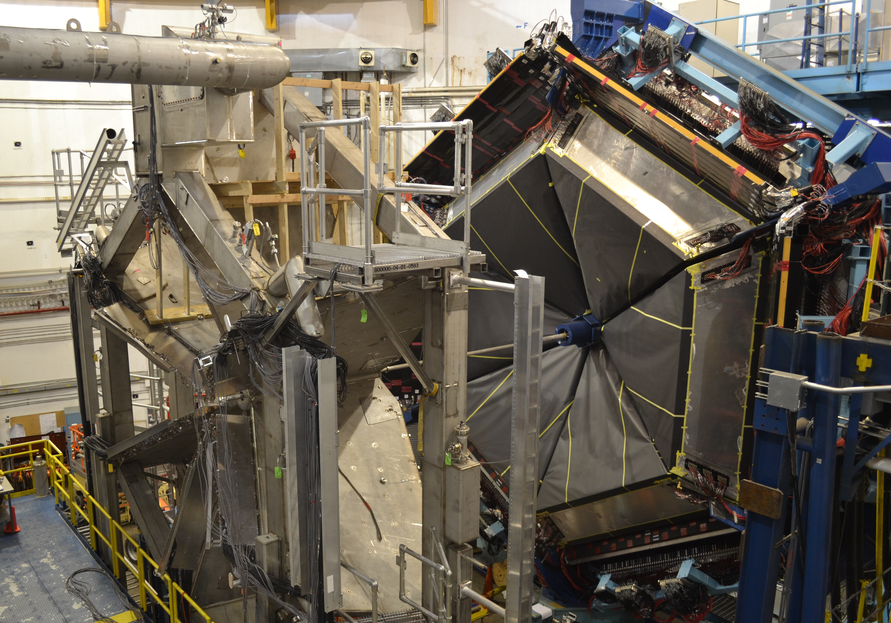
Hall B – CLAS12 Torus Magnet Complete
Successful power tests to full current of 3770A
PCAL
Torus Magnet
FTOF
e⁻ →
LTCC
Torus to full current November 4, mapping completed November 9

Slide 9
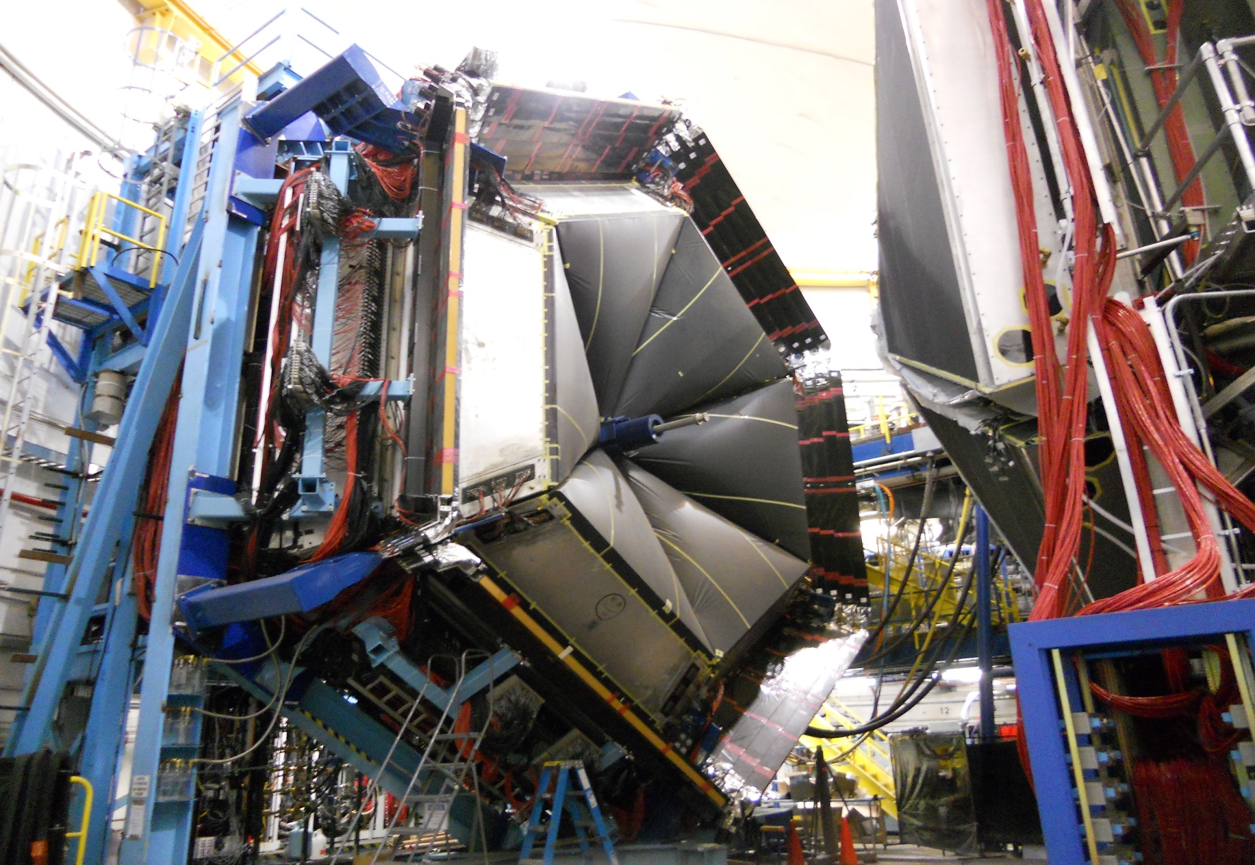
Hall B – CLAS12 Forward Spectrometer
Forward Carriage is Fully Installed
Detector Construction is 100% Complete

Slide 10
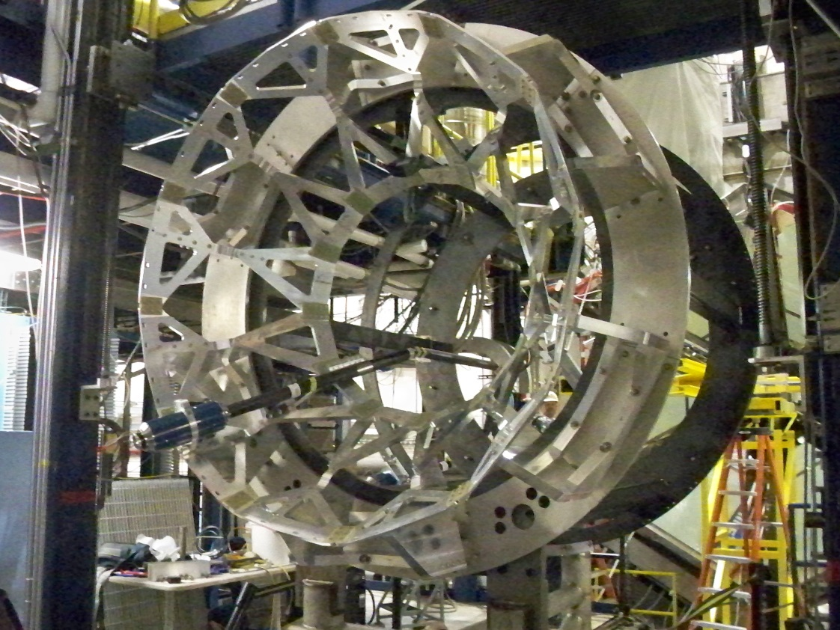
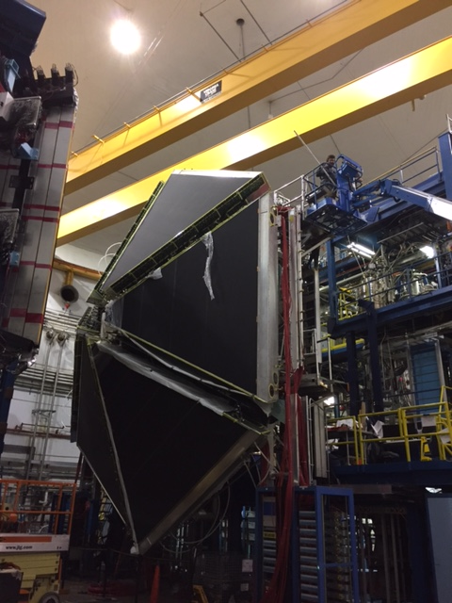
Hall B - CLAS12 Installation Status
Drift Chambers are all Installed
CTOF on Temporary Support

Slide 11
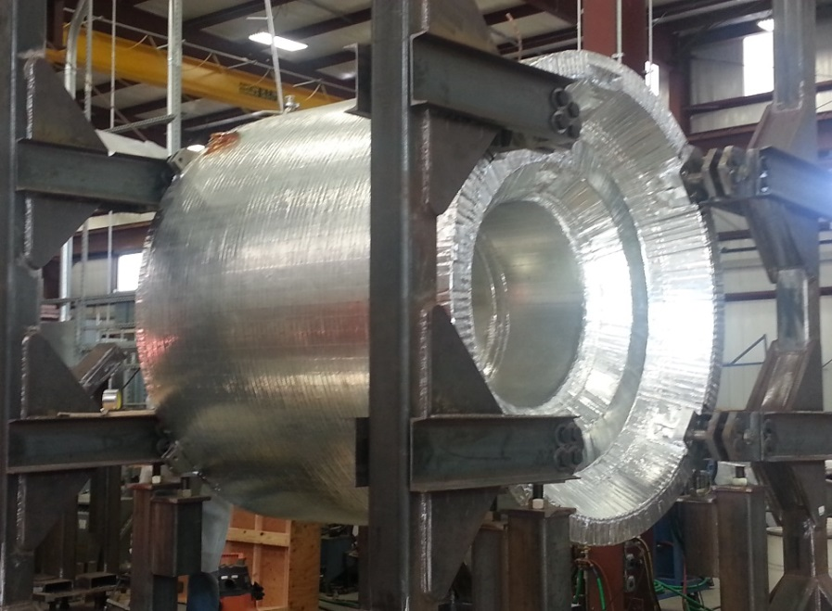
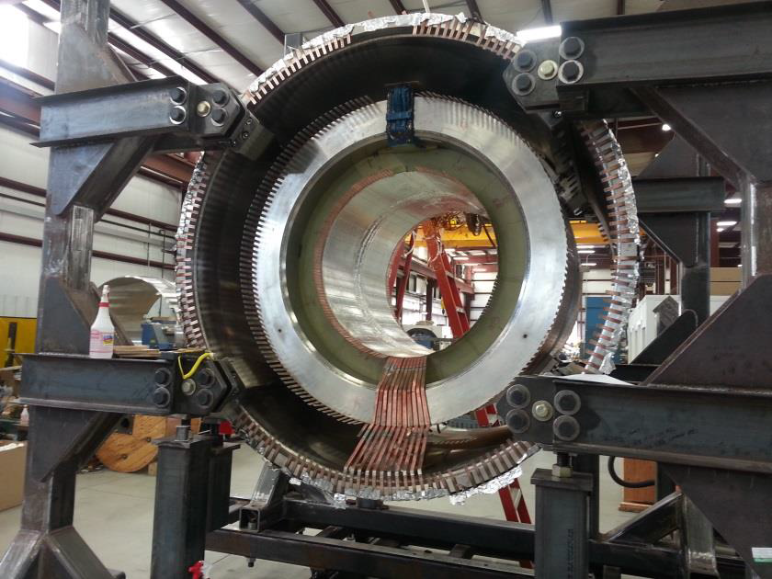
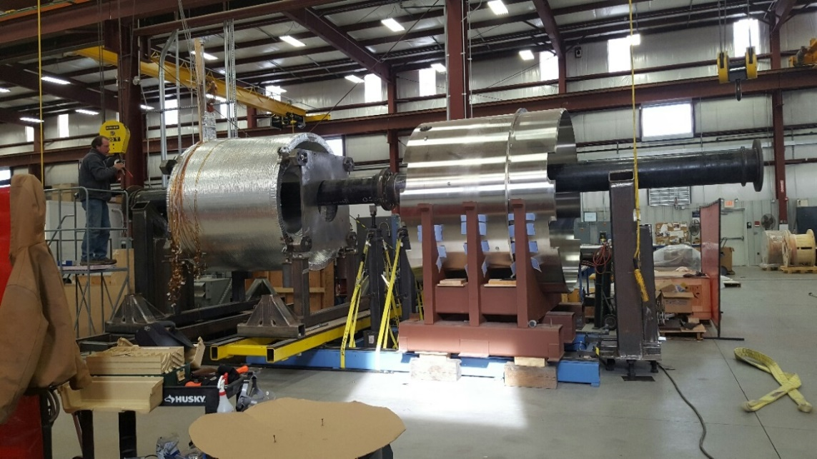
Hall B - CLAS12 Solenoid @ Vendor (ETI)
Integration confirmed by survey Nov 1st
Aluminum Reflective Tape Dec 20
Coils 1 thru 4
Coil 5
Progress January 9 2017

Slide 12
Hall B - CLAS12 Current Installation Plan
The Forward Spectrometer is nearly complete
  High Threshold Cerenkov Counter remains to be installed, late January
The Central Detectors are being installed
  CTOF is going in now
  SVT goes in immediately afterwards, same week as HTCC
  Beamline, temporary target follow
Beam run to demonstrate Key Performance Parameters follows
  Early February is planned
This accommodates the arrival of the Solenoid, now expected late March
The CTOF, HTCC and SVT will have to be removed temporarily to accommodate installing the solenoid and connecting it to cryogenics and I&C services as well as its main power supply
Expect to complete Solenoid, including cool-down and power tests, by August 2017

Slide 13
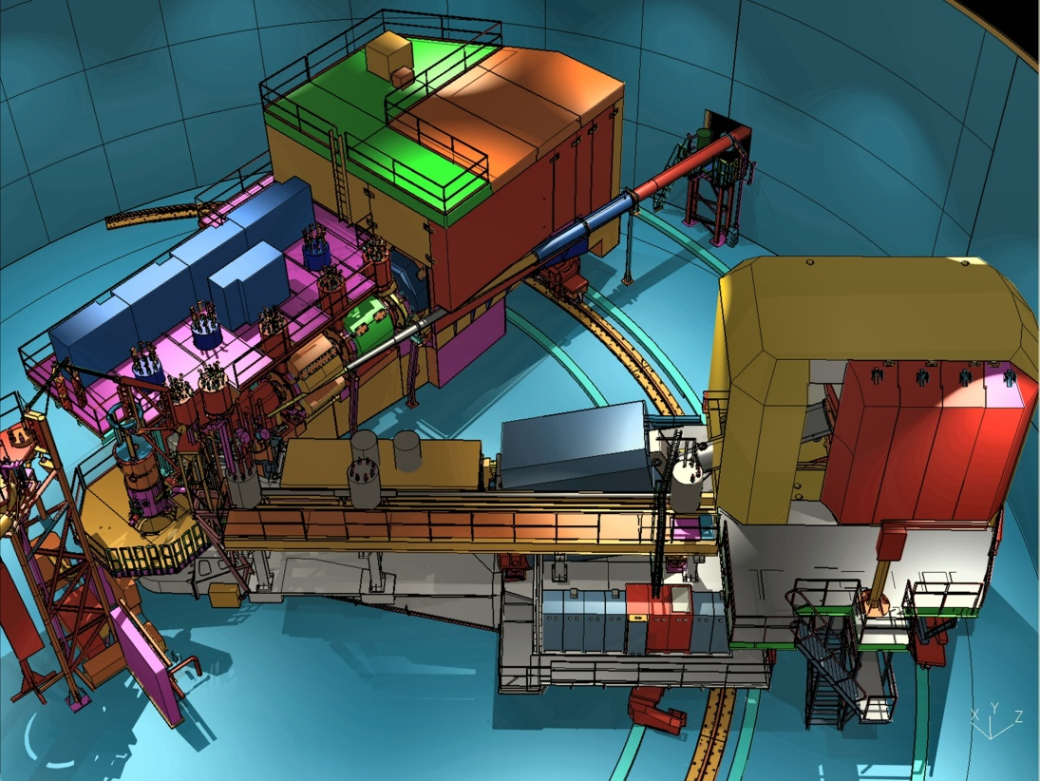
Hall C Equipment
SHMS (New)
HMS (Exists)
SHMS – Super High Momentum Spectrometer ; HMS – High Momentum Spectrometer

Slide 14




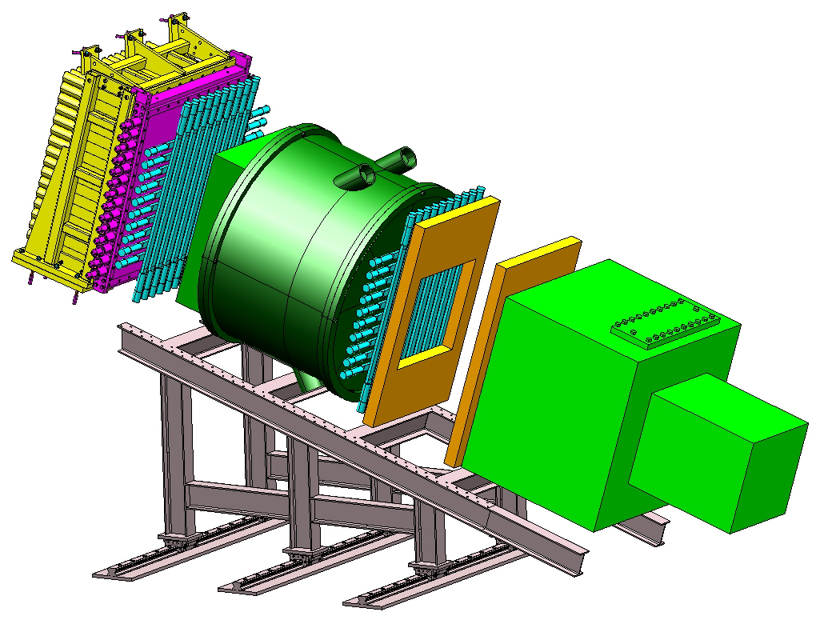




Hall C - SHMS Detectors
Noble Gas Cerenkov
Drift Chambers
Trigger Hodoscopes
  3 Planes Scintillator
  1 Plane Quartz
Heavy Gas Cerenkov*
Calorimeter
Detector Frames
Aerogel
C₄F₈O Heavy Gas Cerenkov *
Drift Chambers
Ar/Ne Noble-Gas Cerenkov
Shower Counter
PreShower Counter
S2 Hodoscope
(Funding Color Codes):
12 GeV Project Funded
NSF MRI Funding
Gift from NIKHEF and NSL
Aerogel Cerenkov
S1 Hodoscope
Main Detector Support Structures

Slide 15
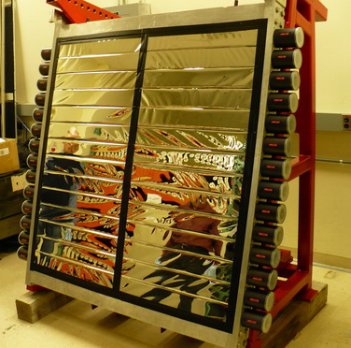
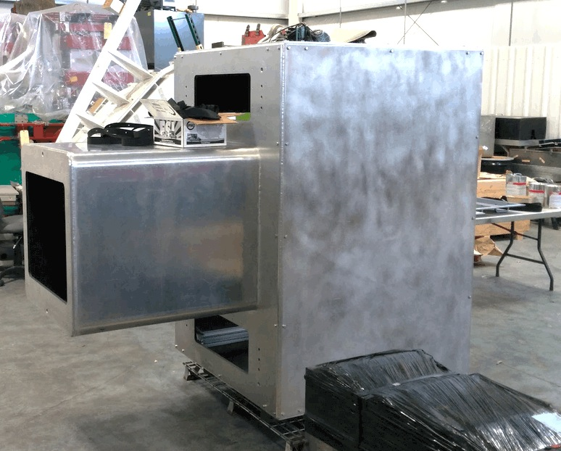
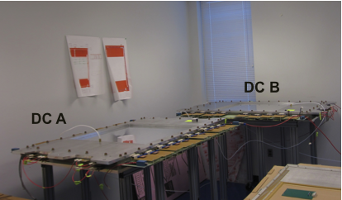
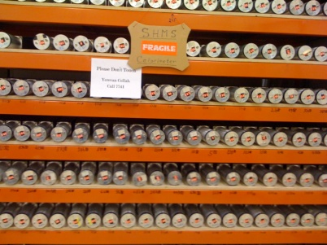
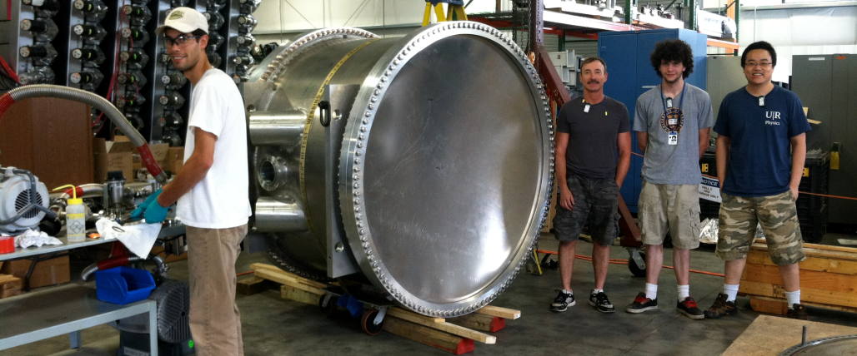
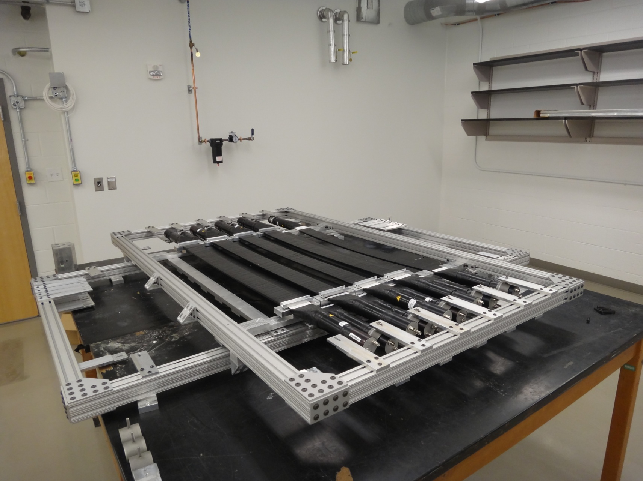
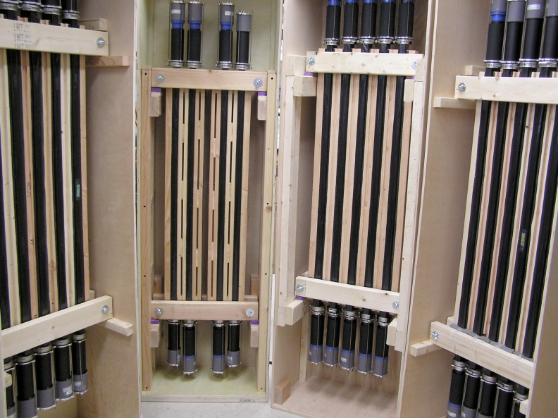
Hall C - Detectors COMPLETE
NGC
(U. of Va)
PreShower Counters
Drift Chambers
(Hampton U.)
Shower Counters
(ANSL)
HGC Cerenkov
(U. of Regina)
Scintillator Hodoscopes
(James Madison U.)
Quartz Hodoscope
(North Carolina A&T)

Slide 16
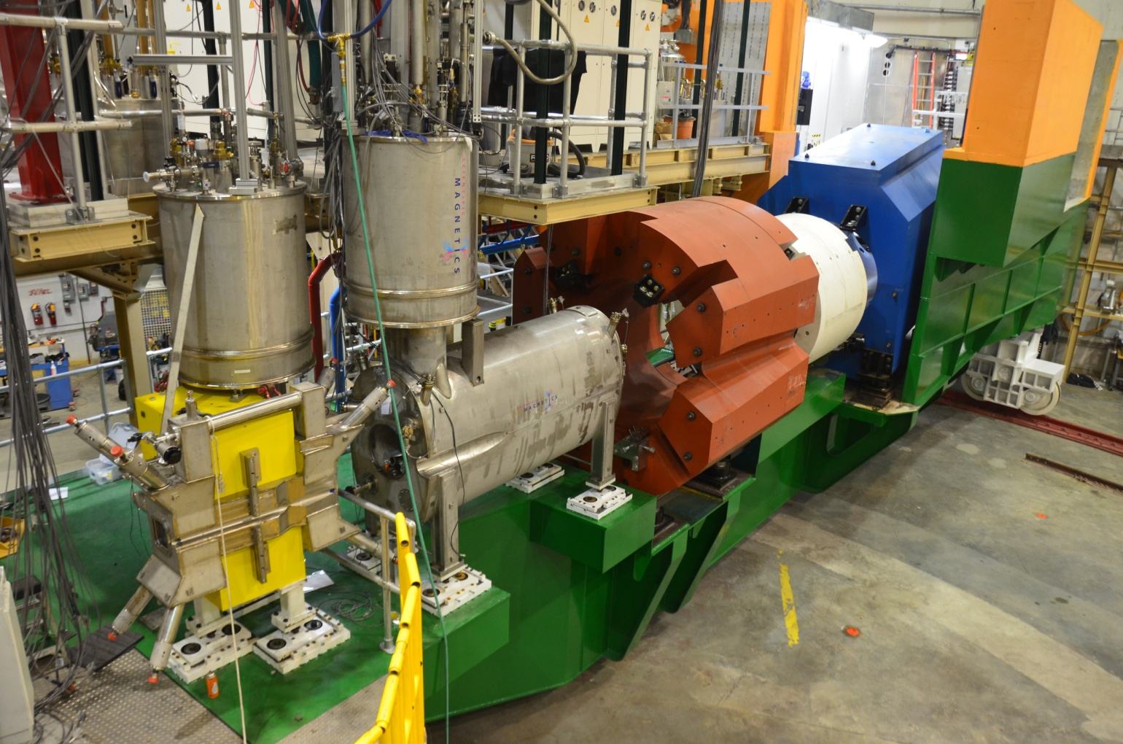
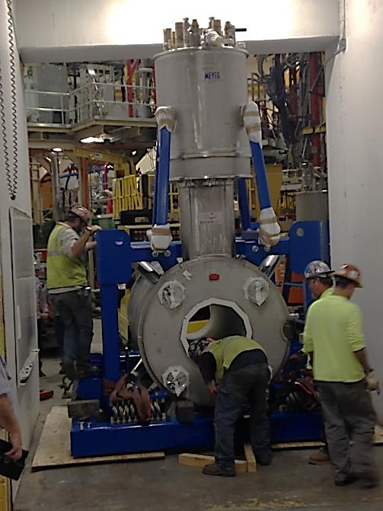
Hall C - SHMS Magnets
Quad 1 (Q1):
Installed
Power test to operational current
Horizontal Bend (HB):
Installed
Power test to operational current
Quad 2 (Q2):
Installed
Power test to operational current
Quad 3 (Q3):
Installed
Pumped down
Dipole (D):
Installed
Having CCR attached
Q2 entering Hall C
HB
Q1
Q2

Slide 17
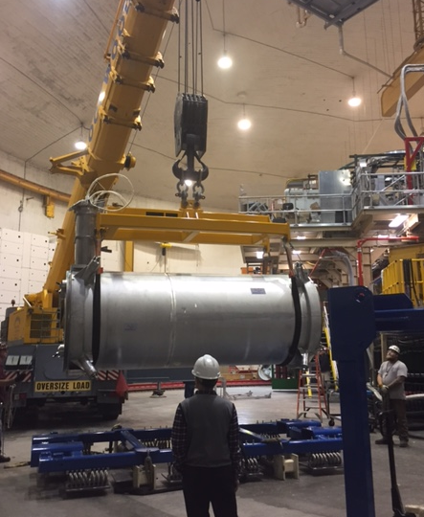
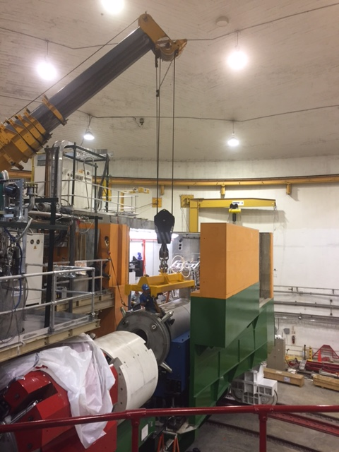
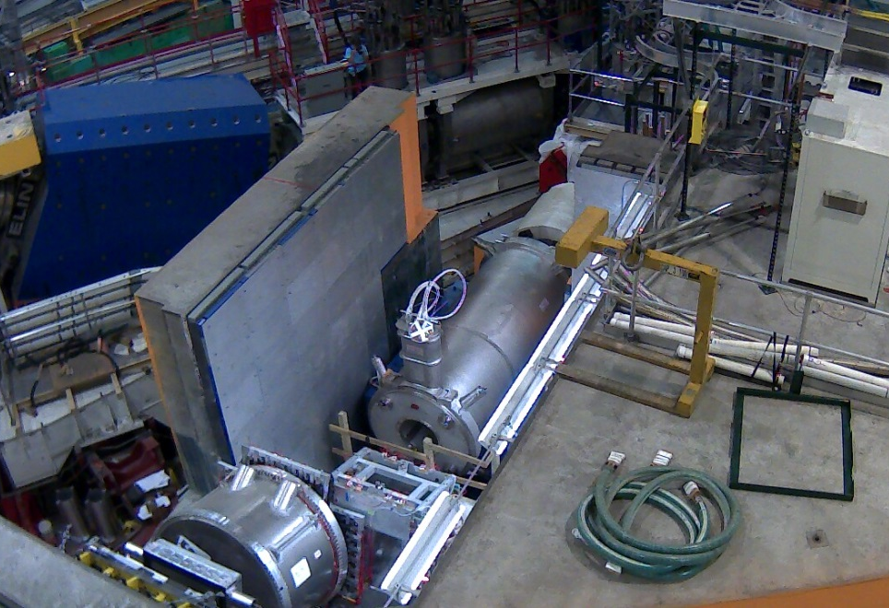
Hall C: Dipole Installation
Staged for lift
Lowered in place
On SHMS carriage
Passed receipt inspections including hi-pot test.
Having Cryogenic Control Reservoir attached

Slide 18
12 GeV Project Work Remaining
Hall B - CLAS12
  Install CTOF (ongoing) and SVT
  Install HTCC and Moeller Shield
  Deliver beam to demonstrate formal 12 GeV Project milestone (February)
Hall B - CLAS12 Solenoid Magnet
  Complete construction at ETI (March)
  Install Solenoid in Hall B and connect cryogenics and I&C (April-May)
  Pump down, cool, energize magnet (June-August)
Hall C - SHMS
  Connect Dipole cryogenic control reservoir (Nov-Jan)
  Pump down, cool, energize Dipole/Q3 magnets (Nov-Feb)
  Deliver beam to demonstrate formal 12 GeV Project milestone (March)

Slide 19
Summary
Upgraded accelerator delivering physics quality beam
12 GeV-era Research Program underway:
  First experiment complete (PRad)
  Hall A DVCS (part 1) and G_{M}^{p} complete
  Hall D GlueX production data-taking began
12 GeV Project: Halls B & C ~98% complete
  Detector construction and (most) installation complete
  Schedule driven by superconducting magnets
Hall B & C commissioning: Spring 2017
Project completion: September 2017

