Slide 1


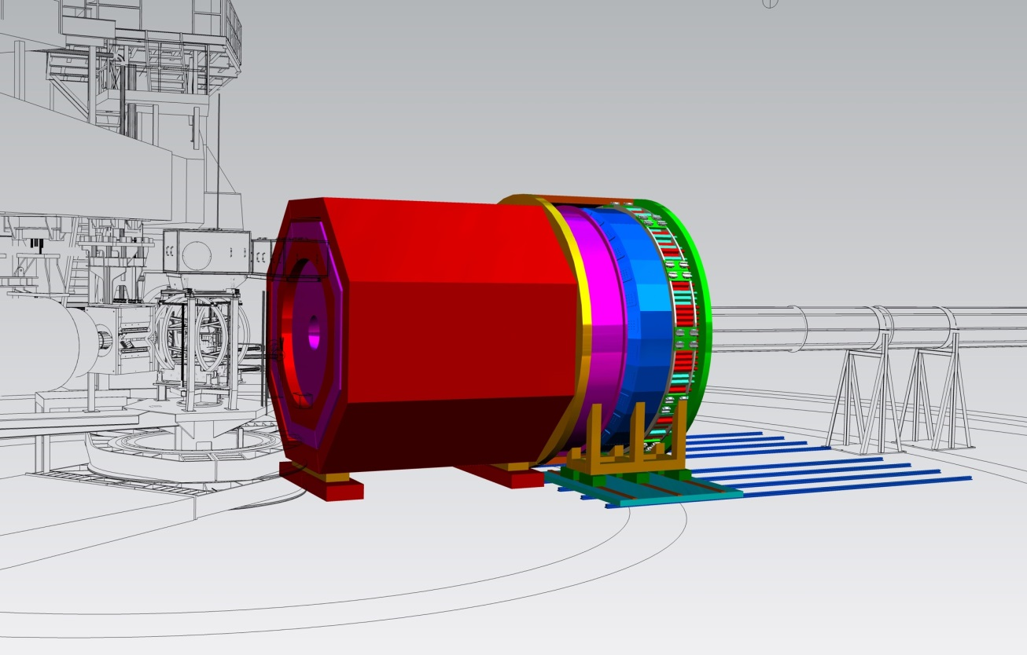
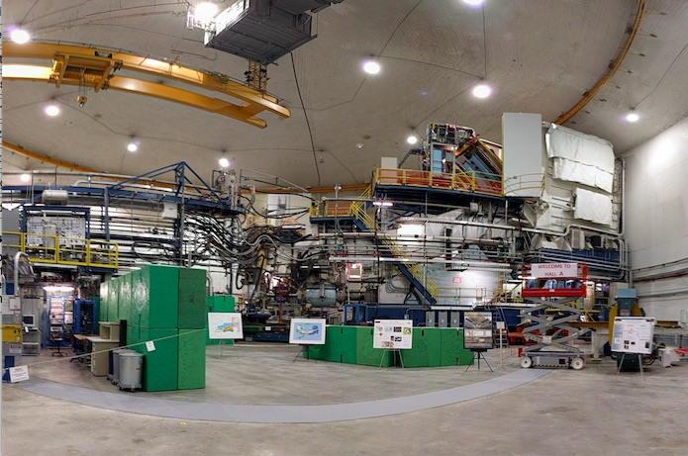
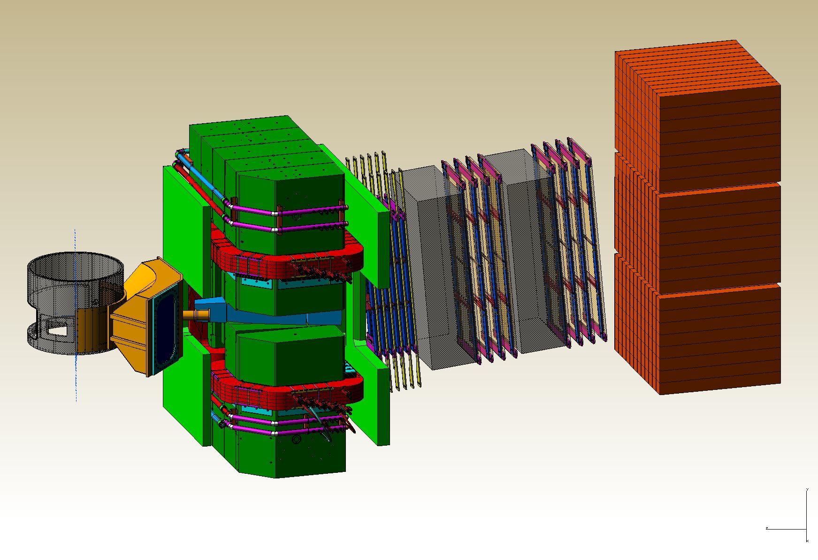
Hall A Update
Thia Keppel
User Group Board of Directors
January 2017

Slide 2
Hall A Projected Experiment Schedule, updated 1/2017
Experiments in red represent PAC42 “high impact” experiments
Spring | Fall | Spring | Fall | Spring | Fall
DVCS –I/ GMp | DVCS –I/ GMp
 |  | Ar(e,e’p)* | ³H/³He group
 |  |  |  | ³H/³He group | TBD: APEX PREX12 CREX A₁^{n} DVCSII
CY
2016
CY 2017
CY
2018
schedule not final
SBS 2019?
MOLLER, SoLID →
*possible best effort
2

Slide 3
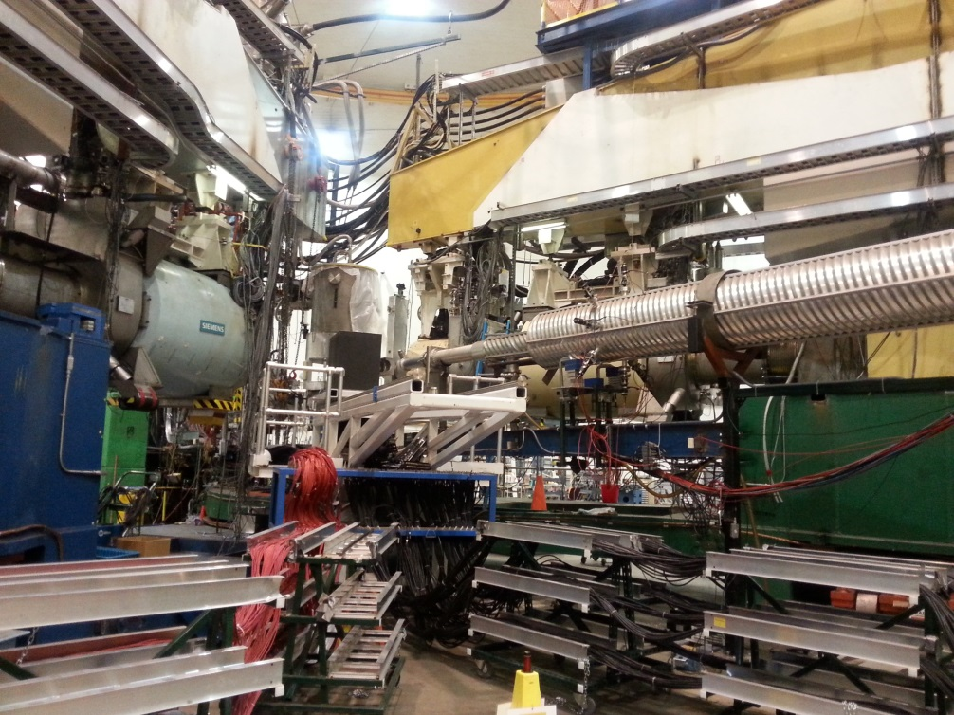
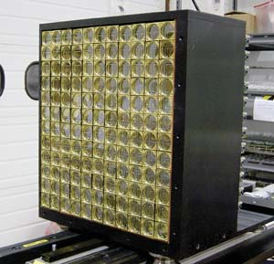
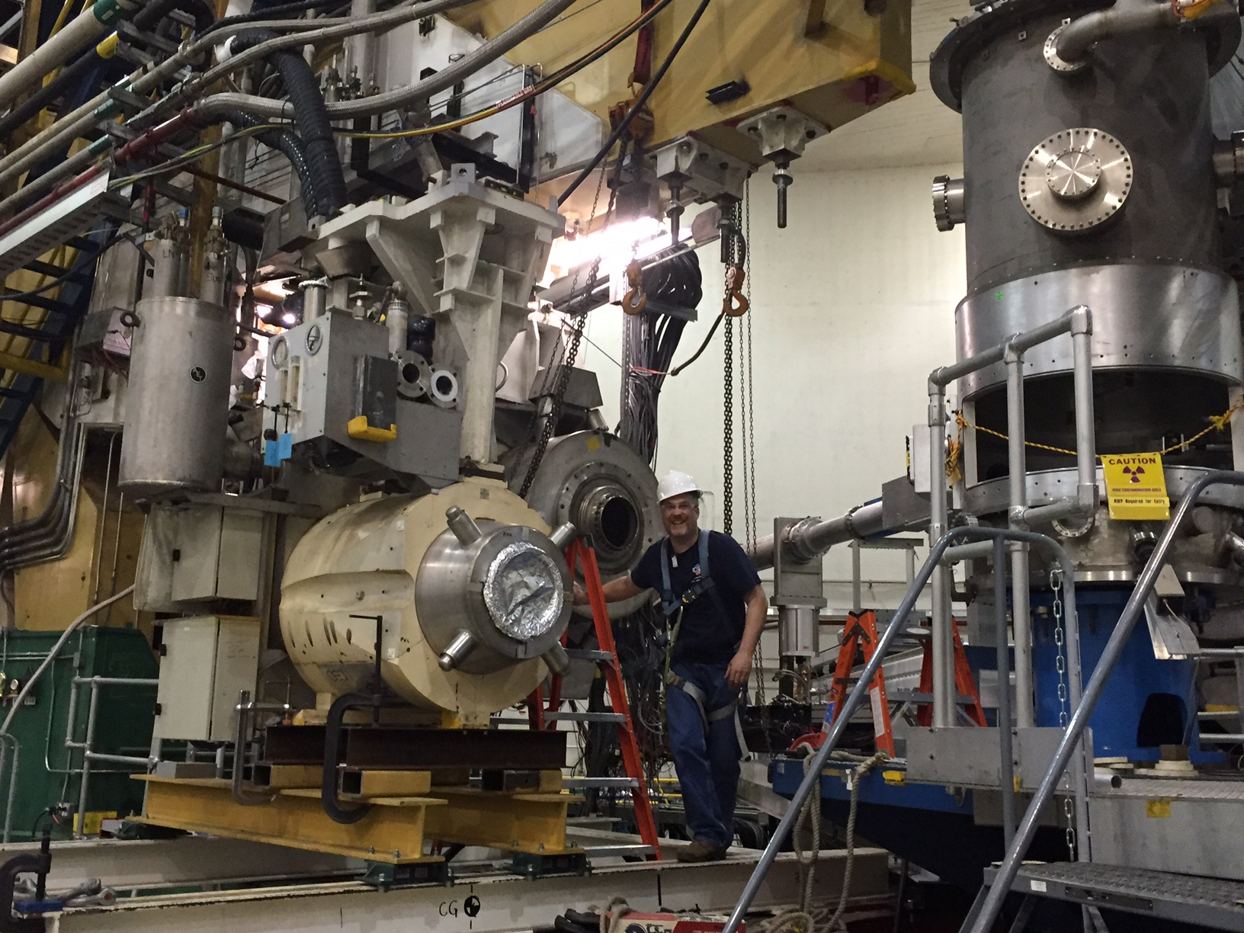
DVCS / G_{M}^{p} Experiments – Phase I – complete!
Phase I: aiming for 50% of proposed 100 day beam time, achieved 49.5%
Started up with this program Fall 2014
Started up again Spring 2015 with 20 uAmp, 11 GeV beam, resistive “SOS” quad on right arm
Fall 2016 resistive quads (“SOS” + new duplicate) replacing both Q1s
Optics studies accomplished
First Compton polarimetry in Spring 2016 Run
New high field Moller commissioning in Spring 2016 run, regular use Fall 2016
Arc beam energy measurements now “routine”, single Hall spin dance verification
3
Notes:
F2 and C12 scans good for acceptance studies

Slide 4
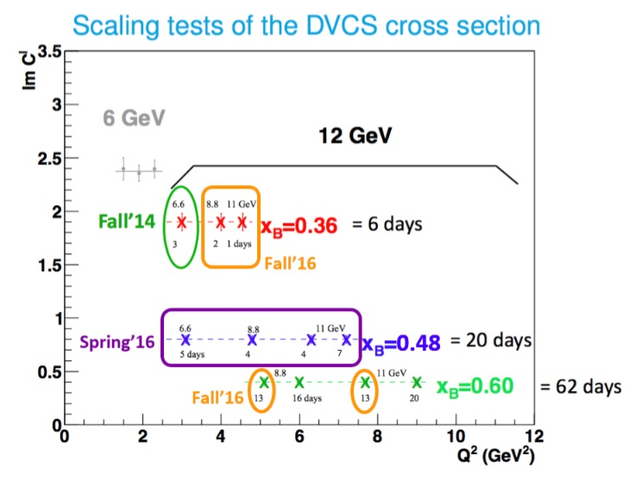
DVCS-I and G_{M}^{p}: Concurrent Experiments in Hall A at 11 GeV
High impact experiment for 3D nucleon imaging
  Deeply Virtual Compton Scattering (DVCS) provides access to Generalized Parton Distributions (GPDs)
Will provide highest available Q² measurement of the DVCS cross section
  Demonstration of scaling critical to full JLab 12 GeV GPD program
DVCS
High Q² Form Factors
  Reducing G_{M}^{p} uncertainties will enable Super BigBite high impact program of Form Factor Measurements
G_{M}^{p}
4

Slide 5
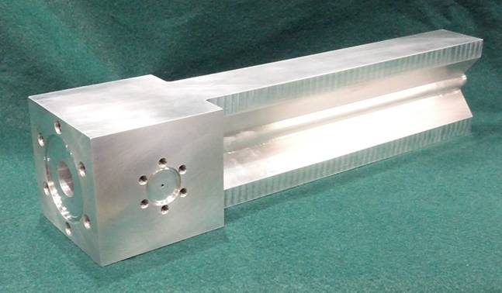
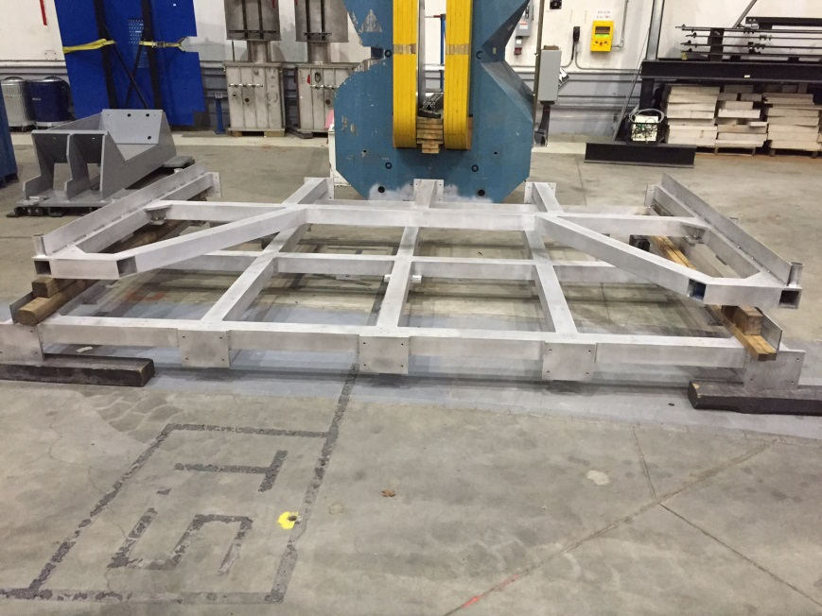
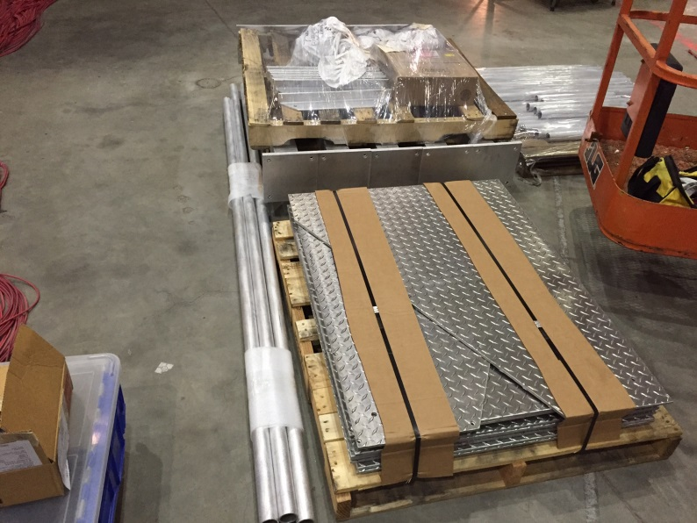
Tritium Experiment Group Preparations
Four experiments approved by PAC 42, 2 PAC 40 “high impact”
Successful target safety/design review September 2015
Successful ERR March 2016
BigBite no longer planned for use
Power, water upgrades
8 graduate students on site
Installation currently underway
  Vent system
  Target and safety systems
  Scattering chamber rotation
  Target installation platform
5

Slide 6
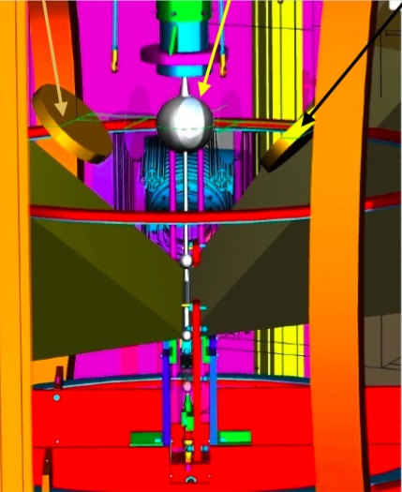
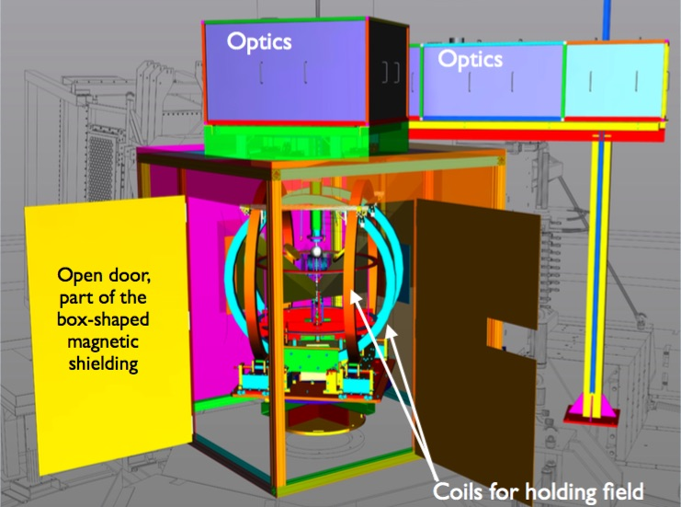
Beyond ³H
    Polarized ³He target improvements and continued development
        Phase I upgrade of existing target
          Implementable in either Hall
          Convection cell
        Phase II (SBS GEn type) design frozen, report Summer 2016
          Convection cell
          Dual pumping
          40 cm
          Metal end windows for high current
        Phase II (SBS Gen type) ready by June 2019
    APEX
        Septum magnet purchased by collaboration now in test lab, added fittings and manifold
        Computation fluid dynamics for target design
        Laser heating tests planned (Silviu Covrig)
6

Slide 7
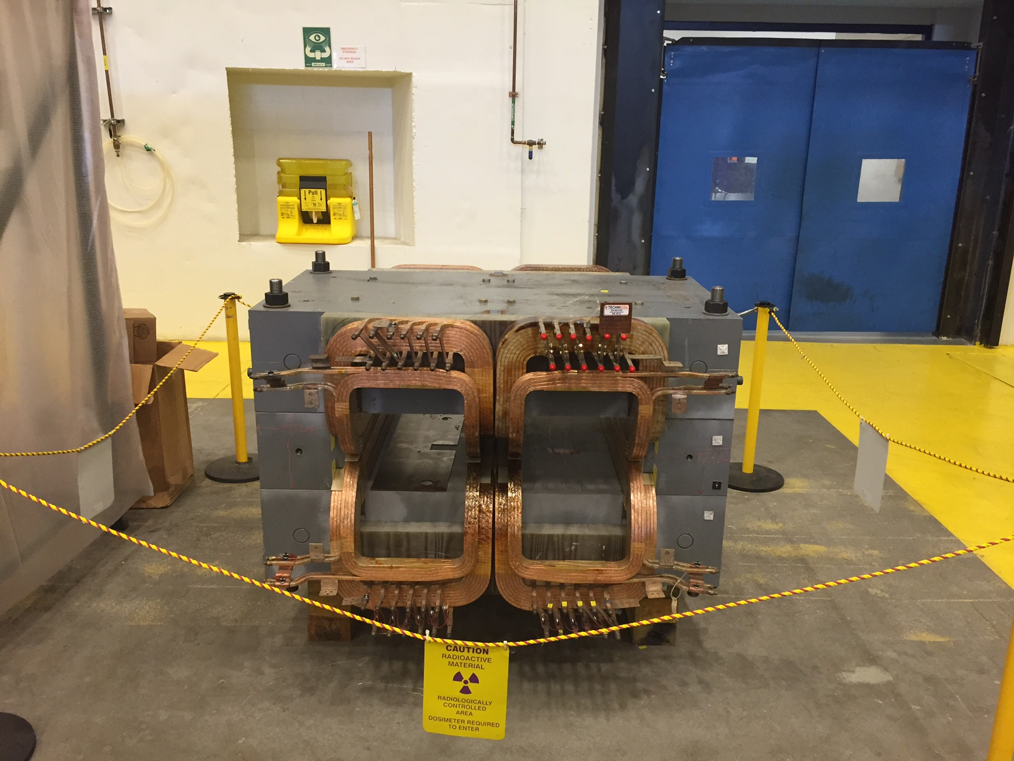
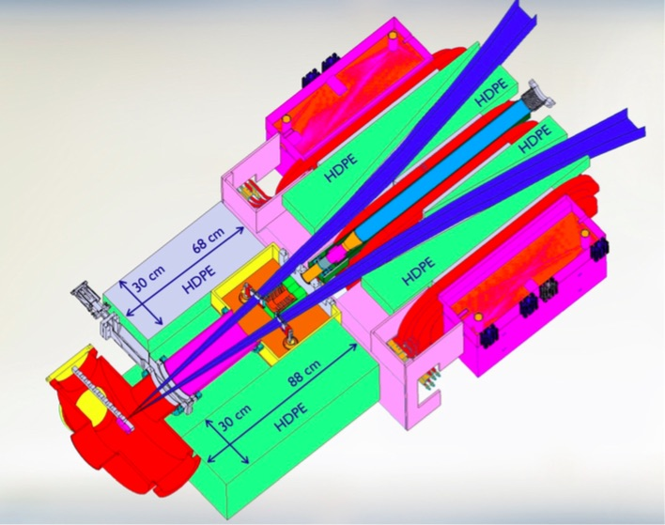
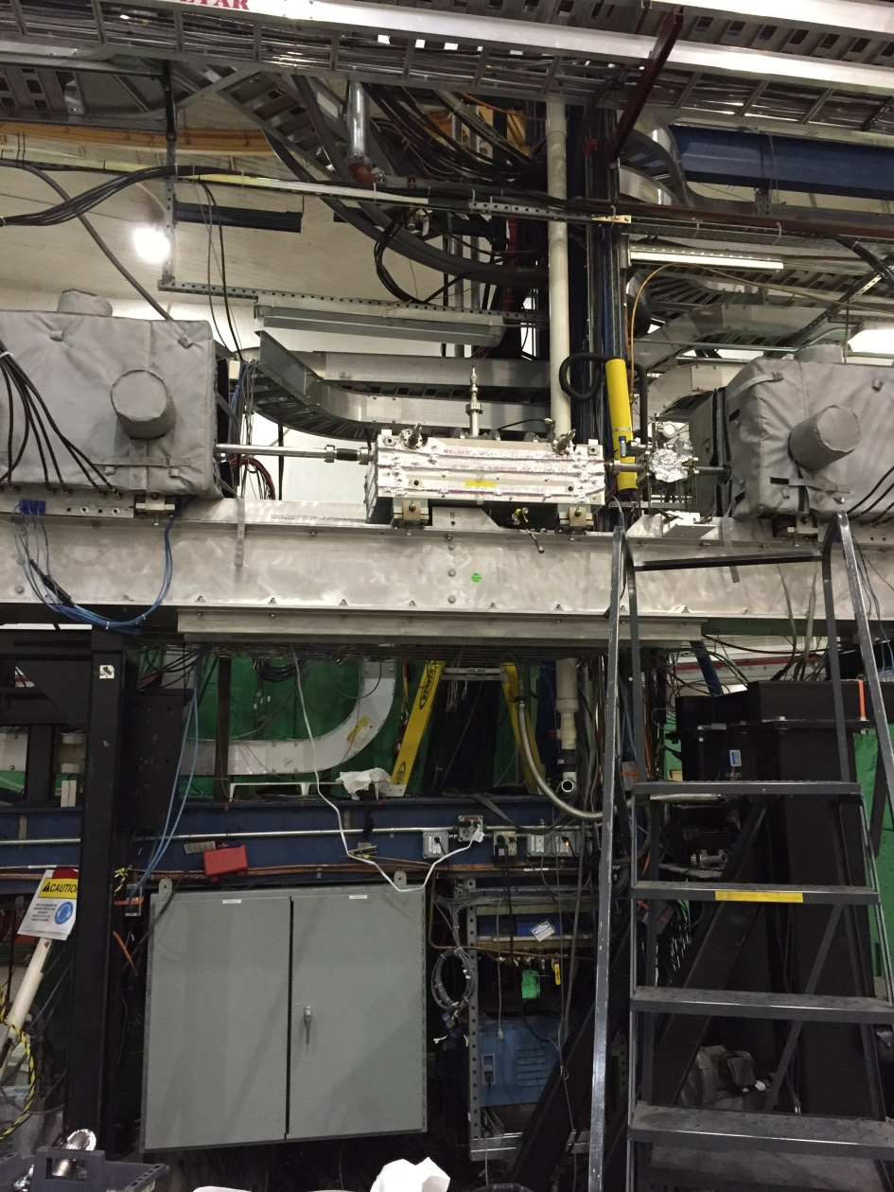
Beyond ³H
    PREX2/CREX
      Preparing for ERR Spring 2017
      Combined target chamber, shielding design
      Common target position
      Computation fluid dynamics for target design, target heating tests planned
      Beamline instrumentation in place, diagnostic testing ongoing
        Second x,y,Q girder (from Hall C), new “Musson” cavity electronics, Hall C halo monitor, lumi monitors
      Polarimetry (as discussed above)
      Regular parity quality beam meetings
7

Slide 8
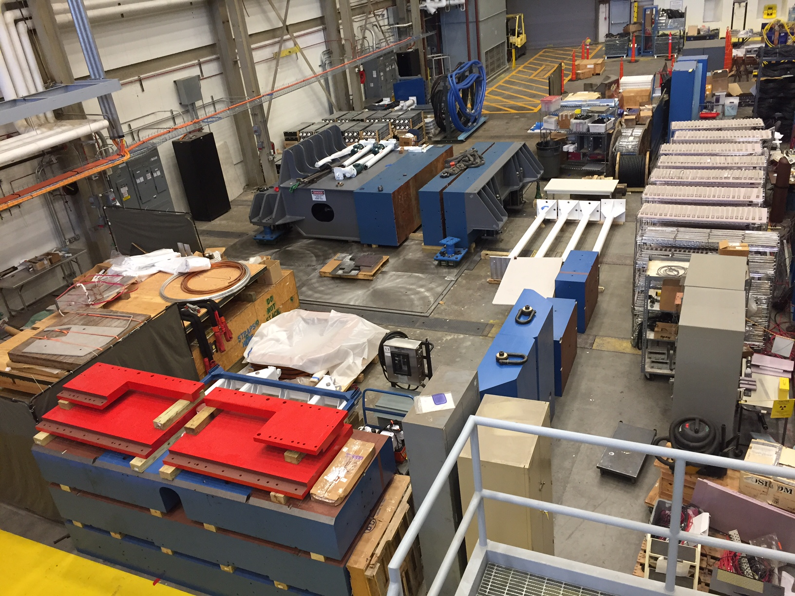
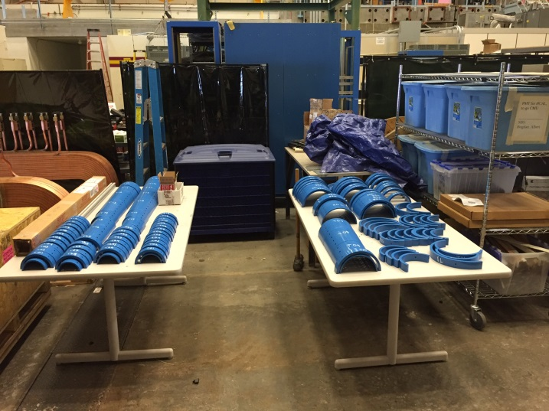
SBS Construction
Project started FY2013
  Successfully passed final annual review November 2016
  Preparing for Closeout ~January 2017!
  Working on how to handle further reporting (“UPP”s?!)
Spectrometer, Infrastructure, ECAL work at JLab
GEM construction at UVA, INFN
Coordinate detector from Idaho State, CNU
HCAL Hadron calorimeter from CMU
More! Large and active collaboration
8

Slide 9
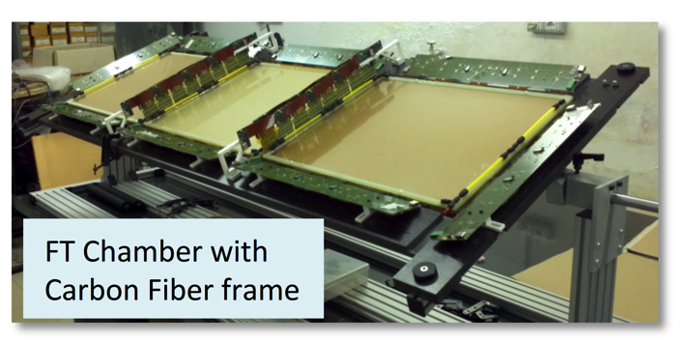
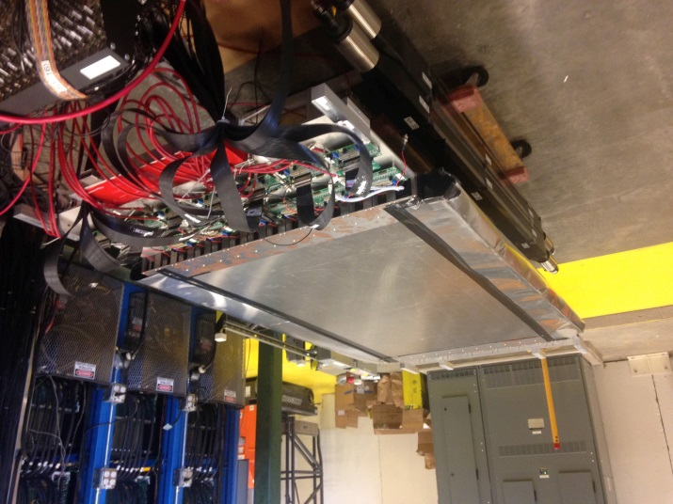
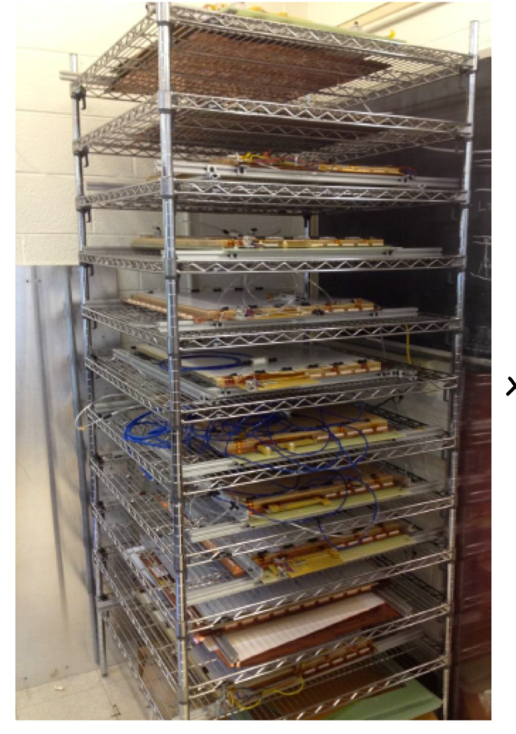
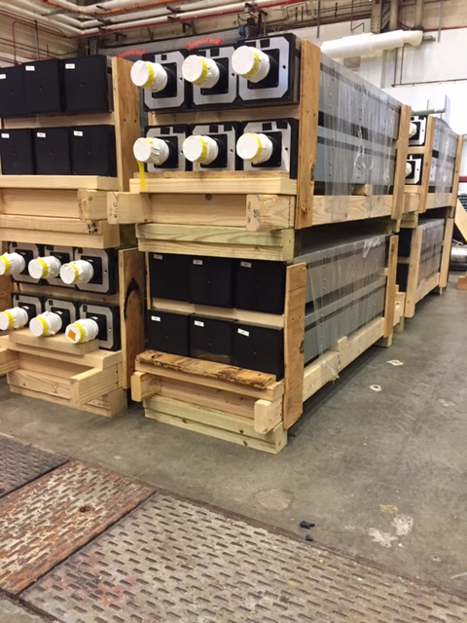
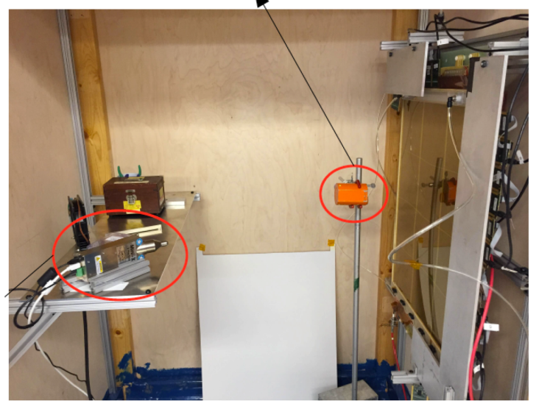
Super Bigbite Spectrometer (SBS) Detectors
INFN Front Tracker at JLab
CDET module constructed at JLab
Rear GEM tracker modules at UVA
High rate X-ray testing setup for GEMs
Hadron Calorimeter modules at JLab

Slide 10
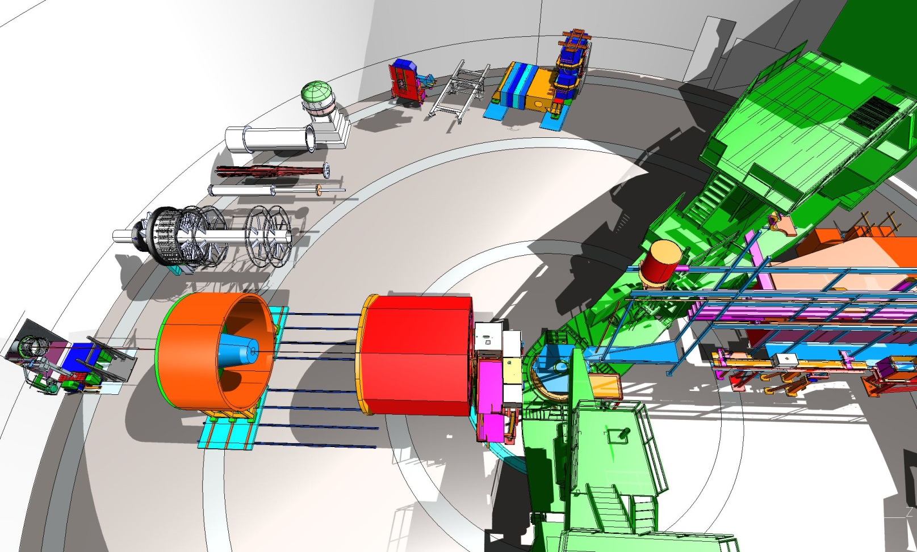
Moving to more future installations – MOLLER and SoLID
10

Slide 11
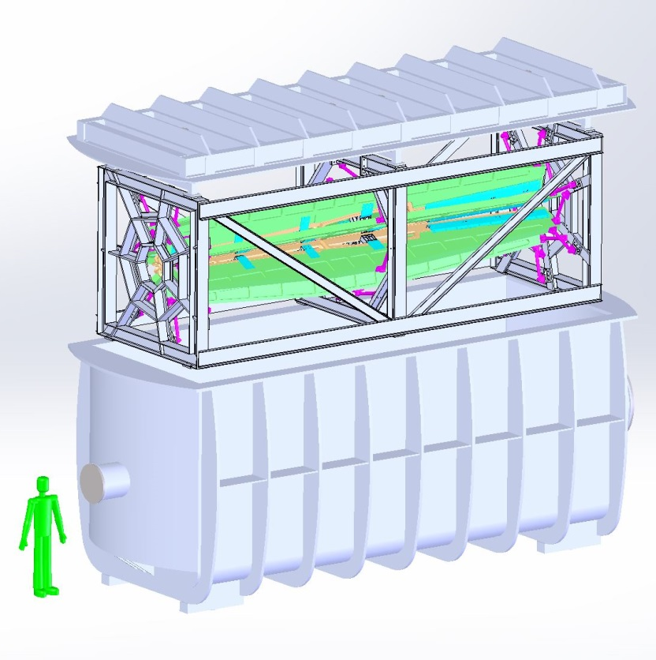
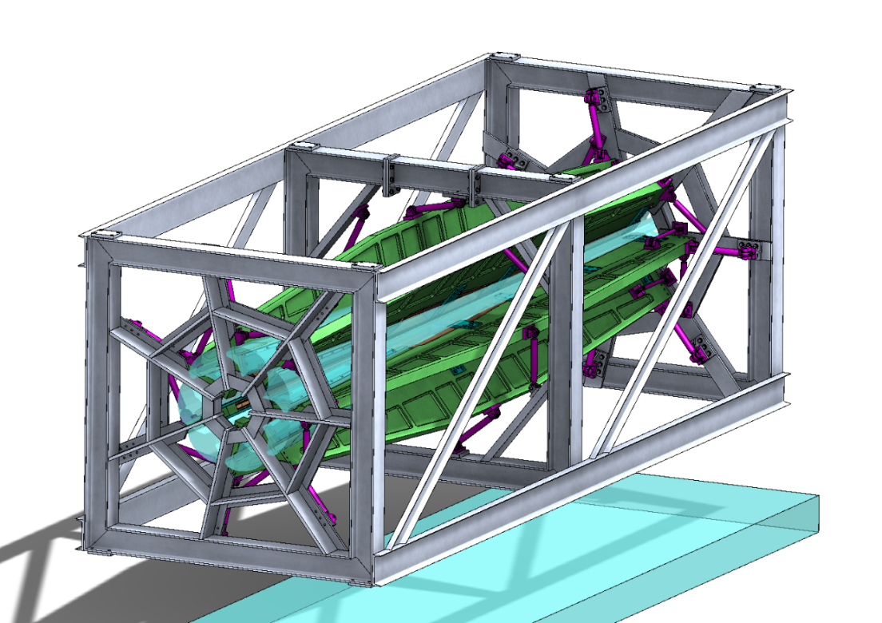
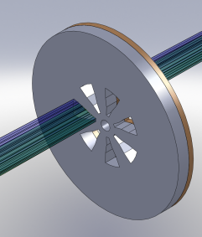
MOLLER
    Successful Science Review September 2014
    Supporting ongoing magnet and collimator development work at MIT
      July 2016 informal on site (at JLab) report
    Polarimetry and parity beamline instrumentation testing symbiotically to Hall A program
    Director’s cost, schedule, technical December 2016
      Just received draft report for fact checking
    Looking towards CD0 2018
11

Slide 12
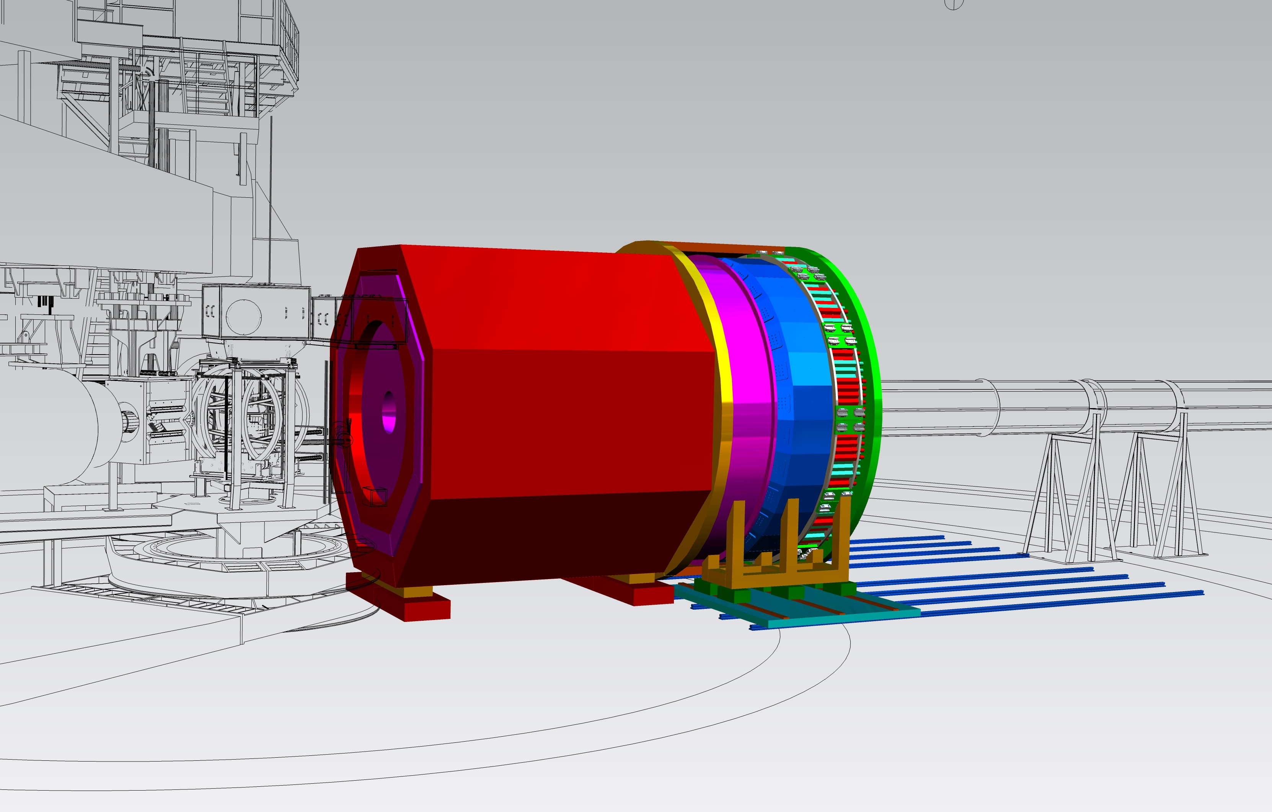
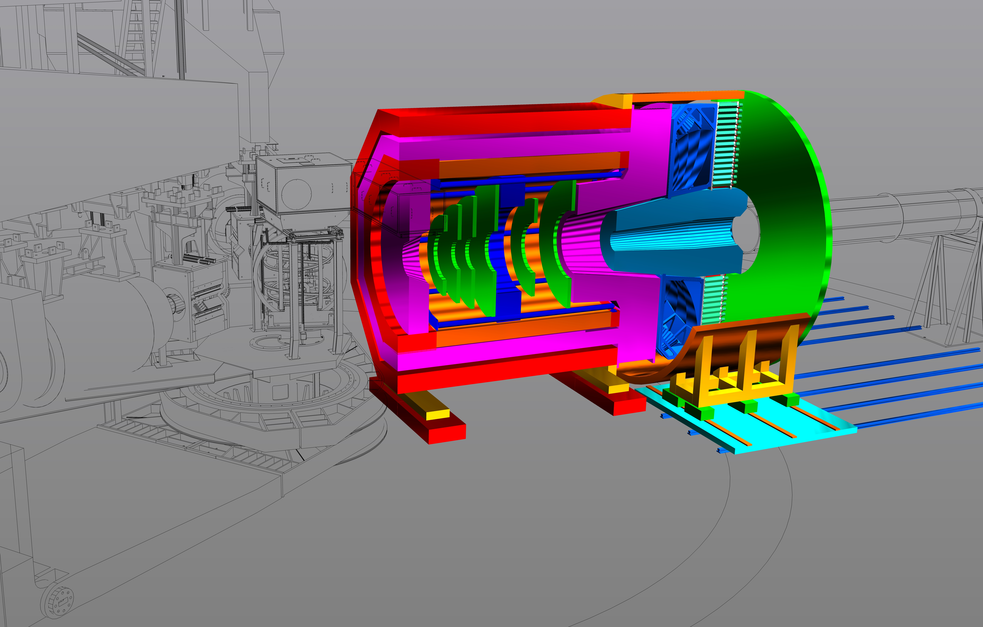
SoLID
    Director’s Review Feb. 2015
    DOE-NP Update Nov. 2015
    Draft response to Director’s Review submitted to Physics Division 12/16
  Looking towards Science Review in 2017, CD0 in 2019
  Continued optimization
    Background studies
    Magnetic fields
    Cost and manpower
12

Slide 13
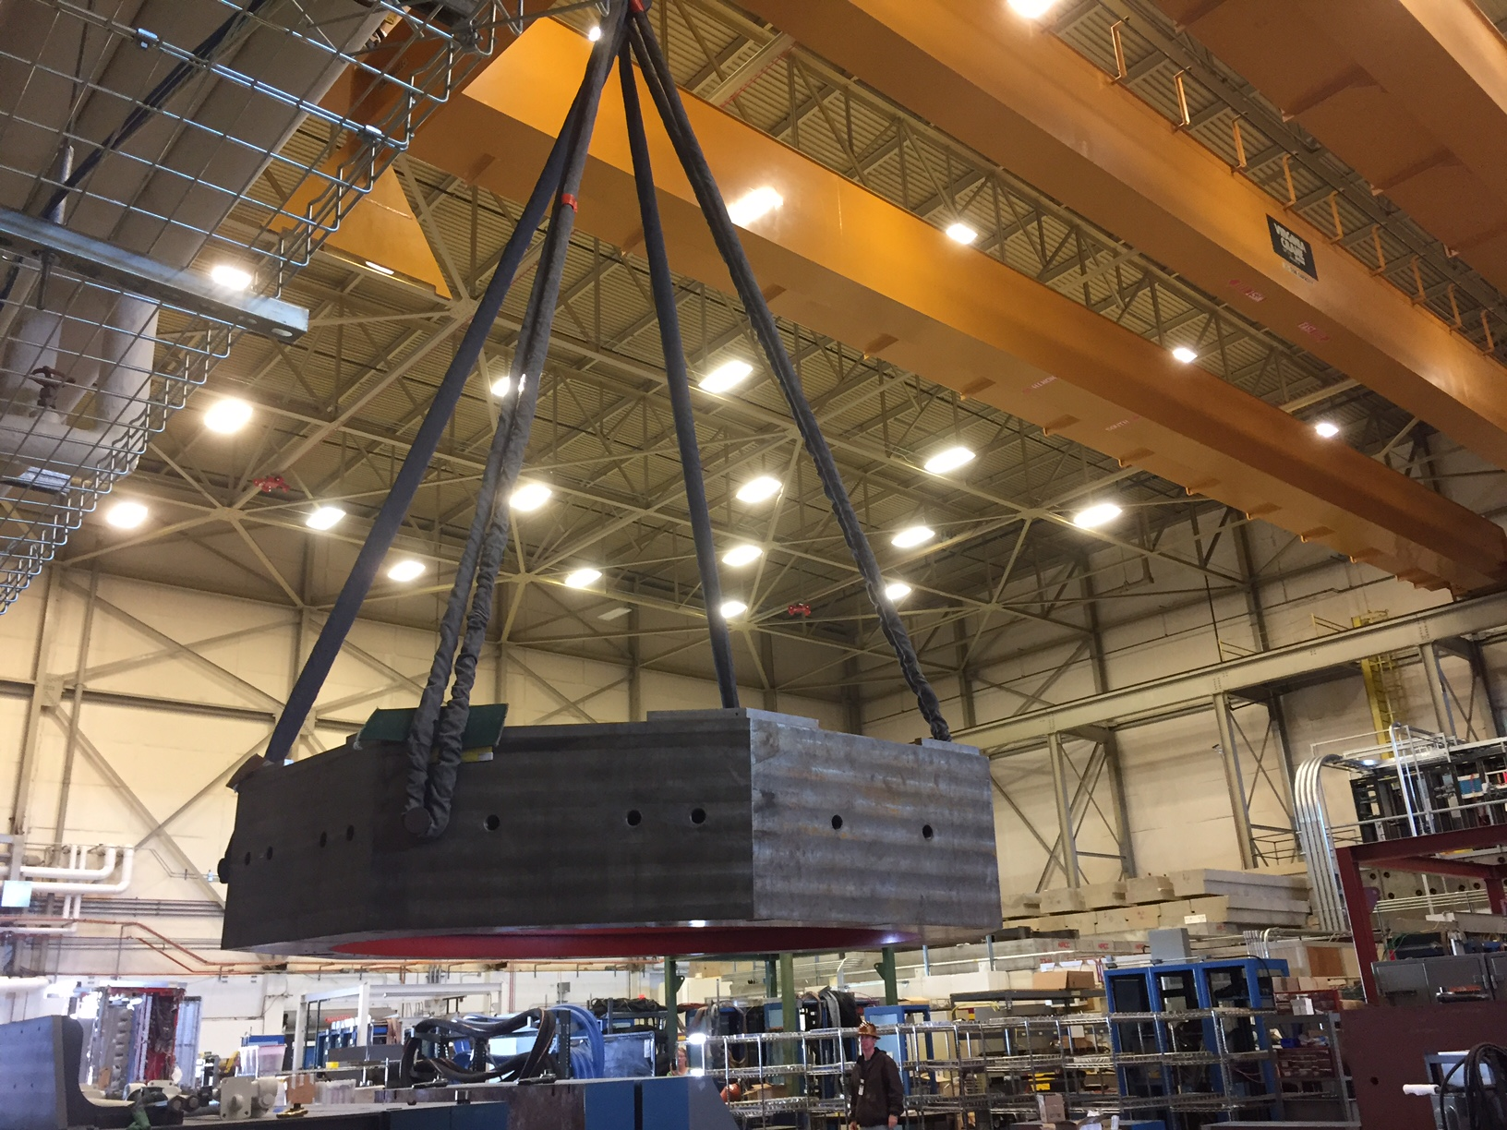
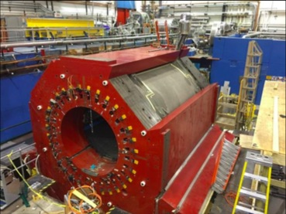
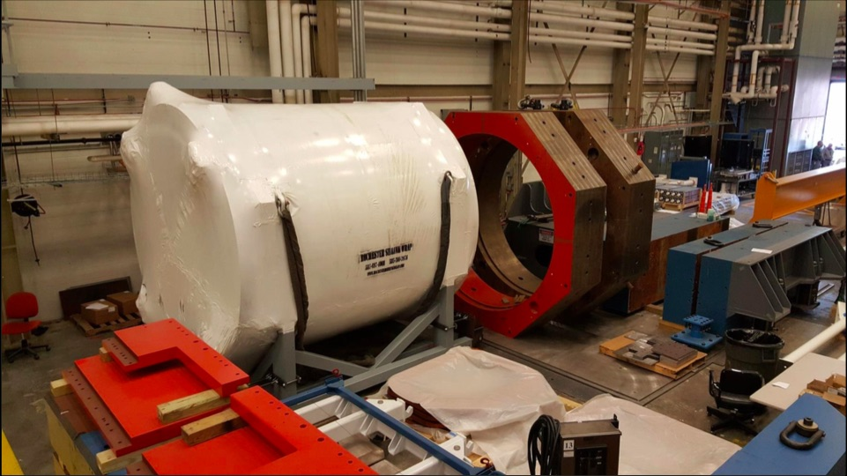
SoLID
The CLEO magnet has arrived at JLab! Well, started to arrive... still ~50 trucks of steel to come.
Cryostat and coil collars in JLab test lab high bay
1,000 tons of steel removed
13

Slide 14
Publications in 2016
Rosenbluth separation of the π⁰ electroproduction cross section, M. Defurne et al., Phys. Rev. Lett. 117 (2016) no.26, 262001
Measurements of d2n and A1n: Probing the neutron spin structure, D. Flay et al., Phys. Rev. D 94 (2016) no.5, 052003
Electroexcitation of the D+(1232) at low momentum transfer, A. Bloomberg et al., Phys. Lett. B 760 (2016) 267-272
Proton radius from electron scattering data, D. Higinbotham et al., Phys. Rev. C 93 (2016) 5, 055207
JLab Measurements of the 3He Form Factors at Large Momentum Transfers, A. Camsonne et al., arXiv:1411.4088, submitted for publication
First measurement of unpolarized SIDIS cross section and cross section ratios from a 3He target, X. Yan et al., arXiv:1610.02350, submitted for publication
Studies of relative gain and timing response of fine-mesh photomultiplier tubes in high magnetic fields, V. Sulkosky et al., Nucl. Instrum. Meth. A 827 (2016)
Beam Position Reconstruction for the g2p Experiment in Hall A at Jefferson Lab, Pengjia Zhu et al., Nucl. Instrum. Meth. A 808 (2016)

Slide 15
Other information of note:
  New Hall A/C Staff Scientist Simona Malace to start June 2017
  Hall A Collaboration Meeting next week January 18-19, 2017
Summary
  First JLab 11 GeV science programs (DVCS/GMp) complete!
  Dynamic science program planned moving forward
  Supporting extensive and diverse activities requisite to 11 GeV era science program
Questions?

