Slide 1

JLab Science Update
Robert McKeown
UGBOD
January 10, 2019

Slide 2
Outline
Recent Highlights
12 GeV Program, PAC
Future Projects
EIC
Summary

Slide 3
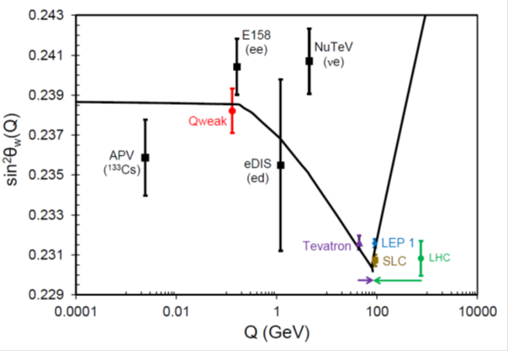
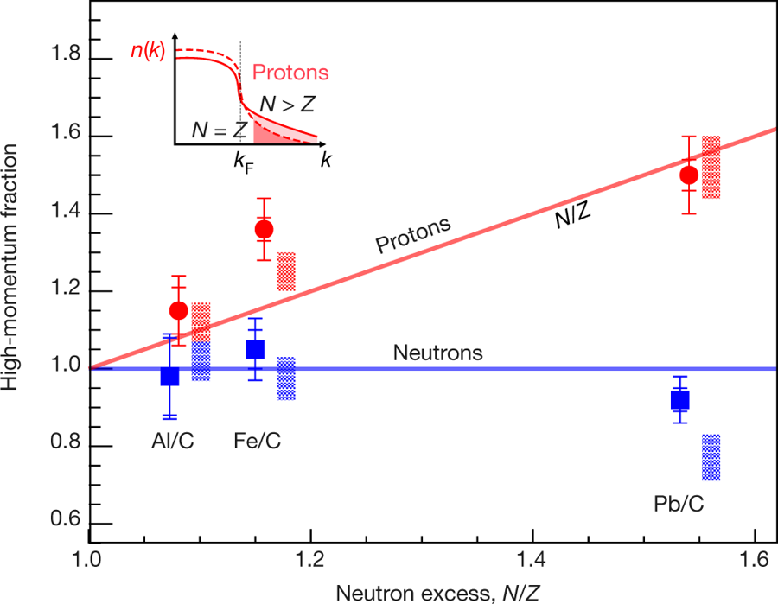
Results Published in Nature
Final Qweak results:
Nature 557, 207–211 (2018)
An accurate calculation of the nucleon axial charge with lattice QCD:
Nature 558, 91-94 (2018)
The weak charge of the proton – “Qweak”, represents the (tiny) difference of the charge of the proton and it’s mirror image
The pressure distribution in the proton:
Nature 557 (2018) no.7705, 396-399
Ultrafast Nucleons in Asymmetric Nuclei:
Nature 560 (2018) no.7720, 617-621
Analysis of 6 GeV CLAS DVCS data on the proton.

Slide 4
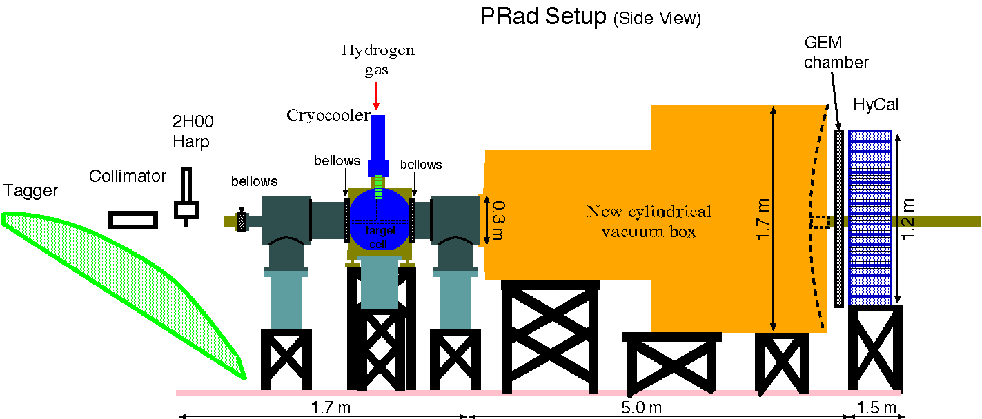
Prad: First completed experiment in 12 GeV era
e - beam

Slide 5
Proton Radius Result from PRad (Preliminary)
PRad Preliminary result:
R_{p} = 0.830 ± 0.008 (stat.) ± 0.018 (syst.) fm

Slide 6
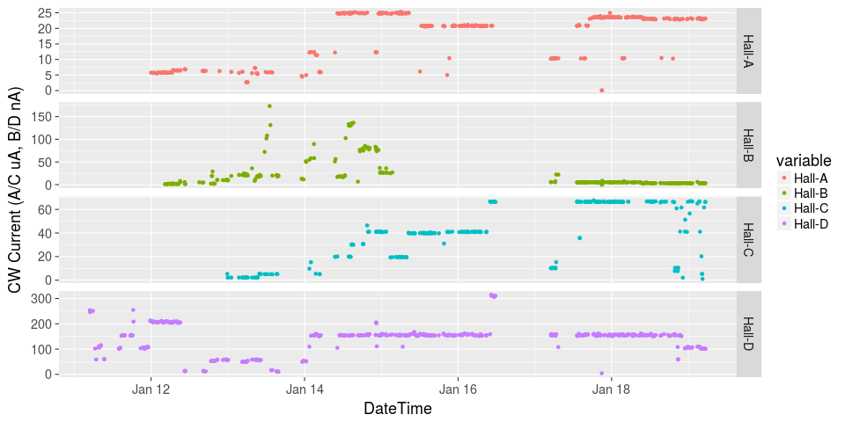
Initiated Four Hall Operation!
μA
A up!
nA
Installation
B up!
Beam Current
Pass Change
μA
C up!
D up!
nA

Slide 7
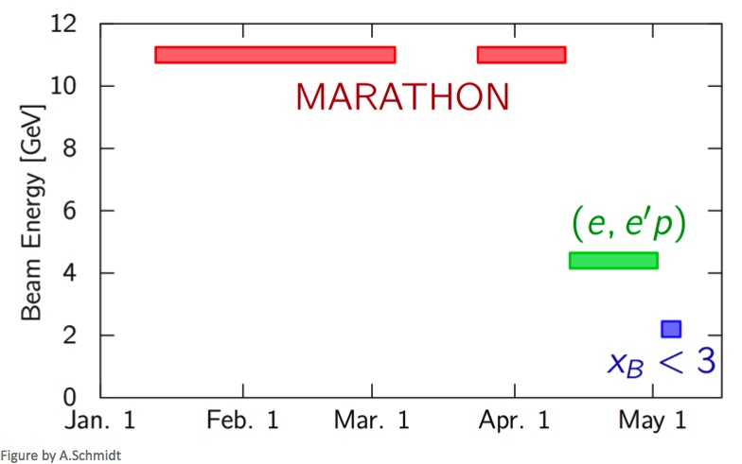
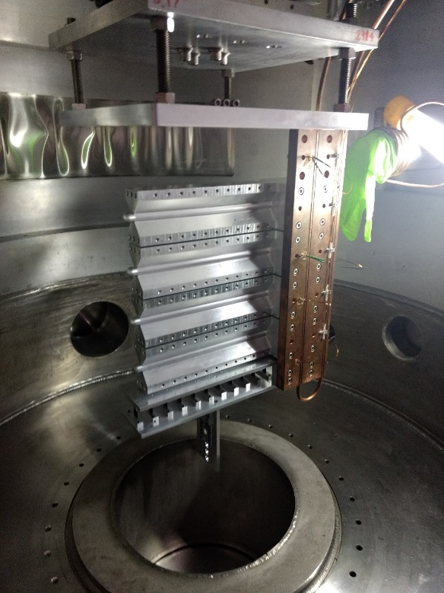
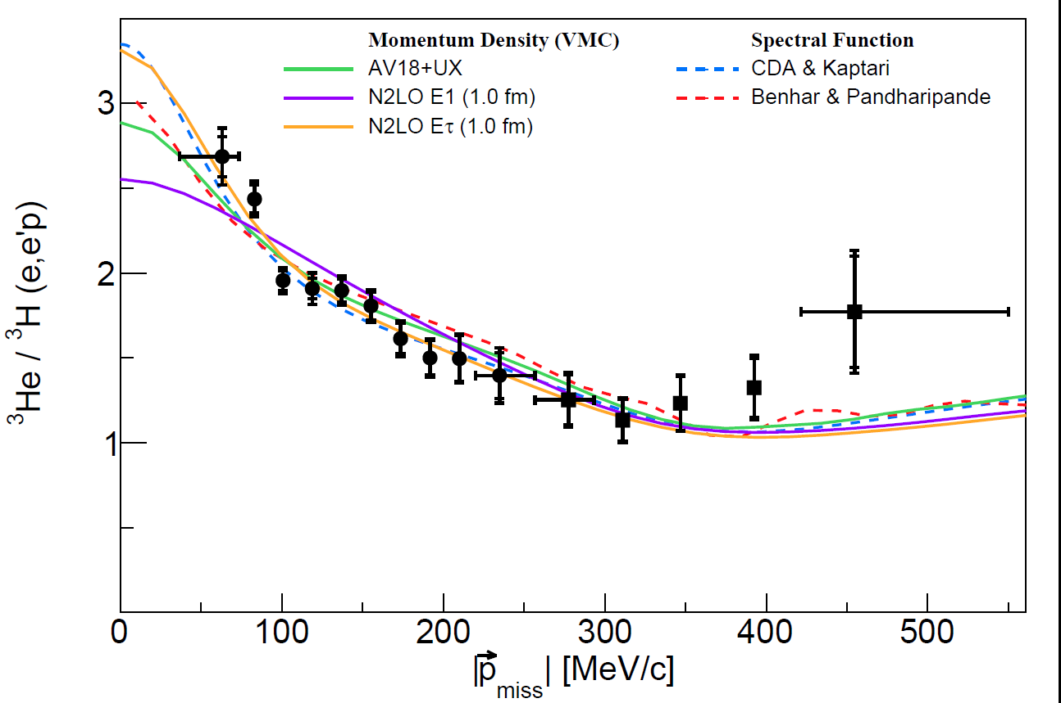
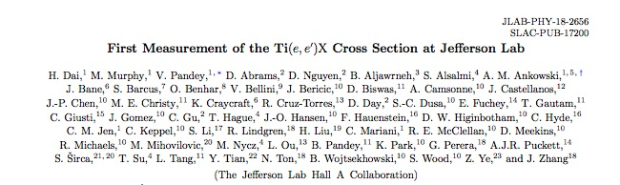
Hall A
Running tritium family of experiments in 2018 – all 4 complete!
Continue to publication results of previous 12 GeV experiments
Published in Phys. Rev. C98 (2018) no.1, 014617

Slide 8
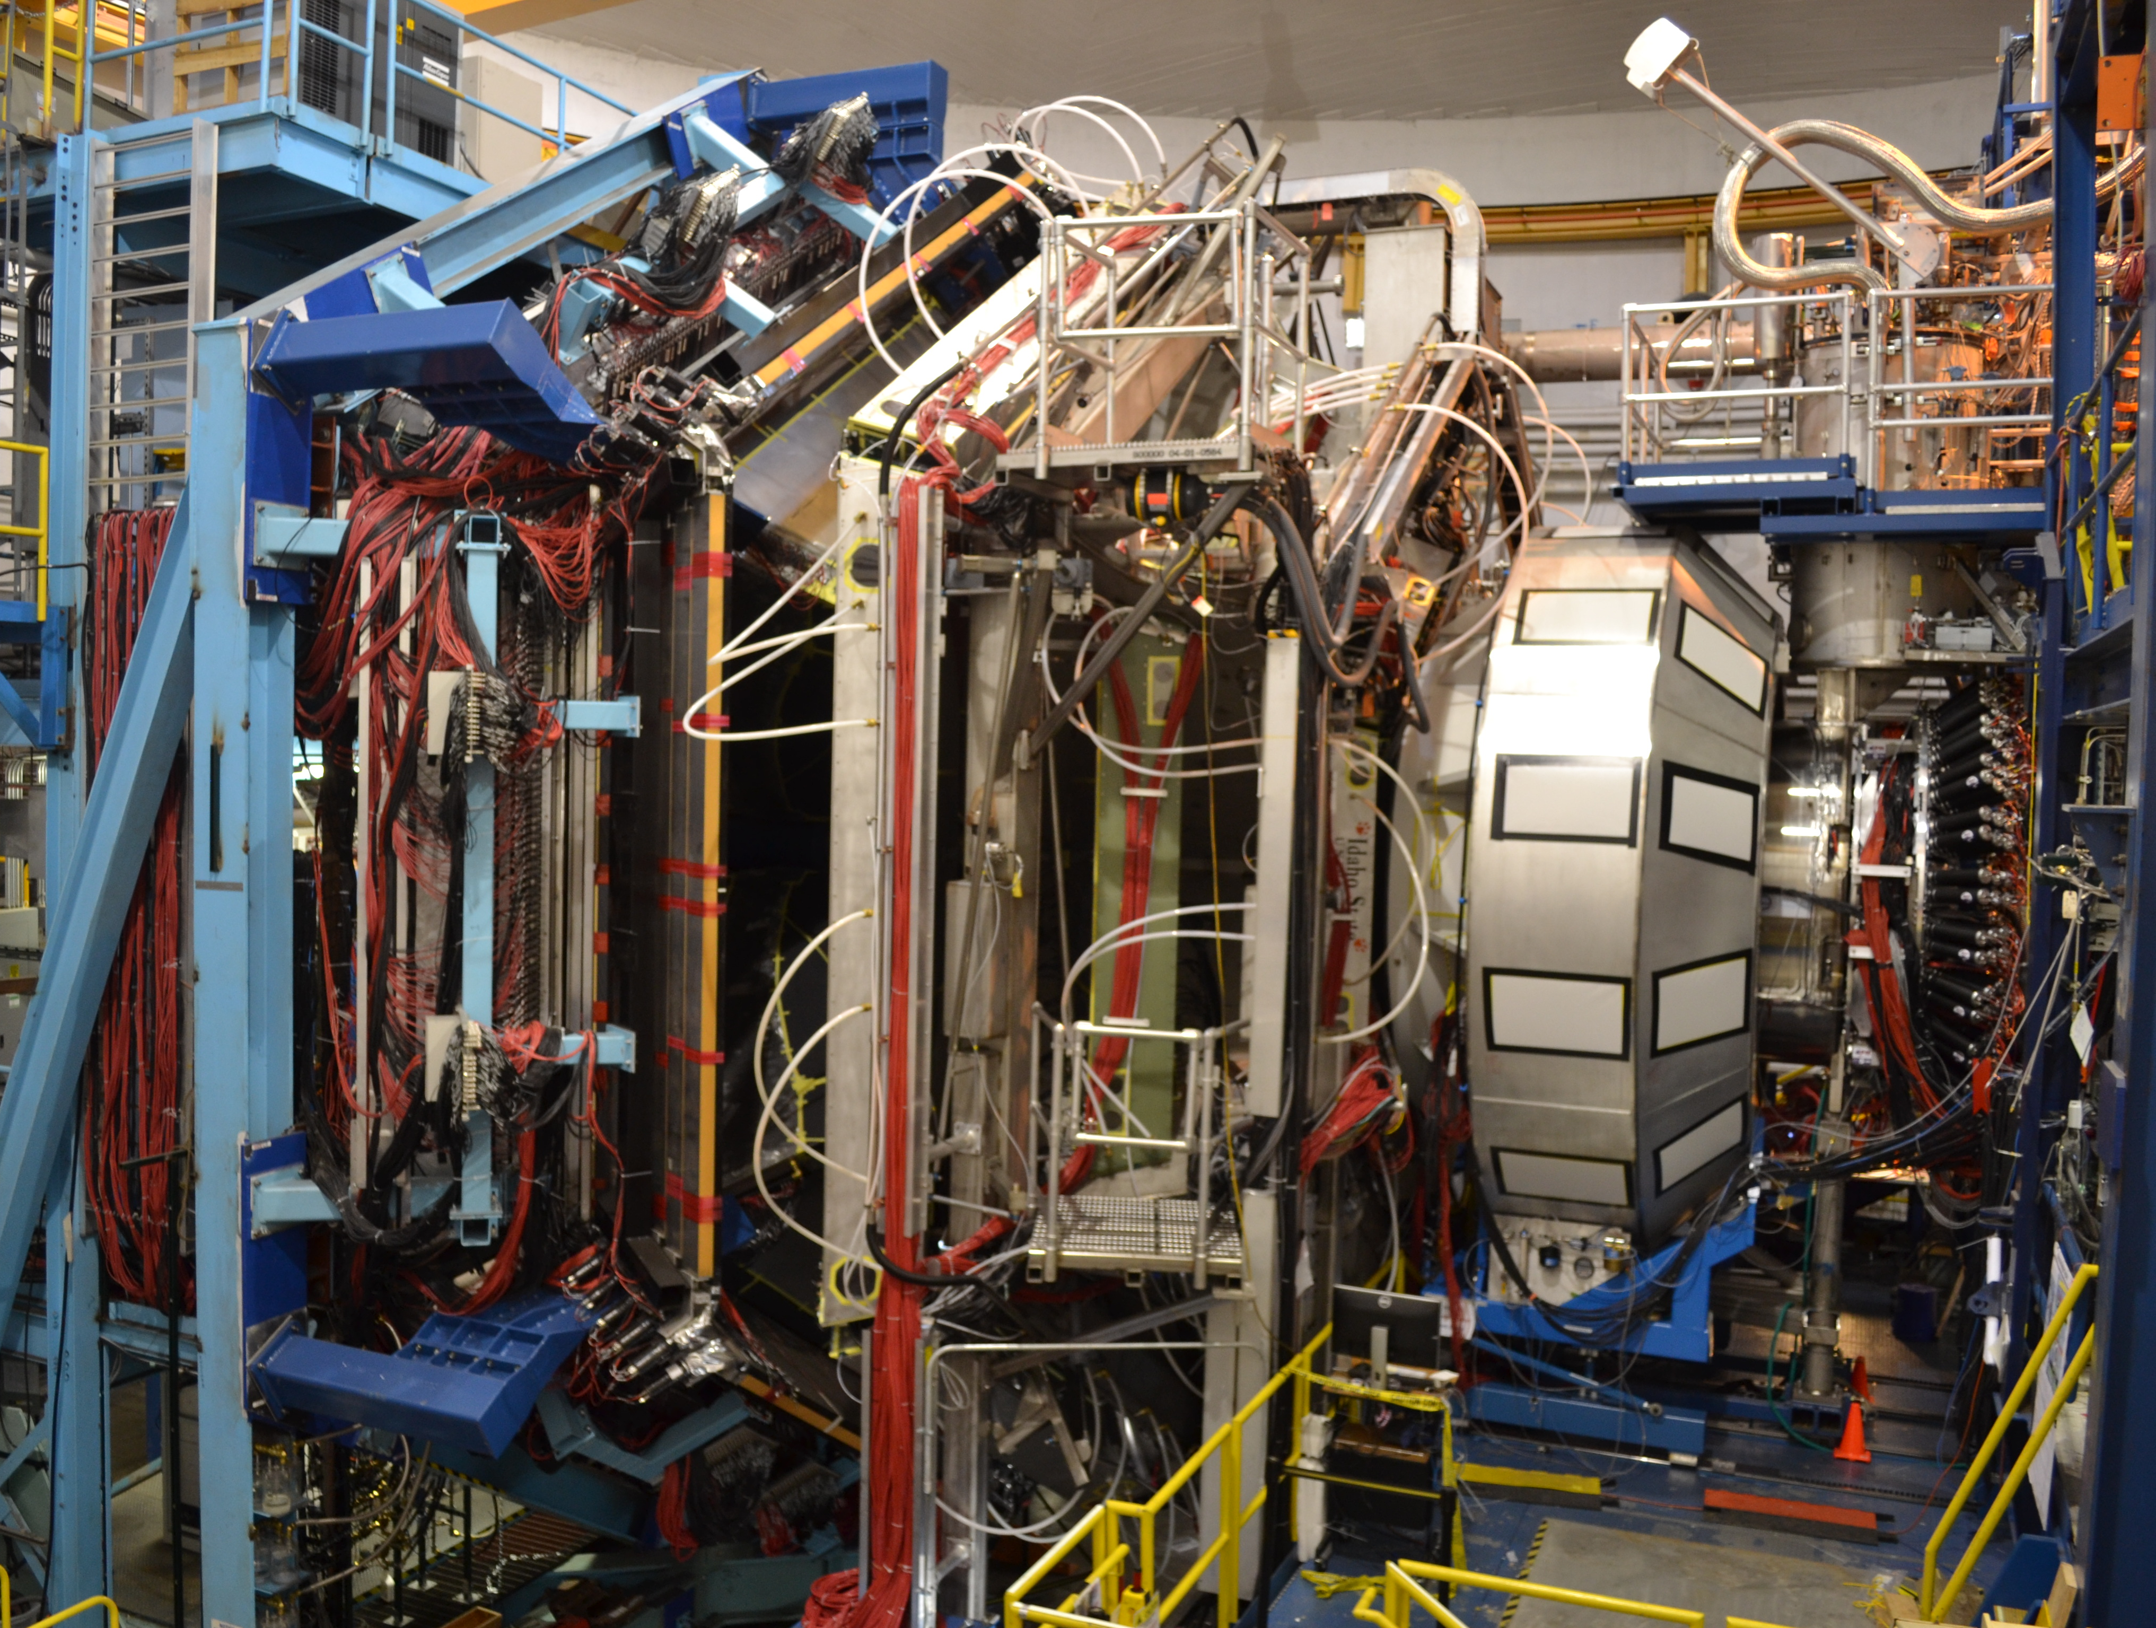
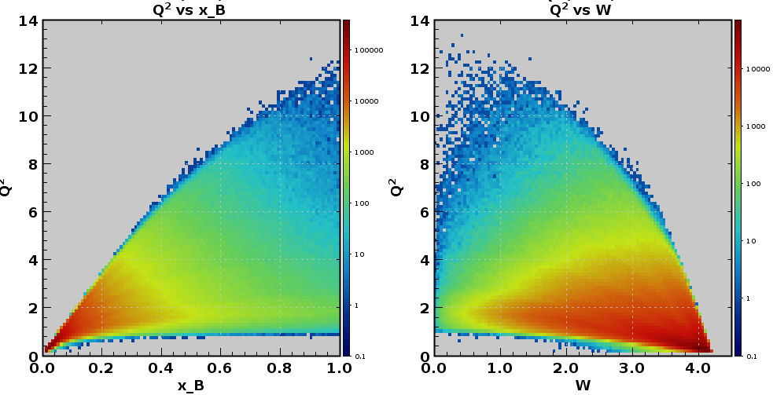
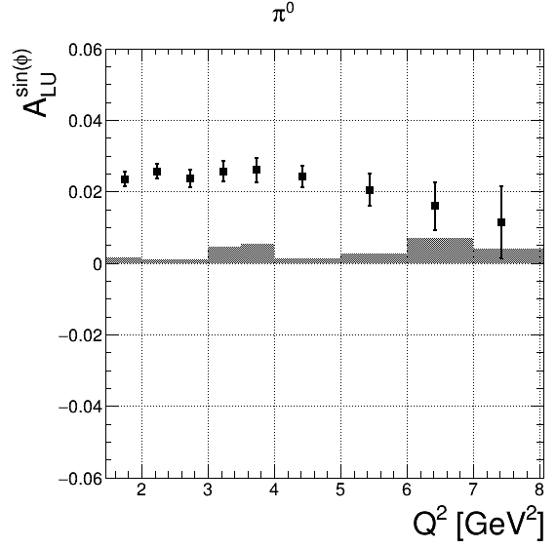
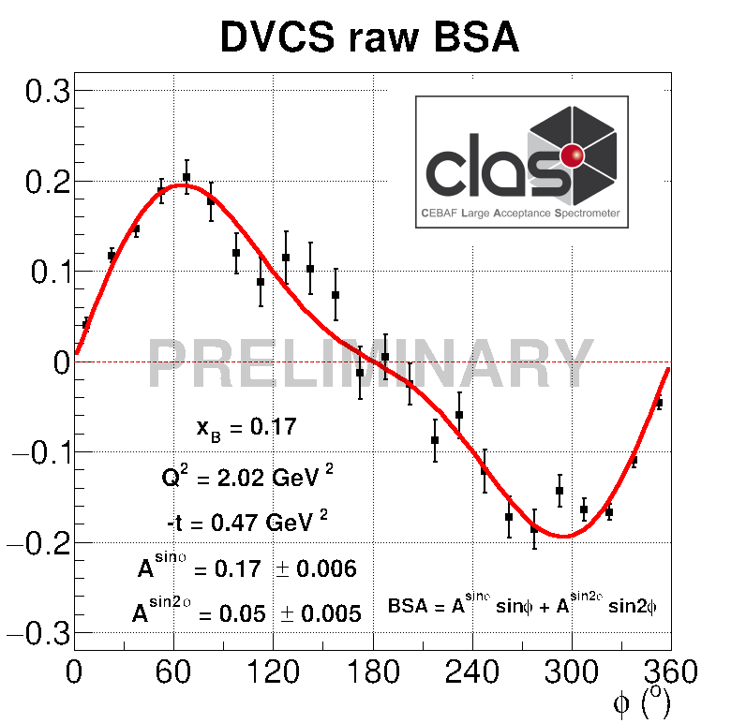
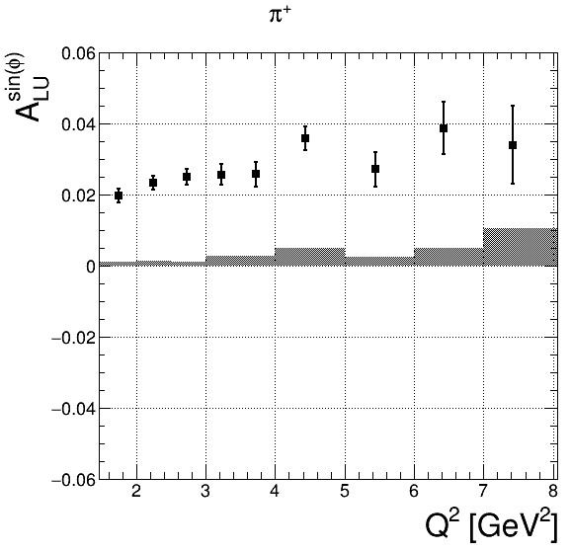
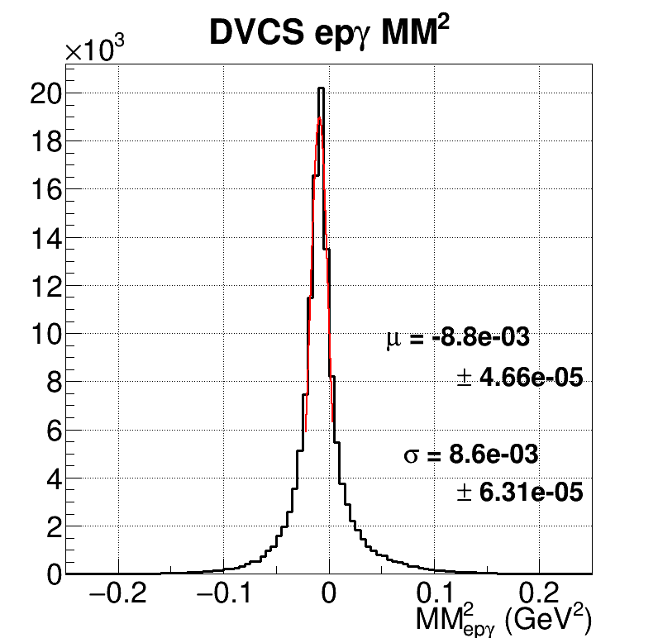
Hall B – CLAS12: toward High Impact science
Kinematic reach at 10.6 GeV
p(e,e’π)X
Beam-spin asymmetry
p(e,e’)X
Q² (GeV²)
π⁰
￼
x_{B}
π⁺

Slide 9
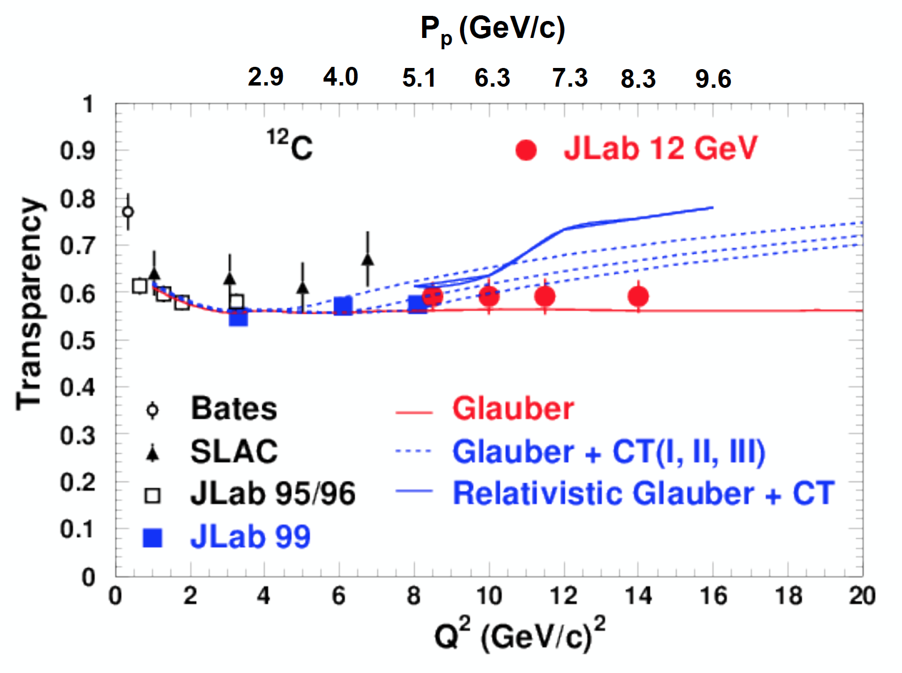
Hall C
SHMS calibration initial physics data acquired
  F₂^{H,D} structure functions, EMC effect
  D(e,e’p) at high missing momentum
  Color Transparency (CT) – ¹²C(e,e’p)
    Data for 3 points acquired.
    Highest Q² is where BNL A(p,2p) saw rise in transparency
  TMD studies (SIDIS) and Kaon electroproduction scaling measurement underway
Analyses of CT, F2, D(e,e’p), EMC underway
Projected Color Transparency errors
overlaps BNL data
Preliminary

Slide 10
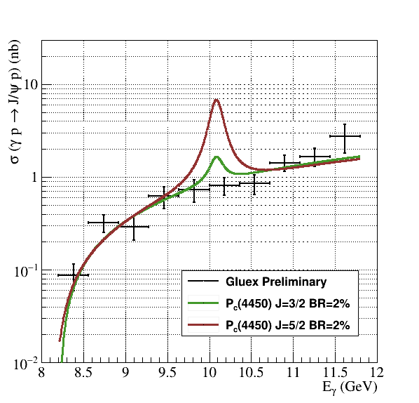
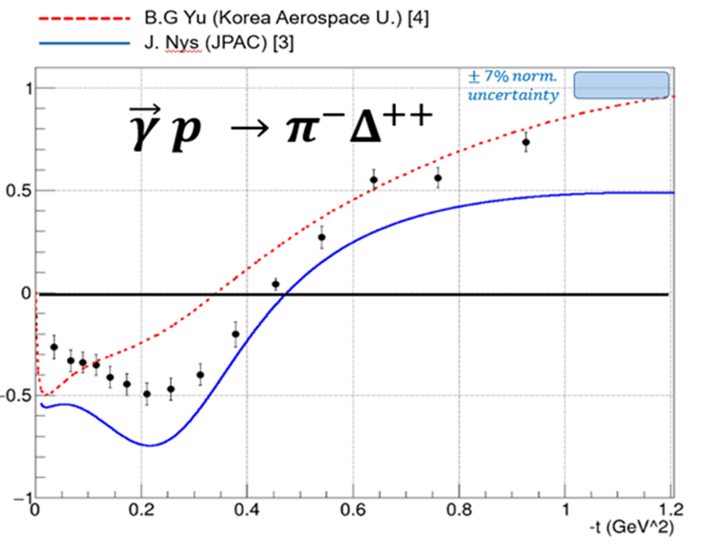
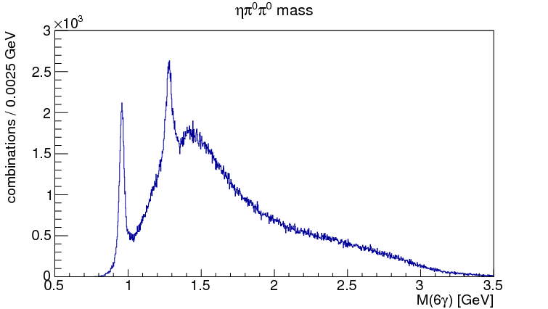
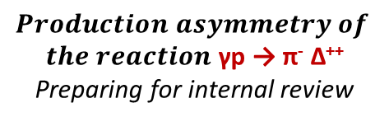

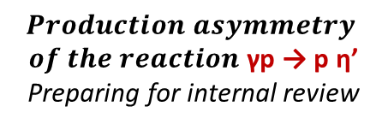
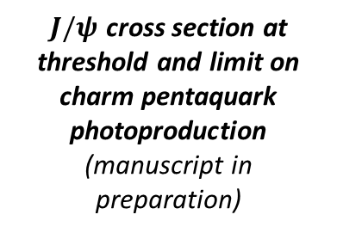

Hall D: analysis as of Fall 2018
$J/ψ$ production at threshold
$$Production Asymmetries$$
η′
$$Production asymmetry$$
$of the reaction$ γp → p η’
Preparing for internal review
$$Production asymmetry of$$
$the reaction$ γp → π⁻ Δ⁺⁺
Preparing for internal review
$J/ψ$ cross section at threshold and limit on charm pentaquark photoproduction
(manuscript in preparation)
f₁(1285)/η(1295)
GlueX-I is complete
25% of data analyzed
3 papers in preparation
Getting ready for Primex-η and GlueX-II (with DIRC)
η′
γp → p ηπºπº → p 6γ

Slide 11
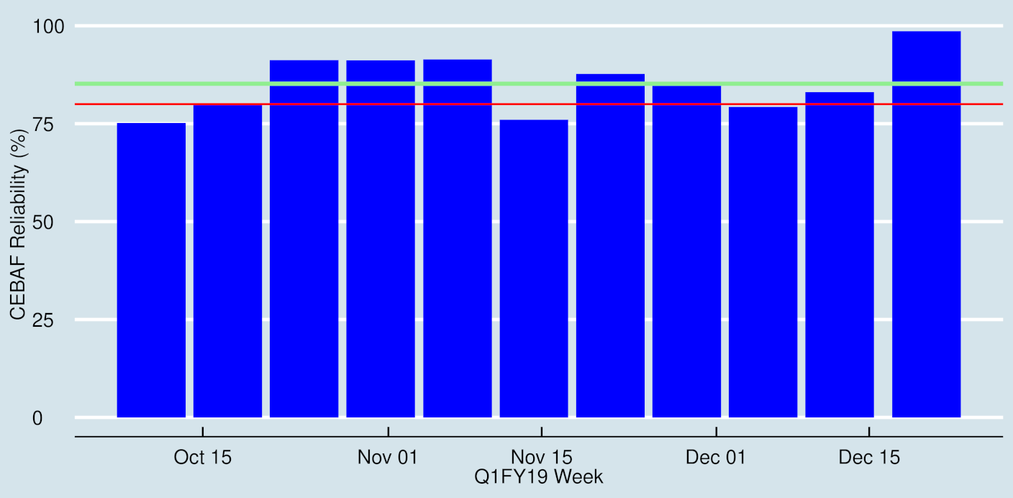
Excellent fy19-q1 CEBAF performance

Slide 12

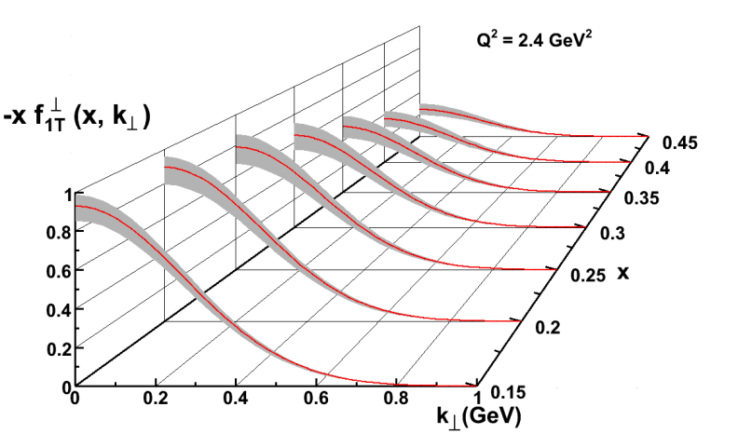
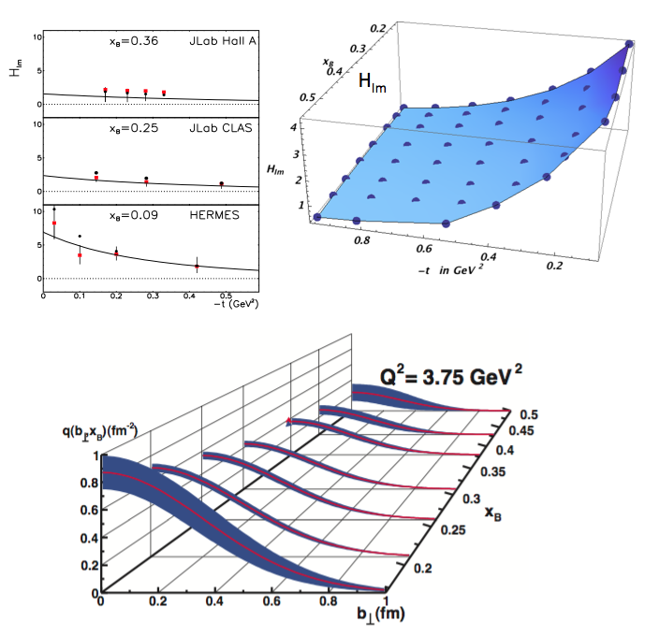
Nuclear Femtography
5D
Transverse Momentum Distribution (TMD)
– Confined motion in a nucleon (semi-inclusive DIS)
Generalized Parton Distribution (GPD)
– Spatial imaging (exclusive DVCS)
Requires
– High luminosity
– Polarized beams and targets
– Sophisticated detector systems
3D
Center for Nuclear Femtography
Proposal to Commonwealth of Virginia
  Initial request of $0.5M for pilot study awarded; funding of ~$2M/year envisioned
Consortium of Virginia universities
Theoretical physics, experimental physics, computation, data science, statistics – interdisciplinary effort
Benefit to 12 GeV program and future EIC studies
Symposium on Imaging and Visualization in Science’ , UVa, Dec. 10-11, 2018.
Major new capability
with JLab @ 12 GeV

Slide 13
Approved experiments
Topic | Hall A | Hall B | Hall C | Hall D | Other | Total
The Hadron spectra as probes of QCD | 0 | 2 | 1 | 3 | 0 | 6
The transverse structure of the hadrons | 6 | 3 | 3 | 1 | 0 | 13
The longitudinal structure of the hadrons | 2 | 3 | 6 | 0 | 0 | 11
The 3D structure of the hadrons | 5 | 9 | 6 | 0 | 0 | 20
Hadrons and cold nuclear matter | 8 | 5 | 7 | 0 | 1 | 21
Low-energy tests of the Standard Model and Fundamental Symmetries | 3 | 1 | 0 | 1 | 2 | 7
Total | 24 | 23 | 23 | 5 | 3 | 78
Total Experiments Completed | 4.6 | 2.7 | 2.1 | 0.8 | 0 | 10.2
Total Experiments Remaining | 19.4 | 20.3 | 20.9 | 4.2 | 3.0 | 67.8

Slide 14
Approved Experiments – PAC Days
Topic | Hall A | Hall B | Hall C | Hall D | Other | Total
The Hadron spectra as probes of QCD | 0 | 219 | 11 | 540 | 0 | 770
The transverse structure of the hadrons | 150.5 | 85 | 110 | 25 | 0 | 370.5
The longitudinal structure of the hadrons | 65 | 230 | 165 | 0 | 0 | 460
The 3D structure of the hadrons | 409 | 872 | 197 | 0 | 0 | 1478
Hadrons and cold nuclear matter | 220 | 275 | 205 | 0 | 14 | 714
Low-energy tests of the Standard Model and Fundamental Symmetries | 547 | 180 | 0 | 79 | 60 | 866
Total Days | 1392 | 1861 | 688 | 644 | 74 | 4658.5
Total Days - Without SoLID | 917.5 | 1861 | 688 | 644 | 28 | 4139
Total Approved Run Group Days (includes MIE) | 1392 | 1026 | 645 | 444 | 74 | 3581
Total Approved Run Group Days (without SoLID) | 917.5 | 1026 | 645 | 444 | 28 | 3061
Total Days Completed | 138.4 | 52 | 44.5 | 93 | 0 | 327.9
Total Days Remaining | 779 | 974 | 600.5 | 351 | 28 | 2733
A Decade of Experiments!

Slide 15
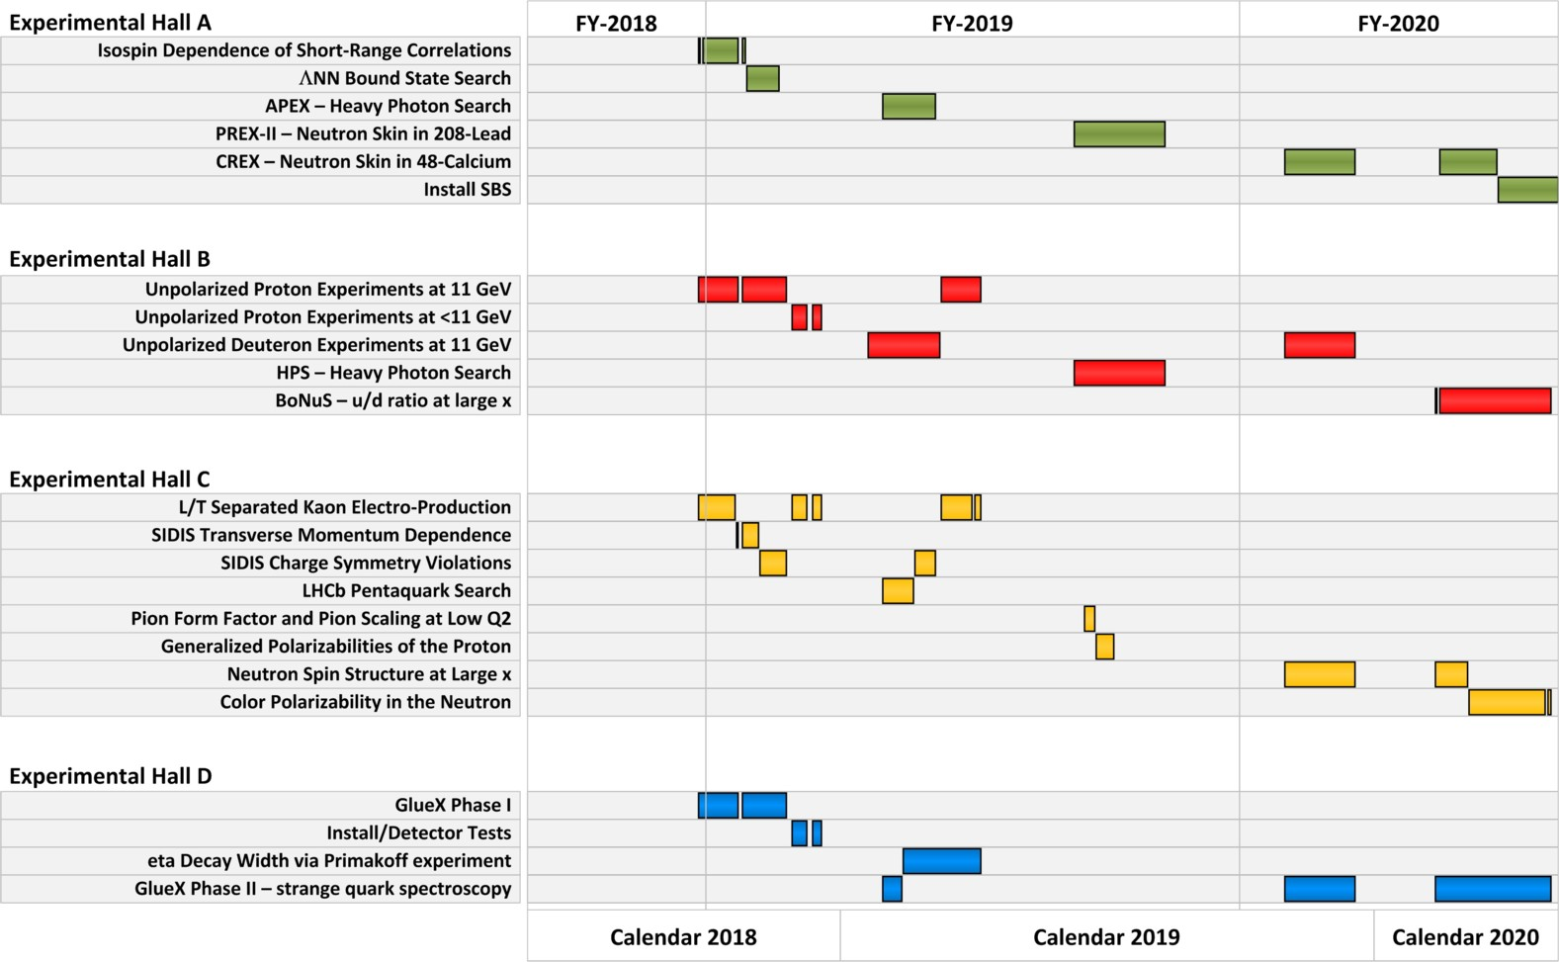
Published FY19-20 Schedule

Slide 16
PAC47
July 29th - August 2, 2019
Proposals will be due June 10 (call being drafted)
New members: Markus Diehl, Barbara Erasmus,
Matthias Grosse Perdekamp
Will initiate Jeopardy process...

Slide 17
PAC47 Jeopardy
Proposal | Hall | Title | Contact Person | PAC days | Rating | Scheduled?
E12-06-101 | C | Measurement of the Charged Pion Form Factor to High Q2 | G. Huber* | 52 | A (HI) | No
E12-06-104 | C | Measurement of the Ratio R=sigmaL/sigmaT in Semi-Inclusive Deep-Inelastic Scattering | R. Ent* | 40 | A- | No
E12-06-105 | C | Inclusive Scattering from Nuclei at $x > 1$ in the quasielastic and deeply inelastic regimes | D. Day* | 32 | A- (HI) | No
E12-06-107 | C | The Search for Color Transparency at 12 GeV | D. Dutta* | 26 | B+ | 35% complete
E12-06-110 | C | Measurement of Neutron Spin Asymmetry A1n in the Valence Quark Region Using an 11 GeV Beam and a Polarized 3He Target in Hall C | X. Zheng* | 36 | A (HI) | Yes
E12-06-114 | A | Measurements of Electron-Helicity Dependent Cross Sections of Deeply Virtual Compton Scattering with CEBAF at 12 GeV | C. Hyde* | 100 | A (HI) | 50% complete
E12-06-121 | C | A Path to 'Color Polarizabilities' in the Neutron: A Precision Measurement of the Neutron $g_2$ and $d_2$ at High $Q^2$ in Hall C | B. Sawatzky* | 29 | A- | Yes
E12-06-122 | A | Measurement of neutron asymmetry A1n in the valence quark region using 8.8 GeV and 6.6 GeV beam energies and Bigbite spectrometer in Hall A | B. Wojtsekhowski* | 23 | A- | No
E12-07-105 | C | Scaling Study of the L-T Separated Pion Electroproduction Cross Section at 11 GeV | T. Horn* | 36 | A- | No
E12-07-109 | A | Large Acceptance Proton Form Factor Ratio Measurements at 13 and 15 (GeV/c)2 Using REcoil Polarization Method | B. Wojtsekhowski* | 45 | A- (HI) | No
2 partial complete  jeopardy
3 unscheduled non-HI jeopardy
3 unscheduled HI (1 scheduled to install) ??

Slide 18
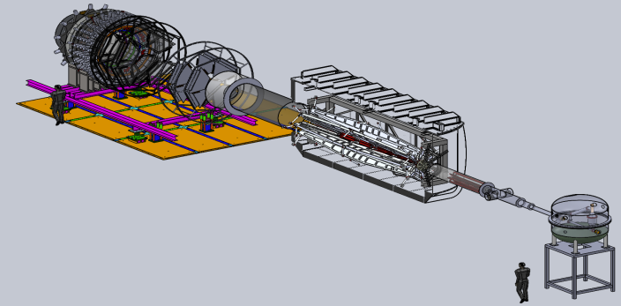

Future Projects
MOLLER experiment
(Possible MIE – FY20-24)
– Precision Standard Model Test
– DOE science review (Sept. 2014) – strong endorsement
– Director’s Cost, Schedule and Technical review held Dec. 2016
– CD-0 approved, Dec. 2016
(project paused due to budget)
– Awaiting green light to proceed
SoLID
– Large acceptance, high lumi
– SIDIS and PVDIS
– CLEO Solenoid 
– International collaboration
– Director’s review (Feb. 2015)
 new pre-CDR complete
– Awaiting science review from ONP

Slide 19

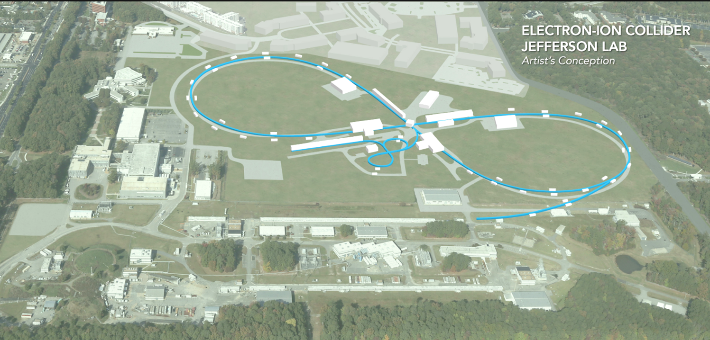
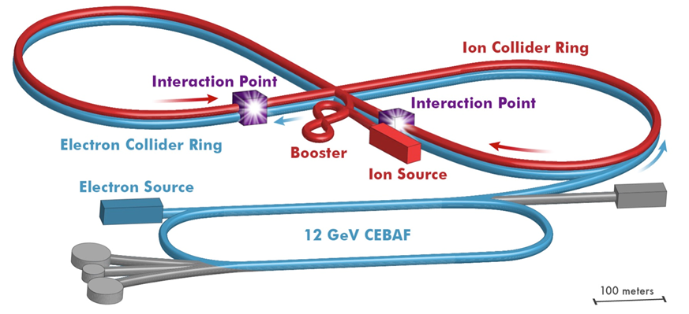
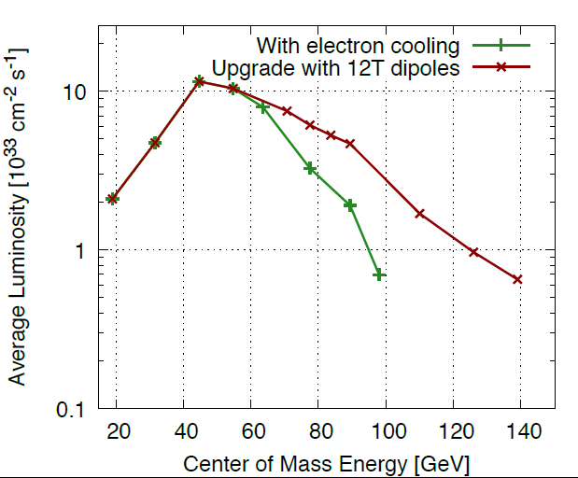
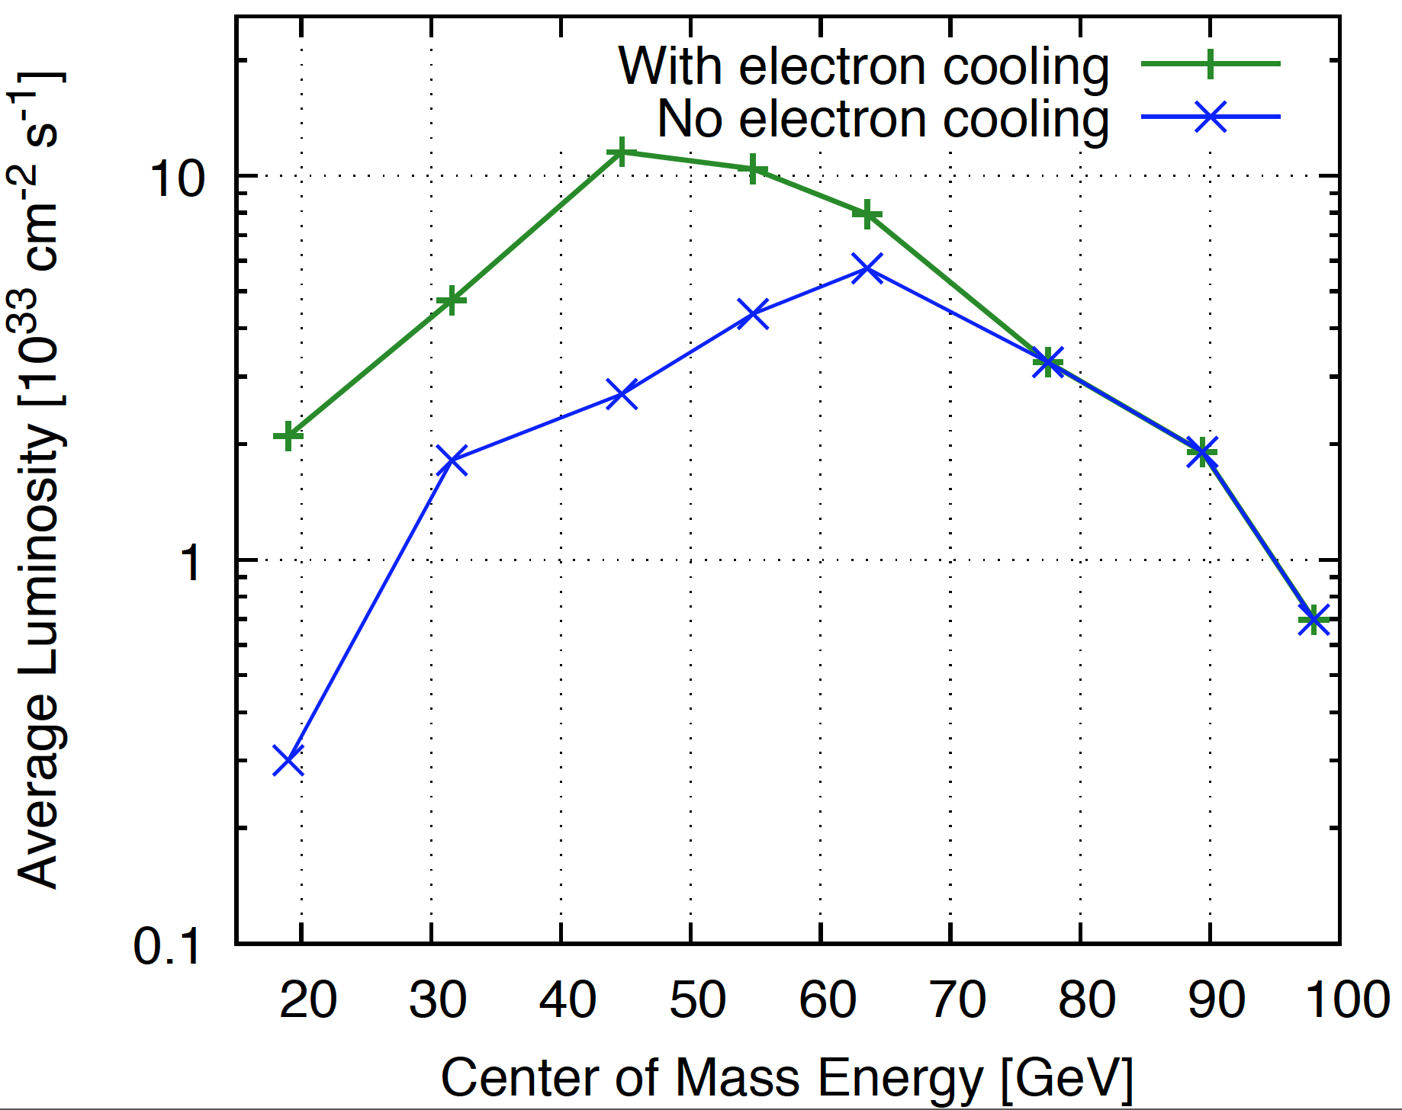

Electron Ion Collider at Jefferson Lab
JLab EIC Figure 8 Concept
    High Polarization (including deuterons)
    High Luminosity
    Energy Range: √s : 20 to 100-140 GeV (magnet technology choice)
    Low technical risk
    Flexible timeframe for construction
    consistent w/running 12 GeV CEBAF
    High performance, low-risk, well-reviewed
    Cost effective operations
    Fulfills White Paper, NAS Requirements
100 fb⁻¹/yr
PreCDR under revision,
E_{CM} 65100GeV
+ With DC and BB cooling
× With DC cooling only

Slide 20

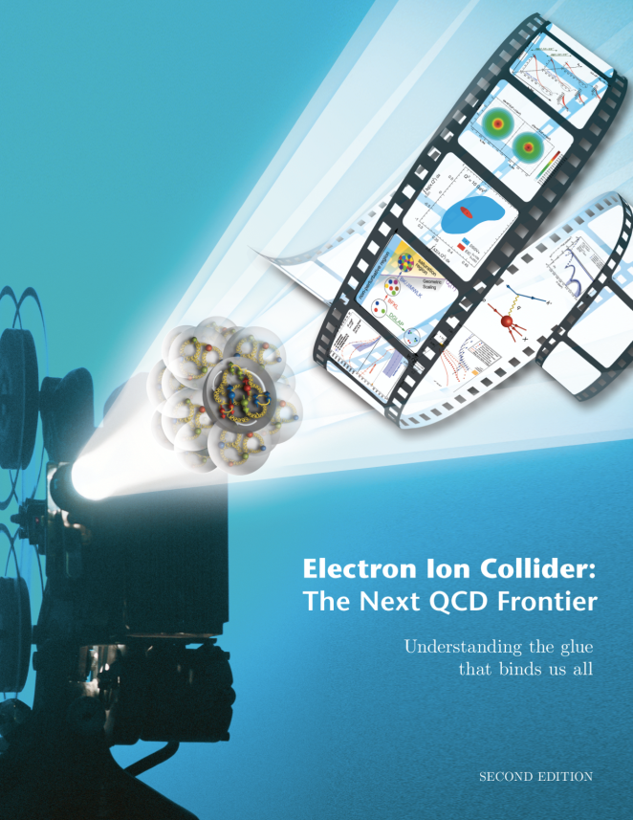
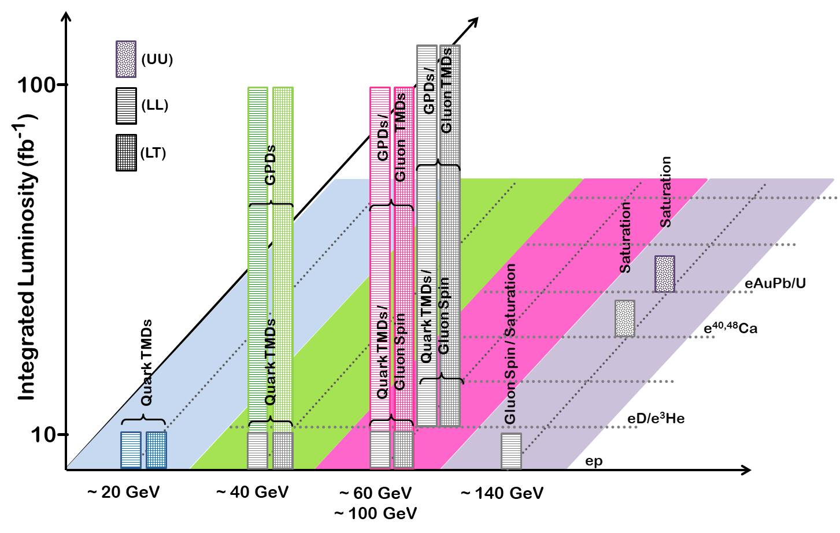
EIC white paper Science goals
Note: Total of ~640 fb⁻¹
  10³⁴ cm⁻²s⁻¹  6 fb⁻¹/week,
  ( >100 fb⁻¹ /year)
  10³³ cm⁻²s⁻¹  0.6 fb⁻¹/week,
  ( >10 fb⁻¹ /year)

Slide 21
Summary
12 GeV science program at JLab is underway
  4 Hall operation is now routine
  A broad program of 78 approved experiments with many opportunities for discovery is planned
  Initial science results are already being reported
Future Equipment projects
  MOLLER: CD0 – hope for FY20 start
  SoLID: Prepare for DOE science review
  NSF mid-scale?
Continue development of JLEIC

