Slide 1
Computing Update User Group Board of Directors Meeting Amber Boehnlein IT Division Director
Outline
IT Division News
Other News

Slide 2
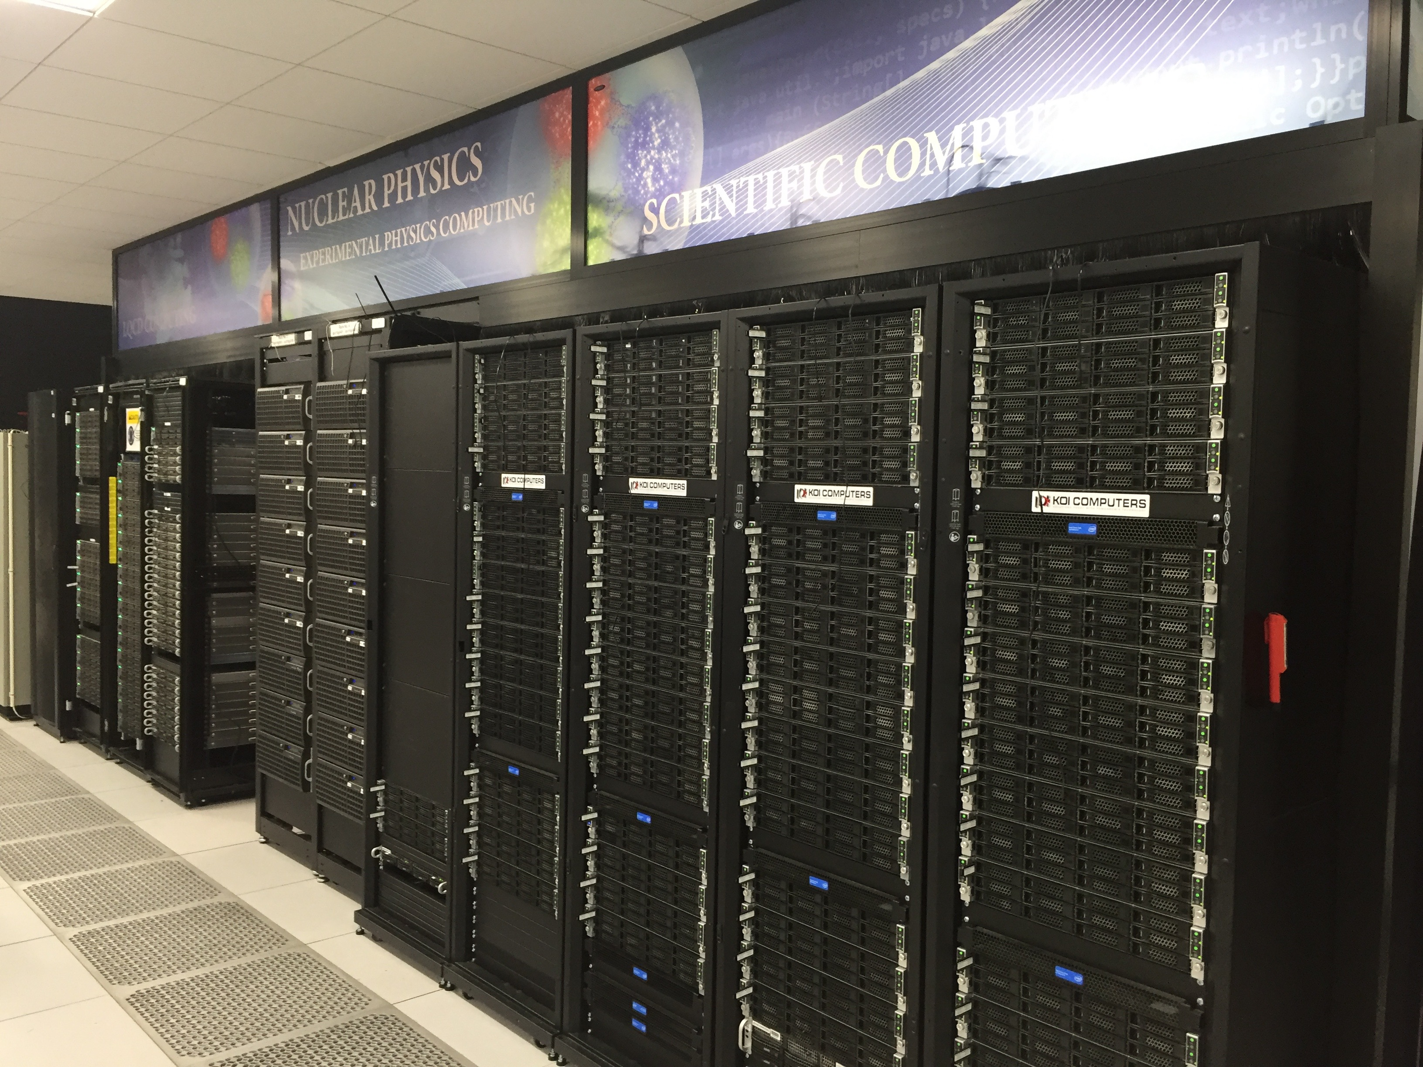
IT News
100% Internet uptime
IT service survey- Calls for more engagement/collaboration between IT & Physics
Last survey in 2016: time for another one
Made improvements to User Audit and other user management tools
We are always open to suggestions
PAC proposal submission improved and this year deploying Unicheck
Now ORCID ‘members’
rollout in process
Publications—At 85%+ manuscripts logged to DOE
We are consistently the best in the DOE complex

Slide 3
2019 IT
First phase of migration to Office365-cloud version and other cloud services complete
Replacing CCPR system with ServiceNow
Will allow dashboards and better quantification of tickets.
Rolling out in March
Hiring students for “Cyber Operations Lab’
2019 is largely an administrative year: many projects for the benefit of the Jefferson Lab but of less interest to the User community.

Slide 4
SciComp News
JLAB Existing Hardware
SciPhy Cluster:
LQCD-Ext (2016)
17,152 Xeon Phi KNL cores +
12,500 Xeon Phi cores as for last week
14,520 conventional Intel cores
5,000 Physics Farm
6,000 ‘DNR’ nodes
3,520 cores added in 2018
 | Current | FY19 | FY20
CPU (M-core-hours/year) | 37 | 87 | 90
Scratch Disk & Cache Disk (PB) | 0.65 | 1.1 | 2
Tape (GB/s) | 3 | 5 | 7
WAN bandwidth (Gbps) | 10 | 10 | 10
Proposed resources

Slide 5
SciComp News
Developed a 3 year plan for computing resources for the experimental program
2018 S&C review endorsed approach of mix of resources
Provisioning to peaks is not affordable
GlueX running MC jobs offsite using OSG and (mostly) collaboration resources at universities
GlueX also now running reconstruction at NERSC
Have allocations for GlueX and CLAS12 at NERSC for 2019
Network bottlenecks observed on our current 10G link to ESNET
Some tuning required on our part
ESNet will light a second 10G link March/April 2018

Slide 6
2019 SciComp
IT and Physics continues to host a computing round table to discuss common topics
Speakers often comment on what a nice series it is (makes it easier to get good speakers)
However it is getting harder to maintain…
Waiting for the S&C review report…
Close out was positive.
Some technical projects this year such as phasing out PBS on the farm
Machine Learning will be a lab focal area for the year.
IT will be hiring
Establish working group (s) based grass roots effort
Working with University CS and Math groups as well

Slide 7
Open Data & Data Cataloging
Open Data discussed at last summers’ meeting…
Many considerations…
Technical; infrastructure; policy; cost….
Some initiatives
ORCID is the de facto standard.
Digital Object Identifier- USQCD has done some work
Software Citations--Dan Katz of UIUC is spearing heading
CERN Open Data
Can schedule a Round Table on this topic

