Slide 1
Report to the JLUO Board of Directors
Elizabeth L. Lawson
Chief Governance Officer / Principal JSA/JLab Liaison
SURA Corporate Secretary
JSA Board Liaison and Secretary
January 11, 2019

Slide 2
Jefferson Lab Committee Charter
SURA Executive Committee renamed former JSA Programs Committee as the Jefferson Lab Committee in September 2018
SURA Board approved new Committee charter November 2018 including the responsibilities to monitor and oversee the SURA Residence Facility and JSA Initiatives Fund Program, both of which are important for JLab users.
Steering Group
Elizabeth Beise, UMD, Chair
Jerry Draayer, SURA/JSA
Paul Eugenio, FSU
Tanja Horn, Catholic
Krishna Kumar, Stony Brook
Stuart Henderson, JSA/JLab
Zisis Papandreou, Regina
Elizabeth Lawson, SURA/JSA
Next JLab Committee Meeting: Georgia Tech, Atlanta, March 28, 2019

Slide 3
JSA Initiatives Fund Program – Community Building Initiative
JSA Initiatives Fund Program supports specific projects, initiatives, and activities that:
Further the scientific outreach and enhance the Lab’s scientific and technology programs
Leverage commitments and resources of others, including the Lab itself
Benefit the Lab’s extended user community
FY2019 Program includes 32 awards for $400K
Over $600K contributing funds associated with 2019 awards
FY19 IF Program Status (to date)
FY2019 awards: $400,000
Prior year carryover: $154,939
Total IF program $554,939
Expenditures $ 24,752
Program balance $530,187
Initiatives Fund Program website: http://www.jsallc.org/IF/IFIndex.html

Slide 4
JSA Initiatives Fund Program – History
JSA has committed over $5.8M and made ~370 awards
Total award amounts of over $6.2M
‘Extra’ award funds result of IF guideline that unused prior year funds are returned for current year awards
Note: Starting in FY17, lobbying costs were not deducted from the Director’s Discretionary Fund account

Slide 5
JSA Initiatives Fund Program – Schedule
Jun 3: Call for proposals made
Jul 15: Proposals due
o/a Jul 22: Revised proposals received following JSA review
o/a Jul 29: Proposals distributed to Lab management and UG BoD
o/a Aug 30: Lab and UG BoD reviews submitted
o/a Sep 16: Proposals distributed to chair-appointed evaluation committee
o/a Oct 21: Evaluation committee review conducted
o/a Nov 4: Award decisions submitted to CEO for concurrence
o/a Nov 18: Proposers notified of outcome
o/a Nov 26: Press release issued
Post award: JSA debriefs PI’s re. proposals

Slide 6
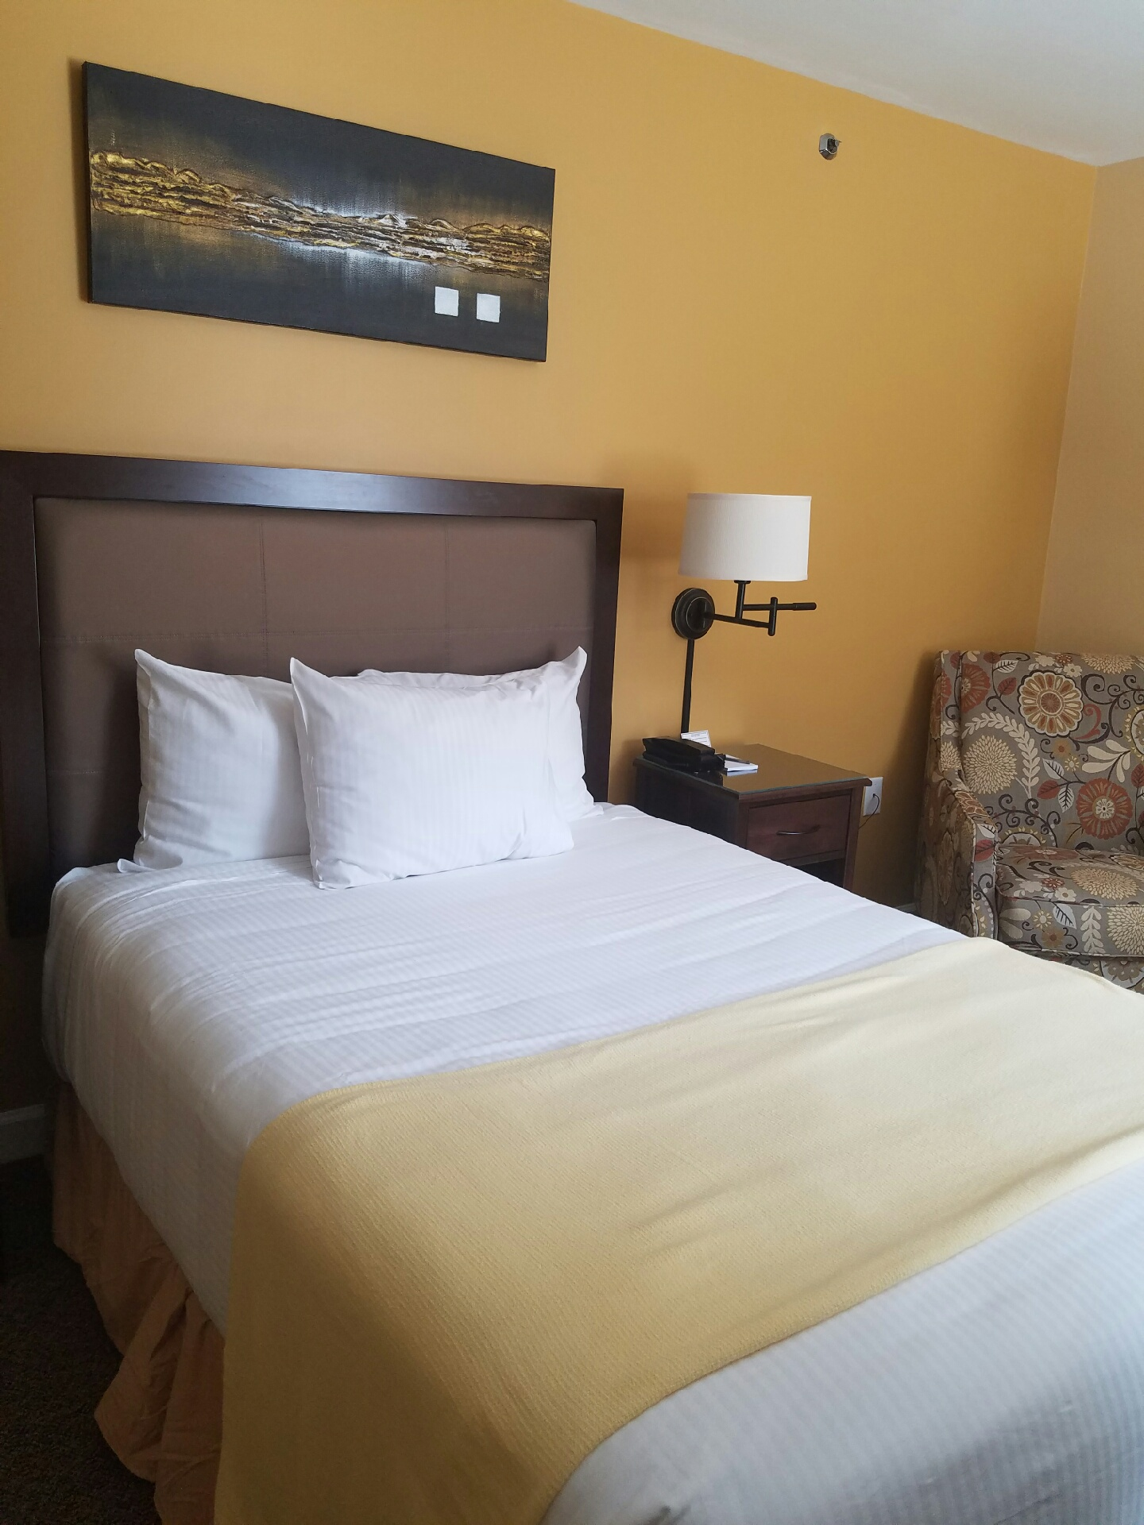
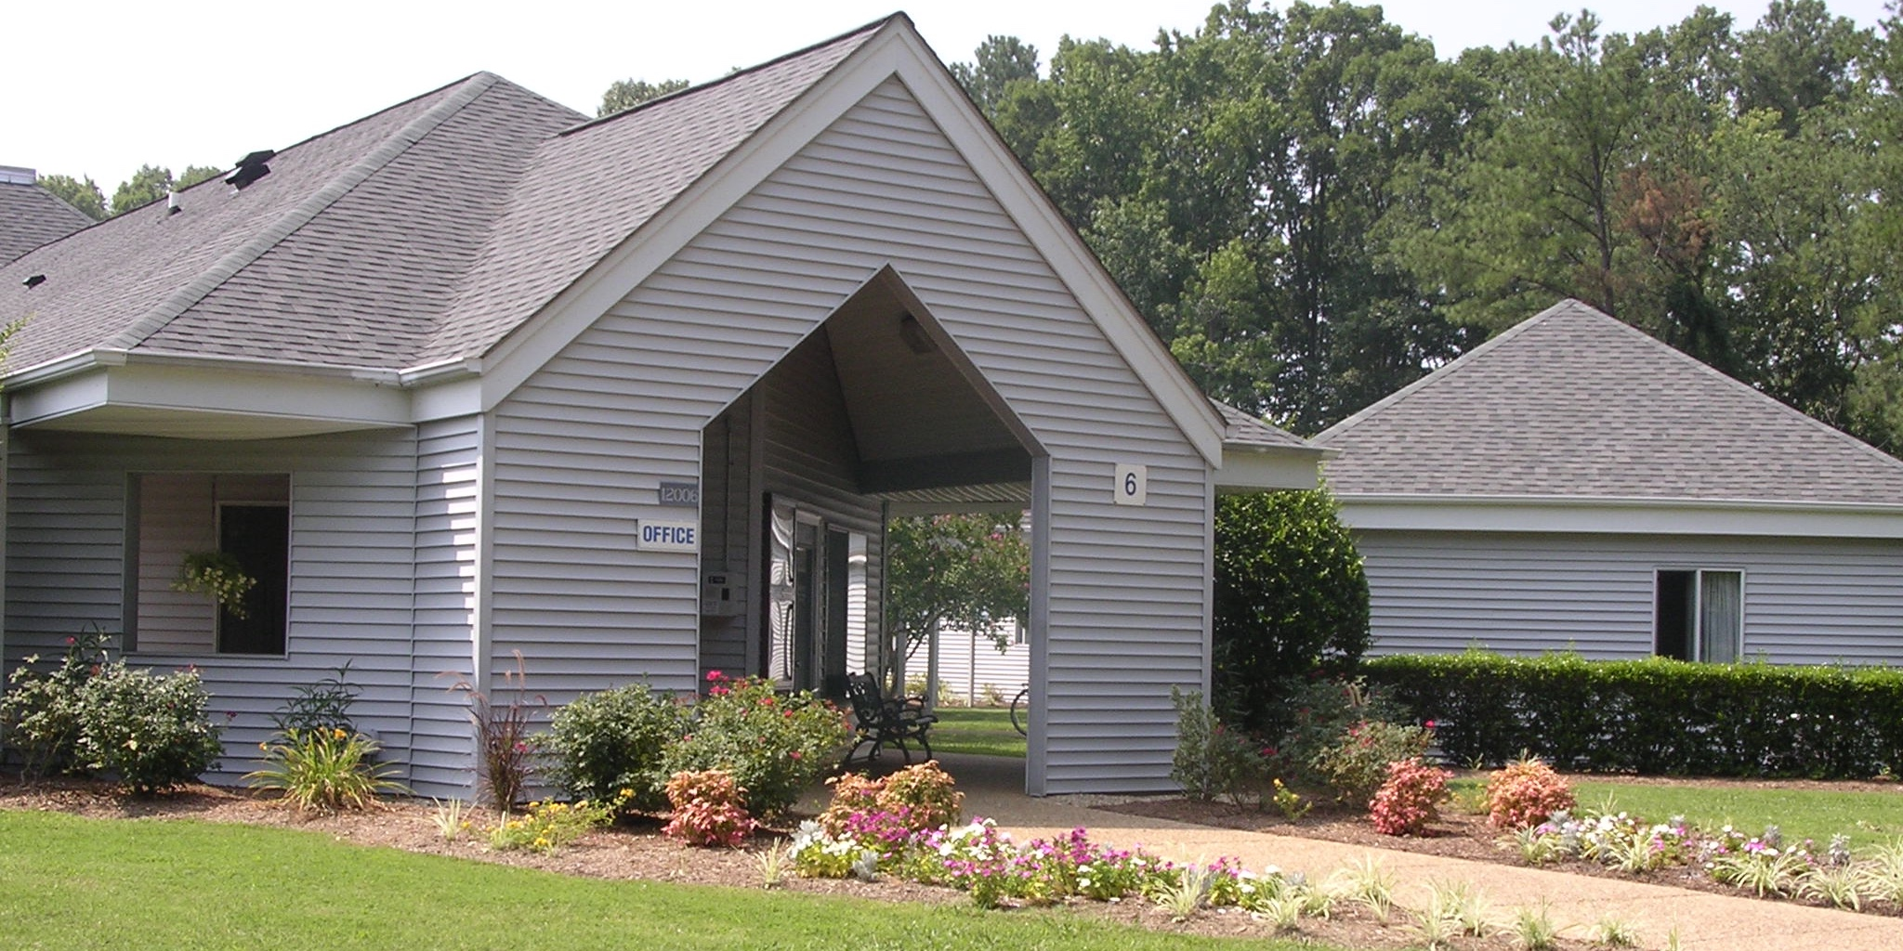
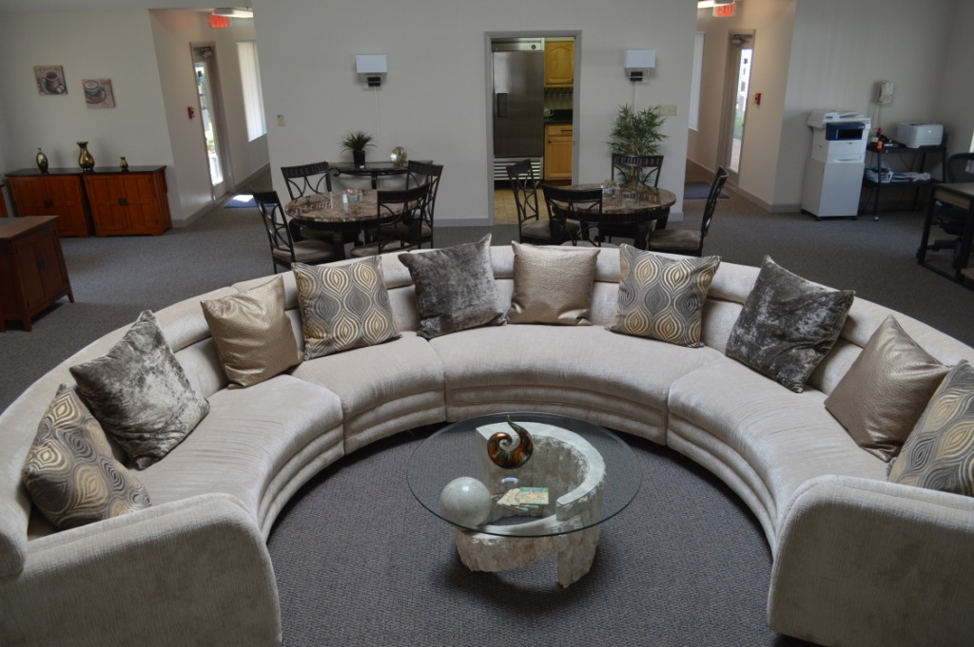
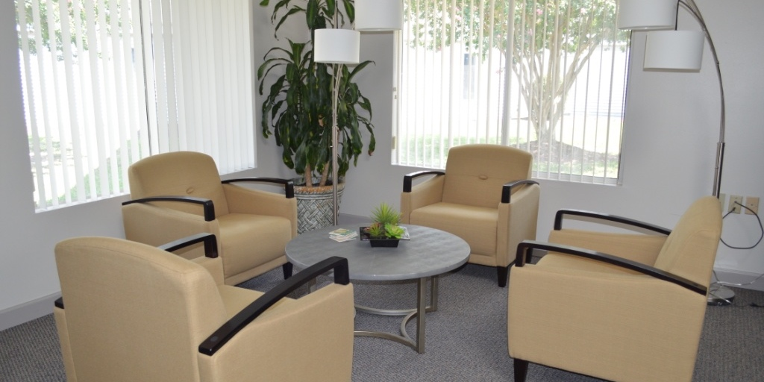
SURA Residence Facility
SURA continues to manage and operate the Residence Facility on a break-even basis for use by researchers and students at the Lab
Facility operations finished out FY2018 in the positive with revenues of $554.2K (69.6% occupancy) and expenditures of $473.5K.
Business model enables economical rate structure, with ADR of ~$61 (33% less than GSA lodging per diem of $95)
Renovations completed
2018, Building 9; HVAC replacements
2017, Building 3; Roof replacements
2016, Building 8; Main building
2015, Building 2
FY2019 Budget
Break-even operating budget anticipates rate increase April 1, 2019
Capital budget includes renovation of Building 10 and parking lot paving
Guest satisfaction
Remains very high: overall 96% satisfaction
Much encouragement to continue renovations

Slide 7
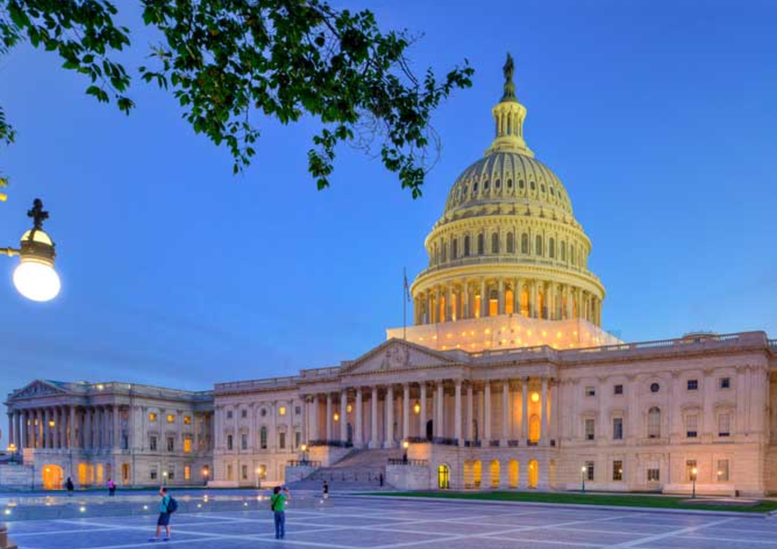
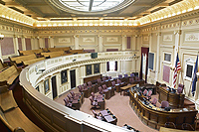
SURA / JSA Relations Program
Regular meetings with federal and state lobbyists, regular meetings and discussions with federal, state, and local officials, representatives, and staffers, and Lab user community
Funding boost for SC in FY19 appropriations is result of Virginia delegation’s advocacy and meetings with Virginia delegation
Seed funding from Virginia for the Center for Nuclear Femtography, supported by Virginia university presidents
Successfully negotiated language in Virginia budget bill exempting JSA from sales tax on personal property for biennial
Working with City of NN, State of VA, College of W&M, private developer, and regional groups to ensure land and infrastructure issues are successfully resolved for future Lab expansion
Electron-Ion Collider User Group
Supported EIC User Group’s advocacy efforts on Capitol Hill in early December

