Slide 1
Sub-ps bunch length measurements
at the JLab FEL
with coherent transition radiation (CTR)
and “Martin-Puplett” interferometer
Pavel Evtushenko, JLab
The key principles of the diagnostic
Operation of the Matrin-Puplett interferometer
An examples of data
Low frequency cut-off
Data Evaluation in frequency domain
Pulsed beam vs. CW beam measurements

Slide 2
ps and sub-ps bunch length measurements using CTR
Transition radiation is produced when the electron bunch passes a boundary of two media.
Respond time is zero. Shape of the radiation pulse is a “copy” of the electron bunch shape.
When the wave length of the radiation becomes more than the bunch length the radiation becomes COHERENT. ( λ >> L )
Power is proportional to:
incoherent radiation ∼ N
coherent radiation ∼ N²
Measurements of the radiation spectrum give information about the bunch length.

Slide 3
Coherent radiation power spectrum
- Coulomb field of electron bunch
- Fourier transform of the Coulomb field
- Power spectrum of the bunch
- Power spectrum of a single electron
- Bunch Form Factor (BFF)

Slide 4
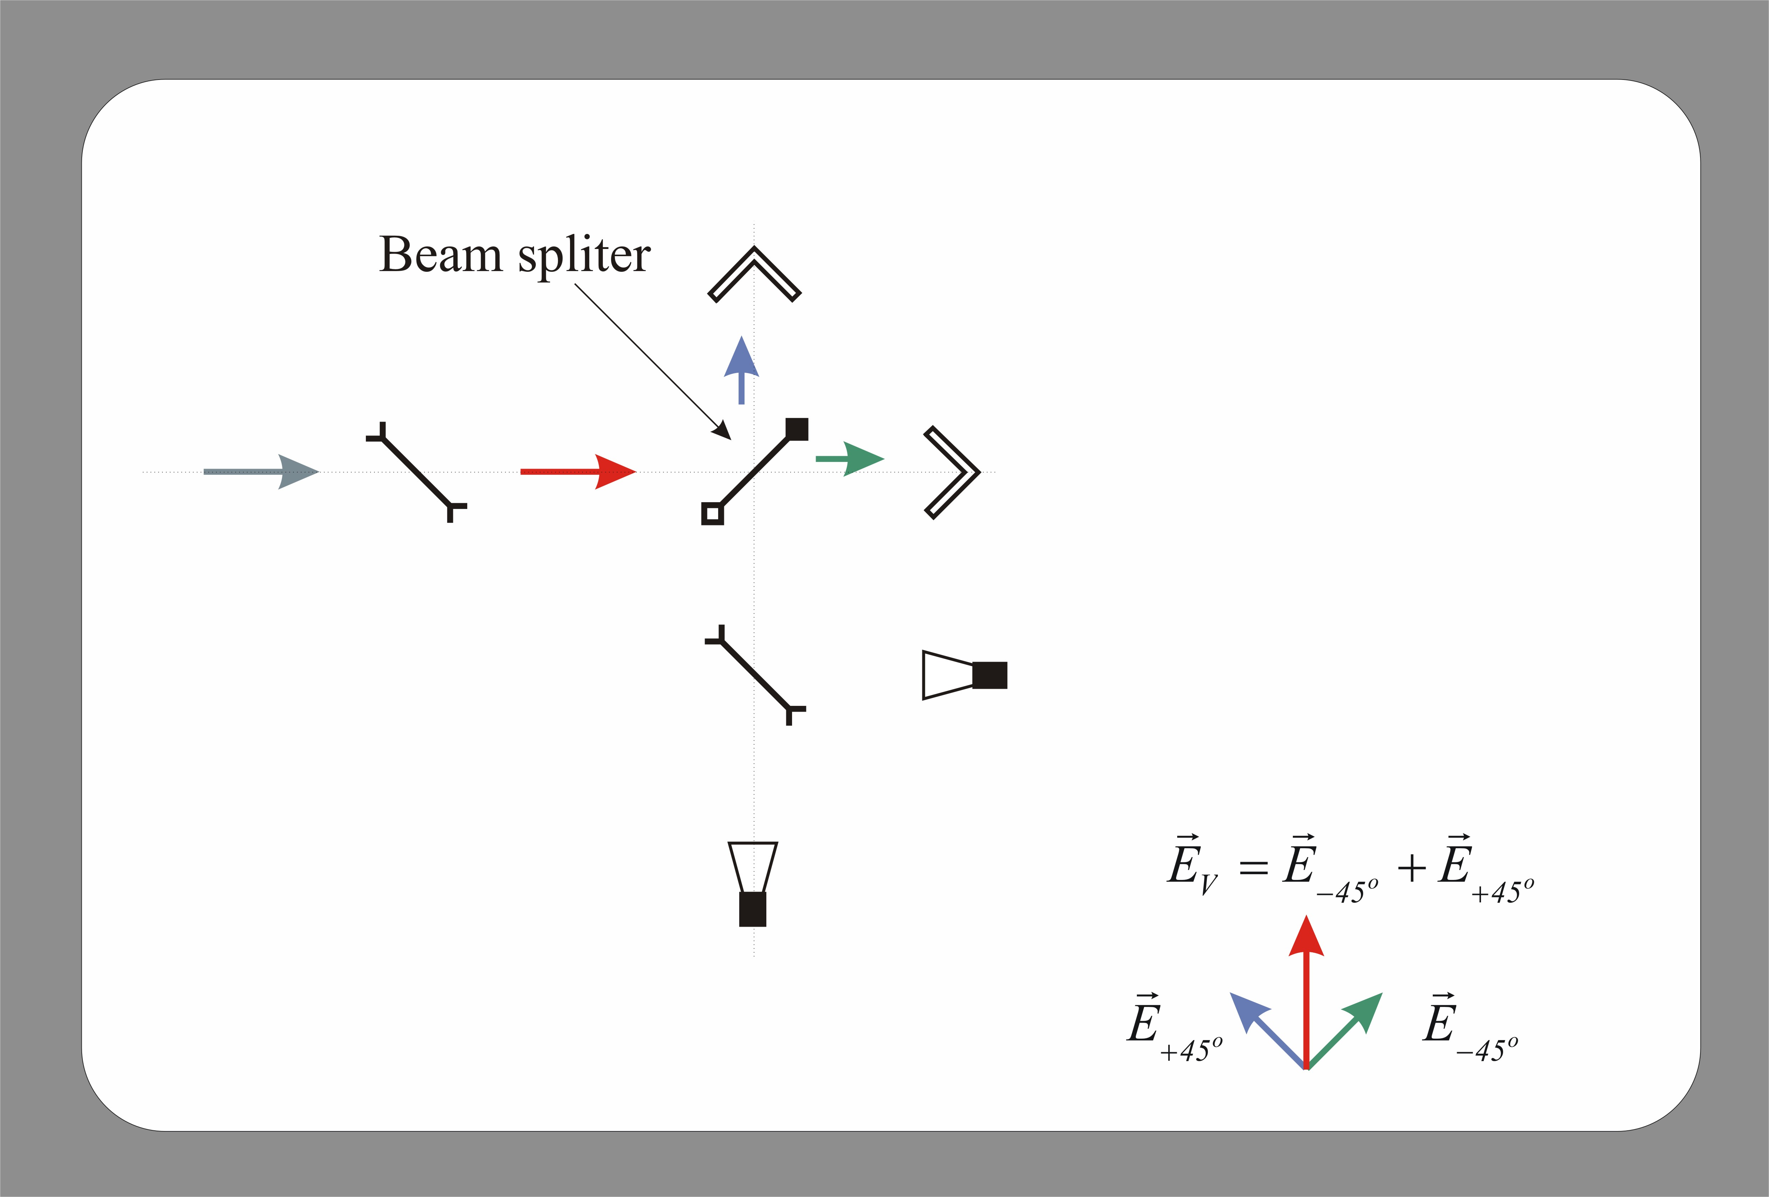
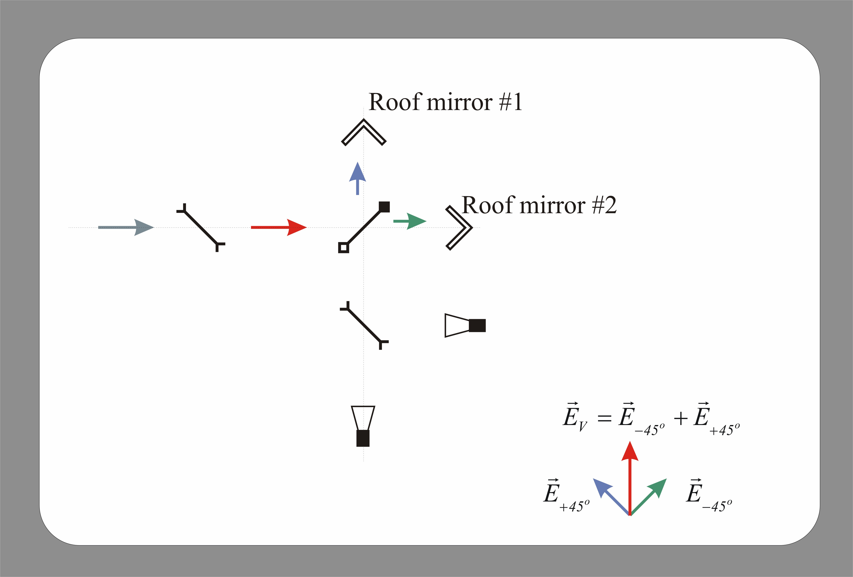
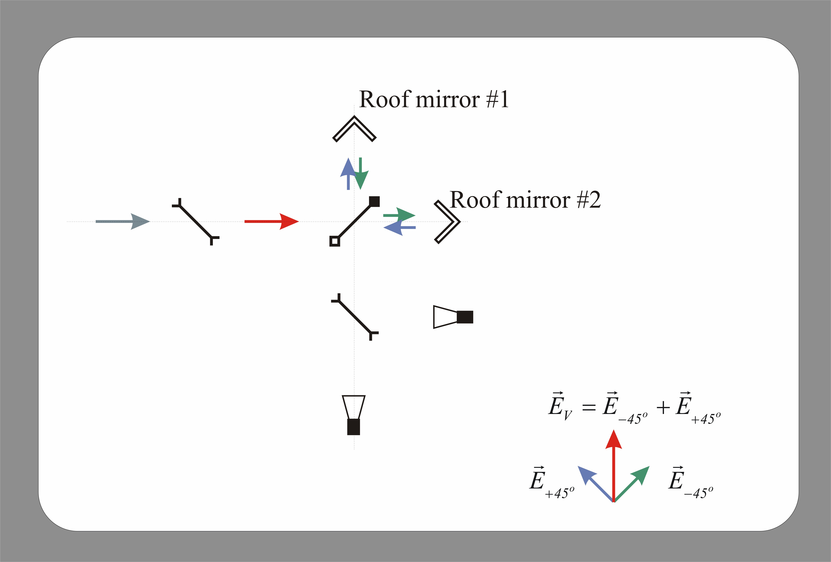
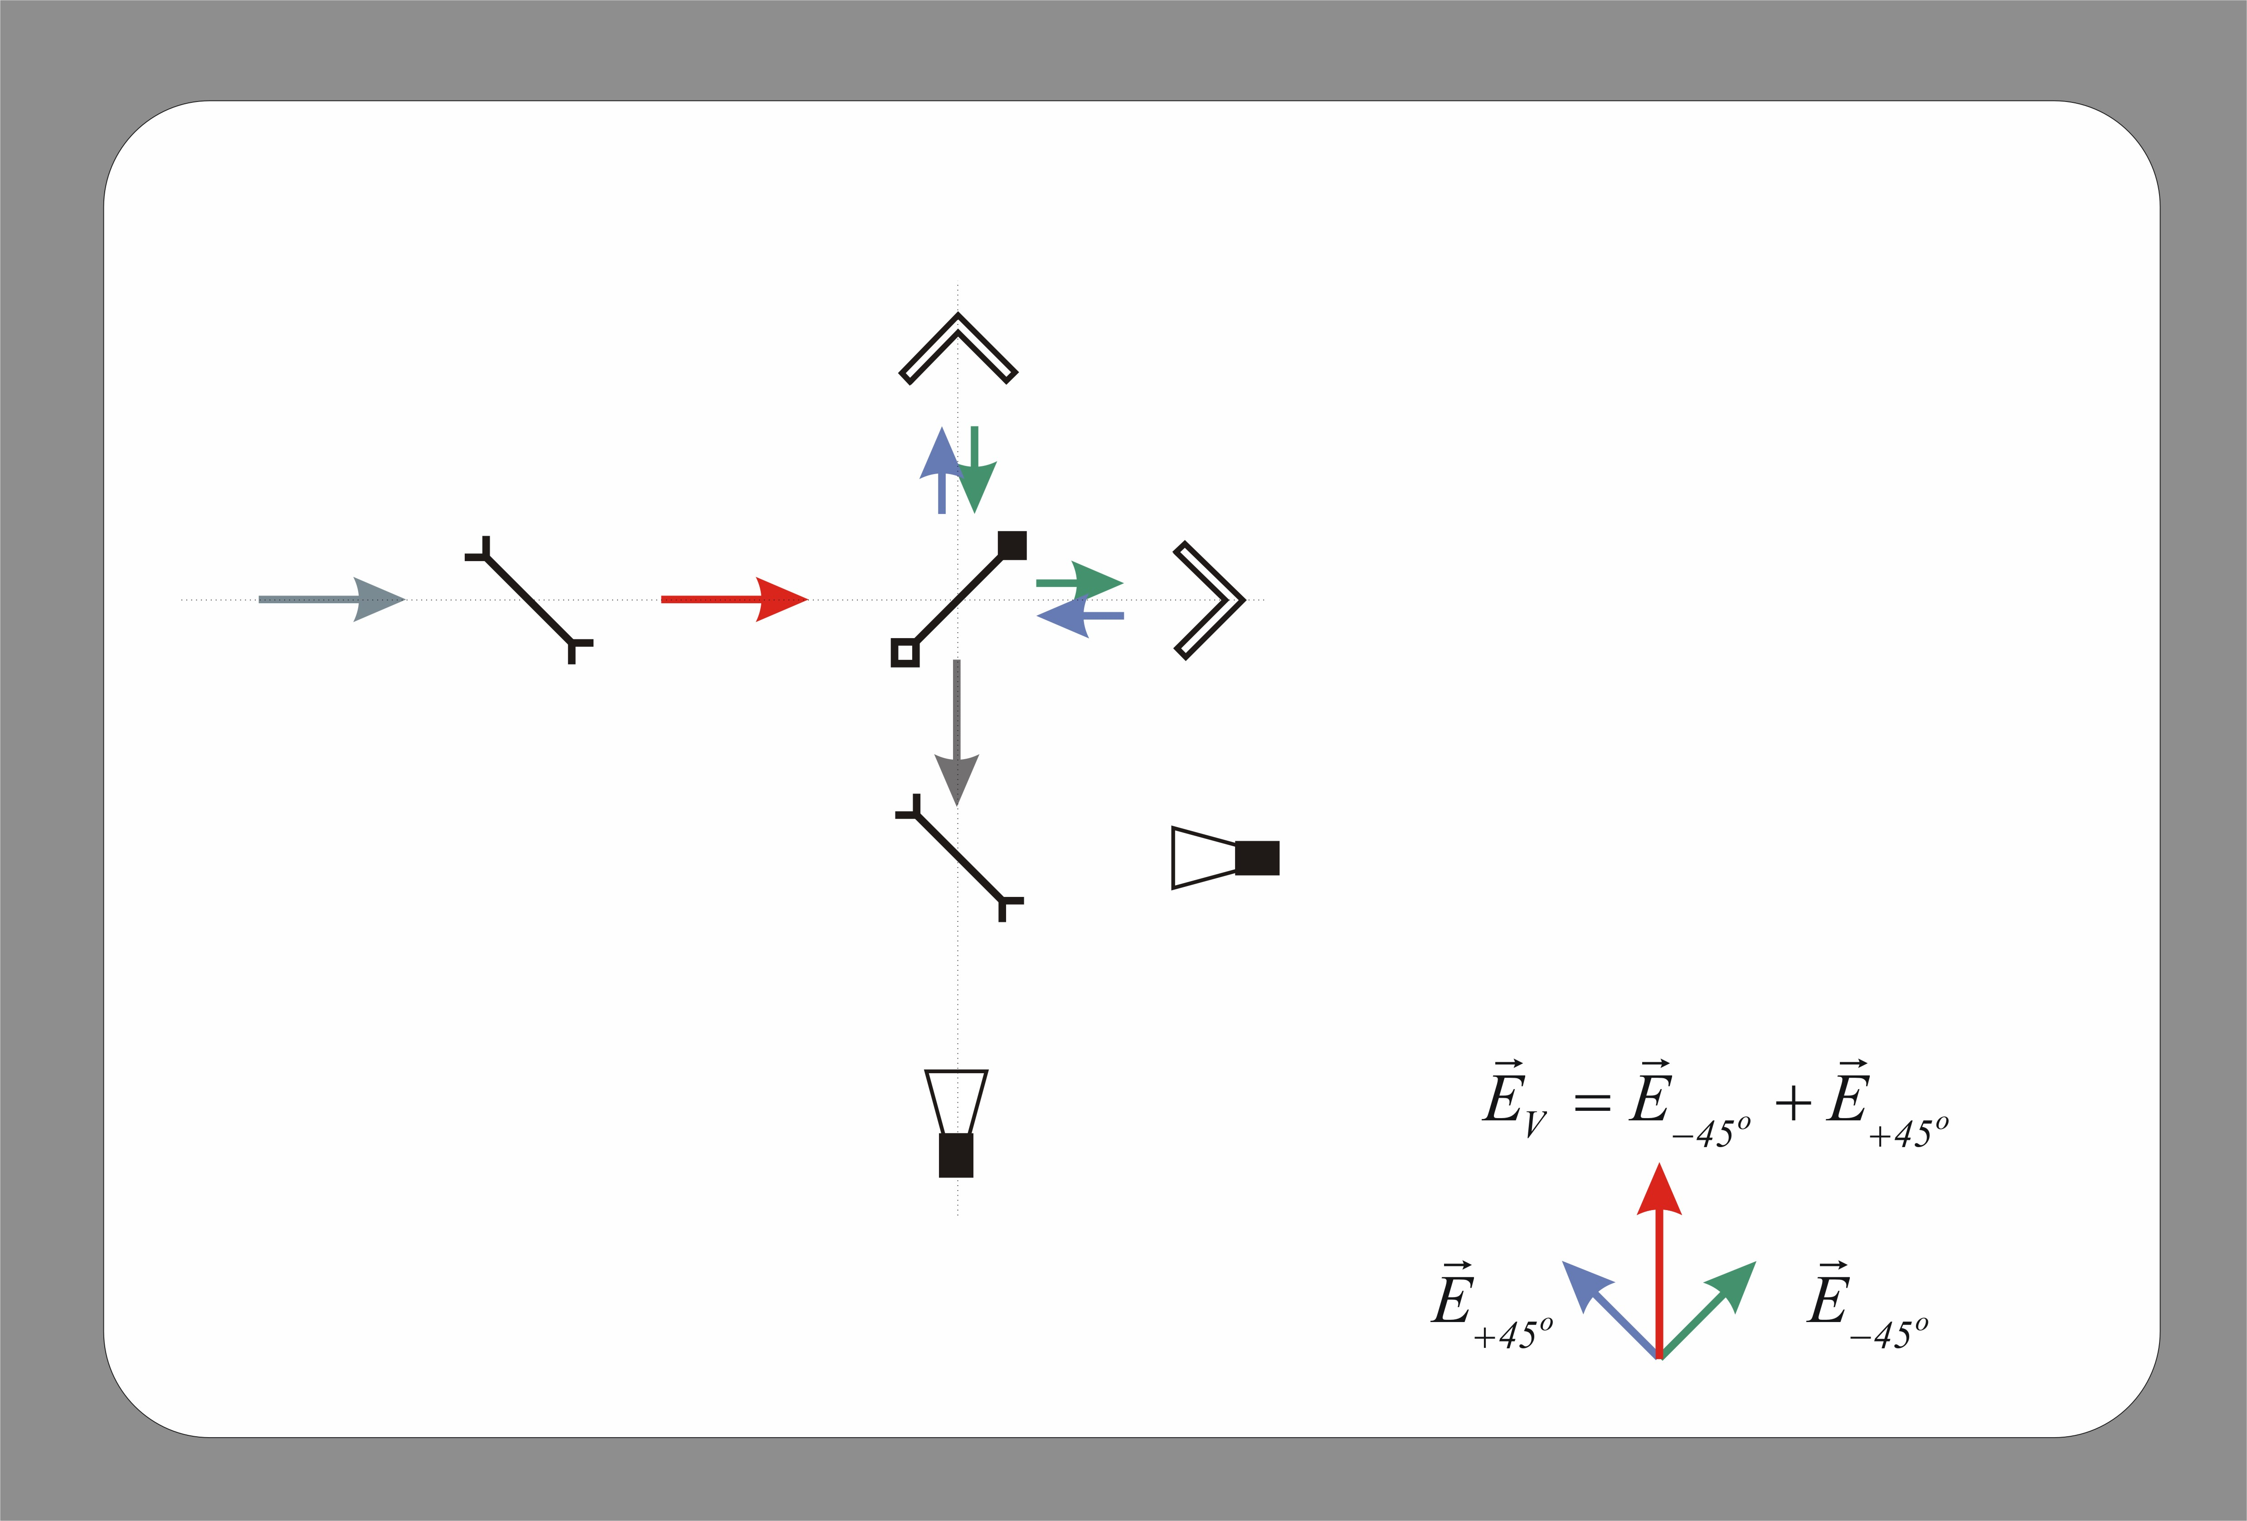
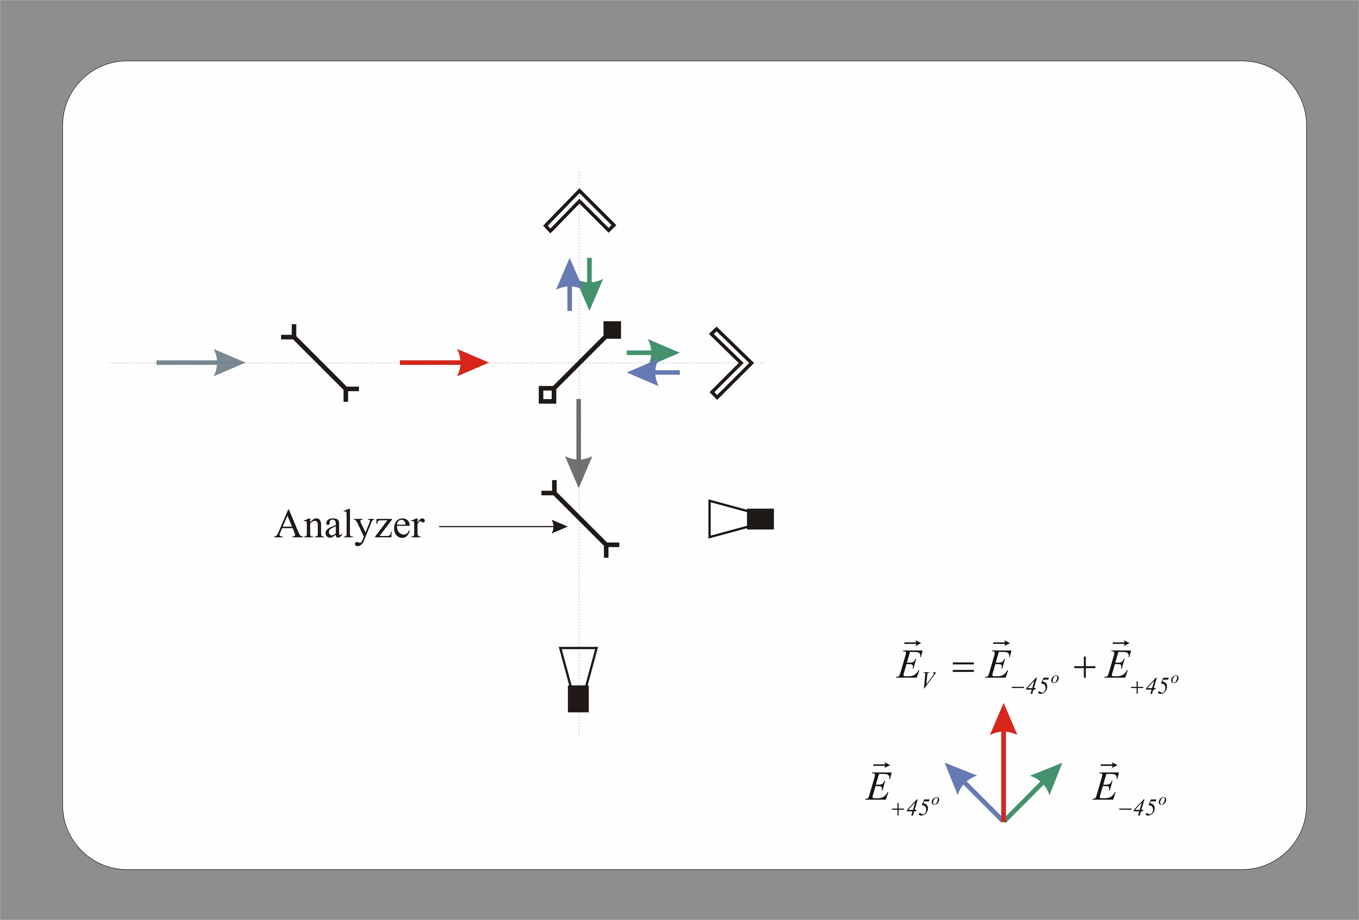
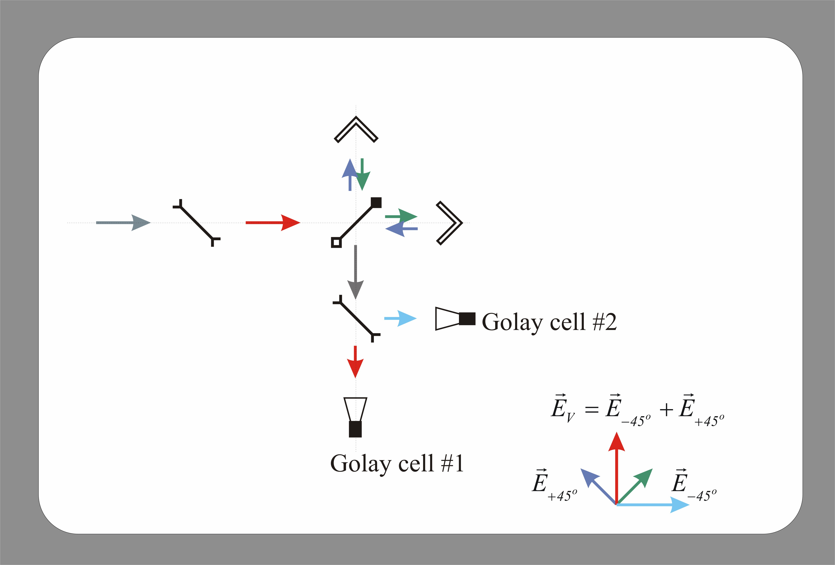
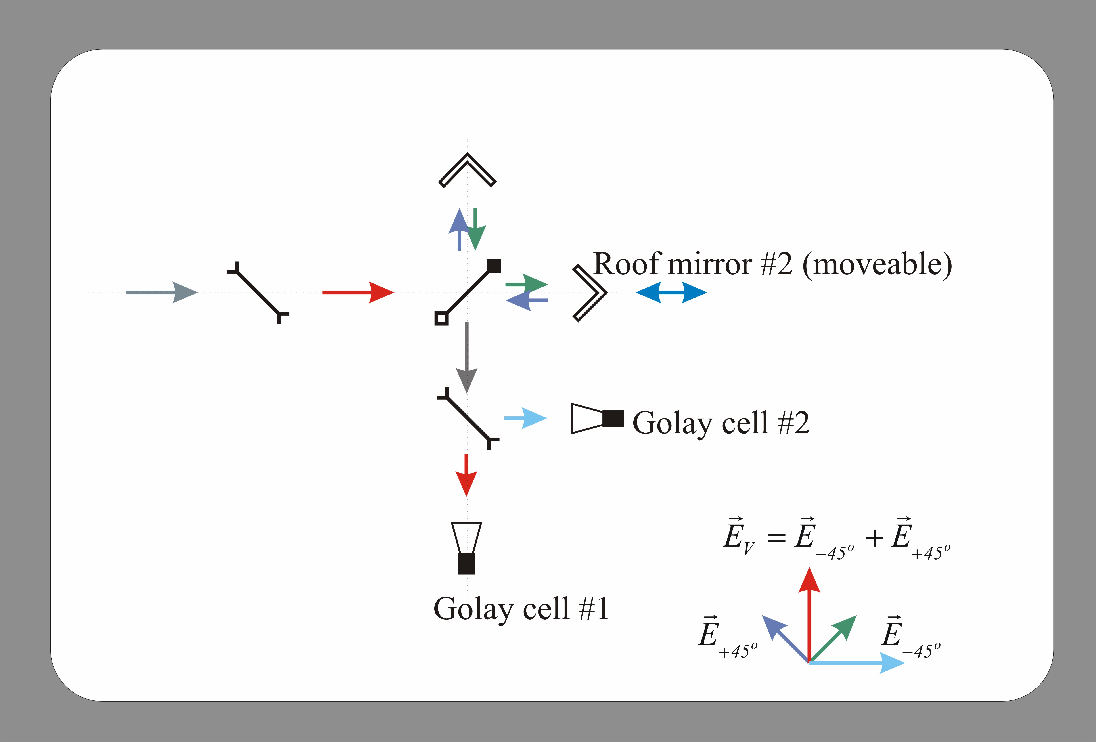
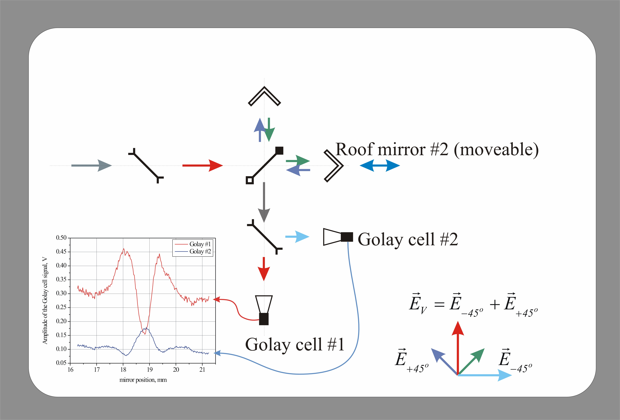
The Martin-Puplett interferometer operation

Slide 5
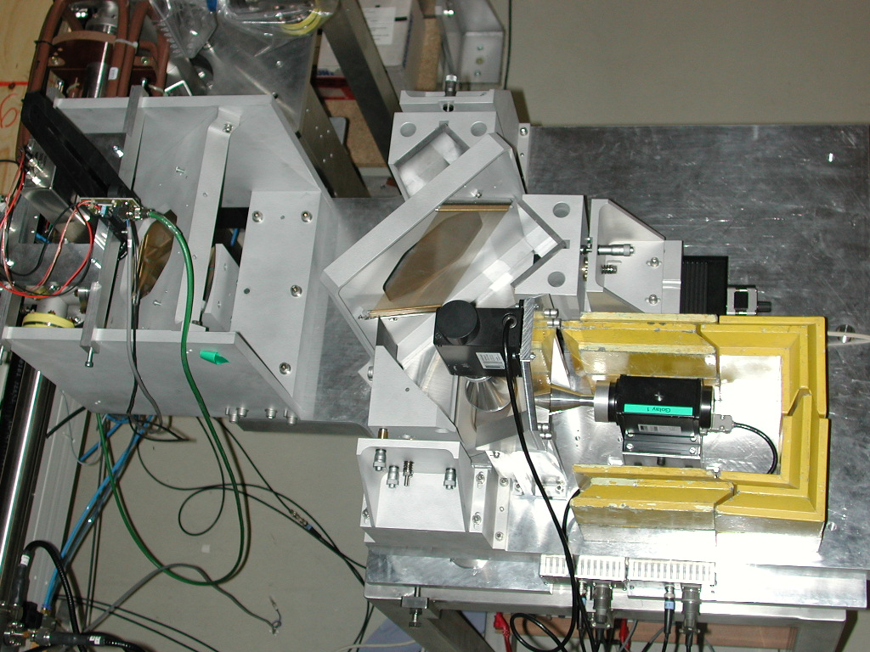
The Martin-Puplett interferometer

Slide 6
The Martin-Puplett interferometer
longitudinal field profile
at the MPI entrance
longitudinal field profile
at the MPI exit
detectors measure
intensity I∝E²
the autocorrelation function is
measured with the help of the MPI
The Wiener-Khintchine theorem says:
“the Fourier transform of the autocorrelation function
is the power spectrum”.

Slide 7
The MPI scan

Slide 8
Interferogram - the normalized difference

Slide 9
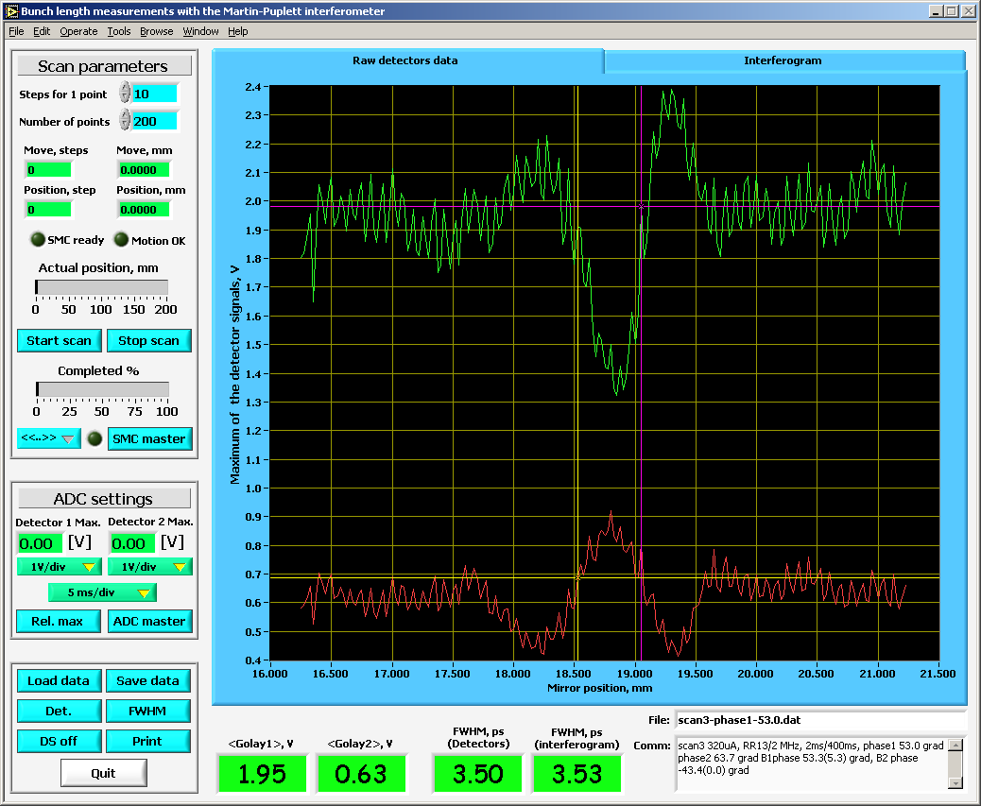
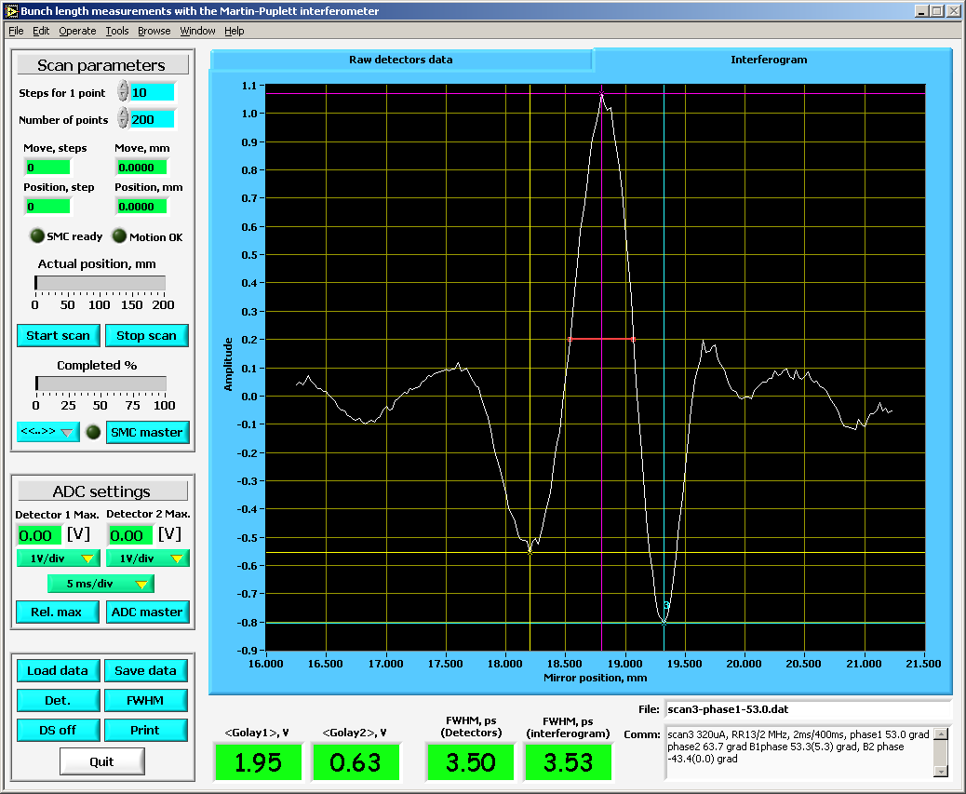
The use of two detectors: raw data vs. interferogram

Slide 10
Bunch length reconstruction
the Gaussian shape
of the bunch is assumed
its power spectrum is
also Gaussian
low frequency cut-off
diffraction on the Golay
cell input window
two filter functions
were considered:
The fit function is used

Slide 11
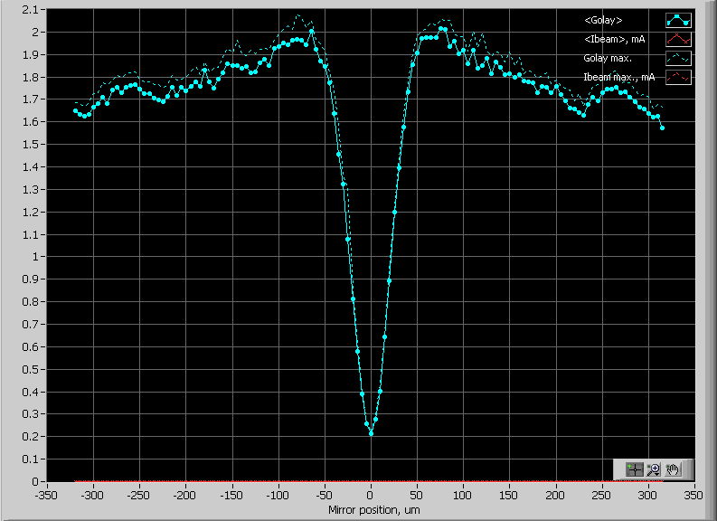
Jlab FEL CTR interferogram
step size – 5 um, 128 steps

Slide 12
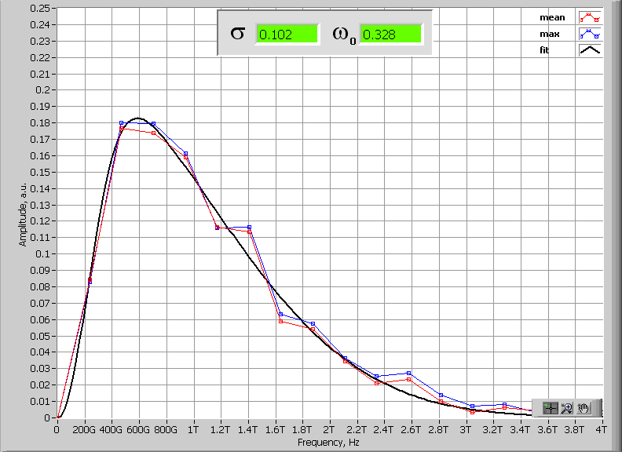
Jlab FEL CTR spectrum and the fit function

Slide 13
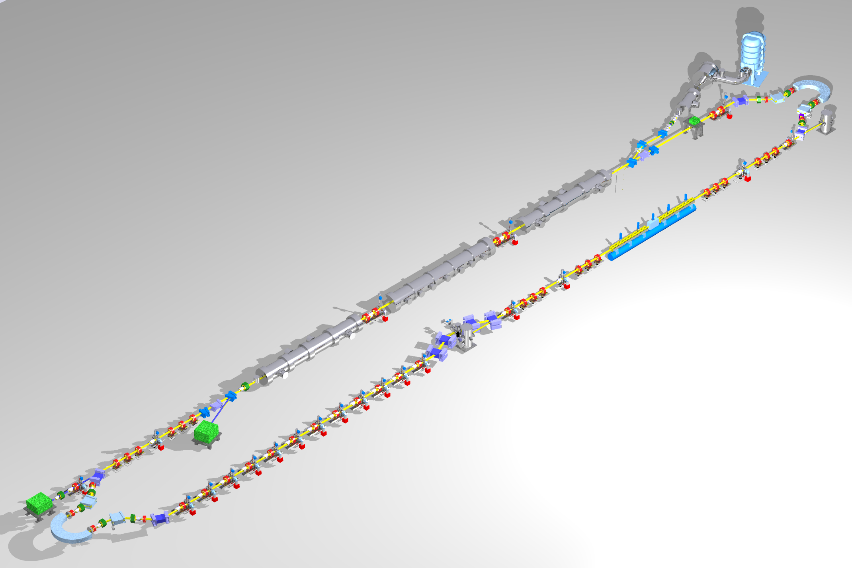
JLab FEL (layout and longitudinal matching)
Requirements on phase space:
Long bunch in linac
high peak current (short bunch) at FEL
bunch length compression at wiggler
“small” energy spread at dump
energy compress while energy recovering
“short” RF wavelength/long bunch
⇒ get slope and curvature right
E
φ
E
E
E
φ
φ
φ
modified Martin-Puplett
interferometer (step scan)
is used with CTR;
only tune (pulsed) beam
Michelson interferometer
(rapid scan)
is used with CSR;
CW beam

Slide 14
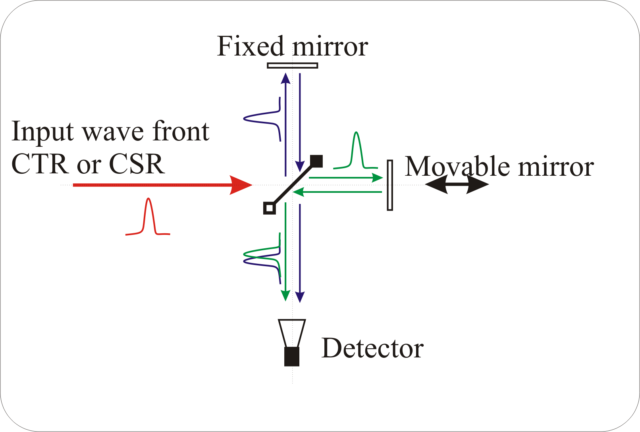
Interferometers
We use two different interferometers;
essentially both are a modification
of the Michelson interferometer.
The two interferometers differ in
implementation;
Beam splitter
Polarizer
Detector
Focusing element
Mirror position measurements
Modified Marin-Puplett interferometer:
(step scan device)
beam splitter & polarizer (wire grids)
detector (Golay cell)
focusing (Plano-convex lens)
mirror position is set by
step motor
Used with CTR
Michelson interferometer:
(rapid scan device 2 sec/scan)
beam splitter (silicon)
detector (pyroelectric)
focusing (parabolic mirrors)
mirror position is measured by
another built-in interferometer
Used with CSR

Slide 15
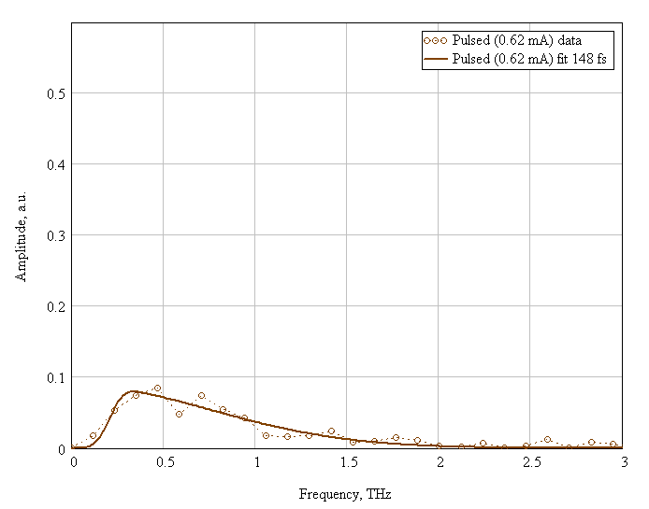
Pulsed beam measurements; RMS 148 fs
The mod. Martin-Puplett interferometer (the Happek device) measurements

Slide 16
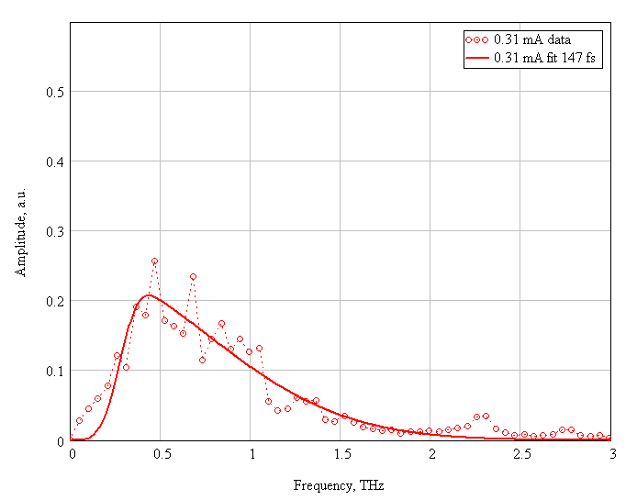
CW beam measurements 0.31 mA; RMS 147 fs

Slide 17
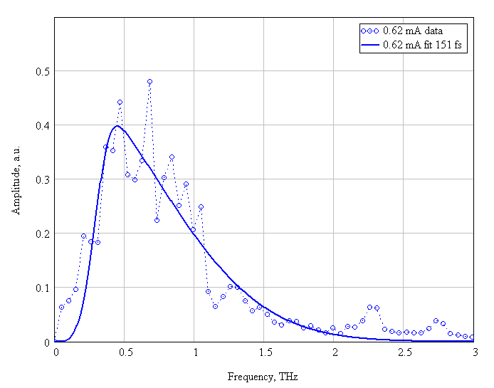
CW beam measurements 0.62 mA; RMS 151 fs

Slide 18
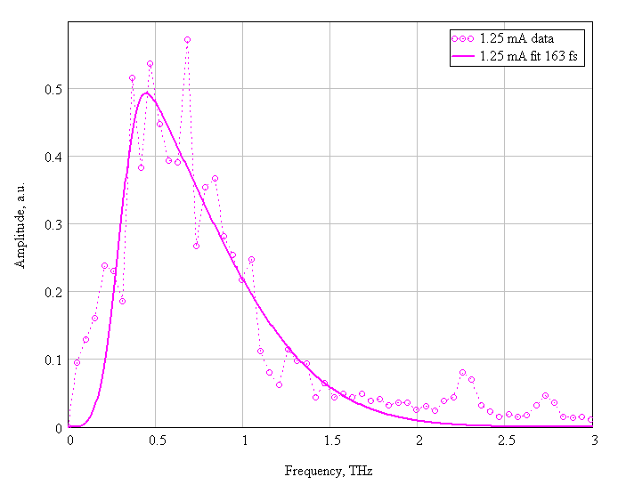
CW beam measurements 1.25 mA; 163 fs

Slide 19
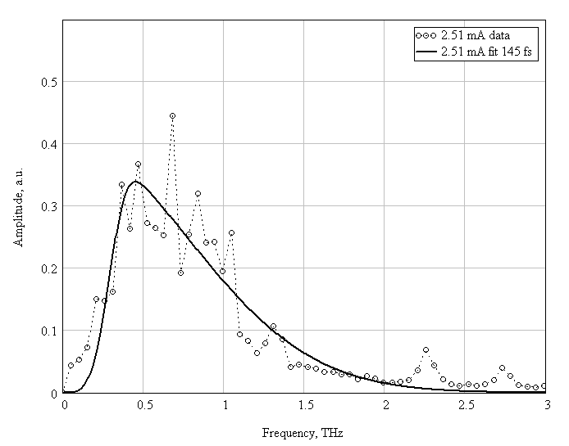
CW beam measurements 2.51 mA; 145 fs

Slide 20
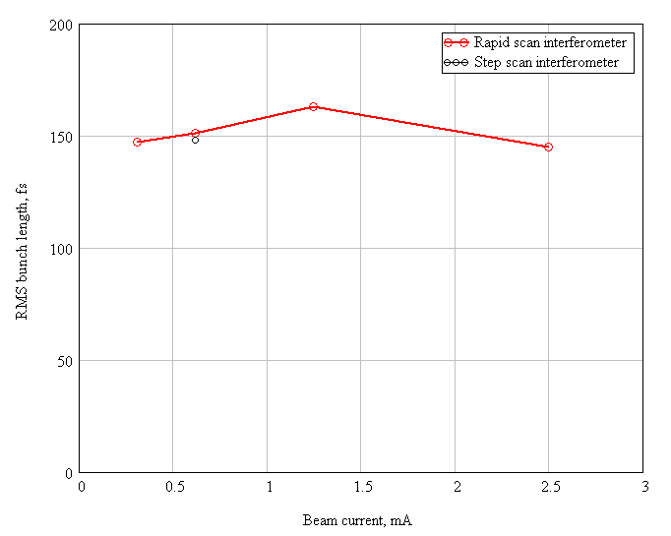
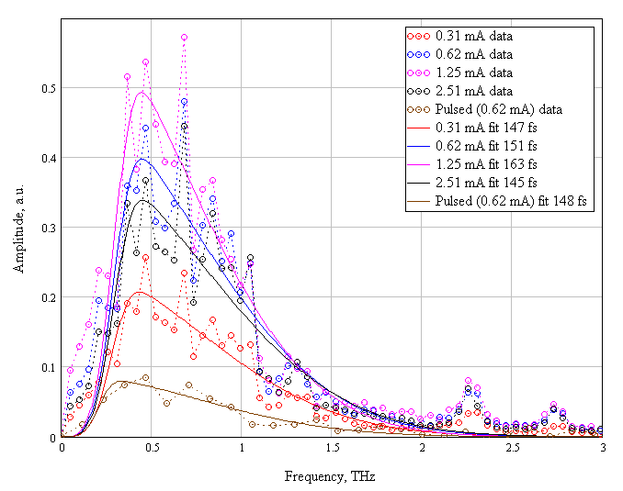
Pulsed beam measurements vs. CW beam
The bunch length does not change with beam current.

