Slide 1
Transverse emittance
One of the ways to define the transverse
emittance is the statistical approach
Emittance is the second order momentum of
the distribution function of the electrons
Two different techniques were used
to measure the transverse emittance.
The multislit mask in the injector 9 MeV
Quadrupole scan for high energy beam beam
Why and when it is right to use either method ?

Slide 2
Beam envelope analysis
- RMS beam size, ε - geometrical emittance
I - the beam peak current, I_{A} – Alfen current
external field (focusing)
influence of emittance
synchrotron radiation
space charge force
It is reduced in a drift space to:
The following ratio tells either the beam is
emittance dominated R₀<1 or space charge dominated R₀>1.

Slide 3
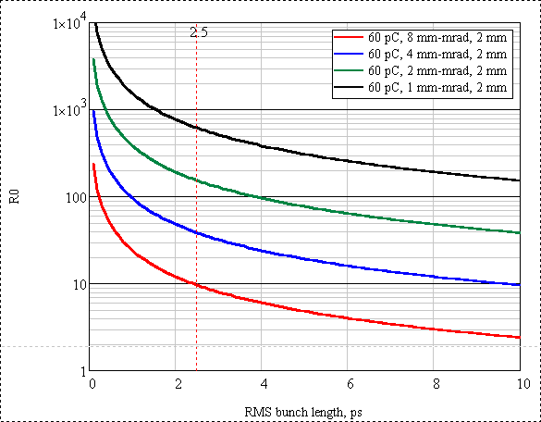
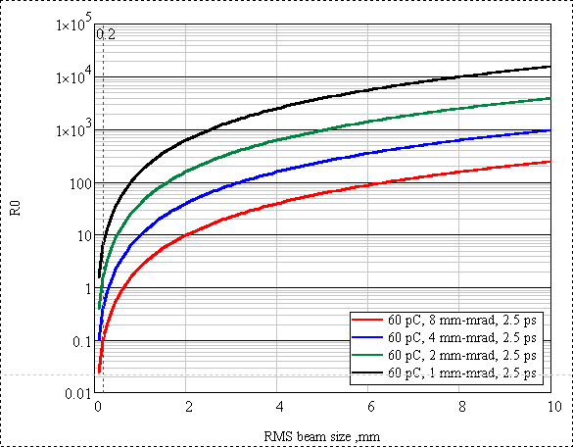
Space charge / emittance (R₀) injector
For typical beam parameters in the injector:
at 9 MeV beam energy,
2.5 ps RMS bunch length,
~ 2 mm RMS beam size R₀>>1.
Simple quadrupole scan dose not work properly.
Notes:
This slide shows the calculated R0 ration for the injector beam and fir the accelerated to 12 MeV beam.
The calculations are made with realistic value of the transverse emittance. The table shows the emittance value with corresponding bunch charge.
Beam size in the injector (if focused) mm in the order of magnitude. This calculations are made assuming the 1.5 mm RMS beam size.
There is the peak current in the R0 ration, that we estimate as Q/bunch length.
Our gun does 450 ps long bunches. The bunch is compressed in the injector down to 10 ps.
So the right part of the plot shows the situation au the gut, while the left part shows
what is going on at the linac entrance and this is what are a mainly interesting.

Slide 4
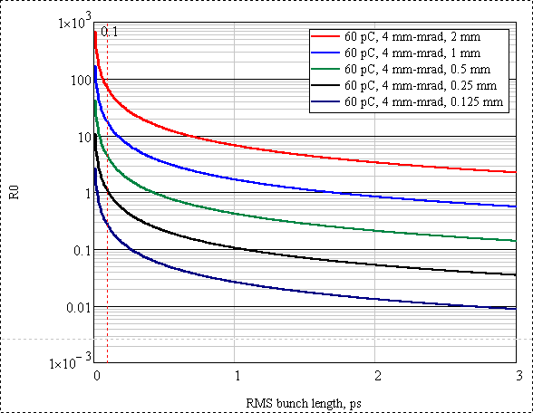
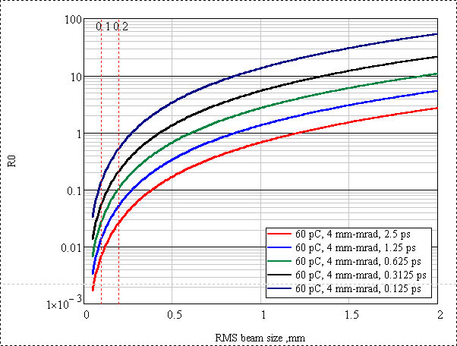
Space charge / emittance (R₀) LINAC
Even high energy 135 MeV beam can be made space charge dominated is the transverse beam size is made sufficiently large. The shorter is the bunch the easier it is
to make the beam space charge dominated
Notes:
This slide shows the calculated R0 ration for the injector beam and fir the accelerated to 12 MeV beam.
The calculations are made with realistic value of the transverse emittance. The table shows the emittance value with corresponding bunch charge.
Beam size in the injector (if focused) mm in the order of magnitude. This calculations are made assuming the 1.5 mm RMS beam size.
There is the peak current in the R0 ration, that we estimate as Q/bunch length.
Our gun does 450 ps long bunches. The bunch is compressed in the injector down to 10 ps.
So the right part of the plot shows the situation au the gut, while the left part shows
what is going on at the linac entrance and this is what are a mainly interesting.

Slide 5
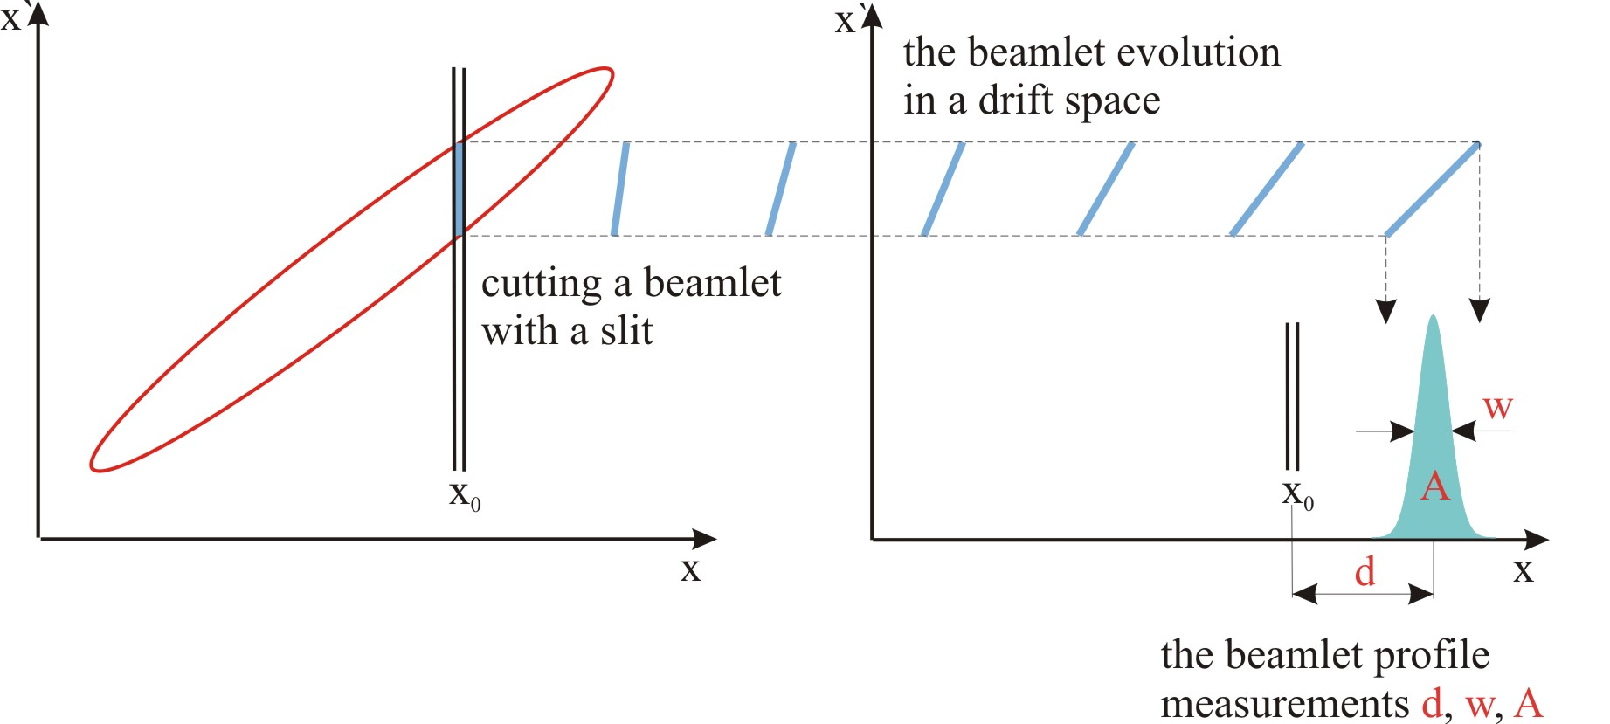
Multislit emittance measurements (idea)
Mask is used to cut
a small beamlet(s)
every beamlet is
emittance dominated
Beam profile measurements:
YAG:Ce view screen

Slide 6
The multislit mask design
Angular acceptance of the slit must be significantly
bigger then the uncorrelated beam divergence.
At the end of the drift space the distance from any
beamlet to a neighboring has to be bigger than
the beamlet width
The drift space has to be long enough to let the
beamlet expand so that at the end of the drift
space its RMS size is much bigger than the slit width
Residual space charge force between the beamlets
has to be negligible, i.e., the beam behind the mask
is emittance dominated

Slide 7
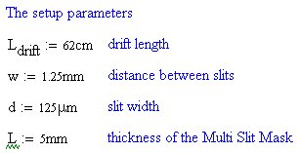
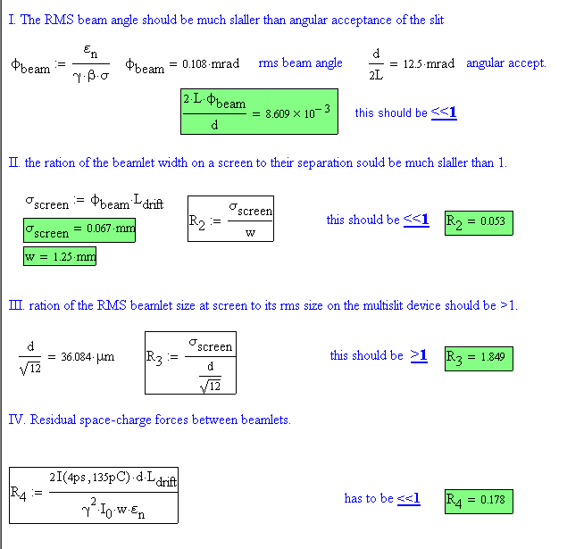
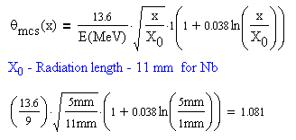
The multislit mask design (2)

Slide 8
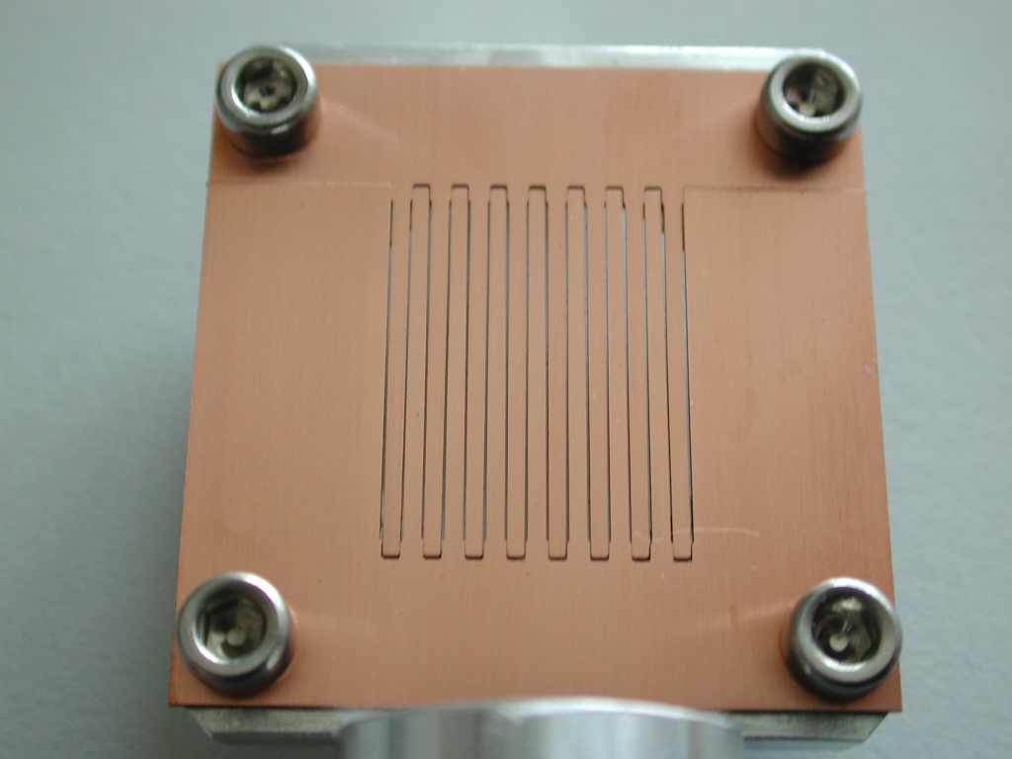
The multislit mask (example)
the mask is made of 1mm thick cupper
it consists of two parts; 1.6 mm period; 100 µm slit width
made on a wire-cut machine
(the machine has resolution of 5 µm)

Slide 9
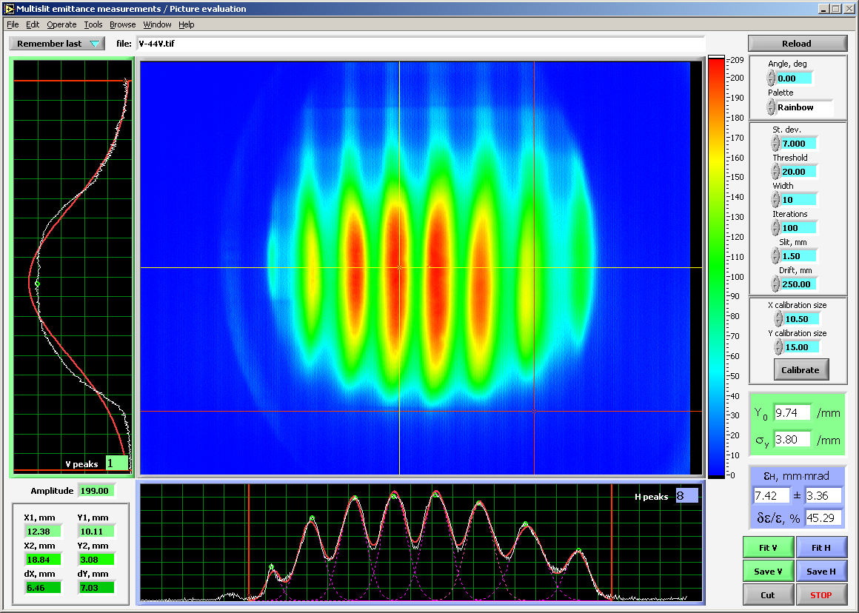
Multislit data evaluation

Slide 10
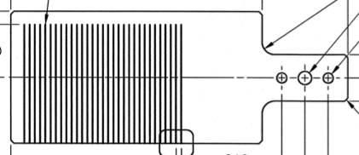
The multislit mask (example 2)
the mask is made of 5 mm Nb;
1.25 mm period;
125 µm slit width
made on a EDM
Drift length 62 cm

Slide 11
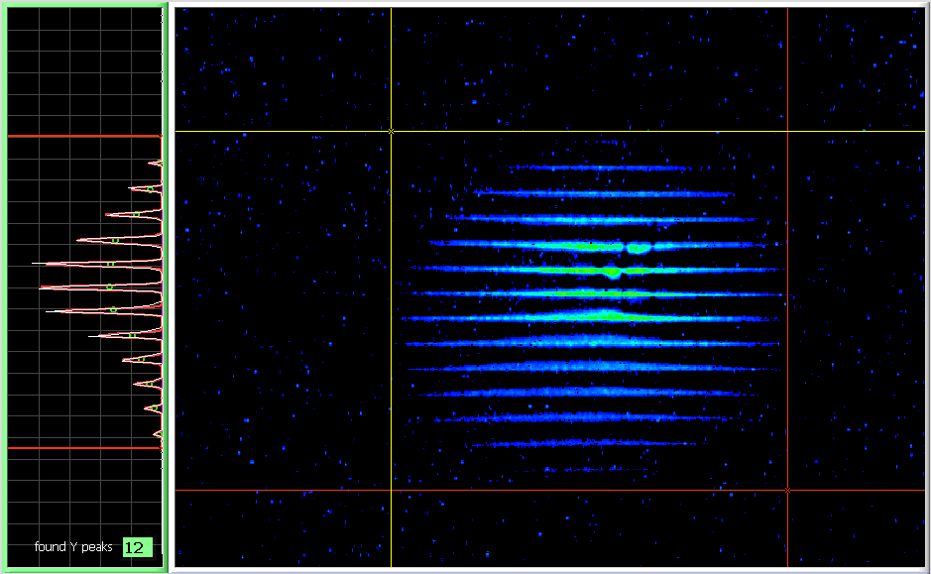
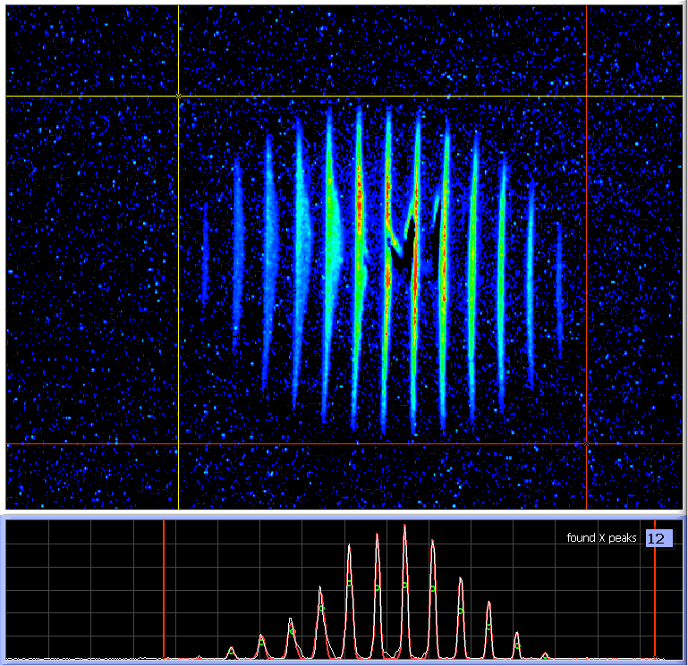
JLab FEL Injector emittance measurements
is well established technique
works for space charge dominated beam
beam profile is measured with YAG, phosphor or ceramic viewer
measures not only the emittance but the Twiss parameters as well
has enough information to reconstruct the phase space
has been implemented as on-line diagnostics
works with diagnostics (low duty cycle, average current) beam only
challenges: to make such measurements with CW beam

Slide 12
Emittance calculation
- Multi Gaussian fit
- Statistical weights of beamlets
- RMS beam size
- RMS beam divergence (both correlated and uncorr.)
- x – x` correlation
- RMS emittance
- Twiss parameters

Slide 13
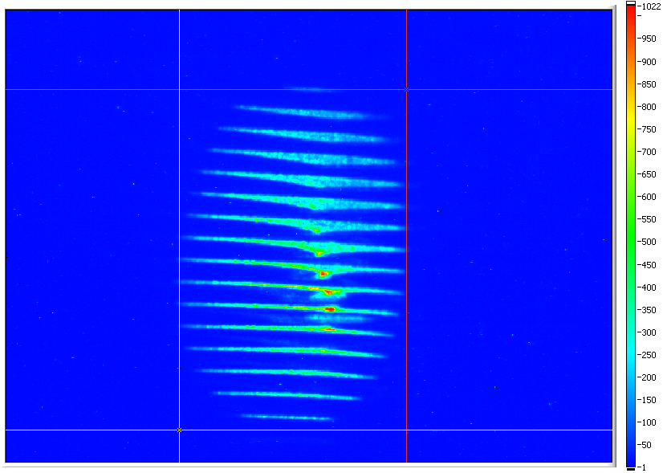
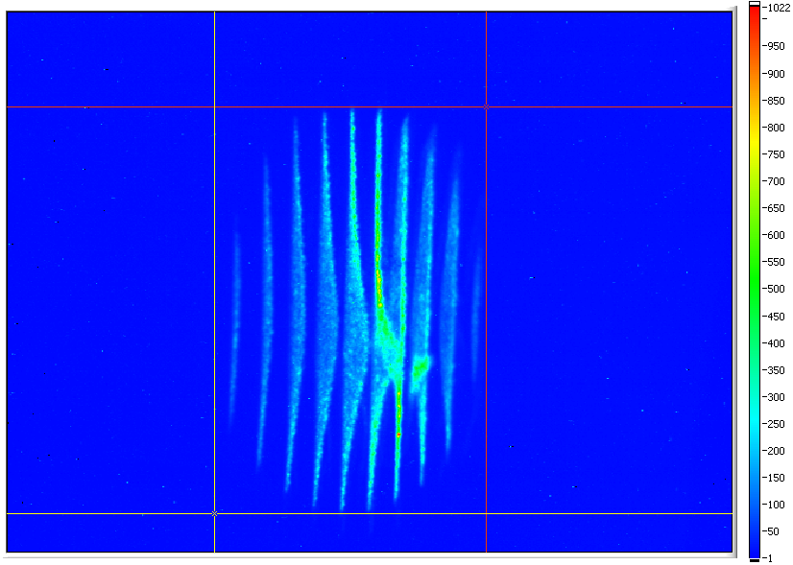
Injector; transverse emittance measurements
Measured at the JLab FEL at 270 pC
When a portion of the beam has different Twiss parameters, i.e., differently positioned in the phase space it also can be seen rather well.
like here, for instance
(no, there is nothing
wrong with the mask)
Other things to remember:
control ghost pulses, when using photo gun
RF transients
transverse beam stability
alignment of the slit mask

