Slide 1
Longitudinal transfer function
a.k.a. (M₅₅) measurements
at the JLab FEL
Pavel Evtushenko, JLab
Jlab IR/UV upgrade longitudinal phase space evolution
Mixer – Phase detector
Calibrating phase measurements
Measurements procedure

Slide 2
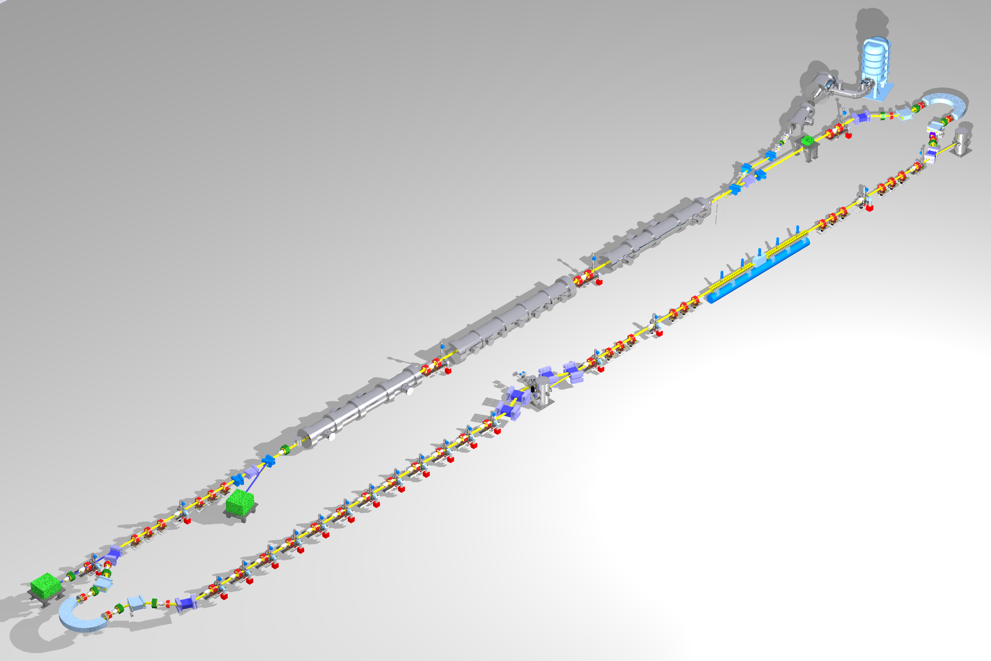
JLab FEL (layout and longitudinal matching)
Requirements on phase space:
Long bunch in linac
high peak current (short bunch) at FEL
bunch length compression at wiggler
“small” energy spread at dump
energy compress while energy recovering
“short” RF wavelength/long bunch
⇒ get slope and curvature right
E
φ
E
E
E
φ
φ
φ

Slide 3
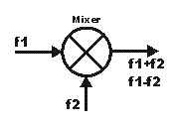
RF mixer – phase detector
- Ohm’s law, where G(t) – conductance
first term DC signal - phase difference,
second term filtered out with low pass filter

Slide 4
Calibration
the M55 receiver chassis is placed very close to MO – minimizes cable phase drift
the phase shifter is calibrated first with the help of Network analyzer
For the calibration of the phase detector MO and beam are kept at the same phase,
while the phase sifter is scanned in the range ~ 360 deg.
the calibration gives the sensitivity i.e. V_{out} – Δϕ and zero crossing
around zero crossing the V_{out} =V_{out} (Δϕ) is almost linear and least amplitude dependent

Slide 5
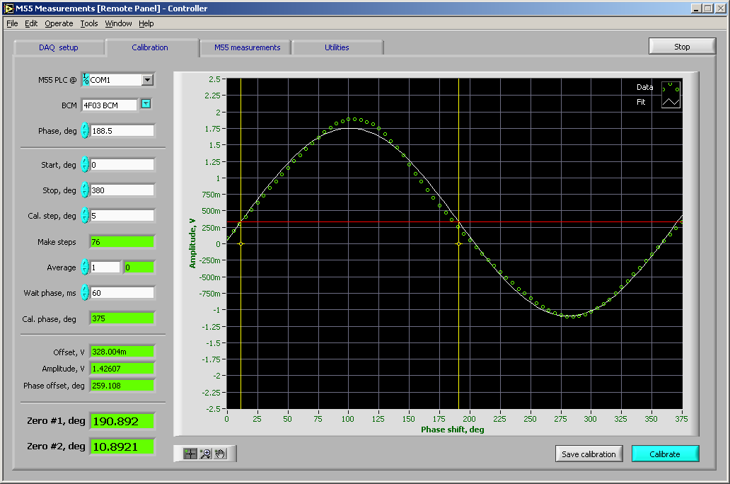
Calibration (2)

Slide 6
Measurements
similarly to the mixer (phase detector) phase of RF signal can be modulated
practically phase of the MO going to the LLRF module is modulated
LLRF tracks the MO phase variations and moved the phases of RF elements of the system
DL, Buncher, SRF cavities
the modulation is also calibrated and cross-checked by shifting phase via LLRF
High level application knows both calibrations (modulator and phase detector).
During the measurements injector MO is modulated at low frequency – few Hz but
NOT subharmonic of 60 Hz !!! (take you favorite strange frequency - 2.718281828459 Hz )
two signals: phase detector output and modulator drive signal are digitized simultaneously
by two ADC channels
using the calibration the ϕ_{in} and ϕ_{out} are calculated and plotted one vs. another
beam with macro pulses at 60 Hz is used – the machine needs to be setup quite well
start from smaller amplitude and work towards higher
the range of the phase modulation can be DC shifted

Slide 7
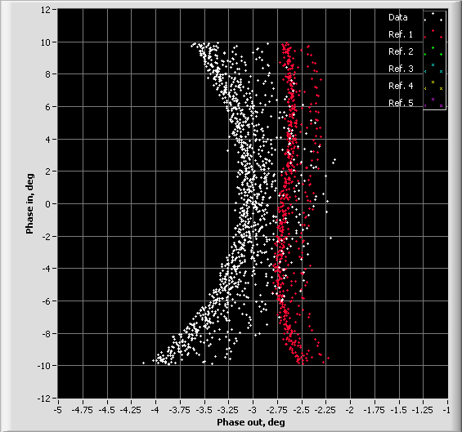
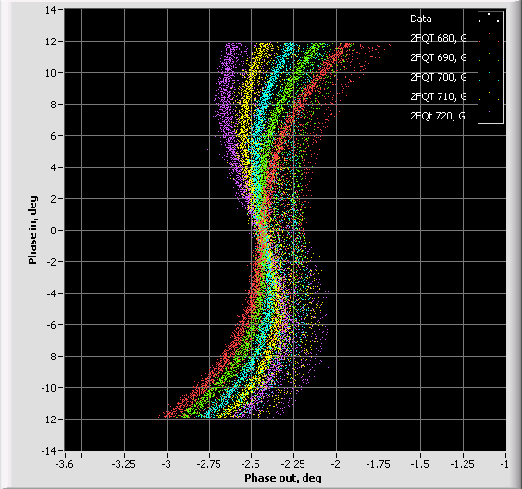
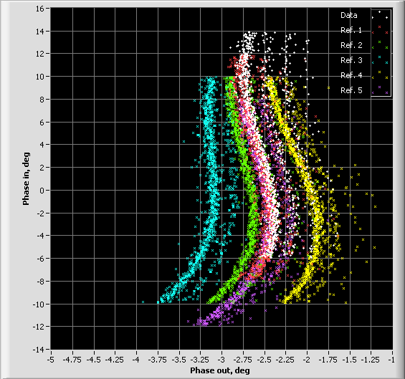
Measurements (2)
The M₅₆ and T₅₆₆ transport matrix elements are validated via longitudinal transfer function measurements – essential for optimal bunch compression.
T₅₆₆ is adjusted by sextupoles in dispersive location (ARC1)
M₅₆ is adjusted by quadrupoles in dispersive location (ARC1)
Changes in the E₀ and it effect on the bunch compression
Notes:
Changing M56 in fig, 2 and 3 (positive and neg. M56) and fig. 4. wrong sextupoles, and fig. 5 with corrected sextupoles.

