Slide 1
The FEL as a Diagnostic*
Stephen Benson
U.S. Particle Accelerator School
January 17, 2011
* This work was supported by U.S. DOE Contract No. DE-AC05-84-ER40150, the Air Force Office of Scientific Research, DOE Basic Energy Sciences, the Office of Naval Research, and the Joint Technology Office.

Slide 2
Outline
FEL tutorial
Dependence of FEL gain on:
Beam steering
Emittance
Bunch length and energy spread
Some examples
Conclusions

Slide 3
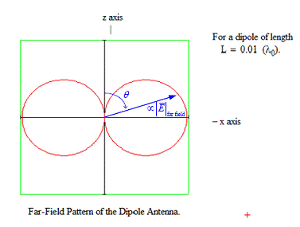
Relativistic Hertzian Dipole

Slide 4
FEL MECHANISM

Slide 5
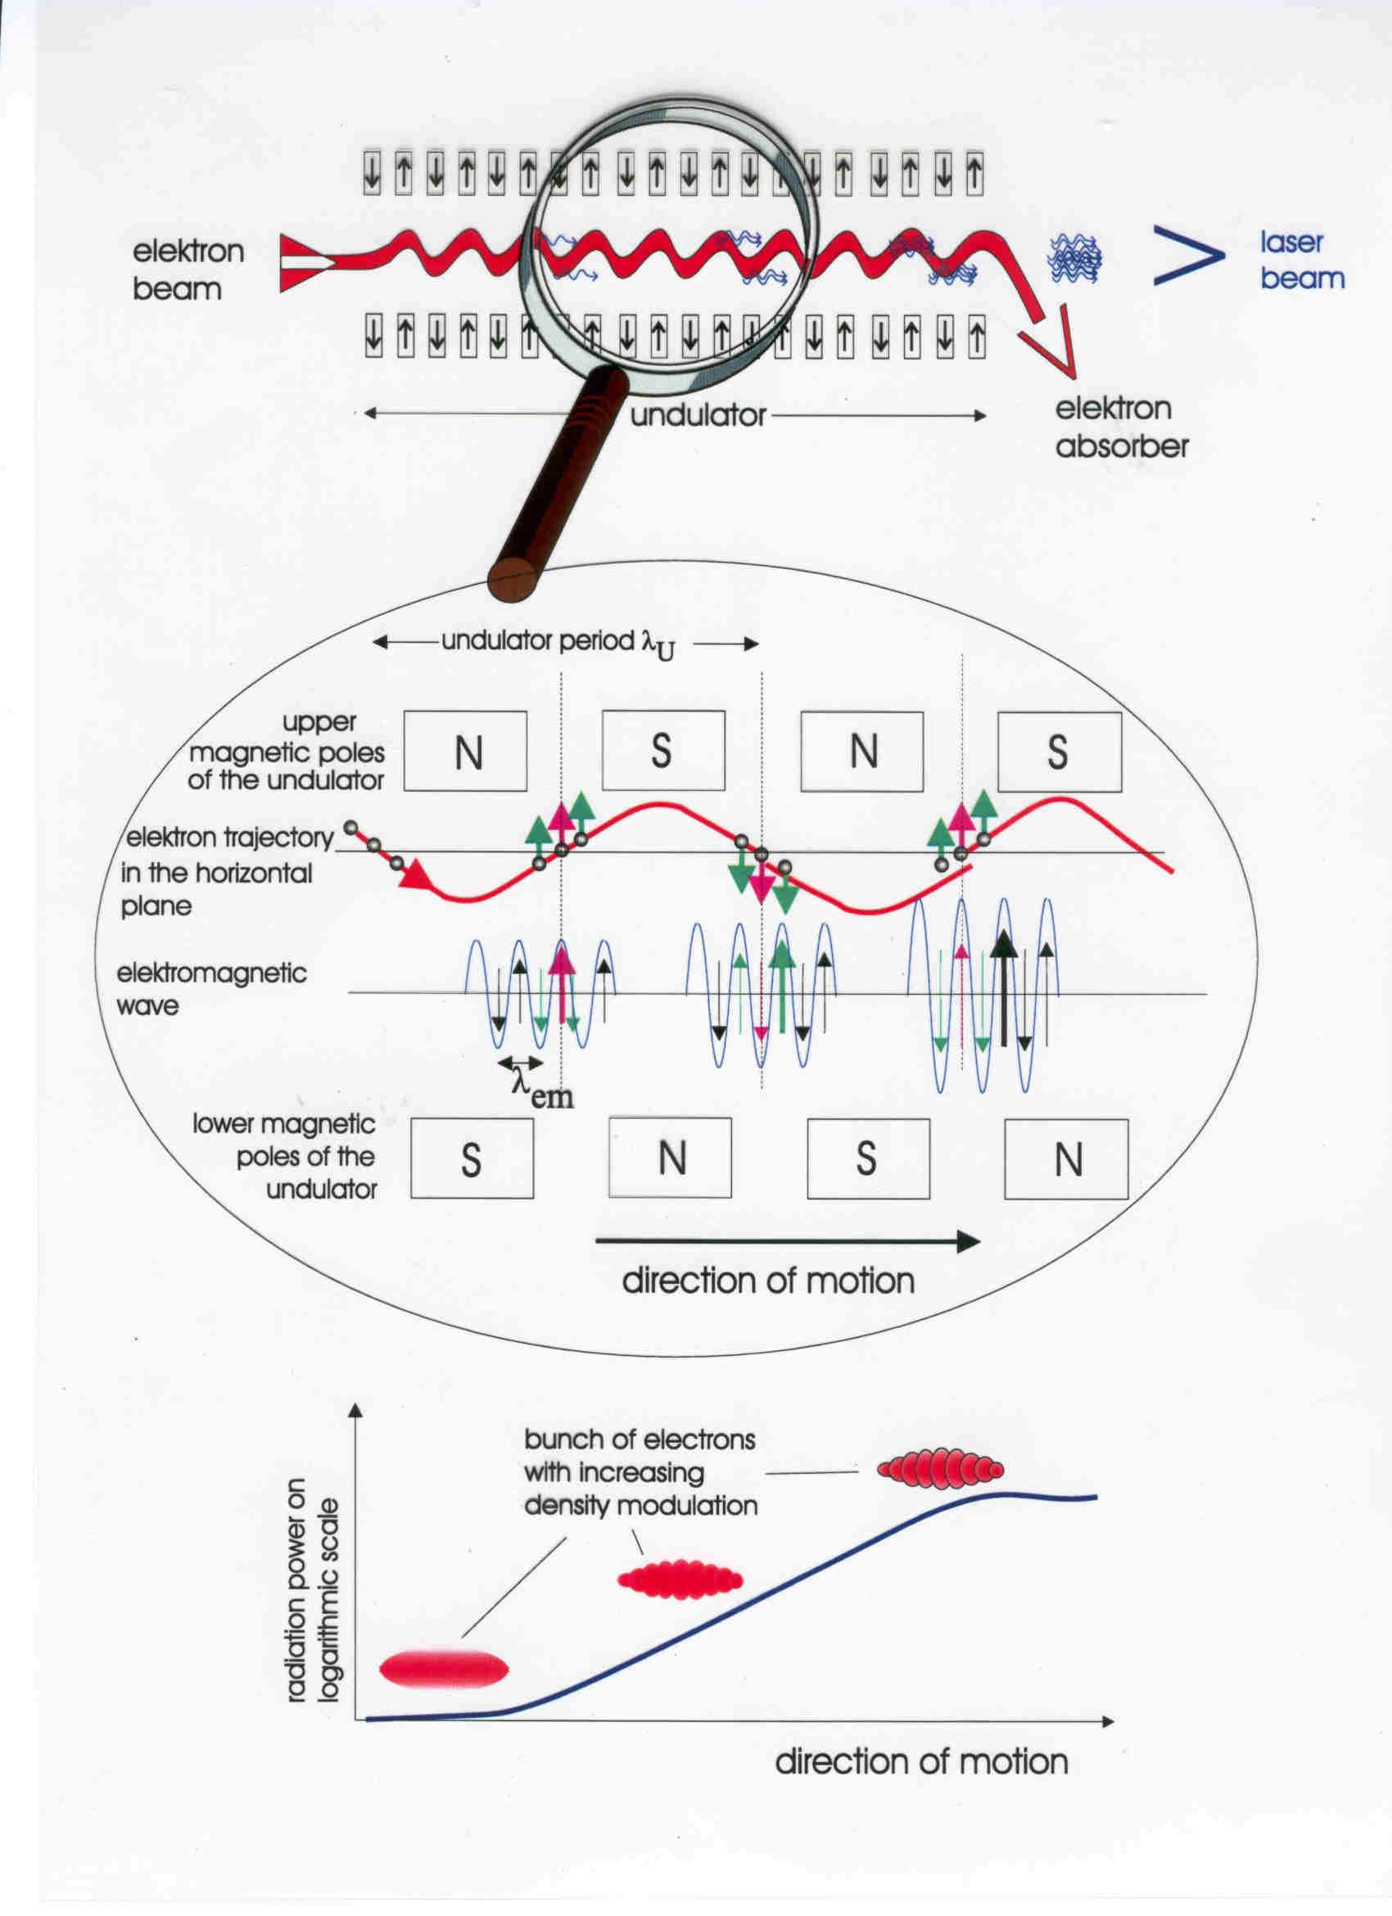
How an FEL works

Slide 6
The Synchronous Condition, cont.
If put in mathematical terms, the synchronous condition is:
This can be rewritten by using the formula for the electron velocity:
So we we now have:
Where K=0.934 T⁻¹cm⁻¹ λ_{W}B_{rms} is the wiggler parameter, and γ is the electron relativistic energy normalized to the electron rest mass.

Slide 7
The Pendulum Equation
Let us define a pondermotive phase ζ
For an electron at the resonant energy the pondermotive phase is constant and the electron sees a force proportional to sin(ζ). The equation of motion of the electron motion with respect to this pondermotive potential is that of a pendulum:
Where we define the dimensionless field amplitude a as
where

Slide 8
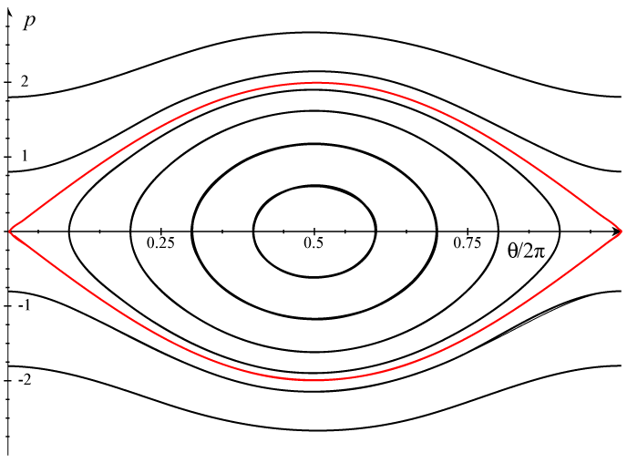
Motion in the Pendulum Phase Space
The height of the separatrix is proportional to a^{1/2}.
The vertical position is proportional to the energy detuning.
The maximum small signal gain occurs outside the separatrix.
Saturation occurs in the separatrix.

Slide 9
The Field Equation
As the electrons bunch they radiate coherently. The radiated field adds to the original bunching field. Depending on the initial electron velocity it can add in phase, in quadrature, or out of phase. This defines a new equation:
Where we define the normalized current as
Where ρ is the electron density. For low gain (j<1), the gain is just G=0.135j . The pendulum and field equations must be solved self-consistently and are applicable in low and high field and low and high gain.

Slide 10
Spontaneous radiation and Gain
The spectrum of the spontaneous radiation is just:
The width is inversely proportional to the number of wiggler periods and the height is proportional to the square of the number of wiggler periods.
The gain is proportional to the slope of the spontaneous radiation so it is proportional to the cube of the number of periods.

Slide 11
Exercise
Remember that the pondermotive phase is
And that
Show that
And
Thus show that gain occurs for energies lower than the resonant energy and for wavelengths longer than the resonant wavelength.

Slide 12
Gain
The gain spectrum is given by:
Note that this is for small signal only. The curve broadens and reduces in amplitude for large signal.
Also note that the peak gain does not occur for the resonant wavelength. As we will soon see it is even further from resonance for a typical device.

Slide 13
Now Reality Raises its Ugly Head
So far, I have assumed a spherical cow:
A monochromatic plane wave
A mono-energetic electron beam
A beam with infinite transverse extent with electrons traveling along parallel paths.
A perfect wiggler.
Now we have to transition to the real world where beams have transverse extent, bandwidth, energy spread, emittance, and wigglers and beam transport magnets have focusing and steering errors.
For this course we will assume perfect mirrors since this is an electron diagnostics course.

Slide 14
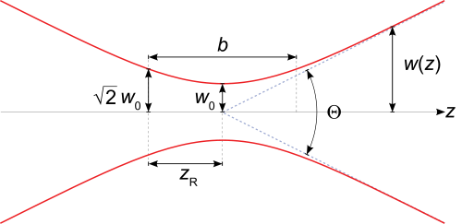
Reality #1: Real Optical Modes
A realistic optical cavity contains a superposition of Gauss-Hermite or Gauss Laguerre eigenmodes, the lowest of which is defined as:
With the waist size and radius of curvature defined by
And the Guoy phase shift given by

Slide 15
Higher order modes
Higher order modes multiply the basic Gaussian mode by a set of Hermite or Laguerre polynomials.
The Guoy phase shift for a TEM_{n0} L-G mode is 2n+1 times that of the fundamental mode.
The minimum mode volume for a Gaussian mode occurs for

Slide 16
Reality #2: Electron beam size
Ideally you want all the electrons to sit where the electric field is largest, i.e. on axis. The wiggler focuses in one direction and the electrons drift freely in the other.
Unfocused direction:
Just like the optical mode. Can fit electron beam inside the optical mode if and if we set
Focused direction
Wiggler field usually has the form:
The stronger field away from the axis introduces a wavelength shift and provides a linear restoring force. Electrons oscillate with a period:

Slide 17
Electron beam size (cont.)
If the matched betatron period is less than the wiggler length (strong focusing case) the rms beam size scallops as it goes down the wiggler. In the transverse space the electrons travel on circular trajectories. The increase in the average phase space volume leads to an increase in the effective emittance

Slide 18
Weak focusing case
For a matched betatron period much longer than the wiggler it might be better to focus the beam in the wiggler center to improve the filling factor.
Matched envelope
Focused envelope
Unfocused envelope

Slide 19
Filling factor
In general you would like to have as many of the electrons as possible in the part of the optical mode with the largest field. You can define an effective filling factor
The 1+α²/7 term is due to the Guoy phase shift. This factor is unity for a filamentary beam, N>>1, and z_{R}=L/3.

Slide 20
Reality #3: Angular effects
The wavelength is shifted by changing K, which changes the longitudinal velocity, Changing the angle of the electron beam does the same thing. In fact
This leads to a detuning
Note that the detuning is unidirectional so an angular spread leads to an asymmetric distribution in ν

Slide 21
Reality #4: Energy spread
Real beams have energy spread. This leads to a distribution in ν₀. The distribution is as symmetric as the energy distribution. The spread in ν_{ο} is
We can define a inhomogeneous gain reduction factor for Gaussian distributions as

Slide 22
Longitudinal match
For a given longitudinal emittance you can have a longer or shorter bunch as long as the energy spread is adjusted to keep the emittance constant. In general you want a very short bunch but:
If the energy spread gets too large the gain reduction factor starts going down fast.
A short bunch might be short compared to the slippage length Nλ. The gain vs. bunch length goes as:
But all this assumes an upright bunch. If you have a skewed longitudinal distribution the energy spread will be large but the bunch length will be larger as well so the peak current won’t be as high as it could be. One therefore expects the gain to vary quadratically around the bunch length minimum.

Slide 23
Offsets instead of spreads
Everything so far has concentrated on distributions. What if the whole beam moves?
Angular shift: Want the angular shift to be less than the mode divergence so we want
As an example for 400 nm and 90 cm z_{R} we want the angle error to be less than 380 µrad.
Position shift: Want the transverse position to be smaller than half the waist size (mode jumps if you exceed this) so
Energy shifts just lead to wavelength shifts, which is bad for users but not for gain and power.

Slide 24
What about Jitter?
An important parameter for jitter is the resonator critical frequency
For example, for f_{rt}=4.678 MHz and Q=10, f_{res} = 74.5 kHz.
For jitter at frequencies much less than f_{res} the FEL generally follows the changes so the jitter looks like a DC change at any one time.
For jitter at frequencies higher than f_{res} the FEL integrates over the motion so the effect is to blur the beam out (e.g. a phase jitter would effectively increase the bunch length).
For jitter near f_{res} the FEL can react strongly to the jitter. The effects can be larger than the DC shift would indicate.

Slide 25
Three Dimensional Simulations

Slide 26
FEL MECHANISM

Slide 27
UV Demo Beamline Layout
E = 135 MeV
67 pC pulses @ 4.68 MHz
(>20 μJ/pulse in 250–700 nm UV-VIS)
(UV beamline and commissioning funded by AFOSR and BES. Wiggler on loan from Cornell U.

Slide 28
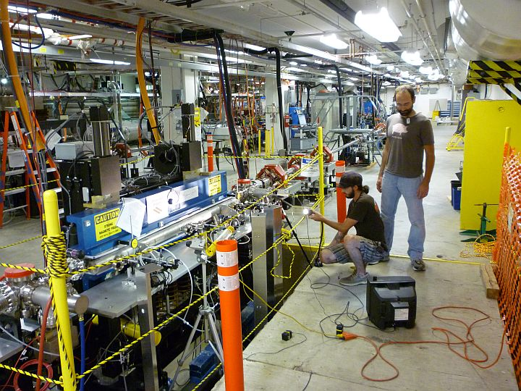
Cornell Undulator A Prototype

Slide 29
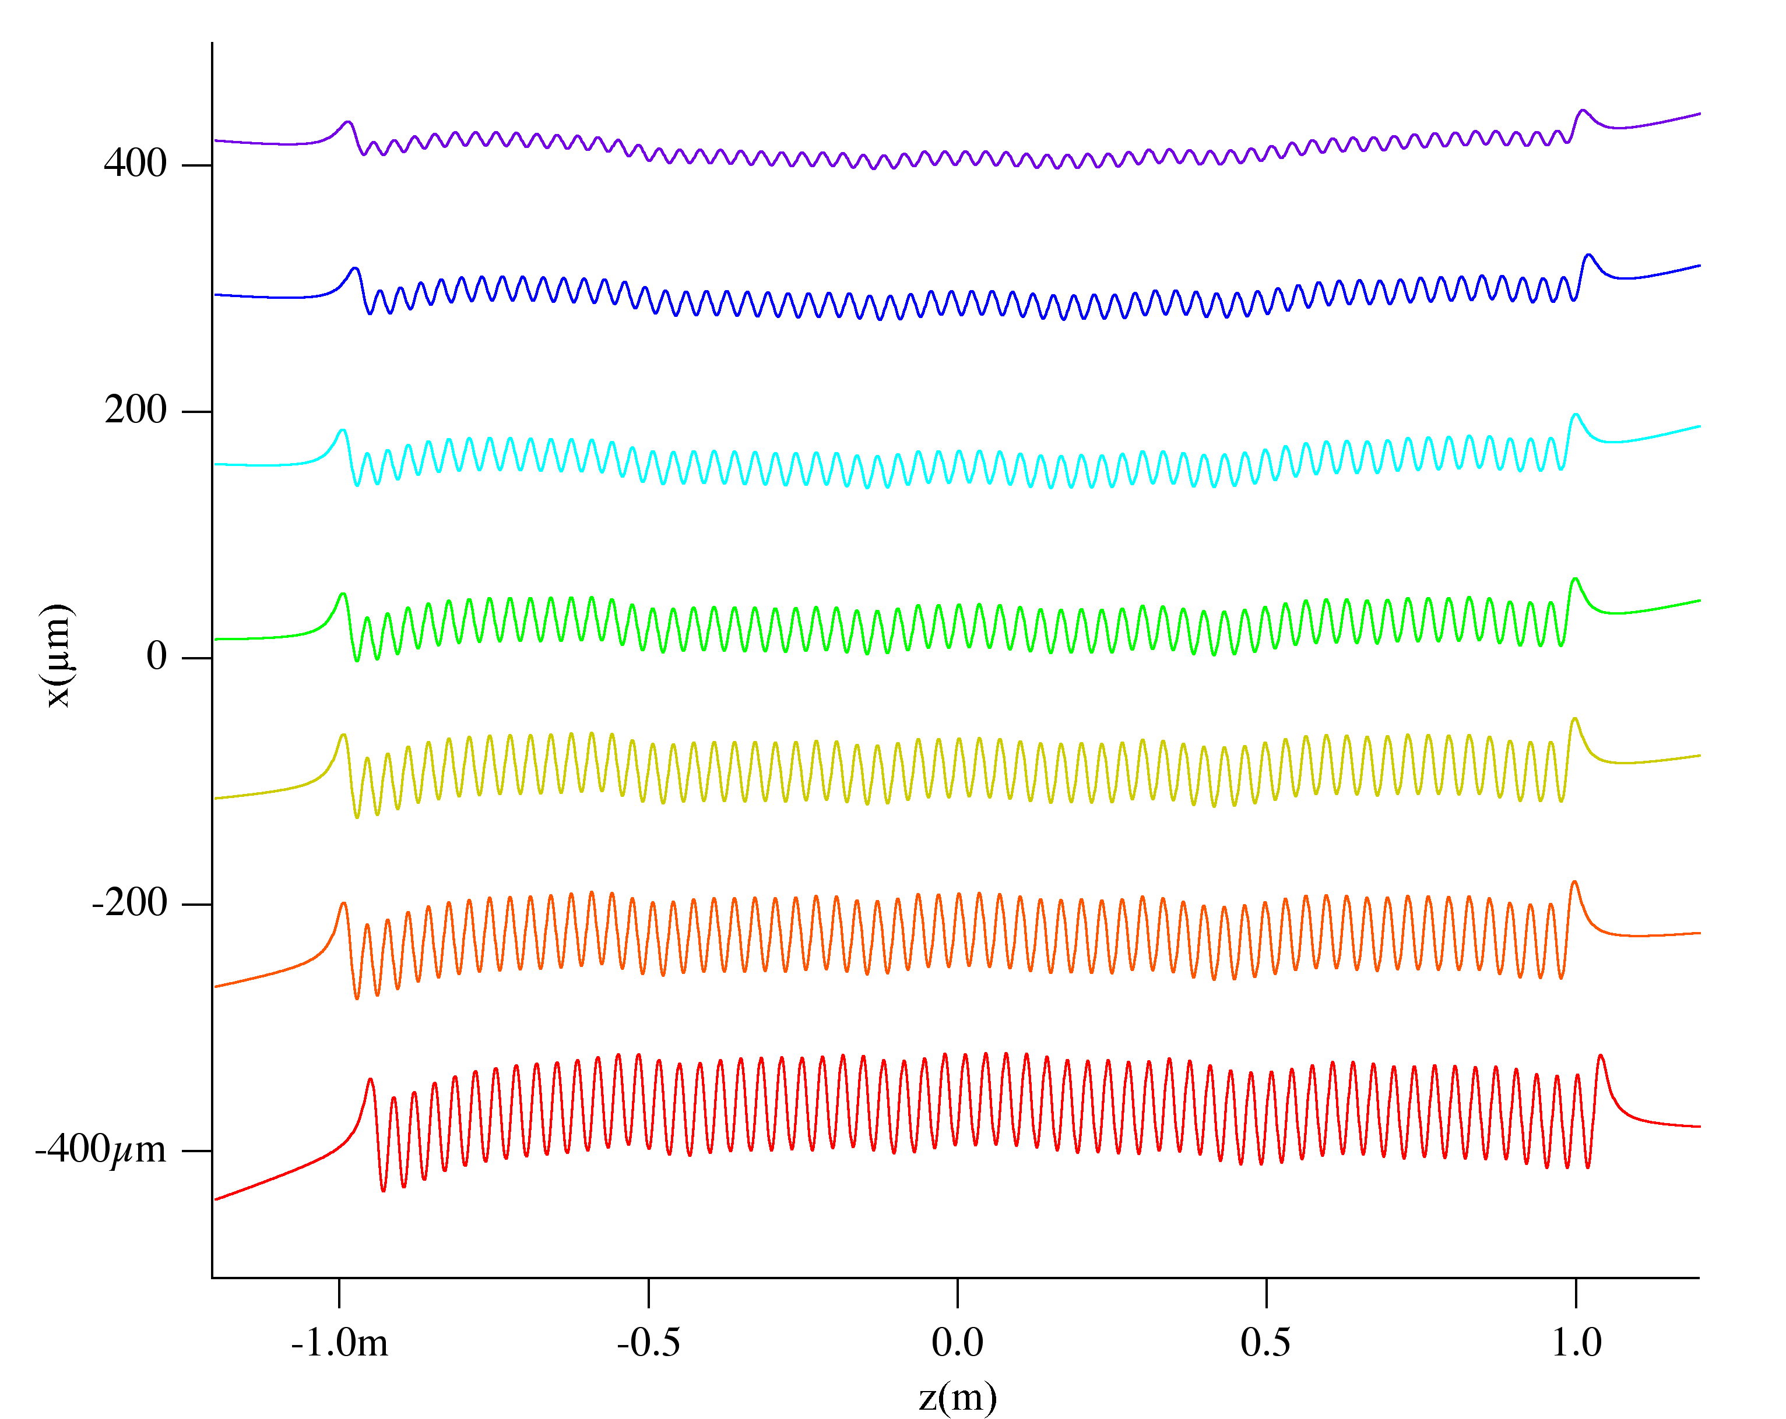
UV Wiggler trajectories in Cornell Wiggler

Slide 30
Very High Gain Seen at 400 nm

Slide 31
Conclusions
For optimum laser performance three things are required
The electron beam should be as small as possible compared to the optical mode.
The detuning spread must be less than about π/4 from all effects.
The beam must be stable. The parameters should vary by no more than about 1/10 of their spreads.
If any of these things are not true the FEL will let you know!

