Slide 1
Establishing Lasing in the FEL*
Stephen Benson
U.S. Particle Accelerator School
January 28, 2011
* This work was supported by U.S. DOE Contract No. DE-AC05-84-ER40150, the Air Force Office of Scientific Research, DOE Basic Energy Sciences, the Office of Naval Research, and the Joint Technology Office.

Slide 2
Ideal FEL

Slide 3
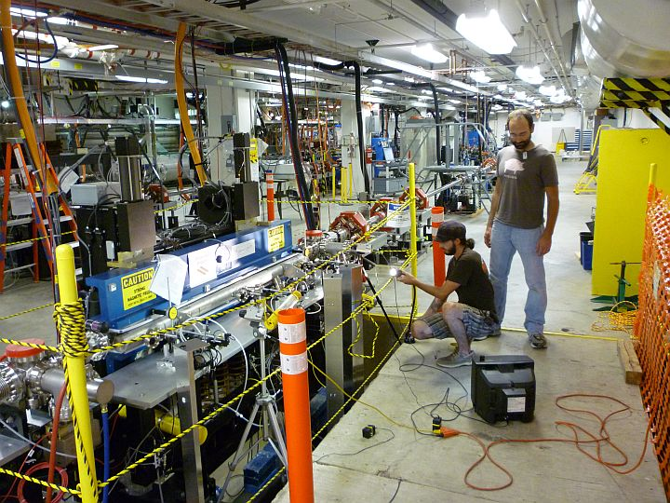
Real FEL

Slide 4
Spontaneous radiation and Gain
The spectrum of the spontaneous radiation is just:
The width is inversely proportional to the number of wiggler periods and the height is proportional to the square of the number of wiggler periods.
The gain is proportional to the slope of the spontaneous radiation so it is proportional to the cube of the number of periods.

Slide 5
What do you have to do to establish lasing?
The electron beam has to have small energy spread and transverse emittance and a good longitudinal match (high peak current).
Miniphase and optimize vernier cavity to get close to optimal longitudinal match.
Match to get beta function waists equal to about 40% of the wiggler length at the center of the wiggler.
The optical cavity has to be aligned with its optical axis coincident with the wiggler axis.
Can check with cavity enhancement.
The electron beam has to be aligned along the wiggler axis and overlapped with the optical mode. (remember they are both really small!!!)
The cavity length has to be within a few microns of synchronous length or no gain occurs.

Slide 6
A few numbers for the 400 nm UVFEL
Remember the optical mode waist vs. position:
In our case z_{R} = 93 cm and the wavelength is 400 nm so
w₀ = 344 µm
The minimum beta function is supposed to be 80 cm so the electron beam size is about (assuming 5 mm-mrad emittance)
σ_{x} = σ_{y} = 123 µm
The mirror piezos move the mirrors at the rate of ~15 µrad/V
A corrector change of 10 G-cm steers a 135 MeV beam by 22 µrad
The wiggler vertical betatron phase advance is 66.7°. This means that the beam moves 78% of the amount vertically as horizontally at the end of the wiggler

Slide 7
Weak focusing case
For a matched betatron period much longer than the wiggler it might be better to focus the beam in the wiggler center to improve the filling factor.
Matched envelope
Focused envelope
Unfocused envelope

Slide 8
Allowed offsets
Everything so far has concentrated on distributions. What if the whole beam moves?
Angular shift: Want the angular shift to be less than the mode divergence so we want
As an example for 400 nm and z_{R}=93 cm we want the angle error to be less than 370 µrad.
Position shift: Want the transverse position to be smaller than half the waist size (mode jumps if you exceed this) so
If I steer at the wiggler entrance the horizontal offset will dominate the angular error. ~40 G-cm will steer 170 µm at wiggler center. This changes the angle by ~90 µrad.

Slide 9
Mirror Steering
The mode rotates by about M/2 times the steering of one mirror. The magnification is defined as:
For a 32 meter cavity with a 93 cm Rayleigh range the magnification is 296 so the mode rotates by 148 times the mirror steering.
So the mode moves about 2.4 mm on the mirror for a 1 µrad steering.
This means that the mode will miss the mirrors for a shift of less than 10 µrad.

Slide 10
Aligning the cavity
Wiggler jaw
Wiggler jaw

Slide 11
UV Demo Beamline Layout
E = 135 MeV
67 pC pulses @ 4.68 MHz
(>20 μJ/pulse in 250–700 nm UV-VIS)
(UV beamline and commissioning funded by AFOSR and BES. Wiggler on loan from Cornell U.

Slide 12
Very High Gain Seen at 400 nm

Slide 13
Conclusions
For optimum laser performance three things are required
The electron beam should be as small as possible compared to the optical mode and should be inside the optical mode.
The detuning spread must be less than about π/4 from all effects.
The beam must be stable. The parameters should vary by no more than about 1/10 of their spreads.
If any of these things are not true the FEL will let you know!

