Slide 1
Emittance Measurement: Quadrupole Scan
C. Tennant
USPAS – January 2011
Notes:
Multislit → space charge dominated beam, multi-monitor → high power and/or finely tuned beam, quad scan → versatile

Slide 3
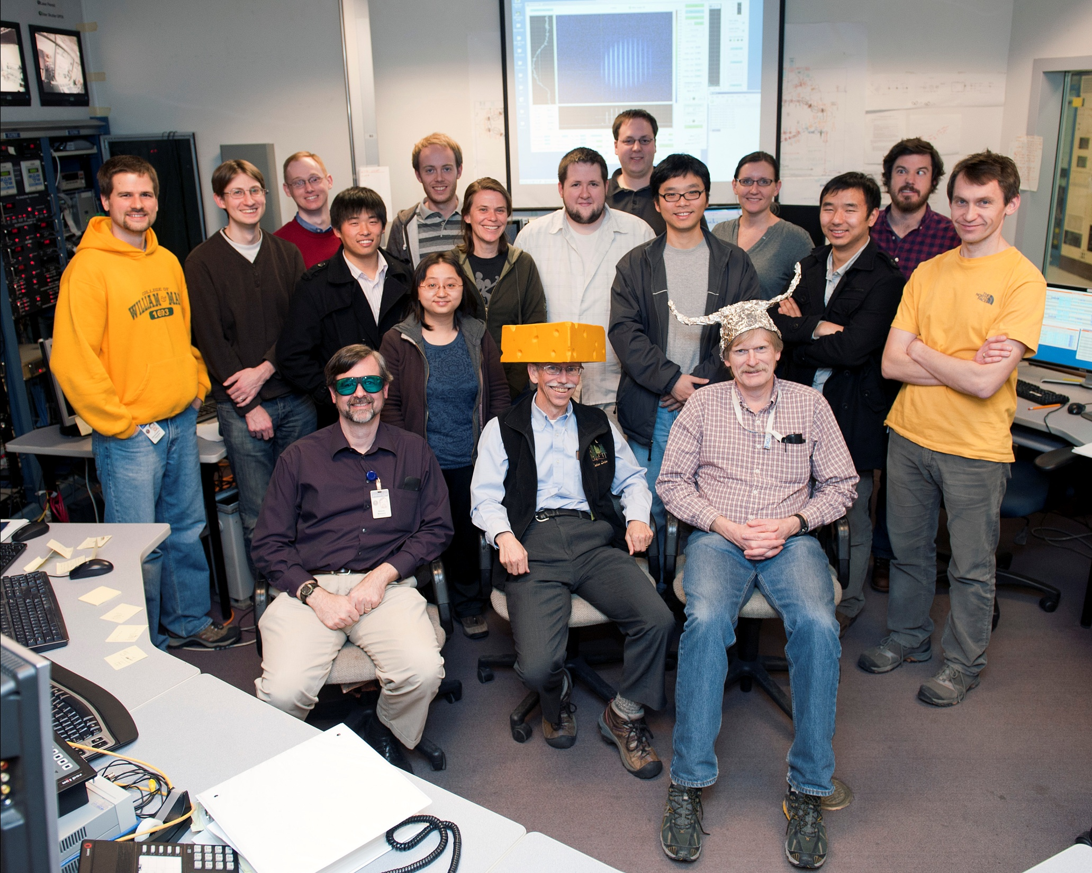

Slide 5
Quadrupole Scan Formalism
We want to know (β,α,γ,ε) at location 1 using information from location 2
A typical quad-drift-monitor arrangement
Quad (1)
Monitor (2)
Knowing how the Twiss parameters propagate we can relate (β₂,α₂) to (β₁,α₁)
Combining the previous two expressions we get the following relation
Notes:
Need a place where the betatron size dominiates → non-dispersed location

Slide 6
Quadrupole Scan Formalism – Thin Lens
For a thin lens quadrupole and drift, the transfer matrix is given by
The beam size (squared) at the “monitor” is then expressed as
The beam size (squared) at the “monitor” is then expressed as
Notes:
Assumes we know the transfer matrix → space charge needs to be negligible for this method

Slide 7
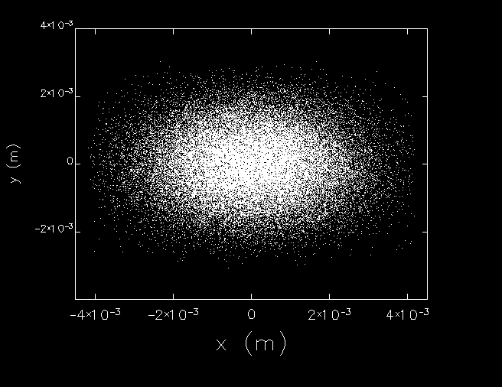
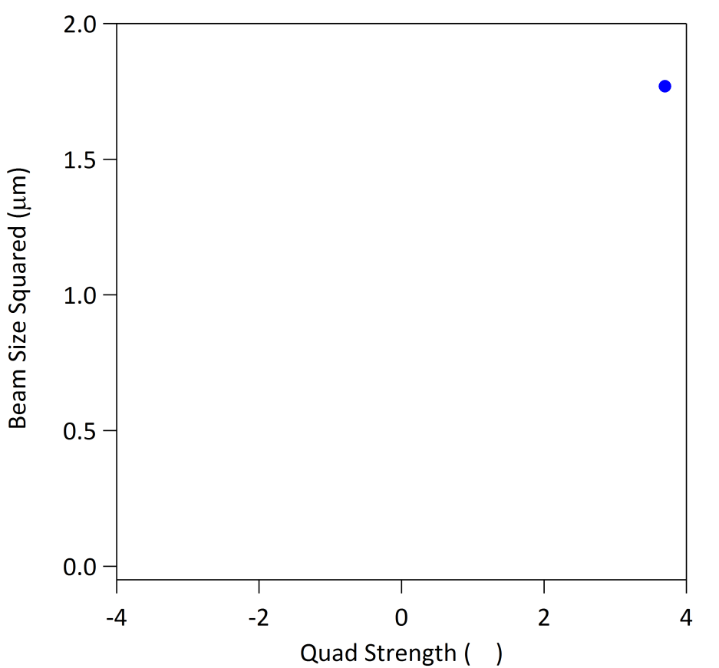
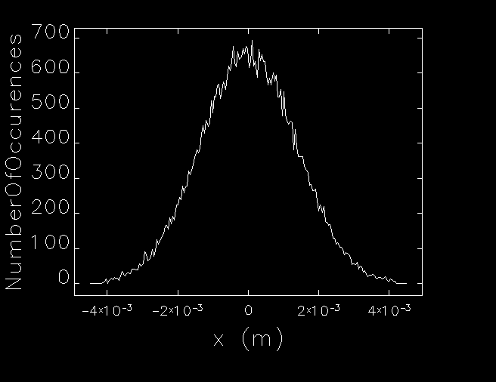
Simulated Quadrupole Scan
RMS beam size
Δ = +2500 G
(m⁻²)

Slide 8
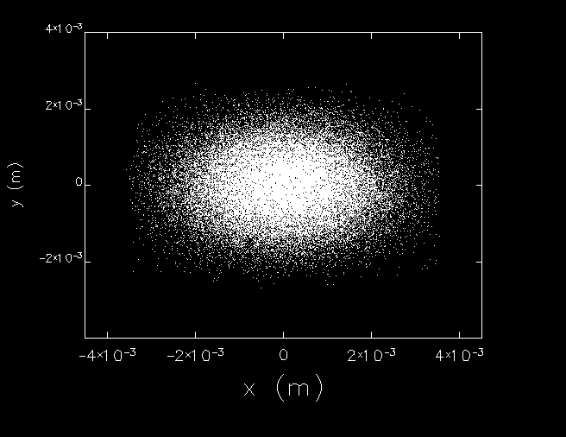
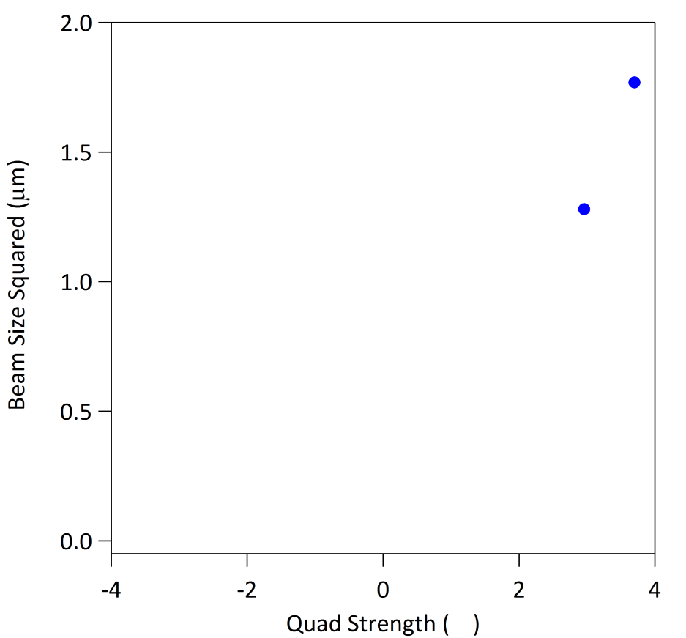
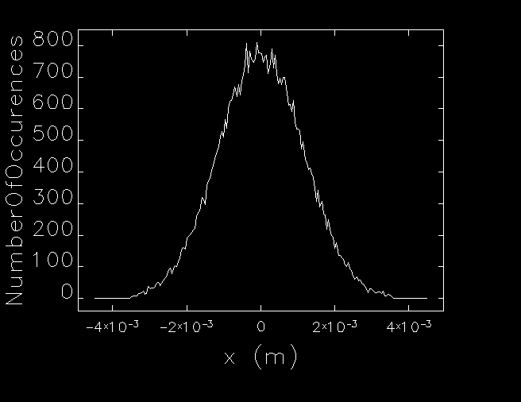
Simulated Quadrupole Scan
RMS beam size
= +2000 G
(m⁻²)

Slide 9
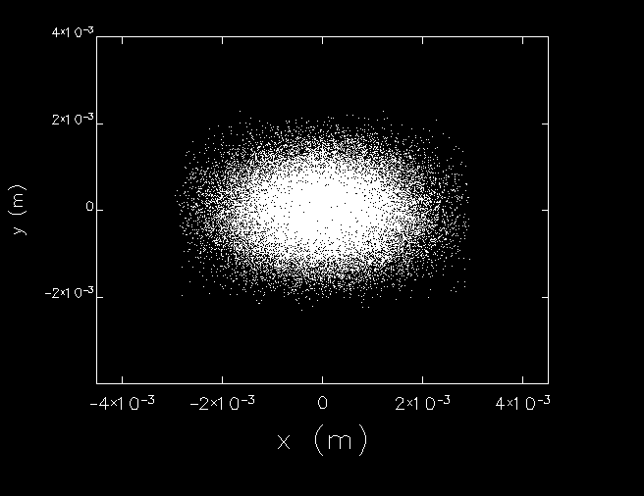
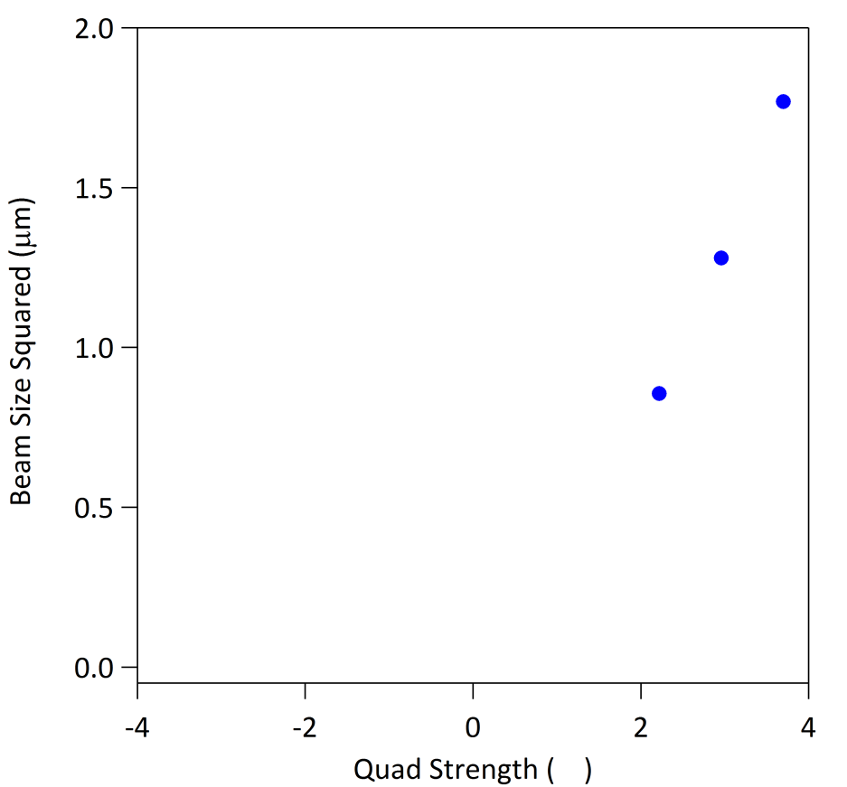
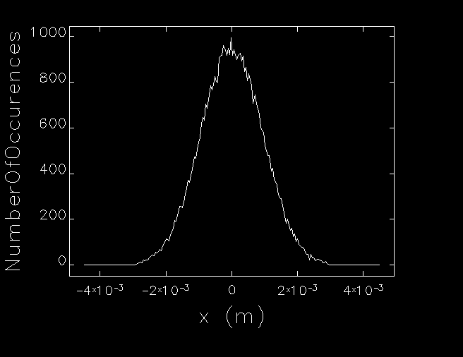
Simulated Quadrupole Scan
RMS beam size
Δ = +1500 G
β_{x} = 21.90 m
α_{x} = 11.87
ε_{x} = 7.73 mm-mrad
(m⁻²)

Slide 10
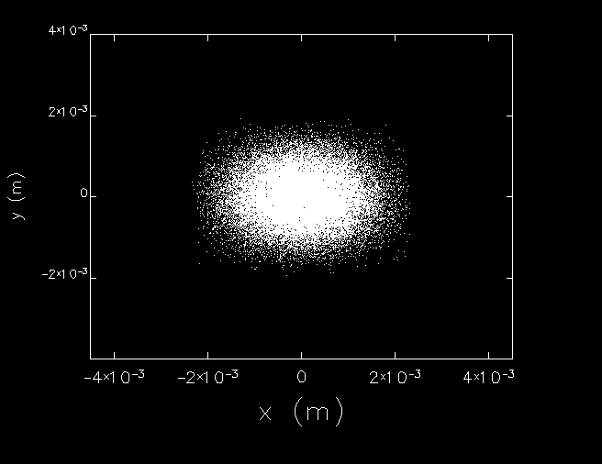
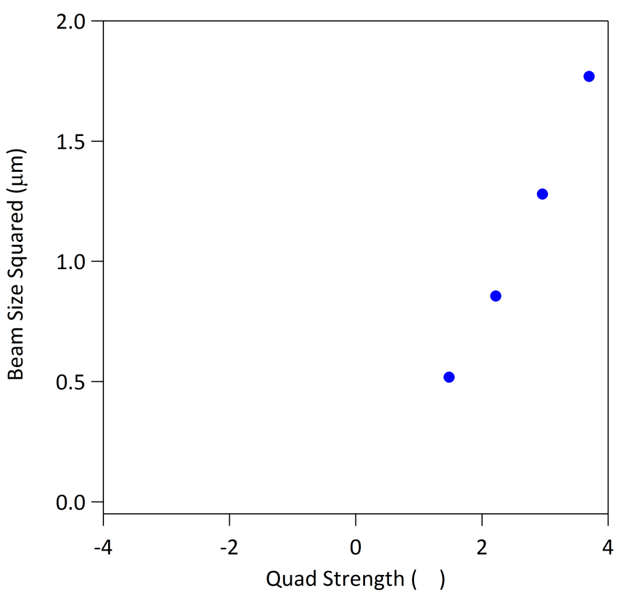
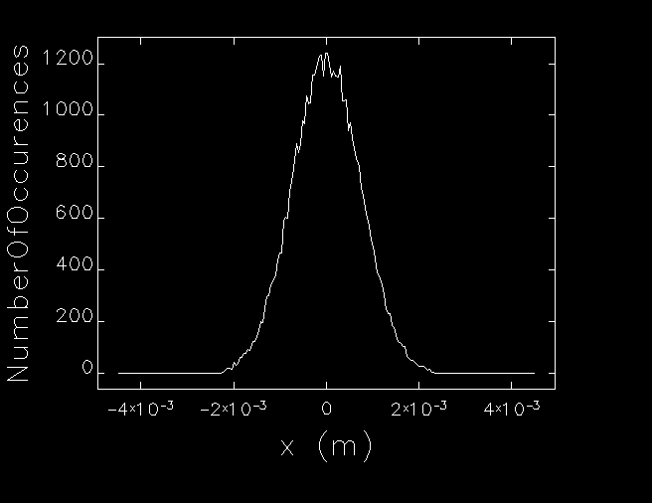
Simulated Quadrupole Scan
RMS beam size
= +1000 G
β_{x} = 18.95 m
α_{x} = 10.25
ε_{x} = 8.96 mm-mrad
(m⁻²)

Slide 11
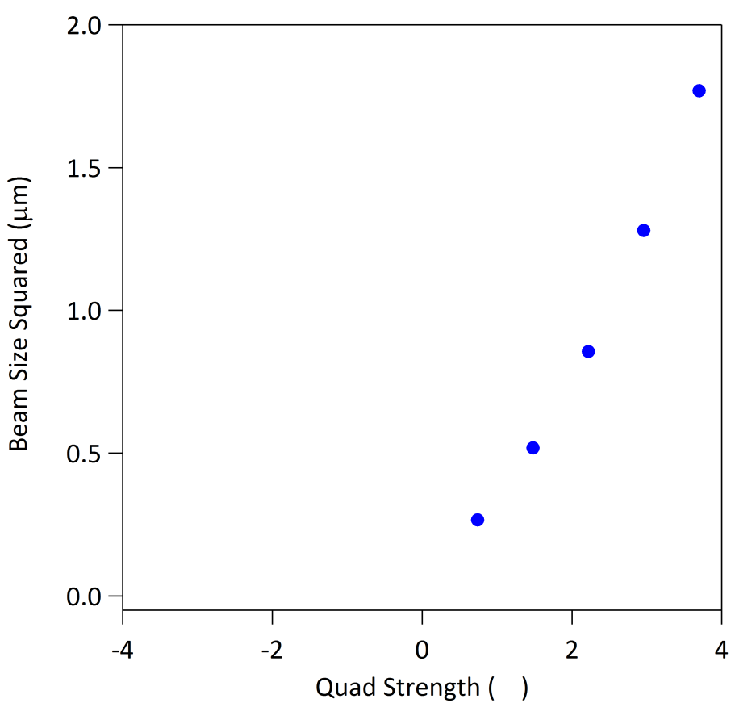
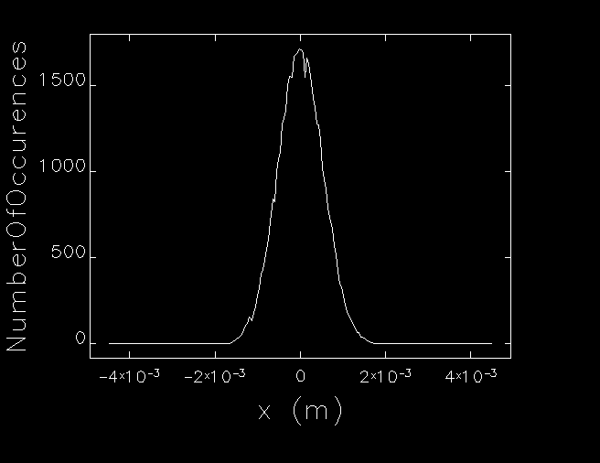
Simulated Quadrupole Scan
RMS beam size
Δ = +500 G
β_{x} = 18.38 m
α_{x} = 9.93
ε_{x} = 9.24 mm-mrad
(m⁻²)

Slide 12
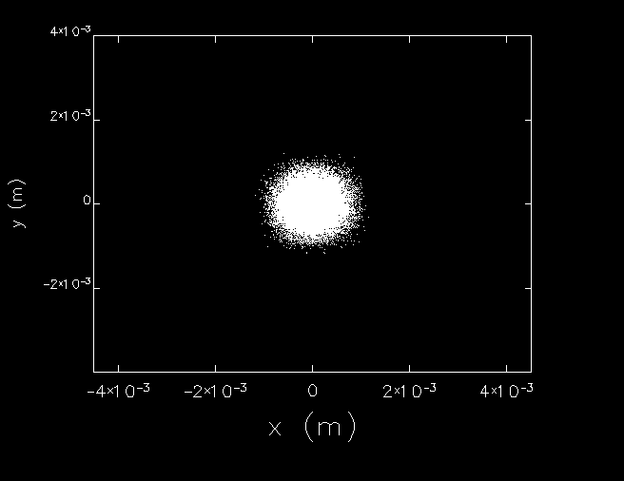
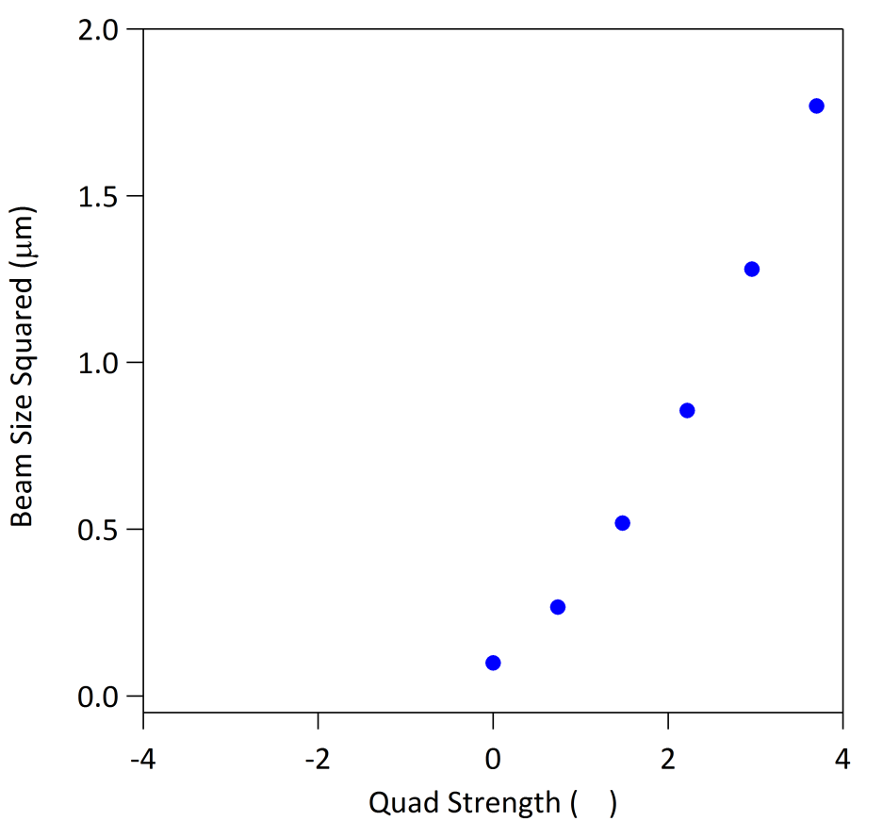
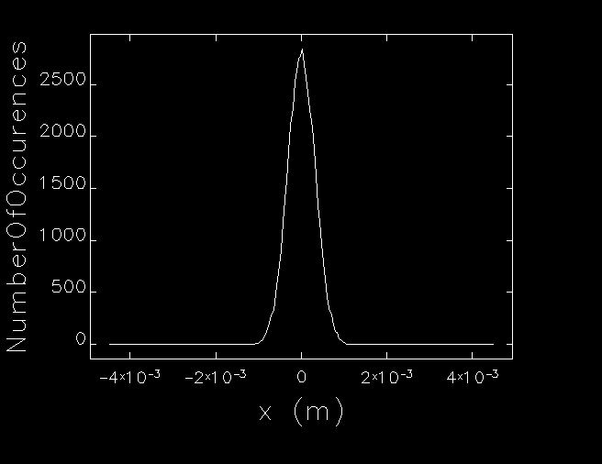
Simulated Quadrupole Scan
RMS beam size
Δ = 0 G
β_{x} = 18.22 m
α_{x} = 9.85
ε_{x} = 9.32 mm-mrad
(m⁻²)

Slide 13
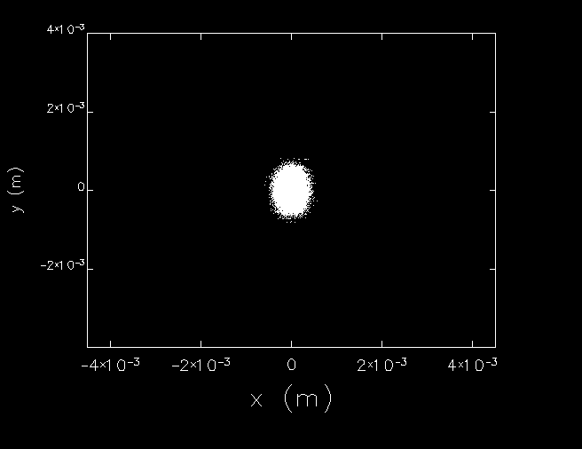
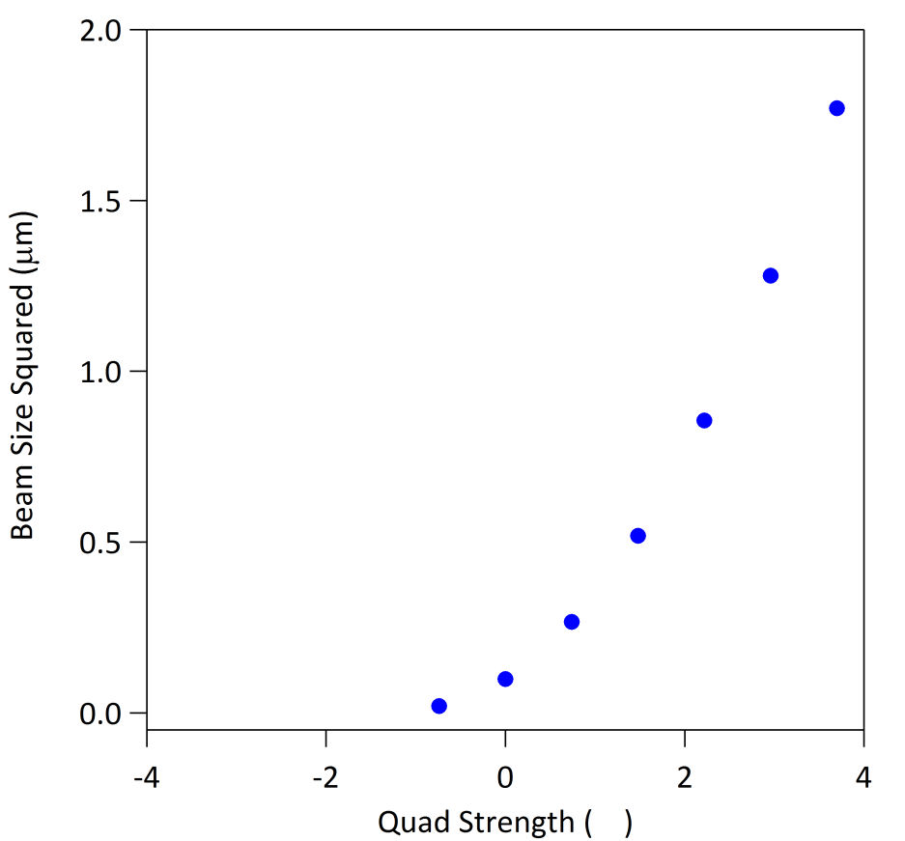
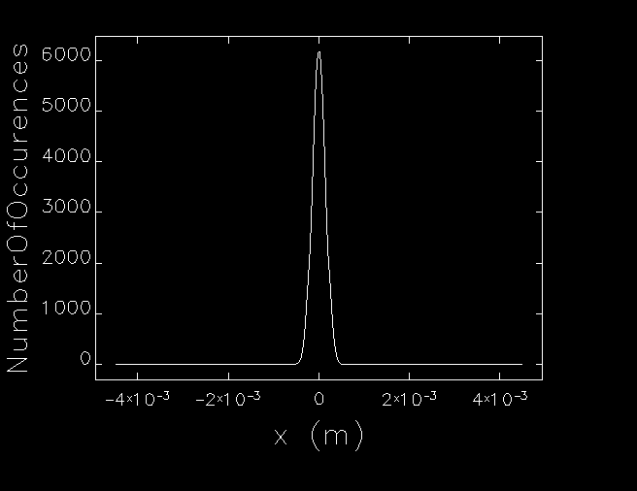
Simulated Quadrupole Scan
RMS beam size
Δ = -500 G
β_{x} = 18.17 m
α_{x} = 9.82
ε_{x} = 9.35 mm-mrad
(m⁻²)

Slide 14
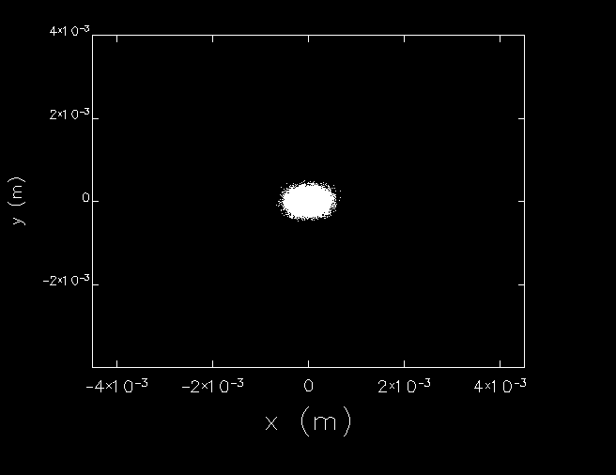
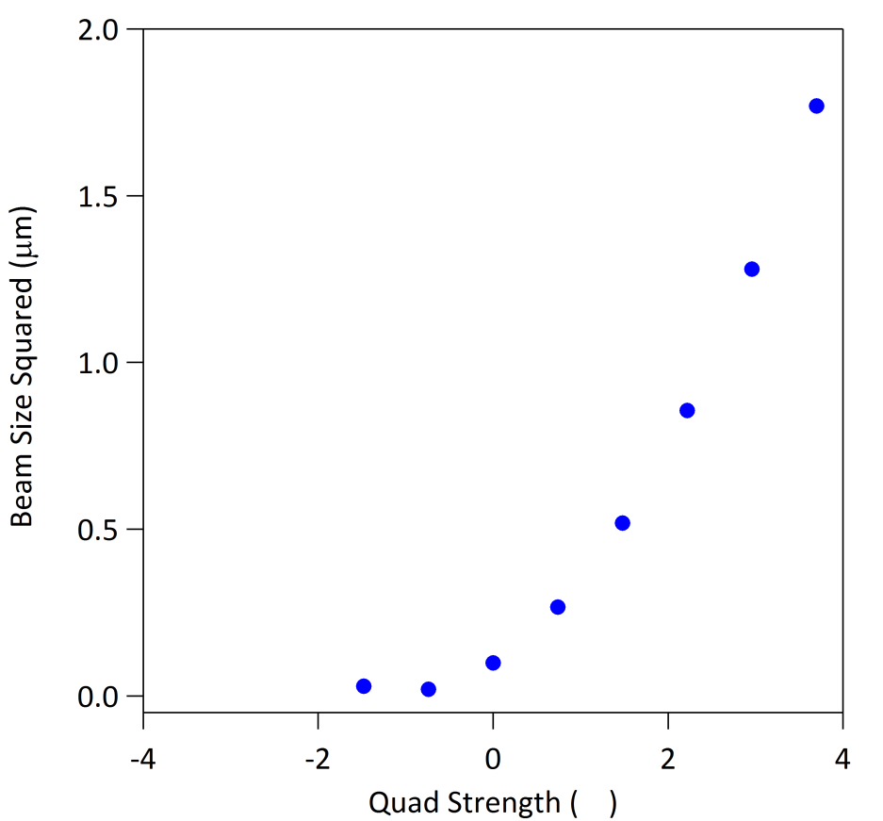
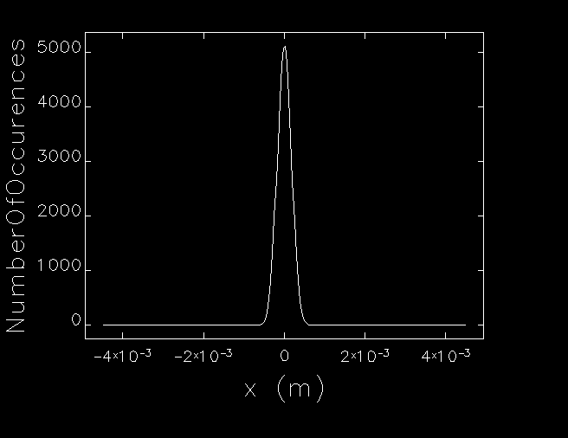
Simulated Quadrupole Scan
RMS beam size
Δ = -1000 G
β_{x} = 18.15 m
α_{x} = 9.81
ε_{x} = 9.36 mm-mrad
(m⁻²)

Slide 15
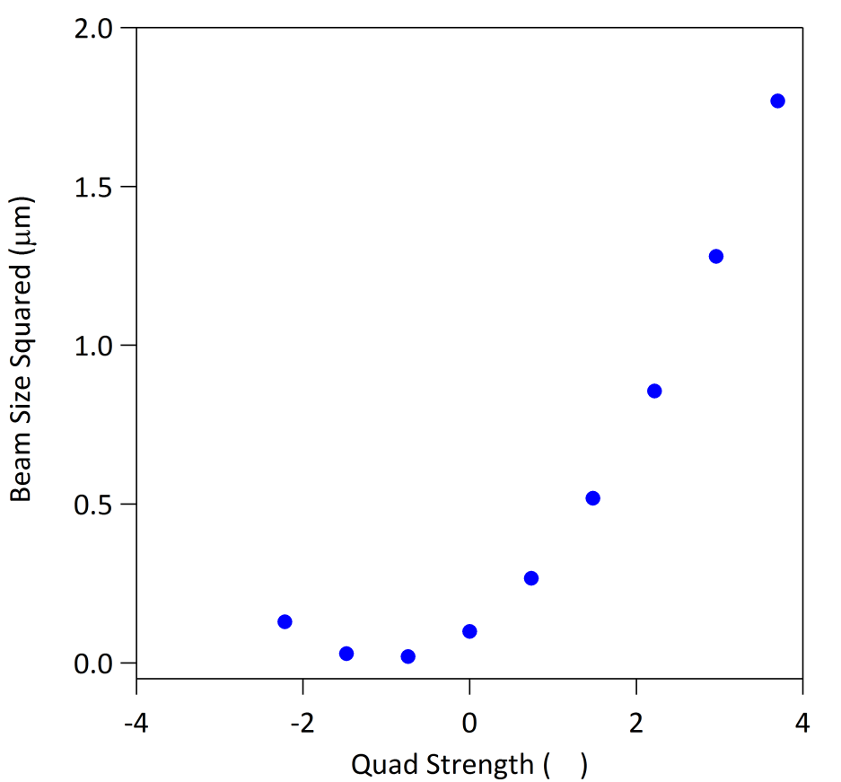
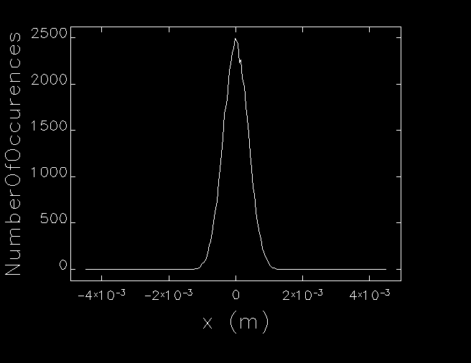
Simulated Quadrupole Scan
RMS beam size
Δ = -1500 G
β_{x} = 18.15 m
α_{x} = 9.81
ε_{x} = 9.36 mm-mrad
(m⁻²)

Slide 16
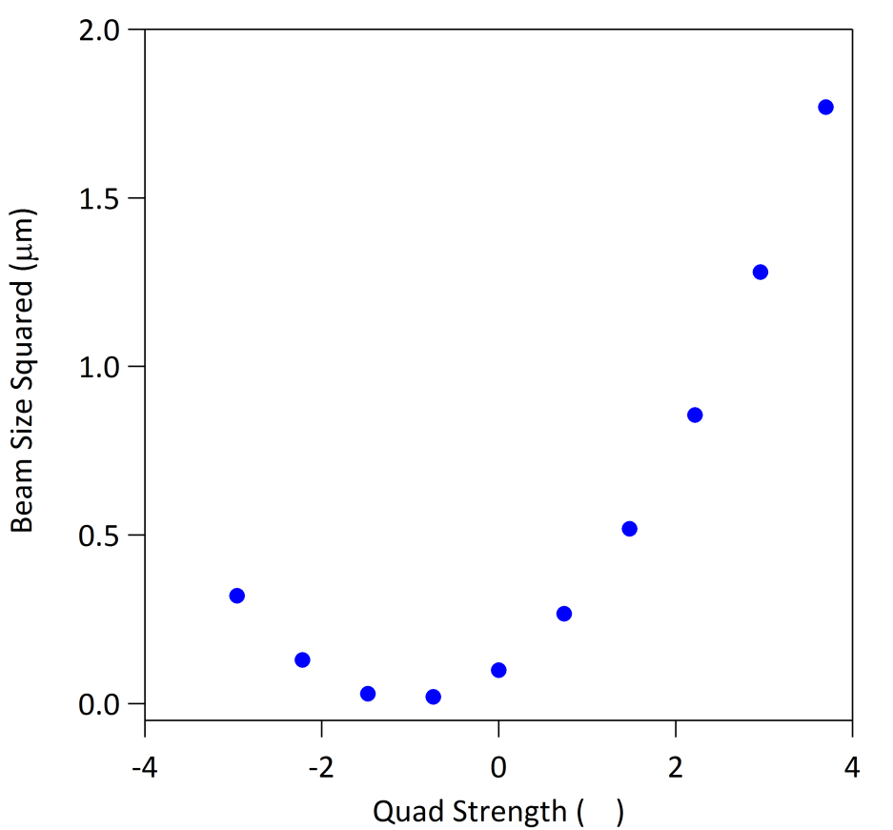
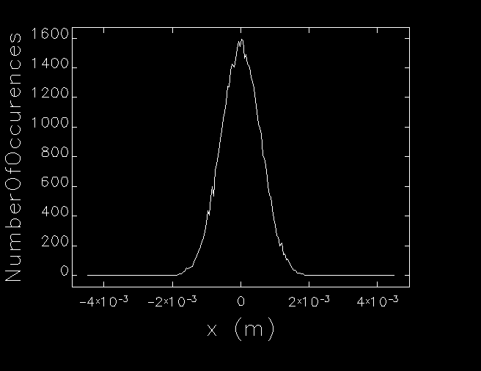
Simulated Quadrupole Scan
RMS beam size
Δ = -2000 G
β_{x} = 18.15 m
α_{x} = 9.81
ε_{x} = 9.36 mm-mrad
(m⁻²)

Slide 17
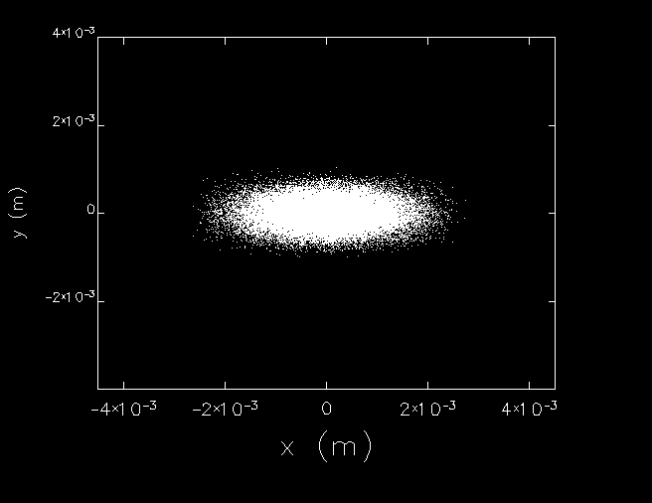
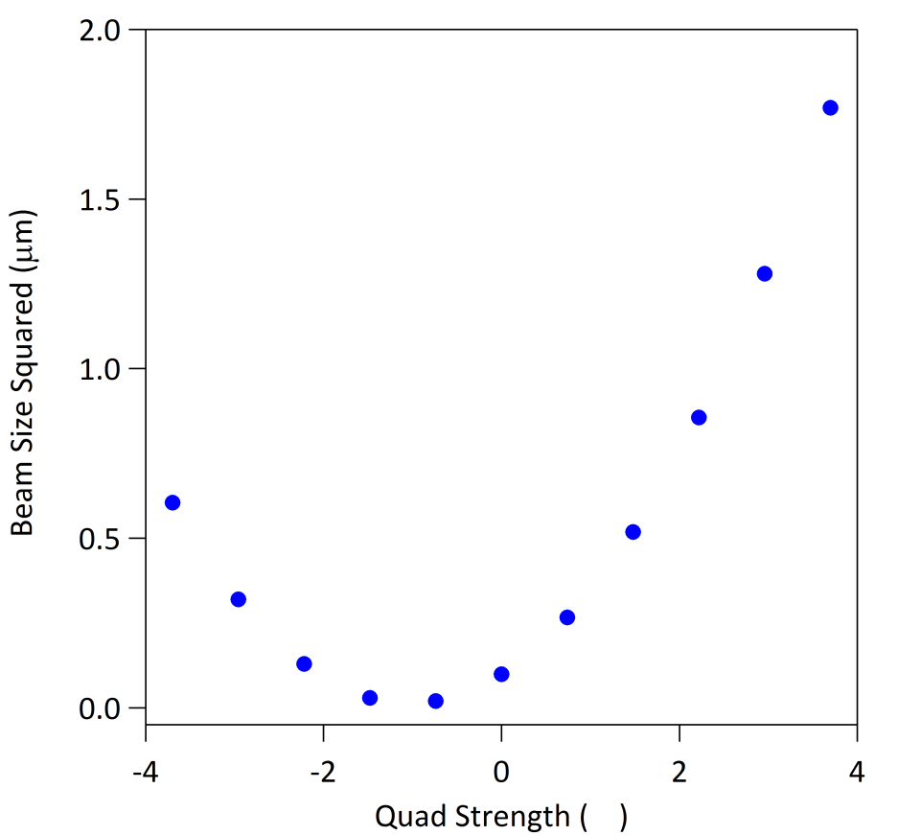
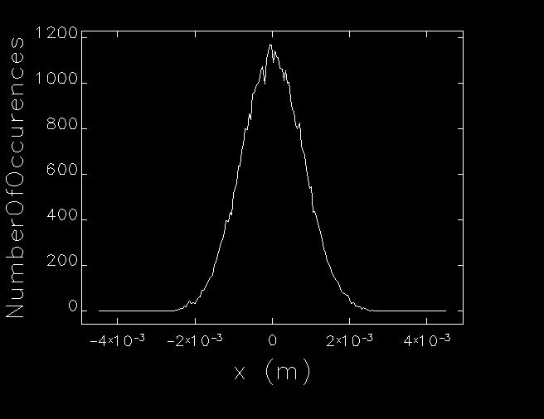
Simulated Quadrupole Scan
RMS beam size
Δ = -2500 G
β_{x} = 18.15 m
α_{x} = 9.81
ε_{x} = 9.36 mm-mrad
(m⁻²)

Slide 18
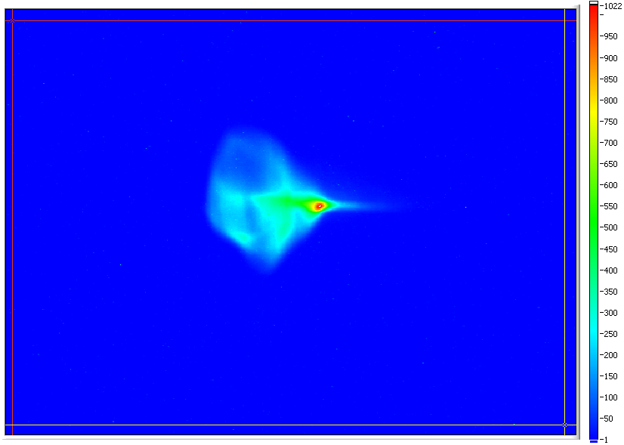
(courtesy P. Evtushenko)

Slide 19
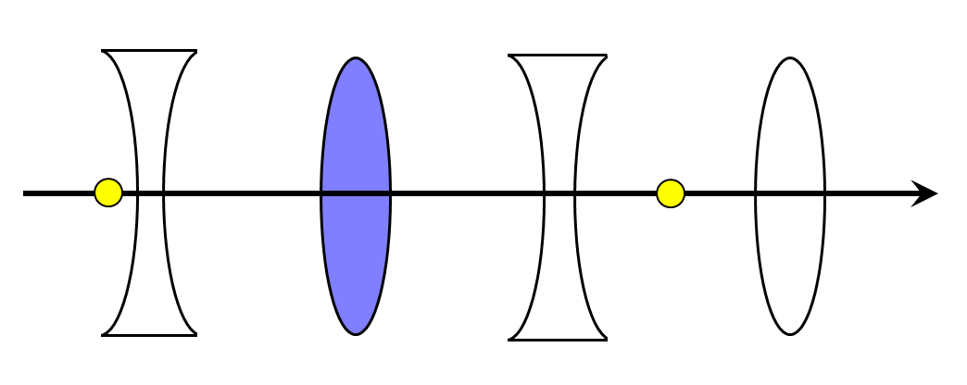
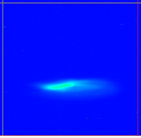
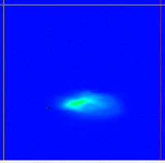
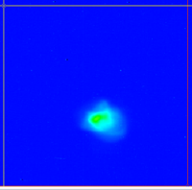
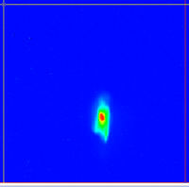
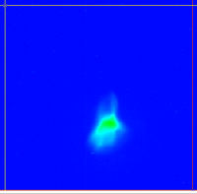
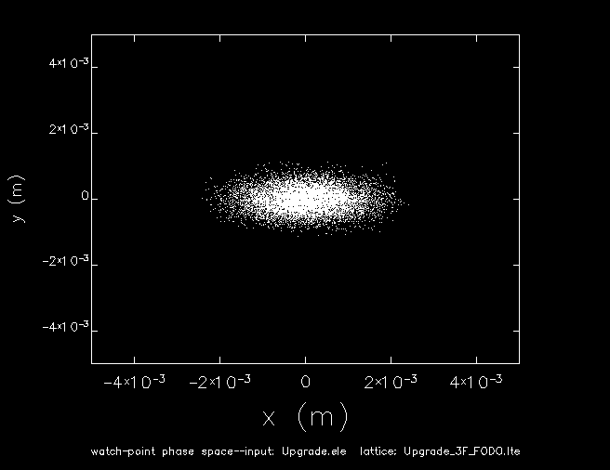
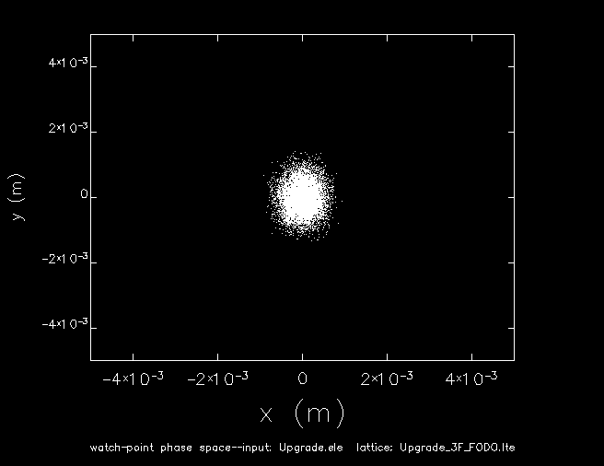
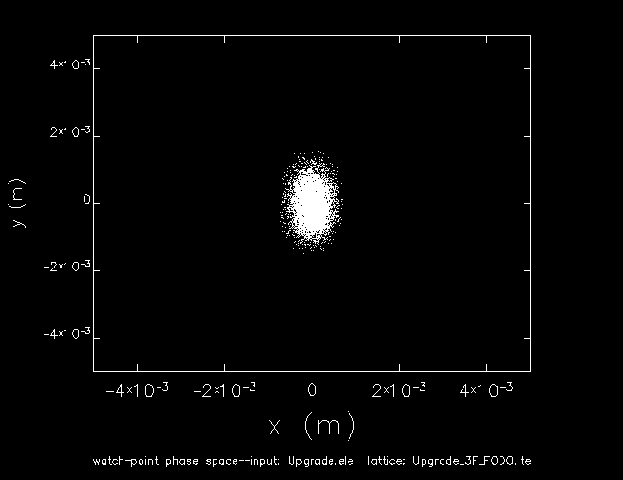
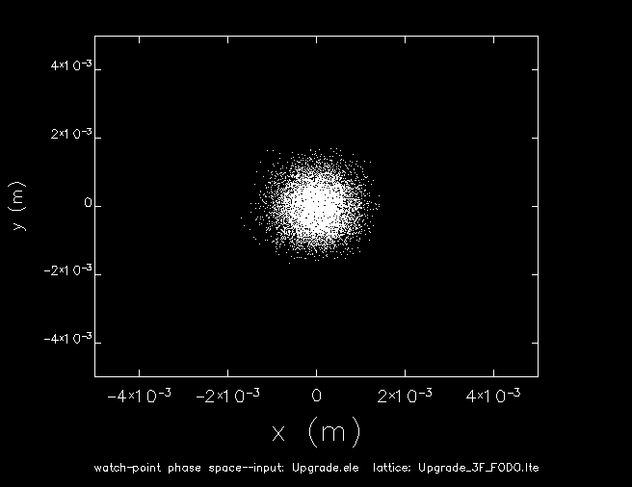
Transverse Phase Space Tomography
3F region setup as six 90º matched FODO periods
Scan quad from 1500 G to 5500 G and observe beam at downstream viewer
This generates an effective rotation of 157˚ of the horizontal phase space
monitor
observation point
5 mm
5 mm
1500 G
2500 G
3500 G
4500 G
5500 G

Slide 20
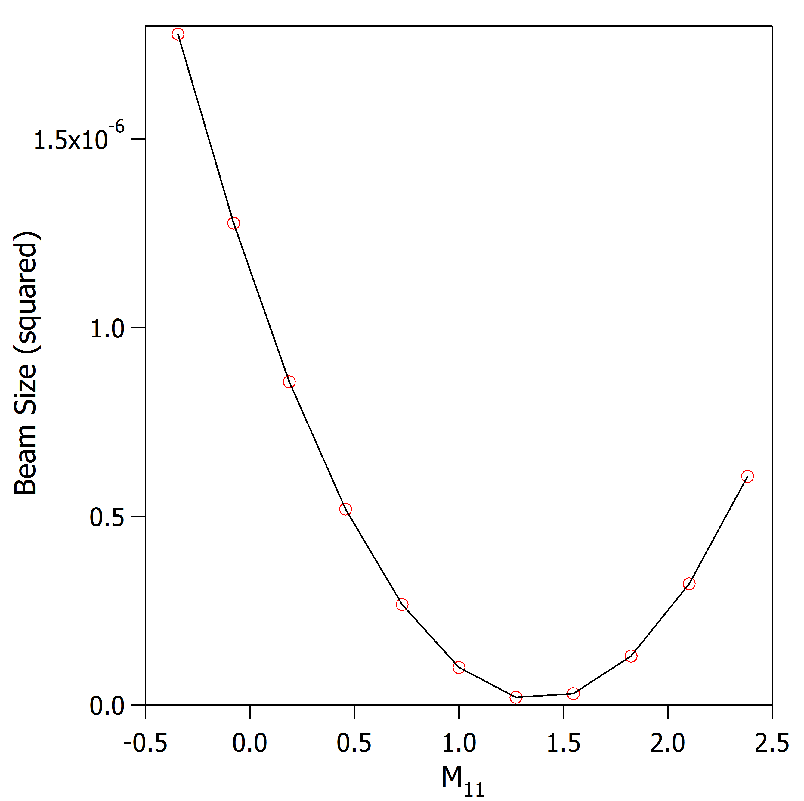
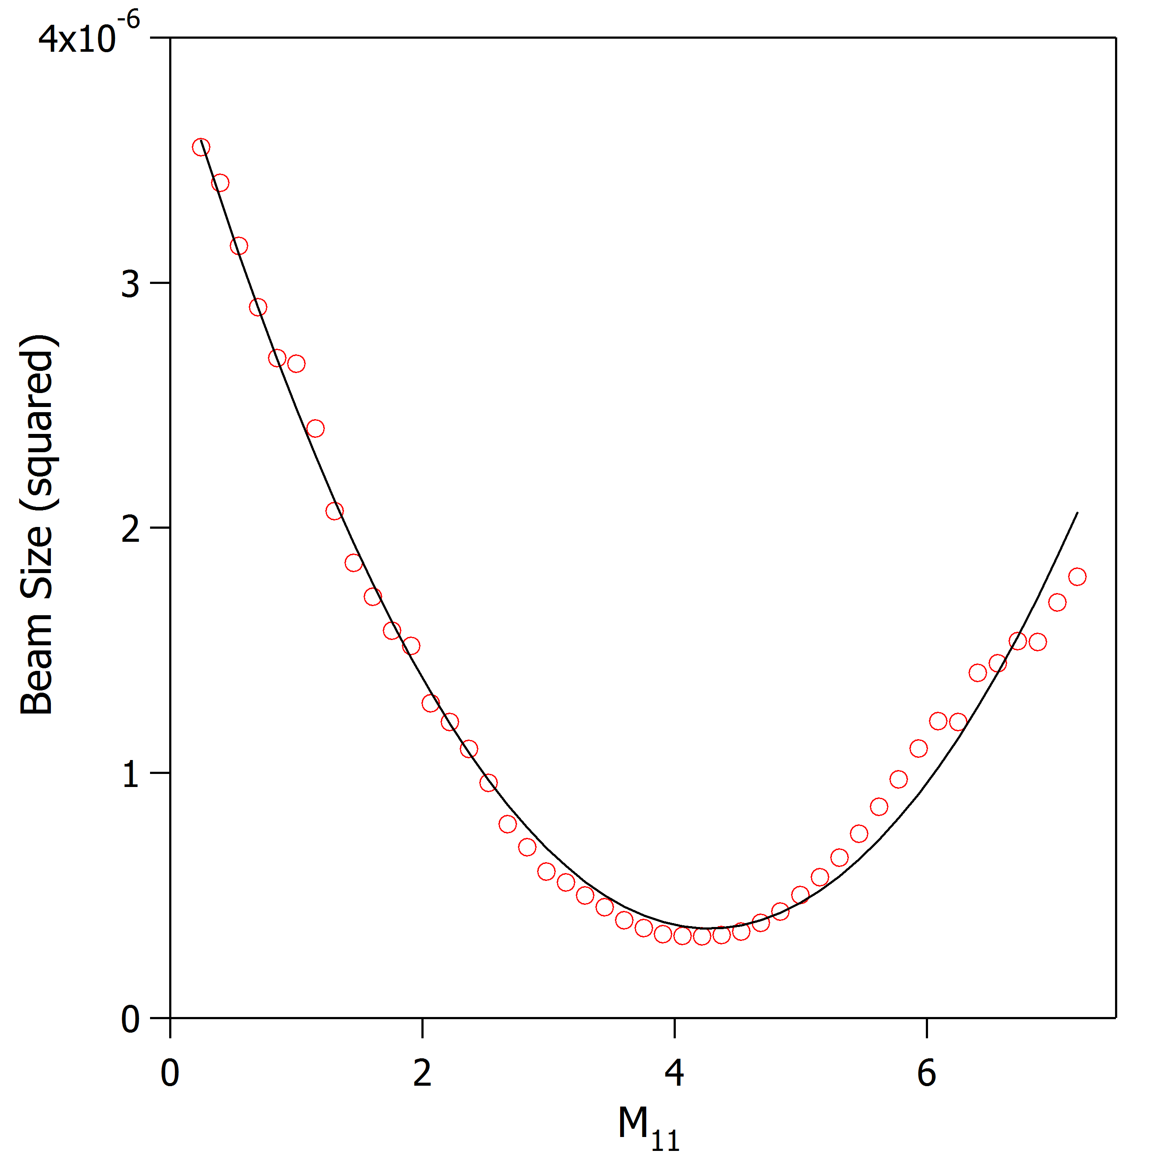
Real vs Simulated Data

Slide 21
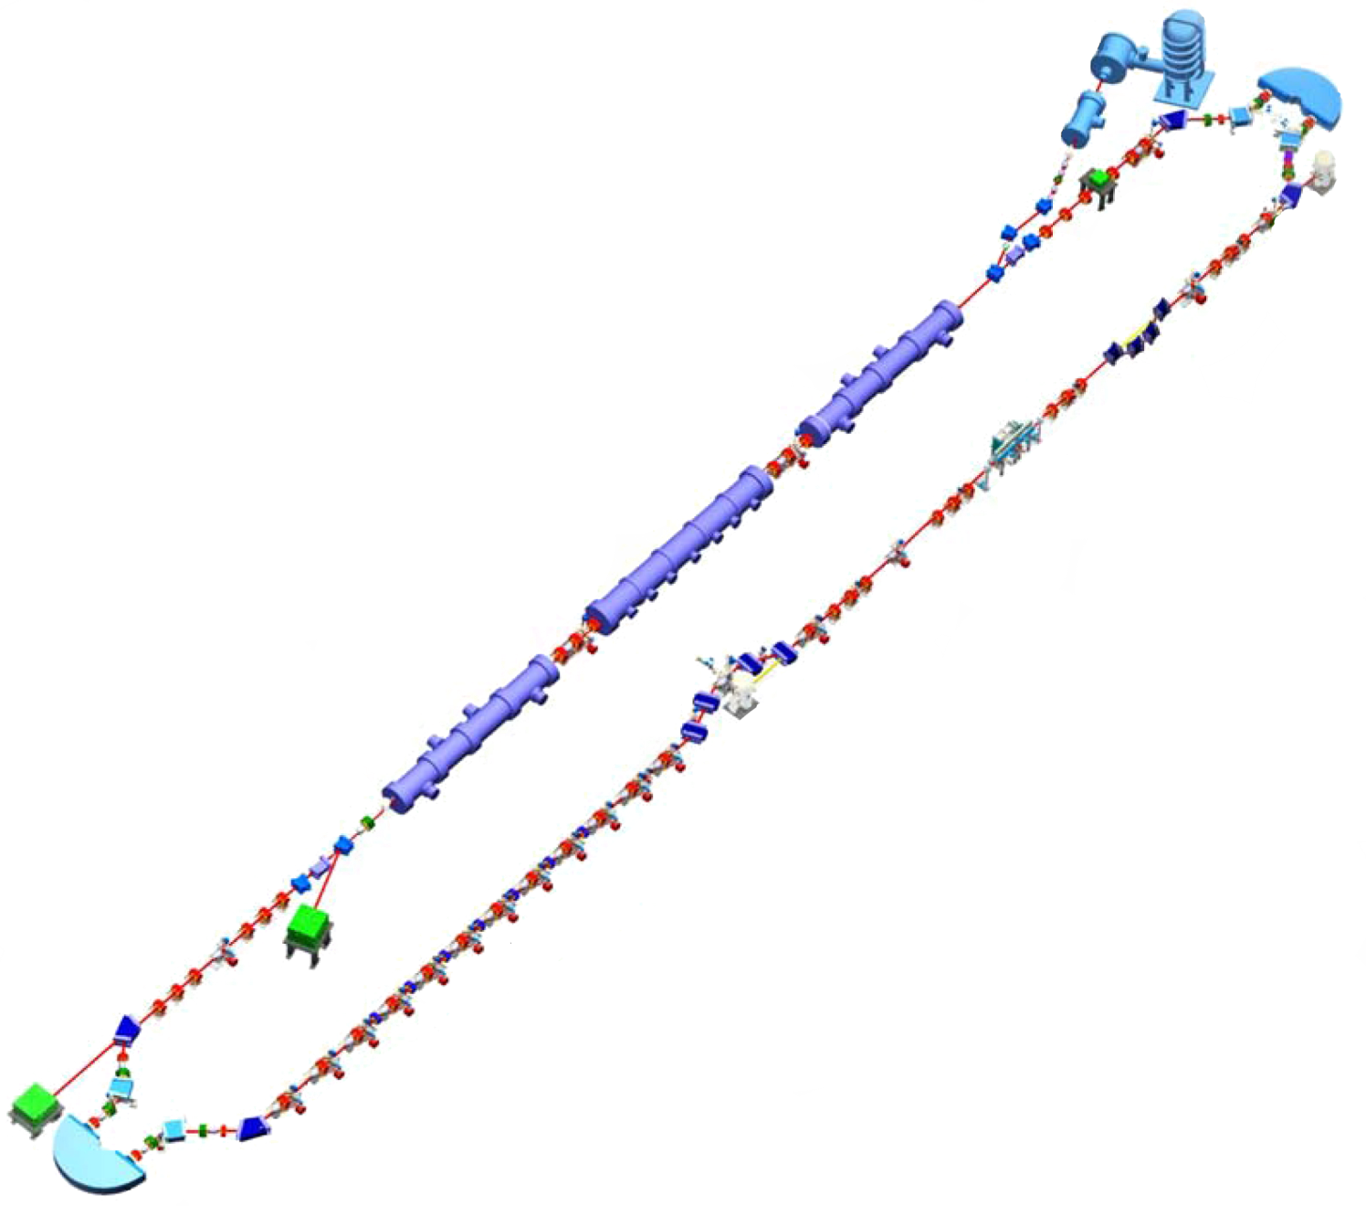
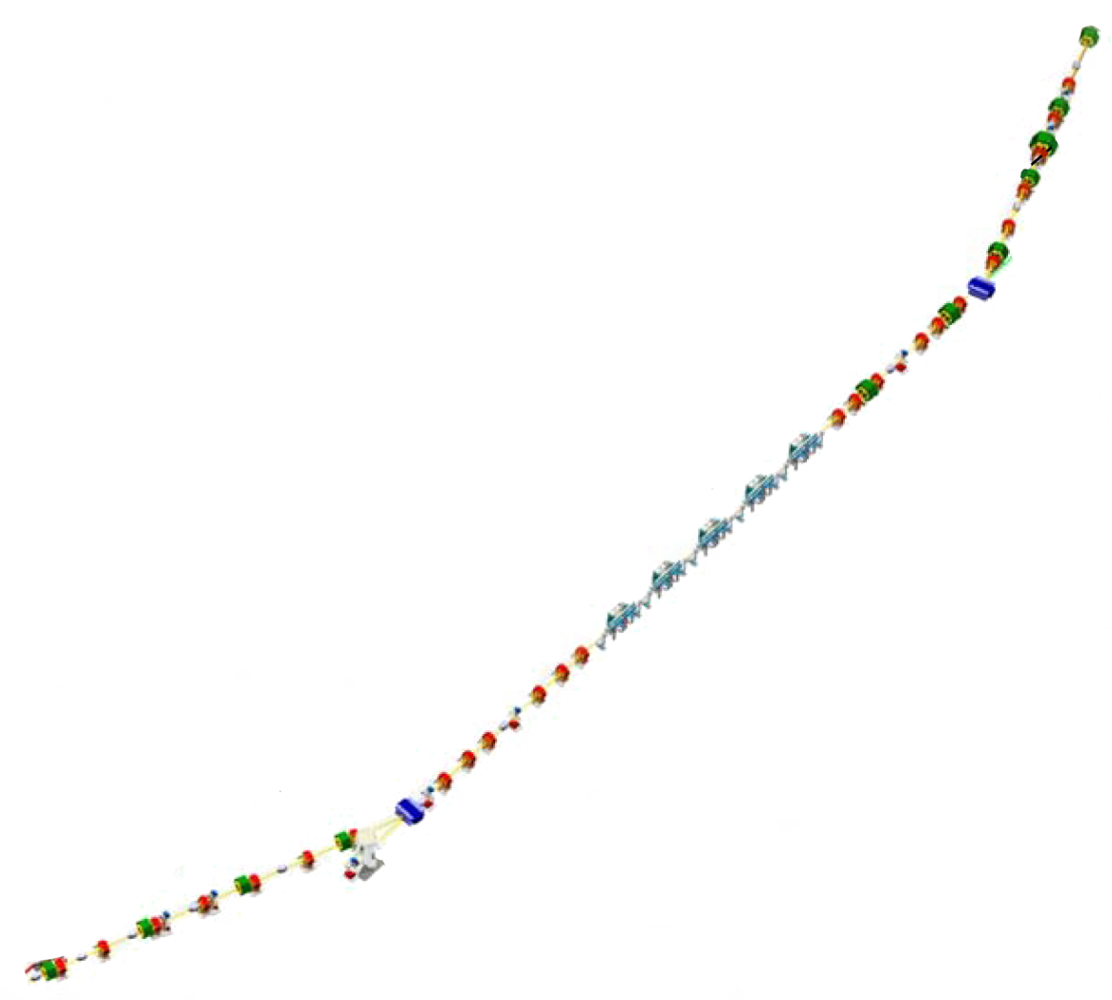
Measurement in 2F Region
2F region
2F03
2F04
2F05
2F06
monitor
observation point
Compare with multislit and multi-monitor emittance measurement
2F

Slide 22
Transverse Emittance in the FEL
2F
6F
8F
5F
Normalized Emittance (mm-mrad)
PRELIMINARY
Location in FEL

Slide 23
Quadrupole Centering
Zero BPMs
Add focusing
Observe change in BPM
Steer in the direction of offset
Return quad to nominal strength
Iterate Steps (1-5)
BPM

Slide 24
Data Analysis
Quad Scans possible in 2F
Check quad centering
Be careful about image saturation
Measure beam size two different ways:
Manually place cursors to make edge-to-edge measurement
(RMS ~ edge-to-edge/6)
use Auto ROI to get RMS value as a function of Cut Level
how does it affect the emittance measurement?
Compare data to multi-slit and multi-monitor emittance measurements? Do emittances evolve as you expect?

