Slide 1
Phasing

Slide 2
Overview
Phase control very important for successful operation of ERL – must have “right” phase to get both bunch length compression at FEL & energy spread compression at dump
=>Need to know where beam is timed relative to RF waveform
Basic idea to get this information is simple: energy gain from a cavity is a function of RF phase
To set the phase to “crest”, maximize the energy gain
Use calibrated RF drive controls to set phase offsets
=> Need a way to measure energy…

Slide 3
Spectrometer Design
Again, idea is notionally simple:
bend angle is a function of energy
vary phase => vary energy => vary bending
“just” look at bend to determine crest
Sadly, life ain’t simple:
cavities steer as well as accelerate; the steering is phase dependent:
Beam offsets in focusing fields/cavity misalignments
Coupler (HOM and FP) kicks
these can dominate at low energy (as in our injector)
high-energy orbit
reference (on-energy) orbit
low-energy orbit

Slide 4
How to disentangle?
Need a means of sorting out betatron motion from energy
Can monitor beam behavior in nondispersed location (betatron component), propagate forward/backward to dispersed location & extract betatron portion of motion
Need machine model, software, lots of symmetry, …
or,…
can impose (or notice) symmetries available in dispersed region and save some effort

Slide 5
Bates Bend as a Spectrometer
(
Transport from cavity -> start of 180º dipole in Bates bend:
Output position depends on cavity steering and energy - both are phase-dependent:
Transport from cavity through 180º dipole in Bates bend:
Betatron part of output flips sign:
Average of readings depends on energy deviation only:

Slide 6
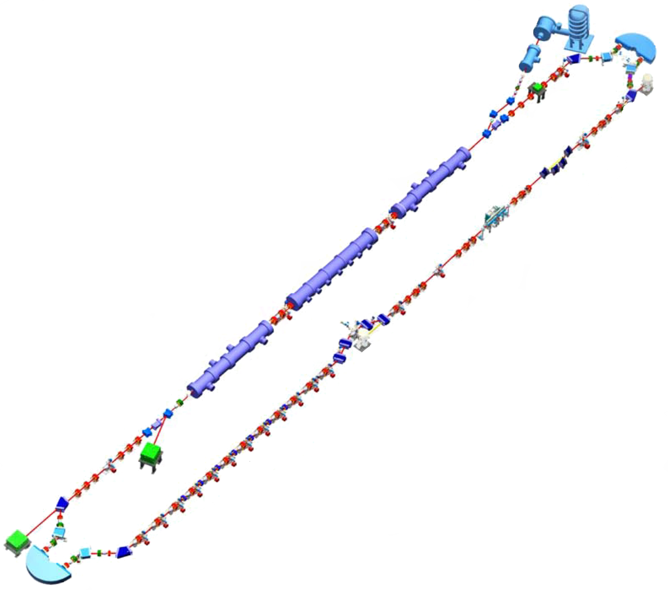
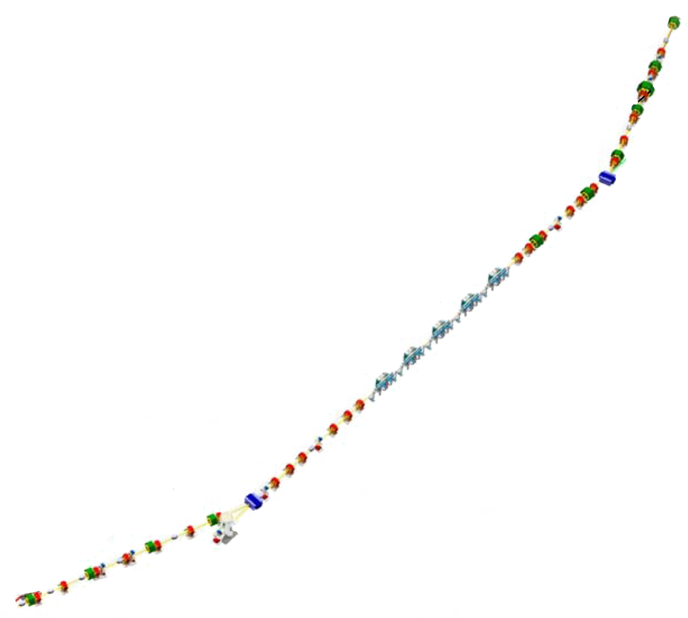
Basic trick: use dispersed beamline with –I spatial transform between a pair of observation points;
average of results from the two observations cancels steering effects
IPM5F03
DC Gun
In our ERL, we have BPMs immediately upstream/downstream of the 180º dipoles & provide the position reading and their average on the BPM displays
IPM2F07, IPM2F09 ⬄<x_{2F08}>, IPM5F01, IPM5F03 ⬄<x_{5F02}>
<x> is direct measure of δp/p
IPM5F01
IR Wiggler
SRF Linac
Bunching Chicane
UV FEL Transport Line
IPM2F07
Dump
IPM2F09

Slide 7
Phasing Process – Individual Cavities
Waveform is cosine, but with arbitrary (and possibly slowly varying) phase offset depending on cables, gallery temperature, market forces, demons…
Vary phase while watching <x> to establish phase φ_{crest} at which maximum position occurs
Position is symmetric around crest phase (cosine function)
Crest phase is midpoint between symmetric offsets from maximum
φ_{crest}
=(φ₁+φ₂)/2
<x>
x_{reference}
x_{o}
Δφ
φ₁
φ₀
φ₂
φ
-180º
180º

Slide 8
Cryomodule Gang Phase
Energy after a cryomodule is a sum of individual cavity gains and is affected by remnant phasing errors
Can include systematic “gang phase” – add/subtract same phase offset for all cavities – to eliminate residual
Suppresses phasing errors and allows you to set systematic offset for all cavities (e.g. for chirp)
Also provides diagnostic for individual cavity phase
when gang phase wanders away from nominal value (with energy more or less constant), all phases are likely drifting systematically due to environmental changes such as zone-to-zone cabling-driven drifts
When gang phase wanders and energy drops, cavity phases are wandering off from crest randomly
Gang phasing done same way as cavity phasing:
Pick an offset gang phase (e.g. 10º)
Set reference position at offset (e.g., zero BPMs)
Move gang phase to maximize offset, then back to reference value
“Crest” gang phase is then midpoint (average) of the two phases

Slide 9
Phasing for Energy Recovery: Path Length
DC Gun
Energy recovered beam phase is set by recirculator path length, which is controlled by steering trims in end of pi-bends
Vary trims to set final energy to dump line set-point & deliver beam cleanly to beam dump
dump line serves as spectrometer
IR Wiggler
SRF Linac
Bunching Chicane
UV FEL Transport Line
Dump

Slide 10
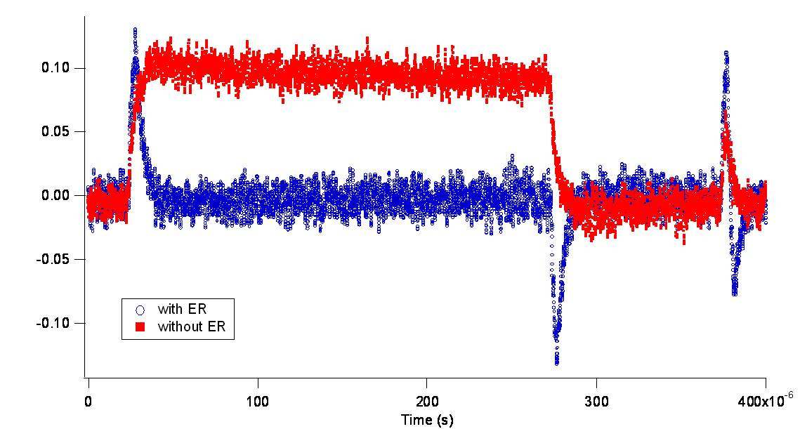
Phasing the Linac Using ONLY the Linac- Transient Phasing
During initial beam threading (either acceleration or recovery) you often can’t get beam to a spectrometer – need another means of phasing
Can use beam loading to (roughly) determine timing of beam relative to cavity RF field
RF drive/controls (“GASK”) tell you if the beam is drawing power from a cavity
For single pass, can find 0-crossing & step beam to crest by moving phase 90º – just look at gradient request and dial phase until it vanishes
For two passes, can (roughly) set path length for full energy recovery (beams 180º out of phase) by setting 2nd pass timing to eliminate beam loading – just watch gradient request and vary path length to zero it

